Slide 1
CS405/505 Data Mining
Lecture 21

Slide 2
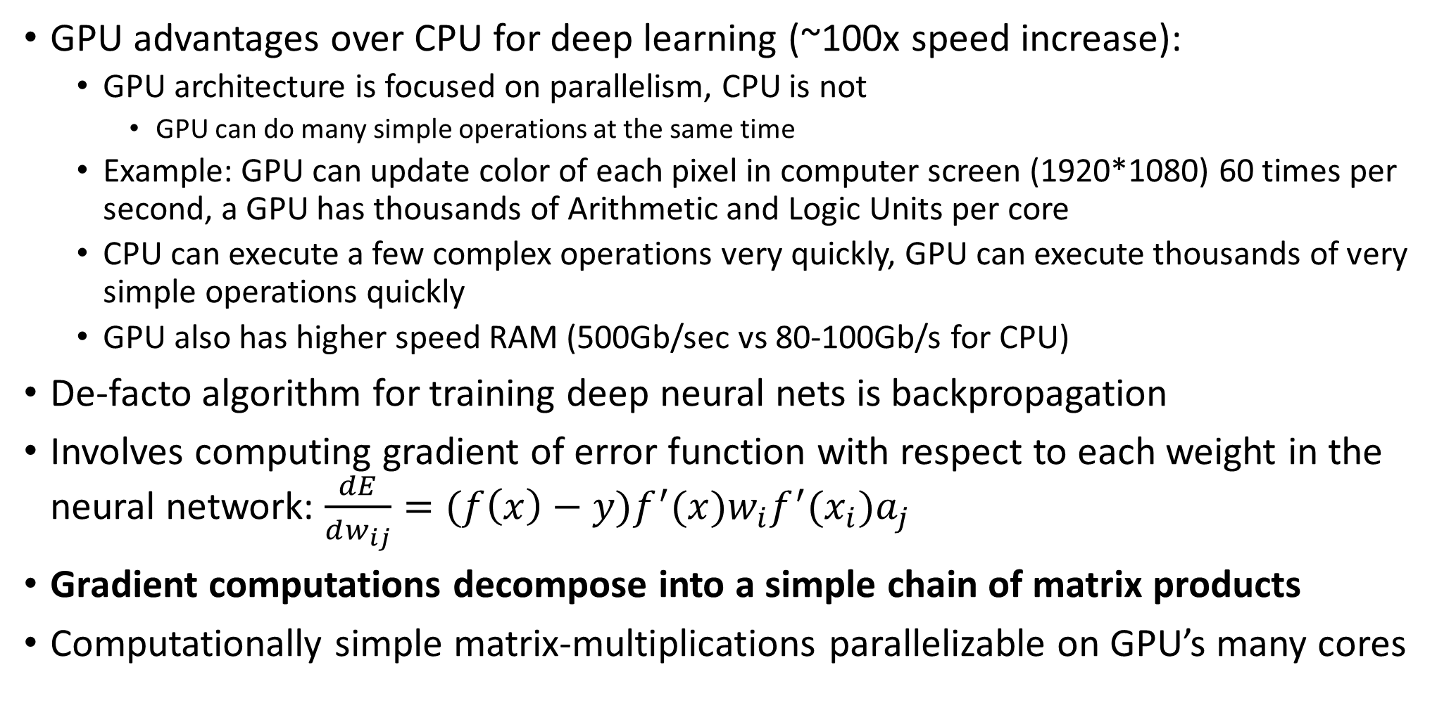
Derivation of backpropagation in matrix-vector form
GPU advantages over CPU for deep learning (~100x speed increase):
GPU architecture is focused on parallelism, CPU is not
GPU can do many simple operations at the same time
Example: GPU can update color of each pixel in computer screen (1920*1080) 60 times per second, a GPU has thousands of Arithmetic and Logic Units per core
CPU can execute a few complex operations very quickly, GPU can execute thousands of very simple operations quickly
GPU also has higher speed RAM (500Gb/sec vs 80-100Gb/s for CPU)
De-facto algorithm for training deep neural nets is backpropagation
Involves computing gradient of error function with respect to each weight in the neural network: $\frac{dE}{dw_{ij}}=(f\left(x\right)−y)f^{′}(x)w_{i}f^{′}(x_{i})a_{j}$
Gradient computations decompose into a simple chain of matrix products
Computationally simple matrix-multiplications parallelizable on GPU’s many cores

Slide 3
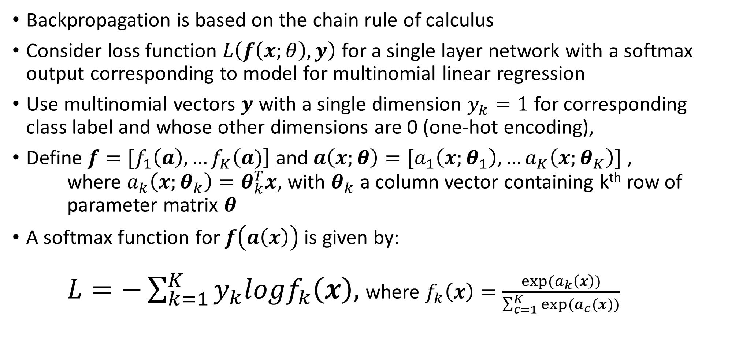
Backpropagation
Backpropagation is based on the chain rule of calculus
Consider loss function $L\left(f\left(x;θ\right),y\right)$ for a single layer network with a softmax output corresponding to model for multinomial linear regression
Use multinomial vectors $y$ with a single dimension $y_{k}=1$ for corresponding class label and whose other dimensions are 0 (one-hot encoding),
Define $f=[f_{1}\left(a\right),…f_{K}\left(a)\right]$ and $a\left(x;θ\right)=[a_{1}\left(x;θ_{1}\right),…a_{K}\left(x;θ_{K}\right)]$ , where $a_{k}\left(x;θ_{k}\right)=θ_{k}^{T}x$, with $θ_{k}$ a column vector containing k^{th} row of parameter matrix $θ$
A softmax function for $f\left(a\left(x\right)\right)$ is given by: $L=−\sum_{k=1}^{K}{y_{k}logf_{k}\left(x\right),}$ where $f_{k}\left(x\right)=\frac{exp⁡(a_{k}\left(x\right))}{\sum_{c=1}^{K}{exp⁡(a_{c}(x))}}$

Slide 4
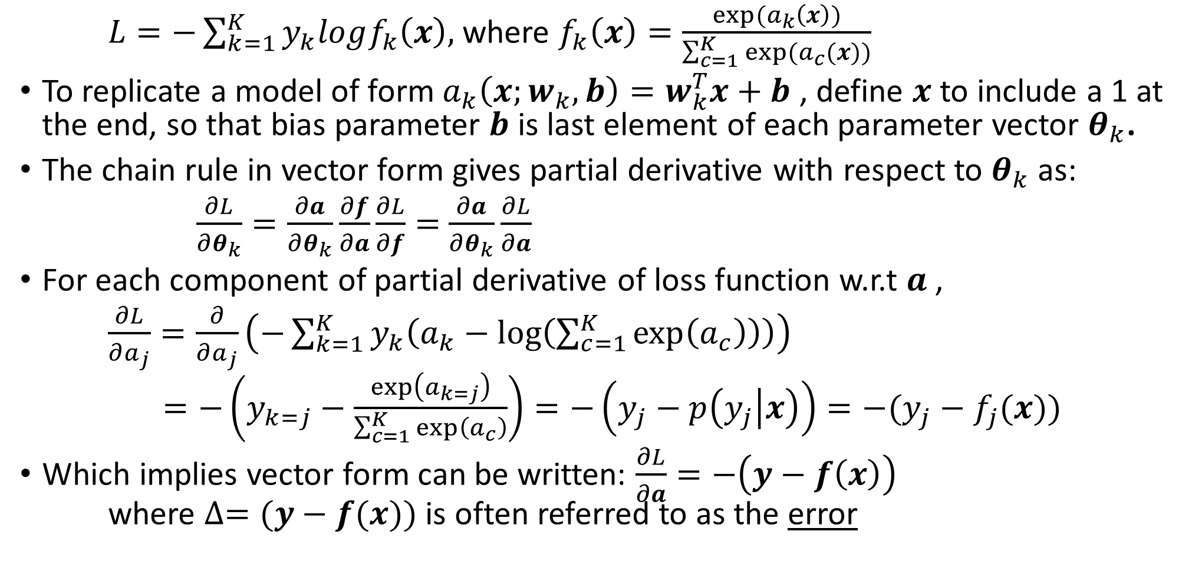
Backpropagation
$L=−\sum_{k=1}^{K}{y_{k}logf_{k}\left(x\right),}$ where $f_{k}\left(x\right)=\frac{exp⁡(a_{k}\left(x\right))}{\sum_{c=1}^{K}{exp⁡(a_{c}(x))}}$
To replicate a model of form $a_{k}\left(x;w_{k},b\right)=w_{k}^{T}x+b$ , define $x$ to include a 1 at the end, so that bias parameter $b$ is last element of each parameter vector $θ_{k}$.
The chain rule in vector form gives partial derivative with respect to $θ_{k}$ as:
$\frac{∂L}{∂θ_{k}}=\frac{∂a}{∂θ_{k}}\frac{∂f}{∂a}\frac{∂L}{∂f}=$ $\frac{∂a}{∂θ_{k}}\frac{∂L}{∂a}$
For each component of partial derivative of loss function w.r.t $a$ ,
$\frac{∂L}{∂a_{j}}=\frac{∂}{∂a_{j}}\left(−\sum_{k=1}^{K}{y_{k}\left(a_{k}−\log\left(\sum_{c=1}^{K}{\exp\left(a_{c}\right)}\right)\right)}\right)$
$=−\left(y_{k=j}−\frac{\exp\left(a_{k=j}\right)}{\sum_{c=1}^{K}{\exp\left(a_{c}\right)}}\right)=−\left(y_{j}−p\left(y_{j} | x\right)\right)=−(y_{j}−f_{j}(x))$
Which implies vector form can be written: $\frac{∂L}{∂a}=−\left(y−f\left(x\right)\right)$ where $∆=(y−f(x))$ is often referred to as the error

Slide 5

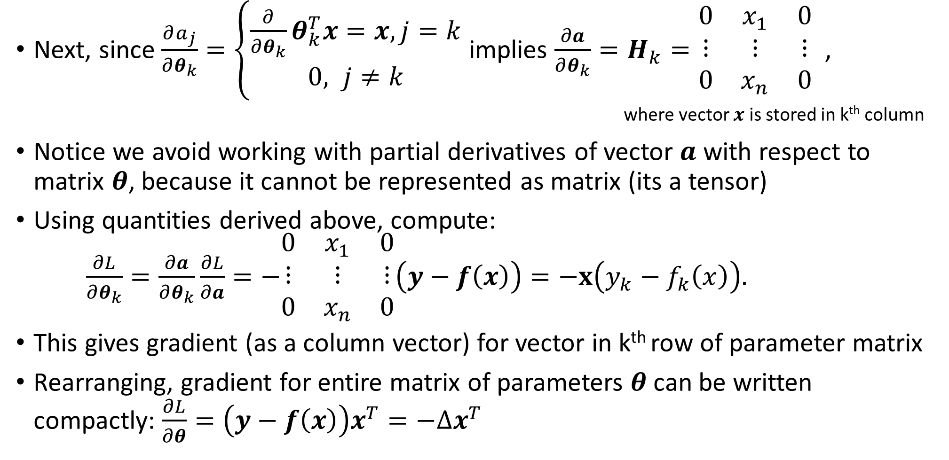
Backpropagation
Next, since $\frac{∂a_{j}}{∂θ_{k}}=\left\{\begin{aligned}\frac{∂}{∂θ_{k}}θ_{k}^{T}x=x, j=k \\ 0, j≠k\end{aligned}\right.$ implies $\frac{∂a}{∂θ_{k}}=H_{k}=\begin{matrix}0 & x_{1} & 0 \\ ⋮ & ⋮ & ⋮ \\ 0 & x_{n} & 0\end{matrix}$ , where vector $x$ is stored in k^{th} column
Notice we avoid working with partial derivatives of vector $a$ with respect to matrix $θ$, because it cannot be represented as matrix (its a tensor)
Using quantities derived above, compute: $\frac{∂L}{∂θ_{k}}=\frac{∂a}{∂θ_{k}}\frac{∂L}{∂a}=−\begin{matrix}0 & x_{1} & 0 \\ ⋮ & ⋮ & ⋮ \\ 0 & x_{n} & 0\end{matrix}\left(y−f\left(x\right)\right)=−x\left(y_{k}−f_{k}\left(x\right)\right).$
This gives gradient (as a column vector) for vector in k^{th} row of parameter matrix
Rearranging, gradient for entire matrix of parameters $θ$ can be written compactly: $\frac{∂L}{∂θ}=\left(y−f\left(x\right)\right)x^{T}=−∆x^{T}$
This formulates the computation of the gradient matrix as the error times $x^{T}$

Slide 6
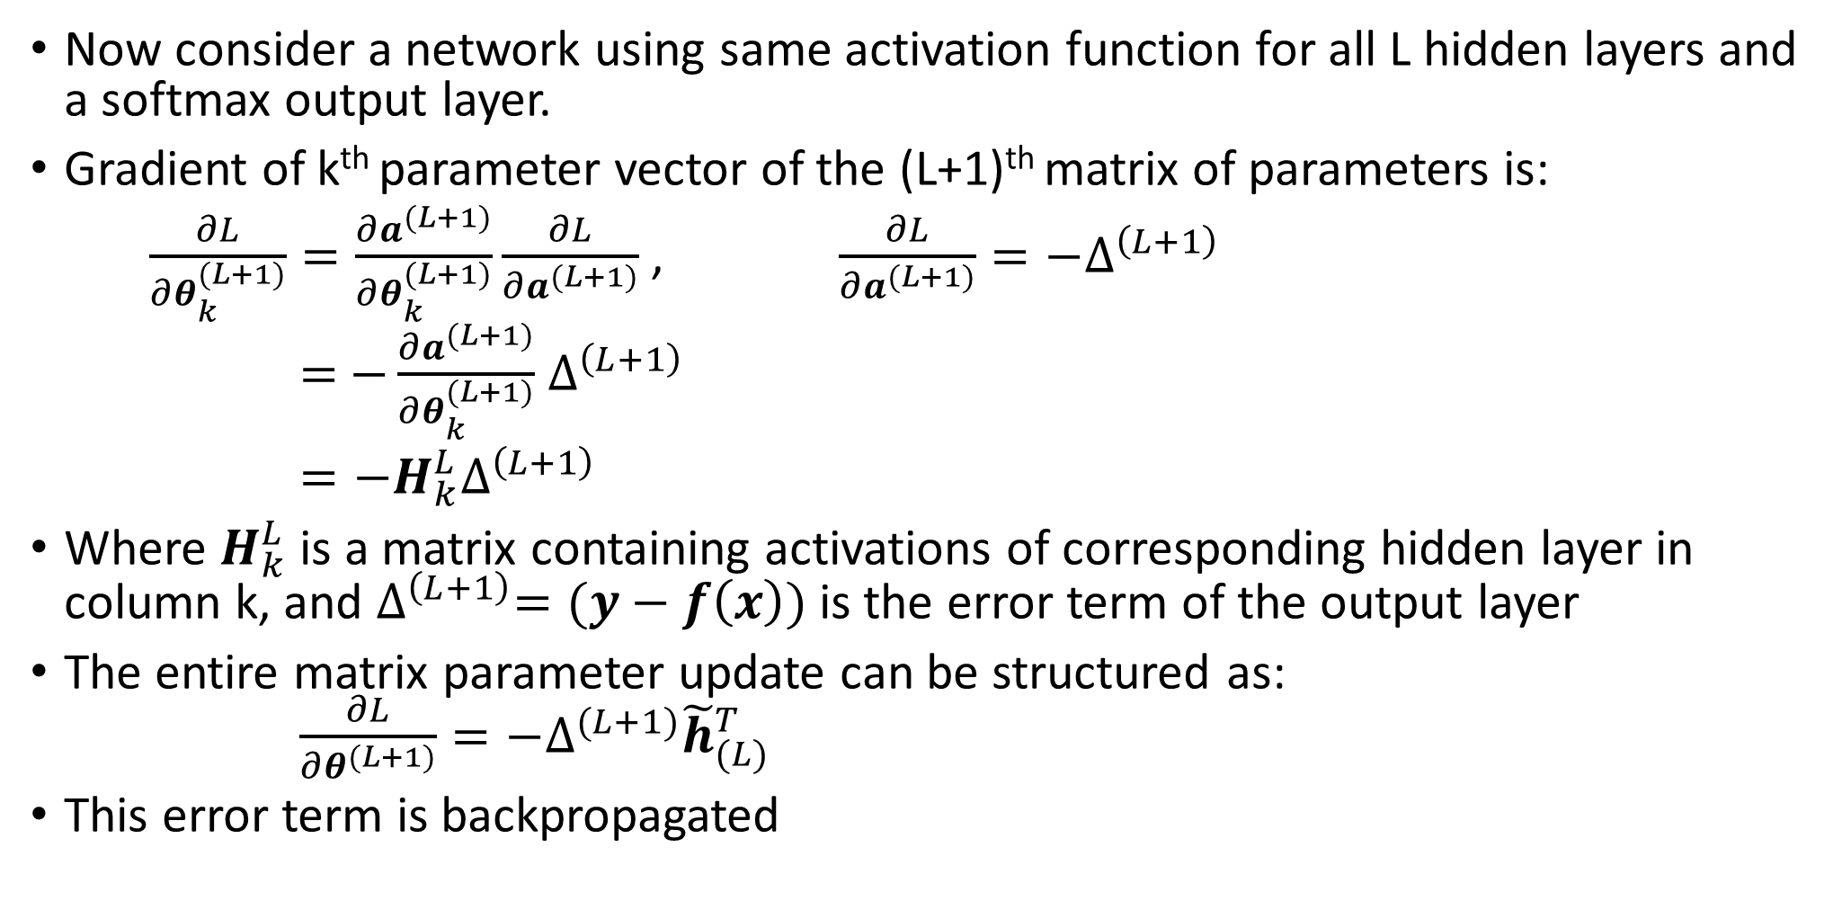
Backpropagation
Now consider a network using same activation function for all L hidden layers and a softmax output layer.
Gradient of k^{th} parameter vector of the (L+1)^{th} matrix of parameters is:
$\frac{∂L}{∂θ_{k}^{(L+1)}}=\frac{∂a^{(L+1)}}{∂θ_{k}^{(L+1)}}\frac{∂L}{∂a^{(L+1)}}$ , $\frac{∂L}{∂a^{(L+1)}}=−∆^{\left(L+1\right)}$
$=$ $−\frac{∂a^{(L+1)}}{∂θ_{k}^{(L+1)}}$ $∆^{\left(L+1\right)}$
$=−H_{k}^{L}∆^{\left(L+1\right)}$
Where $H_{k}^{L}$ is a matrix containing activations of corresponding hidden layer in column k, and $∆^{\left(L+1\right)}=(y−f\left(x\right))$ is the error term of the output layer
The entire matrix parameter update can be structured as: $\frac{∂L}{∂θ^{(L+1)}}=−∆^{(L+1)}{\tilde{h}}_{(L)}^{T}$
This error term is backpropagated

Slide 7
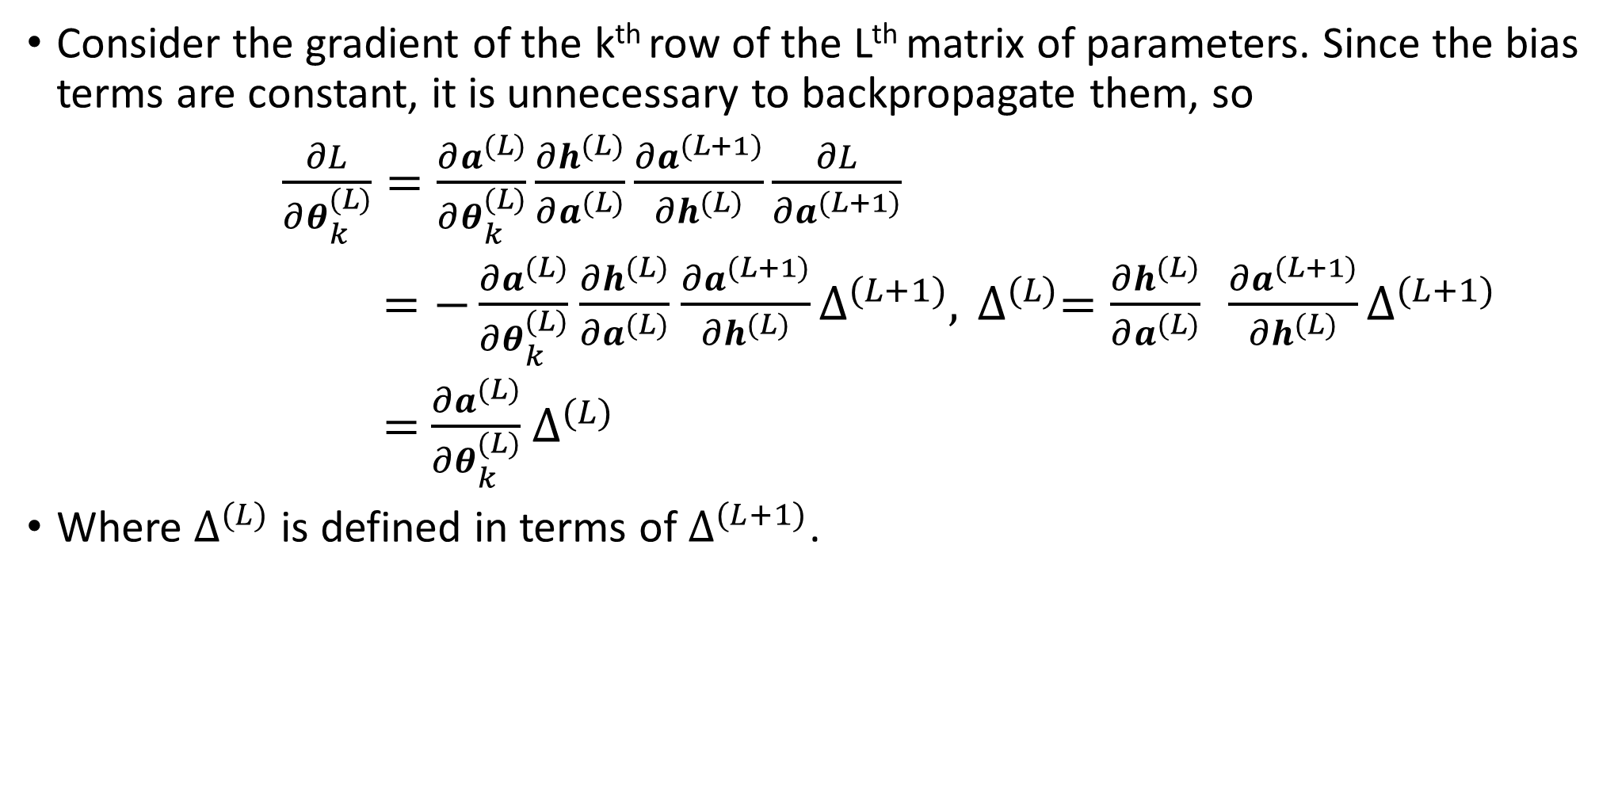
Backpropagation
Consider the gradient of the k^{th} row of the Lth matrix of parameters. Since the bias terms are constant, it is unnecessary to backpropagate them, so
$\frac{∂L}{∂θ_{k}^{(L)}}=\frac{∂a^{(L)}}{∂θ_{k}^{(L)}}\frac{∂h^{(L)}}{∂a^{(L)}}\frac{∂a^{(L+1)}}{∂h^{(L)}}\frac{∂L}{∂a^{(L+1)}}$
$=−\frac{∂a^{(L)}}{∂θ_{k}^{(L)}}$ $\frac{∂h^{(L)}}{∂a^{(L)}}$ $\frac{∂a^{(L+1)}}{∂h^{(L)}}∆^{(L+1)},$ $∆^{(L)}=\frac{∂h^{(L)}}{∂a^{(L)}} \frac{∂a^{(L+1)}}{∂h^{(L)}}∆^{(L+1)}$
$=$ $\frac{∂a^{(L)}}{∂θ_{k}^{(L)}}$ $∆^{(L)}$
Where $∆^{(L)}$ is defined in terms of $∆^{(L+1)}$.

Slide 8
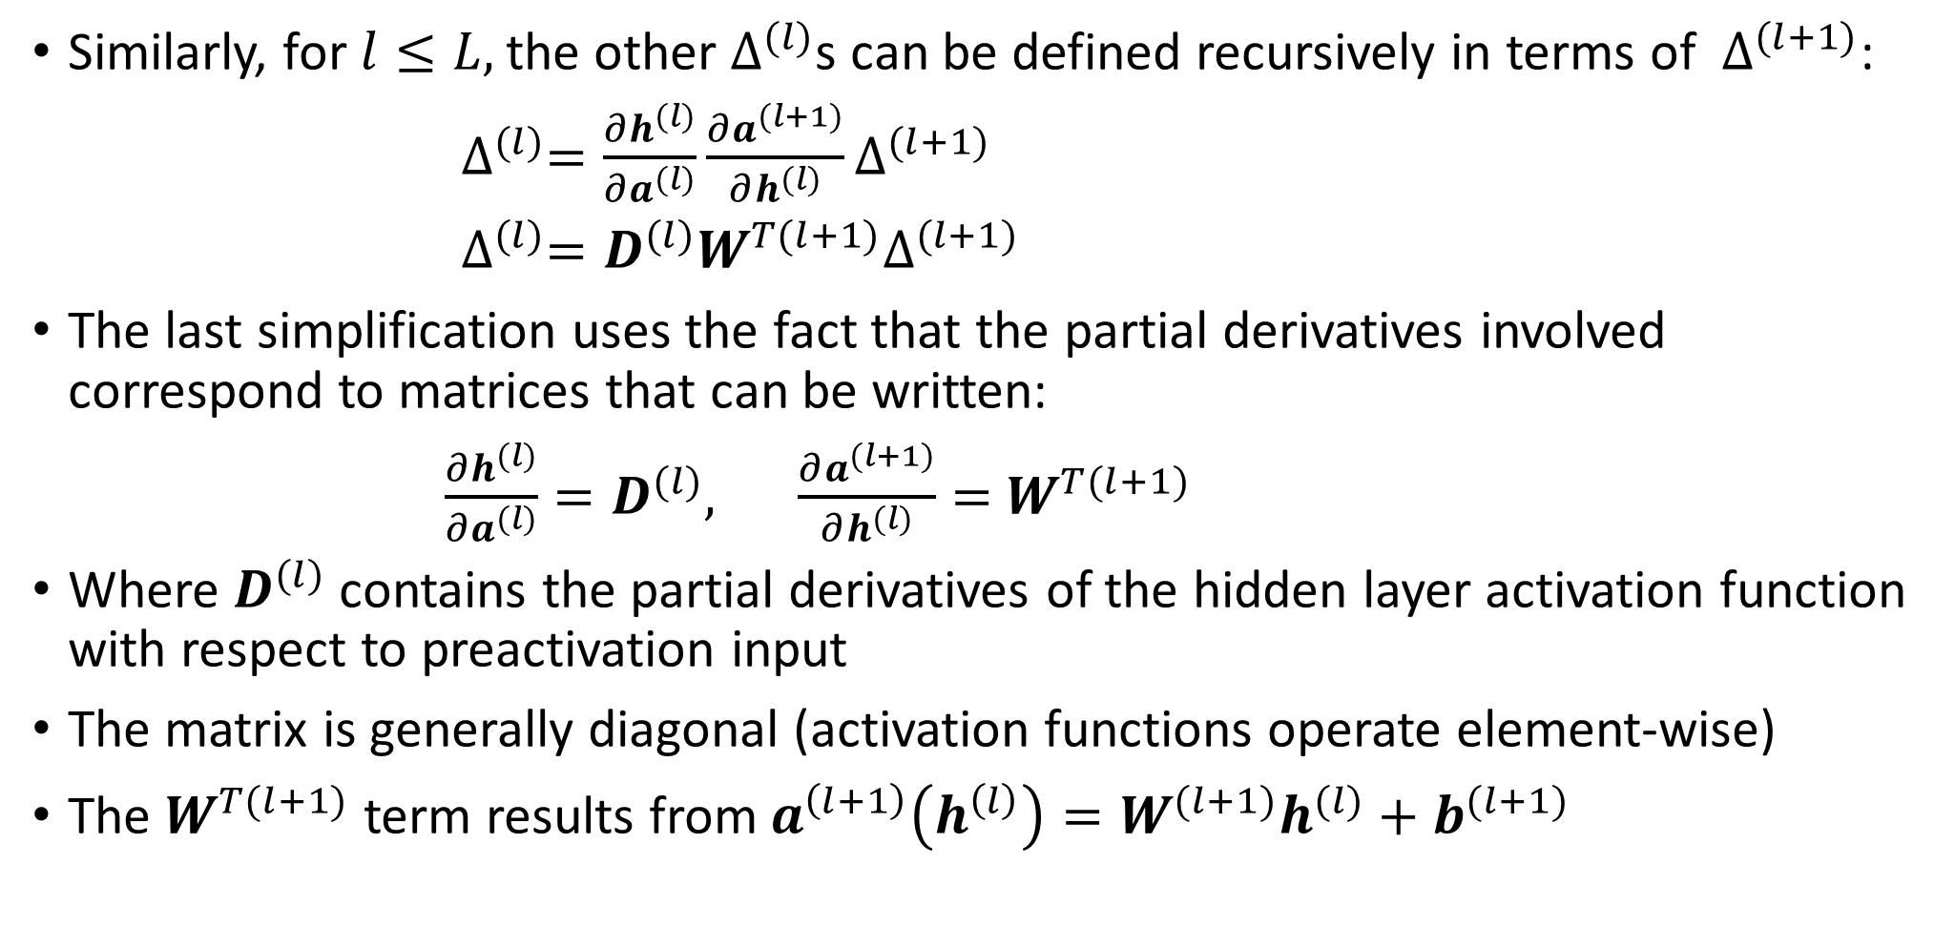
Backpropagation
Similarly, for $l≤L,$the other $∆^{(l)}$s can be defined recursively in terms of $∆^{(l+1)}$:
$∆^{(l)}=\frac{∂h^{(l)}}{∂a^{(l)}}\frac{∂a^{(l+1)}}{∂h^{(l)}}∆^{(l+1)}$
$∆^{(l)}=D^{(l)}W^{T(l+1)}∆^{(l+1)}$
The last simplification uses the fact that the partial derivatives involved correspond to matrices that can be written:
$\frac{∂h^{(l)}}{∂a^{(l)}}=D^{(l)},$ $\frac{∂a^{(l+1)}}{∂h^{(l)}}=$ $W^{T(l+1)}$
Where $D^{(l)}$ contains the partial derivatives of the hidden layer activation function with respect to preactivation input
The matrix is generally diagonal (activation functions operate element-wise)
The $W^{T(l+1)}$ term results from $a^{\left(l+1\right)}\left(h^{\left(l\right)}\right)=W^{(l+1)}h^{(l)}+b^{(l+1)}$

Slide 9
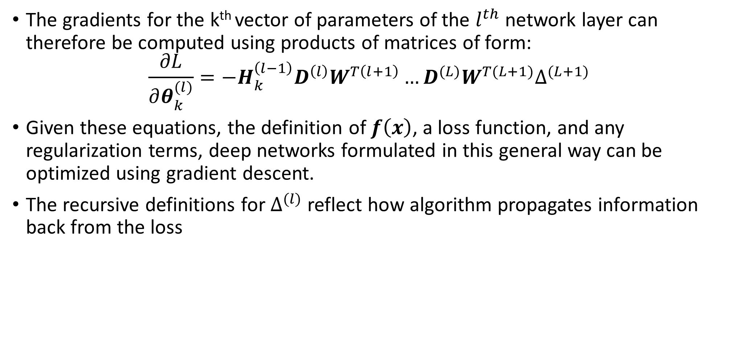
Backpropagation
The gradients for the k^{th} vector of parameters of the $l^{th}$ network layer can therefore be computed using products of matrices of form:
$$\frac{∂L}{∂θ_{k}^{(l)}}=−H_{k}^{\left(l−1\right)}D^{\left(l\right)}W^{T\left(l+1\right)}…D^{(L)}W^{T(L+1)}∆^{(L+1)}$$
Given these equations, the definition of $f\left(x\right)$, a loss function, and any regularization terms, deep networks formulated in this general way can be optimized using gradient descent.
The recursive definitions for $∆^{(l)}$ reflect how algorithm propagates information back from the loss

Slide 10
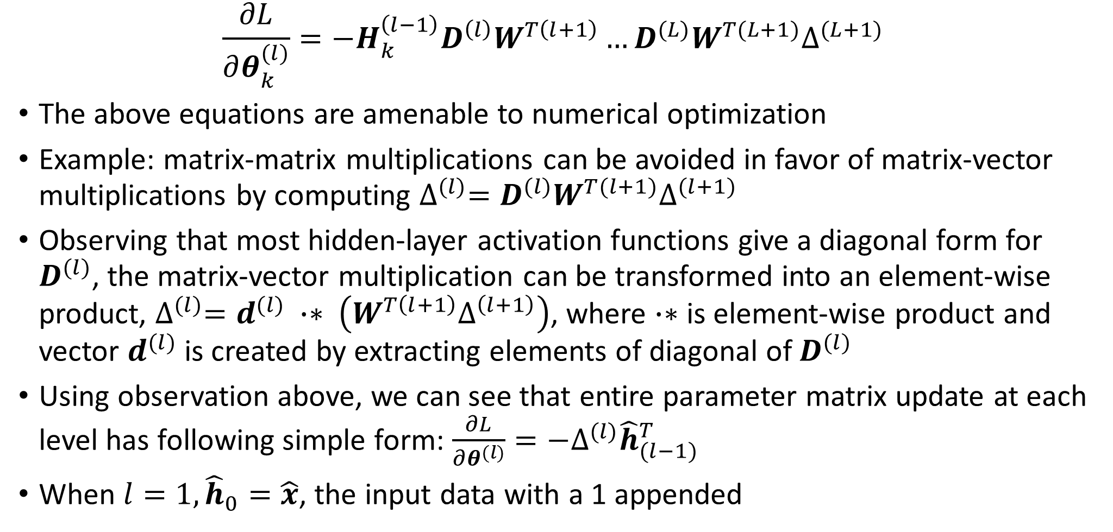
Backpropagation
$$\frac{∂L}{∂θ_{k}^{(l)}}=−H_{k}^{\left(l−1\right)}D^{\left(l\right)}W^{T\left(l+1\right)}…D^{(L)}W^{T(L+1)}∆^{(L+1)}$$
The above equations are amenable to numerical optimization
Example: matrix-matrix multiplications can be avoided in favor of matrix-vector multiplications by computing $∆^{(l)}=D^{(l)}W^{T(l+1)}∆^{(l+1)}$
Observing that most hidden-layer activation functions give a diagonal form for $D^{(l)}$, the matrix-vector multiplication can be transformed into an element-wise product, $∆^{(l)}=d^{(l)} ∙∗ \left(W^{T\left(l+1\right)}∆^{\left(l+1\right)}\right)$, where $∙∗$ is element-wise product and vector $d^{(l)}$ is created by extracting elements of diagonal of $D^{(l)}$
Using observation above, we can see that entire parameter matrix update at each level has following simple form: $\frac{∂L}{∂θ^{(l)}}=−∆^{(l)}{\hat{h}}_{(l−1)}^{T}$
When $l=1, {\hat{h}}_{0}=\hat{x}$, the input data with a 1 appended

Slide 11
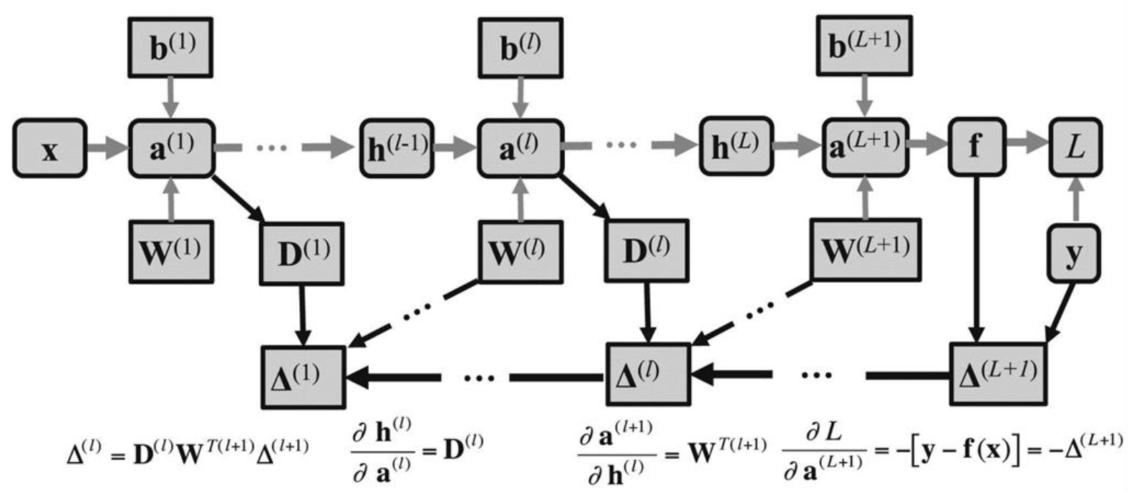
Backpropagation in a deep network (forward computation shown in gray arrows)

Slide 12
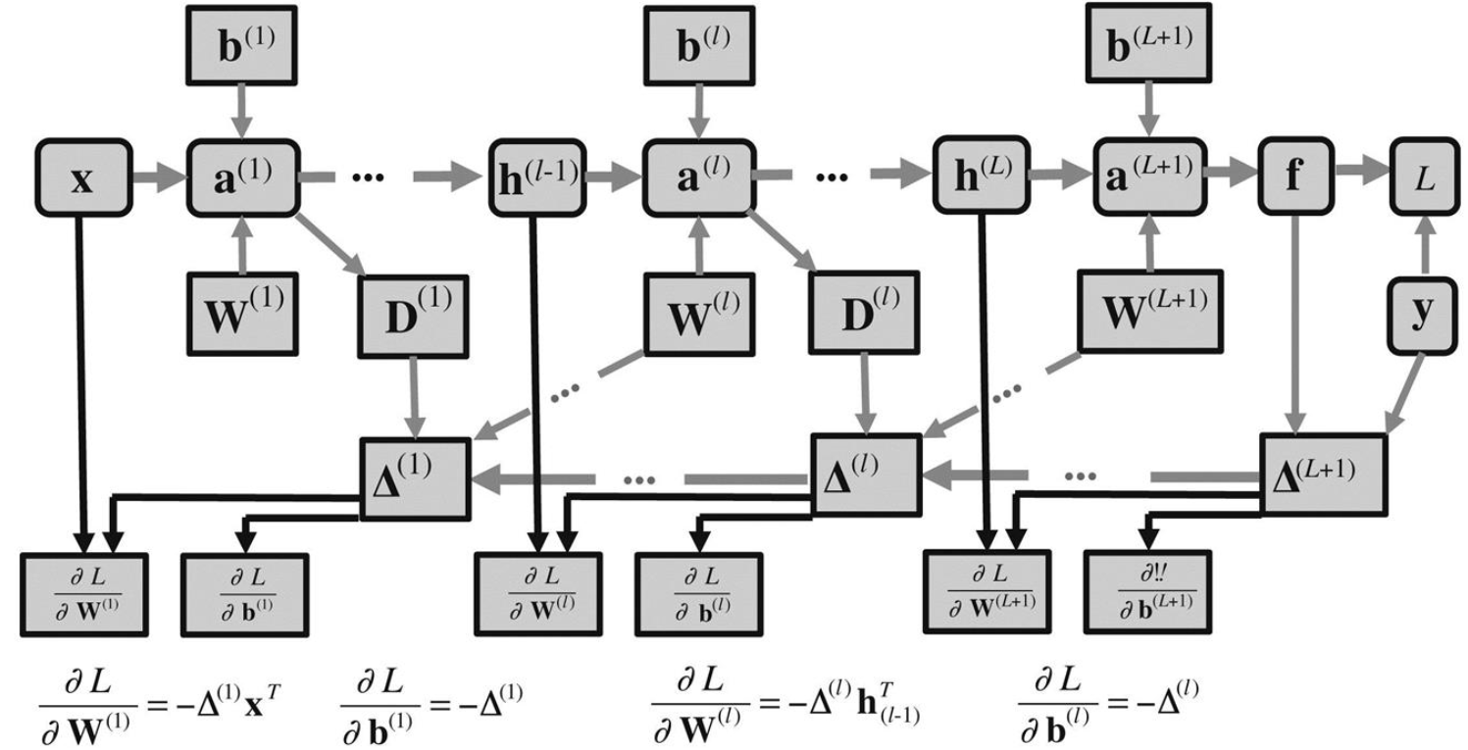
Parameter updates (black arrows) that follow the forward and backward propagation steps (gray arrows)

Slide 13
Computation graphs and complex network structures
For a simple feedforward network, learning takes place in two phases: a forward pass and a backward pass
Using vector notation, we saw above that gradient computations decompose into a simple chain of matrix products
What if the graph does not have a simple layered structure?
More complex computations consisting of applying functions to intermediate results can also be represented by computation graphs
Implementing general mechanisms for efficient backpropagation is complex
Using concept of computation graph, gradient information simply needs to be propagated along the path found by reversing arrows in graph used to define steps of forward propagation of information
Learning in a deep network could be by gradient descent, or more sophisticated methods that exploit higher-order derivatives.
In practice, a variation of stochastic gradient descent based on mini-batches is by far the most popular method, software packages often optimized assuming this is the case

Slide 14
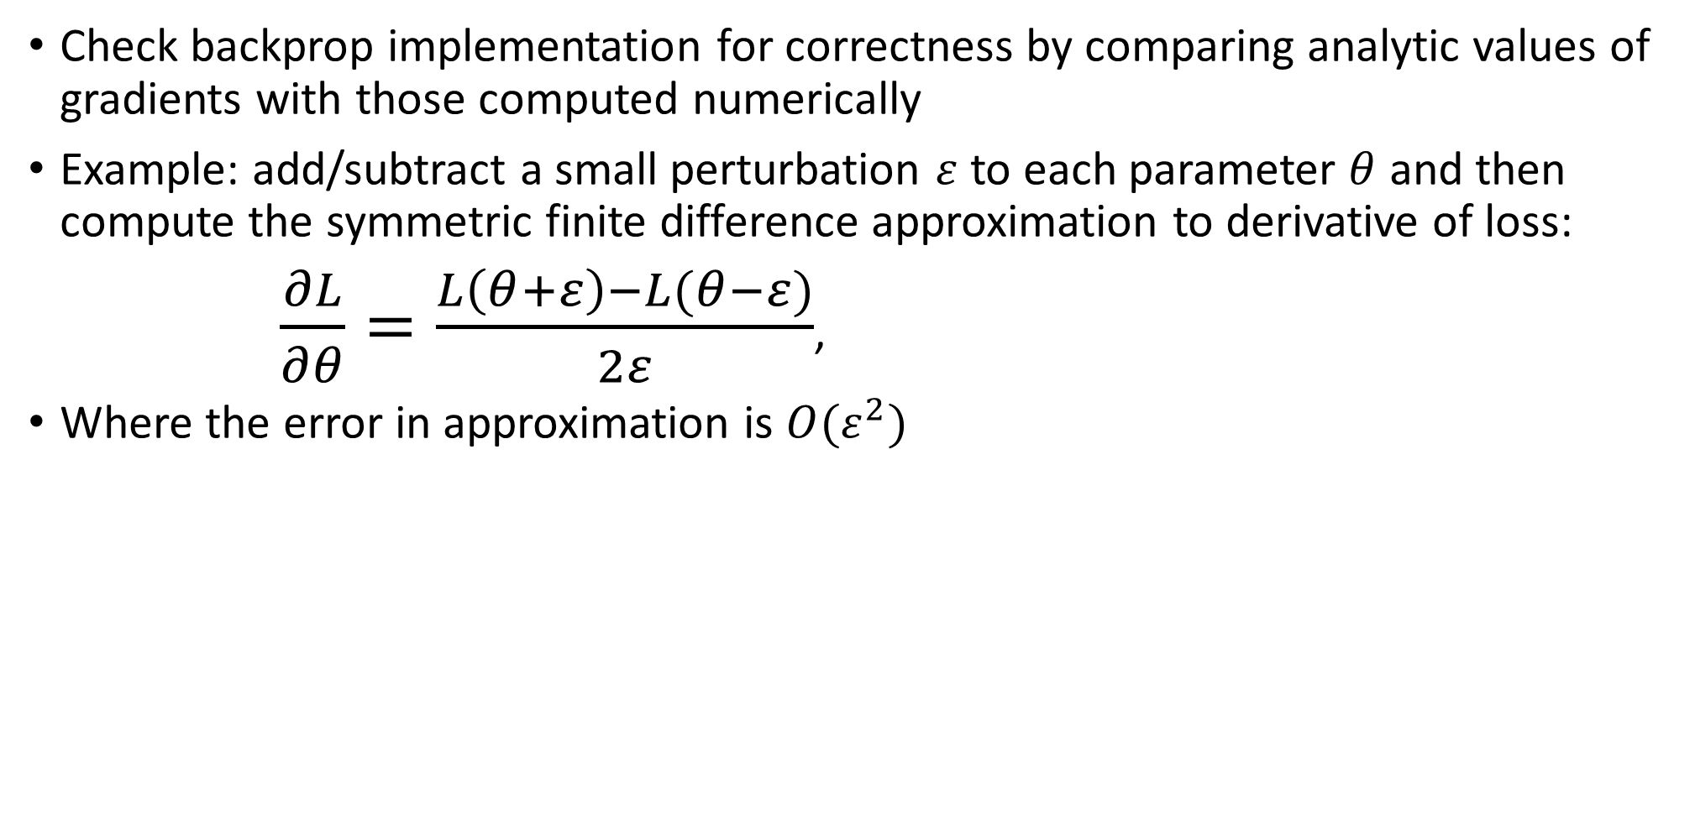
Checking backpropagation implementations
Check backprop implementation for correctness by comparing analytic values of gradients with those computed numerically
Example: add/subtract a small perturbation $ε$ to each parameter $θ$ and then compute the symmetric finite difference approximation to derivative of loss:
$\frac{∂L}{∂θ}=\frac{L\left(θ+ε\right)−L(θ−ε)}{2ε}$,
Where the error in approximation is $O(ε^{2})$

Slide 15
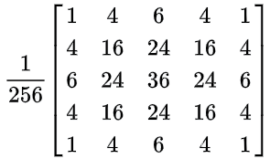
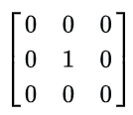
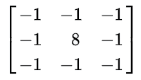



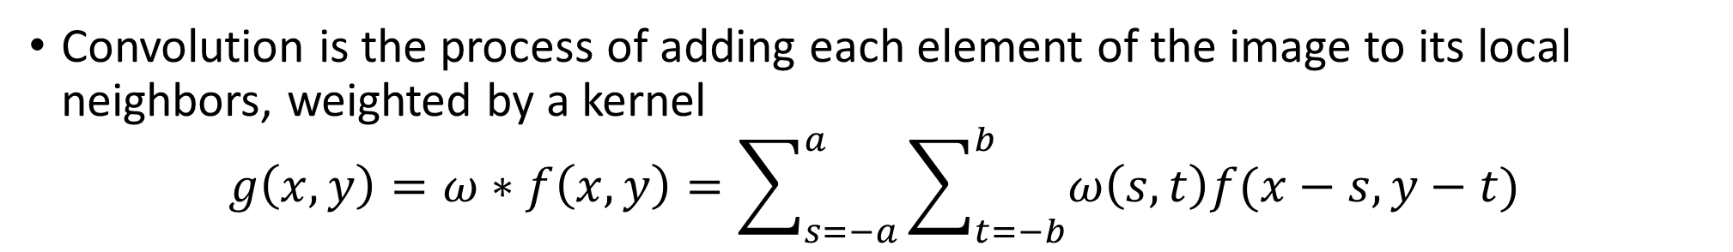
Convolutional neural networks (CNNs)
Convolution is the process of adding each element of the image to its local neighbors, weighted by a kernel
$$g\left(x,y\right)=ω∗f\left(x,y\right)=\sum_{s=−a}^{a}{\sum_{t=−b}^{b}{ω\left(s,t\right)f(x−s,y−t)}}$$
Original
Gaussian blur (5x5)
Edge detection
https://en.wikipedia.org/wiki/Kernel_(image_processing)

Slide 16
Convolutional neural networks (CNNs)
CNNs are a special kind of feedforward network proven extremely successful for image analysis
When classifying images, filtering them first can provide a useful set of spatially organized features
CNNs allow us to learn these filters along with other parameters of the network
Each filter implemented by multiplying a relatively small spatial zone of image by a set of weights, and feeding the result into an activation function

Slide 17
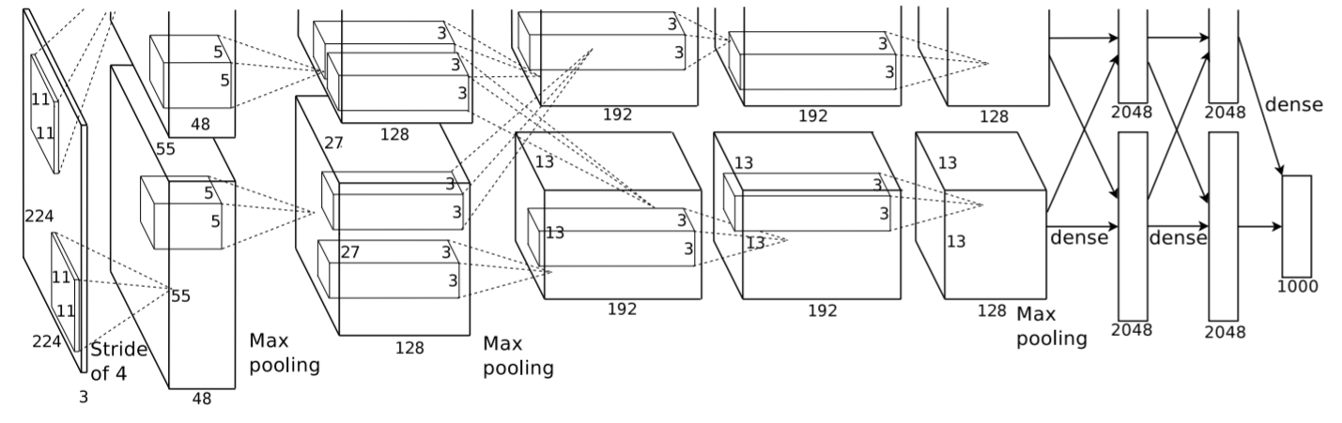
ImageNet classification with deep convolutional neural networks
Trained large, deep convolutional neural network to classify the 1.2 million high-resolution images in ImageNet contest into 1000 different classes
Achieved error rate of 17.0%, considerably better than previous state-of-the-art (26%)
Neural network has 60 million parameters and 650,000 neurons
Consists of 5 convolutional layers, some of which are followed by max-pooling layers and three fully-connected layers with a final 1000-way softmax

Slide 18
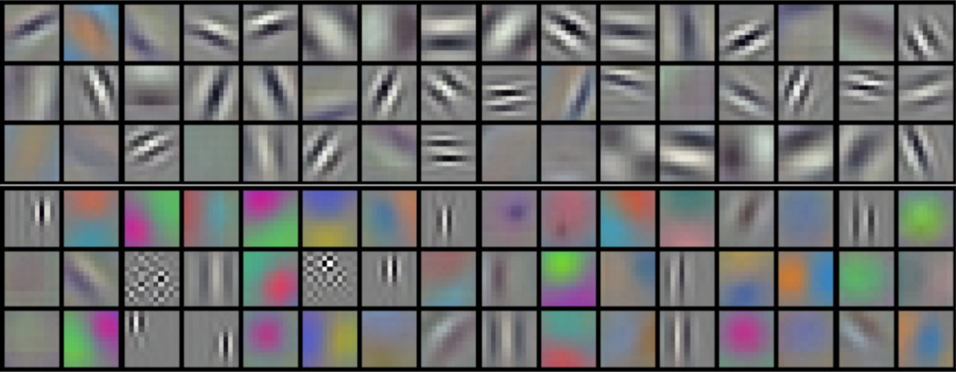
96 convolutional filters of size 11x11x3 learned by the first convolutional layer on the 224x224x3 input images
The top 48 filters were learned on GPU 1, the bottom 48 kernels on GPU 2
Taken from “ImageNet classification with deep convolutional neural networks”

Slide 19
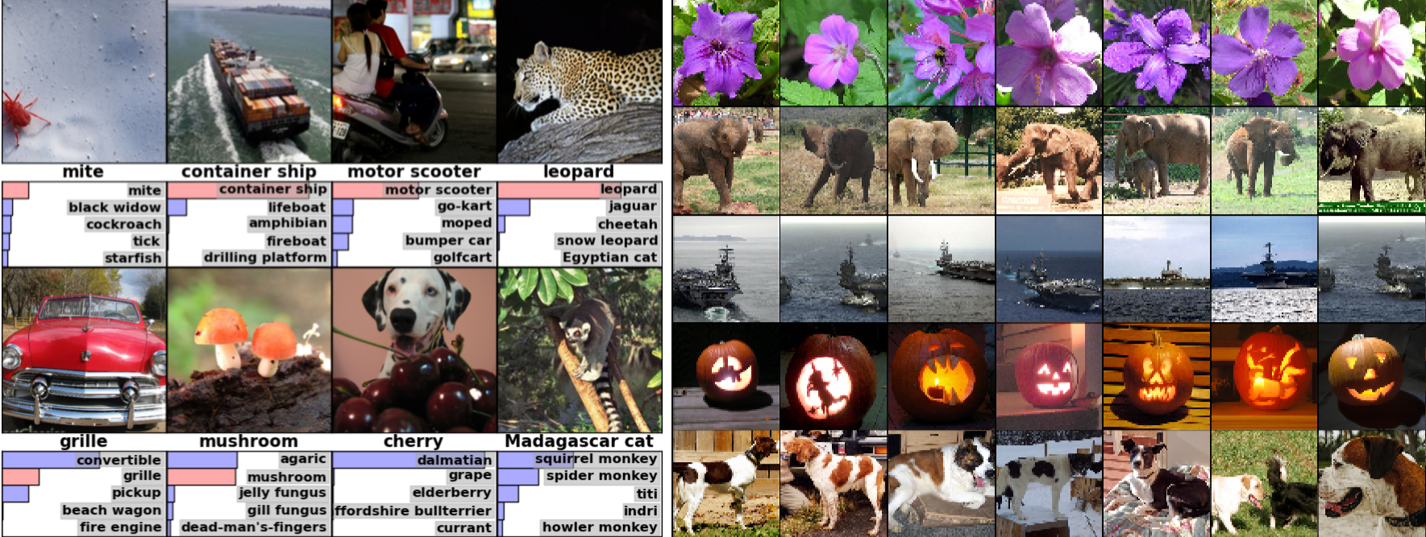
Left: 8 images and the 5 labels considered most probable by CNN, correct label is written under each image, and probability assigned to correct label in red
Right: column 1 = 5 test images, column 2-7 = 6 training instances producing feature vectors in last hidden layer with smallest Euclidean distance from test image

Slide 20
Recap
Backpropagation in matrix-vector form enables GPU-accelerated learning
Overview of different gradient descent algorithms: https://ruder.io/optimizing-gradient-descent/
Convolutional neural networks (CNNs)
Next lecture: more about CNNs and an example in keras

