Slide 1
Data Mining CS 405/505
Lecture 2
Friday, September 6th 2019

Slide 2

More administrative info
Moodle coming soon
Assignment #1: written (no coding)
Midterm (2nd week of October):
written, in class, covering chapters 2,3,4,5
Assignment #2, #3: coding in python
Final project: coding in python
Will release projects by Oct 1st
Today: chapter 2 + python example using Spyder

Slide 3
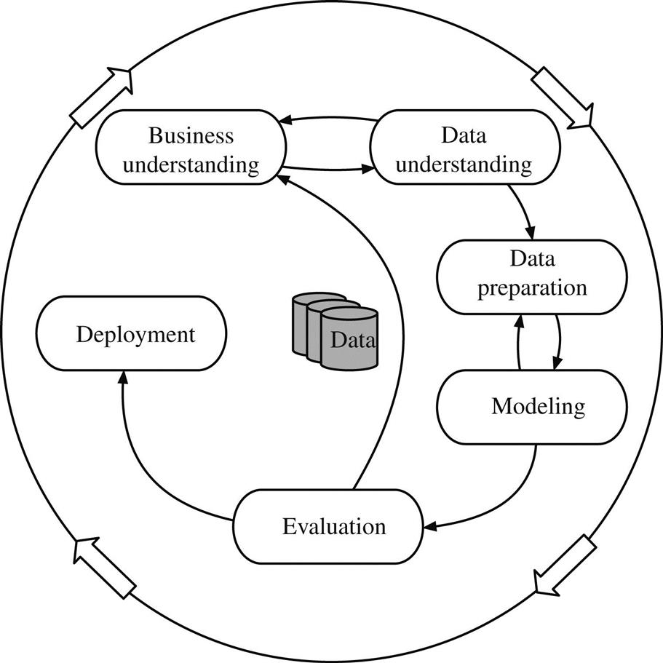
Recap Lecture 1: the data mining process
Understand what you want to achieve (business understanding)
Acquire initial dataset (data understanding)
Prepare the raw data for machine learning algorithm (data preparation)
Run the machine learning algorithm on the data (modeling)
Evaluate the output (evaluation)
Put into practice (deployment)

Slide 4
Chapter 2: Input
We will cover:
What is meant by “learning a concept from data”
Structure of input data to machine learning algorithms
Instances and Attributes
Getting the data ready for learning
Next class: specific machine learning algorithms

Slide 5
2.1 What’s a Concept?
Four styles of learning common in data mining applications
Classification learning (classify unseen examples, supervised)
Association learning (look for any association among features, many rules)
Clustering (look for groups of examples that belong together, unsupervised)
Numeric prediction (predict numeric quantity instead of discrete class)
Regardless of style of learning, the “thing to be learned” is the concept
Output of learning scheme is the concept description
Question: what style of learning did we see previously?
(iris problem, weather problem, contact lens problem)
Mostly classification problems

Slide 6
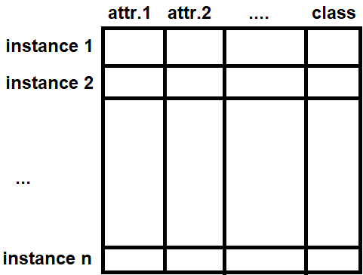
2.2 What’s in an Example?
The input to a machine learning algorithm is a set of instances
Instances are the things to be classified, associated, or clustered
Until now we have called them examples
Instances are characterized by the values of a set of predetermined attributes
Standard scenario:
Each instance is an individual, independent example of concept to be learned
Examples:
Contact lens, iris, weather
Most practical data mining problems can be expressed this way
Matrix of instances vs attributes

Slide 7

2.3 What’s in an Attribute?
Each instance is characterized by its attributes (features)
Instances are rows, attributes are columns
The value of an attribute for a particular instance is a measurement of the quantity to which the attribute refers
Different types of attributes:
Nominal attributes
Ordinal attributes
Interval attributes
Ratio attributes

Slide 8



Nominal attributes
Prespecified, finite set of possibilities
sometimes called categorical, enumerated, or discrete
Distinct symbols, values serve as labels/names
“Outlook” from weather data (sunny, overcast, rainy)
Sunny
Overcast
Rainy

Slide 9
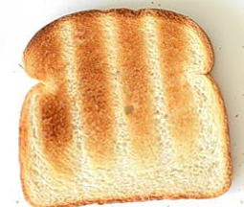
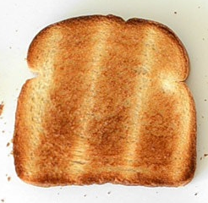
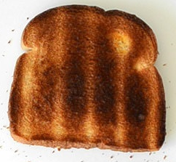
Ordinal attributes
Can be ordered (ranked), but no notion of distance
toasted < burned < charred
Cannot directly add/subtract the values, distinction from nominal to ordinal not always clear
<
<
toasted
burned
charred

Slide 10
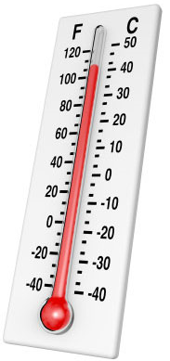
Interval quantity attributes
Interval quantities have values that are not only ordered, but measured in fixed and equal units
Temperature (degrees)
Dates (year)
Can subtract, but adding/multiplying is meaningless
Starting point (zero) is completely arbitrary

Slide 11
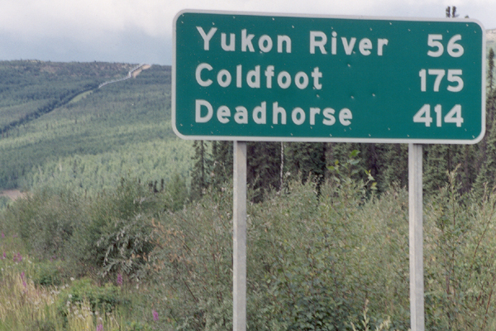
Ratio quantity attributes
Ratio quantities are ones for which the measurement scheme inherently defines a zero point
Real numbers, can multiple and add together (distances)
We will work only with nominal and ratio, in practice, the distinction between ordinal and ratio is irrelevant (normalization)

Slide 12
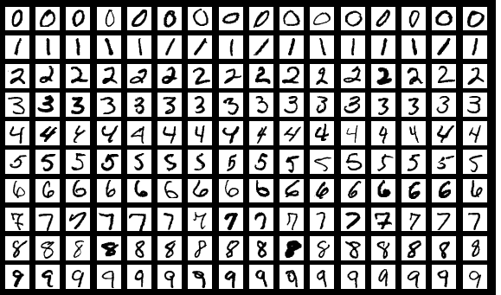
Handwritten digit dataset example
160 instances (on this slide)
10 classes, 16 instances per class
Real dataset has 70,000 instances (MNIST dataset)
Each image is 28x28 pixels
How many attributes?
784 (28*28)
Each pixel is an attribute

Slide 13
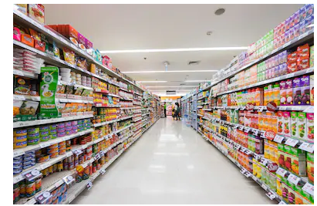



Preparing the input
Real data is often low in quality (full of artifacts/missing values), data cleaning is often necessary
Practical issues (record keeping across different departments, etc.)
Sparse data
Sparse data is when most instances have value of 0 for most attributes
Supermarket basket
Dealing with sparse data
Use indices

Slide 14
Preparing the input
Missing values
Frequently encountered, indicated by -1 or NaN
May be meaningful in their own right (survey respondents)
In these cases, you can replace the NaN with some number and include the missing values
Inaccurate values
Typographic errors, outliers, instrumental errors
Car rental ZIP code example
Unbalanced data
In classification problems, rare that classes are equally represented in dataset
Flinks example, Ireland weather example
If different machine-learning algorithms all converge to exact same accuracy
We will consider cost-sensitive evaluation, classification, and learning
Getting to know your data
Histogram, scatter plots

Slide 15

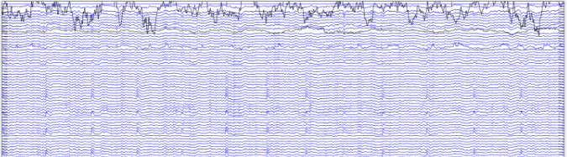
Example of corrupt data
-Independent component analysis (ICA) will not work well on this data
-ICA expects similar magnitude for each electrode and a degree of covariance

Slide 16

Input recap
Datasets are composed of instances, each with a number of attributes
The number of attributes can be very large
The attributes can be strings (nominal) or float/double/int (ratio)
Input is often sparse, missing, unbalanced, or inaccurate
Garbage in = garbage out

Slide 17

Python example
Spyder
Scientific programming IDE for python
Designed for scientists, engineers, and data analysts
unique combination of advanced editing and interactive execution
Combines text editor with ipython console
Numpy ndarrays
https://docs.scipy.org/doc/numpy-1.13.0/reference/arrays.ndarray.html
Matplotlib.pyplot
https://matplotlib.org/api/pyplot_api.html
Built in toy datasets
Use anaconda to install: https://anaconda.org/anaconda/spyder

