Slide 1
Data Mining CS 405/505
Lecture 3
Monday, September 9th 2019

Slide 2
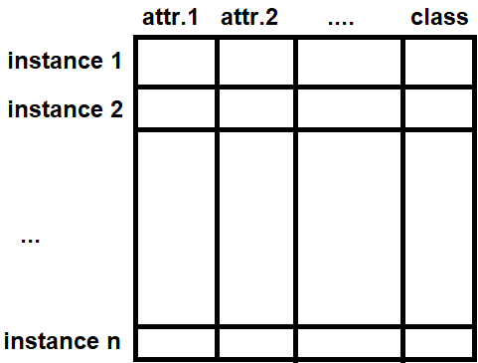

Review
Instances and attributes (features) are the input
The model produced by the machine learning algorithm is the output (concept)
Output of the model is the concept description

Slide 3
Outline:
High level overview of different types of output
Basic knowledge representation (decision tables)
Linear models
Decision trees
Rule sets (classification rules, association rules, exceptions to rules)
Instance-based learning
Clustering algorithm output (flat clusters, dendrograms)

Slide 4
Overview
Many techniques we will cover produce easily comprehensible descriptions of structural patterns in data
Before examining these techniques in depth, need to see how structural patterns can be expressed
Know where you’re going to see how to get there

Slide 5
Tables
Outlook | Temperature | Humidity | Windy | Play
Sunny | Hot | High | False | No
Sunny | Hot | High | True | No
Overcast | Hot | High | False | Yes
Rainy | Mild | High | False | Yes
Rainy | Cool | Normal | False | Yes
Rainy | Cool | Normal | True | No
Overcast | Cool | Normal | True | Yes
Sunny | Mild | High | False | No
Sunny | Cool | Normal | False | Yes
Rainy | Mild | Normal | False | Yes
Sunny | Mild | Normal | True | Yes
Overcast | Mild | High | True | Yes
Overcast | Hot | Normal | False | Yes
Rainy | Mild | High | True | No
Output is the same as the input
Table 1.2 (decision table for weather data)
Attribute selection (leave some out of table) (Chapter 8)

Slide 6
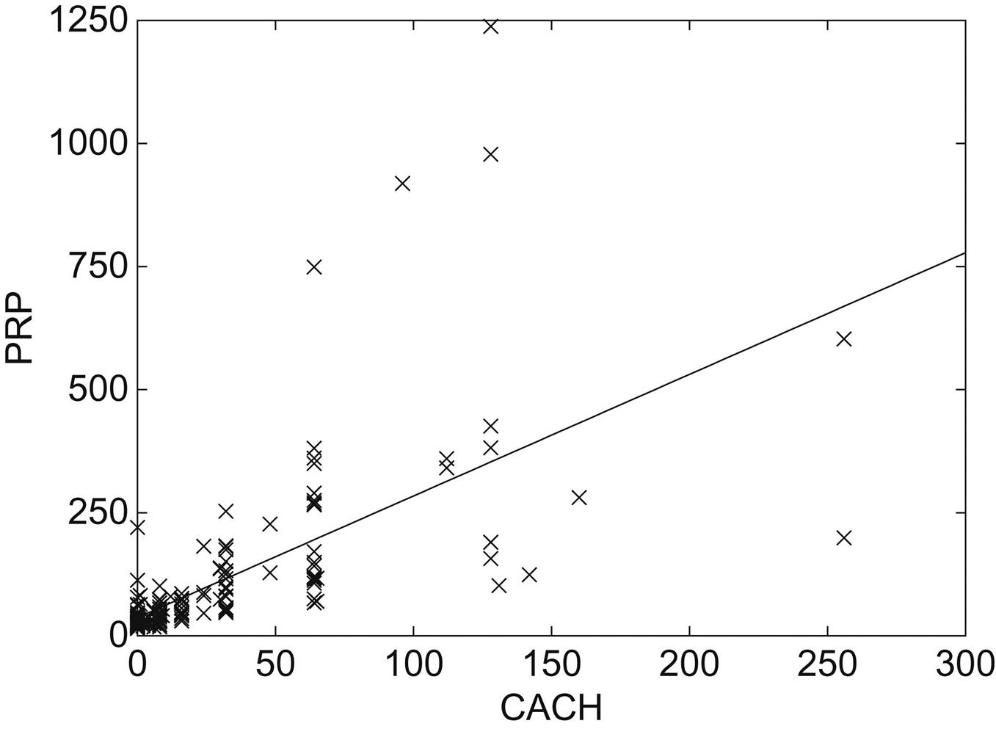
3.2 Linear Models
Output is sum of weighted attribute values
Easiest to visualize in 2 dimensions
Generate prediction by plugging observed value of CACH into expression to obtain a value for performance

Slide 7
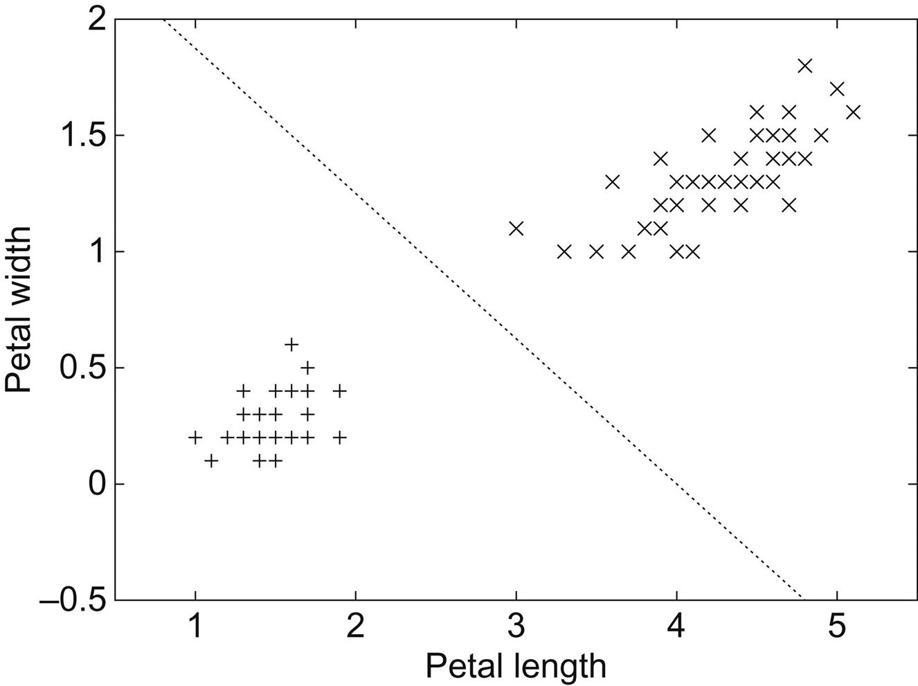
Linear models for decision boundary
Line produced by the model separates the two classes
Defines where decision changes from one class to another
Decision boundary
Points lying on the line given by equation
Given a test instance, prediction is produced by plugging observed values of attributes in question into expression, and checking if >0 or <0
Extending model to multiple attributes results in hyperplane

Slide 8
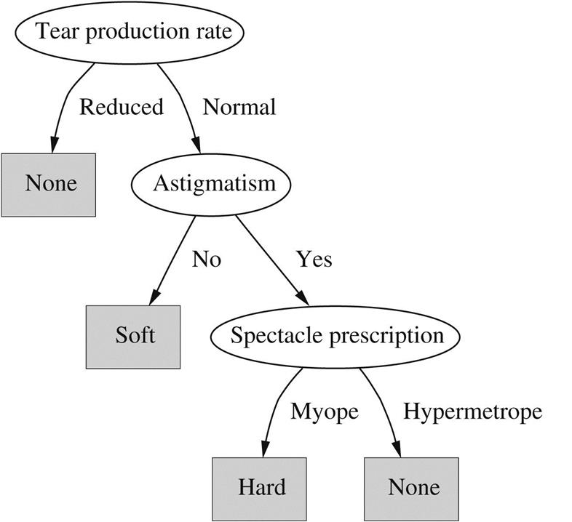
3.3 Trees
Divide and conquer approach
Example: contact lens data
Each node tests a given attribute, comparing it to a constant
Leaf nodes give a classification that applies to all instances that reach the leaf
Unknown instances are routed down the tree according to value of attributes until a leaf is reached
Nominal attributes: number of children = number of possible values
Numerical attributes: two-way or three-way split (below, within, above)
Can also split on a combination of attributes, or by comparing attributes
Construct a decision tree by hand

Slide 9
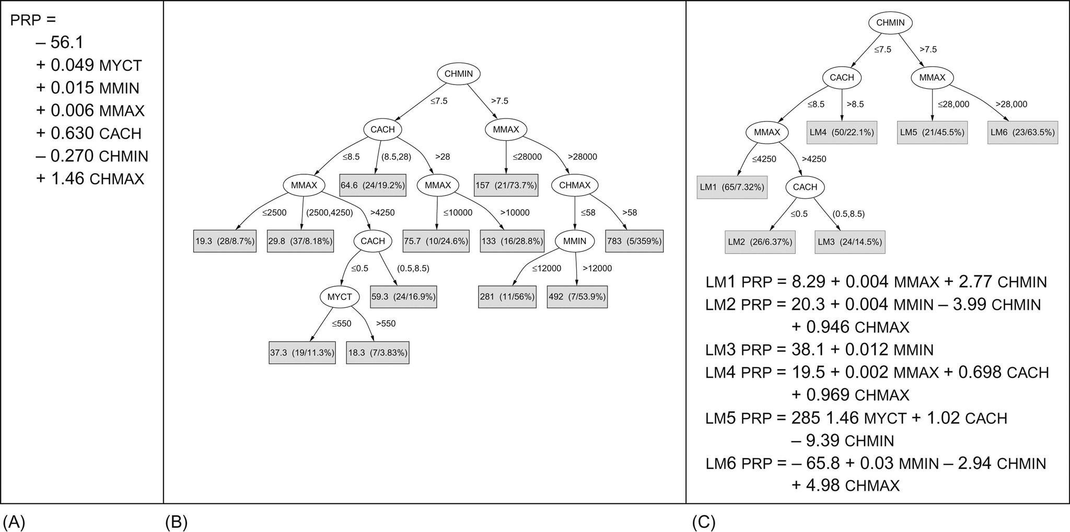
Linear regression vs regression tree vs model tree
A) Regression equation for
CPU performance
data
B) Regression tree for CPU performance data. Leaves of tree are numbers that represent the average outcome for instances that reach the leaf.
Larger, more complex than regression equation, but also more accurate than regression equation.
Model tree (leaves contain linear expressions)

Slide 10
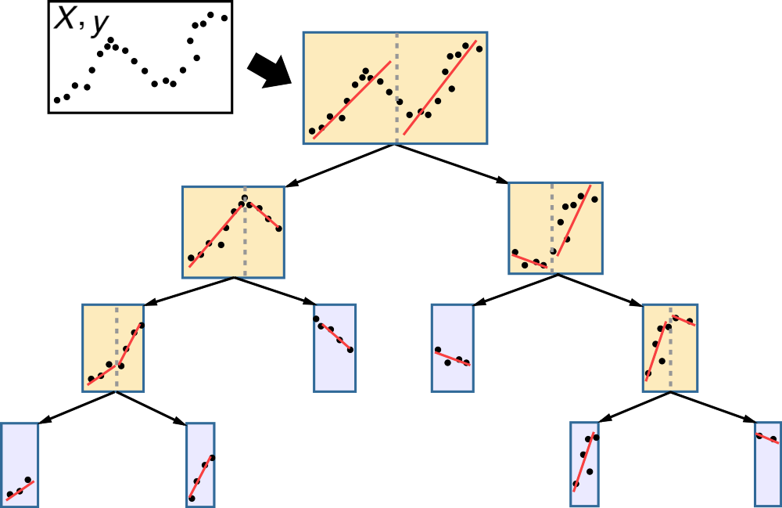
Model Tree example:
Combine regression equation with regression tree
Model tree approximates continuous functions by linear patches

Slide 11
3.4 Rules
Popular alternative to decision trees
Antecedent and consequent
antecedent
consequent

Slide 12
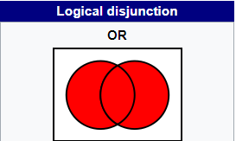
Classification Rules
Easy to read set of classification rules off a decision tree (one rule per leaf)
Antecedent = tests on nodes leading up to leaf
Consequent = class assigned by the leaf
Order in which rules are read off tree is irrelevant (unambiguous)
In general, rules read directly off decision tree are overly complex
Decision trees cannot easily express disjunction (“or”) implied among different rules in a set
Going from rules to tree? Difficult to transform a given set of rules into a decision tree

Slide 13
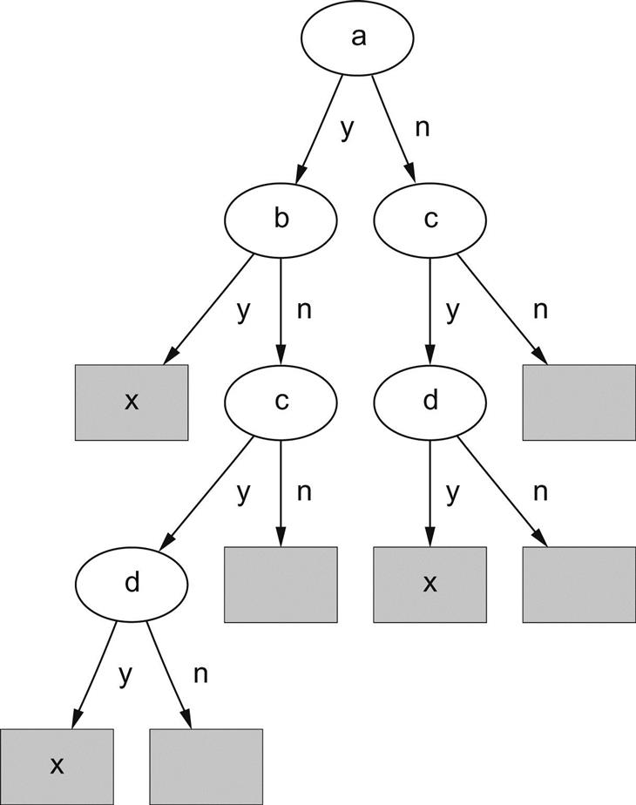

Example:
Rule 1
Rule 2
Take an example where two rules have the same structure but different attributes
Need to choose a single test for root node
If we choose ‘a’ as root node, the second rule must be repeated twice in the tree (replicated subtree problem)

Slide 14
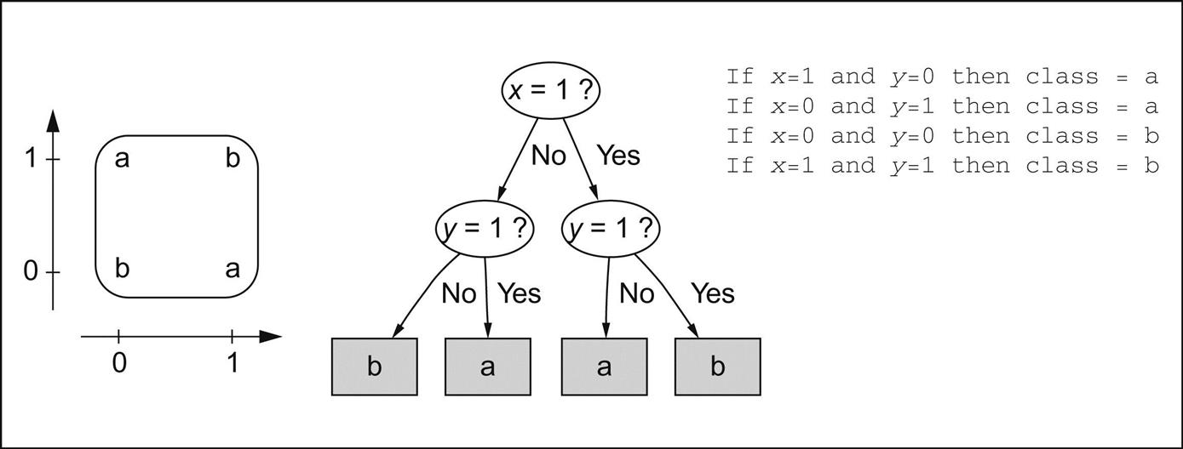
Replicated subtree problem
Take XOR (exclusive-or) function, for example
Tree does not reflect true symmetry of problem
Rules are not notably more compact here, but in other situations rules are much more compact than trees

Slide 15
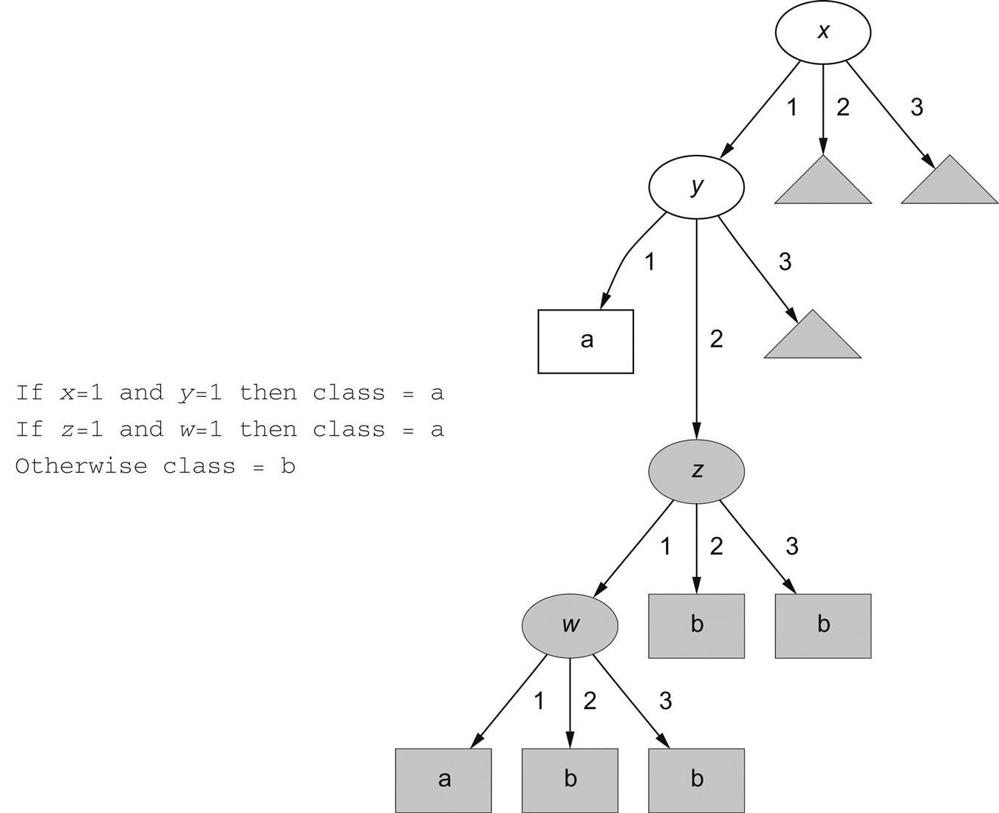
Replicated subtree
x, y, z, w can take values 1, 2, or 3
Default rules
Each small gray triangle contains the entire 3 level subtree in gray (child of node y)
Extreme example

Slide 16
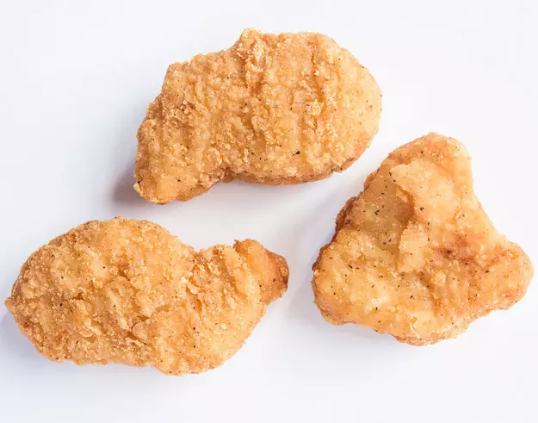
More about rules:
Rules are popular because each rule seems to represent an independent “nugget” of knowledge
New rules can be added to existing rule set without disturbing pre-existing rules, whereas adding to a tree may require reshaping the entire tree
However, this ignores the fact that some rule sets are to be interpreted in order (decision list)
Sometimes, different rules will classify the same instance differently (this never happens for decision trees)
Machine learning algorithms that generate rules invariably produce ordered rule sets (Decision lists)
Chicken nugget

Slide 17
Association rules
Association rules predict any attribute (not just class)
Can predict combinations of attributes
Not intended to be used together as a set (as with classification rules)
Express regularities underlying the dataset
Coverage – number of instances predicted correctly, or the proportion of all instances covered by the rules
Accuracy - number of instances predicted correctly, expressed as a proportion of all instances to which it applies
Coverage = number of days that are both cool, and have normal humidity
Accuracy = proportion of cool days with normal humidity

Slide 18
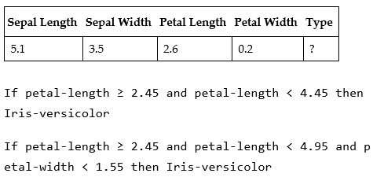

Rules with exceptions
Allowing classification rules to have exceptions, means we can make incremental modifications to rule set without reengineering entire set
Consider the iris problem, we find a new flower, classed by expert as I. setosa
Misclassified by two of the rules found earlier
Change bounds of existing rules?
Solution: add an exception!

Slide 19
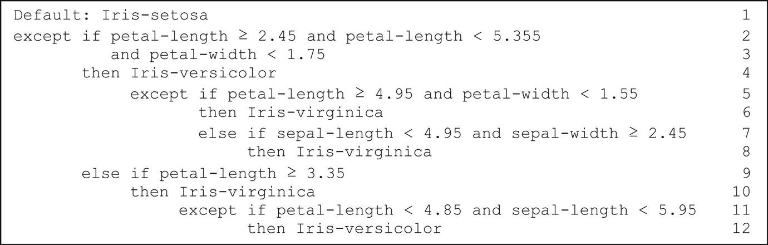
Full rule set with exceptions for iris dataset
Default outcome: I. setosa (normally choose most frequent class)
Mirrors how we think of real problems in our heads (more comprehensible than if…then…else)
Scales up well (locality property) – each individual statement needs only be considered in context of rules/exceptions that lead to it, whereas with decision lists, all prior rules need to be reviewed to determine the precise effect of an individual rule, crucial for understanding large rule sets

Slide 20


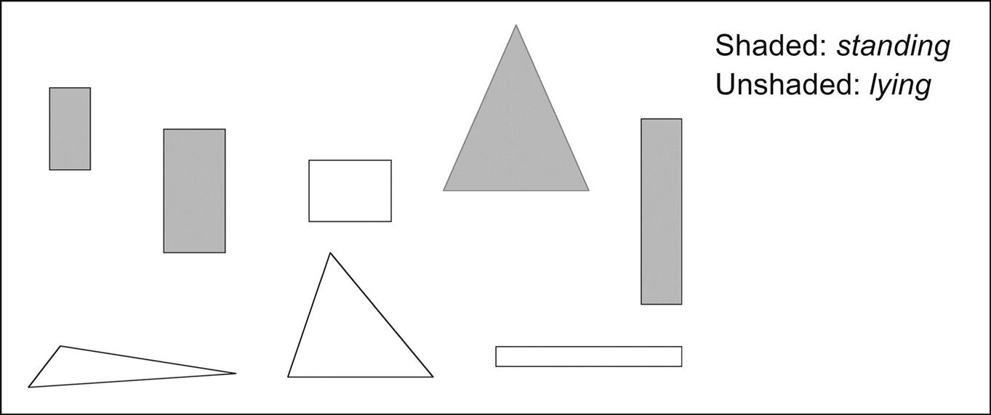
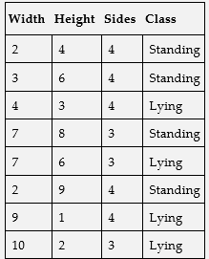
More expressive rules
Until now, we have only tested rules against a constant (iris dataset)
Suppose we have 8 blocks, and we wish to learn “standing” concept
Learning algorithm is given width, height, and number of sides
We can augment existing datasets by adding attributes such as width>height (Flinks example) - preprocessing

Slide 21
Recap
Linear models
Decision trees
Rules
Next class: instance-based representation

