Slide 1
CS405/505 Data Mining
Lecture 4

Slide 2
Recap
Input
Output

Slide 3
Algorithms: the basic methods (chapter 4)
Rudimentary rule learning (1R)
Naïve Bayes for probabilistic classification
Divide and conquer for learning Decision Trees
Separate and conquer for learning Decision Rules
Apriori algorithm for mining Association Rules
Linear regression for numeric prediction
Logistic regression for classification
Mistake-driven algorithms (Perceptron and Winnow)
Instance based learning – data structures for nearest neighbour search
K-means clustering and Hierarchical clustering
Multi-instance learning

Slide 4
Basic ideas
Simplicity first approach (simple ideas often work very well!)
Simple structure datasets can exhibit:
Single attribute is relevant, all others are redundant
Small number of independent rules governing assignment to different classes
Strong (linear?) dependencies among different subsets of attributes
Each of the above cases is handled best by a specific algorithm

Slide 5
Inferring Rudimentary Rules
1R (1-Rule)
Easiest way to find simple classification rules from set of instances
Generates one-level decision tree expressed in form of a set of rules that all test a single attribute
Simple, computationally cheap, characterizes structure of data well
Simple rules frequently achieve surprisingly high accuracy because structure underlying real-world datasets is often quite rudimentary (example)
Idea: make rules that test a single attribute and branch accordingly

Slide 6
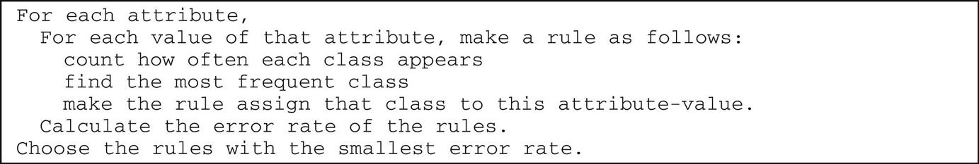
1R (1-Rule) algorithm

Slide 7
Applying 1R to raw data
Outlook | Temperature | Humidity | Windy | Play
Sunny | Hot | High | False | No
Sunny | Hot | High | True | No
Overcast | Hot | High | False | Yes
Rainy | Mild | High | False | Yes
Rainy | Cool | Normal | False | Yes
Rainy | Cool | Normal | True | No
Overcast | Cool | Normal | True | Yes
Sunny | Mild | High | False | No
Sunny | Cool | Normal | False | Yes
Rainy | Mild | Normal | False | Yes
Sunny | Mild | Normal | True | Yes
Overcast | Mild | High | True | Yes
Overcast | Hot | Normal | False | Yes
Rainy | Mild | High | True | No
For each attribute:
(start with Outlook)
For each value of that attribute
(start with Sunny)
Count how often each class appears
Find the most frequent class
Make the rule assign that class to this attribute-value
Calculate error rate of rules and choose rules with smallest error

Slide 8
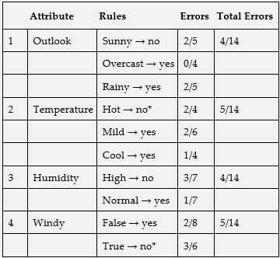
1R (1-Rule)
Outlook
Sunny->no
2/5
Rainy->yes
2/5
Overcast->yes
0/4
If Outlook=Sunny then Play=no
If Outlook=Overcast then Play=yes
If Outlook=Rainy then Play=yes

Slide 9
1R (1-Rule)
Temperature
Outlook
Hot
>no
2/4
Mild >yes
2/6
Cool >yes
1/4
Windy
Total errors: 5/14
Sunny
>no
2/5
Overcast>yes
0/4
Rainy
>yes
2/5
Humidity
False >yes
2/8
True >no
3/6
Total errors: 4/14
Total errors: 5/14
High >no
3/7
Normal>yes
1/7
Total errors: 4/14

Slide 10
1R (1-Rule) algorithm

Slide 11
Missing values and Numeric attributes for 1R
1R accommodates both missing values and numeric attributes
Missing is treated as just another attribute value
ie: Outlook can take 4 values: Sunny, Overcast, Rainy, Missing
Numeric attributes can be converted into nominal attributes using a simple discretization method

Slide 12


Discretization of numerical attributes
Step 1: sort training examples according to the values of the numeric attribute
Sorted temperature values from weather data
Step 2:place breakpoints wherever class changes (producing eight categories in this case)
Small problem here: two instances with same value of temperature “72”, but different class
Solution: move breakpoint at 72 up one, producing a mixed partition where “no” is the majority class
More serious problem: breakpoint procedure tends to form large number of categories
(identification code example)
Solution: impose a minimum limit on number of instances of majority class in a given partition (3 here)
Because next example is also “yes”, we lose nothing by including it in 1st partition
…and any adjacent partitions with same majority class can be merged.
Final rule set: if Temperature <= 77.5 then Play=Yes, if Temperature > 77.5 then Play=No

Slide 13
4.2 Simple Probabilistic Modeling
1R bases decisions on the single attribute that works best
Another technique is to allow all attributes to make equally important and independent contributions towards the decision
Naïve Bayes

Slide 14
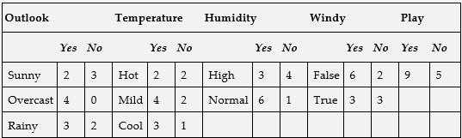


Simple Probabilistic Modeling
Summary of weather data obtained by counting how many times each attribute-value pair occurs with each value (yes/no) for play
Observed probabilities given a value for “Play”
Suppose we encounter a new example:
Treating the 5 features (Outlook, Temperature, Humidity, Windy, Play) as equally important, independent pieces of evidence:

Slide 15


Simple Probabilistic Modeling (Naïve Bayes)
Naïve Bayes
Bayes’ Rule and Basic Probability

Slide 16
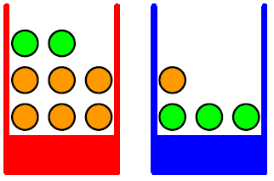
Basic Probability
Consider two boxes containing mixtures of fruit
Probability of selecting red box is 40% or 0.4 (arbitrarily set for sake of example)
Probability of selecting blue box is 60% or 0.6
Each piece of fruit within the box is equally likely
apple
orange
Red box, P(red) = 0.4
Blue box, P(blue) = 0.6

Slide 17
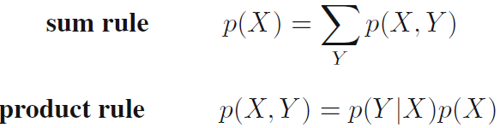
Basic Probability
We would like to answer questions such as:
1) What is the overall probability of selecting an apple?
2) Given that we selected an orange, what is the probability that we picked from blue box?
We can use the Rules of Probability to answer these questions
p(X) = Marginal Probability
p(X,Y) = Joint Probability
P(Y|X) = Conditional Probability
p(Y|X)p(X) = p(Y)p(X) = p(Y,X) = P(X,Y) if X and Y are independent (coin toss example)
(question 1)

Slide 18



Bayes’ Theorem
Product rule
Symmetry property
Bayes’ Theorem
P(Y) = prior (initial degree of belief in Y)
p(X|Y) = likelihood
p(X) = normalization constant
X is the evidence, Y is the class whose probability we want to estimate given the evidence

Slide 19
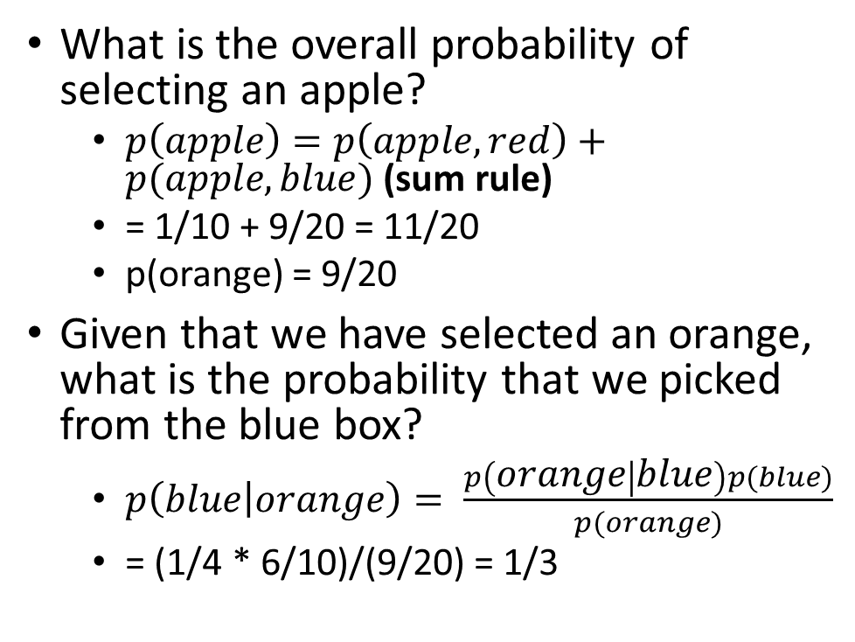
Using Bayes’s Theorem
Bayes’ Theorem
What is the overall probability of selecting an apple?
$p\left(apple\right)=p\left(apple,red\right)+p(apple,blue)$ (sum rule)
= 1/10 + 9/20 = 11/20
p(orange) = 9/20
Given that we have selected an orange, what is the probability that we picked from the blue box?
$p\left(blue | orange\right)= \frac{p\left(orange | blue\right)p(blue)}{p(orange)}$
= (1/4 * 6/10)/(9/20) = 1/3
apple
orange
Red box, P(red) = 0.4
Blue box, P(blue) = 0.6

Slide 20
Cancer example:
Bayes’ Theorem
posterior
likelihood
prior
1% of people have cancer (prior) and 99% do not
Cancer is detected by test 80% of the time when it exists
Therefore missed 20% of time
10% of tests return positive when its actually negative
Therefore, 90% of tests accurately return no cancer
What is the probability you have cancer given a positive test?
p(cancer|+test) = p(+test|cancer)p(cancer) / p(+test)
p(+test) = p(false positive) + p(true positive) = 0.099+0.008 = 0.107
p(false positive) = p(no cancer)p(+test|no cancer) = 0.99*0.1 = 0.099
p(true positive) = p(cancer)p(+test|cancer) = 0.01*0.8 = 0.008
=> p(cancer|+test) = 0.8*0.01 / 0.107 = 0.0748
Given a negative test?

Slide 21
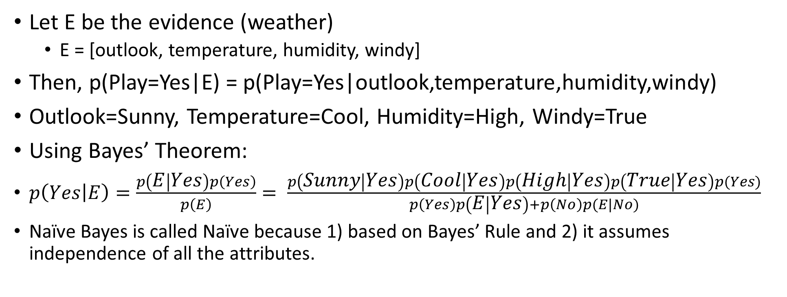
Naïve Bayes
Bayes’ Theorem
Let E be the evidence (weather)
E = [outlook, temperature, humidity, windy]
Then, p(Play=Yes|E) = p(Play=Yes|outlook,temperature,humidity,windy)
Outlook=Sunny, Temperature=Cool, Humidity=High, Windy=True
Using Bayes’ Theorem:
$p\left(Yes | E\right)=\frac{p\left(E | Yes\right)p\left(Yes\right)}{p\left(E\right)}= \frac{p\left(Sunny | Yes\right)p\left(Cool | Yes\right)p\left(High | Yes\right)p\left(True | Yes\right)p(Yes)}{p\left(Yes\right)p\left(E | Yes\right)+p\left(No\right)p(E|No)}$
Naïve Bayes is called Naïve because 1) based on Bayes’ Rule and 2) it assumes independence of all the attributes.

Slide 22
Pitfalls, missing values, and numeric attributes
Suppose Play=No for every case of Outlook=Sunny
Then, p(Sunny|Yes) = 0, nullifying the previous example no matter what the value of all the other attributes
Solution: use a Laplace estimator to add a small constant to each probability
Missing values can just be omitted from the calculation
Numeric attributes – calculate mean and std. of our training sample and assume a Gaussian distribution to get probability for new sample value

Slide 23


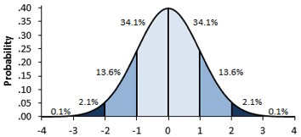
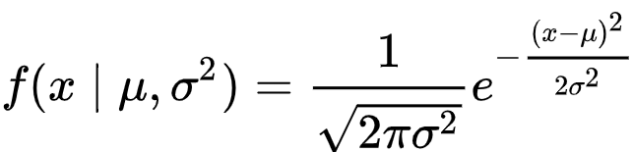
Using Gaussian distribution to estimate probabilities for numerical attributes in Naïve Bayes
Outlook |  |  | Temperature |  |  | Humidity |  |  | Windy |  |  | Play
 | Yes | No |  | Yes | No |  | Yes | No |  | Yes | No | Yes | No
Sunny | 2 | 3 |  | 83 | 85 |  | 86 | 85 | False | 6 | 2 | 9 | 5
Overcast | 4 | 0 |  | 70 | 80 |  | 96 | 90 | True | 3 | 3
Rainy | 3 | 2 |  | 68 | 65 |  | 80 | 70
 |  |  |  | 64 | 72 |  | 65 | 95
 |  |  |  | 69 | 71 |  | 70 | 91
 |  |  |  | 75 |  |  | 80
 |  |  |  | 75 |  |  | 70
 |  |  |  | 72 |  |  | 90
 |  |  |  | 81 |  |  | 75
Sunny | 2/9 | 3/5 | Mean | 73 | 74.6 | Mean | 79.1 | 86.2 | False | 6/9 | 2/5 | 9/14 | 5/14
Overcast | 4/9 | 0/5 | Std dev | 6.2 | 7.9 | Std dev | 10.2 | 9.7 | True | 3/9 | 3/5
Rainy | 3/9 | 2/5

Slide 24
Summary
Naïve Bayes provides a simple approach to representing, using, and learning probabilistic knowledge
Rivals and sometimes outperforms more sophisticated classifiers on many datasets
Always try the simpler things first! (1R, Naïve Bayes)
Naïve Bayes is effective in classification problems because it is sufficient for the correct class to receive the greatest probability
Naïve Bayes performs poorly when redundant attributes are present
Skews the probability estimates (extra temperature example)

