Slide 1
CS405/505 Data Mining
Lecture 20

Slide 2
Deep learning overview
One of the most striking developments in machine learning is the rise of deep learning, which is now at the forefront of current research
We will look at key differences between traditional neural network architectures and those that have become popular with deep learning
Detailed derivation of backpropagation in matrix-vector form
Deep convolutional networks, autoencoders, recurrent neural networks, and stochastic approaches based on Boltzmann machines
Practical aspects of training models on large datasets
Role of GPU computing

Slide 3
Deep learning preface
Major impact: speech recognition, computer vision, natural language processing
Google translate seq2seq model
Key to success is use of much larger quantities of data than before, deep neural networks are high-capacity models (many parameters)
Three approaches to making predictions from data using machine learning:
1) classical techniques: predicting directly from a set of features pre-specified by the user
2) representation learning techniques: transform features into some intermediate representation prior to mapping them to final predictions
Example: PCA followed by nearest-neighbor classifier
3) deep learning techniques: a form of representation learning using multiple transformation steps to create very complex features

Slide 4
Deep learning preface
A simple 3-layer perceptron learns representation by adapting hidden layer to the task of interest
Making a network ‘deep’ by adding further hidden layers subjects features to a sequence of transformations
Each layer’s transformation is a kind of inference
Complex inferences can be modeled as a series of computational steps
Most deep learning methods use multilayer perceptrons as building blocks
Main reason for using deep learning is its empirical effectiveness
Outperforms state-of-the-art alternatives
Some networks also implement soft variants of logic functions, and can behave like logic gates (xor).
Functions that can be compactly represented by multilevel networks may require far more elements (neurons) when expressed as shallower architectures

Slide 5
Deep learning preface
Deep learning methods frequently based on backpropagation
A variation of stochastic gradient descent called ‘mini batch’ training
Deep learning renaissance sparked by successes on key benchmark problems:
ImageNet
Large scale visual recognition challenge
Labeled faces in the wild challenge
Easy availability of high-speed computation using GPUs has been critical to success of deep learning
When formulated in matrix-vector form, computation can be accelerated using optimized graphics libraries and hardware (NVIDEA GPU - tensorflow)
As network models become more complex, some quantities can only be represented using tensors, a generalization of matrices permitting an arbitrary number of indices

Slide 6
10.1 Deep feedforward networks
Four key developments have played a role in the resurgence of neural networks:
1) proper evaluation of machine learning methods
2) vastly increased amounts of data
3) deeper and larger network architectures
4) accelerated training using GPU techniques
Regarding #1 – machine learning challenges with large test sets ensure results from different labs are directly comparable
The MNIST evaluation: database of handwritten digits, 60,000 training instances and 10,000 test instances, encoded as 28x28 pixel grayscale images

Slide 7
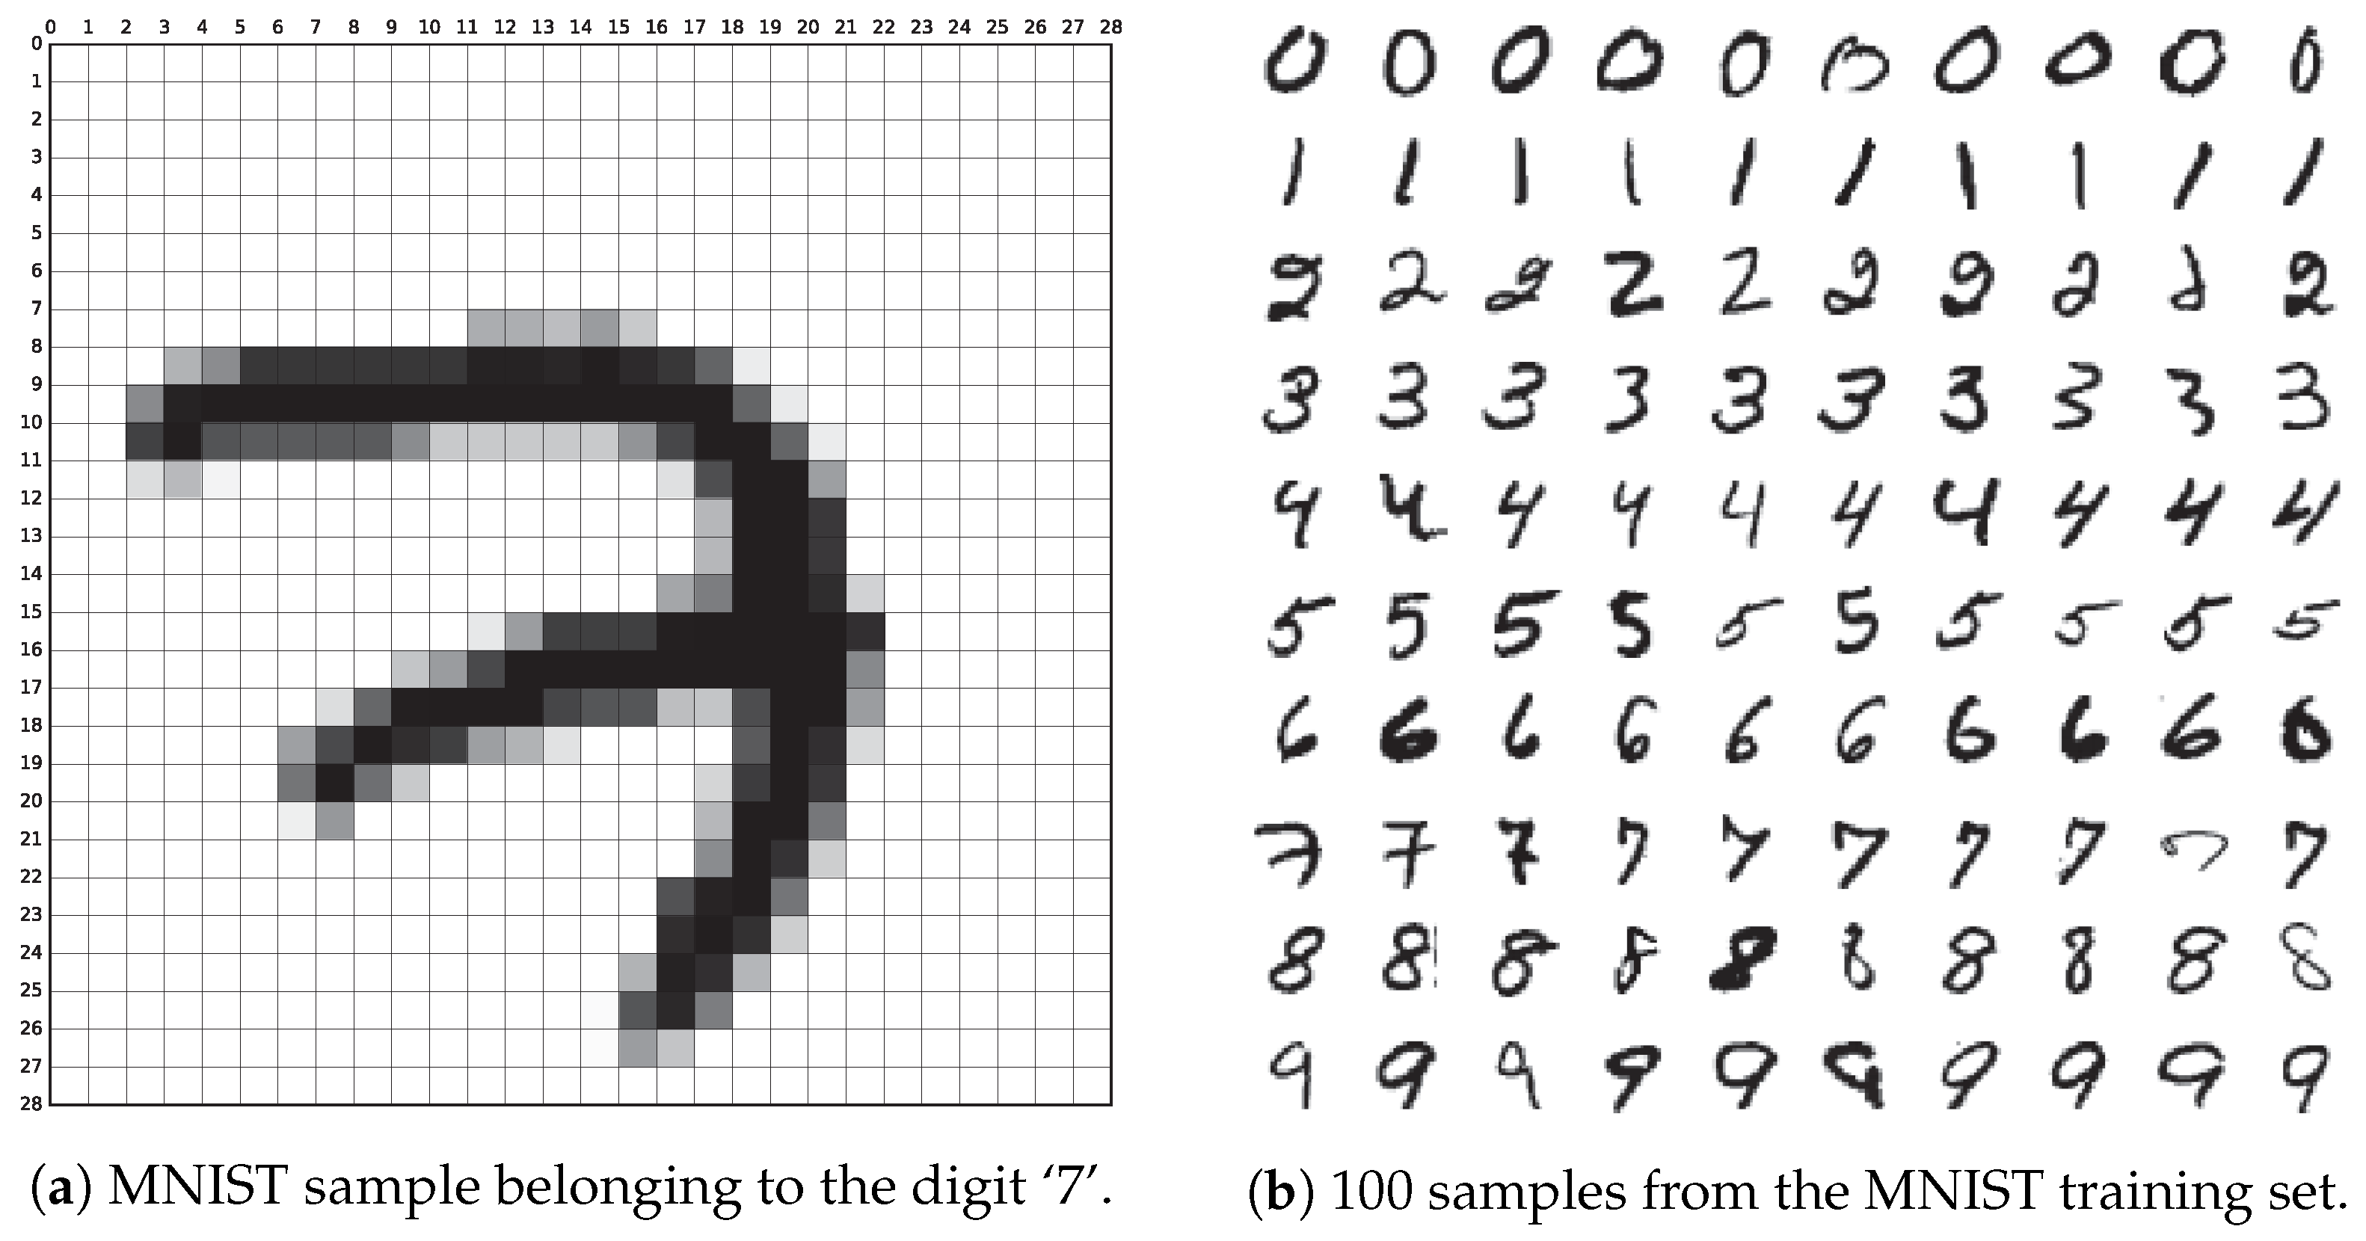
28*28=784 features

Slide 8
Classifier | Test Error Rate (%) | References
Linear classifier (1-layer neural net) | 12.0 | LeCun et al. (1998)
K-nearest-neighbors, Euclidean (L2) | 5.0 | LeCun et al. (1998)
2-Layer neural net, 300 hidden units, mean square error | 4.7 | LeCun et al. (1998)
Support vector machine, Gaussian kernel | 1.4 | MNIST Website
Convolutional net, LeNet-5 (no distortions) | 0.95 | LeCun et al. (1998)
Methods not using distortions of original dataset
Virtual support vector machine, deg-9 polynomial, (2-pixel jittered and deskewing) | 0.56 | DeCoste and Scholkopf (2002)
Convolutional neural net (elastic distortions) | 0.4 | Simard, Steinkraus, and Platt (2003)
6-Layer feedforward neural net (on GPU) (elastic distortions) | 0.35 | Ciresan, Meier, Gambardella, and Schmidhuber (2010)
Large/deep convolutional neural net (elastic distortions) | 0.35 | Ciresan, Meier, Masci, Maria Gambardella, and Schmidhuber (2011)
Committee of 35 convolutional networks (elastic distortions) | 0.23 | Ciresan, Meier, and Schmidhuber (2012)
Methods using distortions of original dataset
Use of transformations to extend size of dataset an important technique in deep learning
Plausible synthetic distortion of data multiplies the amount of data available, prevents overfitting, and helps network to generalize
Ensembles are used to achieve top performance in many settings

Slide 9
Losses and regularization
Different activation functions can be used for multilayer perceptrons
Sigmoid, linear, step function, etc.
In the past, was common practice to use sigmoid as output activation function and base final-layer loss function on squared error
Later designs embraced the natural probabilistic encoding for a given data type by defining output activation functions as the negative log of distribution functions used to make probabilistic predictions
Predictions can then correspond precisely to underlying probability models defined by Bernoulli or Gaussian distributions, as in linear/logistic regression
Viewed in this way, logistic regression is a neural network with no hidden units
Intuitive explanation of binary cross entropy loss and sigmoid (with numpy code): https://towardsdatascience.com/understanding-binary-cross-entropy-log-loss-a-visual-explanation-a3ac6025181a

Slide 10
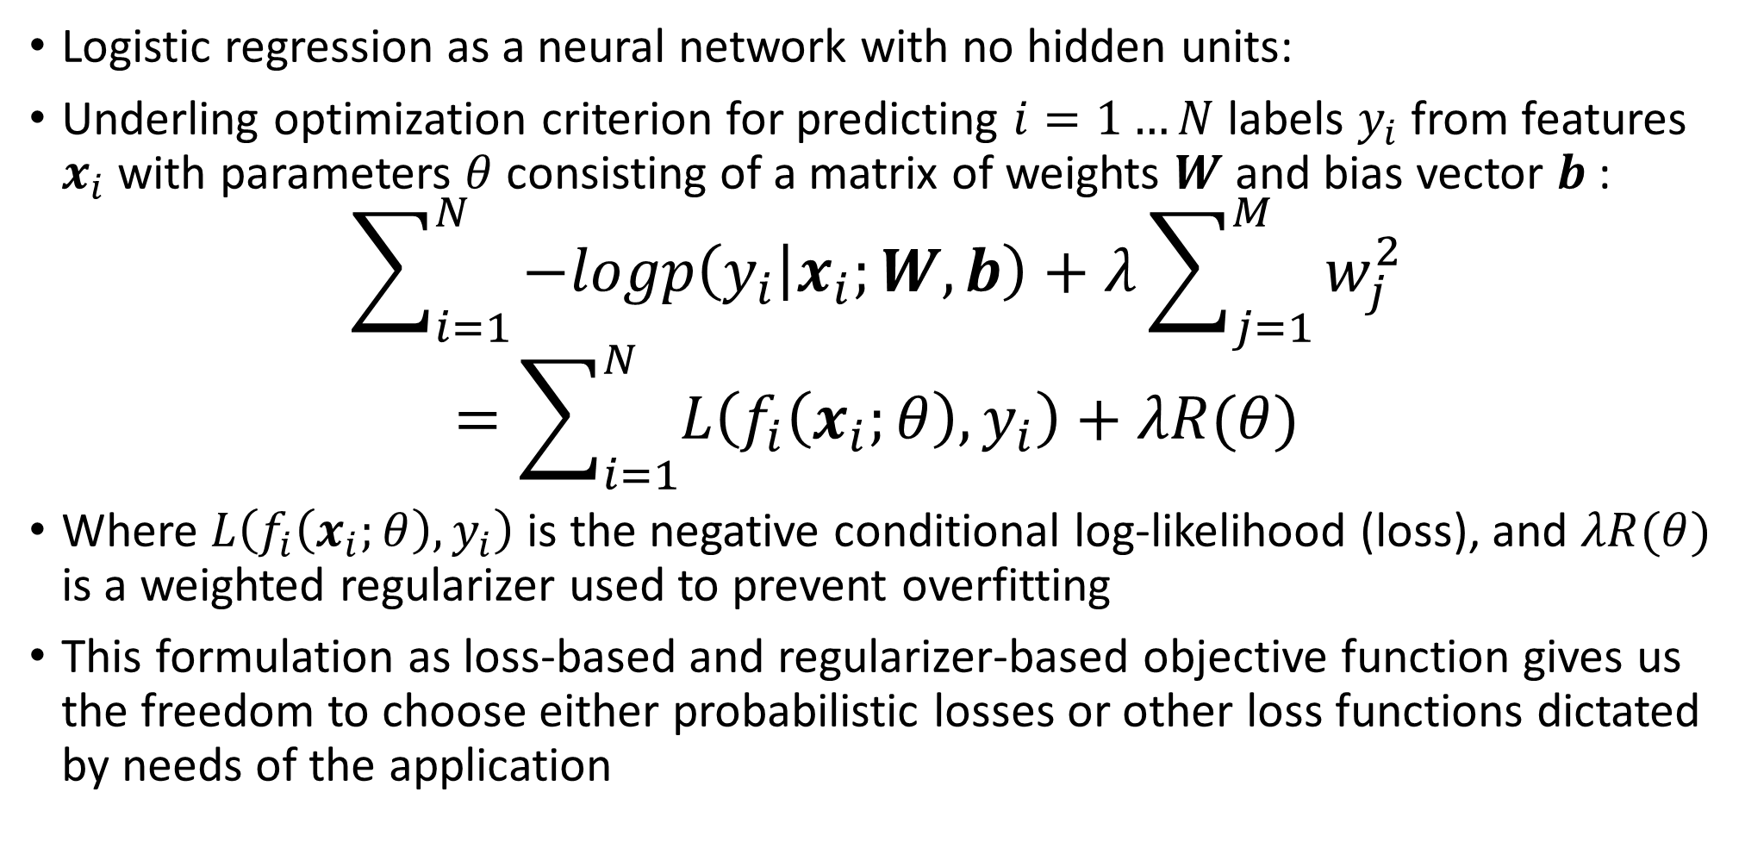
Losses and regularization
Logistic regression as a neural network with no hidden units:
Underling optimization criterion for predicting $i=1…N$ labels $y_{i}$ from features $x_{i}$ with parameters $θ$ consisting of a matrix of weights $W$ and bias vector $b$ :
$$\sum_{i=1}^{N}{−logp\left(y_{i} | x_{i};W,b\right)+λ\sum_{j=1}^{M}{w_{j}^{2}}}$$
$$=\sum_{i=1}^{N}{L\left(f_{i}\left(x_{i};θ\right),y_{i}\right)}+λR(θ)$$
Where $L\left(f_{i}\left(x_{i};θ\right),y_{i}\right)$ is the negative conditional log-likelihood (loss), and $λR(θ)$ is a weighted regularizer used to prevent overfitting
This formulation as loss-based and regularizer-based objective function gives us the freedom to choose either probabilistic losses or other loss functions dictated by needs of the application

Slide 11
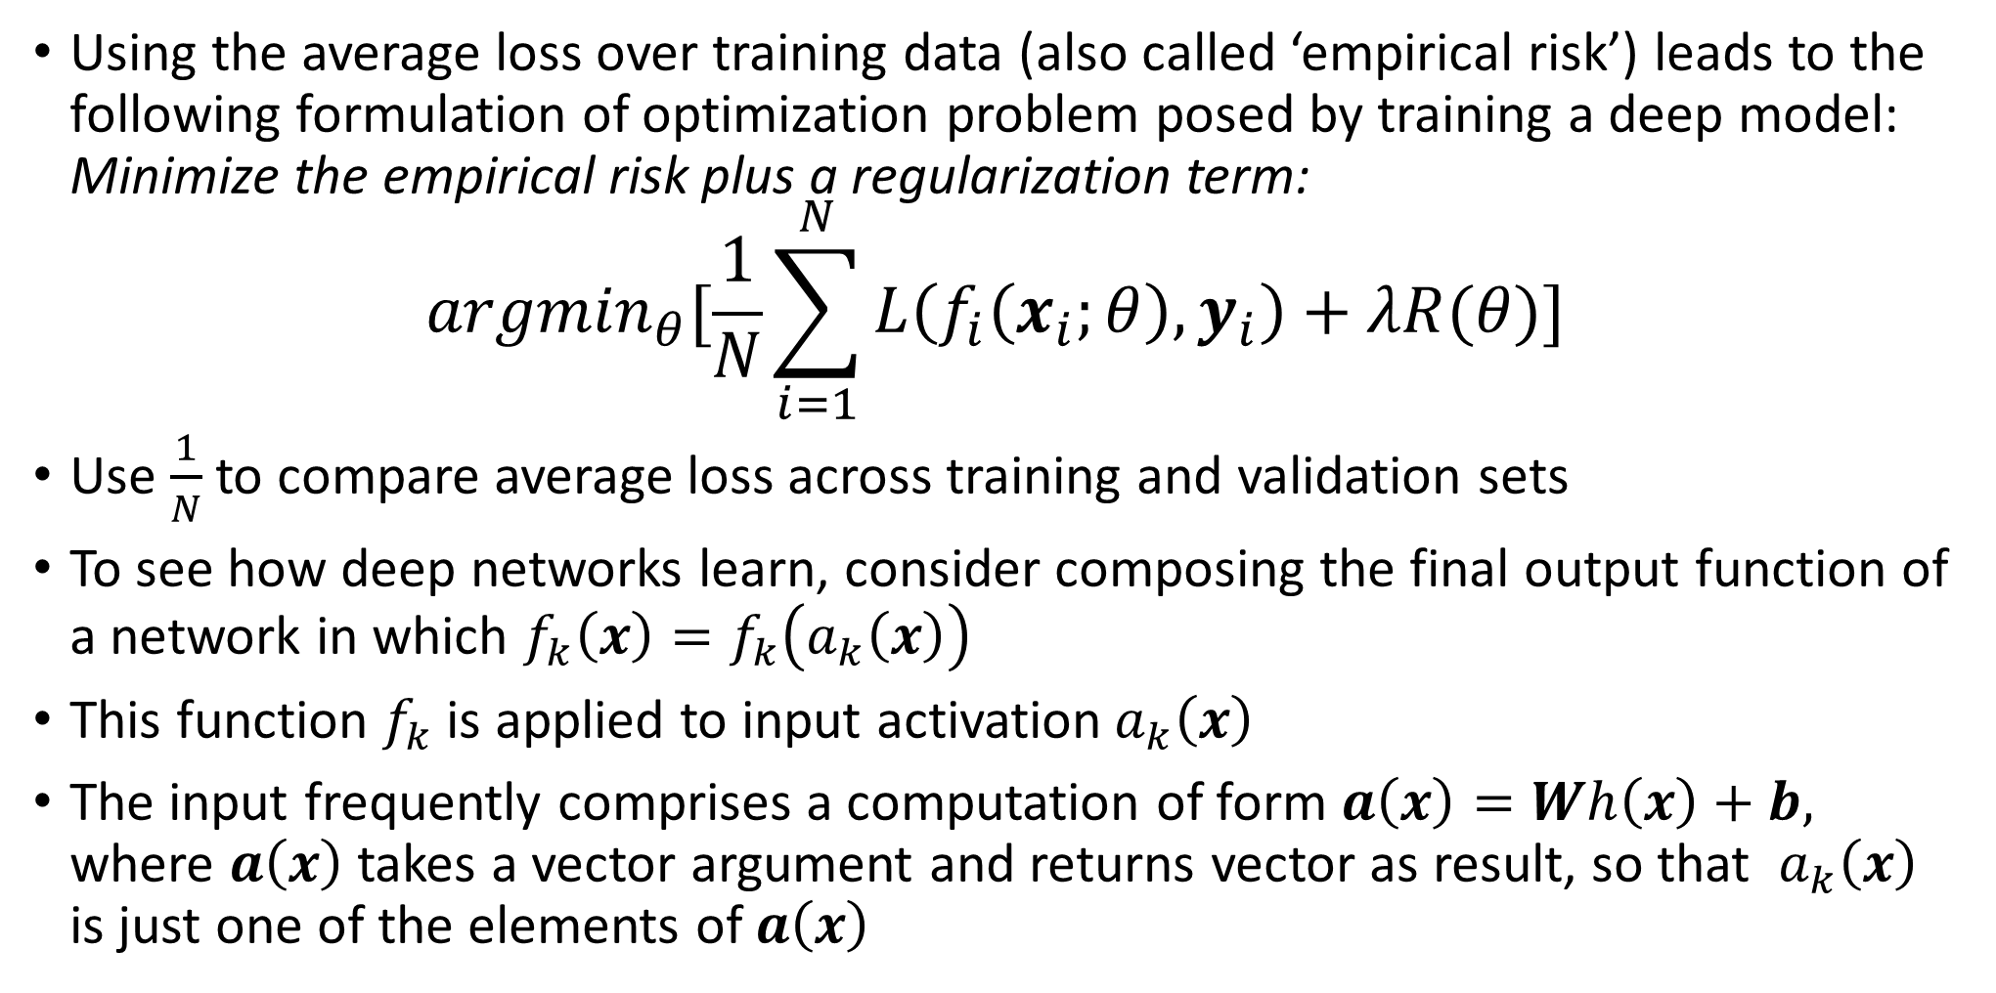
Losses and regularization
Using the average loss over training data (also called ‘empirical risk’) leads to the following formulation of optimization problem posed by training a deep model: Minimize the empirical risk plus a regularization term:
$${argmin}_{θ}[\frac{1}{N}\sum_{i=1}^{N}{L\left(f_{i}\left(x_{i};θ\right),y_{i}\right)+λR(θ)}]$$
Use $\frac{1}{N}$ to compare average loss across training and validation sets
To see how deep networks learn, consider composing the final output function of a network in which $f_{k}\left(x\right)=f_{k}\left(a_{k}\left(x\right)\right)$
This function $f_{k}$ is applied to input activation${ a}_{k}\left(x\right)$
The input frequently comprises a computation of form $a\left(x\right)=Wh\left(x\right)+b,$ where $a\left(x\right)$ takes a vector argument and returns vector as result, so that ${ a}_{k}\left(x\right)$ is just one of the elements of $a\left(x\right)$

Slide 12
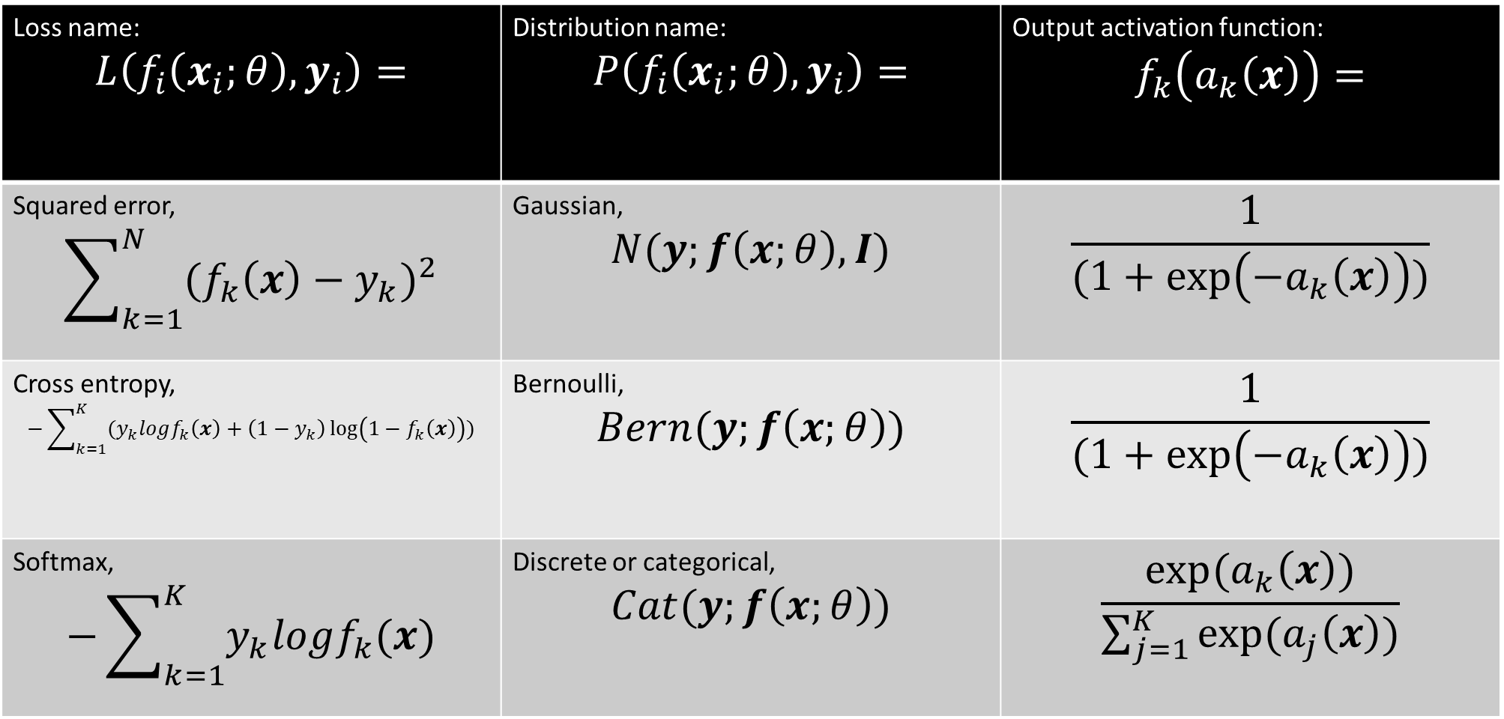
Commonly used loss functions, output activation functions, and underlying distributions from which they derive
Loss name: $$L\left(f_{i}\left(x_{i};θ\right),y_{i}\right)=$$ | Distribution name: $$P\left(f_{i}\left(x_{i};θ\right),y_{i}\right)=$$ | Output activation function: $$f_{k}\left(a_{k}\left(x\right)\right)=$$
Squared error, $$\sum_{k=1}^{N}{{{(f}_{k}\left(x\right)−y_{k})}^{2}}$$ | Gaussian, $$N(y;f\left(x;θ\right),I)$$ | $$\frac{1}{(1+\exp\left(−a_{k}\left(x\right)\right))}$$
Cross entropy, $$−\sum_{k=1}^{K}{(y_{k}logf_{k}\left(x\right)+\left(1−y_{k}\right)\log\left(1−f_{k}\left(x\right)\right))}$$ | Bernoulli, $$Bern(y;f\left(x;θ\right))$$ | $$\frac{1}{(1+\exp\left(−a_{k}\left(x\right)\right))}$$
Softmax, $$−\sum_{k=1}^{K}{y_{k}logf_{k}(x)}$$ | Discrete or categorical, $$Cat(y;f\left(x;θ\right))$$ | $$\frac{exp⁡(a_{k}\left(x\right))}{\sum_{j=1}^{K}{exp⁡(a_{j}\left(x\right))}}$$
Commonly used in deep learning classification problems

Slide 13
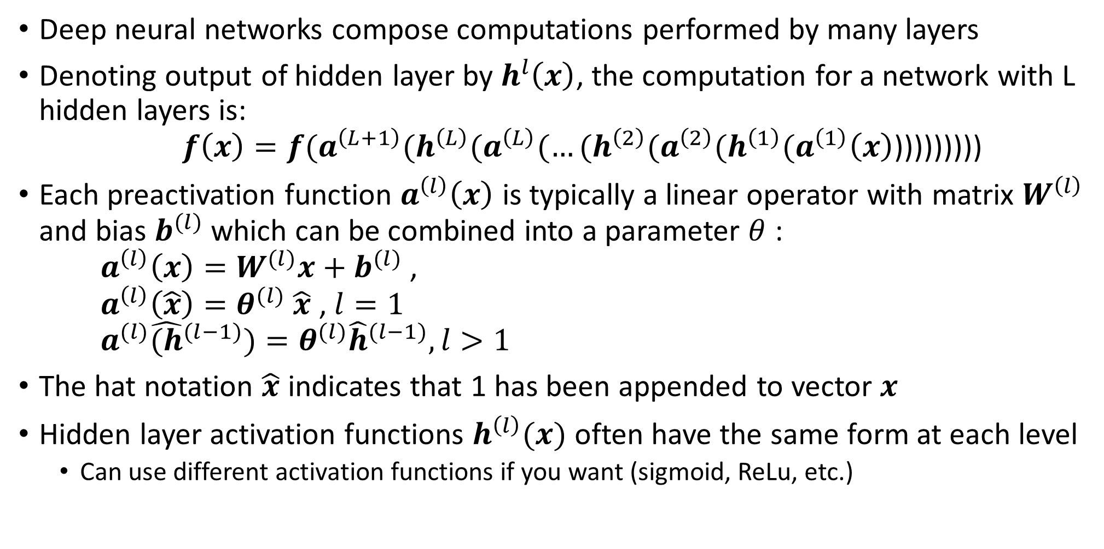
Deep layered network architecture
Deep neural networks compose computations performed by many layers
Denoting output of hidden layer by $h^{l}\left(x\right)$, the computation for a network with L hidden layers is: $f\left(x\right)=f(a^{\left(L+1\right)}(h^{\left(L\right)}(a^{\left(L\right)}(…(h^{\left(2\right)}(a^{\left(2\right)}(h^{\left(1\right)}(a^{\left(1\right)}\left(x\right)$)))))))))
Each preactivation function $a^{\left(l\right)}\left(x\right)$ is typically a linear operator with matrix $W^{\left(l\right)}$ and bias $b^{(l)}$ which can be combined into a parameter $θ$ : $a^{\left(l\right)}\left(x\right)=W^{(l)}x+b^{(l)}$ , $a^{\left(l\right)}\left(\hat{x}\right)=θ^{(l)}$ $\hat{x}$ , $l=1$ $a^{(l)}{\hat{(h}}^{(l−1)})=θ^{(l)}{\hat{h}}^{(l−1)}, l>1$
The hat notation $\hat{x}$ indicates that 1 has been appended to vector $x$
Hidden layer activation functions $h^{\left(l\right)}(x)$ often have the same form at each level
Can use different activation functions if you want (sigmoid, ReLu, etc.)

Slide 14
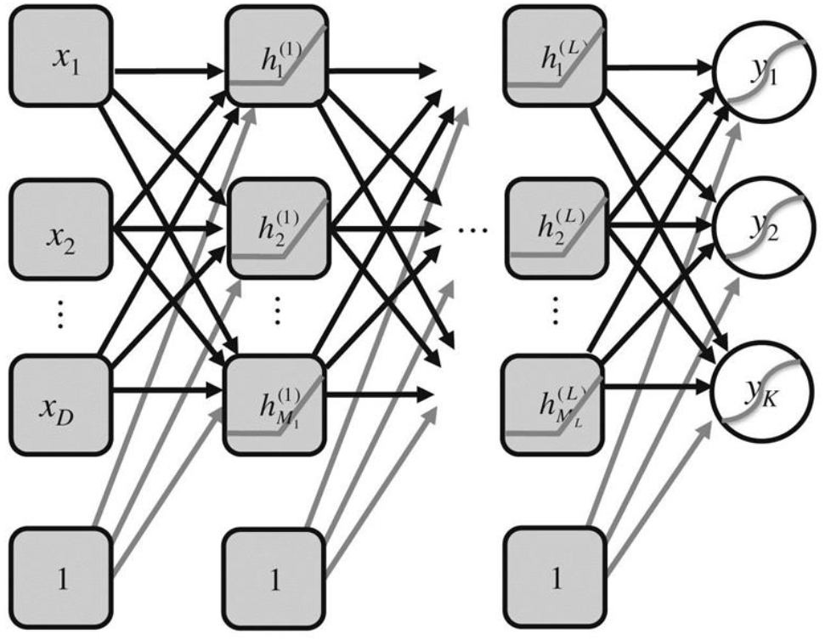
Example network
Example network
In contrast to graphical models such as Bayesian networks, hidden units here are intermediate deterministic computations, which is why they are not represented as circles
However, output variables are drawn as circles because they can be formulated probabilistically
$f\left(x\right)=f(a^{\left(L+1\right)}(h^{\left(L\right)}(a^{\left(L\right)}(…(h^{\left(2\right)}(a^{\left(2\right)}(h^{\left(1\right)}(a^{\left(1\right)}\left(x\right)$)))))))))

Slide 15
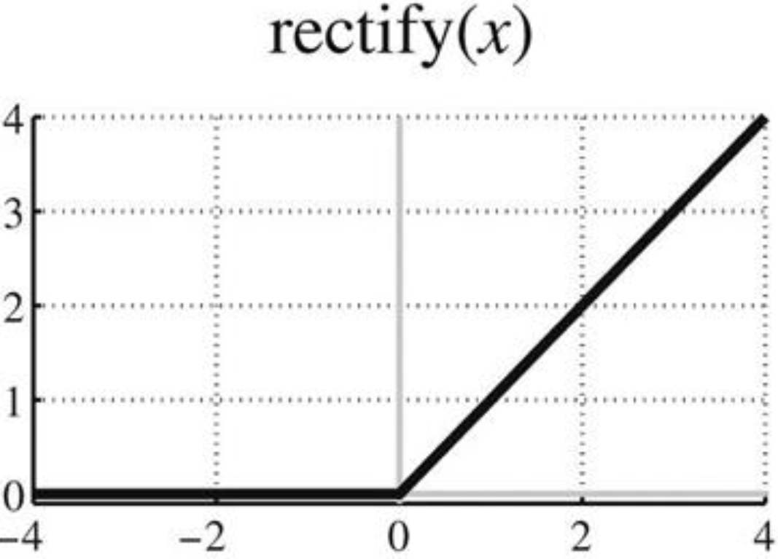
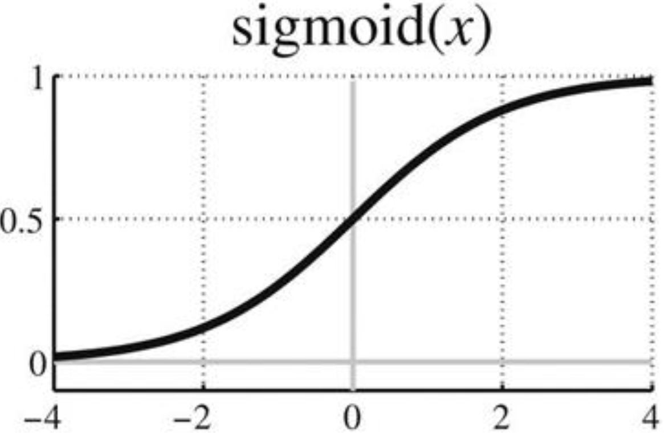
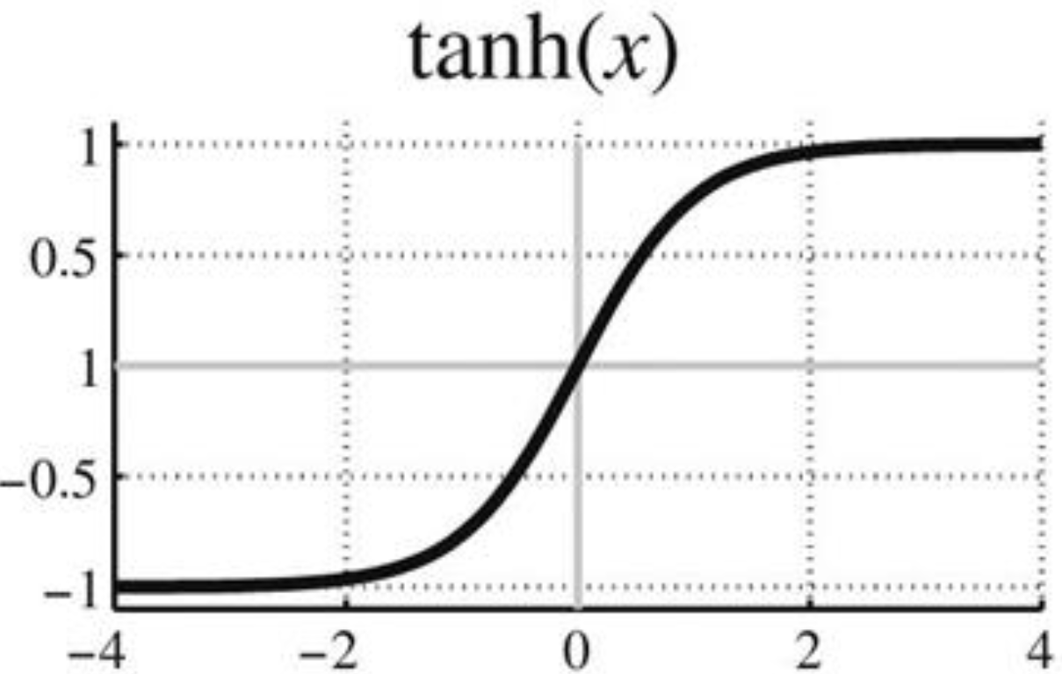
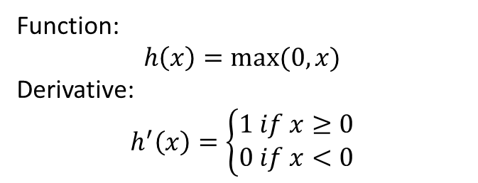
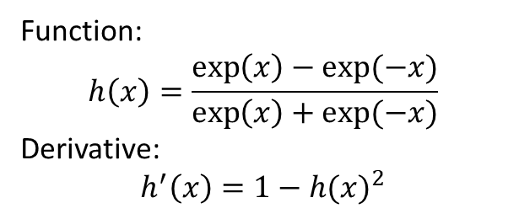
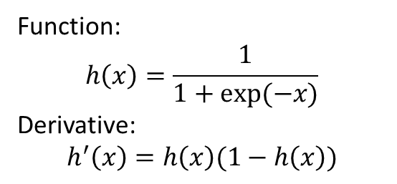
Activation functions
Activation functions operate on preactivation vectors in elementwise fashion
Sigmoid functions have been popular, but tanh is sometimes preferred because it has a steady state at 0
More recently, rectified linear functions (ReLUs) have been found to yield superior results in many different settings
ReLU is 0 for negative values, so some units will output 0, giving a ‘sparseness’ property that is useful
ReLU has simple gradient (0 or 1), helps address the vanishing/exploding gradient problem (more on that later)
Function:
$$h\left(x\right)=\frac{1}{1+exp⁡(−x)}$$
Derivative:
$$h^{′}\left(x\right)=h\left(x\right)(1−h\left(x\right))$$
Function:
$$h\left(x\right)=\frac{\exp\left(x\right)−exp⁡(−x)}{\exp\left(x\right)+exp⁡(−x)}$$
Derivative:
$$h^{′}\left(x\right)=1−{h(x)}^{2}$$
Function:
$$h\left(x\right)=max⁡(0,x)$$
Derivative:
$$h^{′}\left(x\right)=\left\{\begin{aligned}1 if x≥0 \\ 0 if x<0\end{aligned}\right.$$

Slide 16
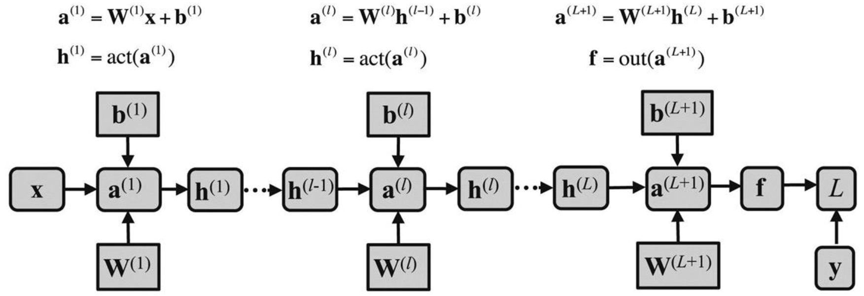
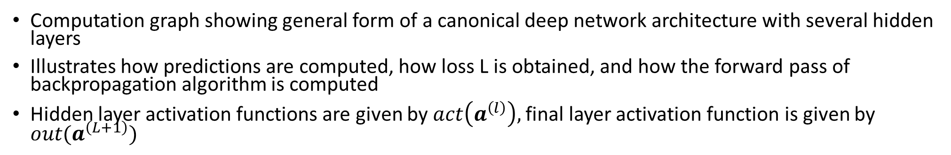
Computation graph showing forward propagation
Computation graph showing general form of a canonical deep network architecture with several hidden layers
Illustrates how predictions are computed, how loss L is obtained, and how the forward pass of backpropagation algorithm is computed
Hidden layer activation functions are given by $act\left(a^{\left(l\right)}\right),$final layer activation function is given by $out(a^{\left(L+1\right)})$

Slide 17
Keras demo in python
Simple feedforward network on MNIST

