Slide 1
CS405/505 Data Mining
Lecture 21

Slide 2
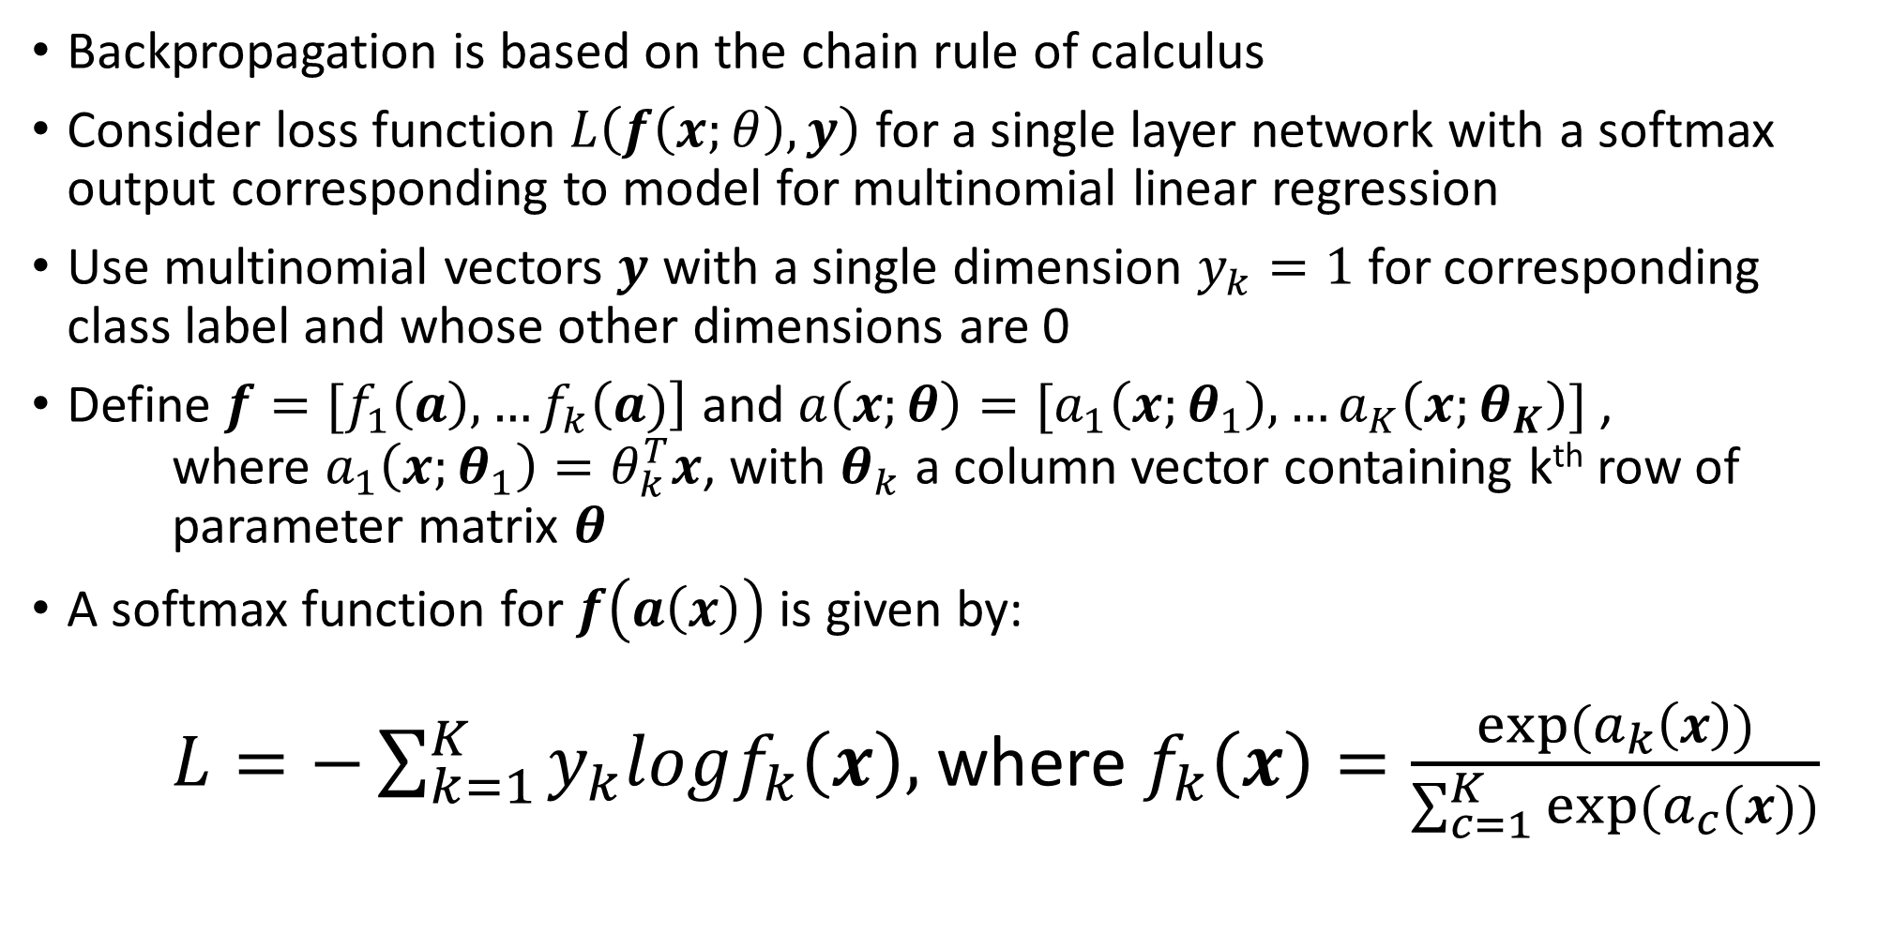
Backpropagation
Backpropagation is based on the chain rule of calculus
Consider loss function $L\left(f\left(x;θ\right),y\right)$ for a single layer network with a softmax output corresponding to model for multinomial linear regression
Use multinomial vectors $y$ with a single dimension $y_{k}=1$ for corresponding class label and whose other dimensions are 0
Define $f=[f_{1}\left(a\right),…f_{k}\left(a)\right]$ and $a\left(x;θ\right)=[a_{1}\left(x;θ_{1}\right),…a_{K}\left(x;θ_{K}\right)]$ , where $a_{1}\left(x;θ_{1}\right)=θ_{k}^{T}x$, with $θ_{k}$ a column vector containing k^{th} row of parameter matrix $θ$
A softmax function for $f\left(a\left(x\right)\right)$ is given by: $L=−\sum_{k=1}^{K}{y_{k}logf_{k}\left(x\right),}$ where $f_{k}\left(x\right)=\frac{exp⁡(a_{k}\left(x\right))}{\sum_{c=1}^{K}{exp⁡(a_{c}(x))}}$

Slide 3
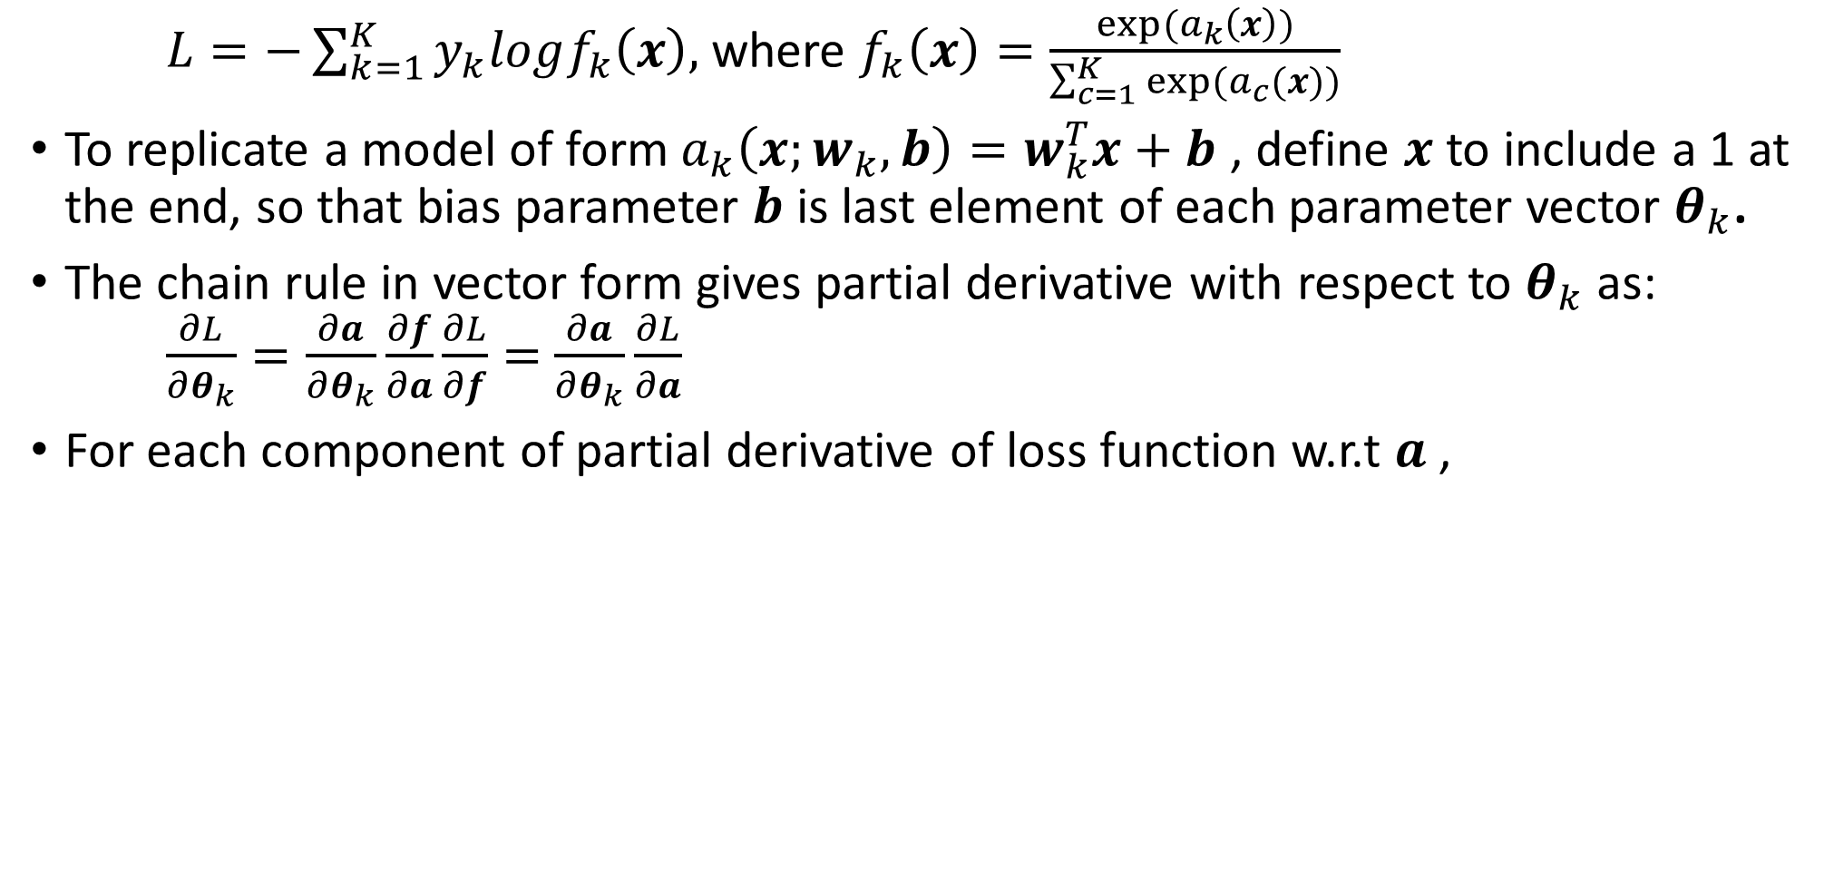
Backpropagation
$L=−\sum_{k=1}^{K}{y_{k}logf_{k}\left(x\right),}$ where $f_{k}\left(x\right)=\frac{exp⁡(a_{k}\left(x\right))}{\sum_{c=1}^{K}{exp⁡(a_{c}(x))}}$
To replicate a model of form $a_{k}\left(x;w_{k},b\right)=w_{k}^{T}x+b$ , define $x$ to include a 1 at the end, so that bias parameter $b$ is last element of each parameter vector $θ_{k}$.
The chain rule in vector form gives partial derivative with respect to $θ_{k}$ as: $\frac{∂L}{∂θ_{k}}=\frac{∂a}{∂θ_{k}}\frac{∂f}{∂a}\frac{∂L}{∂f}=$ $\frac{∂a}{∂θ_{k}}\frac{∂L}{∂a}$
For each component of partial derivative of loss function w.r.t $a$ ,

