Slide 1
CS405/505 Data Mining
Lecture 13

Slide 2
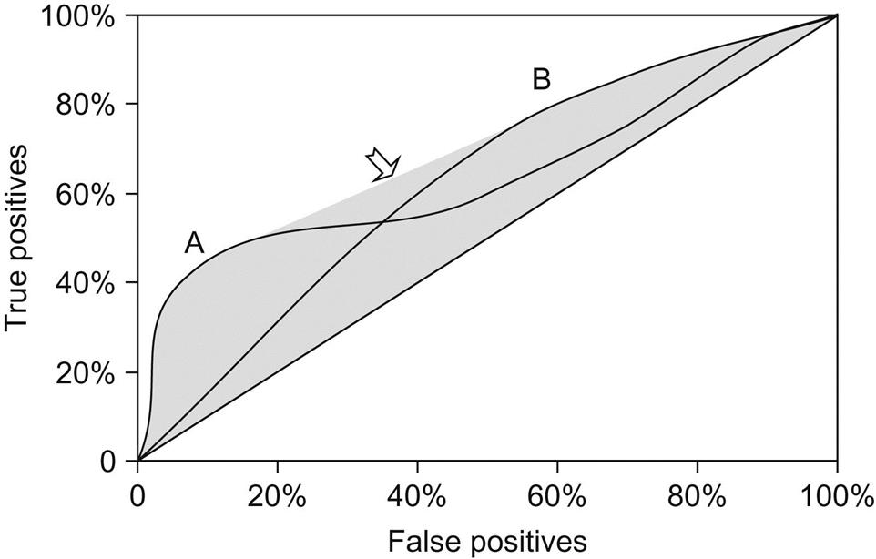
Recap
ROC curves and their relatives (lift carts, recall-precision curves) are useful for exploring tradeoffs among different classifiers over a wide range of scenarios
However, they are not ideal for evaluating machine learning models in situations with known error costs
Not easy to use ROC chart to read off the expected cost of a classifier for a fixed cost matrix and class distribution
Example: hard to tell for what cost and class distributions A outperforms B at the crossover point

Slide 3
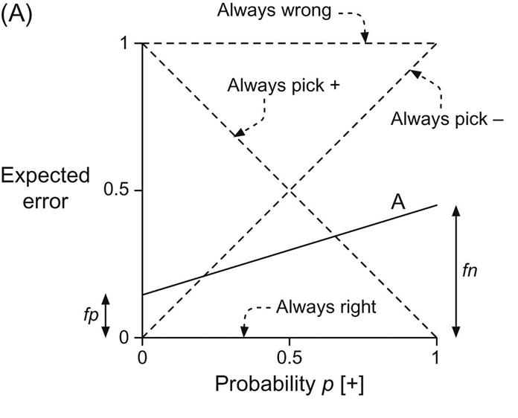
Cost curves
In cost curves, a single classifier corresponds to a straight line showing how performance varies as class distribution changes
A) plots expected error vs probability of one of the classes, denoted by + and –
Diagonals show performance of two extreme classifiers
Want to be as close to bottom as possible
Line marked A represents error rate of a particular classifier
False positive rate (fp) is expected error on subsample of instances containing only -’s (p(+)=0)
False negative rate (fn) is expected error on a subset containing only +’s (p(-)=0)
Can use these curves to investigate behavior of algorithm under different class distributions

Slide 4
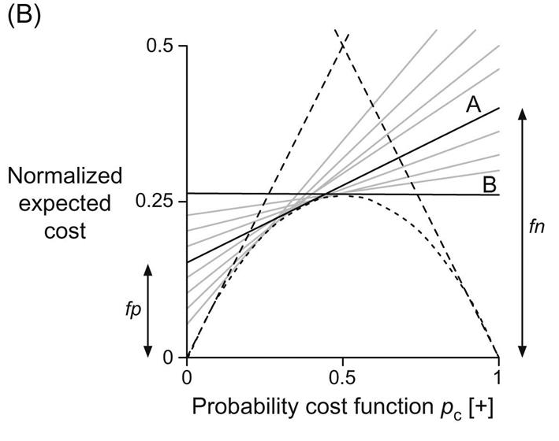
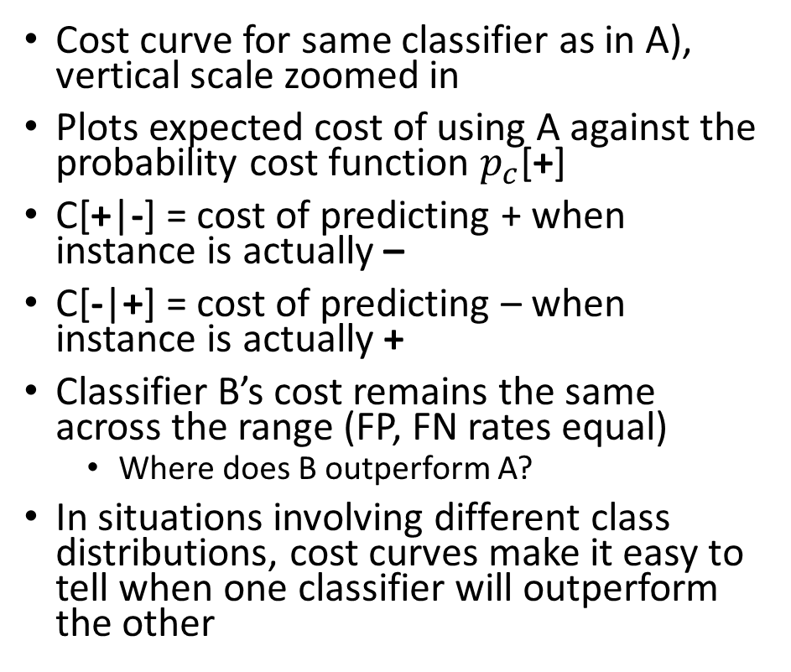
Cost curves
Cost curve for same classifier as in A), vertical scale zoomed in
Plots expected cost of using A against the probability cost function $p_{c}$[+]
C[+|-] = cost of predicting + when instance is actually –
C[-|+] = cost of predicting – when instance is actually +
Classifier B’s cost remains the same across the range (FP, FN rates equal)
Where does B outperform A?
In situations involving different class distributions, cost curves make it easy to tell when one classifier will outperform the other
X-axis: $Probability cost function p_{c}[+]= \frac{P\left(+\right)C[−|+]}{P\left(+\right)C\left[− | +\right]+P\left(−\right)C[+|−]}$
Y-axis: $Normalized expected cost=fn∙p_{c}[+]+fp∙(1−p_{c}[+])$

Slide 5
Cost curves
Cost curves represent each classifier by a straight line
Gray (and black) lines indicate different classifiers
Operating region of classifier B ranges from x-axis value of ~0.25 to ~0.75, outside this range B is outperformed by trivial classifiers (straight dashed lines)
We could decide to use B when probability cost function is between 0.25 and 0.75, otherwise use the trivial classifier
When might these cost curves be useful?

Slide 6
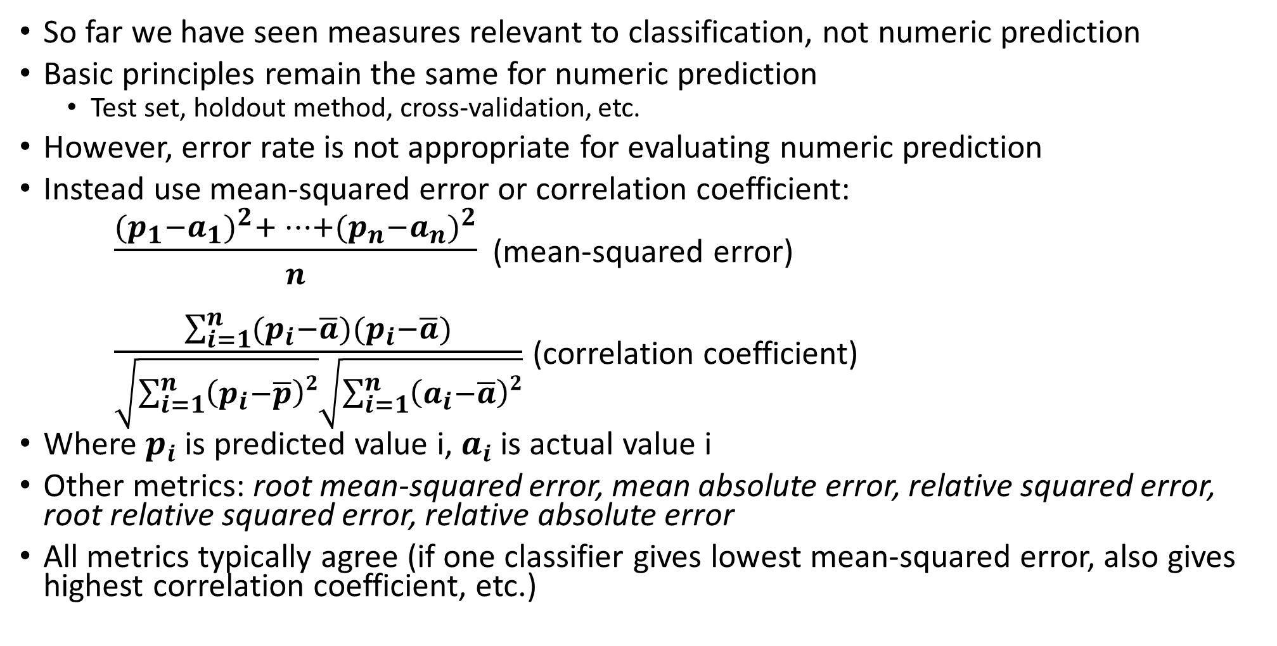
Evaluating numeric prediction
So far we have seen measures relevant to classification, not numeric prediction
Basic principles remain the same for numeric prediction
Test set, holdout method, cross-validation, etc.
However, error rate is not appropriate for evaluating numeric prediction
Instead use mean-squared error or correlation coefficient:
$\frac{{(p_{1}−a_{1})}^{2}+…+{(p_{n}−a_{n})}^{2}}{n}$ (mean-squared error)
$\frac{\sum_{i=1}^{n}{(p_{i}−\overline{a})(p_{i}−\overline{a})}}{\sqrt{\sum_{i=1}^{n}{\left(p_{i}−\overline{p}\right)2}}\sqrt{\sum_{i=1}^{n}{\left(a_{i}−\overline{a}\right)2}}}$ (correlation coefficient)
Where $p_{i}$ is predicted value i, $a_{i}$ is actual value i
Other metrics: root mean-squared error, mean absolute error, relative squared error, root relative squared error, relative absolute error
All metrics typically agree (if one classifier gives lowest mean-squared error, also gives highest correlation coefficient, etc.)

Slide 7
The minimum descriptor length (MDL) principle
Machine learning algorithms can be seen as learning a “theory” of data
The theory can generate new facts by classifying unseen instances
Occam’s Razor: best scientific theory is the smallest one explaining all the facts
Einstein: “Everything should be made as simple as possible, but no simpler”
MDL principle: best theory for a body of data is the one that minimizes the size of the theory plus information necessary to specify exceptions to the theory
Formally: given a set of instances, a learning scheme infers a theory from them (decision tree, set of weights, rules, etc.). Then, according to MDL the best theory is the one that minimizes the number of bits required to communicate the theory along with the labels of the examples from which it was made.

Slide 8
MDL
Suppose learning scheme comes up with theory T based on training examples E, requires L(T) bits to transmit (L for length)
We also want to transmit class labels, so assume E stands for collection of class labels in the training set
Training set E can be encoded in certain number of bits L(E|T), which is given by informational loss function summed over all members of training set
Total description length (required information) is then: L(T) + L(E|T)
MDL recommends choosing theory T such that this sum is minimized

Slide 9
MDL polynomial example
L(T) + L(E|T)
We have a bunch of points D={(x₁,y₁)…(x_{n},y_{n})} we want to fit with a polynomial
To describe the polynomial H of degree k, we need to do the following:
Discretize the coefficients to some level of precision (4 byte float?)
Need to describe the precision also
Describe the degree k
Describe the k+1 coefficients
Describe points D:
Use some fixed code for x values
Use a code for the deviations y_{i}-L(x_{i})
L(T)
L(E|T)

Slide 10
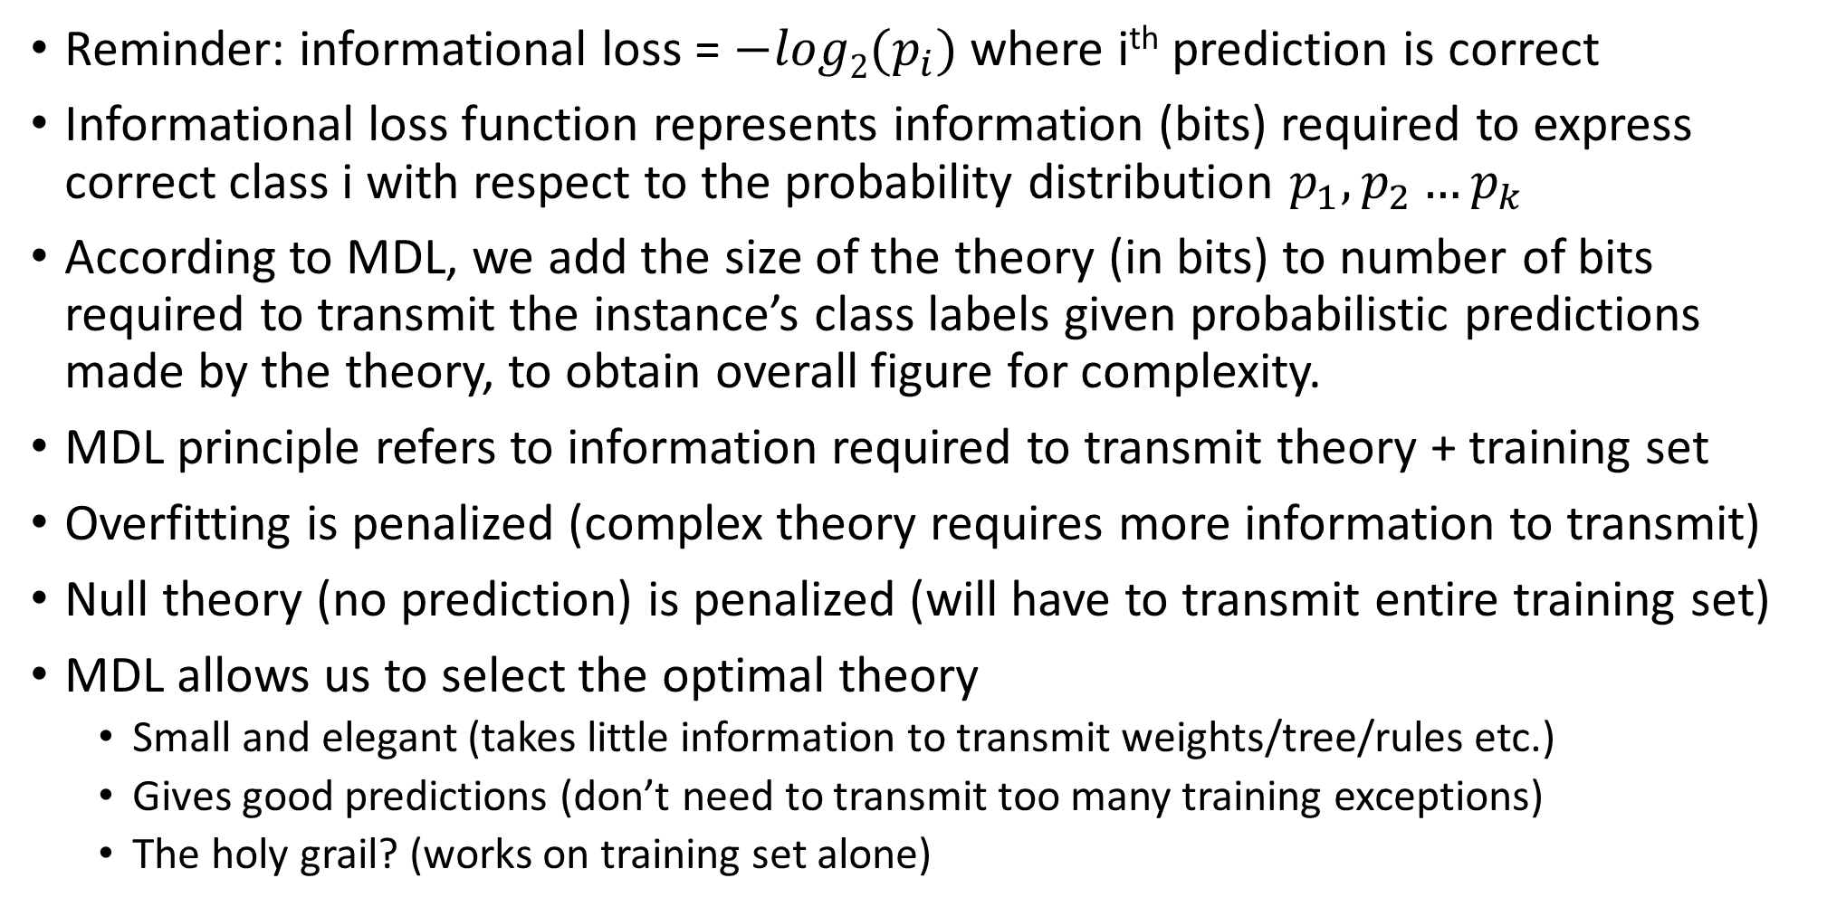
Informational loss function and MDL
Reminder: informational loss = $−log2(p_{i})$ where i^{th} prediction is correct
Informational loss function represents information (bits) required to express correct class i with respect to the probability distribution $p_{1},p_{2}…p_{k}$
According to MDL, we add the size of the theory (in bits) to number of bits required to transmit the instance’s class labels given probabilistic predictions made by the theory, to obtain overall figure for complexity.
MDL principle refers to information required to transmit theory + training set
Overfitting is penalized (complex theory requires more information to transmit)
Null theory (no prediction) is penalized (will have to transmit entire training set)
MDL allows us to select the optimal theory
Small and elegant (takes little information to transmit weights/tree/rules etc.)
Gives good predictions (don’t need to transmit too many training exceptions)
The holy grail? (works on training set alone)

Slide 11
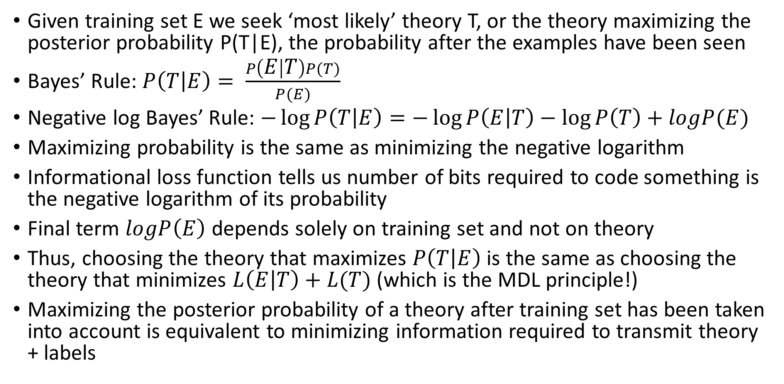
MDL and probability theory
Given training set E we seek ‘most likely’ theory T, or the theory maximizing the posterior probability P(T|E), the probability after the examples have been seen
Bayes’ Rule: $P\left(T | E\right)= \frac{P\left(E | T\right)P(T)}{P(E)}$
Negative log Bayes’ Rule: $−\log{P\left(T | E\right)}=−\log{P\left(E | T\right)}−\log{P\left(T\right)}+logP(E)$
Maximizing probability is the same as minimizing the negative logarithm
Informational loss function tells us number of bits required to code something is the negative logarithm of its probability
Final term $logP\left(E\right)$ depends solely on training set and not on theory
Thus, choosing the theory that maximizes $P\left(T | E\right)$ is the same as choosing the theory that minimizes $L\left(E | T\right)+L(T)$ (which is the MDL principle!)
Maximizing the posterior probability of a theory after training set has been taken into account is equivalent to minimizing information required to transmit theory + labels

Slide 12
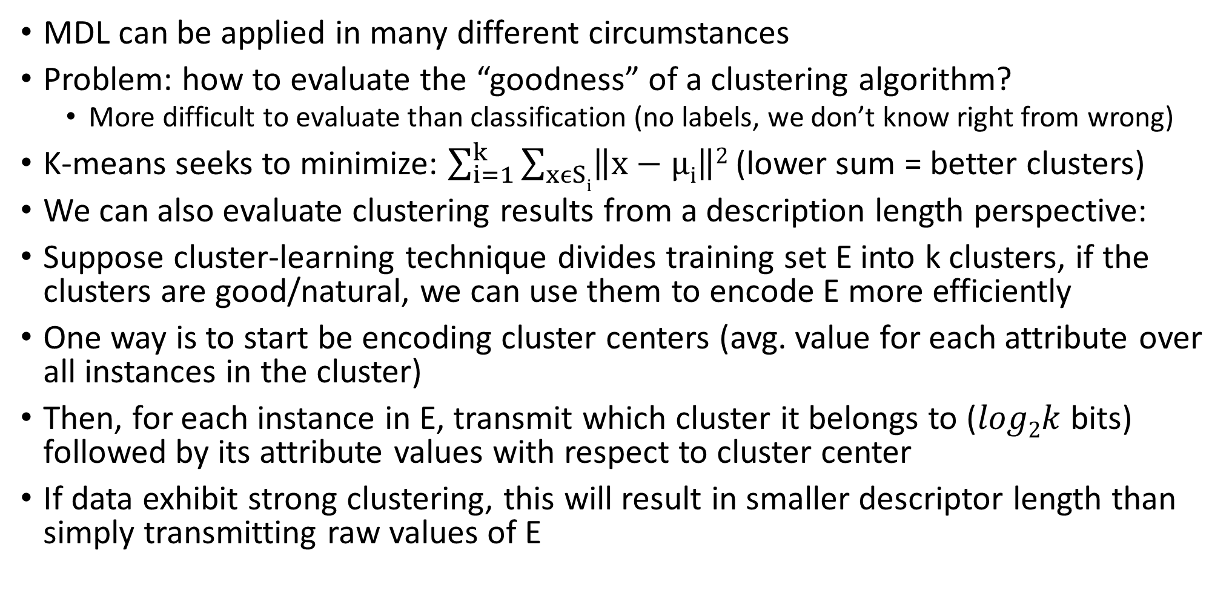
Applying MDL to clustering
MDL can be applied in many different circumstances
Problem: how to evaluate the “goodness” of a clustering algorithm?
More difficult to evaluate than classification (no labels, we don’t know right from wrong)
K-means seeks to minimize: $\sum_{i=1}^{k}{\sum_{xϵSi}{\left\|x−μi\right\|2}}$ (lower sum = better clusters)
We can also evaluate clustering results from a description length perspective:
Suppose cluster-learning technique divides training set E into k clusters, if the clusters are good/natural, we can use them to encode E more efficiently
One way is to start be encoding cluster centers (avg. value for each attribute over all instances in the cluster)
Then, for each instance in E, transmit which cluster it belongs to ($log2k$ bits) followed by its attribute values with respect to cluster center
If data exhibit strong clustering, this will result in smaller descriptor length than simply transmitting raw values of E

Slide 13
5.12 using validation set for model selection
MDL principle is an example of “model selection criterion” which can be used to determine appropriate complexity of a model for a given dataset
MDL can be used to guess right complexity for a model
Many strategies exist (other than MDL), they all seek to balance the predictive performance of the training data with the model’s complexity
A simple alternative to guessing what model complexity will maximize predictive performance is to use a validation set for model selection
Hyperparameter tuning

Slide 14
Python example
Cross-validation for error estimates
ROC curve, precision-recall curve

