Slide 1
CS405/505 Data Mining
Lecture 29

Slide 2
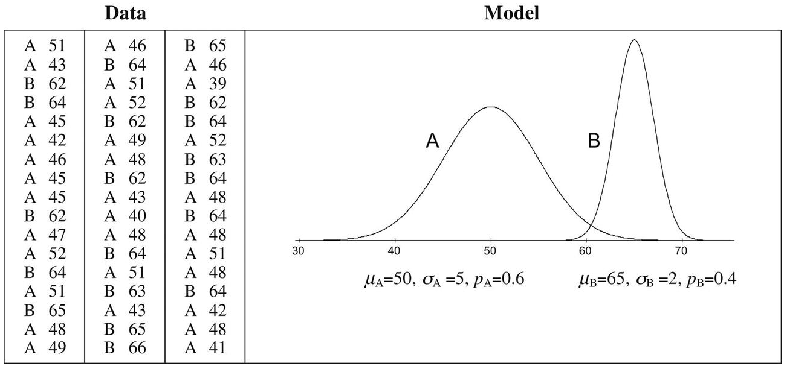
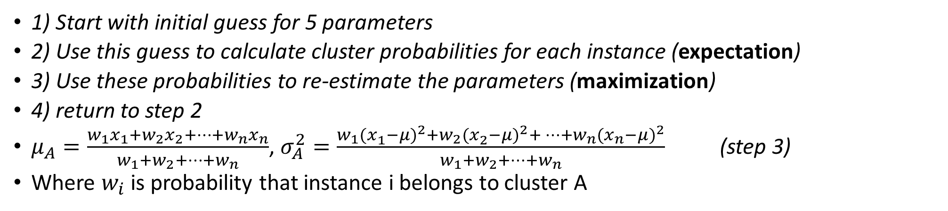
Finite mixture problem – expectation maximization
1) Start with initial guess for 5 parameters
2) Use this guess to calculate cluster probabilities for each instance (expectation)
3) Use these probabilities to re-estimate the parameters (maximization)
4) return to step 2
$μ_{A}=\frac{w_{1}x_{1}+w_{2}x_{2}+…+w_{n}x_{n}}{w_{1}+w_{2}+…+w_{n}}$, $σ_{A}^{2}=\frac{w_{1}{(x_{1}^{ }−μ)}^{2}+w_{2}{(x_{2}^{ }−μ)}^{2}+…+w_{n}{(x_{n}^{ }−μ)}^{2}}{w_{1}+w_{2}+…+w_{n}}$ (step 3)
Where $w_{i}$ is probability that instance i belongs to cluster A

Slide 3

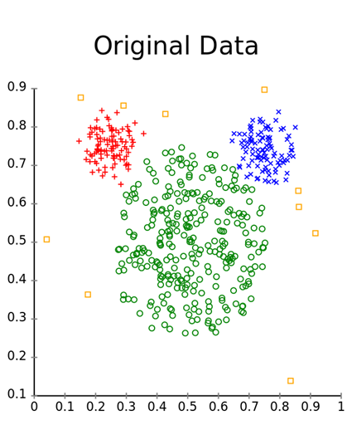
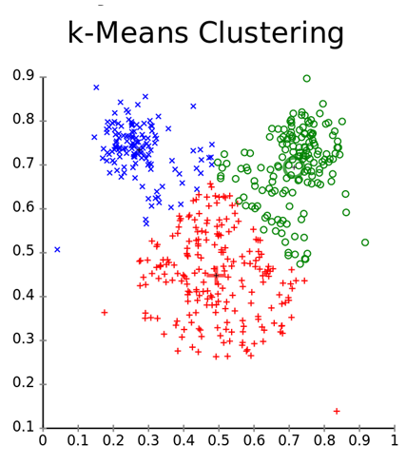
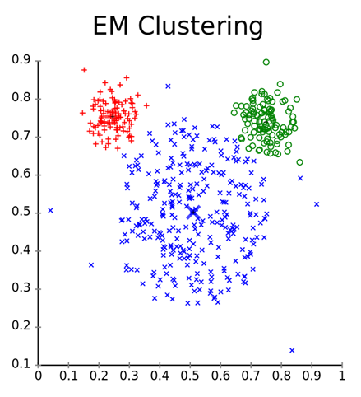
K-means vs EM on mouse dataset
https://en.wikipedia.org/wiki/Expectation%E2%80%93maximization_algorithm

Slide 4
Extending the mixture model
We have seen the gaussian mixture model for two distributions
Let us consider how to extend it to more realistic situations
Formidable mathematical notation (we will not develop in full detail)
Number of attributes can be increased, if we assume attributes are independent
Probabilities for each attribute multiplied together, obtaining joint probability for the instance (just as with Naïve Bayes)
What if the dataset is known to contain two correlated attributes?
Model them jointly by a bivariate normal distribution
Each attribute has its own mean
Instead of two standard deviations, we have a covariance matrix (4 parameters)

Slide 5
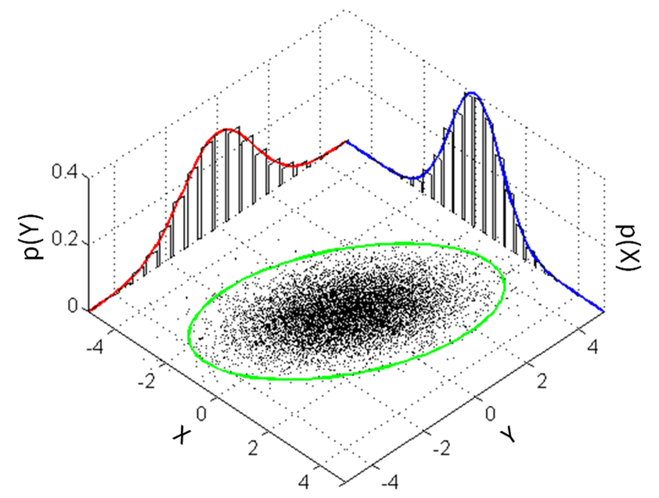
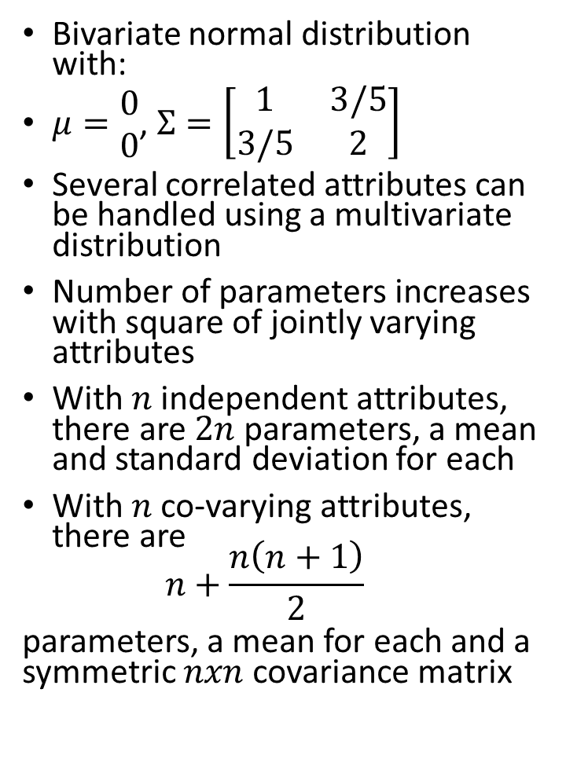
Multivariate normal distribution
Bivariate normal distribution with:
$μ=\begin{matrix}0 \\ 0\end{matrix}$, $Σ=\left[\begin{matrix}1 & 3/5 \\ 3/5 & 2\end{matrix}\right]$
Several correlated attributes can be handled using a multivariate distribution
Number of parameters increases with square of jointly varying attributes
With $n$ independent attributes, there are $2n$ parameters, a mean and standard deviation for each
With $n$ co-varying attributes, there are $n+\frac{n\left(n+1\right)}{2}$
parameters, a mean for each and a symmetric $nxn$covariance matrix

Slide 6
Clustering using prior distributions
Unsure which attributes are correlated? Calculate covariance for every pair
This can result in overfitting (covariance increases number of parameters)
Overfitting can also occur if we specify too many clusters
We should penalize the model for introducing new parameters. How?
Adopt a Bayesian approach, where every parameter has a prior probability distribution whose effect is incorporated into overall likelihood figure
A simpler way to select an appropriate model is use a validation set
Compute likelihood on separate validation set that has not been used to fit model

Slide 7
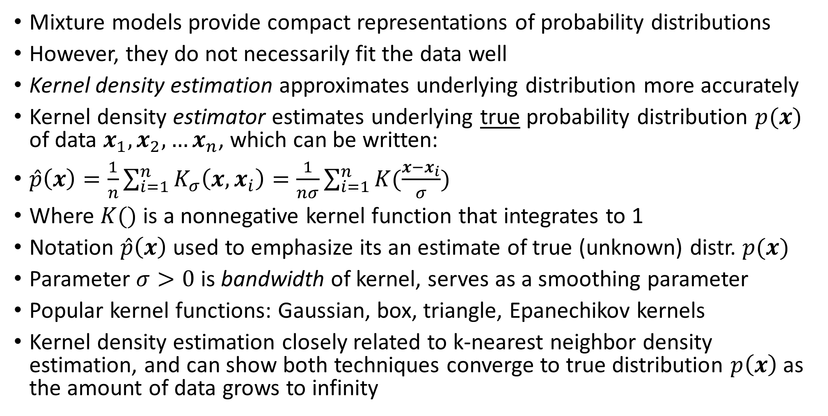
Kernel density estimation
Mixture models provide compact representations of probability distributions
However, they do not necessarily fit the data well
Kernel density estimation approximates underlying distribution more accurately
Kernel density estimator estimates underlying true probability distribution $p(x)$ of data $x_{1},x_{2},…x_{n}$, which can be written:
$\hat{p}\left(x\right)=\frac{1}{n}\sum_{i=1}^{n}{K_{σ}\left(x,x_{i}\right)=\frac{1}{nσ}\sum_{i=1}^{n}{K(\frac{x−x_{i}}{σ})}}$
Where $K()$ is a nonnegative kernel function that integrates to 1
Notation $\hat{p}\left(x\right)$ used to emphasize its an estimate of true (unknown) distr. $p(x)$
Parameter $σ>0$ is bandwidth of kernel, serves as a smoothing parameter
Popular kernel functions: Gaussian, box, triangle, Epanechikov kernels
Kernel density estimation closely related to k-nearest neighbor density estimation, and can show both techniques converge to true distribution $p\left(x\right)$ as the amount of data grows to infinity

Slide 8
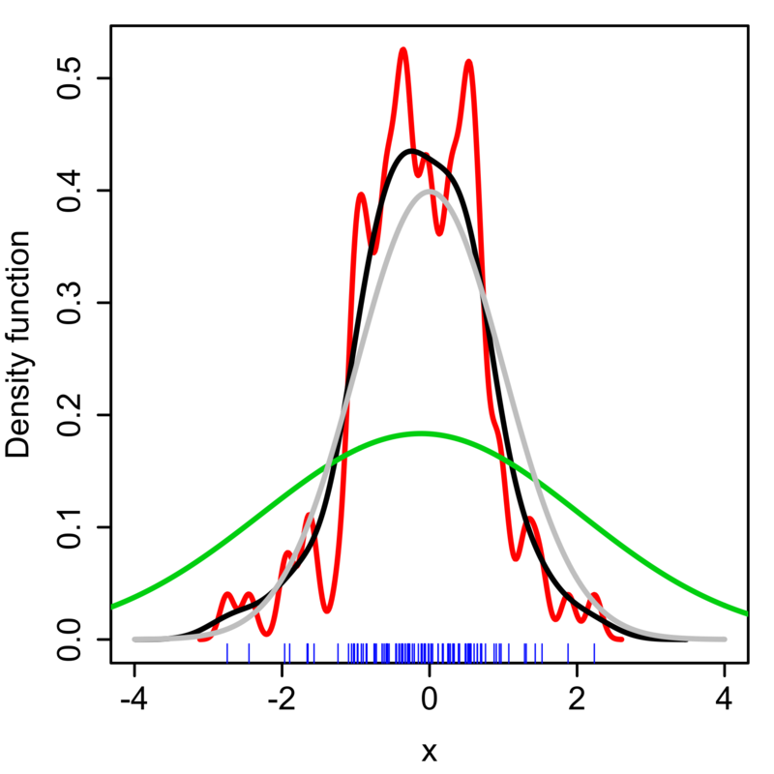
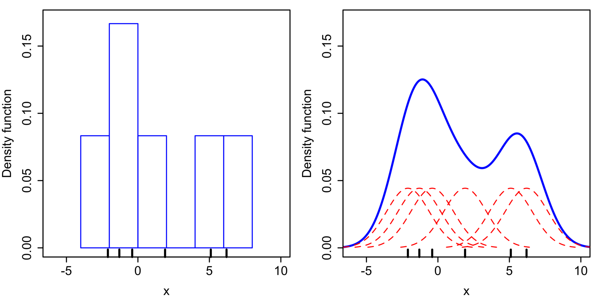
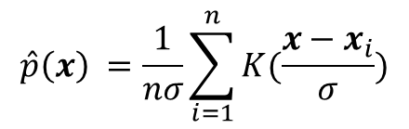



Kernel density estimation
True distribution
$σ$= 2
$$\hat{p}\left(x\right) =\frac{1}{nσ}\sum_{i=1}^{n}{K(\frac{x−x_{i}}{σ})}$$
$σ$= 0.337
$σ$= 0.05
Comparison of histogram (left) and kernel density estimate (Right) constructed using the same data. 6 individual kernels are the red dashed curve, kernel density estimate is the blue curve. Data points are the black bars on horizontal axis.
Kernel density estimate with different bandwidths and 100 points (blue) from a standard normal distribution
https://en.wikipedia.org/wiki/Kernel_density_estimation

Slide 9
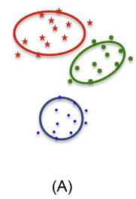
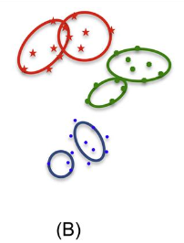
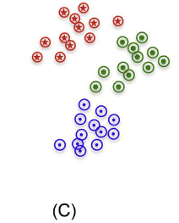
Comparing parametric, semiparametric, and nonparametric density models for classification
Can view mixture model as intermediate between two extreme ways of modeling
Extreme 1: single parametric form such as the Gaussian distribution
Easy to estimate parameters, however data often arises from more complex distribution
Extreme 2: mixture model with one Gaussian for each data point
This is kernel density estimation with Gaussian kernel function
All 3 approaches define density models for each class, so Bayes’ rule can be used to compute posterior probability over all classes given any input
Kernel density estimators guaranteed to converge to true underlying distribution as amount of data increases, which means classifiers constructed from them have attractive properties
A) Single Gaussian distribution used to model each class, this approach is often referred to as a parametric technique
B) Gaussian mixture model with two components per class, a semiparametric technique in which number of Gaussians can be determined using a variety of methods
C) Kernel density estimate, with a Gaussian kernel on each example, a nonparametric method where complexity grows in proportion to data

Slide 10
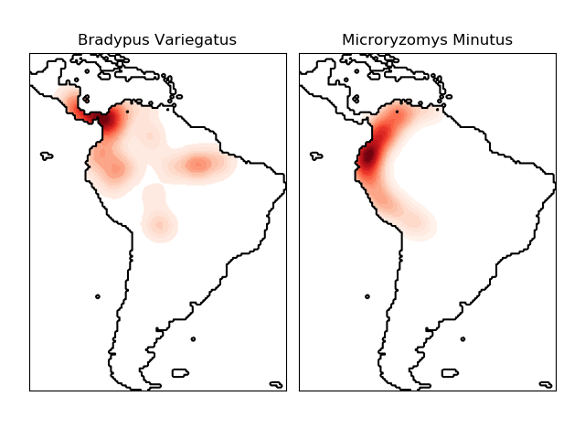
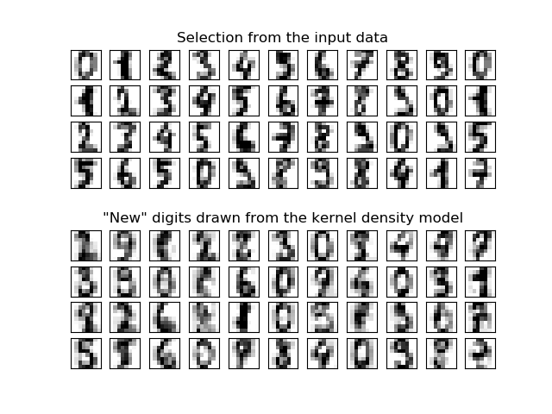
Sklearn’s density estimation module
https://scikit-learn.org/stable/modules/density.html
Kernel density estimation for non-parametric generative models, here, a new set of handwritten digits has been generated using a gaussian kernel
Kernel density estimation for visualization of geospatial data

Slide 11
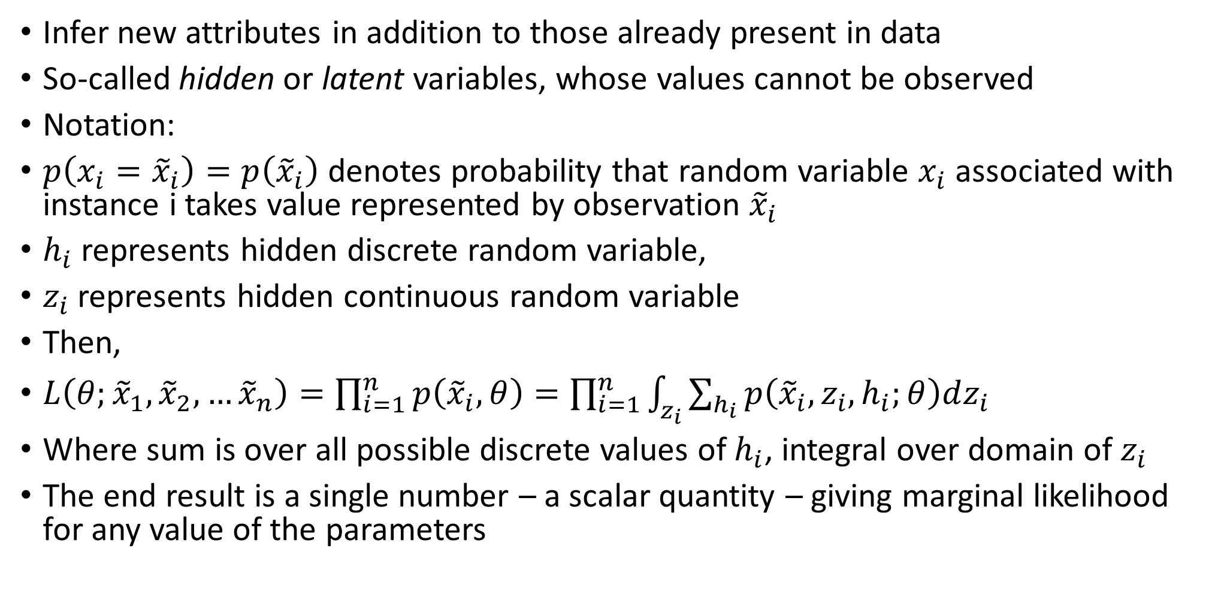
Hidden Variable models
Infer new attributes in addition to those already present in data
So-called hidden or latent variables, whose values cannot be observed
Notation:
$p\left(x_{i}={\tilde{x}}_{i}\right)=p\left({\tilde{x}}_{i}\right)$ denotes probability that random variable $x_{i}$ associated with instance i takes value represented by observation ${\tilde{x}}_{i}$
$h_{i}$ represents hidden discrete random variable,
$z_{i}$ represents hidden continuous random variable
Then,
$L\left(θ;{\tilde{x}}_{1},{\tilde{x}}_{2},…{\tilde{x}}_{n}\right)=\prod_{i=1}^{n}{p\left({\tilde{x}}_{i},θ\right)=\prod_{i=1}^{n}{\int_{z_{i}}^{ }{\sum_{h_{i}}^{ }{p\left({\tilde{x}}_{i},z_{i},h_{i};θ\right)dz_{i}}}}}$
Where sum is over all possible discrete values of $h_{i}$, integral over domain of $z_{i}$
The end result is a single number – a scalar quantity – giving marginal likelihood for any value of the parameters

Slide 12
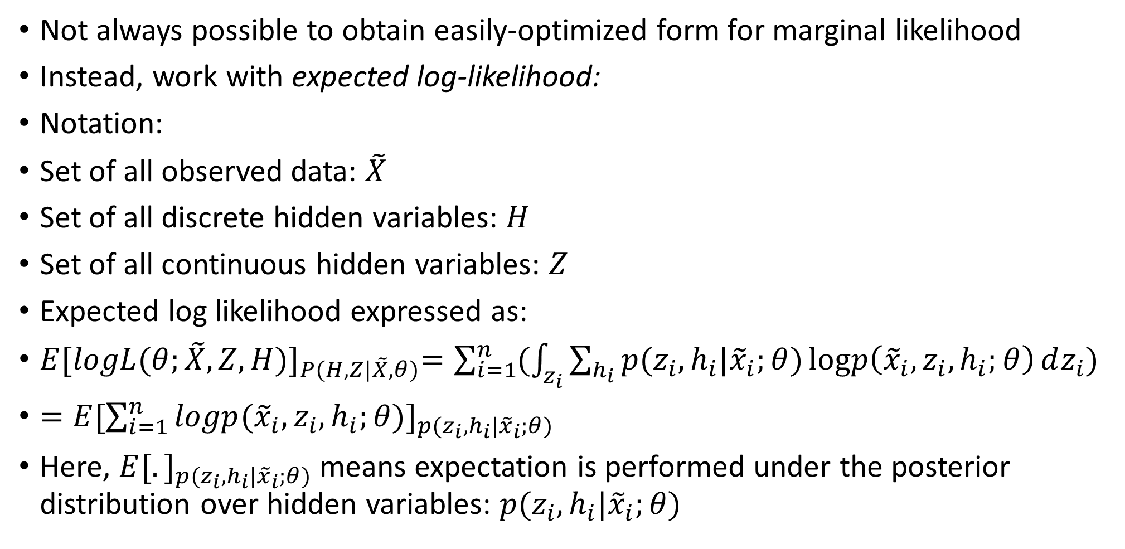
Expected log-likelihoods and expected gradients
Not always possible to obtain easily-optimized form for marginal likelihood
Instead, work with expected log-likelihood:
Notation:
Set of all observed data: $\tilde{X}$
Set of all discrete hidden variables: $H$
Set of all continuous hidden variables: $Z$
Expected log likelihood expressed as:
$E{[logL(θ;\tilde{X},Z,H)]}_{P(H,Z|\tilde{X},θ)}=\sum_{i=1}^{n}{(\int_{z_{i}}^{ }{\sum_{h_{i}}^{ }{p(z_{i},h_{i}|{\tilde{x}}_{i};θ})\operatorname{logp}\left({\tilde{x}}_{i},z_{i},h_{i};θ\right)dz_{i}})}$
$=E{[\sum_{i=1}^{n}{logp({\tilde{x}}_{i},z_{i},h_{i};θ)}]}_{p(z_{i},h_{i}|{\tilde{x}}_{i};θ)}$
Here, $E{[.]}_{p(z_{i},h_{i}|{\tilde{x}}_{i};θ)}$ means expectation is performed under the posterior distribution over hidden variables: $p(z_{i},h_{i}|{\tilde{x}}_{i};θ)$

Slide 13
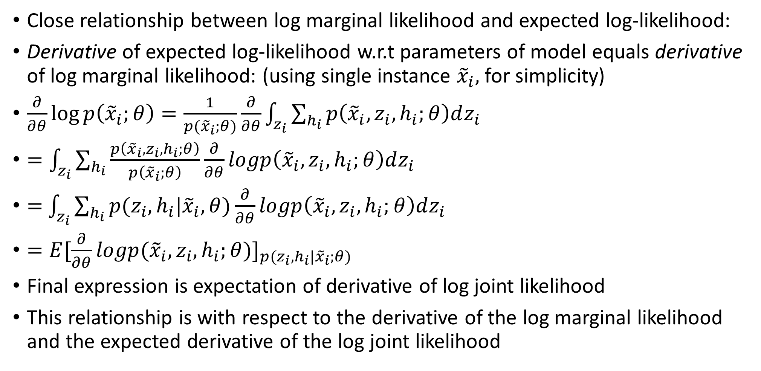
Expected log-likelihoods and expected gradients
Close relationship between log marginal likelihood and expected log-likelihood:
Derivative of expected log-likelihood w.r.t parameters of model equals derivative of log marginal likelihood: (using single instance ${\tilde{x}}_{i},$ for simplicity)
$\frac{∂}{∂θ}\log{p\left({\tilde{x}}_{i};θ\right)}=\frac{1}{p({\tilde{x}}_{i};θ)}\frac{∂}{∂θ}\int_{z_{i}}^{ }{\sum_{h_{i}}^{ }{p\left({\tilde{x}}_{i},z_{i},h_{i};θ\right)dz_{i}}}$
$=\int_{z_{i}}^{ }{\sum_{h_{i}}{\frac{p\left({\tilde{x}}_{i},z_{i},h_{i};θ\right)}{p\left({\tilde{x}}_{i};θ\right)}}}\frac{∂}{∂θ}logp\left({\tilde{x}}_{i},z_{i},h_{i};θ\right)dz_{i}$
$=$ $\int_{z_{i}}^{ }{\sum_{h_{i}}{p(z_{i},h_{i}|{\tilde{x}}_{i},θ)}}\frac{∂}{∂θ}logp\left({\tilde{x}}_{i},z_{i},h_{i};θ\right)dz_{i}$
$=E{[\frac{∂}{∂θ}logp({\tilde{x}}_{i},z_{i},h_{i};θ)]}_{p(z_{i},h_{i}|{\tilde{x}}_{i};θ)}$
Final expression is expectation of derivative of log joint likelihood
This relationship is with respect to the derivative of the log marginal likelihood and the expected derivative of the log joint likelihood

Slide 14
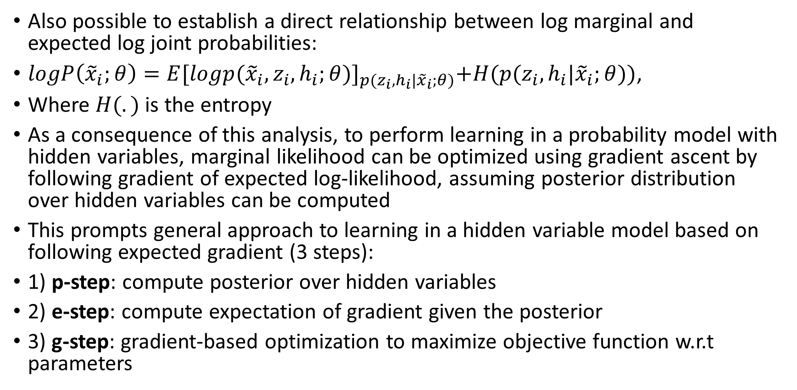
Expected log-likelihoods and expected gradients
Also possible to establish a direct relationship between log marginal and expected log joint probabilities:
$logP\left({\tilde{x}}_{i};θ\right)=E{[logp({\tilde{x}}_{i},z_{i},h_{i};θ)]}_{p(z_{i},h_{i}|{\tilde{x}}_{i};θ)}+H(p(z_{i},h_{i}|{\tilde{x}}_{i};θ))$,
Where $H(.)$ is the entropy
As a consequence of this analysis, to perform learning in a probability model with hidden variables, marginal likelihood can be optimized using gradient ascent by following gradient of expected log-likelihood, assuming posterior distribution over hidden variables can be computed
This prompts general approach to learning in a hidden variable model based on following expected gradient (3 steps):
1) p-step: compute posterior over hidden variables
2) e-step: compute expectation of gradient given the posterior
3) g-step: gradient-based optimization to maximize objective function w.r.t parameters

Slide 15
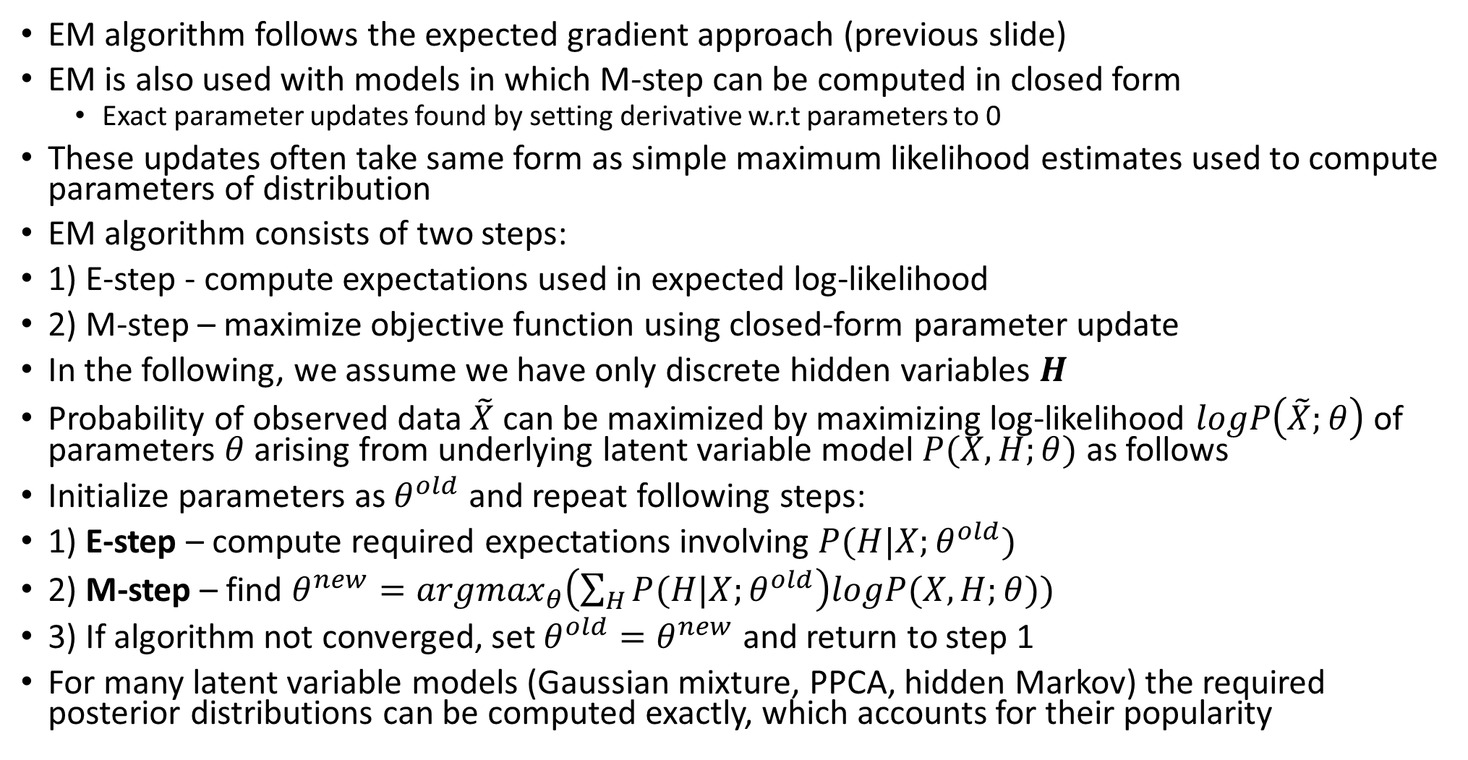
Expectation maximization algorithm
EM algorithm follows the expected gradient approach (previous slide)
EM is also used with models in which M-step can be computed in closed form
Exact parameter updates found by setting derivative w.r.t parameters to 0
These updates often take same form as simple maximum likelihood estimates used to compute parameters of distribution
EM algorithm consists of two steps:
1) E-step - compute expectations used in expected log-likelihood
2) M-step – maximize objective function using closed-form parameter update
In the following, we assume we have only discrete hidden variables $H$
Probability of observed data $\tilde{X}$ can be maximized by maximizing log-likelihood $logP\left(\tilde{X};θ\right)$ of parameters $θ$ arising from underlying latent variable model $P(X,H;θ)$ as follows
Initialize parameters as $θ^{old}$ and repeat following steps:
1) E-step – compute required expectations involving $P(H|X;θ^{old})$
2) M-step – find $θ^{new}={argmax}_{θ}\left(\sum_{H}{P(H|X;θ^{old}}\right)logP(X,H;θ))$
3) If algorithm not converged, set $θ^{old}=θ^{new}$ and return to step 1
For many latent variable models (Gaussian mixture, PPCA, hidden Markov) the required posterior distributions can be computed exactly, which accounts for their popularity

Slide 16
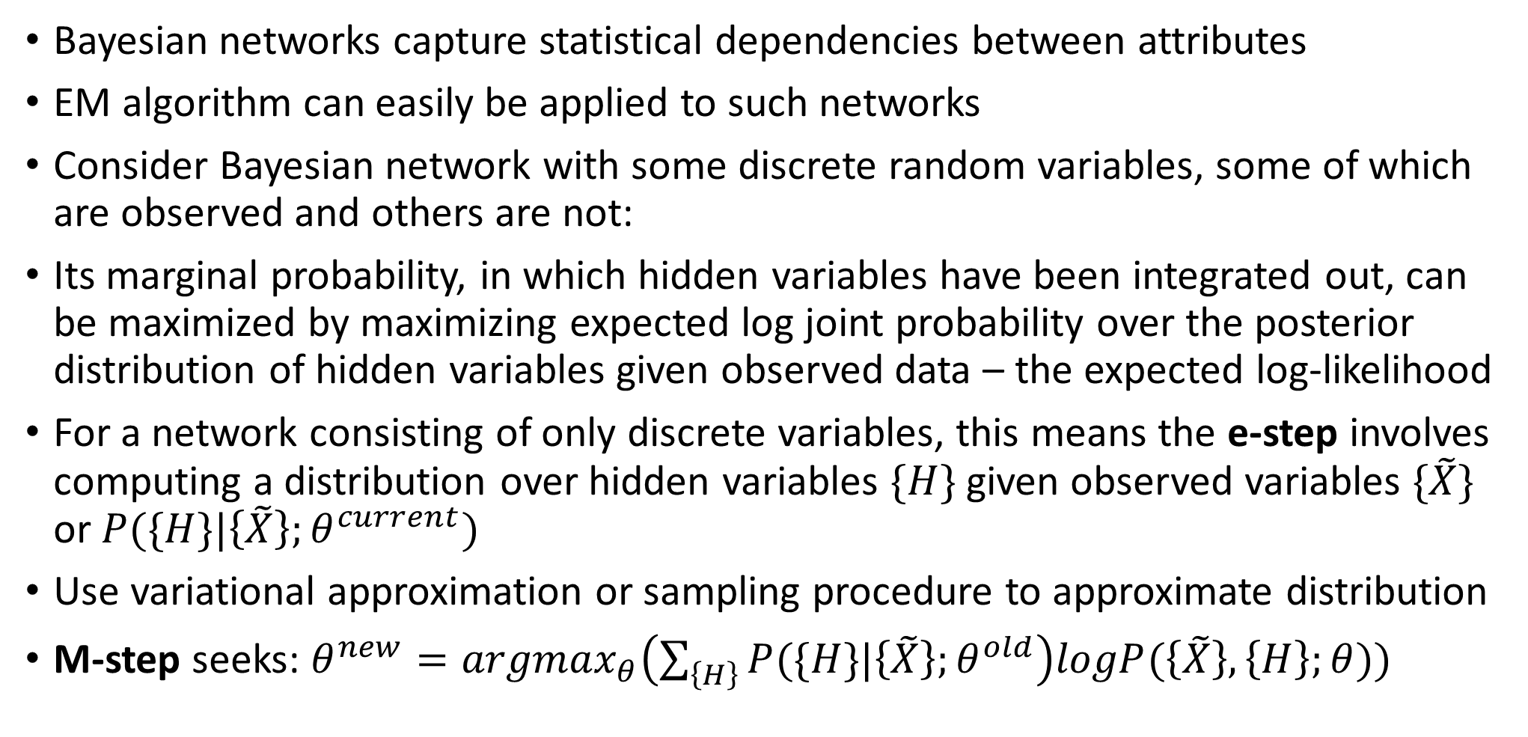
Applying expectation maximization algorithm to Bayesian networks
Bayesian networks capture statistical dependencies between attributes
EM algorithm can easily be applied to such networks
Consider Bayesian network with some discrete random variables, some of which are observed and others are not:
Its marginal probability, in which hidden variables have been integrated out, can be maximized by maximizing expected log joint probability over the posterior distribution of hidden variables given observed data – the expected log-likelihood
For a network consisting of only discrete variables, this means the e-step involves computing a distribution over hidden variables $\{H\}$ given observed variables $\{\tilde{X}\}$ or $P(\{H\}|\left\{\tilde{X}\right\};θ^{current})$
Use variational approximation or sampling procedure to approximate distribution
M-step seeks: $θ^{new}={argmax}_{θ}\left(\sum_{\left\{H\right\}}{P(\{H\}|\left\{\tilde{X}\right\};θ^{old}}\right)logP(\left\{\tilde{X}\right\},\left\{H\right\};θ))$

Slide 17
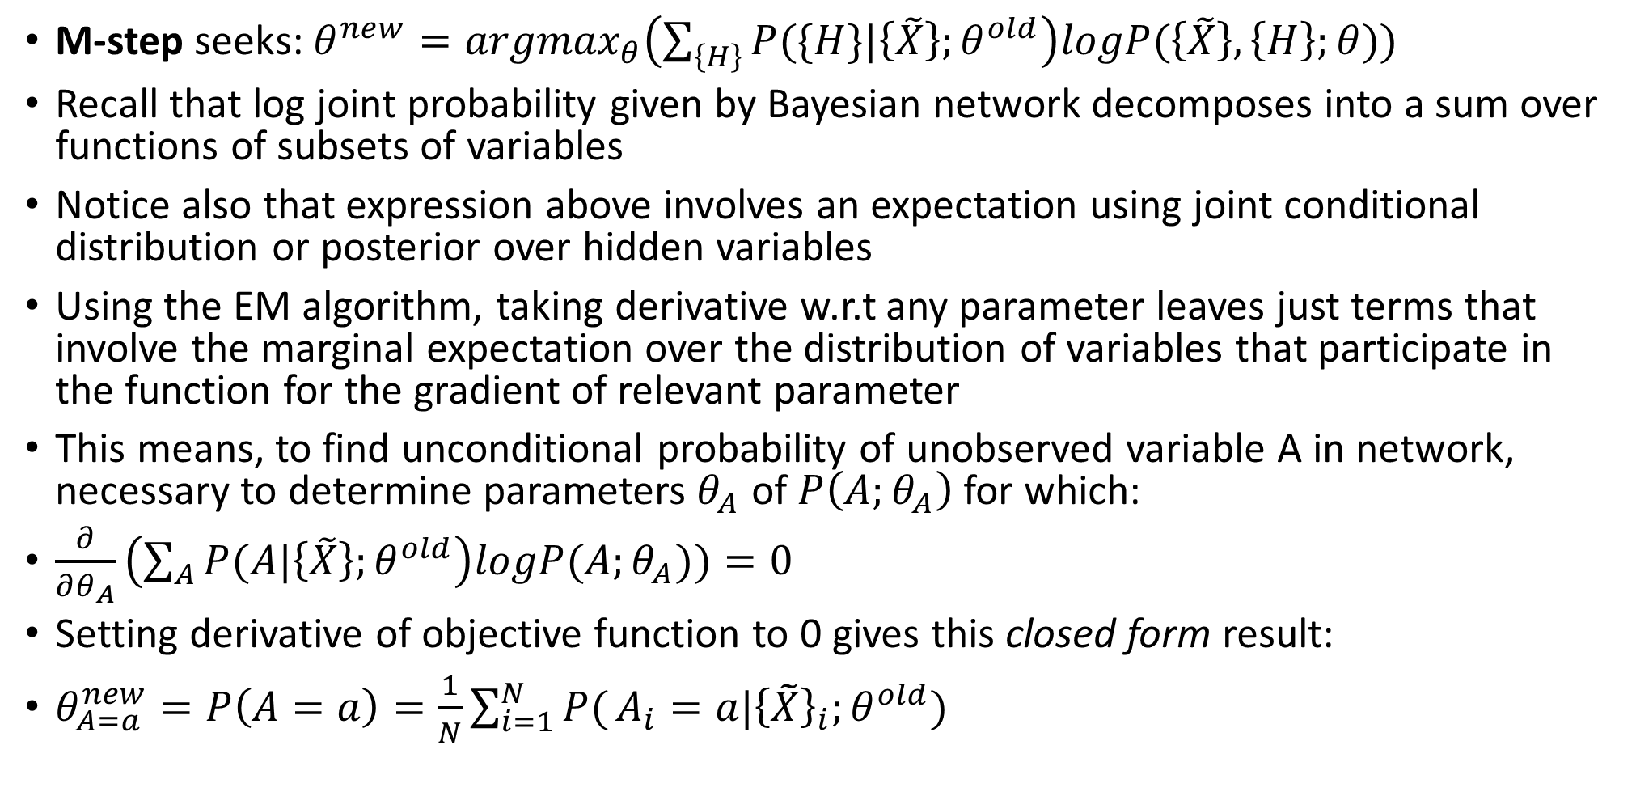
Applying expectation maximization algorithm to Bayesian networks
M-step seeks: $θ^{new}={argmax}_{θ}\left(\sum_{\left\{H\right\}}{P(\{H\}|\left\{\tilde{X}\right\};θ^{old}}\right)logP(\left\{\tilde{X}\right\},\left\{H\right\};θ))$
Recall that log joint probability given by Bayesian network decomposes into a sum over functions of subsets of variables
Notice also that expression above involves an expectation using joint conditional distribution or posterior over hidden variables
Using the EM algorithm, taking derivative w.r.t any parameter leaves just terms that involve the marginal expectation over the distribution of variables that participate in the function for the gradient of relevant parameter
This means, to find unconditional probability of unobserved variable A in network, necessary to determine parameters $θ_{A}$ of $P\left(A;θ_{A}\right)$ for which:
$\frac{∂}{∂θ_{A}}\left(\sum_{A}{P(A|\left\{\tilde{X}\right\};θ^{old}}\right)logP(A;θ_{A}))=0$
Setting derivative of objective function to 0 gives this closed form result:
$θ_{A=a}^{new}=P\left(A=a\right)=\frac{1}{N}\sum_{i=1}^{N}{P(}A_{i}=a|{\left\{\tilde{X}\right\}}_{i};θ^{old})$

Slide 18
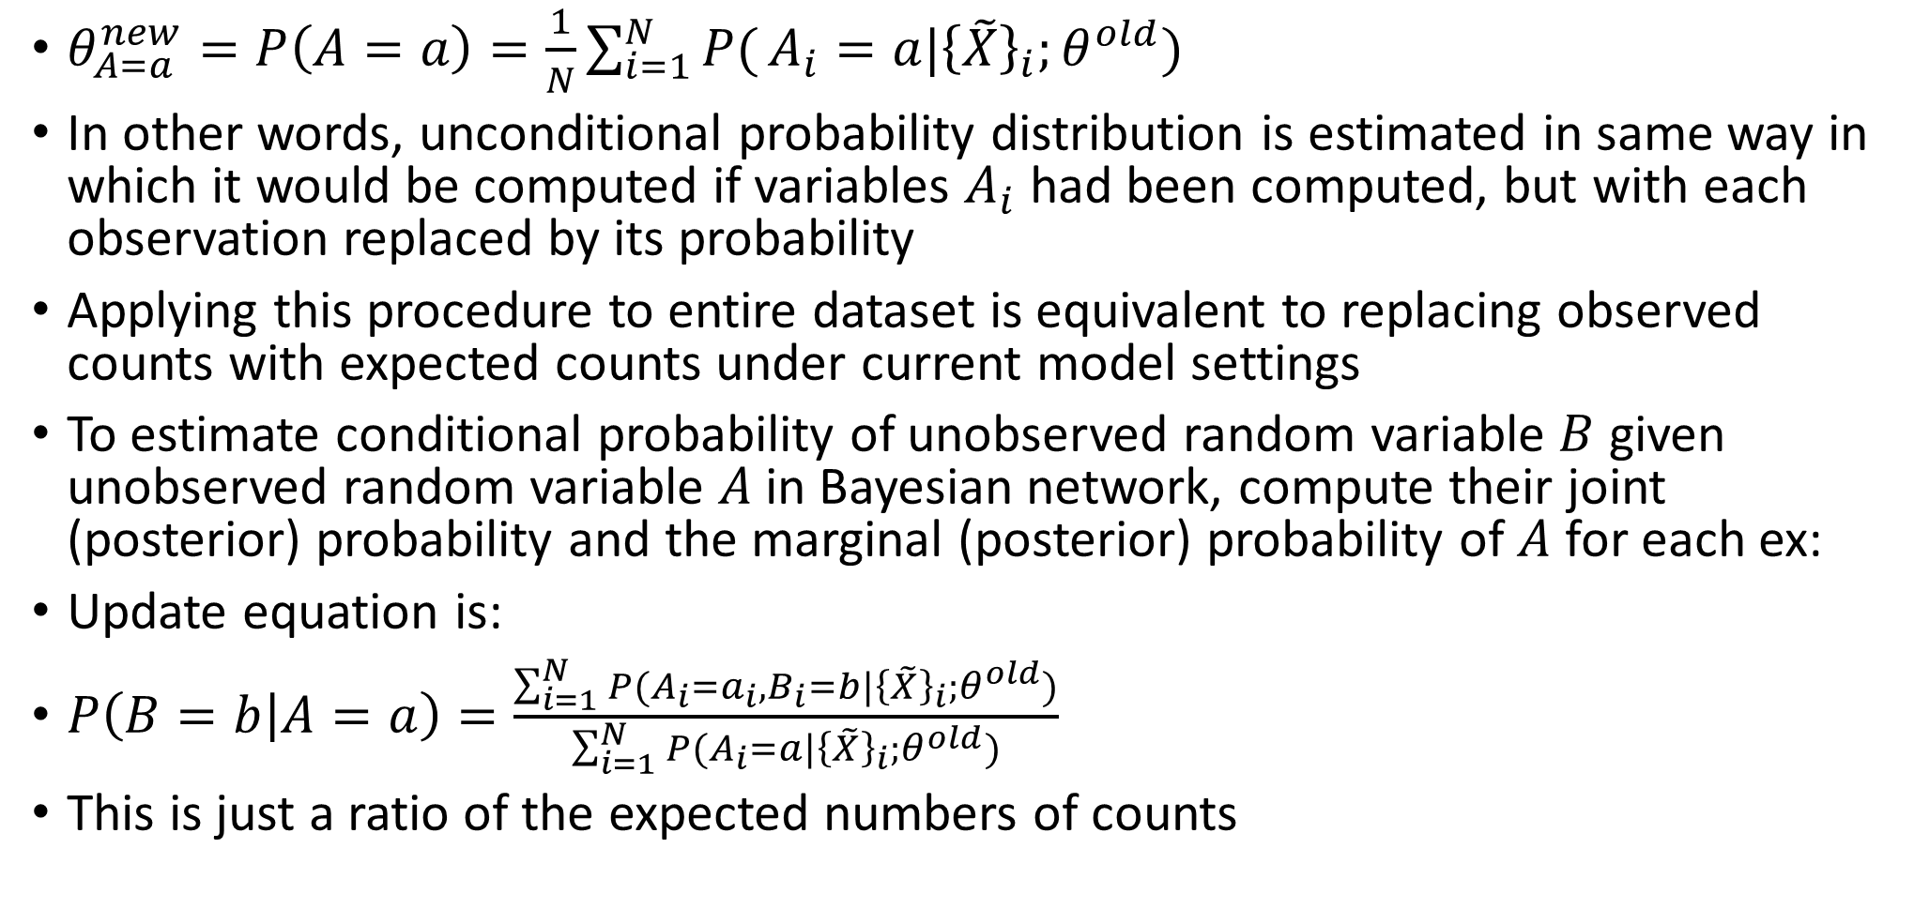
Applying expectation maximization algorithm to Bayesian networks
$θ_{A=a}^{new}=P\left(A=a\right)=\frac{1}{N}\sum_{i=1}^{N}{P(}A_{i}=a|{\left\{\tilde{X}\right\}}_{i};θ^{old})$
In other words, unconditional probability distribution is estimated in same way in which it would be computed if variables $A_{i}$ had been computed, but with each observation replaced by its probability
Applying this procedure to entire dataset is equivalent to replacing observed counts with expected counts under current model settings
To estimate conditional probability of unobserved random variable $B$ given unobserved random variable $A$in Bayesian network, compute their joint (posterior) probability and the marginal (posterior) probability of $A$ for each ex:
Update equation is:
$P\left(B=b | A=a\right)=\frac{\sum_{i=1}^{N}{P(A_{i}=a_{i},B_{i}=b|{\left\{\tilde{X}\right\}}_{i};θ^{old})}}{\sum_{i=1}^{N}{P(A_{i}=a|{\left\{\tilde{X}\right\}}_{i};θ^{old})}}$
This is just a ratio of the expected numbers of counts
If some of the variables are fully observed, expression can be adapted by replacing inferred probabilities by observed values – effectively assigning the observations a value of 1.
If variable B has multiple parents, A can be replaced by the set of parents.

Slide 19
Summary
Expectation maximization:
E-step – compute likelihood
M-step – compute new parameters based on likelihood
Repeat
Kernel density estimation:
Approximate true distribution more accurately, but uses more parameters
Extreme form of Gaussian mixture modeling
Hidden variable models:
Infer new attributes
Use EM algorithm
Next class: tips for final project
Gradient boosting classifier hyperparameter tuning
Semi-supervised learning
Multi-instance learning

