Slide 1
CS405/505 Data Mining
Lecture 31

Slide 2
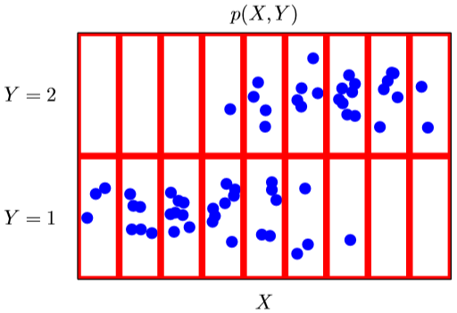
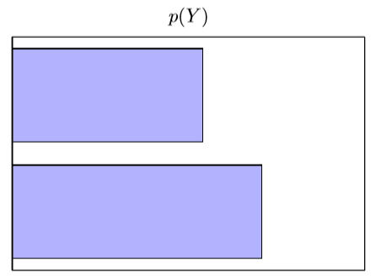
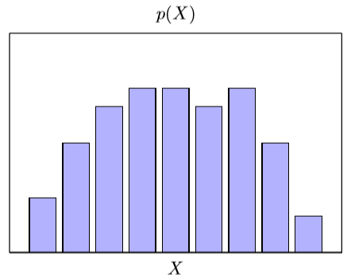
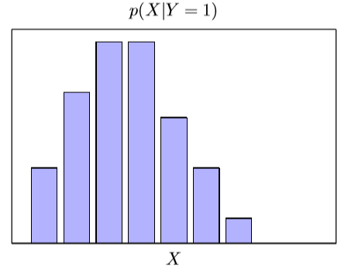
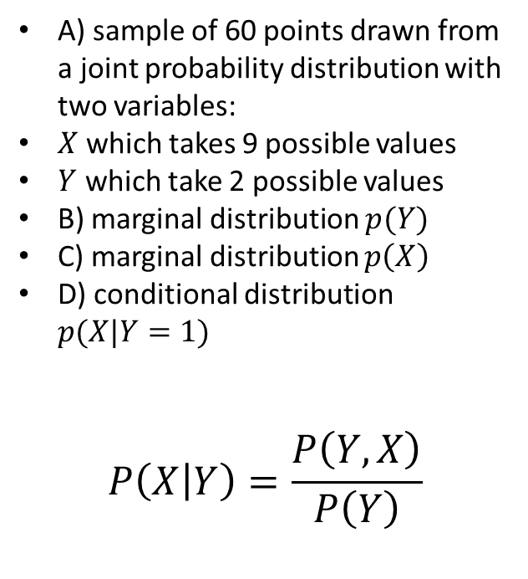
Distributions reminder
A
B
A) sample of 60 points drawn from a joint probability distribution with two variables:
$X$ which takes 9 possible values
$Y$ which take 2 possible values
B) marginal distribution $p(Y)$
C) marginal distribution $p\left(X\right)$
D) conditional distribution $p(X|Y=1)$
$$P\left(X | Y\right)=\frac{P\left(Y,X\right)}{P\left(Y\right)}$$
C
D
Christopher M. Bishop “Pattern Recognition and Machine Learning”

Slide 3
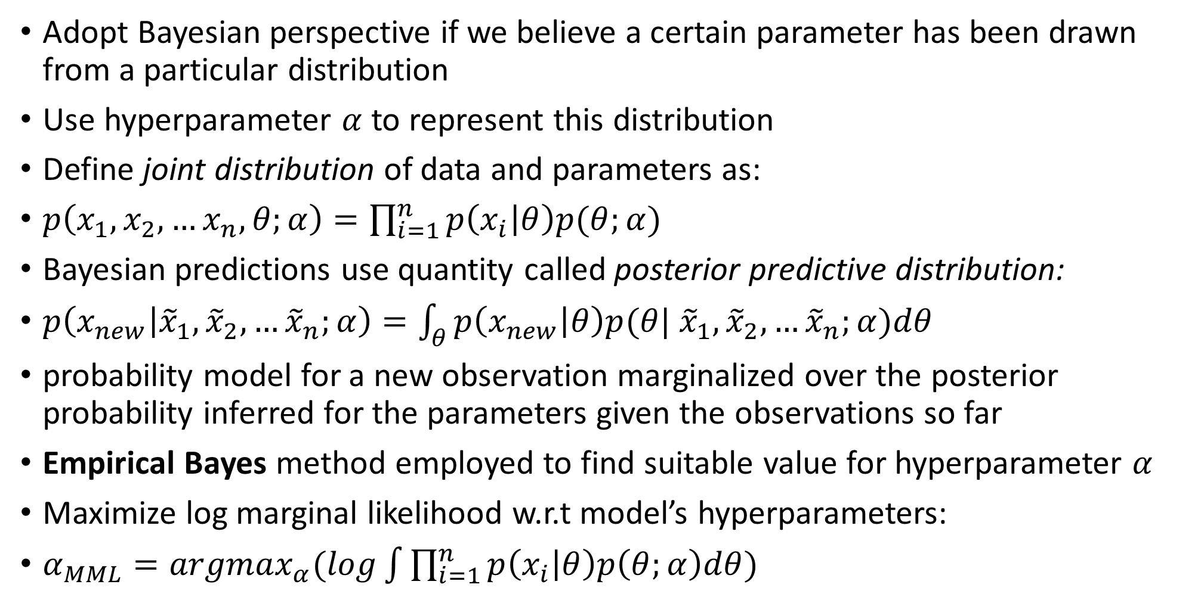
Bayesian estimation and prediction
Adopt Bayesian perspective if we believe a certain parameter has been drawn from a particular distribution
Use hyperparameter $α$ to represent this distribution
Define joint distribution of data and parameters as:
$p\left(x_{1},x_{2},…x_{n},θ;α\right)=\prod_{i=1}^{n}{p\left(x_{i} | θ\right)p(θ;α)}$
Bayesian predictions use quantity called posterior predictive distribution:
$p\left(x_{new} | {\tilde{x}}_{1},{\tilde{x}}_{2},…{\tilde{x}}_{n};α\right)=\int_{θ}^{ }{p\left(x_{new} | θ\right)p(θ|}$ ${\tilde{x}}_{1},{\tilde{x}}_{2},…{\tilde{x}}_{n};α)dθ$
probability model for a new observation marginalized over the posterior probability inferred for the parameters given the observations so far
Empirical Bayes method employed to find suitable value for hyperparameter $α$
Maximize log marginal likelihood w.r.t model’s hyperparameters:
$α_{MML}={argmax}_{α}(log\int{\prod_{i=1}^{n}{p\left(x_{i} | θ\right)p\left(θ;α\right)dθ}})$

Slide 4
Probabilistic inference models
Special methods required to efficiently compute posterior, marginal distributions
This is the field of probabilistic inference
We will now review widely used probabilistic inference methods:
1) Probability propagation
2) Sampling and simulated annealing
3) Variational inference

Slide 5
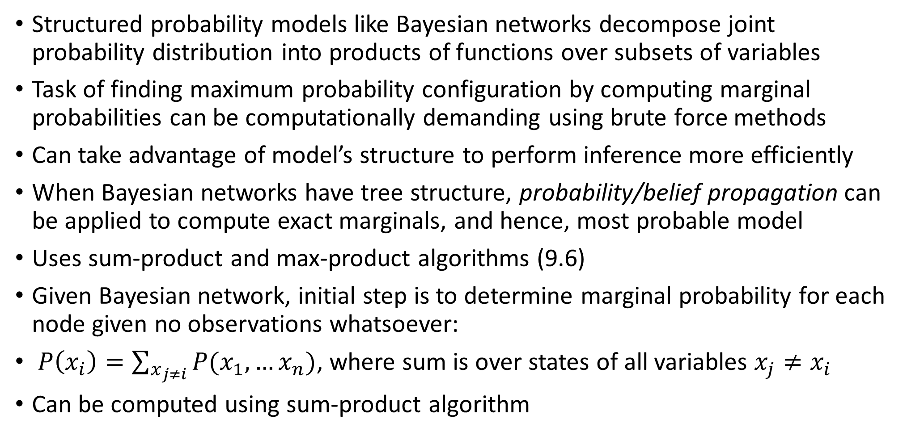
Probability propagation
Structured probability models like Bayesian networks decompose joint probability distribution into products of functions over subsets of variables
Task of finding maximum probability configuration by computing marginal probabilities can be computationally demanding using brute force methods
Can take advantage of model’s structure to perform inference more efficiently
When Bayesian networks have tree structure, probability/belief propagation can be applied to compute exact marginals, and hence, most probable model
Uses sum-product and max-product algorithms (9.6)
Given Bayesian network, initial step is to determine marginal probability for each node given no observations whatsoever:
$P\left(x_{i}\right)=\sum_{x_{j≠i}}{P(x_{1},…x_{n})}$, where sum is over states of all variables $x_{j}≠x_{i}$
Can be computed using sum-product algorithm

Slide 6
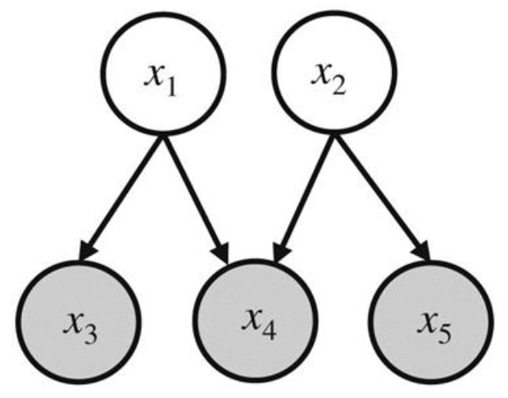
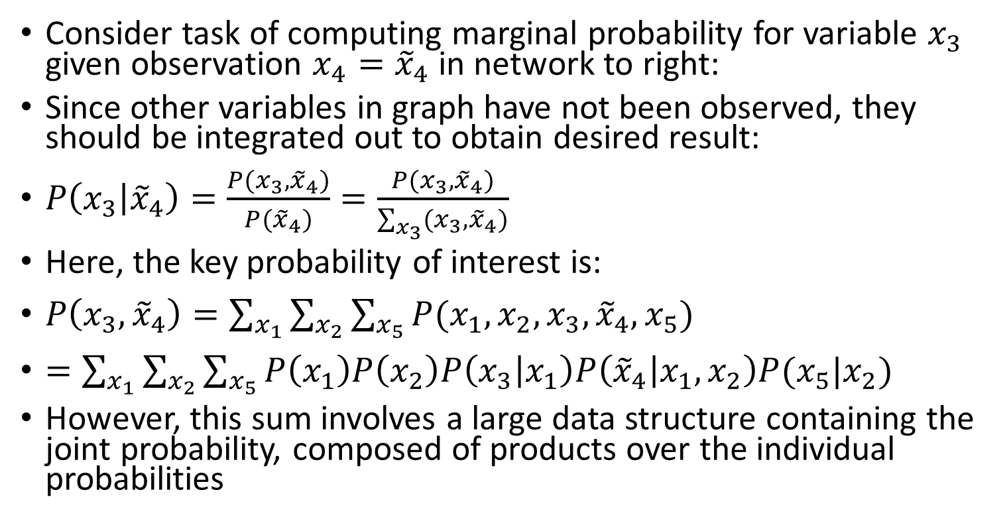
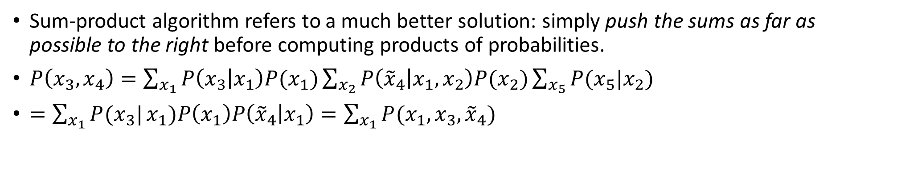
Sum-product algorithm
Consider task of computing marginal probability for variable $x_{3}$ given observation $x_{4}={\tilde{x}}_{4}$ in network to right:
Since other variables in graph have not been observed, they should be integrated out to obtain desired result:
$P\left(x_{3} | {\tilde{x}}_{4}\right)=\frac{P(x_{3},{\tilde{x}}_{4})}{P({\tilde{x}}_{4})}=\frac{P(x_{3},{\tilde{x}}_{4})}{\sum_{x_{3}}{(x_{3},{\tilde{x}}_{4})}}$
Here, the key probability of interest is:
$P\left(x_{3},{\tilde{x}}_{4}\right)=\sum_{x_{1}}{\sum_{x_{2}}{\sum_{x_{5}}{P(x_{1},x_{2},x_{3},{\tilde{x}}_{4},x_{5})}}}$
$=\sum_{x_{1}}{\sum_{x_{2}}{\sum_{x_{5}}{P\left(x_{1}\right)P\left(x_{2}\right)P\left(x_{3} | x_{1}\right)P\left({\tilde{x}}_{4} | x_{1},x_{2}\right)P(x_{5}|x_{2})}}}$
However, this sum involves a large data structure containing the joint probability, composed of products over the individual probabilities
Sum-product algorithm refers to a much better solution: simply push the sums as far as possible to the right before computing products of probabilities.
$P\left(x_{3},x_{4}\right)=\sum_{x_{1}}{P\left(x_{3} | x_{1}\right)P(x_{1})}\sum_{x_{2}}{P\left({\tilde{x}}_{4} | x_{1},x_{2}\right)P(x_{2})}\sum_{x_{5}}{P(x_{5}|x_{2})}$
$=\sum_{x_{1}}{P(x_{3}|}x_{1})P\left(x_{1}\right)P\left({\tilde{x}}_{4} | x_{1}\right)=\sum_{x_{1}}{P(x_{1},x_{3},{\tilde{x}}_{4})}$

Slide 7
Sampling
Sampling methods are popular with fully Bayesian methods using distributions on parameters, or graphical models with cyclic structures
Use Markov chain Monte Carlo methods to generate random samples from probability distributions that are difficult to compute
Gibbs sampling is a special case of Metropolis-Hastings algorithm
Allows to generate samples from joint distribution even when true distribution is a complex continuous function
Samples can then be used to approximate expectations of interest, and approximate marginal distributions of subsets of variables
Point of Gibbs sampling: given a multivariate distribution, easier to sample from conditional distribution than marginalize by integrating over joint distribution

Slide 8
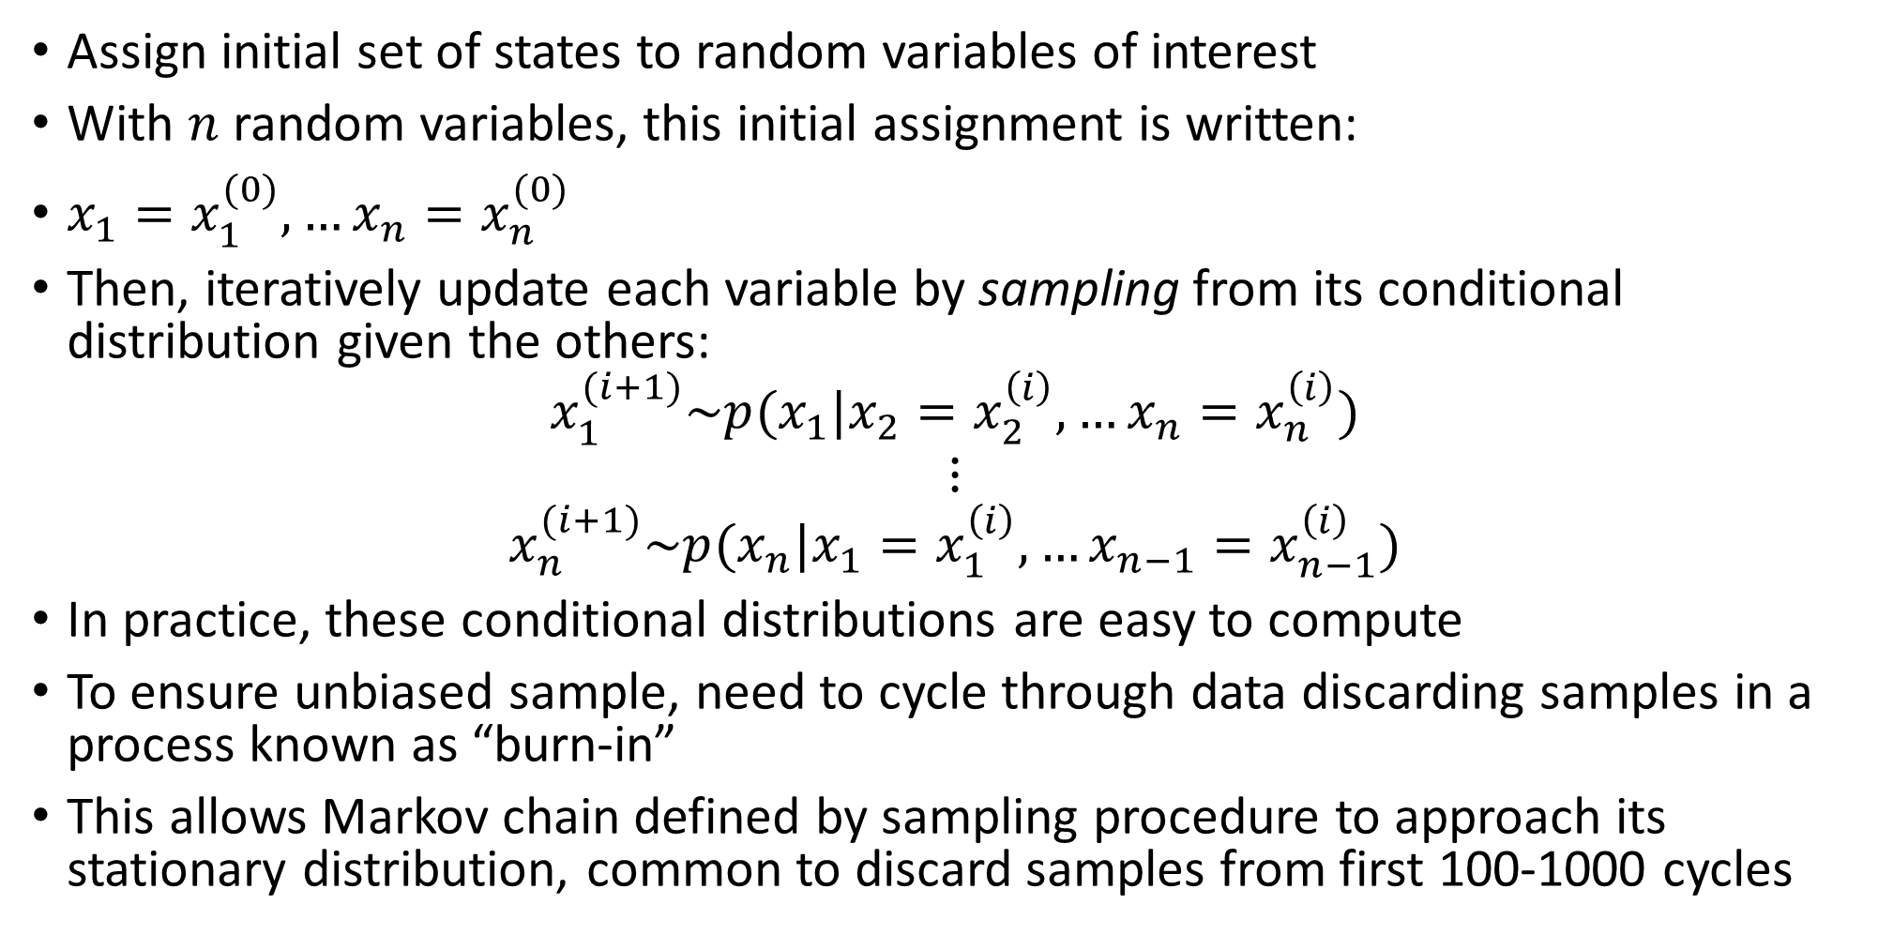
Gibbs sampling
Assign initial set of states to random variables of interest
With $n$ random variables, this initial assignment is written:
$x_{1}=x_{1}^{(0)},…x_{n}=x_{n}^{(0)}$
Then, iteratively update each variable by sampling from its conditional distribution given the others:
$$x_{1}^{(i+1)}\sim p(x_{1}|x_{2}=x_{2}^{\left(i\right)},…x_{n}=x_{n}^{\left(i\right)})$$
$$⋮$$
$$x_{n}^{(i+1)}\sim p(x_{n}|x_{1}=x_{1}^{\left(i\right)},…x_{n−1}=x_{n−1}^{\left(i\right)})$$
In practice, these conditional distributions are easy to compute
To ensure unbiased sample, need to cycle through data discarding samples in a process known as “burn-in”
This allows Markov chain defined by sampling procedure to approach its stationary distribution, common to discard samples from first 100-1000 cycles

Slide 9
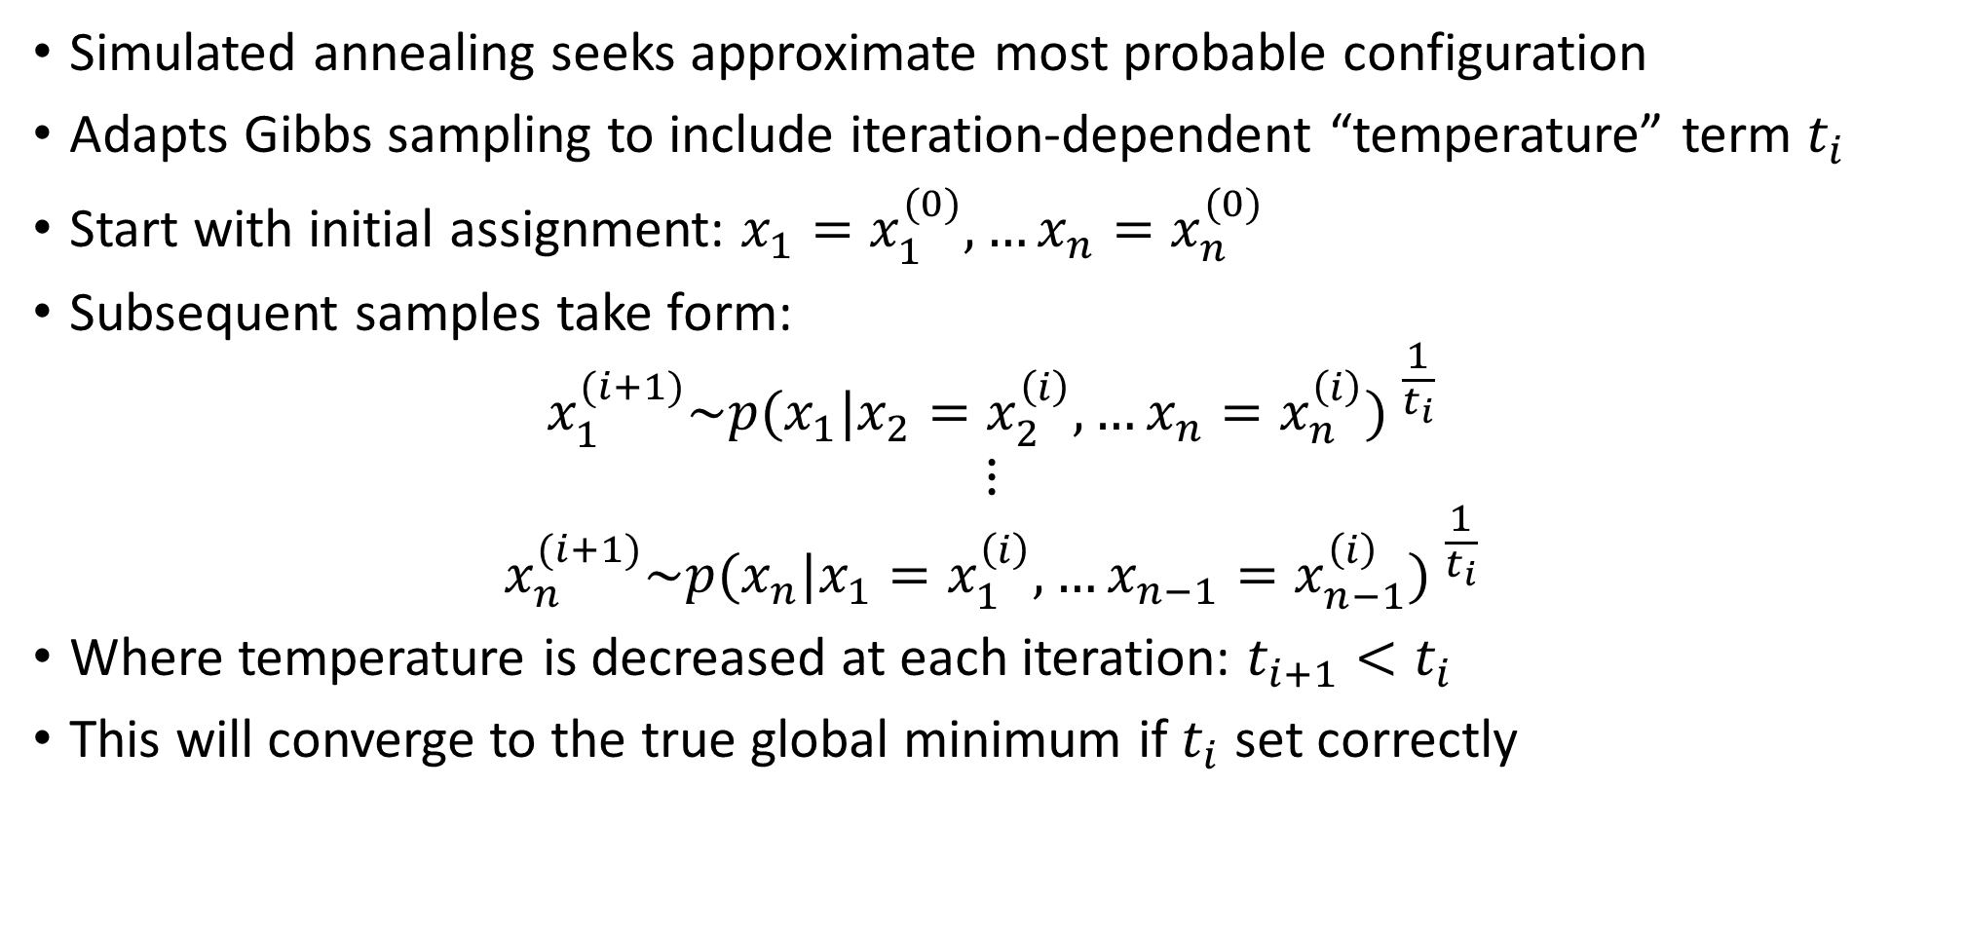
Simulated annealing
Simulated annealing seeks approximate most probable configuration
Adapts Gibbs sampling to include iteration-dependent “temperature” term $t_{i}$
Start with initial assignment: $x_{1}=x_{1}^{(0)},…x_{n}=x_{n}^{(0)}$
Subsequent samples take form:
$$x_{1}^{(i+1)}\sim {p(x_{1}|x_{2}=x_{2}^{\left(i\right)},…x_{n}=x_{n}^{\left(i\right)}) }^{\frac{1}{t_{i}}}$$
$$⋮$$
$$x_{n}^{(i+1)}\sim {p(x_{n}|x_{1}=x_{1}^{\left(i\right)},…x_{n−1}=x_{n−1}^{\left(i\right)}) }^{\frac{1}{t_{i}}}$$
Where temperature is decreased at each iteration: $t_{i+1}<t_{i}$
This will converge to the true global minimum if $t_{i}$ set correctly

Slide 10
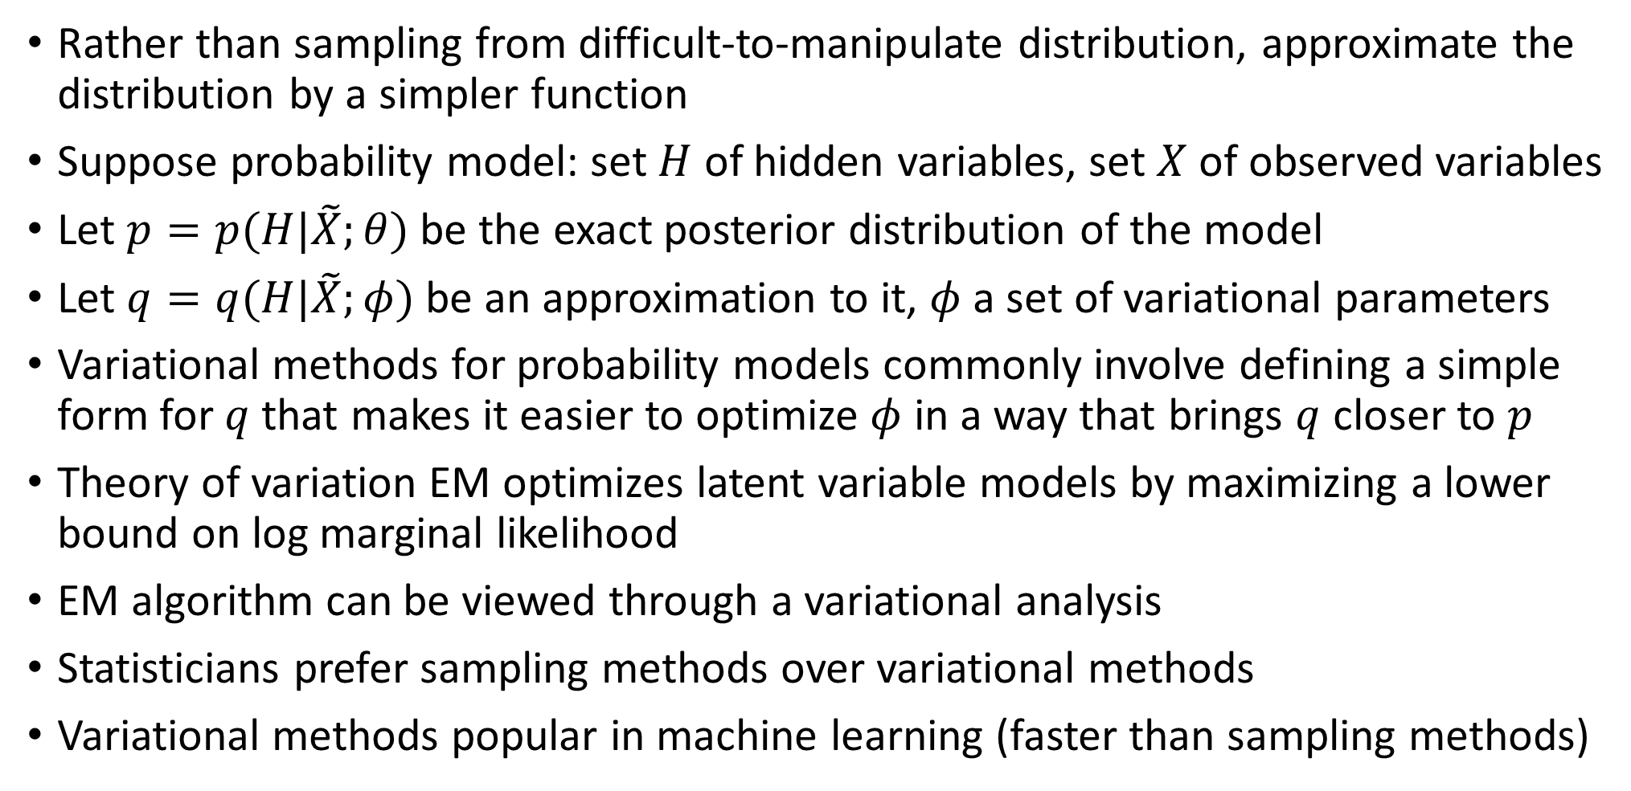
Variational inference
Rather than sampling from difficult-to-manipulate distribution, approximate the distribution by a simpler function
Suppose probability model: set $H$ of hidden variables, set $X$ of observed variables
Let $p=p(H|\tilde{X};θ)$ be the exact posterior distribution of the model
Let $q=q(H|\tilde{X};φ)$ be an approximation to it, $φ$ a set of variational parameters
Variational methods for probability models commonly involve defining a simple form for $q$ that makes it easier to optimize $φ$ in a way that brings $q$ closer to $p$
Theory of variation EM optimizes latent variable models by maximizing a lower bound on log marginal likelihood
EM algorithm can be viewed through a variational analysis
Statisticians prefer sampling methods over variational methods
Variational methods popular in machine learning (faster than sampling methods)

Slide 11
9.6 Graphical models and factor graphs
Bayesian networks give intuitive picture of probabilistic model corresponding to how we have decomposed joint probability of random variables representing attributes into product of conditional and unconditional distributions
Alternatively, can approximate joint distribution using mixture models (Gaussian)
We will see how mixture models can be illustrated using Bayesian networks
We will introduce ‘plate notation’, which allows us to visualize the result of techniques that treat parameters as random quantities
As before, we view attributes as random variables, instances as observations

Slide 12
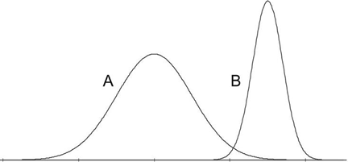
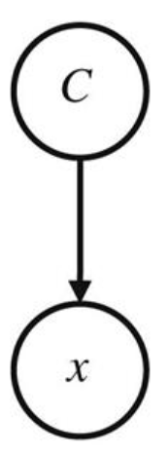
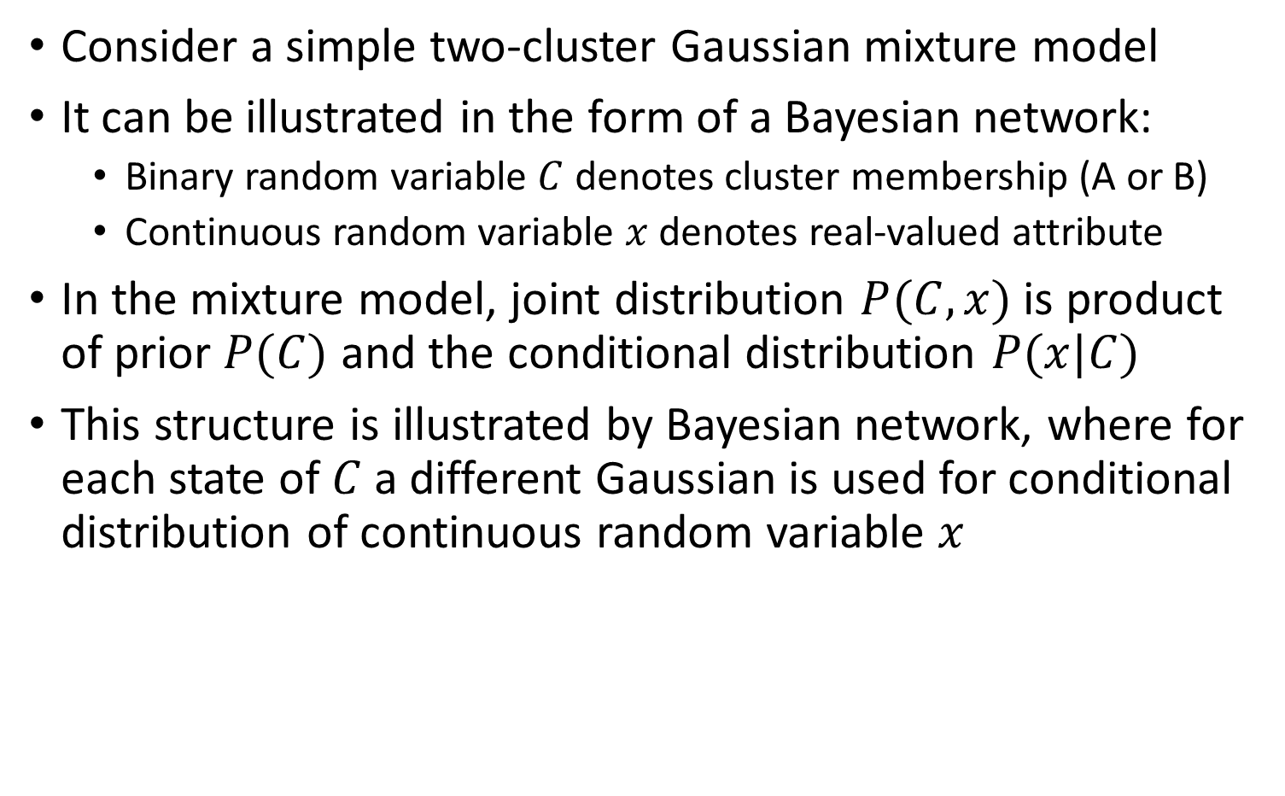
Graphical Models and Plate Notation
Consider a simple two-cluster Gaussian mixture model
It can be illustrated in the form of a Bayesian network:
Binary random variable $C$ denotes cluster membership (A or B)
Continuous random variable $x$ denotes real-valued attribute
In the mixture model, joint distribution $P(C,x)$ is product of prior $P(C)$ and the conditional distribution $P(x|C)$
This structure is illustrated by Bayesian network, where for each state of $C$ a different Gaussian is used for conditional distribution of continuous random variable $x$

Slide 13
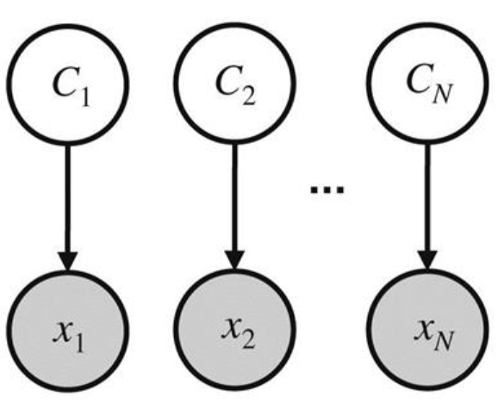
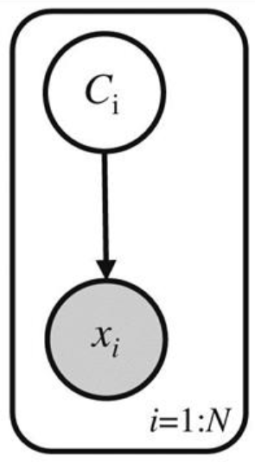


Graphical Models and Plate Notation
Multiple Bayesian networks can be used to visualize underlying joint likelihood that results whenever parameter estimation is performed
Probability model for $N$ observations $x_{1}=x_{1}, x_{2}=x_{2},…x_{N}=x_{N}$ can be conceptualized as $N$ Bayesian networks, one for each variable $x_{i}$ observed at $x_{i}$
A “plate” is simply a box around a Bayesian network that denotes a certain number of replications of it
Plate to the right indicates $i=1,…N$ networks, each with an observed value for $x_{i}$
Plate notation captures a model for the joint probability of entire data with a simple picture

Slide 14
Probabilistic Principle Component Analysis
PCA can be viewed as consequence of performing parameter estimation in a special type of linear Gaussian hidden variable model
Underlying idea: represent data as being generated by Gaussian distributed continuous hidden variable that is linearly transformed under Gaussian model
PCs of given dataset correspond to underlying factorized covariance model for corresponding multivariate Gaussian distribution model for the data
Set of hidden variables used to represent input data in lower dimensional space
Each dimension corresponds to independent random variable drawn from Gaussian distribution with zero mean, unit variance

Slide 15
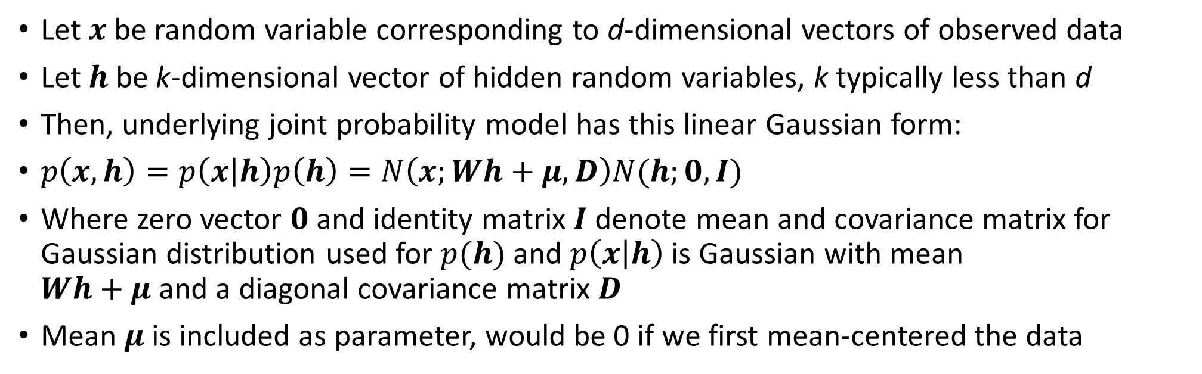
Probabilistic Principle Component Analysis
Let $x$ be random variable corresponding to d-dimensional vectors of observed data
Let $h$ be k-dimensional vector of hidden random variables, k typically less than d
Then, underlying joint probability model has this linear Gaussian form:
$p\left(x,h\right)=p\left(x | h\right)p\left(h\right)=N\left(x;Wh+μ,D\right)N(h;0,I)$
Where zero vector $0$ and identity matrix $I$ denote mean and covariance matrix for Gaussian distribution used for $p(h)$ and $p\left(x | h\right)$ is Gaussian with mean $Wh+μ$ and a diagonal covariance matrix $D$
Mean $μ$ is included as parameter, would be 0 if we first mean-centered the data

Slide 16
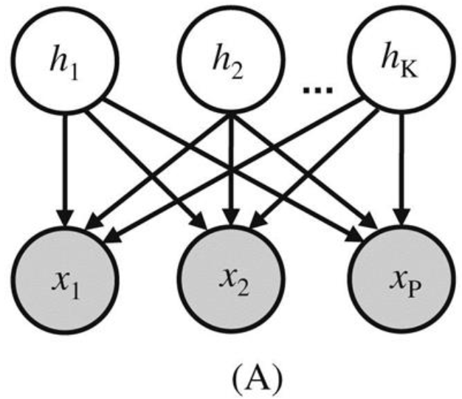

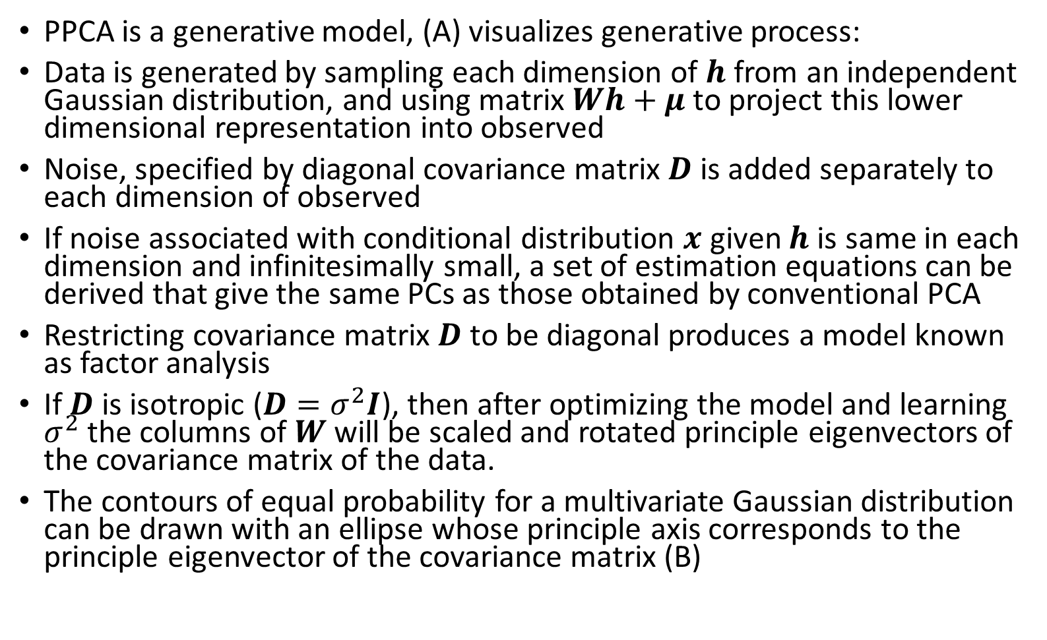
Probabilistic Principle Component Analysis
PPCA is a generative model, (A) visualizes generative process:
Data is generated by sampling each dimension of $h$ from an independent Gaussian distribution, and using matrix $Wh+μ$ to project this lower dimensional representation into observed
Noise, specified by diagonal covariance matrix $D$ is added separately to each dimension of observed
If noise associated with conditional distribution $x$ given $h$ is same in each dimension and infinitesimally small, a set of estimation equations can be derived that give the same PCs as those obtained by conventional PCA
Restricting covariance matrix $D$ to be diagonal produces a model known as factor analysis
If $D$ is isotropic ($D=σ^{2}I$), then after optimizing the model and learning $σ^{2}$ the columns of $W$ will be scaled and rotated principle eigenvectors of the covariance matrix of the data.
The contours of equal probability for a multivariate Gaussian distribution can be drawn with an ellipse whose principle axis corresponds to the principle eigenvector of the covariance matrix (B)

Slide 17
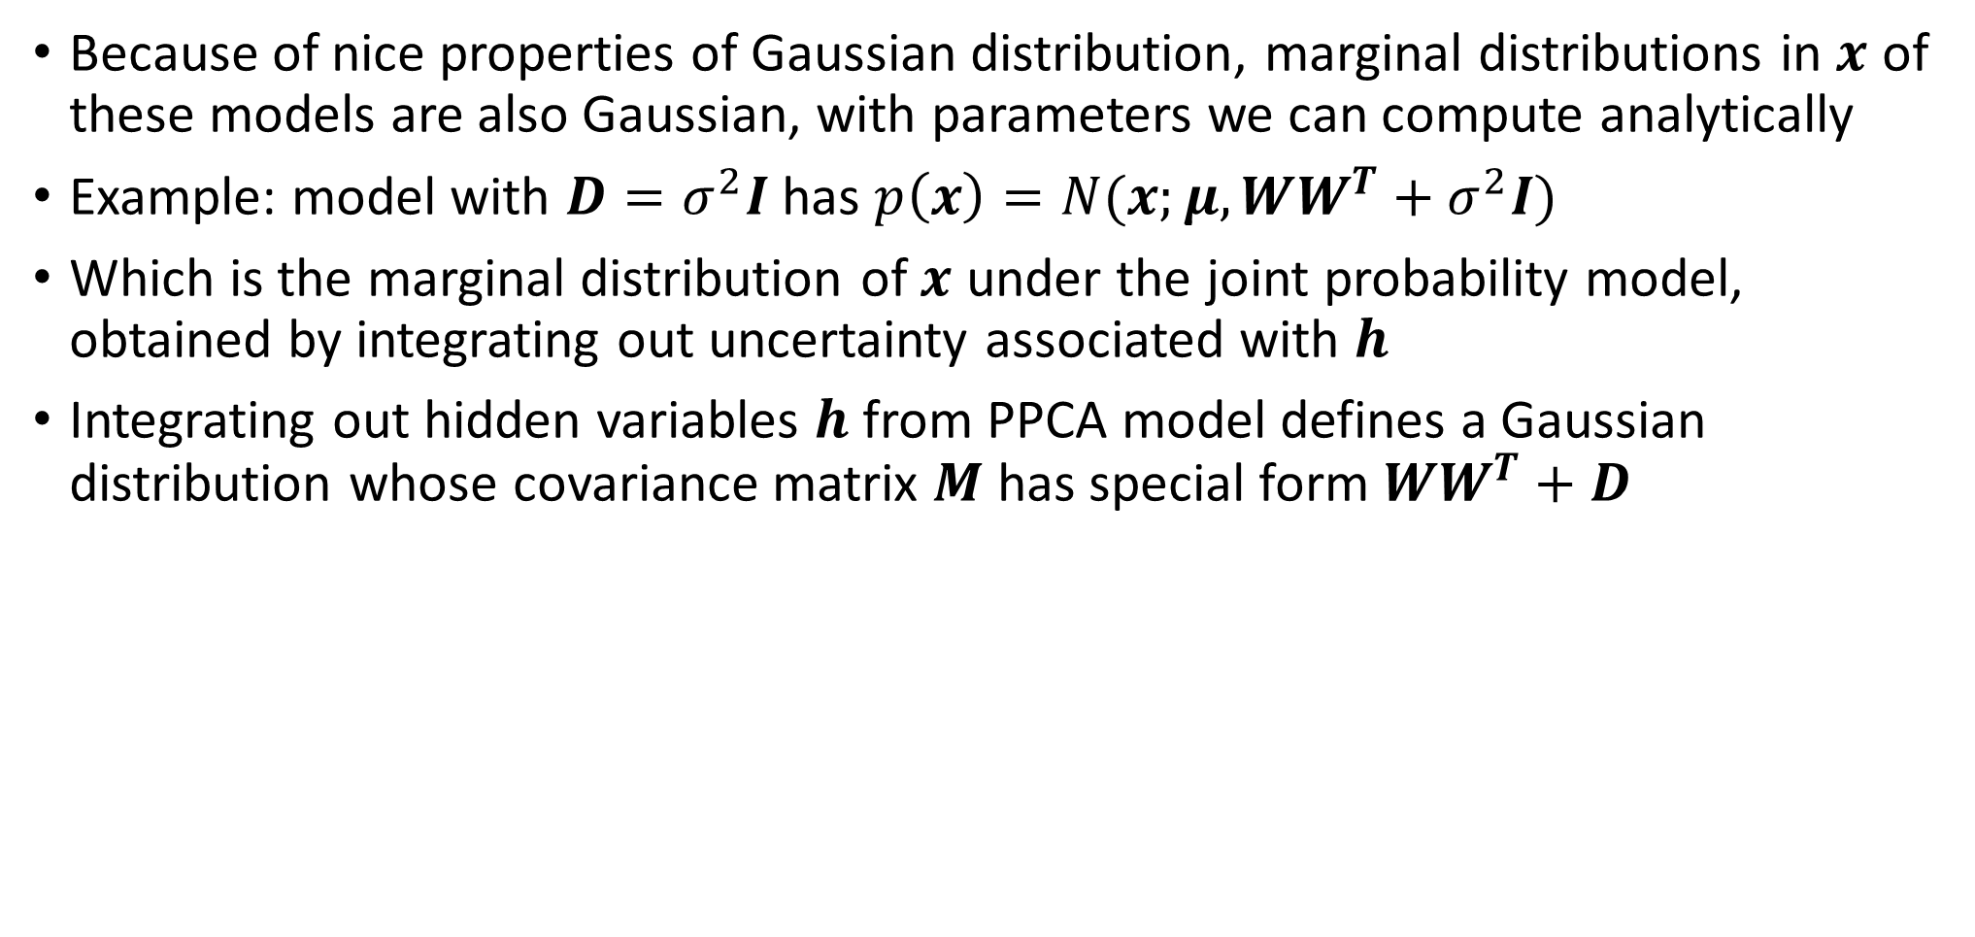
Probabilistic Principle Component Analysis
Because of nice properties of Gaussian distribution, marginal distributions in $x$ of these models are also Gaussian, with parameters we can compute analytically
Example: model with $D=σ^{2}I$ has $p\left(x\right)=N(x;μ,WW^{T}+σ^{2}I)$
Which is the marginal distribution of $x$ under the joint probability model, obtained by integrating out uncertainty associated with $h$
Integrating out hidden variables $h$ from PPCA model defines a Gaussian distribution whose covariance matrix $M$ has special form $WW^{T}+D$

Slide 18
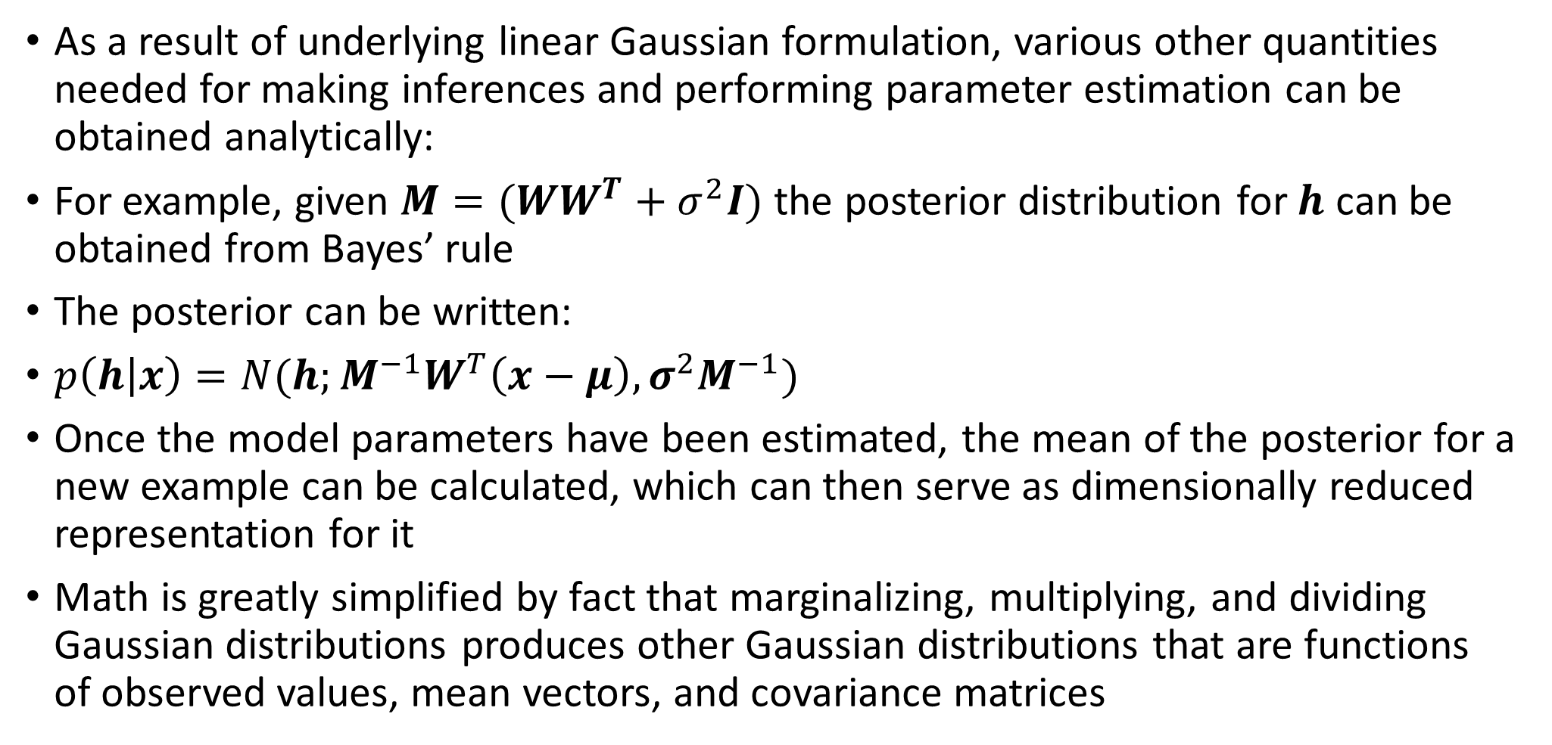
Inference with PPCA
As a result of underlying linear Gaussian formulation, various other quantities needed for making inferences and performing parameter estimation can be obtained analytically:
For example, given $M=(WW^{T}+σ^{2}I)$ the posterior distribution for $h$ can be obtained from Bayes’ rule
The posterior can be written:
$p\left(h | x\right)=N(h;M^{−1}W^{T}\left(x−μ\right), σ^{2}M^{−1})$
Once the model parameters have been estimated, the mean of the posterior for a new example can be calculated, which can then serve as dimensionally reduced representation for it
Math is greatly simplified by fact that marginalizing, multiplying, and dividing Gaussian distributions produces other Gaussian distributions that are functions of observed values, mean vectors, and covariance matrices

Slide 19
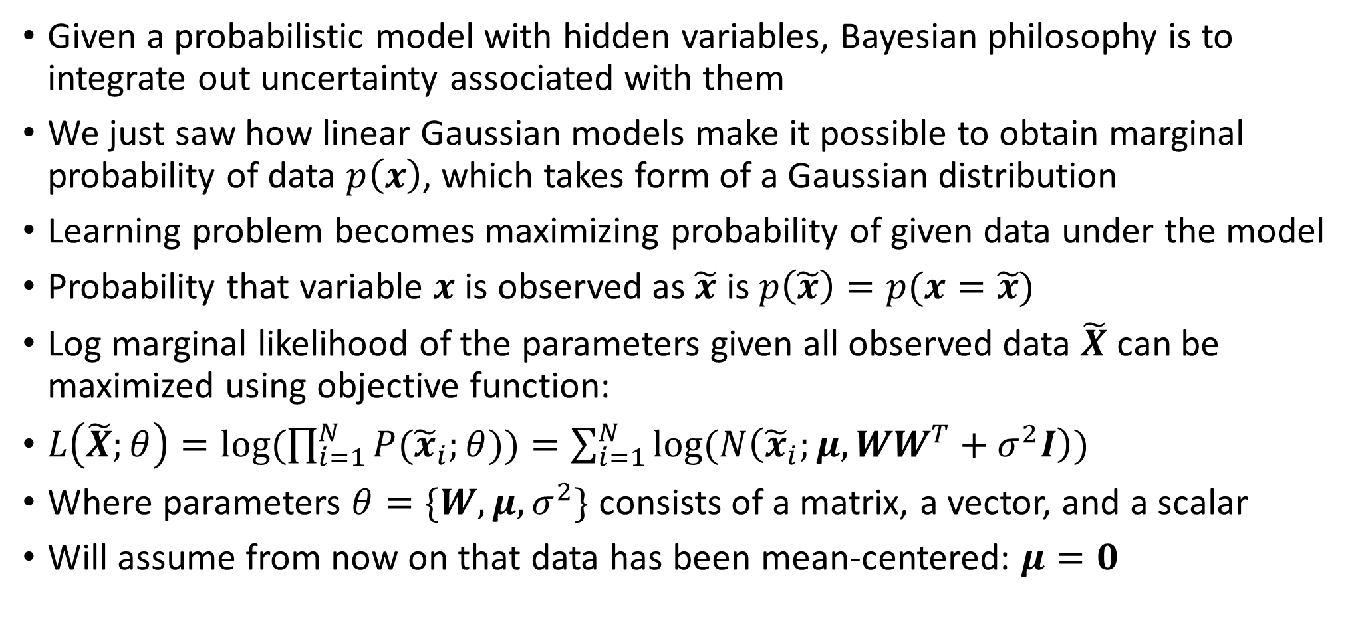
Marginal log-likelihood for PPC
Given a probabilistic model with hidden variables, Bayesian philosophy is to integrate out uncertainty associated with them
We just saw how linear Gaussian models make it possible to obtain marginal probability of data $p\left(x\right)$, which takes form of a Gaussian distribution
Learning problem becomes maximizing probability of given data under the model
Probability that variable $x$ is observed as $\tilde{x}$ is $p\left(\tilde{x}\right)=p(x=\tilde{x})$
Log marginal likelihood of the parameters given all observed data $\tilde{X}$ can be maximized using objective function:
$L\left(\tilde{X};θ\right)=log⁡(\prod_{i=1}^{N}{P({\tilde{x}}_{i};θ))=\sum_{i=1}^{N}{log⁡(N\left({\tilde{x}}_{i};μ,WW^{T}+σ^{2}I\right))}}$
Where parameters $θ=\{W,μ,σ^{2}\}$ consists of a matrix, a vector, and a scalar
Will assume from now on that data has been mean-centered: $μ=0$

Slide 20
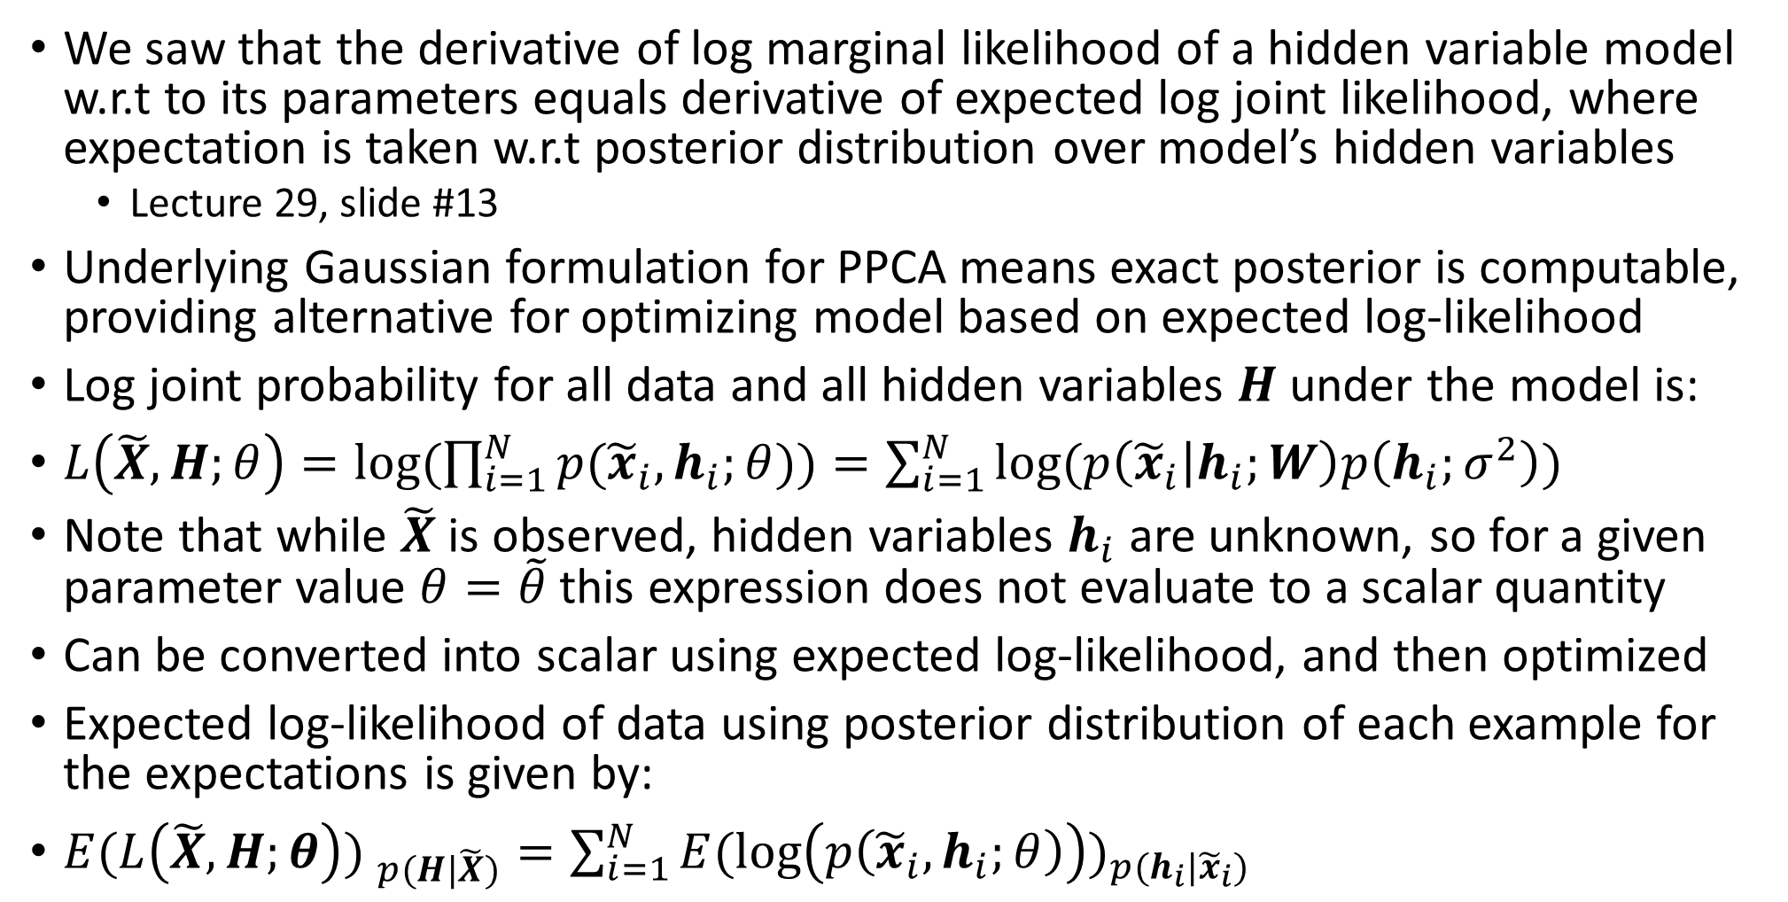
Expected log-likelihood for PPCA
We saw that the derivative of log marginal likelihood of a hidden variable model w.r.t to its parameters equals derivative of expected log joint likelihood, where expectation is taken w.r.t posterior distribution over model’s hidden variables
Lecture 29, slide #13
Underlying Gaussian formulation for PPCA means exact posterior is computable, providing alternative for optimizing model based on expected log-likelihood
Log joint probability for all data and all hidden variables $H$ under the model is:
$L\left(\tilde{X},H;θ\right)=log⁡(\prod_{i=1}^{N}{p({\tilde{x}}_{i},h_{i};θ))=\sum_{i=1}^{N}{log⁡(p\left({\tilde{x}}_{i} | h_{i};W\right)p\left(h_{i};σ^{2}\right))}}$
Note that while $\tilde{X}$ is observed, hidden variables $h_{i}$ are unknown, so for a given parameter value $θ=\tilde{θ}$ this expression does not evaluate to a scalar quantity
Can be converted into scalar using expected log-likelihood, and then optimized
Expected log-likelihood of data using posterior distribution of each example for the expectations is given by:
${E(L\left(\tilde{X},H;θ\right)) }_{p(H|\tilde{X})}=\sum_{i=1}^{N}{{E(\log\left(p\left({\tilde{x}}_{i},h_{i};θ\right)\right))}_{p(h_{i}|{\tilde{x}}_{i})}}$

Slide 21
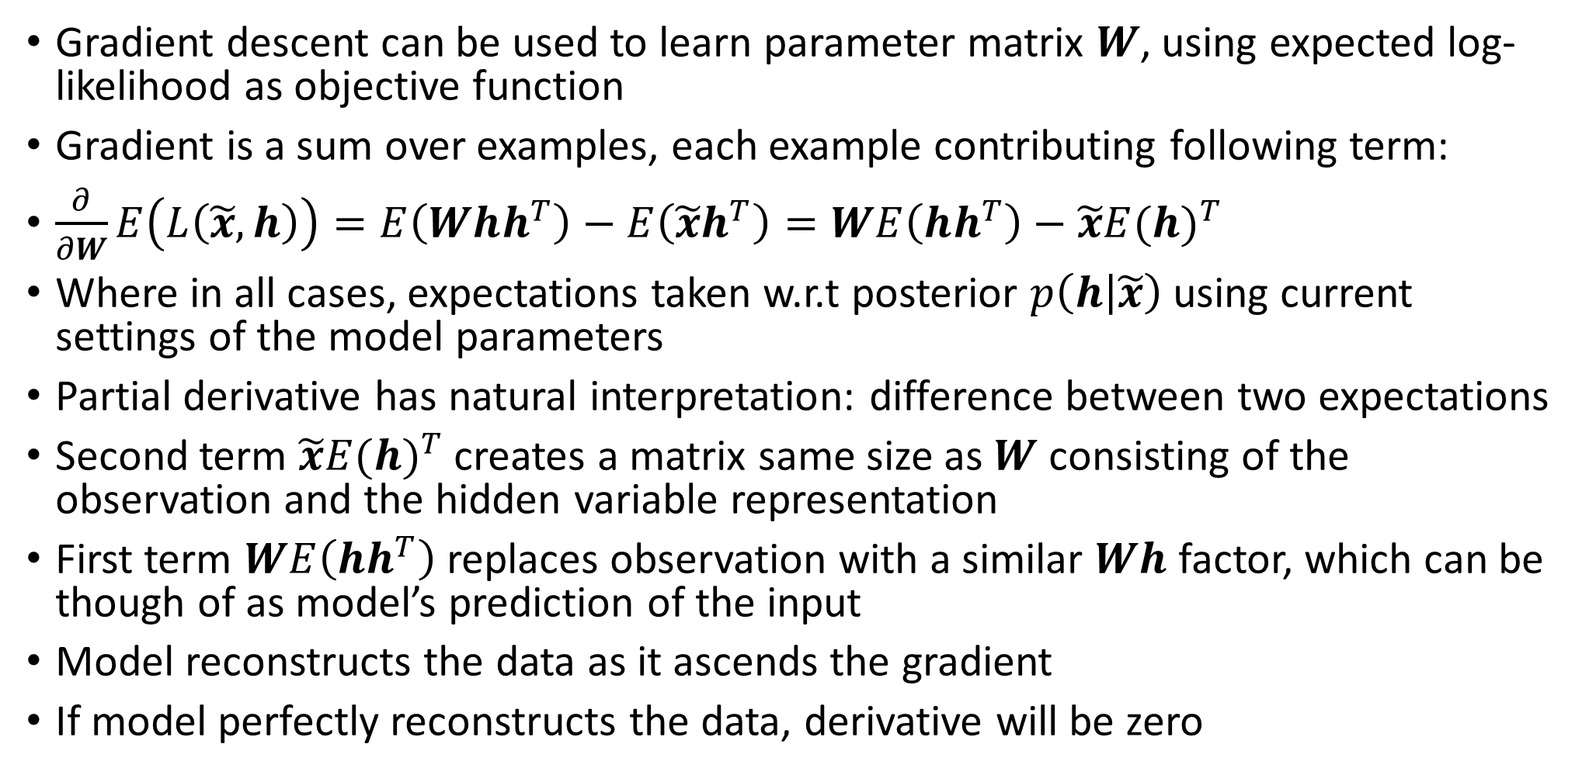
Expected gradient for PPCA
Gradient descent can be used to learn parameter matrix $W$, using expected log-likelihood as objective function
Gradient is a sum over examples, each example contributing following term:
$\frac{∂}{∂W}E\left(L\left(\tilde{x},h\right)\right)=E\left(Whh^{T}\right)−E\left(\tilde{x}h^{T}\right)=WE\left(hh^{T}\right)−\tilde{x}{E(h)}^{T}$
Where in all cases, expectations taken w.r.t posterior $p\left(h | \tilde{x}\right)$ using current settings of the model parameters
Partial derivative has natural interpretation: difference between two expectations
Second term $\tilde{x}{E(h)}^{T}$creates a matrix same size as $W$ consisting of the observation and the hidden variable representation
First term $WE\left(hh^{T}\right)$replaces observation with a similar $Wh$ factor, which can be though of as model’s prediction of the input
Model reconstructs the data as it ascends the gradient
If model perfectly reconstructs the data, derivative will be zero

Slide 22
Summary
Probabilistic inference models
Probability propagation (sum-product algorithm)
Sampling and simulated annealing (easier to sample from conditional distribution)
Variational inference (approximate distribution with continuous function)
Graphical models and plate notation
Illustrate mixture model in form of Bayesian network
Probabilistic PCA
Hidden parameter estimation in a special type of linear Gaussian hidden variable model
Final class:
Generalized Linear Models
Latent Dirichlet Allocation
Hidden Markov Models
Restricted Boltzmann Machines

