Slide 1
Data Mining CS 405/505
Professor: Russell Butler, Ph.D.
Fall 2019

Slide 2
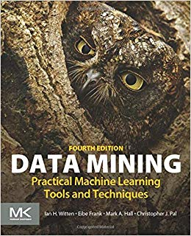
Administrative slide
Check circulated class list
Office hours:
Monday, Wednesday, Friday 9:30 am to 11:00 am
Lecture
3 lectures per week, 50 minutes each
Textbook ($30 on amazon)
Data Mining – Practical Machine Learning Tools and Techniques
Assignments (45%), Midterm (25%), Final Project (30%)
Software:
Linux, Mac, or Windows
Basic coding requirements (python)

Slide 3
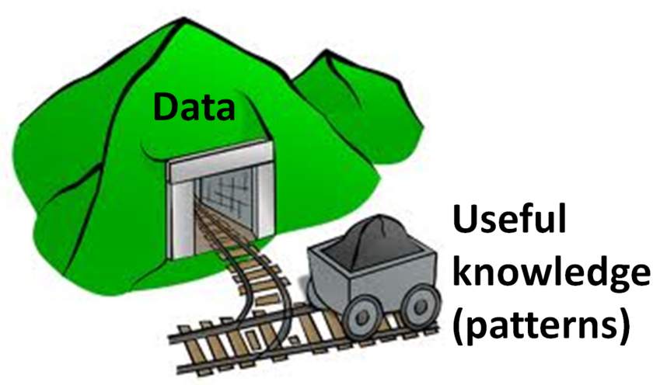
Goal of the course
Learn how to use machine learning algorithms to extract useful information from data and make predictions
Basic theoretical foundation (algorithms + math)
Basic practical implementation (numpy + scikit-learn)
Develop intuition for data
Pitfalls, artifacts, and spurious results
Qualify for data scientist jobs, pass interviews

Slide 4
Preface
What is data mining?
Data mining is the extraction of implicit, previously unknown, and potentially useful information from data
Handling real data
Missing values, imperfect predictions, etc.

Slide 5
Machine learning
The process of machine learning is one of abstraction
Machine learning enables acquisition of structural descriptions from examples
Prediction
Forecasting what will happen in new situations
Structural descriptions
Generate insights for practical applications
To apply machine learning productively, need to understand how the algorithms work

Slide 6
Overview part 1
Machine learning methods will be covered at successive levels of detail
Chapter 1 – What’s it all about?
What is machine learning, where is it used, examples of applications
Chapter 2 – Input
Instances and attributes
Chapter 3 – Output
Knowledge representation
Chapter 4 – Algorithms: the basic methods
Describe basic methods in simplified form
Chapter 5 – Credibility: evaluating what’s been learned
Need to be able to measure how well we are doing

Slide 7
Overview part 2
Advanced techniques of machine learning for data mining
Chapter 6 – trees and rules
Low level issues, complexities of putting into practice
Chapter 7 – extending instance-based and linear models
Low level issues, complexities of putting into practice
Chapter 8 – Data transformations
Selecting and discretizing attributes
Loosely cover chapters 9, 10, 11
Probabilistic methods (9), deep learning (10), semi-supervised (11)
Chapter 12 – Ensemble learning
Combining output from different machine learning techniques

Slide 8
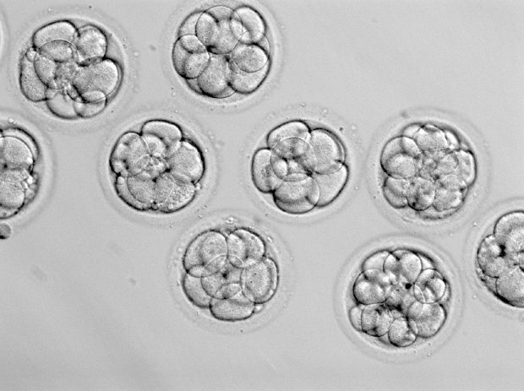
Chapter 1: What’s it all about?
This course is about machine learning techniques for data mining
Human in-vitro fertilization
Selection of embryo based on ~60 features
Problem: Difficult for embryologist to perform comprehensive assessment and compare by hand with historical data
Solution: Apply machine learning using historical data and outcomes of embryos as training data

Slide 9
Patterns in data
This course is about looking for patterns in data
What is a data scientist’s job?
Discover patterns governing process being measured
Encapsulate these patterns into rules/theories
Predict what will happen in new situations
Data mining is about solving problems by analyzing data already present in databases
Customer loyalty example
Data mining is defined as the process of discovering patterns in data

Slide 10
Describing structural patterns
What is meant by a structural pattern?
How do you describe them?
What form does the input take?

Slide 11
Contact lens dataset
Age | Spectacle Prescription | Astigmatism | Tear Production Rate | Recommended Lenses
Young | Myope | No | Reduced | None
Young | Myope | No | Normal | Soft
Young | Myope | Yes | Reduced | None
Young | Myope | Yes | Normal | Hard
Young | Hypermetrope | No | Reduced | None
Young | Hypermetrope | No | Normal | Soft
Young | Hypermetrope | Yes | Reduced | None
Young | Hypermetrope | Yes | Normal | Hard
Prepresbyopic | Myope | No | Reduced | None
Prepresbyopic | Myope | No | Normal | Soft
Prepresbyopic | Myope | Yes | Reduced | None
Prepresbyopic | Myope | Yes | Normal | Hard
Prepresbyopic | Hypermetrope | No | Reduced | None
Prepresbyopic | Hypermetrope | No | Normal | Soft
Prepresbyopic | Hypermetrope | Yes | Reduced | None
Prepresbyopic | Hypermetrope | Yes | Normal | None
Presbyopic | Myope | No | Reduced | None
Presbyopic | Myope | No | Normal | None
Presbyopic | Myope | Yes | Reduced | None
Presbyopic | Myope | Yes | Normal | Hard
Presbyopic | Hypermetrope | No | Reduced | None
Presbyopic | Hypermetrope | No | Normal | Soft
Presbyopic | Hypermetrope | Yes | Reduced | None
Presbyopic | Hypermetrope | Yes | Normal | None
What are the inputs/outputs?
3 possible values for age
2 values each for Prescription
2 values for Astigmatism
2 values for Tear Production Rate
Structural description (rules):
If Tear Production Rate = Reduced, then Recommendation = None
Otherwise, if Age=Young and Astigmatic=No, then Recommendation=Soft
Do these rules generalize from the data, or merely summarize it?

Slide 12
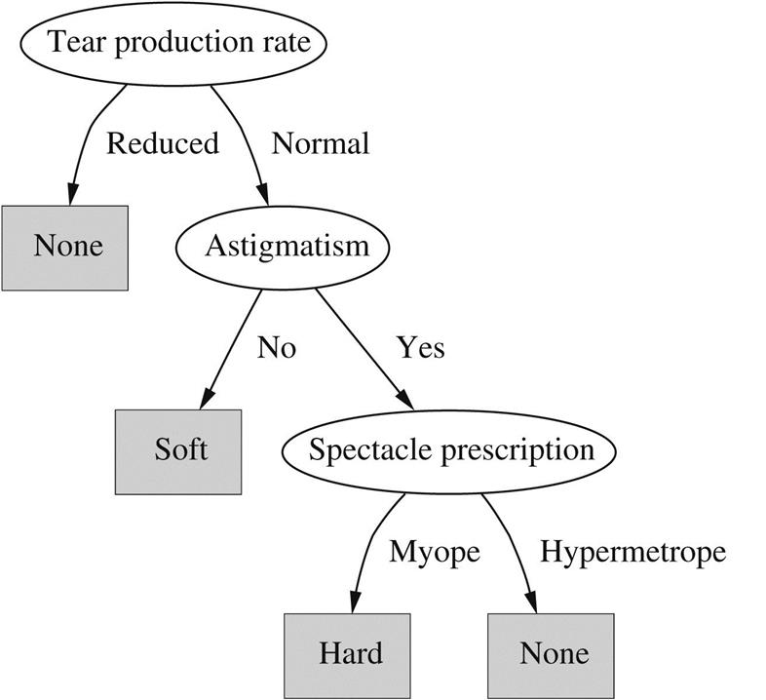
Decision tree for contact lens data
Another type of structural description
Successive testing of attributes
Eventually a leaf is reached

Slide 13
What is learning?
We are interested in improvements in performance
Things learn when they change their behavior in a way that makes them perform better in the future
Training vs learning: vine example, slipper example
These conceptual problems do not arise in the techniques we will discuss
Input data will take the form of a set of examples
Output will take the form of predictions on new examples
In many applications, structural description is at least as important as classification accuracy

Slide 14

Weather dataset
Outlook | Temperature | Humidity | Windy | Play
Sunny | Hot | High | False | No
Sunny | Hot | High | True | No
Overcast | Hot | High | False | Yes
Rainy | Mild | High | False | Yes
Rainy | Cool | Normal | False | Yes
Rainy | Cool | Normal | True | No
Overcast | Cool | Normal | True | Yes
Sunny | Mild | High | False | No
Sunny | Cool | Normal | False | Yes
Rainy | Mild | Normal | False | Yes
Sunny | Mild | Normal | True | Yes
Overcast | Mild | High | True | Yes
Overcast | Hot | Normal | False | Yes
Rainy | Mild | High | True | No
Will John play?
Several standard datasets we will come back to repeatedly
We can create a structural description of this dataset using a decision list as follows:
If Outlook=Sunny and Humidity=High then Play=No
If Outlook=Rainy and Windy=True then Play=No
If Outlook=Overcast then Play=Yes
If Humidity=Normal then Play=Yes
If none of the above then Play=Yes

Slide 15
Weather dataset
Outlook | Temperature | Humidity | Windy | Play
Sunny | Hot | High | False | No
Sunny | Hot | High | True | No
Overcast | Hot | High | False | Yes
Rainy | Mild | High | False | Yes
Rainy | Cool | Normal | False | Yes
Rainy | Cool | Normal | True | No
Overcast | Cool | Normal | True | Yes
Sunny | Mild | High | False | No
Sunny | Cool | Normal | False | Yes
Rainy | Mild | Normal | False | Yes
Sunny | Mild | Normal | True | Yes
Overcast | Mild | High | True | Yes
Overcast | Hot | Normal | False | Yes
Rainy | Mild | High | True | No
Several standard datasets we will come back to repeatedly
We can create a structural description of this dataset using a decision list as follows:
If Outlook=Sunny and Humidity=High then Play=No
If Outlook=Rainy and Windy=True then Play=No
If Outlook=Overcast then Play=Yes
If Humidity=Normal then Play=Yes
If none of the above then Play=Yes

Slide 16
Weather dataset
Outlook | Temperature | Humidity | Windy | Play
Sunny | 85 | 85 | False | No
Sunny | 80 | 90 | True | No
Overcast | 83 | 86 | False | Yes
Rainy | 70 | 96 | False | Yes
Rainy | 68 | 80 | False | Yes
Rainy | 65 | 70 | True | No
Overcast | 64 | 65 | True | Yes
Sunny | 72 | 95 | False | No
Sunny | 69 | 70 | False | Yes
Rainy | 75 | 80 | False | Yes
Sunny | 75 | 70 | True | Yes
Overcast | 72 | 90 | True | Yes
Overcast | 81 | 75 | False | Yes
Rainy | 71 | 91 | True | No
Numerical vs nominal attributes
Here, the first rule might take the form:
if Outlook=Sunny and Humidity>83 then Play=No
Association rules
If Temperature=Cool then Humidity=Normal
If Windy=False and Play=No then Outlook=Sunny and Humidity=High

Slide 17
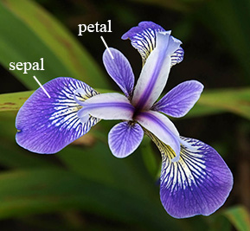
Iris dataset
Instance # | Sepal Length | Sepal Width | Petal Length | Petal Width | Type
1 | 5.1 | 3.5 | 1.4 | 0.2 | Iris setosa
2 | 4.9 | 3.0 | 1.4 | 0.2 | I. setosa
3 | 4.7 | 3.2 | 1.3 | 0.2 | I. setosa
4 | 4.6 | 3.1 | 1.5 | 0.2 | I. setosa
5 | 5.0 | 3.6 | 1.4 | 0.2 | I. setosa
…
51 | 7.0 | 3.2 | 4.7 | 1.4 | Iris versicolor
52 | 6.4 | 3.2 | 4.5 | 1.5 | I. versicolor
53 | 6.9 | 3.1 | 4.9 | 1.5 | I. versicolor
54 | 5.5 | 2.3 | 4.0 | 1.3 | I. versicolor
55 | 6.5 | 2.8 | 4.6 | 1.5 | I. versicolor
…
101 | 6.3 | 3.3 | 6.0 | 2.5 | Iris virginica
102 | 5.8 | 2.7 | 5.1 | 1.9 | I. virginica
103 | 7.1 | 3.0 | 5.9 | 2.1 | I. virginica
104 | 6.3 | 2.9 | 5.6 | 1.8 | I. virginica
105 | 6.5 | 3.0 | 5.8 | 2.2 | I. virginica
…
Following rules might be learned from this dataset
If petal-length < 2.45 then Iris-setosa
If sepal-width < 2.10 then Iris-versicolor
If sepal-width < 2.45 and petal-length < 4.55 then Iris-versicolor
If sepal-width < 2.95 and petal-width < 1.35 then Iris-versicolor
…etc. (15 rules total)
cumbersome

Slide 18
CPU performance dataset
Numeric prediction (both outcome and attributes are numeric)
Write the outcome as a linear sum of weighted attribute values
 | Cycle Time (ns) | Main Memory (Kb) |  | Cache(KB) | Channels |  | Performance
 |  | Min | Max |  | Min | Max
 | MYCT | MMIN | MMAX | CACH | CHMIN | CHMAX | PRP
1 | 125 | 256 | 6000 | 256 | 16 | 128 | 198
2 | 29 | 8000 | 32,000 | 32 | 8 | 32 | 269
3 | 29 | 8000 | 32,000 | 32 | 8 | 32 | 220
4 | 29 | 8000 | 32,000 | 32 | 8 | 32 | 172
5 | 29 | 8000 | 16,000 | 32 | 8 | 16 | 132
…
207 | 125 | 2000 | 8000 | 0 | 2 | 14 | 52
208 | 480 | 512 | 8000 | 32 | 0 | 0 | 67
209 | 480 | 1000 | 4000 | 0 | 0 | 0 | 45

Slide 19
Fielded applications
So far we have only seen toy problems, deliberately chosen to be small
What about machine learning applications that have actually been put to use?
Loan qualification
Machine fault diagnosis
Market basket analysis
Brain activity denoising

Slide 20

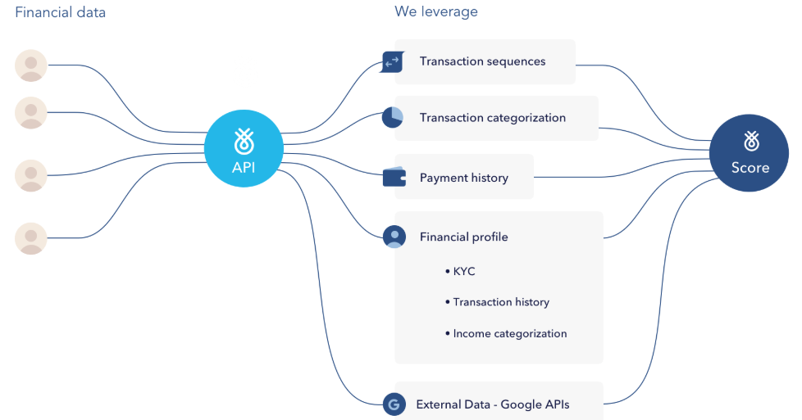
Loan qualification
Bank wants to know which customers will default
Input: bank activity transaction statement (Financial data)
Output: probability of person repaying their loan (Score)
Flinks challenge (final project)

Slide 21
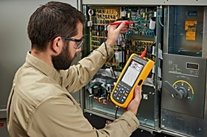
Machine fault diagnosis
Preventative maintenance of electromechanical devices
Dataset of measurements from 600 faulty devices acquired and classified by expert with 20 years of experience
Rule induction algorithm applied to dataset, producing a set of diagnostic rules
Learned rules superior to expert’s handcrafted rules
System put into place because expert approved

Slide 22
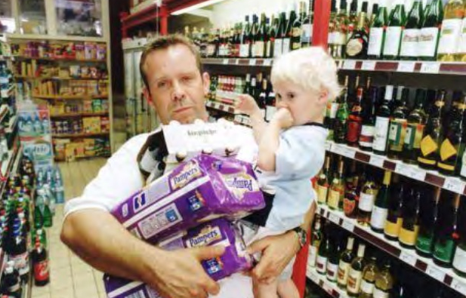
Market basket analysis
Use association techniques to find groups of items that tend to occur together in transactions
Example: on Thursdays, customers often purchase beer and diapers together
Use this info to plan store layout, offer coupons for matching products, etc.

Slide 23
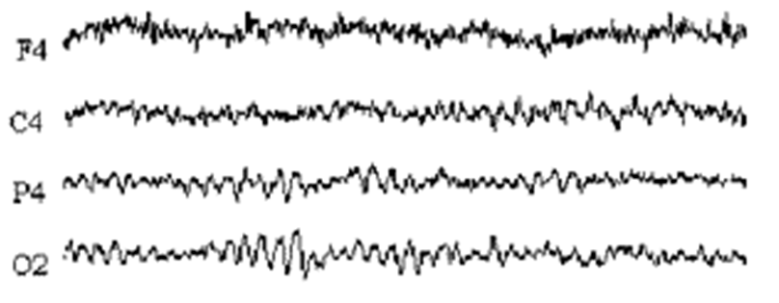

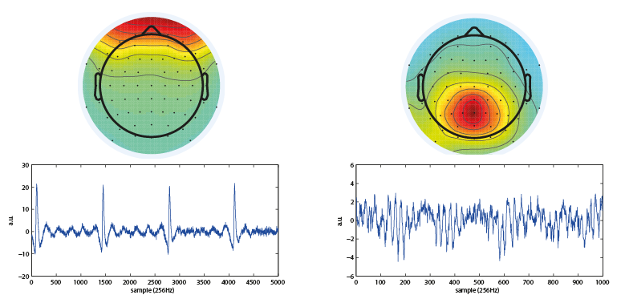
Brain activity denoising
Electroencephalography records a mixture of neuronal and muscular activity
Use independent component analysis (ICA) to unmix these different signals
P4
F4
Eye-blink
component
Visual cortex component

Slide 24
Recap
Data mining is defined as the process of discovering patterns in data
We will use small toy examples to gain intuition about how machine-learning algorithms work
Some assignments and final project will involve solving real world problems using machine-learning in python
Next lecture: chapter 2 and python examples

