Slide 1
Healthy human EEG variability
Russell Butler
Phd Proposal/pre-doc presentation

Slide 2
Healthy human EEG
Sum of all neurons
Depends on distance and curvature

Slide 3
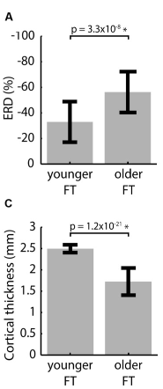
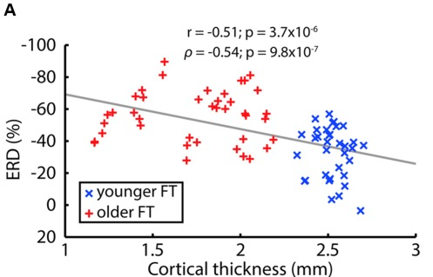
Problem: inter-subject variability >> inter population variability
Problem with using EEG as a functional measure?
The variability with individuals is much greater than across populations
example:

Slide 4


Conceptually, why do we care?
Male/female, liberal/right wing
Different responses to different stimuli
Can EEG detect these population specific response differences?

Slide 5
Caveat(s)?
Non-brain variability my be related to the effect we are trying to measure
Ex: male/female, have different skull thickness
(does not matter for previous example, but maybe in others)

Slide 6
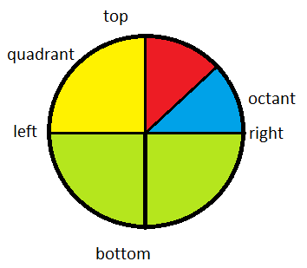

Stimulus/subjects
Retinotopic mapping (10 subjects, 30 areas/subject)
300 areas/visual responses
Ideally more subjects, but easier to collect many areas

Slide 7
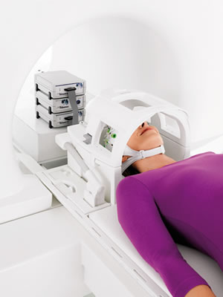
Methods:
Need to know structure and function ground truth
MRI/FMRI
Simultaneous EEG-FMRI

Slide 8
EEG metrics?
Event-related potential? (ERP)
Can look at latency
Event-related spectral perturbation? (ERSP)
Can look at multiple frequencies and peak frequency
Phase?

Slide 9
Results:
Inter-subject variability – depends on what?
1 brain area, 10 subjects
Intra-subject variability – depends on what?
1 subject, 30 brain areas
EEG/ERP not correlated, so which is a better measure of structure?
Which frequency band is most linked to structure?
Sounds crazy because EEG has been around for so long but none of this is currently known

