Slide 1
Host Transmission Cycles
Process Explained

Slide 2
Host Transmission Cycles (aka POS)
  What is a host Transmission/POS cycle?
Host transmission cycles indicate when changes made in the system (CMS) will be effective in a store
Transmission cycles can differ by division
Knowing these cycles are important for pricing accuracy as well as keeping our tag counts low
File Maintenance Clerk schedules are based around the host transmission cycles
Notes:
POS Cycles explained:
Each transmission indicates when changes made in CMS will be effective at store level.
Cycles may vary by division, so it is important to know the POS schedule for each division.
Safeway as a whole has a tag count initiative (to help reduce operating cost), and utilizing the POS schedule helps to manage tag count and the impact to stores.

Slide 3
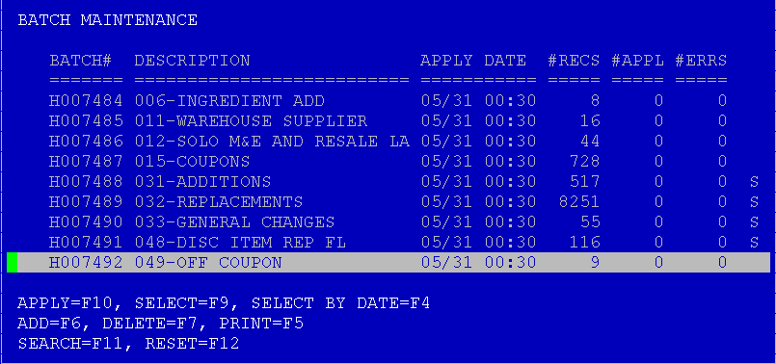
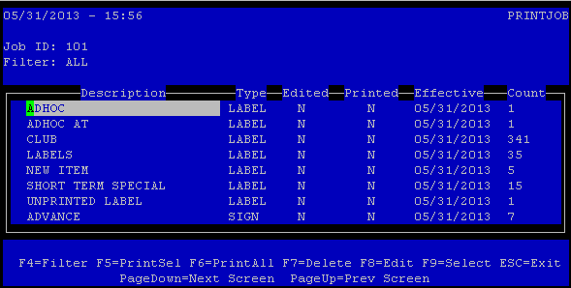
Host Transmission Cycles
Data flows from our CMS system and gathers in the stores database in a batch
The File Maintenance Clerk (FMC) analyzes the batch and prints the tags
Stores have multiple batches on ad day (Wednesday)
  First transmission
    Tags are forecasted for this transmission; stores can plan for the number of tags that will print
  Correction batch
    Tags are not forecasted; these are last minute changes that the store cannot plan for
Notes:
The first batch forecast has a buffer for last minute entries
Divisions that have a Monday for Wed first batch- although we are not able to catch these last minute entries in the forecast for the week, each division is given a buffer for these promotions.
The buffer is an estimated # of tags that will be sent down in the first batch, along with the forecasted amount.
Stores receive hours based off the # of tags that are being sent on Wednesday. Schedules are made based on the allotted hours

Slide 4

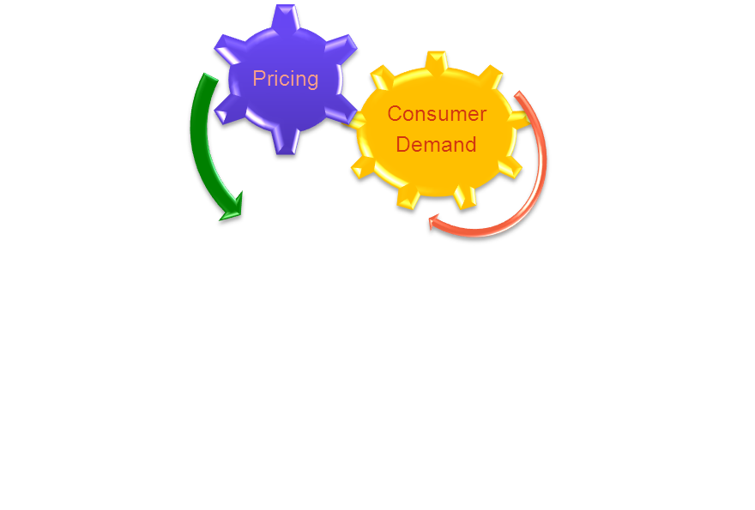
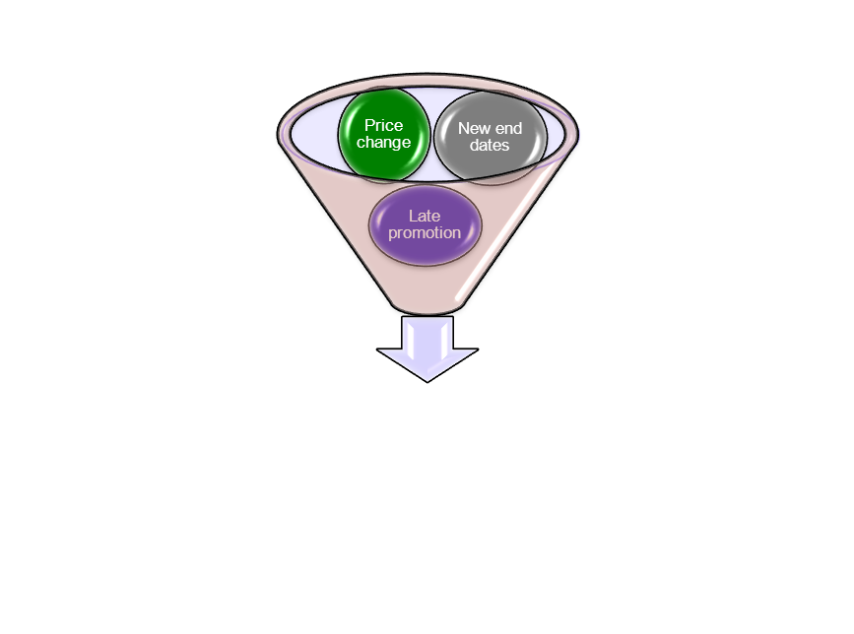
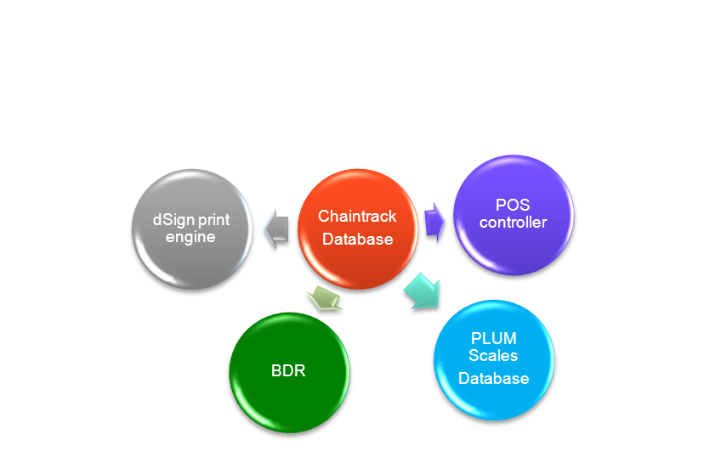

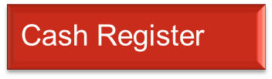






How Information Gets to the Stores
Consumer demand enters promotions into RTPP. CMS entries are priced
HOST
Information flows to the store’s database
A series of mainframe computers located in Salt Lake City, Utah, that allows on-line communication and transfer of data to Safeway Stores
Notes:
Information flows from the host
To the stores’ data base
Is sent to several store server locations
And then to the additional store locations

Slide 5
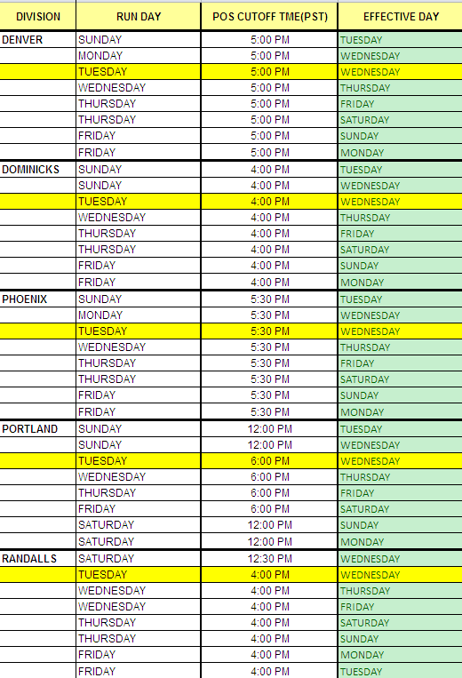
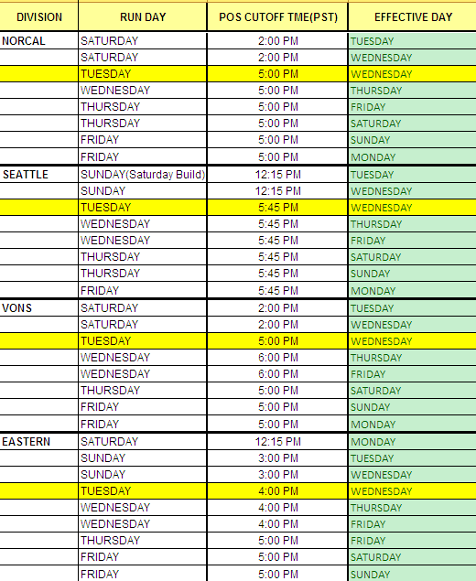
Host Transmission Schedule
Notes:
Cutoff Times indicate when the pricing data will be pulled for transmission. Promotional entries will not be priced after the cutoff time.
Yellow days (usually Tuesdays) are the Correction Batch (more details to come).
Schedules differ by division.

Slide 6
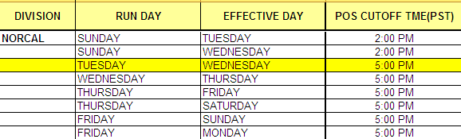


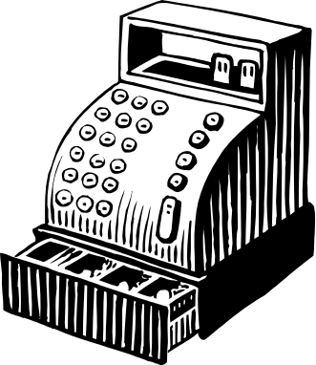
Run Day vs Effective Day
When the information is pulled from our system
Promotional entries should not be priced after transmission cut off – it will create contention issues that delays batch delivery to the stores
When the information is effective in the stores
Notes:
Run Day vs Effective Day:
Run Day = the day information is pulled from our system and sent to the store data base
Effective Day = the day stores analyze the data and it becomes active in their store

Slide 7
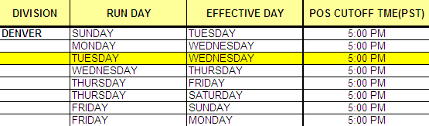
Example: Denver
Correction batch
Today is Monday 6/3
Promotion starts on Wednesday 6/5
Notes:
EX: looking at Denver and their POS cycles…
Pretend today is Monday 6/3 and you notice there is a promotion starting Wed 6/5 that is not yet priced. This promotion can be priced without issues today (Monday/First Batch) as long as its done before the 5pm cutoff. But if it is priced after 5pm Monday or on Tuesday (before 5pm) then it will be included in the Correction Batch, and create unforecasted work for the stores. In both cases the stores will receive the promo tag in time for Wednesday (the start of the promotion). However, use of the Correction Batch should be reserved only for urgent issues as it

Slide 8
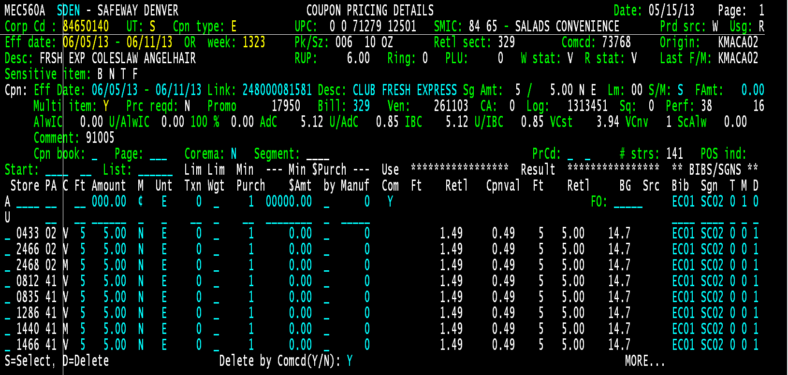
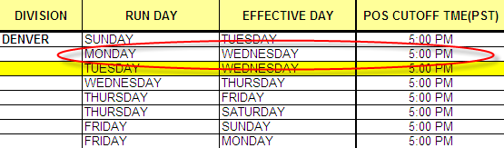
Example: Denver
Notes:
If you price this entry today, it will flow to the store for Wednesday 6/5, however it will be in their first batch

Slide 9
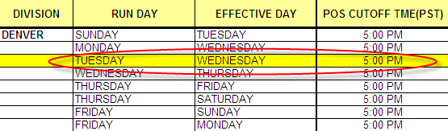
Example: Denver
If you price the entry after 5:00pm today or on Tuesday 6/4 it will flow to the store for Wednesday, and will be captured in their correction batch
Notes:
If you price the entry after the cut off time Monday, then it will be captured in their correction batch.
Anything priced after 5pm on Monday is considered to be priced on Tuesday. All entries priced Tuesday flow in the correction batch
It is important to remember that the correction batch is not forecasted

Slide 10
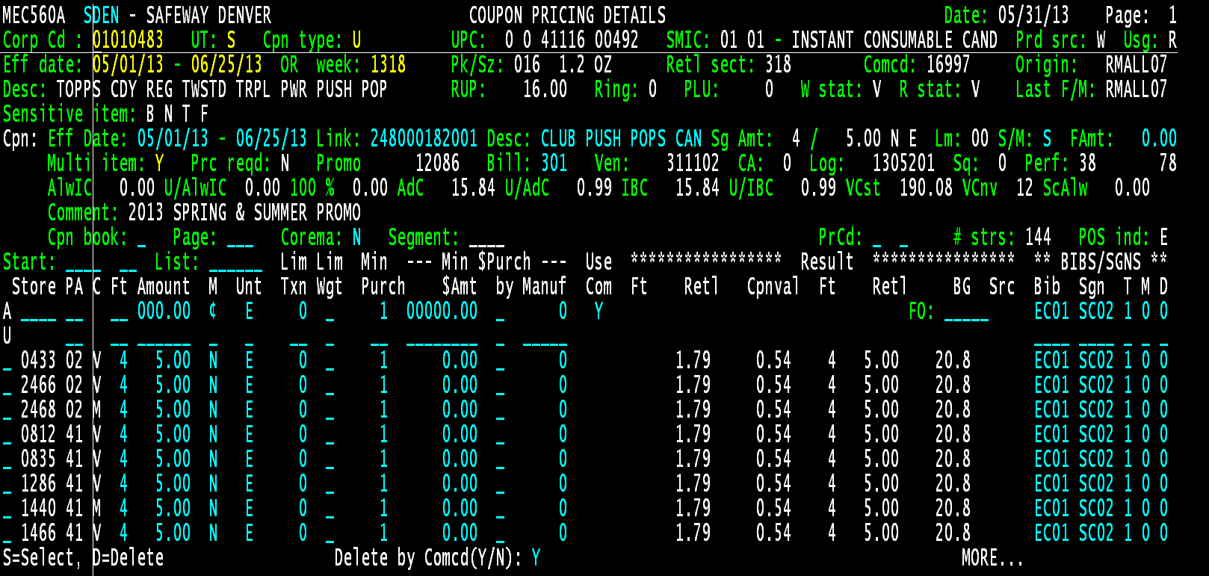
How Do I Impact the Stores
When POS has pulled on an item, the POS indicator will show E. This means tags have been sent to the store and will print in the first transmission before the start of the promotion.
Notes:
If you look at this promotion it started on 5/1. today is 6/4 so the POS is E, because this information has already been sent to the stores and tags are hung.
If today 6/4 to make a change to this promotion (price change, tag id change, end date change) when will the information pull from the system and be sent to the stores?
What batch will it be captured in?

Slide 11

How Do I Impact the Stores
When you make a change to an entry that has POS:E you are sending new tags to the stores (new price, change End Date, different Tag ID)
Notes:
The correction batch is intended to be used for Ad corrections or IMPORTANT changes. If the change made above was to extend the end date to 6/30, then you can wait until tomorrow to make the change, and send the new tags down in the Thursday transmission. The cycles that are not on ad days tend to be on the smaller side, there for making it easier for the stores to capture all the price changes.

Slide 12
Things to Remember
Host Transmission/POS cycles are important to help maintain pricing accuracy and to keep tag counts low
Stores schedule FMC hours based on the tag counts forecasted for the first transmission.
  Sending a large correction batch can overwhelm the stores and put them behind in updating price changes

