Slide 1
Predict Amazon Game review Ratings using PCA
By Zi (Russ) Gu

Slide 2
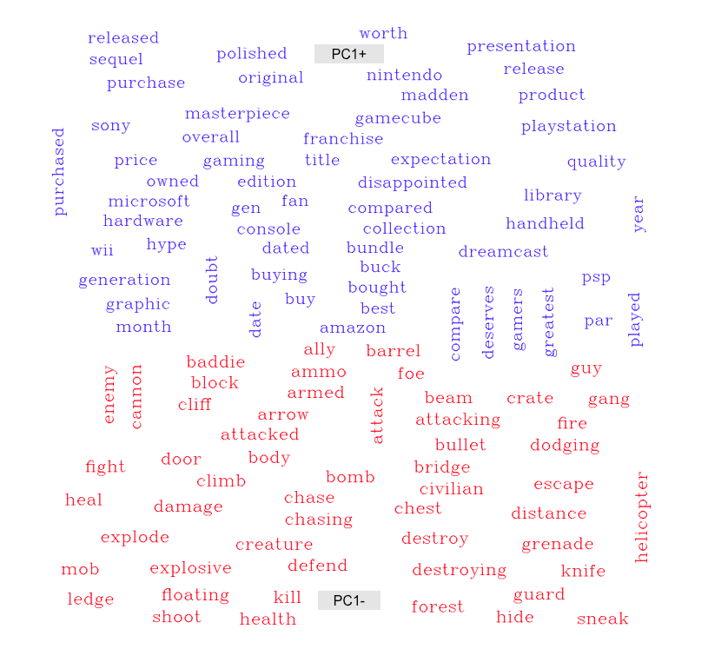

Slide 3
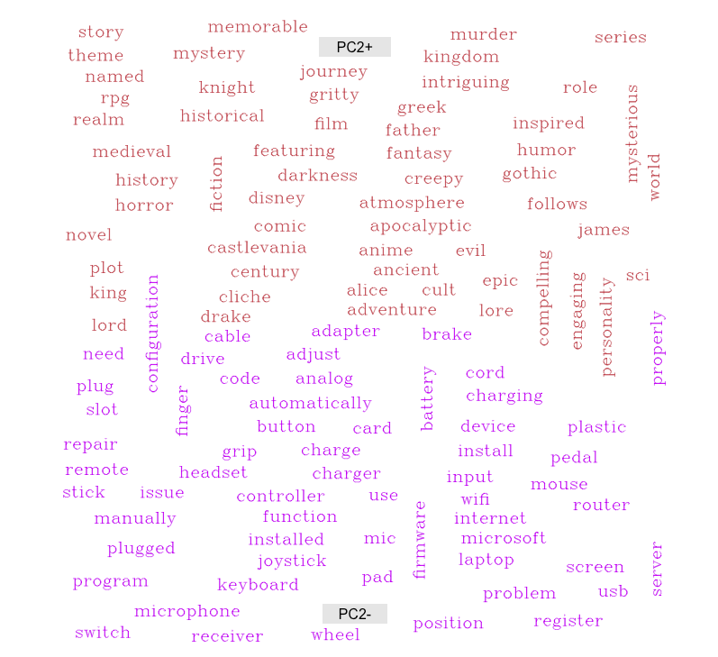

Slide 4
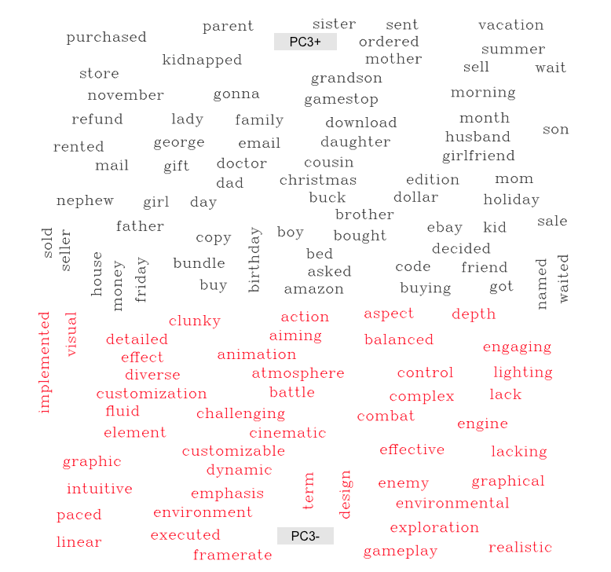

Slide 5
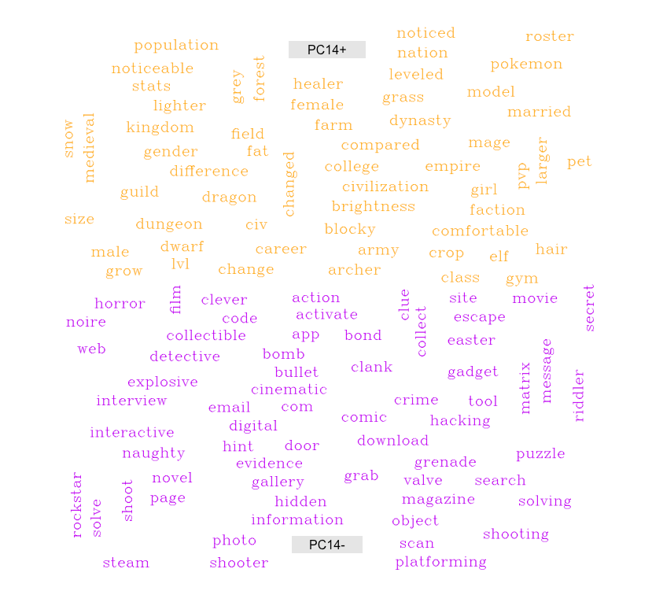

Slide 6
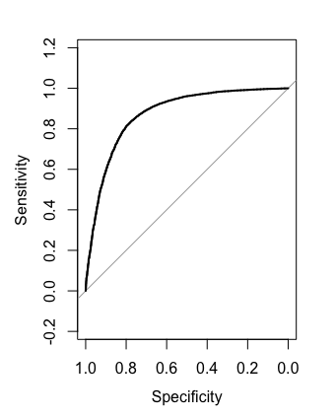

Bag of Words
PCA Features
90/10 split
Notes:
2.5% less error rate

