Slide 1
A/B Testing & Multi-Armed Bandit
By Zi (Russ) Gu

Slide 2
Because he A/B tested on that button
2007 Presidential Campaign, Google product manager Dan Siroker headed the “new media analytics” team in Obama’s campaign and introduced a DONATE button from Google web practice and won $57 million of additional donations.
Why was it so successful?

Slide 3
What’s A/B Testing?

Slide 4
A/B Testing:
Having two versions of the same feature on a product tested by two
groups of users in same size, and finally have all of the users using
the better version of the product.
For example, the colors, images, text, ads, or prices you see—all
the features of a webpage is tuned to best exploit the user’s attention
and likelihood to click on the buttons where the company want them
to click.

Slide 5
Classic A/B Test Setup:
1. Split the traffic evenly between two options
2. Run the test for a set period of time
3. Thereafter giving all the traffic to the winner
Notes:
Example Process of A/B testing:
1. Ask a question: "Why is the bounce rate of my website higher than industry standard?"
2. Do background research: Understand your visitors' behavior using Google Analytics and any other analytics tools running on your website.
3. Construct a hypothesis: "Adding more links in the footer will reduce the bounce rate".
4. Calculate the number of visitors/days you need to run the test for:Always calculate the number of visitors required for a test before starting the test. You can use our A/B Test Duration Calculator.
5. Test your hypothesis: You create a site with A/B test in which the variation (version B) has a footer with more links. You test it against the original and measure bounce rate.
6. Analyze data and draw conclusions: If the footer with more links reduces bounce rate, then you can conclude that increased number of links in the footer is one of the factors that reduces bounce. If there is no difference in bounce, then go back to step 3 and construct a new hypothesis.
7. Report results to all concerned: Let others in Marketing, IT and UI/UX know of the test results and insights generated.

Slide 6
Case Study: SONY
Notes:
https://www.optimizely.com/case-studies/sony/

Slide 7
Context:
SONY found out that bounce rates were higher than average in the last few steps of the funnel—on the pages that asked shoppers to make additional customizations to the products in their shopping cart.
Notes:
Bounce rate: the rate at which users leave the page after viewing the page
From website analytics, the SONY online customer experience team learned that bounce rates were higher than average in the last few steps of the funnel—on the pages that asked shoppers to make additional customizations to the products in their shopping cart.

Slide 8
Action: A/B Testing
Formed Hypothesis:
Shoppers frustrated by the extra steps + more time
to develop extra thoughts
Created a different version of the checkout:
Shorter product descriptions + fewer required fields
+ more pre-selected choices. Split the traffic evenly.
Expectation:
This would drive more purchases
Notes:
The team hypothesized that shoppers assumed they were just about to finish their purchase and were frustrated by the extra steps. Plus, the longer funnel gave shoppers more time to develop second thoughts about their purchases.
To solve for this problem, Sony tested a streamlined version of the checkout. This new funnel had shorter product descriptions, fewer required fields, and more pre-selected choices. Sony hoped that the streamlined option would improve the experience and drive more purchases overall.

Slide 9
Result:
The more streamlined checkout flow increased
online orders by 20.6%, resulting in a significant
increase in online revenue for Sony.

Slide 10
Testing helps you make decisions
based on objective results, not subjective guesses.
It’s a good way to be in touch with how the customers react to the content of your website.
— Evelien Geerens, Web Merchandiser, Sony
Notes:
This is very important because testers would often have the expectation that’s completely opposite from what the result shows. Therefore, it illustrates how A/B testing is important because it delivers results from the clients and gives you a reality check against your subjective expectations.

Slide 11
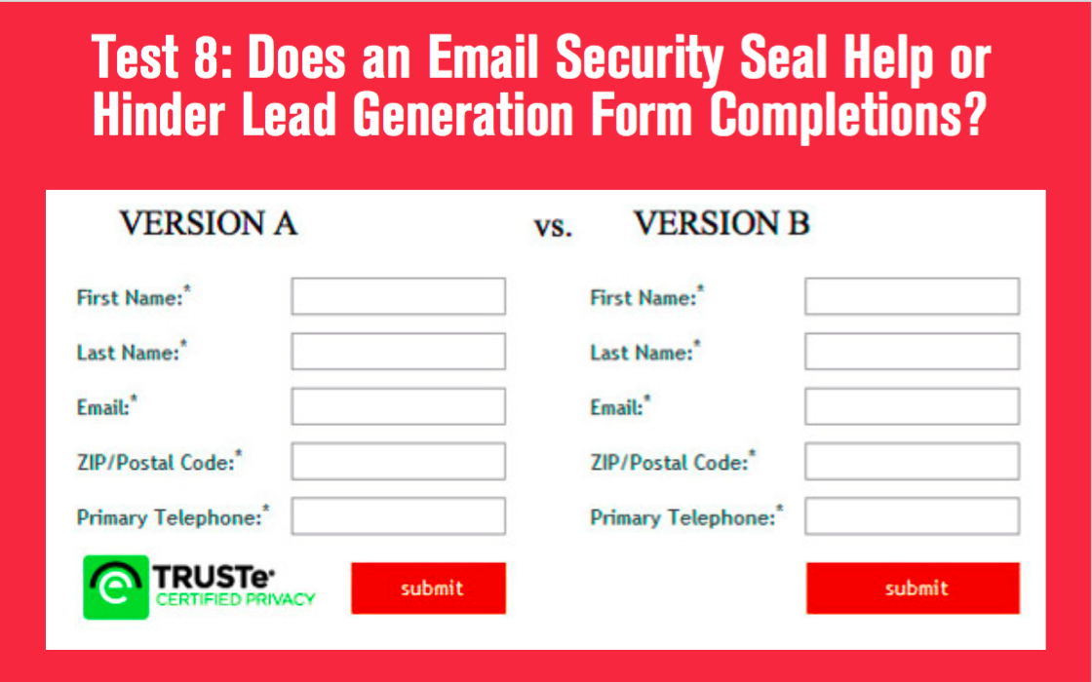

Slide 12
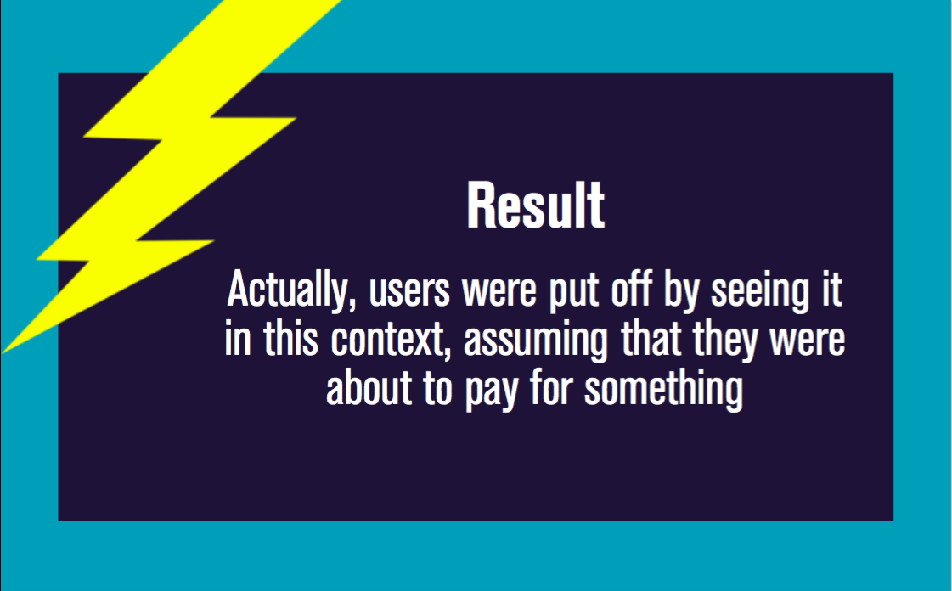

Slide 13
To launch a successful A/B Test, one must:
Form a hypothesis rather than testing random ideas
Let the result speak rather than your subjective guesses
Have sufficient traffic so the results are statistically significant
(A/B significance calculator)
Have sufficient time (time calculator)
If an idea is almost certainly will improve conversion, and
implementing it requires little risk, then skip A/B testing.
Notes:
Traffic: the more traffic you have, the less time it is needed to run the test, because greater sample size leads to greater significance
Time: For Sony they have like several thousands visitors on their webpage per day or even more, therefore they might need less time to run the test.
Skip: Since time is a valuable resource, do skip A/B testing if situation allows

Slide 14
What if I have multiple versions to test?
Test them one against the other sequentially

Slide 15
But that takes a long time
and some options would
be obviously suboptimal in the process.
Do I just waste my time
and wait until the final result?

Slide 16
Multi-Armed Bandit
(MAB)

Slide 17
Multi-Armed Bandit Problem:
Exploration phase:
For 10% of the time, you split your traffic equally between
the two versions
Exploitation phase:
For the rest 90% of the time, you send traffic to currently best
performing version
Continue exploring and exploiting…
Notes:
They’re more efficient because they move traffic towards winning variations gradually, instead of forcing you to wait for a “final answer” at the end of an experiment. They’re faster because samples that would have gone to obviously inferior variations can be assigned to potential winners. Furthermore, they contain a built-in way to deal with issues like seasonality that confound A/B tests.
Back to Sony, they could also do multi-armed bandit if they are to test different versions of the checkout funnel while not losing too much conversion/money during the test

Slide 18
Then why don’t we just use MAB
instead of A/B?

Slide 19
Bandit VS. A/B
Bandit:
Higher Conversion Rate
Greater number of traffic required
Greater amount of time taken for statistical significance
A/B:
Lower Conversion Rate
Smaller number of traffic required
Smaller amount of time taken for statistical significance
Notes:
What multi-armed bandit algorithm does is that it aggressively (and greedily) optimizes for currently best performing variation, but because MAB methods don’t usually test any one variable for a long time, they take a long time to produce results that are statistically significant, because you don’t know whether the variation is “really” worse performing or the current worse performance is due to random chance
Therefore it makes them a better choice for some but not all marketing purposes.

Slide 20
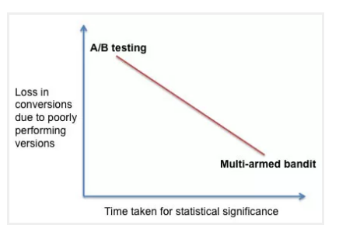
Trade off Between Conversion & Time
Notes:
https://vwo.com/blog/multi-armed-bandit-algorithm/

Slide 21
Suggestion:
For long tests MAB can be the better method
and for middle and relatively shorter tests
A/B can be better.

