Slide 1
Ship Spotting with CNN Image Recognition
Russell Perry

Slide 2
The Goal

Slide 3
The Goal: Satellite Image Analysis
Feature recognition from satellite images is used for research, industry, and government.
“Remote sensing”
The simplest problems in satellite image analysis have distinct features.
Spotting ships in harbor is a basic starting point.

Slide 4
The Data

Slide 5
The Data: Kaggle - Ships in Satellite Imagery
Data consists of 4000 labeled image tiles from satellite photos.
1000 contain image-centered ships, 3000 contain scenes such as partial ships, docks, bridges, and land.
Each tile is 80 x 80 color pixels, with 3 color channels. Pixels are orthorectified to 3 meters - some ships are as much as 30 meters across.
www.kaggle.com/rhammell/ships-in-satellite-imagery/

Slide 6

The Data: Verification
Do array lengths match up?
Checked for NaN values in the data?
Do pixel values make sense? In range?
The Data: Reshaping
Images came as a nested list of 1D arrays with 19200 values, 6400 of each color.
Numpy has quick reshaping and transforming functions.
60:20:20 train:test:validation split

Slide 7
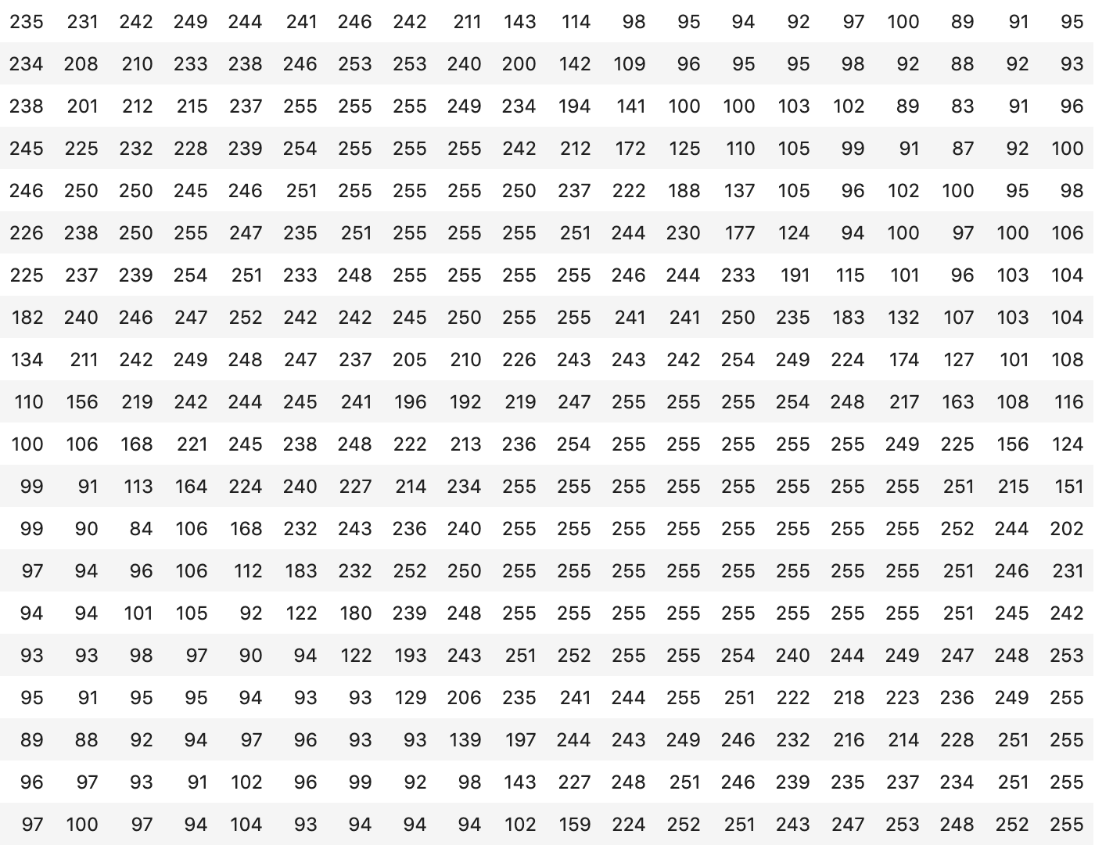
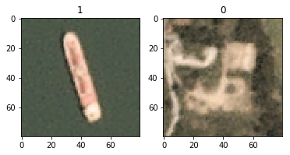
The Data: Result of Reshaping

Slide 8
The Algorithm

Slide 9
The Algorithm: Convolutional Neural Network Overview
CNNs are the algorithm of choice for image recognition. Highlights the features of an image.
Feature matrices are flattened and fed to a regular 1D Neural Networks (fully connected in this case) for classification.
Prabhu, Medium, Understanding of Convolutional Neural Network (CNN)

Slide 10
The Algorithm: Layers Description
Parameters build up fast due to dimensions at play.
n_{f1}
n_{f2}
k_{f2}
w₁
w₂
w₃
...
...
H
k_{f1}
k_{f2}
k_{f1}
D
W
Image
Convolution
Convolution
Or Max Pool
Flatten
to 1-Dimension
Pass to
traditional NN
Approx. #
Output
Parameters:
...
n_{f1} * 2D Filters
(k_{f1} * k_{f1}) * D
n_{f1} * n_{f2} * 2D Filters
(k_{f2} * k_{f2}) * D

Slide 11
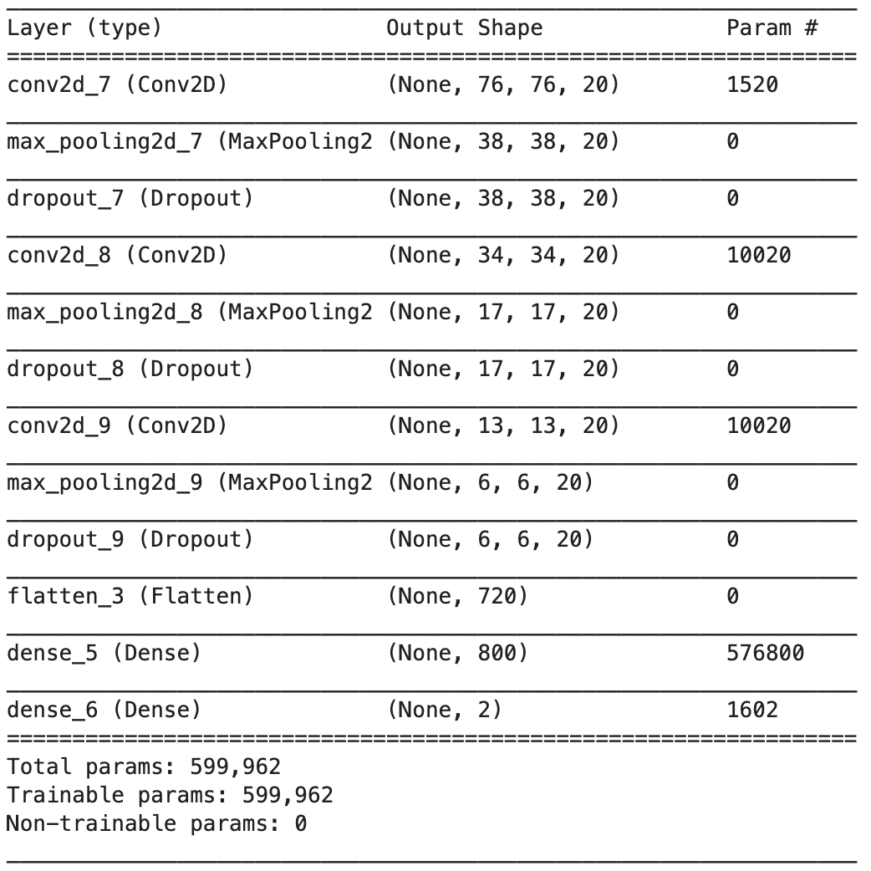
The Algorithm: Layers Description
12 Epochs
5x5 Kernel
3 Convolution layers
2 Dense layers

Slide 12
The Algorithm: Approach
CNN model uses three primary functions, beyond choices such as number/type/order of layers.
Activation
Loss
Optimization (algorithm)
Imagine throwing a bouncy ball into a bowl.
How bouncy?
How steep a bowl?
How do you change the bounciness and modify your throw for next time?
Try them all!

Slide 13
Classification & Validation

Slide 14
Classification & Validation: Concerns
Accuracy is a decent metric, but prone to simply represent data distribution.
Loss function may be good, but if testing multiple loss functions it’s not good for comparison between models.
Confusion matrix is great, allows for comparison between models.
Add in a precision and recall report for an effective trifecta.

Slide 15
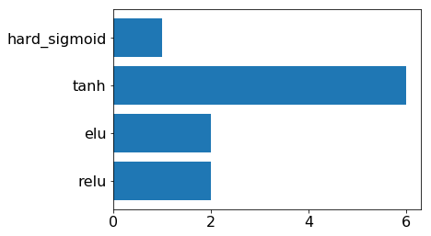
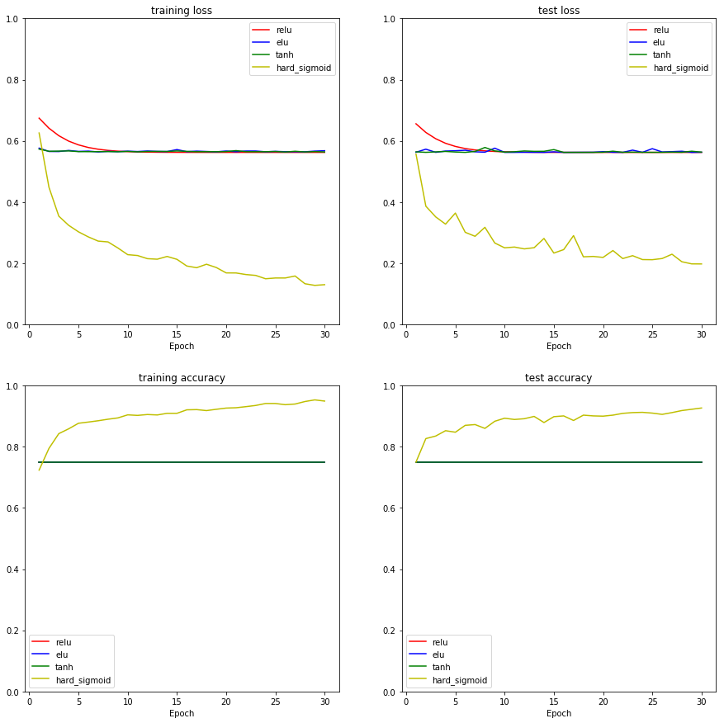
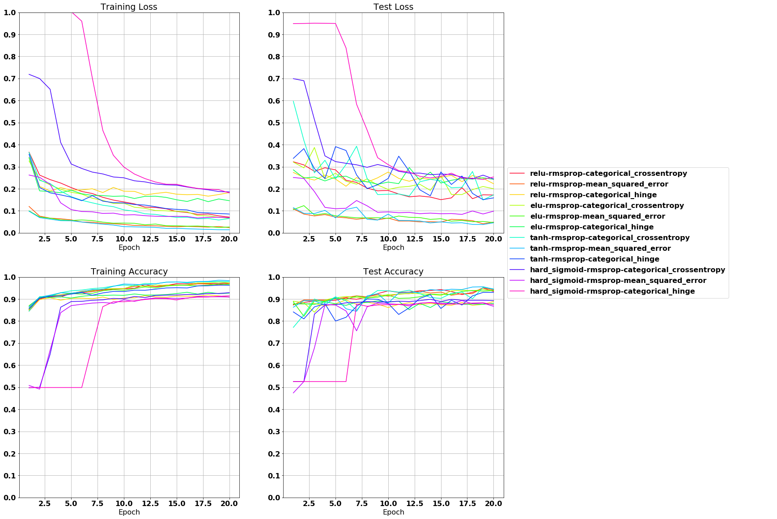
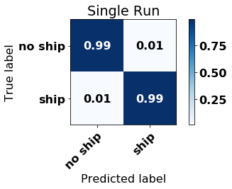
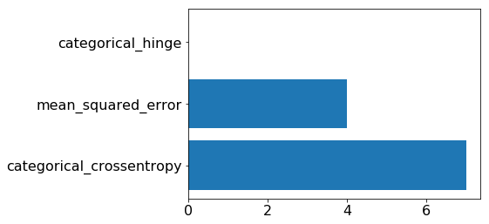
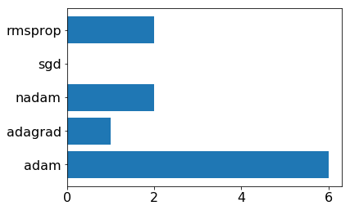
Classification & Validation: Process

Slide 16
Demonstration

Slide 17
Trials & Issues
Complicated models, lots to change!
Number of layers
Functions used
Function used by each layer
Nodes/filters per layer
Balancing performance and speed.
Imbalanced data (1:3, positive:negative)
Balancing data lead to over-fitting.
Opted not to balance as no-ship images had important spread. Rely on optimization to balance weights.
Verification to ... Verify.

Slide 18
Q & A
Russell Perry
rhperry@ucdavis.edu
github.com/russhp
linkedin.com/in/russell-h-perry/
Thank you Sash, Ryan, Minda, and Beheshteh for a great class!

