Slide 1
How To Program MIPS with SPIM

Slide 2
Outline
What is SPIM
Program Structure of MIPS
Data Declaration of MIPS
System Calls In SPIM
How to use SPIM
Appendix
Example 1
Example 2
MIPS Registers

Slide 3
What is SPIM?
Spim is a simulator that runs MIPS32 programs.
reads and executes MIPS assembly language programs
provides a simple debugger
GUI
The newest version of Spim is QtSpim. It’s available for both Microsoft Windows, Linux, and Mac OS X.
Download Link: http://spimsimulator.sourceforge.net/
Notes:
There are also some old versions of Spim, like PCSpim Xspim.

Slide 4
First MIPS Program: Hello World
.data
hello: .asciiz "\n hello world, CS350/402 students"
.globl main
.text
main:
li $v0, 4 # system call code for Print String
la $a0, hello # load address of hello into $a0
syscall # call system call
li $v0,10 # system call code for exit (end of program)
syscall # call system call
Notes:
There are also some old versions of Spim, like PCSpim Xspim.

Slide 5
Program Structure of MIPS
Data Declarations
placed in section of program identified with assembler directive .data
declares variable used in program
Code
placed in section of text identified with assembler directive .text
contains program code (instructions)
starting point of program e.g. given label main:
ending point of program should use exit system call
Comments
anything following # on a line

Slide 6
Data Declarations
format for declarations:
name: storage_type value(s)
hello: .asciiz ”Hello World”
create storage for variable of specified type with given name and specified type
value(s) usually gives initial value(s)
for storage type .space, gives number of spaces to be allocated

Slide 7
Data Declarations – Cont
var1: .word 3 # create a single integer variable with initial value 3
var2: .byte 'a’ # create a single character variable with initial value ‘a’
var3: .asciiz “Hello World” # create a string variable
array1: .byte 'a','b' # create a 2-element character array with elements initialize # to a and b
array2: .space 40 # allocate 40 consecutive bytes, with storage uninitialized # could be used as a 40-element character array, or a # 10-element integer array

Slide 8
First MIPS Program: Hello World
.data
hello: .asciiz "\n hello CS350/402 students, I am Chaoqi"
.globl main
.text
main:
li $v0, 4 # system call code for Print String
la $a0, hello # load address of hello into $a0
syscall # call system call
li $v0,10 # system call code for exit (end of program)
syscall # call system call
Notes:
There are also some old versions of Spim, like PCSpim Xspim.

Slide 9
MIPS System Calls
SPIM provides a small set of operating-system-like services through the MIPS system call (syscall) instruction.
To request a service, a program loads the system call code (see Table below) into register $v0 and the arguments into registers $a0, ..., $a3 (or $f12 for floating point values).
System calls that return values put their result in register $v0 (or $f0 for floating point results).
Notes:
There are also some old versions of Spim, like PCSpim Xspim.

Slide 10
MIPS System Calls
Service | System Call Code | Arguments | Result
print integer | 1 | $a0 = value | (none)
print float | 2 | $f12 = float value | (none)
print double | 3 | $f12 = double value | (none)
print string | 4 | $a0 = address of string | (none)
read integer | 5 | (none) | $v0 = value read
read float | 6 | (none) | $f0 = value read
read double | 7 | (none) | $f0 = value read
read string | 8 | $a0 = address where string to be stored $a1 = number of characters to read + 1 | (none)
memory allocation | 9 | $a0 = number of bytes of storage desired | $v0 = address of block
exit (end of program) | 10 | (none) | (none)
print character | 11 | $a0 = integer | (none)
read character | 12 | (none) | char in $v0
Notes:
There are also some old versions of Spim, like PCSpim Xspim.

Slide 11
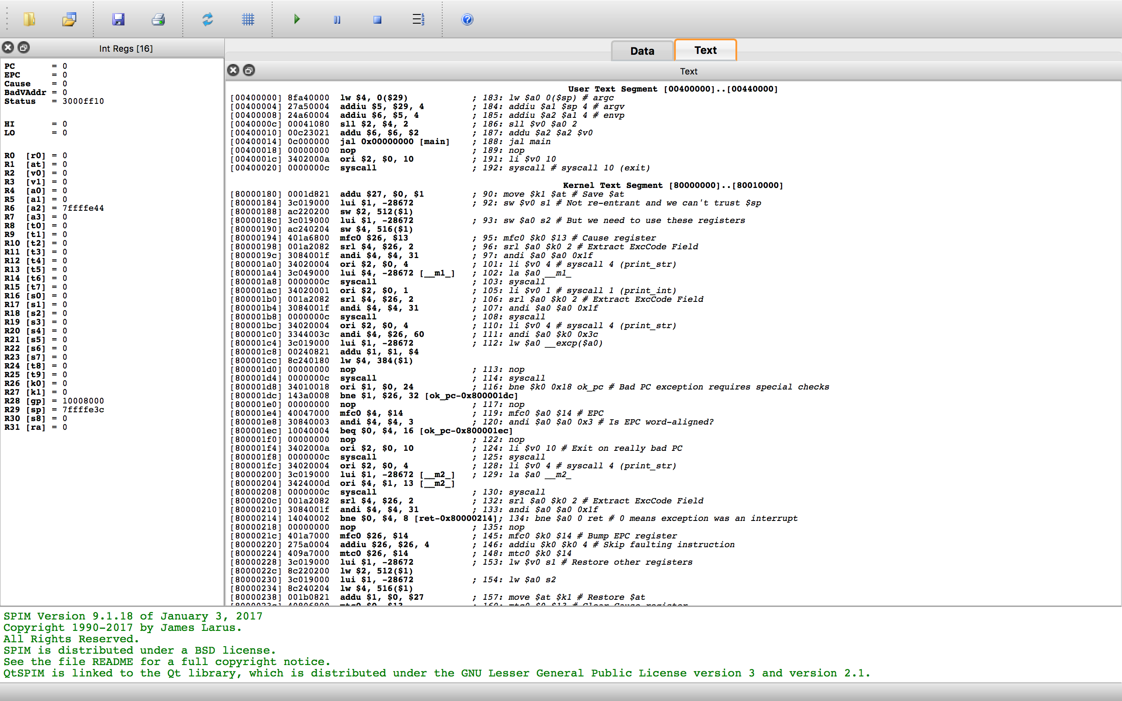
Why is Design Erosion Inevitable with existing software technology?
How to use SPIM
Run your SPIM program
Run your SPIM program One Instruction at a time (Debug)
Clear all the contents in the Registers
New requirements
Even an optimal strategy for designing the system cannot prevent design erosion
Unforseen requirement will change the design once were optimal
Make all things be initialized
Load a MIPS source code
Text Segment
Registers
Message

Slide 12
Example-1
.data # String constants for messages.
pr1: .asciiz "Please enter a string: "
pr2: .asciiz "You entered: "
msg: .asciiz "Welcome to class CS350/CS402!\n"# Space for the input string.
buf: .space 200
.globl main
.text
main:
li $v0, 4 # Print prompt string.
la $a0, pr1
syscall

Slide 13
Example-1
li $v0, 8 # Read string.
la $a0, buf # Buffer
li $a1, 200 # Length of buffer
syscall # Print the messages and the string
li $v0, 4
la $a0, pr2
syscall
li $v0, 4
la $a0, buf
syscall
li $v0, 4
la $a0, msg
li $v0,10
syscall

Slide 14
Example-2
.data
prompt: .asciiz "\n Please Input a value for N = "
result: .asciiz "The sum of the integers from 1 to N is "
bye: .asciiz "\n Have a good day"
.globl main
.text
main:
li $v0, 4 # system call code for Print String
la $a0, prompt # load address of prompt into $a0
syscall # print the prompt message

Slide 15
Example-2
li $v0, 5 # system call code for Read Integer
syscall # reads the value of N into $v0
blez $v0, end # branch to end if $v0 < = 0
li $t0, 0 # clear register $t0 to zero
loop:
add $t0, $t0, $v0 # sum of integers in register $t0
addi $v0, $v0, -1 # summing integers in reverse order
bnez $v0, loop # branch to loop if $v0 is != zero
li $v0, 4 # system call code for Print String
la $a0, result # load address of message into $a0
syscall #print the string

Slide 16
More Example-2
li $v0, 1 # system call code for Print Integer
move $a0, $t0 # move value to be printed to $a0
syscall # print sum of integers
b main # branch to main
end: li $v0, 4 # system call code for Print String
la $a0, bye # load address of msg. into $a0
syscall # print the string
li $v0, 10 # terminate program run and
syscall

Slide 17
MIPS Registers
Register Number | Alternative Name | Description
0 | zero | the value 0
1 | $at | (assembler temporary) reserved by the assembler
2-3 | $v0 - $v1 | (values) from expression evaluation and function results
4-7 | $a0 - $a3 | (arguments) First four parameters for subroutine. Not preserved across procedure calls
8-15 | $t0 - $t7 | (temporaries) Caller saved if needed. Subroutines can use w/out saving. Not preserved across procedure calls
16-23 | $s0 - $s7 | (saved values) - Callee saved. A subroutine using one of these must save original and restore it before exiting. Preserved across procedure calls
24-25 | $t8 - $t9 | (temporaries) Caller saved if needed. Subroutines can use w/out saving. These are in addition to $t0 - $t7 above. Not preserved across procedure calls.
26-27 | $k0 - $k1 | reserved for use by the interrupt/trap handler
28 | $gp | global pointer. Points to the middle of the 64K block of memory in the static data segment.
29 | $sp | stack pointer Points to last location on the stack.
30 | $s8/$fp | saved value / frame pointer Preserved across procedure calls
31 | $ra | return address
Notes:
There are also some old versions of Spim, like PCSpim Xspim.

