Slide 1


Jupyter Notebook
Mark A. Russo
October 14, 2019

Slide 2
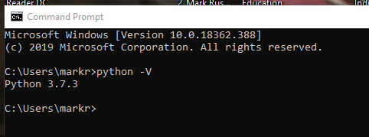
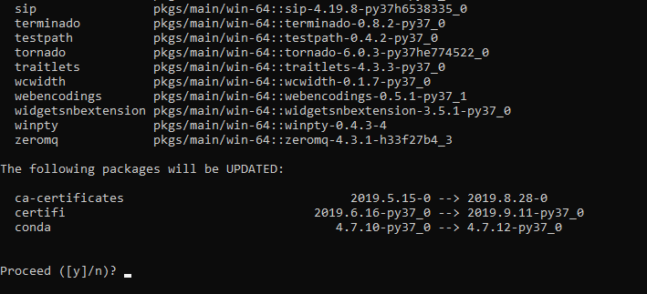
“Install/configure Jupyter Notebook”
Verify install Mini-conda
Verify Juypter

Slide 3
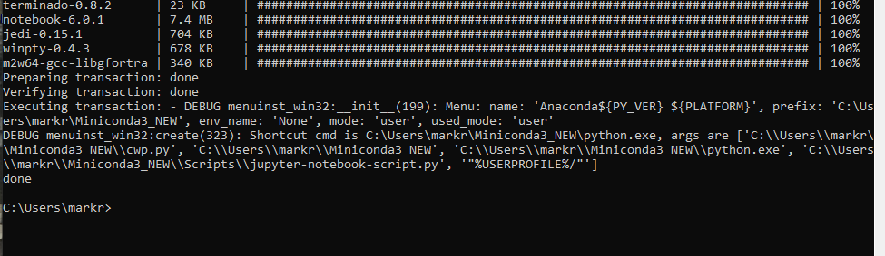
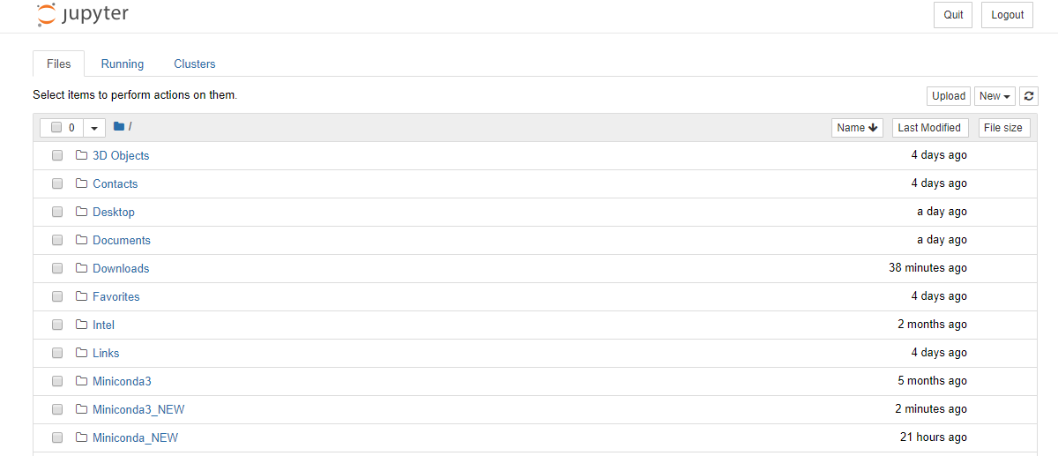
“Install/configure Jupyter Notebook” (cont.)
Environment loaded
Juypter NB created

Slide 4
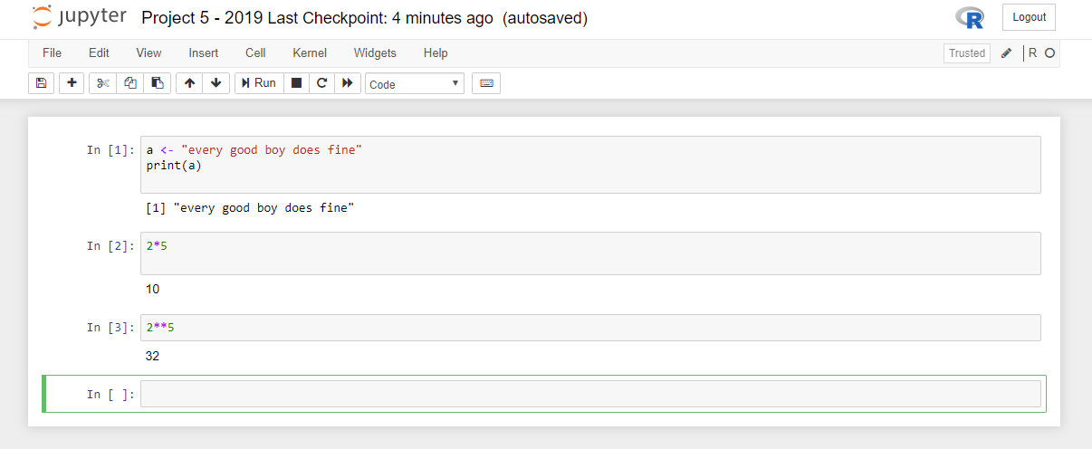
Test of R Environment

Slide 5
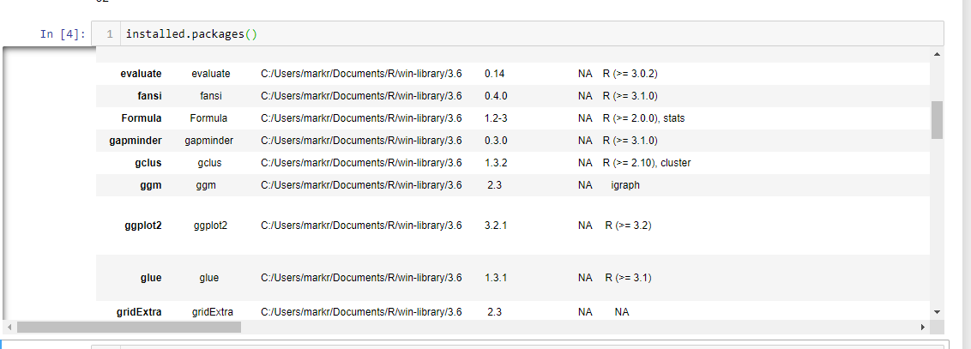
Libraries Loaded

Slide 6
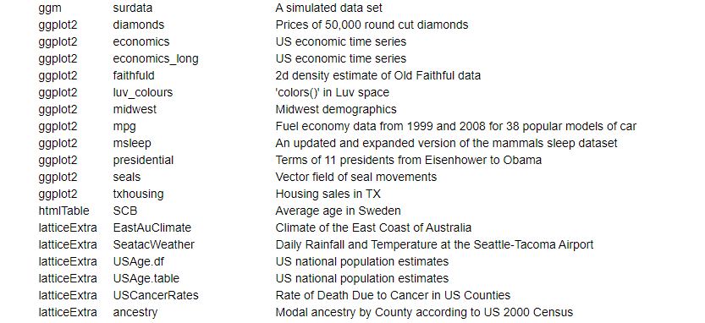
Ggplot Present

Slide 7
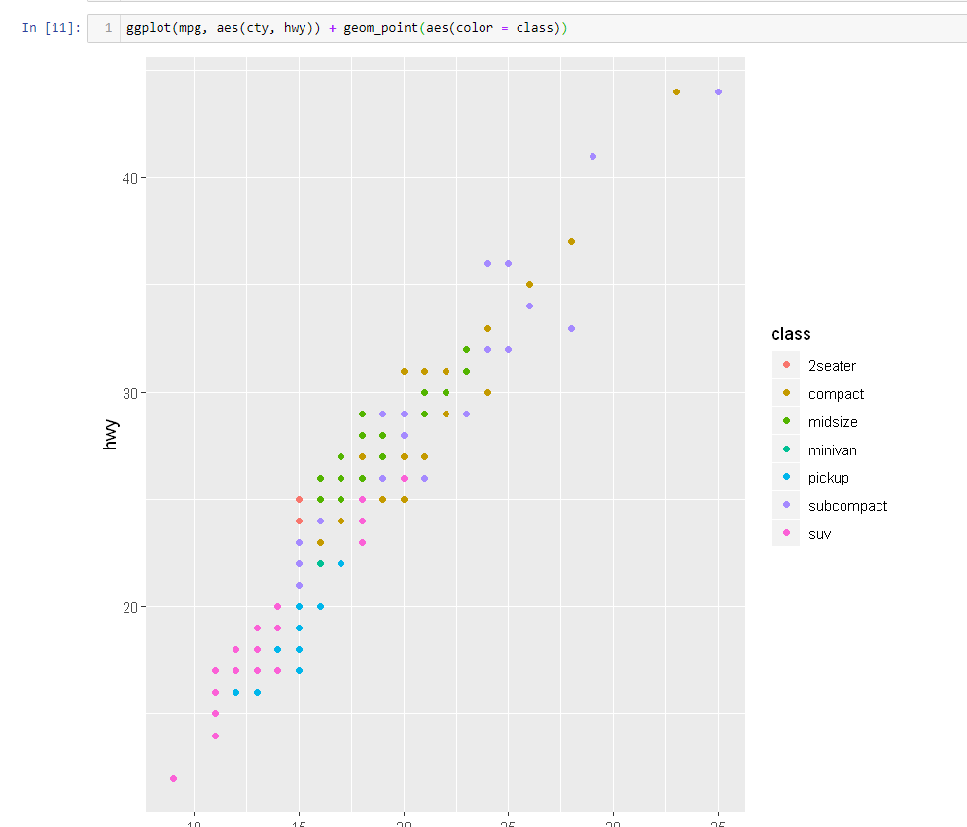
Test Chart

Slide 8
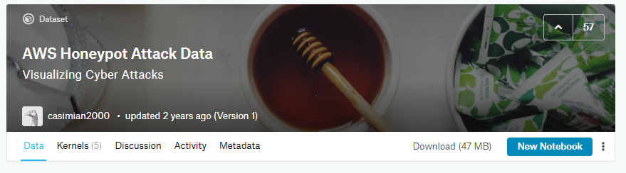
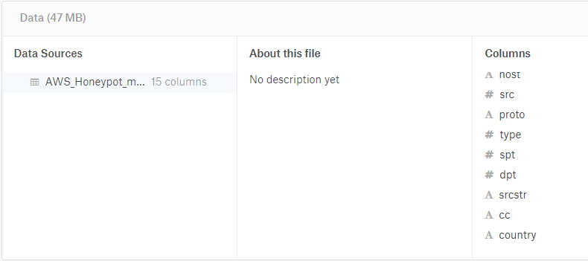
Selected Dataset
Which dataset you chose to analyze?
AWS Honeypot Attack Data (~2013)

Slide 9
Questions re the Dataset
What makes this dataset important?
It identifies major cyber-threats—the average computer user does not do this. It also provides some level of attribution.
What research questions are you asking?
Where are hacks originating (country)?
What ports are being attacked and by whom?
Is China the biggest threat in cyberspace?
Where are the concentrations of attacks originating?

Slide 10
Questions re the Dataset (cont.)
How the dataset applies to a specific business decision? What virtual computer ports need to be better protected.
Why your analysis would be important and/or how it closes gaps in knowledge? Provides information to help IT professionals better identify threats to their networks and data.

Slide 11
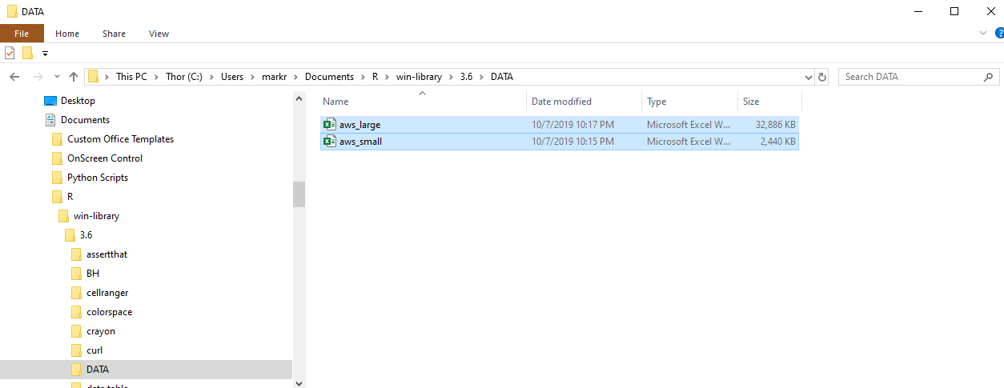
Make data more manageable

Slide 12
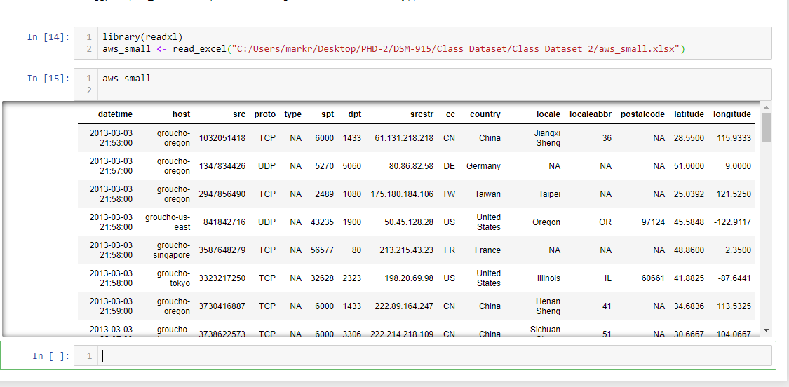
Loaded data in Jupyter Notebook—1000 entries

Slide 13
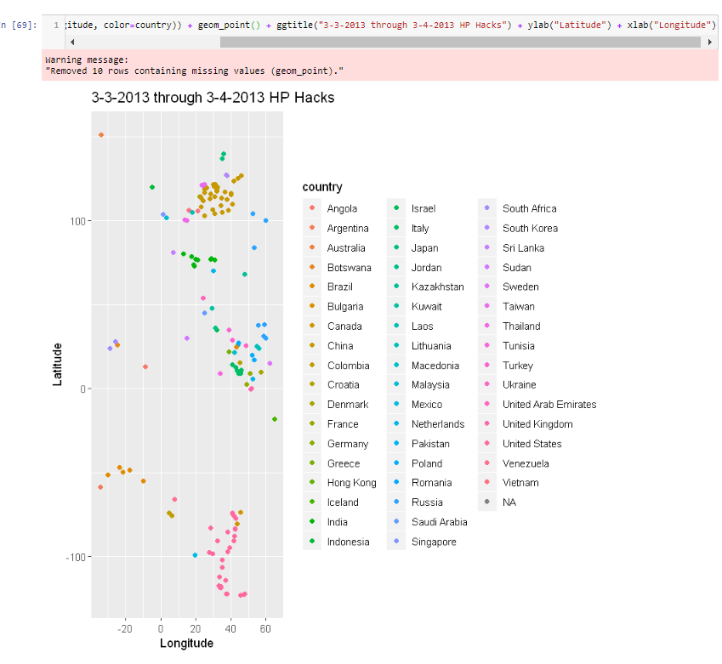
Where are hacks originating (country)? One-day snapshot (2013) of attacks

Slide 14
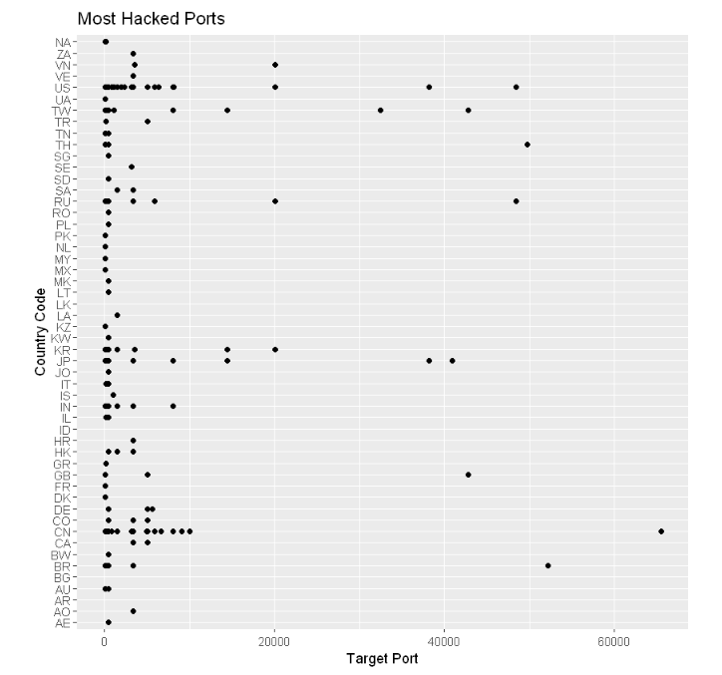
What ports are being attacked and buy whom? (prioritization)

Slide 15
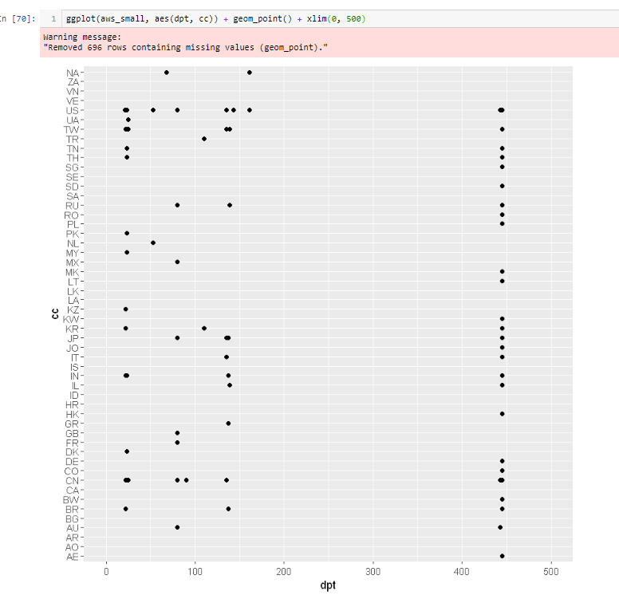
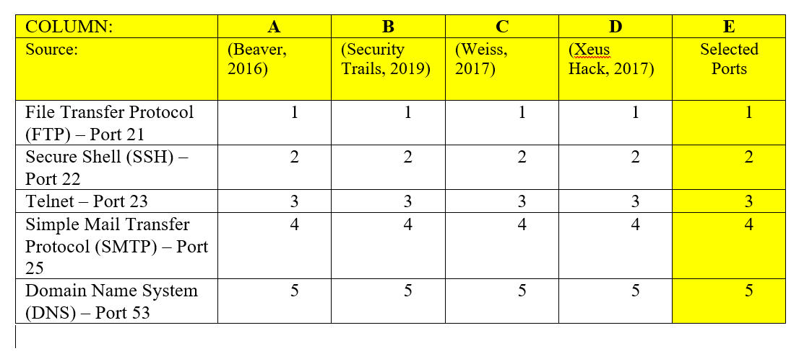
What ports are being attacked and by whom? (adjust scale)

Slide 16
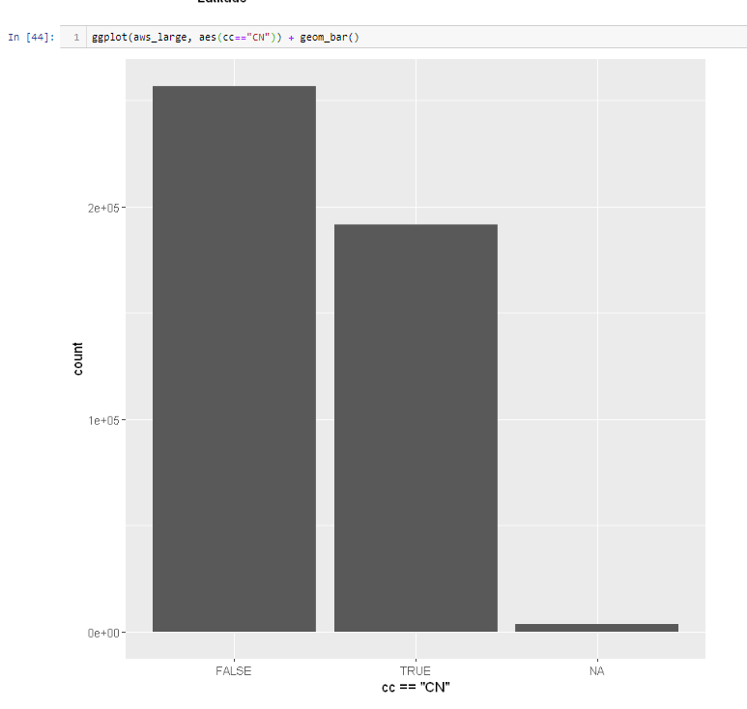
Is China the biggest threat in cyberspace? (Yes)
China accounts for about 80% of the attacks in one day.

Slide 17
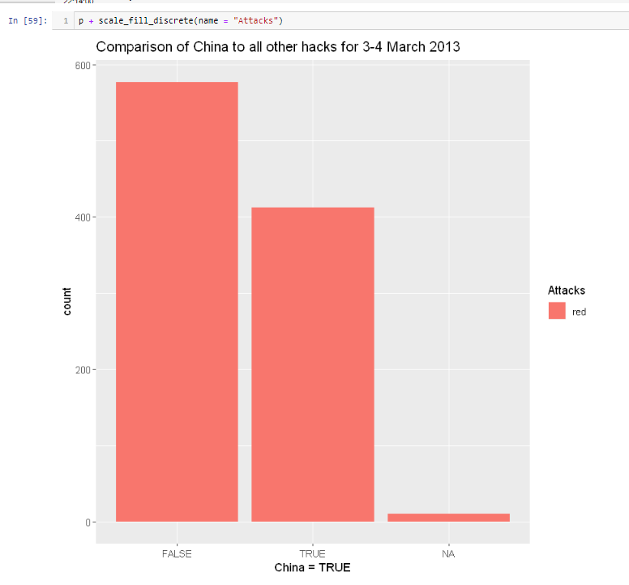
Better visualization

Slide 18
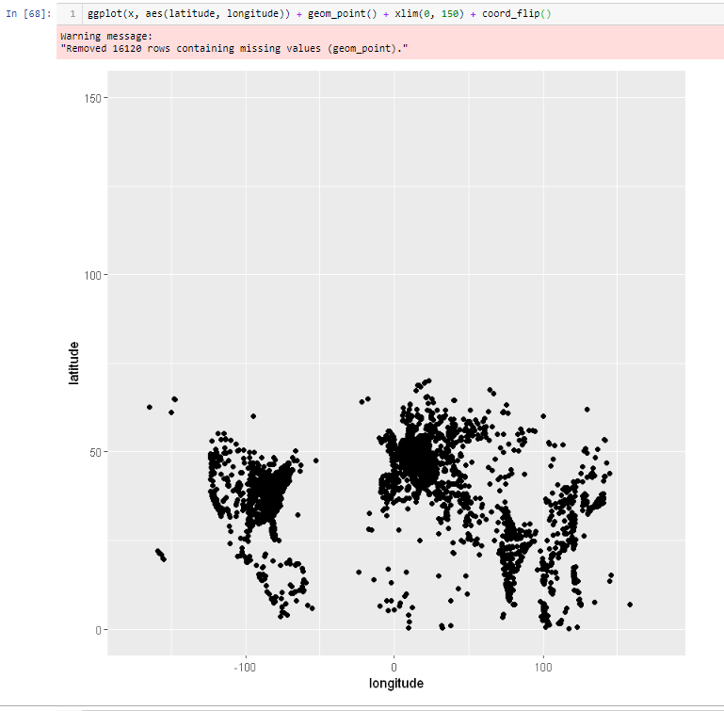
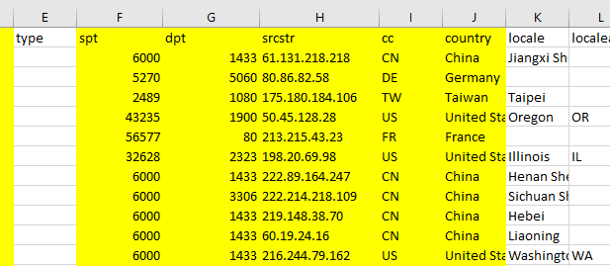
Where are the concentrations of attacks originating? (processing time for 500K locations = 54 seconds)
Beijing - (40N/110E)
Shanghai [APT1] - (31N/112E)
Moscow - (56N/38E)
Washington, DC - (38N/77W)

Slide 19
References
Beaver, K. (2016, March 26). Commonly hacked ports[Blog post]. Dummies. Retrieved from https://www.dummies.com/programming/networking/commonly-hacked-ports/
Kaggle. (n.d.). AWS Honepot Attack Data: Visualizing cyber attacks. Kaggle. Retrieved from https://www.kaggle.com/casimian2000/aws-honeypot-attack-data
Security Trails. (2019, May 7). Top 20 and 200 most scanned ports in the cybersecurity industry [Blog post]. Security Trails. Retrieved from https://securitytrails.com/blog/top-scanned-ports
Weiss, J. (2017, March 7). Vulnerability by common ports dashboard [Blog post]. Tenable. Retrieved from https://www.tenable.com/blog/vulnerabilities-by-common-ports-dashboard
Wickham, H. (2016). ggplot2: elegant graphics for data analysis. Springer.
Xeushack. (2017, January 20). The ultimate hacking cheat sheet: Work smarter, not harder [Blog post]. Xeushack. . Retrieved from http://xeushack.com/the-ultimate-hacking-cheat-sheet
Zelterman, D. (2015). Applied multivariate statistics with R. Cham: Springer.

