Slide 1


Homework Presentation Project 6 – Jupyter Notebook
Mark A. Russo
October 21, 2019

Slide 2
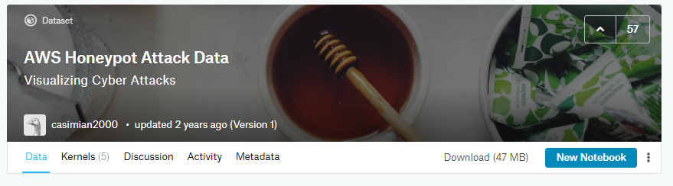
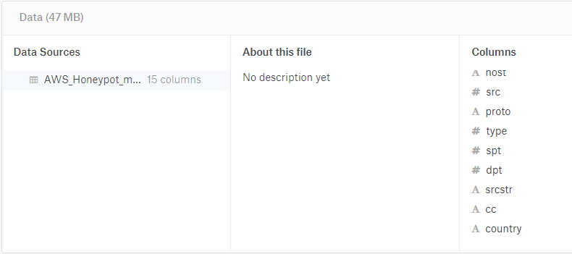
Selected Dataset
Which dataset you chose to analyze?
AWS Honeypot Attack Data (2013)

Slide 3
Questions re the Dataset
What makes this dataset important?
It identifies major cyber-threats—the average computer user does not do this. It also provides some level of attribution.
What research questions are you asking?
Who are the top cyber-attackers?
What are the major attack protocols used by:
China?
Russia?
USA?
Where is the “center of gravity” for cyberattacks?
Is there a relationship between source (attack) and destination (attacked) port ?
Is there a relationship between source (attack) and destination (attacked) protocol ?
Origination of USA Cyberattacks?

Slide 4
Questions re the Dataset (cont.)
How the dataset applies to a specific business decision? What virtual computer ports need to be better protected.
Why your analysis would be important and/or how it closes gaps in knowledge? Provides information to help IT professionals better identify threats to their networks and data.

Slide 5
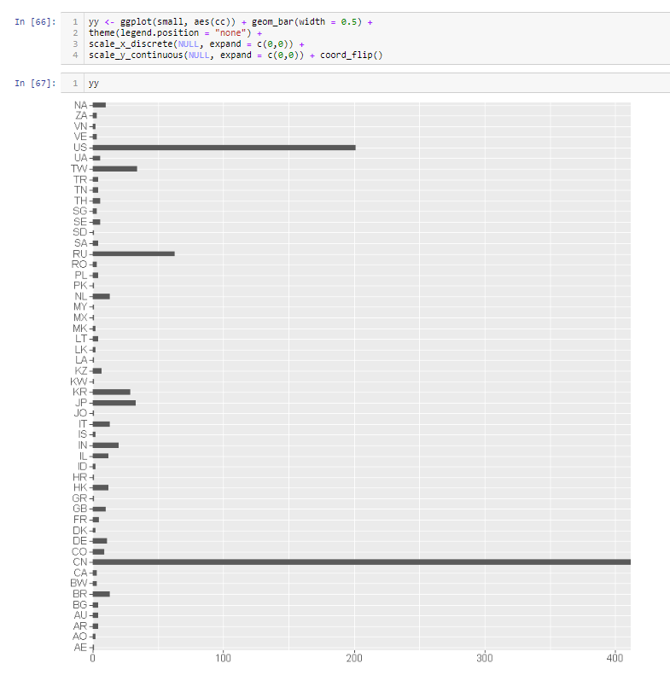
Who are the top cyber-attackers? (small dataset(n)=1000)

Slide 6
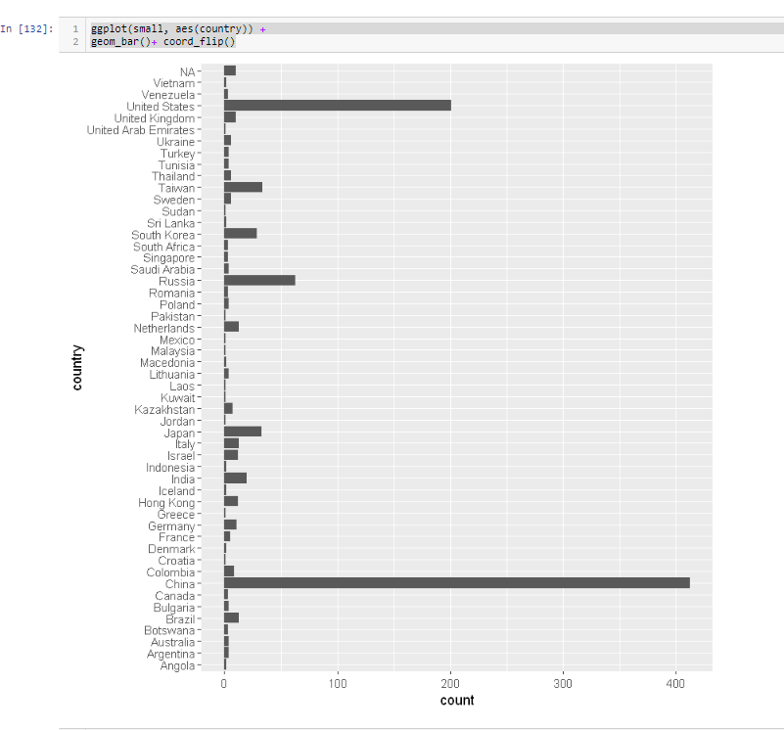
China, USA, Russia

Slide 7
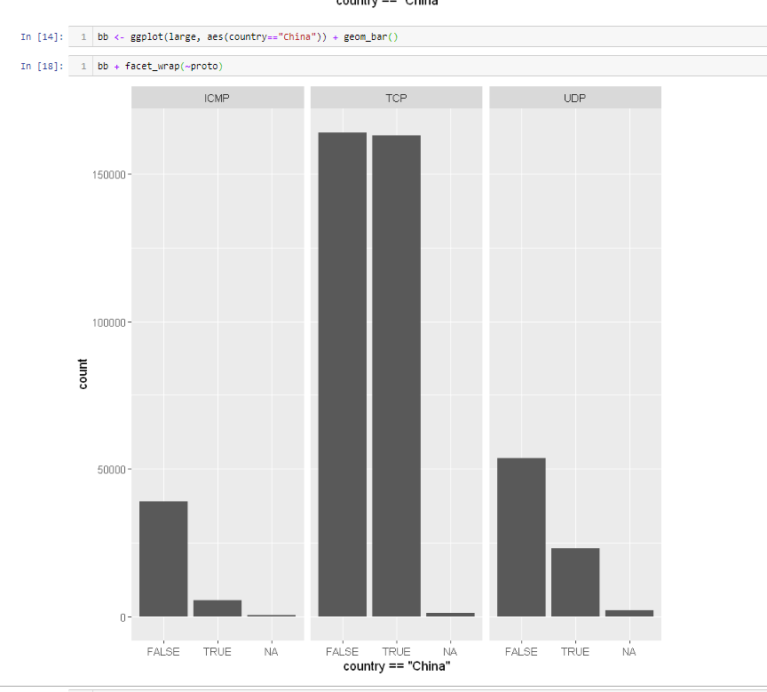
What are the major attack protocols used by China?
China predominantly using Transfer Control Protocol (TCP). The standard protocol for Internet connections and traffic.
TCP and User Datagram Protocol (UDP) – Layer 4, Transfer Layer attack
Internet Control Message Protocol (ICMP) – Layer 3 Physical layer attack –used for error messaging
(Department of Homeland Security, 2014)

Slide 8
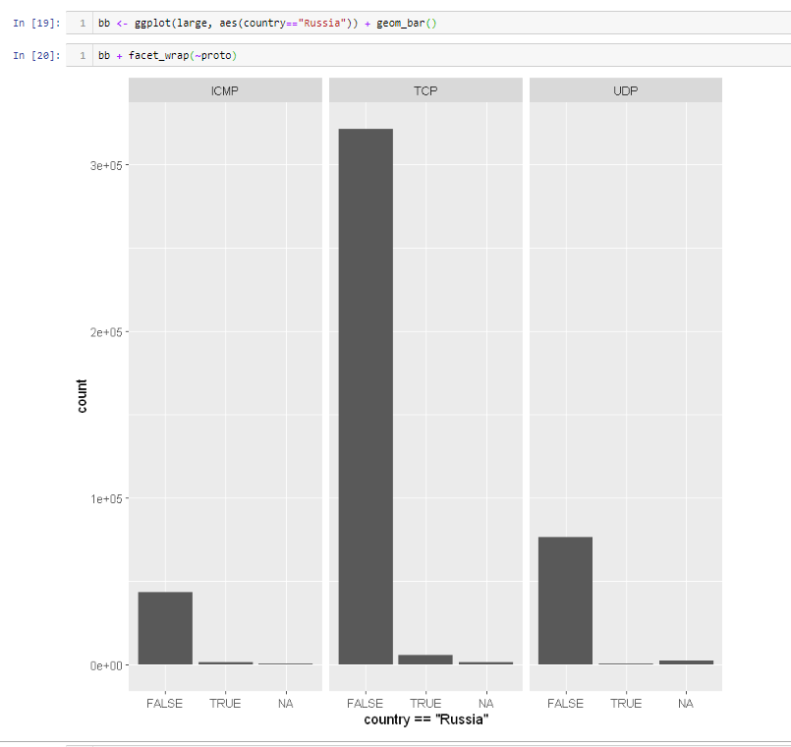
What are the major attack protocols used by Russia?
*probably too small of a sample here

Slide 9
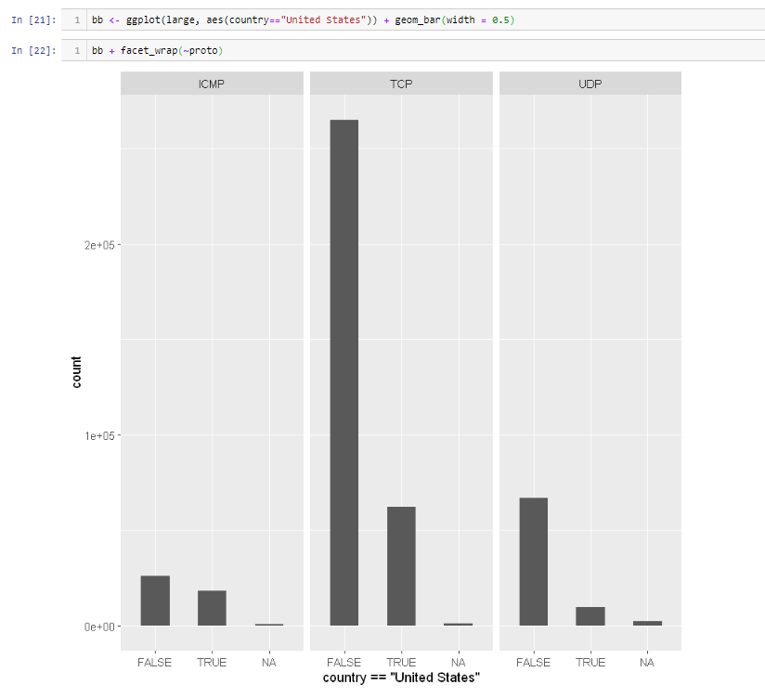
What are the major attack protocols used by the USA?
USA- TCP the most, but interestingly a fair amount of ICMP.

Slide 10
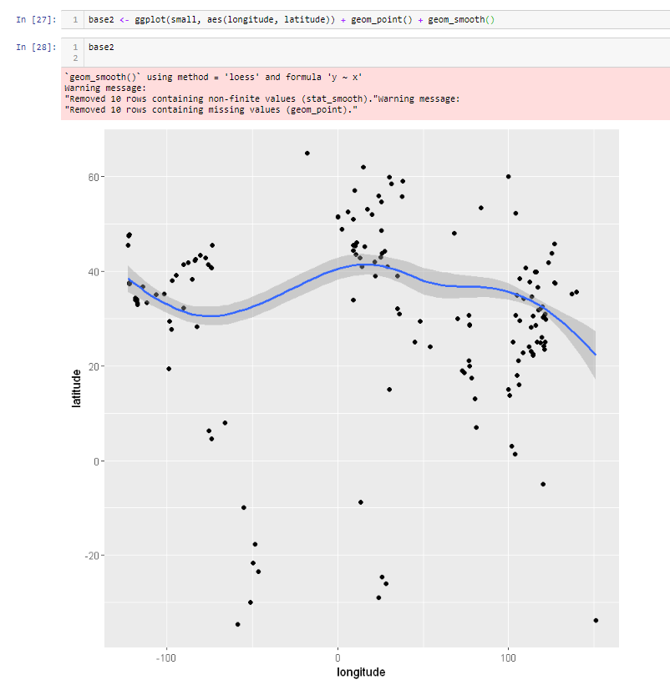
Where is the “center of gravity” for cyberattacks? (small)

Slide 11
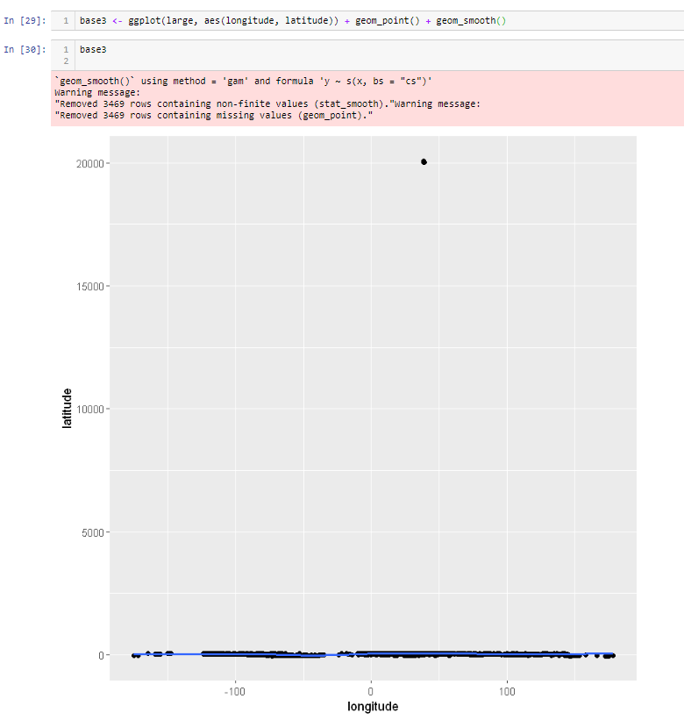
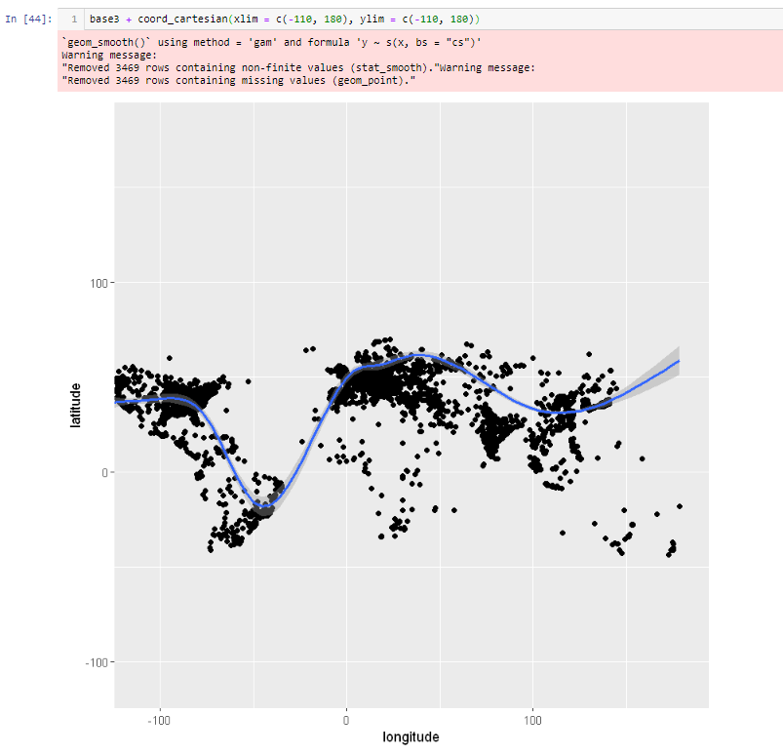
“Center of Gravity” of Cyber-attacks Worldwide (Large dataset (n) = 500K+) Coord_cartesian using x and ylimits to scale
Xlim and ylims help to create more of a geo-representation.
* Note passage of regression line through South America—actually, not a surprise

Slide 12
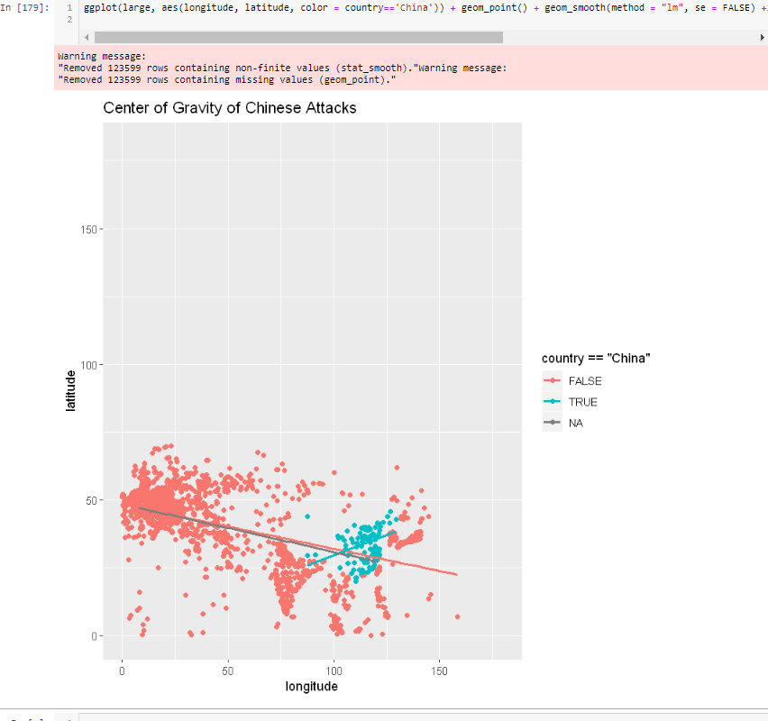
China

Slide 13
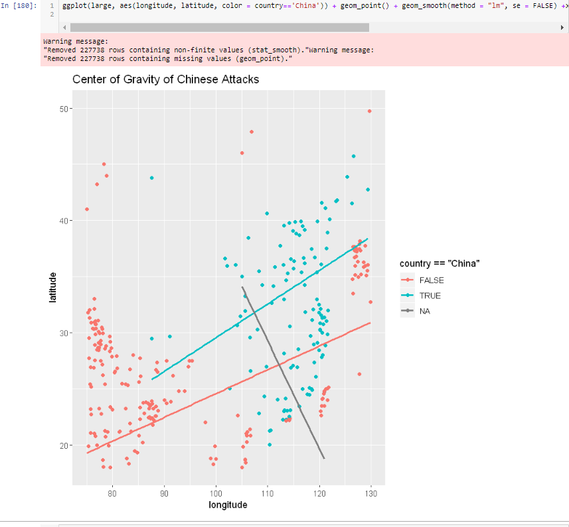
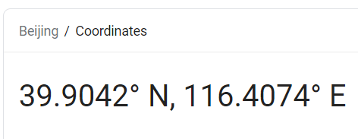
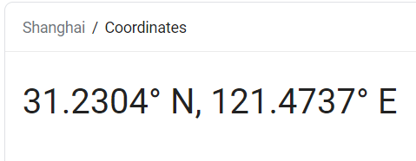
Use limits to fine tune mapping
APT1

Slide 14
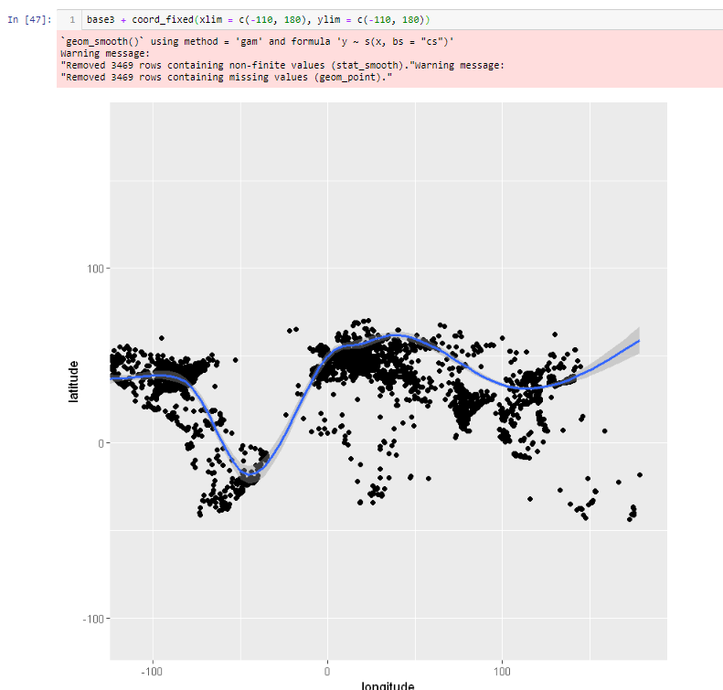
Coord_fixed() – like functionality; no real difference

Slide 15
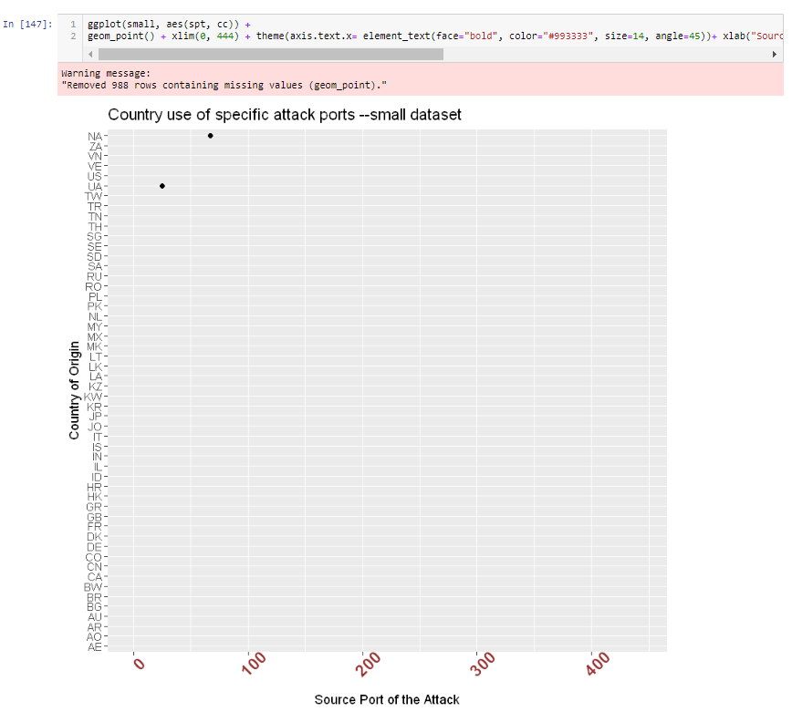
Is there a relationship between source (attack) port and destination port (attacked port)?
*Unsure about number of missing values of 988 from a dataset with 1000 (There are some missing data)

Slide 16
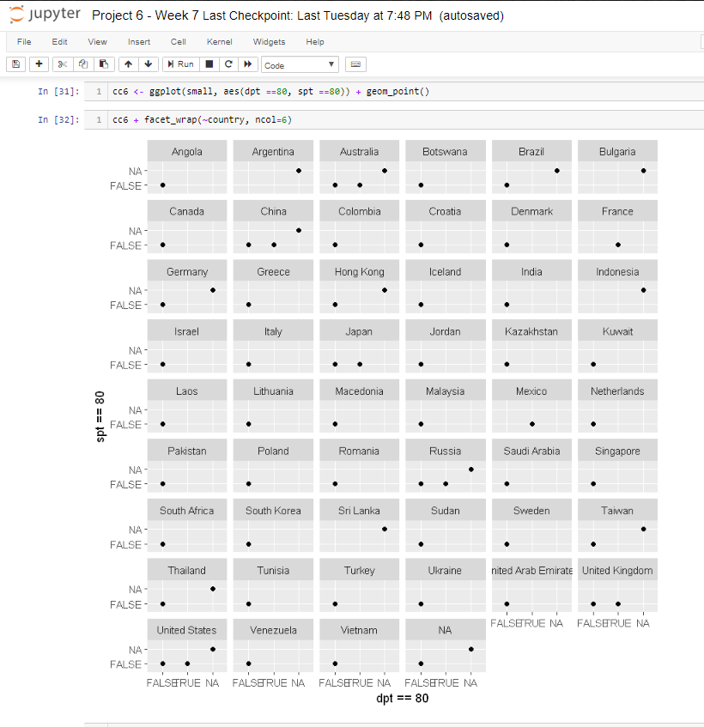
Is there a relationship between source (attack) and destination port (attacked port)? [Port 80-http example]
Using port 80 to attack port 80 relationship

Slide 17
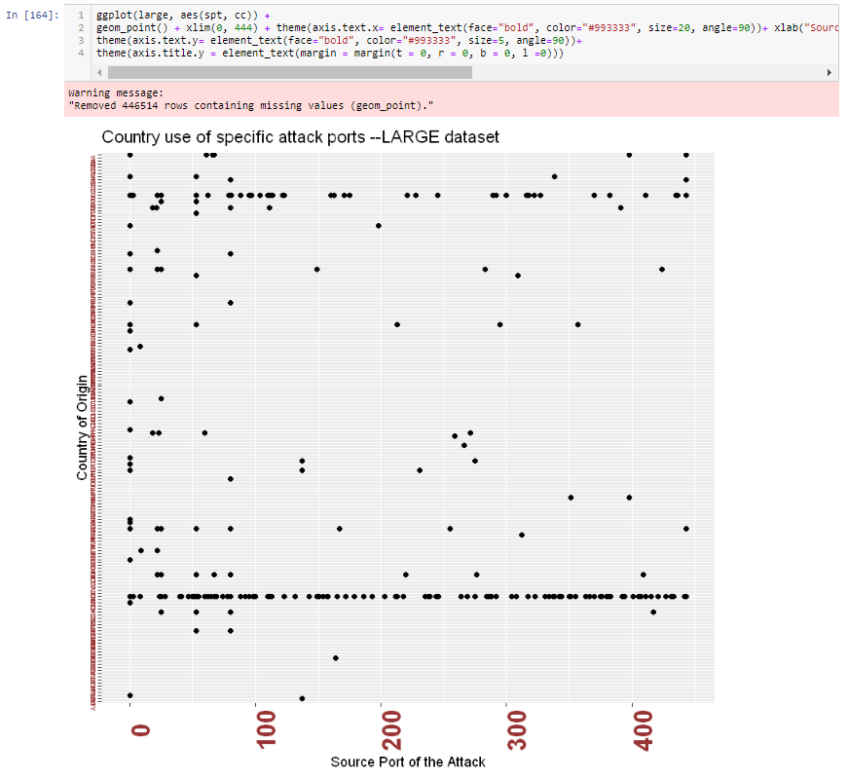
Is there a relationship between source (attack) and destination port (attacked port)? (Large dataset)
HARD TO SEE:
China using the “full spectrum” of ports from 0-500
The US about 50% less—more selective?

Slide 18
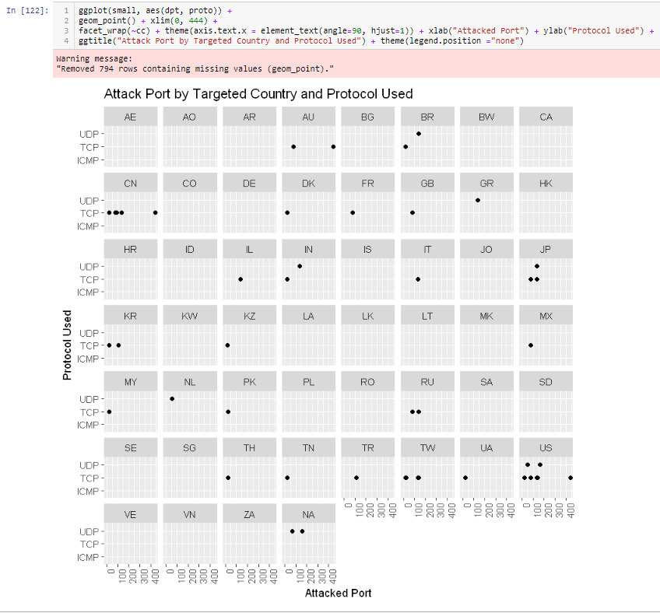
Is there a relationship between source (attack) and destination protocol (attacked port)?

Slide 19
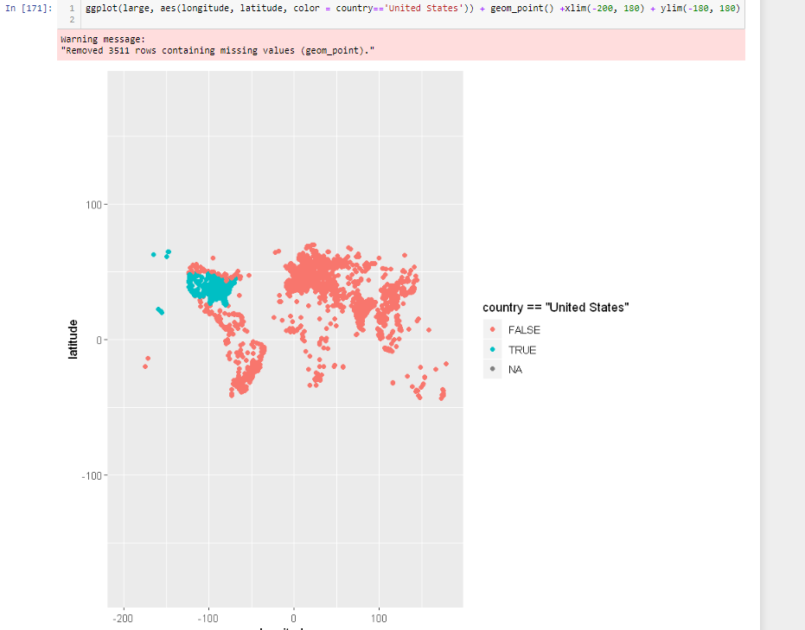
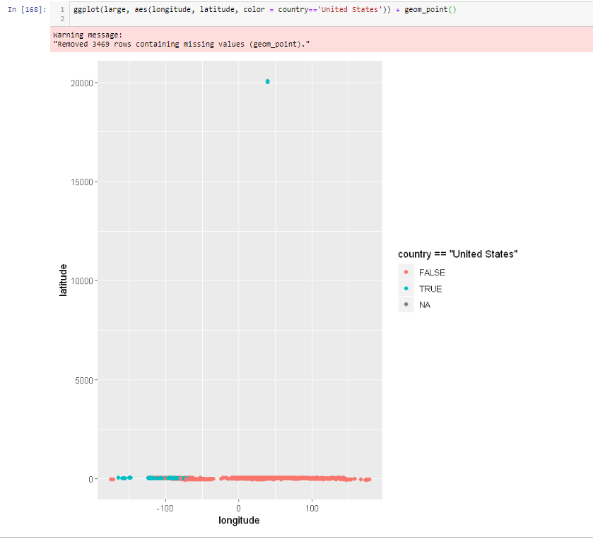
Origination of USA Cyberattacks?

Slide 20
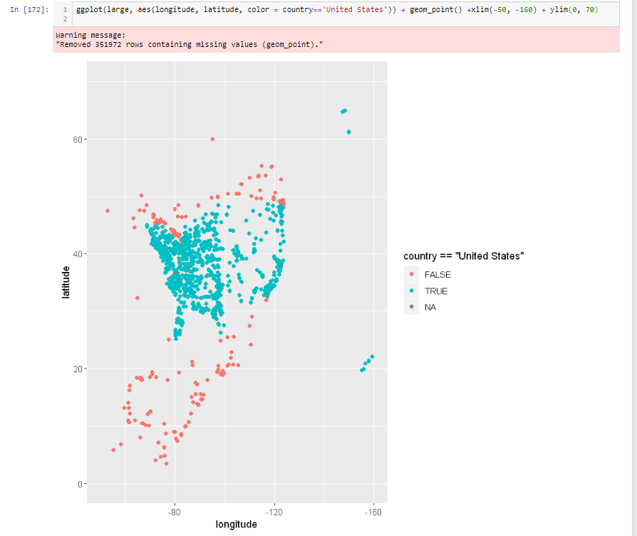
Xlim and ylim “fine-tuning” or NOT
Inverted! Careful!

Slide 21
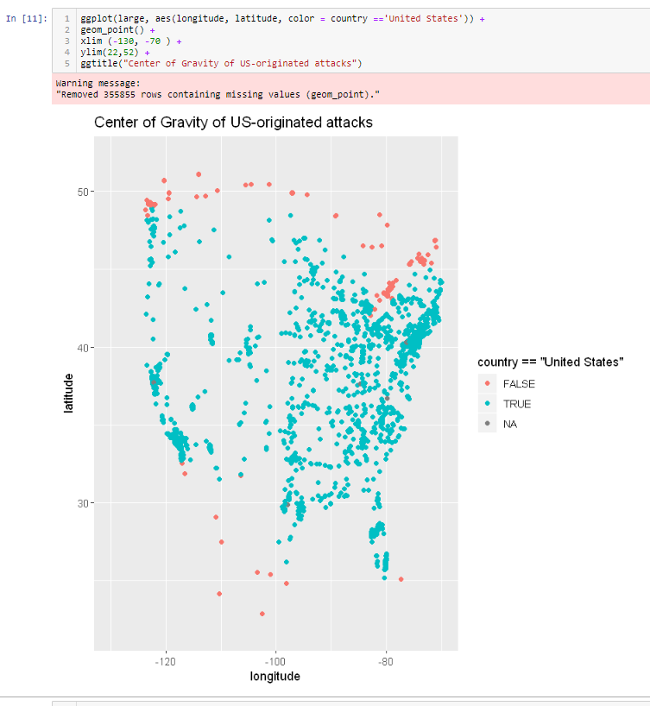
Better mapping

Slide 22
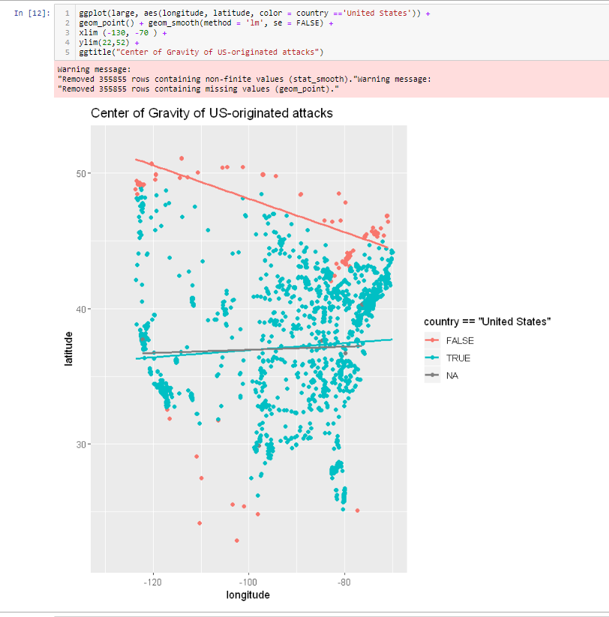
Center of USA Attacks?
*NOTE. These are the Internet Service Provider (ISP) locations, not necessarily the “bad-guys”

Slide 23
R/ggplot/Jupyter NB Lessons Learned
Make sure you re-run libraries and variables after you restart your work in Jupyter notebook.
If it does not look right, recheck your work.

Slide 24
References
Department of Homeland Security (DHS). (2014, January 29). DDOS quick guide. DHS. Retrieved from https://www.us-cert.gov/sites/default/files/publications /DDoS%20Quick%20Guide.pdf
Kaggle. (n.d.). AWS Honeypot Attack Data: Visualizing cyber attacks. Kaggle. Retrieved from https://www.kaggle.com/casimian2000/aws-honeypot-attack-data
Wickham, H. (2016). ggplot2: elegant graphics for data analysis. Springer.
Zelterman, D. (2015). Applied multivariate statistics with R. Cham: Springer.

