Slide 1
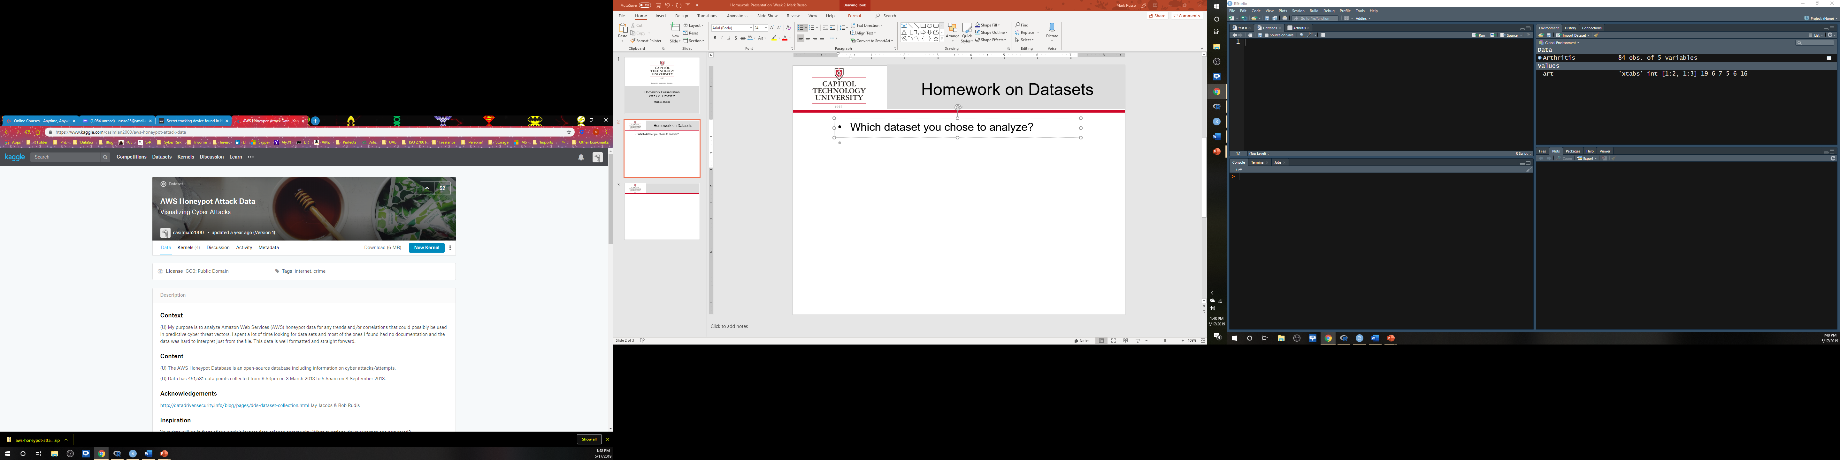

Dataset
Which dataset you chose to analyze?
(2013) AWS Honeypot Attack Data
Kaggle. (2019). Homepage. Retrieved from https://www.kaggle.com
A honeypot is a computer or computer system intended to mimic likely targets of cyberattacks. It can be used to detect attacks or deflect them from a legitimate target. It can also be used to gain information about how cybercriminals operate.
Norton. (2019). What is a honeypot? [Blog post]. Retrieved from https://us.norton.com/internetsecurity-iot-what-is-a-honeypot.html

Slide 2
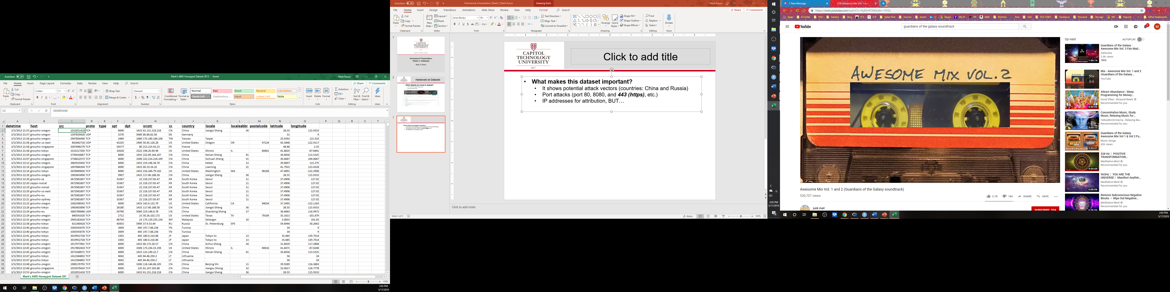
Dataset (cont.)
What makes this dataset important?
It shows potential attack vectors (countries: China and Russia based IP address)
Port attacks (port 80, 8080, and 443 (https), etc.)
IP addresses for attribution, BUT…
Could “feed” an Artificial Neural Network(ANN) with less-than friendly interlopers AKA “hackers”

Slide 3
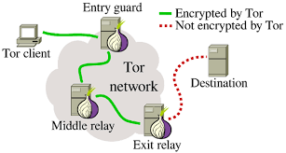
Dataset (cont.)
What research questions are you asking?
Can I use this to supplement an ANN PREDICTIVE ANALYTICS model/framework to better respond to cyberthreats REAL-TIME?
How many more HONEYPOT datasets would be enough? (Rule of 5? What’s the total “population” of honeypots in the US?)
Approaching population the wrong way; a whole sampling of active hackers
Are other data fields needed? (MAC addresses, other IP bounces, known VPN/proxy/TOR addresses, known whitelists/ blacklists)
IP Address 1234
Address “seen” IP Address 9834
IP Address 5678
The Conversation. (2016, May 17). Securing web browsing: Protecting the Tor network. Retrieved from http://theconversation.com/securing-web-browsing- protecting-the-tor-network-56840
IP Address 9834

Slide 4
Dataset (cont.)
How the dataset applies to a specific business decision?
Improve predictive capacity and respond to cyber-threats in real-time (both human and automated)
Leverages evolving Big Data capabilities
Why your analysis would be important and/or how it closes gaps in knowledge?
Provide a RT vice NRT capability
Would close a gap in limited academic study in this area…however, private-sector may be exploring
(a known-unknown)

