Slide 1
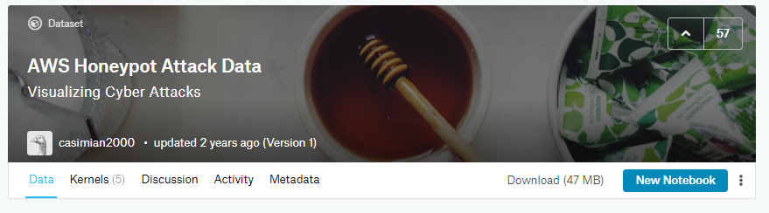
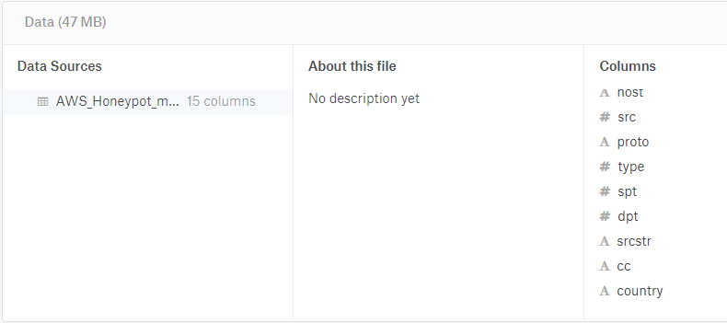
Selected Dataset
Which dataset you chose to analyze?
AWS Honeypot Attack Data (2013)

Slide 2
Questions re the Dataset
What makes this dataset important?
It identifies major cyber-threats—the average computer user does not do this. It also provides some level of attribution.
What research questions are you asking?
How can using themes in R improve the visualization experience?
Where were cyberattacks launched from in 2013?
How to best extract (filter) cyber-attackers from AWS Honeypot datasets?
How to identify gaps in data? (NA, blank)
How to impute (mutate) missing values? (example only)
How many honeypots comprise the AWS 2013 honeynet?

Slide 3
Questions re the Dataset (cont.)
How the dataset applies to a specific business decision? Who were the most active cyber-threats as identified by Amazon’s honeynet array in 2013?
Why your analysis would be important and/or how it closes gaps in knowledge? Provides information to help organizational leadership and IT professionals to better identify threats to their networks and data.

Slide 4
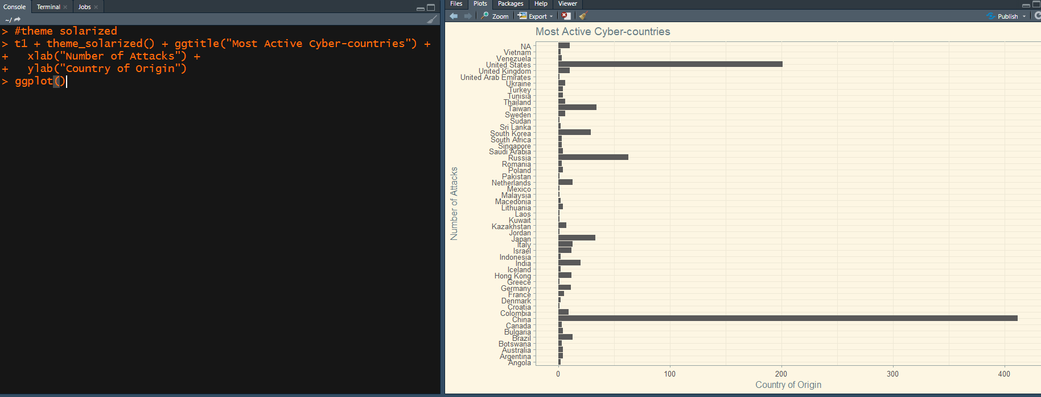
Theme_solarized (better visualization)

Slide 5
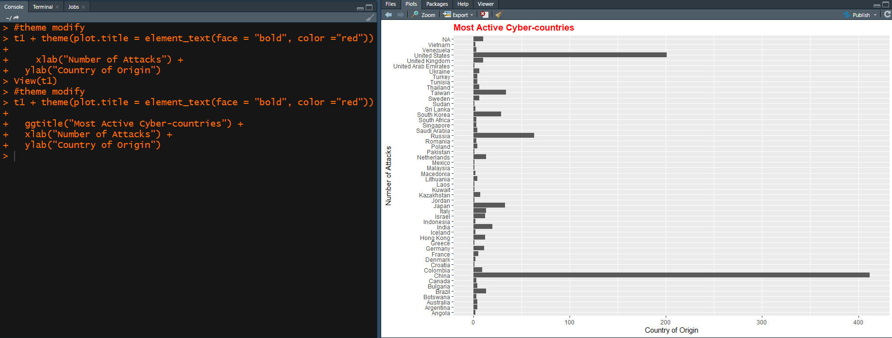
Theme_modify (title) (better visualization)

Slide 6
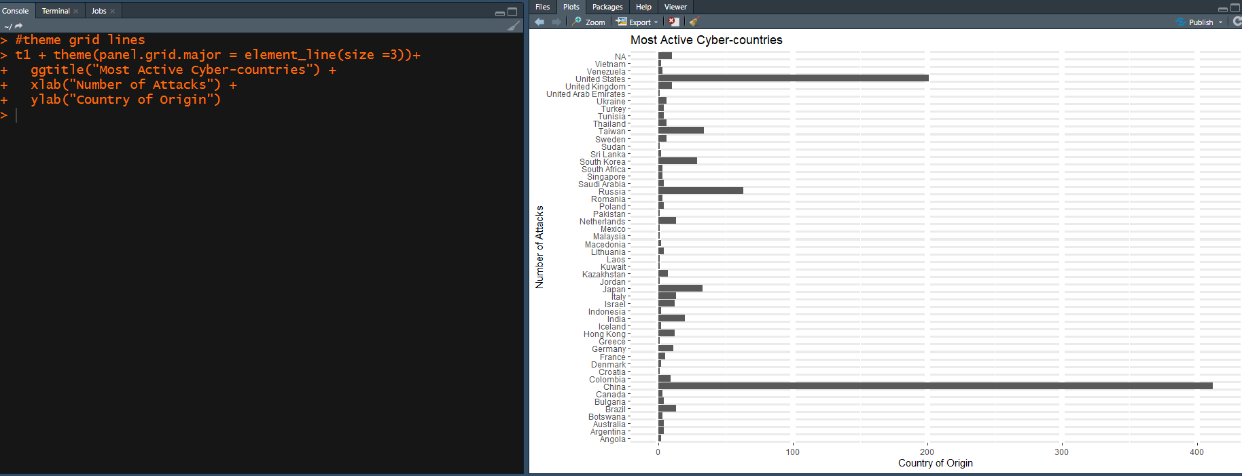
Theme modify_grid.major (better visualization)

Slide 7
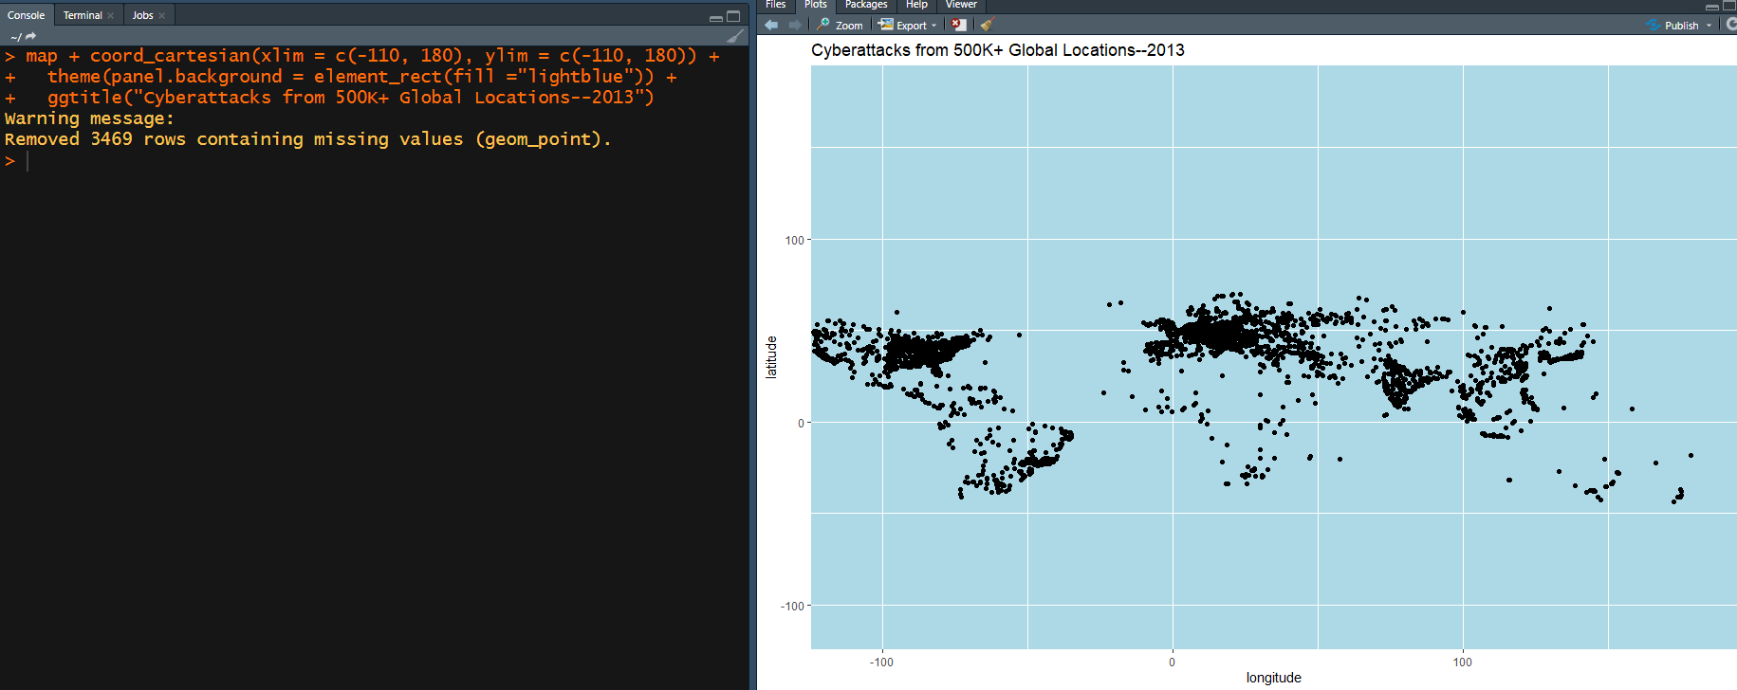
Where were cyberattacks launched from in 2013? (better visualization)

Slide 8
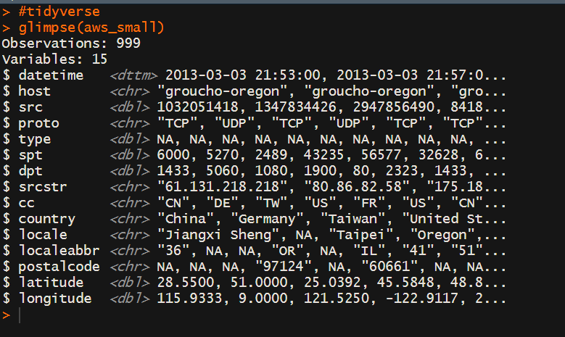
Tidyverse How to best extract (filter) cyber-attackers from the AWS Honeypot datasets?
(Sullivan, 2019)

Slide 9
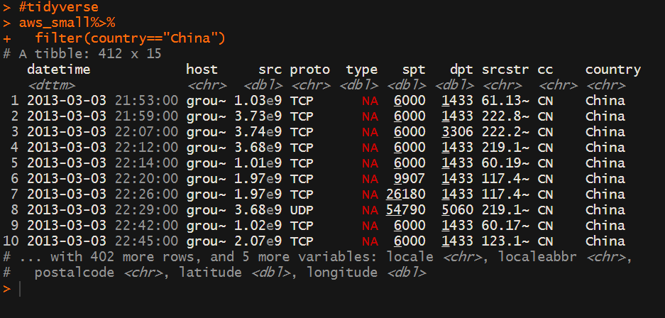
Filter (extract) Chinese Activity

Slide 10
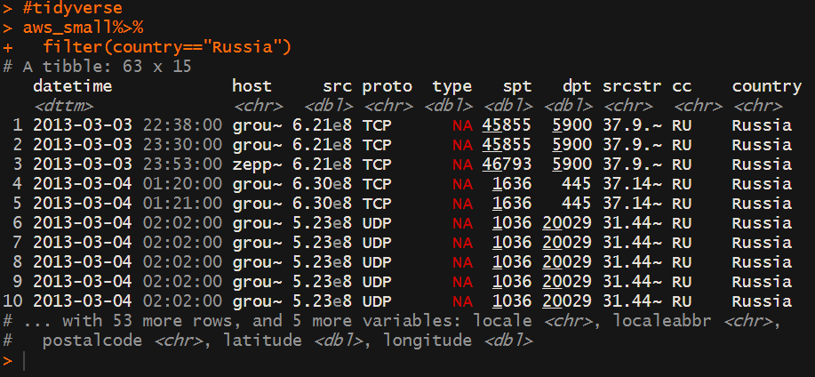
Filter (extract) Russian activity

Slide 11
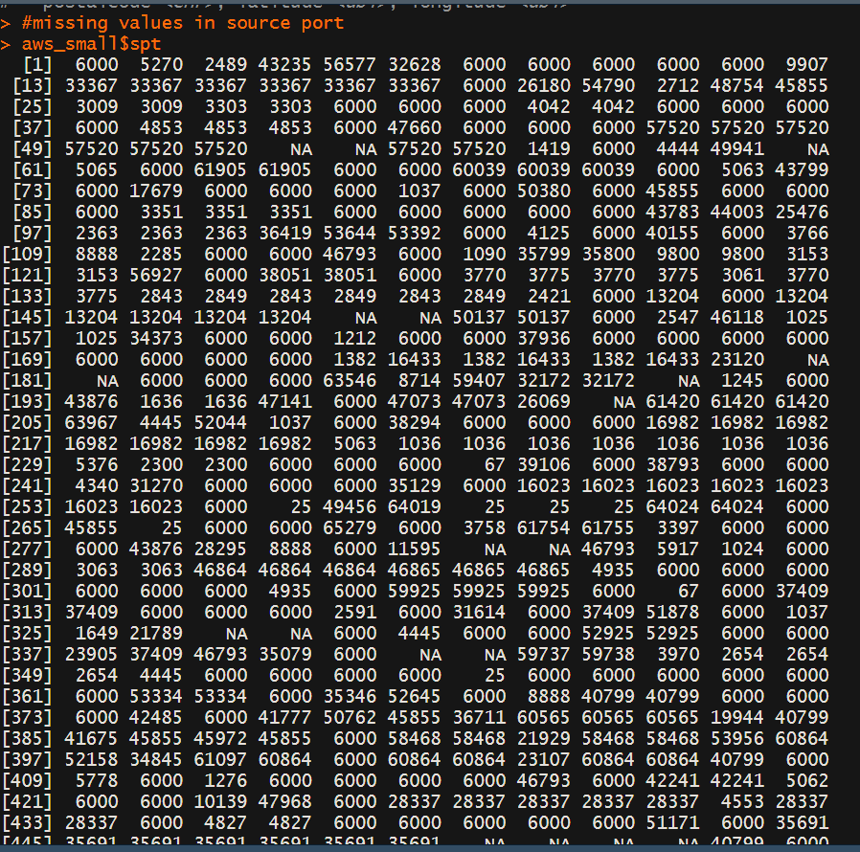
Looking for missing values in “source ports” How to identify gaps in the data?

Slide 12
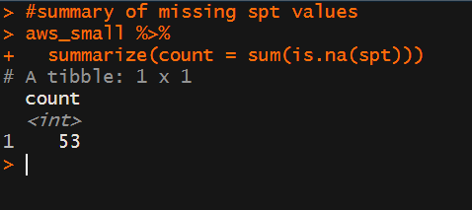
Summary of missing “source port” values
53 out of 1000 missing

Slide 13
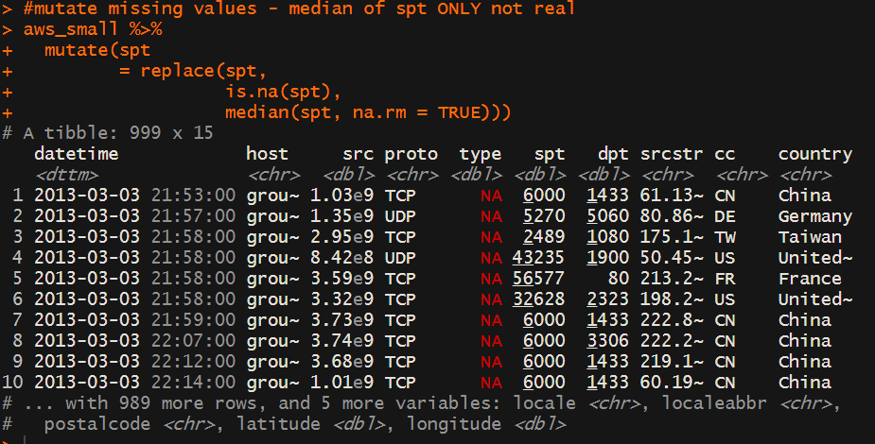
Mutate missing values (only going to replace missing with median value for ports)

Slide 14

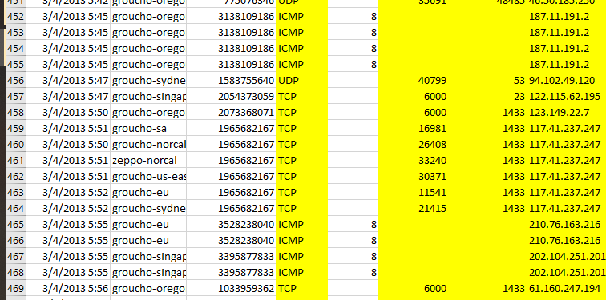
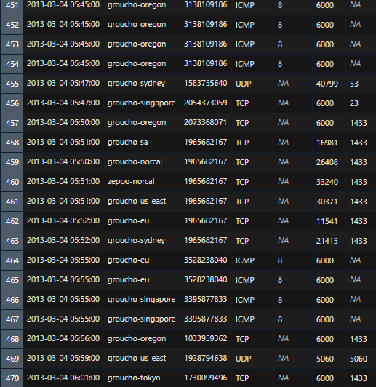
Verify Mutate
Src (source port)

Slide 15
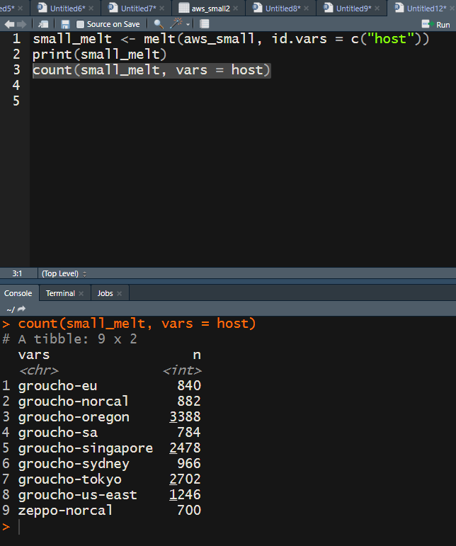
Melt Function How many hosts and their names in the 2013 AWS honeynet array?
Identified 9 specific honeypots

Slide 16
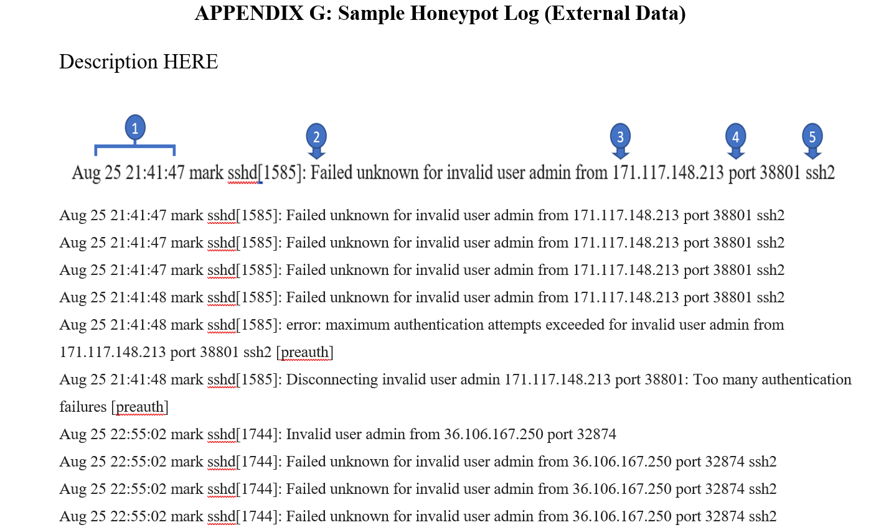
Data Transformation in Excel (Honeypot) ~ “The Not so-tidyverse”
date/time group
Audit warning
Source IP
Source port
Attacked port/protocol

Slide 17
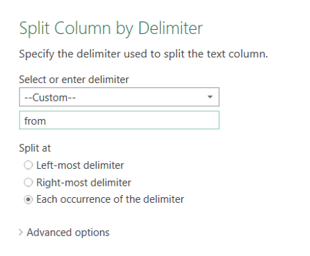
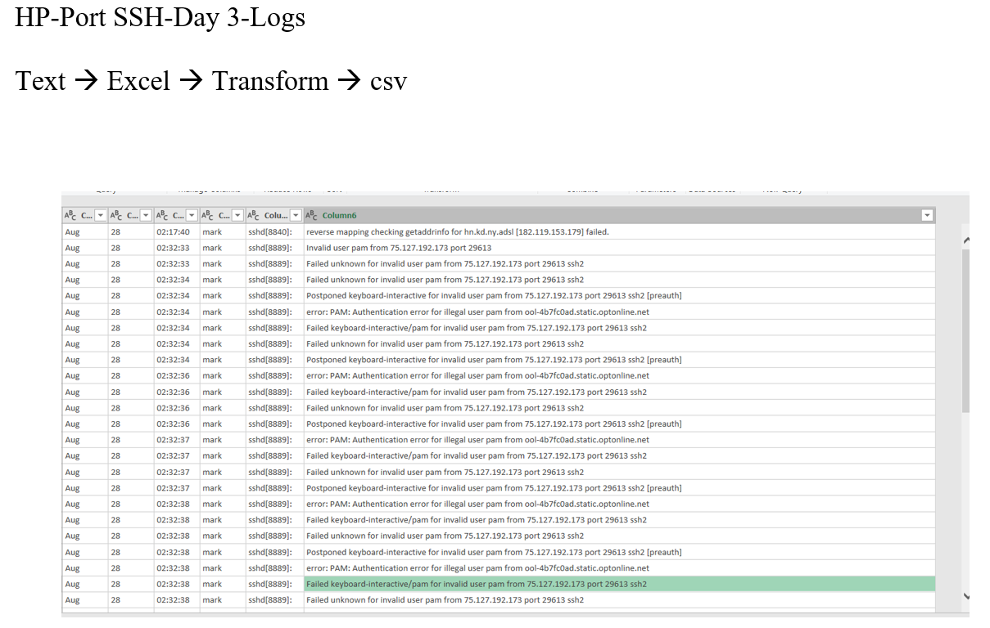
Before: Semi-structured HP Data (parsing tool)

Slide 18
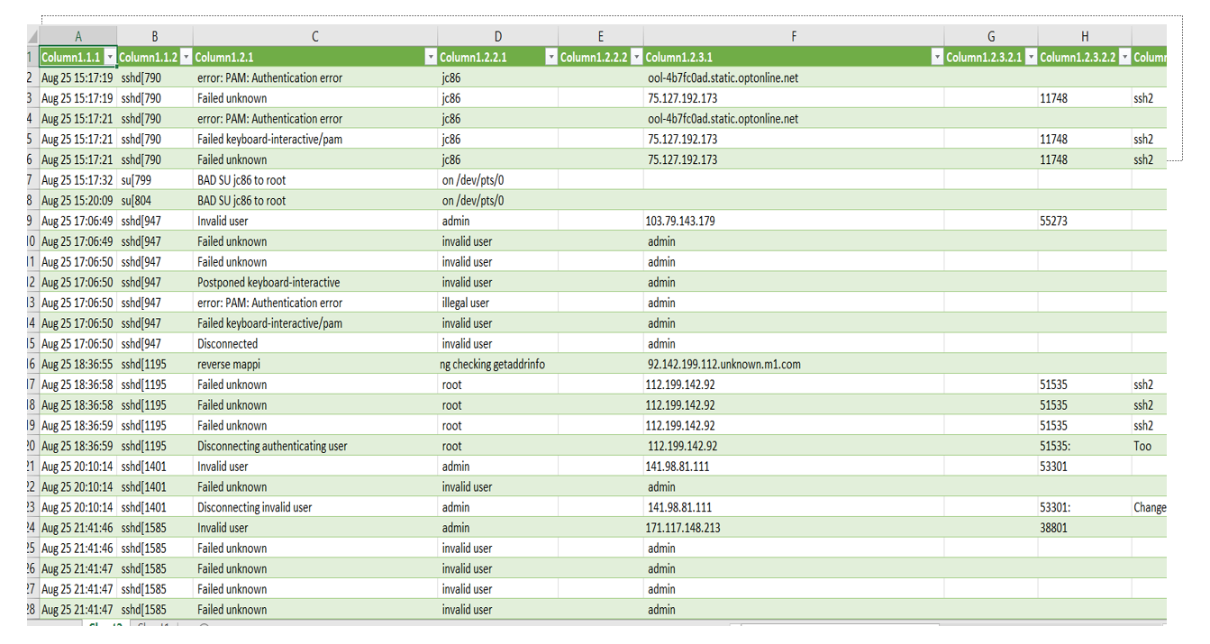
After: More Structured HP Data

Slide 19
References
Data Science Made Simple. (2019, September 23). Melting and casting in R. Data Science Made Simple. Retrieved from http://www.datasciencemadesimple.com/melting-casting-r/
Kaggle. (n.d.). AWS Honepot Attack Data: Visualizing cyber attacks. Kaggle. Retrieved from https://www.kaggle.com/casimian2000/aws-honeypot-attack-data
Sullivan, J. (2019, March 21). Data cleaning with R and the Tidyverse: Detecting missing values. Towards Data Science. Retrieved from https://towardsdatascience.com/data-cleaning-with-r-and-the-tidyverse-detecting-missing-values-ea23c519bc62
Wickham, H. (2016). ggplot2: elegant graphics for data analysis. Springer.
Zelterman, D. (2015). Applied multivariate statistics with R. Cham: Springer.

