Slide 1

Final Project Presentation Data Science Project: Boko Haram “Casualty Calculator” DSM-920: Dr. Perry
Mark A. Russo
December 16, 2019

Slide 2
Final Project Slides

Slide 3
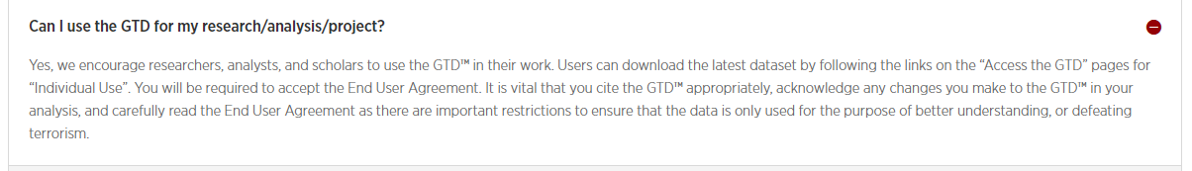
Data Ethics/Data Rights
Ethical Data protection
There are no data ethic concerns.
Using University of Maryland’s Global Terrorism Database (GTD).
No Personally Identifiable Information (PII) of any kind used.
User Agreement is the following:
Licensing Information Link : https://www.start.umd.edu/gtd/
STEP 1. Data Ethics

Slide 4
Objective
Based on past historical wounding of International Red Cross (IRC) support teams by the Boko Haram (BH) terror group, what is the predicted number of casualties based upon the day and month of the year?
STEP 2. Frame Business Problem

Slide 5

Performance Measures
Predict numbers of IRC personnel expected to be killed by BH attacks.
Use current (notional) IRC historical data of numbers wounded by BH engagements:
IRC Medical teams: 11 personnel size , 4 wounded per operation
IRC Food resupply teams: 28, 6 wounded
IRC Data science teams: 7, 1 wounded
STEP 3. Performance Measures

Slide 6

Data Description
BH attack data is collected from 2009 to 2018 using the Global Terror Database (GTD) [currently 92MB].
The GTD is a major event collection effort of terrorist categorical (description) and continuous (number/quantity) variables from around the globe by University of Maryland.
STEP 4. Get Data

Slide 7
Business Objective Achieved
Supervised predictive analytics is used:
Multiple Regression
Applied to BH specific attack data from 2009 to 2018
STEP 5. Explore Data

Slide 8
Prepare Data
Constrained to BH activities only.
Missing data replaced with zero values.
Conversion from Microsoft Excel to Comma Separated Value (csv) files.
STEP 6. Prepare/clean Data

Slide 9
Remarks
What worked:
Multiple Regression
What did not work:
(Univariate) Linear Regression
Logistic Regression
STEP 7. Explore Models

Slide 10
Assumptions
GTD is one of the most extensive and well-kept terrorism databases.
A normal distribution of wounding and killings.
Multiple regression and data visualization will show data relationships.
More wounded results in more casualties.
Higher monthly temperatures will result in reduced wounded personnel and reduced deaths.
GREEN – TRUE
RED – NOT TRUE
STEP 8. Fine-tuning

Slide 11
System Limitations
The Linear regression model assumes there is a linear relationship.
The model misses' extremes, outliers, that may be just as important.
Requires further human subject matter expertise
STEP 8. Fine-tuning (cont.)

Slide 12
Study Results
Appears that for every two persons wounded there is one death.
NOT TRUE: There is a non-linear data relationship.
Time of year (higher temperatures) has no effect on BH attacks.
STEP 9. Results

Slide 13
Study Results (cont.)
Relationship between wounding and kills
Medical Team (sample) for October (10), Day (24), predicated wounding numbers (4) =
6.9 killed out of 11
Food Resupply Team for July(7), Day (27), (6) wounded =
7.8 killed out of 28
Data Science Team for Jan (1), Day (27), and (1) person wounded =
6.9 killed out of 7
STEP 9. Results (cont.)
Casualty Calculator for Boko Haram (2009-2018).ipynb

Slide 14
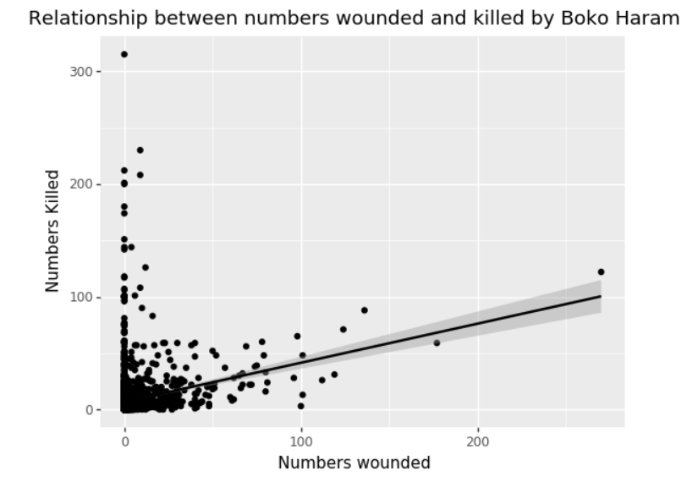
Casualties based on historical data and wounding of personnel
Non-linear relationship
STEP 9. Results (cont.)
Data_visualization_major_factors.ipynb

Slide 15
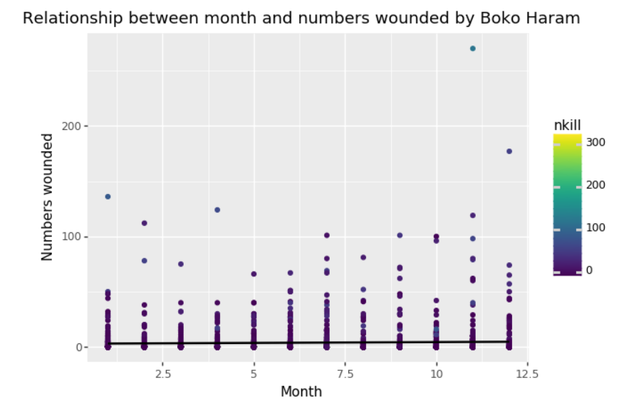
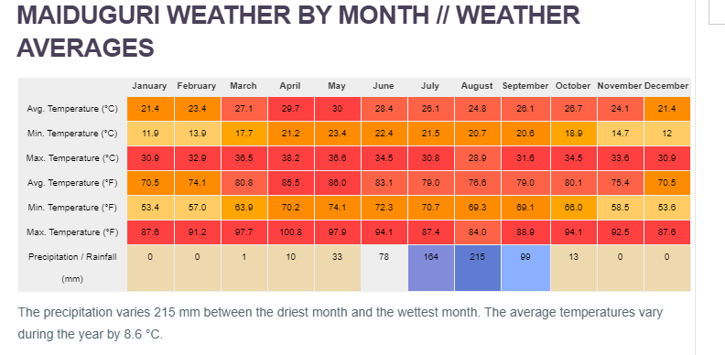
No best time to avoid BH/ Higher temperatures have no effect
STEP 9. Results (cont.)
Source: Climate Data. (n.d.).
Data_visualization_major_factors.ipynb

Slide 16
Value of Effort

Slide 17
Full Slides - Lifecycle

Slide 18
STEP 1: Considering Data Ethics
Ethical Data protection
There are no data protection requirements because this is event-based data publicly available and violates no identified national or international laws to include, for example, the U.S.’s Privacy Act of 1974 or the European Union’s General Data Protection Regulation (GDPR)
There is no Personally Identifiable Information (PII) as defined by OMB Memorandum M-07-1616

Slide 19
STEP 2: Frame the Business Problem
Sub-Step (SS)1. Define objective in business terms
The customer is the International Red Cross (IRC)
Boko Haram (BH) is an active terror group in North Africa. The customer wants to know when to best focus their resources and humanitarian efforts to avoid BH’s attacks and casualties against its in-country personnel.
When does BH cause the greatest number of fatalities and by how much based on historical data points for the three team types? (Linear Regression “Calculator”[LRC]).
What is the relationship between wounding and casualties caused by BH? (Python ggplot visualization).
Which months are the riskiest? (Python ggplot visualization and LRC outputs).

Slide 20
SS1 (continued)
Business problem:
When are the riskiest/deadliest (highest number) months of the year for IRC humanitarian actions?
How many wounded or killed might be expected based on the historical data points collected specific to the BH terrorist group?
Analytic Types: The use of predictive analytics will be employed
“Techniques use data about past events or statuses to predict future events or statuses”
Define objective:
Given the Global Terror Database (GTD) data from the University of Maryland (START) spanning 2009-2018: day, month, numbers wounded, and number killed, determine numbers of expected wounded or killed team members expected for 2020 IRC operations in Nigeria, if encounter BH..

Slide 21
SS 2. Determine how the solution will be used
Determine actual risk (numbers) for go or no-go decisions about humanitarian efforts in Nigeria based on the month (and, day—fine-tune).
Predict BH’s 2020 anticipated casualty rates based upon NGO team’s historical engagement data with BH.
(Notional scenarios) Historical data determined by data science team (typical effects):
Medical teams: 11 personnel , 4 wounded (nwound) per operation
Food resupply teams: 28, wounded 6
Data science teams: 7, wounded 1

Slide 22
SS 3. Identify the current solution
Use of qualitative measures provided by US military and UN forces in theater by intelligence professionals (“subject matter experts”) to “fine tune” likely threat actions.
Use of basic analytic techniques, predominantly qualitative in nature
Understanding BH’s Order of Battle (OB).
Their strengths and weaknesses based on intelligence collection means in theater.
Studying past attack profile.
Using an understanding of local natural terrain employment (e.g., using maximum natural vegetation cover OR launching attacks from high ground).
Employing understandings of general terror group psychology.
Analyses of military intelligence and diplomatic message traffic.

Slide 23
SS 4. Select learning approaches
Supervised training of data employing multiple regression to classify impacts of BH attacks.
Regression: Fitting a model to a set of data
Classification: Uses correctly answered (collected) data
Predicting discrete responses
Missing values deleted or imputed

Slide 24
SS 5. Select data processing style
Use of batch (offline) learning will be employed with select open-source terrorist dataset.
Rationale:
Use static (robust) data from a high-quality repository.
Processing large amounts of historically-housed data.

Slide 25
STEP 3: Select Performance Measures
Select the key metrics
Select comparison method
Define the minimum performance
Identify any comparable problems
Determine if human expertise is available
Determine if manual solution exists
List all the assumptions
Check Assumptions

Slide 26
STEP 3: Select Performance Measures: SS 1. Select the key metrics
Defining success: Regression model able to compute the number of wounded or killed based upon the MONTH of the year given the historical data.
Fine-tune: use both Month and Day
Metrics indicating success: The projected numbers of wounded, and numbers killed that assist to determining BH threats to IRC teams in Nigeria.
Quantification: will be the actual numbers predicted (nwound and nkill).

Slide 27
SS 2. Select comparison method
Least Squares comparison between test and full data set.
Linear regression uses…least squares method to minimize the errors and arrive at a best possible fit…(StackOverflow, n.d.)
Business alignment:
Large projected casualty numbers will inform IRC decision-makers whether to conduct or not conduct operations.
It will ensure life and safety of personnel.

Slide 28
Sub-Steps 3 - 4
SS3. Define minimum performance
Least squares minimized to within 93% (approx. 3 sigma)
SS4. Identify any comparable problem
This problem is specific to BH (scoping) based upon IRC major operational area
There is no comparative situation

Slide 29
SS5
SS5. Determine if human expertise is available
Data Science Team 1 uses basic statistics and has been about 75% accurate in its casualty predictions; can use team’s analysis as a baseline.
Machine learning tools, to include Linear Regression, “can achieve a substantially higher prediction accuracy than [basic] statistical prediction models” (Fang et al., 2019, p. 2).
Would Require a “calibrated” subject matter expert currently not available to IRC (Hubbard & Seiersen, 2016); training scheduled for Data Science Team 1’s state-side return in June 2020.

Slide 30
SS 6: Determine if manual solution exists (how to solve manually)
Any manual solution could be accomplished by statistical analysis of IRC activity logs since 2014 (start of operations in Nigeria)
The holistic solution cannot be resolved using “OCOKA” factors alone (projected-qualitative using classic terrain analysis).
The manual solution would not provide enough definition as required by the stated problem.
OCOKA “Terrain” factors(Army Study Guide, 1999)
Observation and Fields of Fire
Cover and Concealment
Obstacles (man-made and natural)
Key or Decisive Terrain
Avenues of Approach

Slide 31
SS 7: List assumptions
BH will be less active during higher temperature periods in NE Nigeria.
More casualties will occur with larger bodies of NGO activities versus smaller.
BH will focus attacks historically along major Lines of Communication (LOC) where they can attack, resupply, and retreat easily from UN and US forces.
Source: Climate Data. (n.d.).

Slide 32
SS 8: Check assumptions
Verify THESE assumptions
BH will be less active during higher temperature periods in NE Nigeria.
More casualties will occur with larger bodies of NGO activities versus smaller.
BH will focus attacks historically along major Lines of Communication (LOC) where they can attack, resupply, and retreat easily from UN and US forces.

Slide 33
STEP 4: Getting the Data (SS1-3)
SS 1: Identify the data. Using the University of Maryland’s Global Terrorism Database (GTD).
SS 2: Find the data. UMD/START effort: https://gtd.terrorismdata.com/register-type/?type=non-commercial
SS 3: Identify Storage requirements.
Original size = 92 MB
BH only data size = 35 MB
boko_kill.csv (full set) – 185 kb
test_boko.csv (test set) – 9 kb

Slide 34
SS4-5
SS 4: Get Authorization to use the Data. “Individual Use” authorized (see below)
SS 5: Get access authorizations. (completed User Agreement requirements; cited GTD as appropriate).
Licensing Information : https://www.start.umd.edu/gtd/

Slide 35
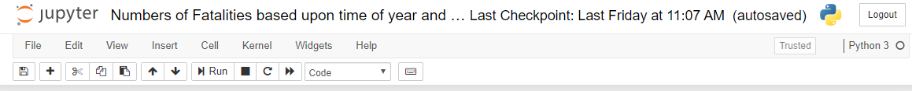
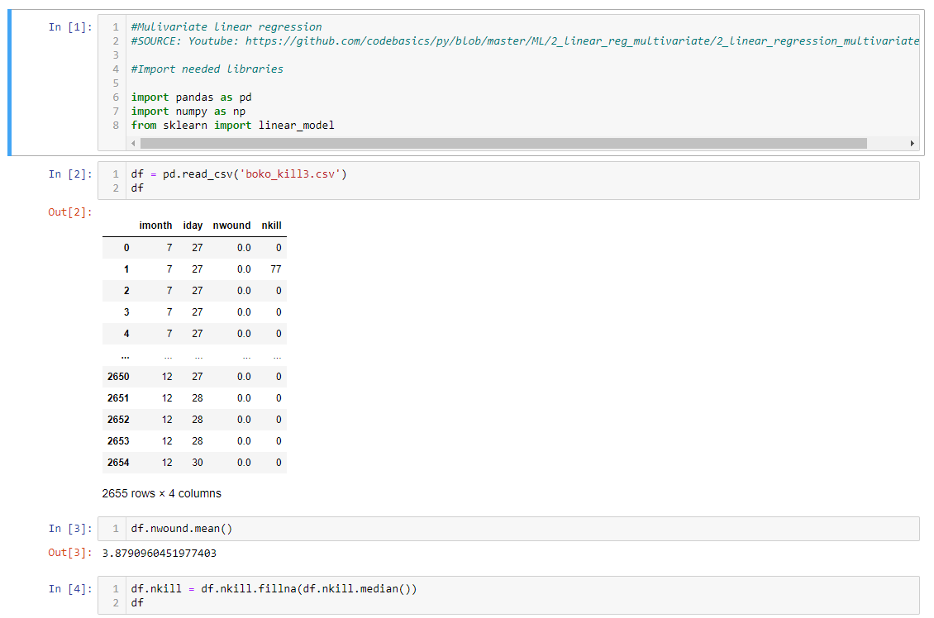
SS6:Create a workspace = Jupyter notebook

Slide 36

S4 Getting the Data/ SS 7 through 10
SS7: Get the data. GTD (as described)
SS8: Identify data structure types.
semi-structured
includes a GTD Codebook
SS9: Convert data format.
Xlsx → csv (only major conversion)
SS10: Anonymize data. Anonymization of data not required. No personal or sensitive information used. This is an open data source repository available to the general public and academia.

Slide 37
S4/SS 11 through 12
SS11: Check data. Re-verified data complete as of December 14, 2019 as correct.
SS12: **Sample test set of 20% of data created on November 23, 2019) = test_boko.csv (Assignment)
Full size = 2665 entries
20% = 533

Slide 38
Step 5: Exploring the Data for Insights
SS1: Create a test set. Test_boko.csv(test set) using pasting approach (sampling without replacement).
SS2: Study each attribute and its characteristics.
Completed by visual inspection and review of GTD codebook download from site. Includes integers, floats, and strings.
Approximately 1% missing values—imputed as zero(0).
Noisiness minimal (outliers identified better in SS4 via visualization step).
Data VERY useful for the purpose sought: able to assess key attributes; observe relationships in the data
Statistical distributions: mainly normal and examples of logarithmic impact nwound and nkill based on engagement.

Slide 39
SS3: Supervised learning (SELECTED)/identify target attributes.
Day (iday)
Month (imonth)
Number of wounded (nwound)
Number killed (nkill)

Slide 40

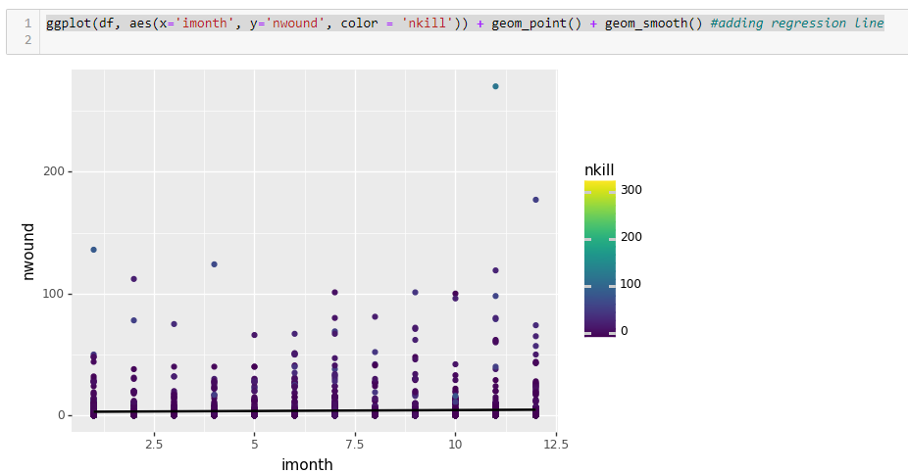
SS4: Visualize the data (ggplot in python; full dataset)
-No apparent better or worse month for wounding by BH; SEE visualization file titled: “xxx.ipynb”
-Outliers: Jan, Apr, Nov, Dec

Slide 41
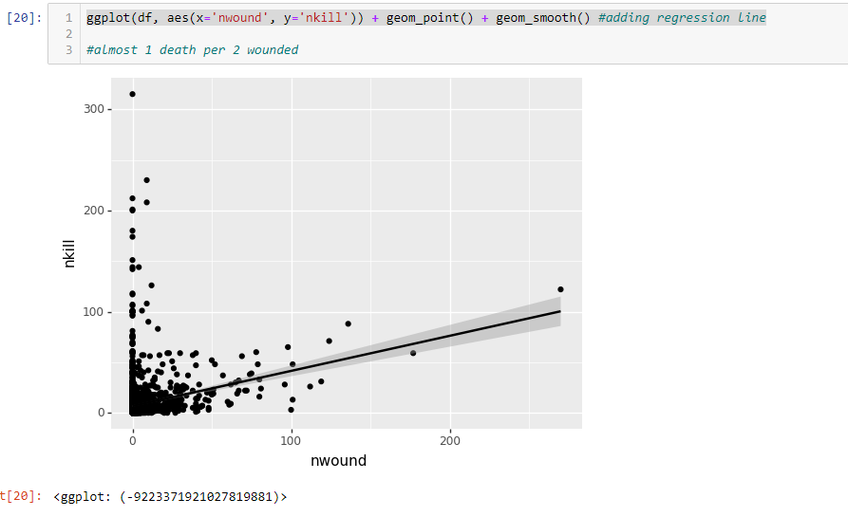
Almost 1 death for every 2 wounded (observed correlation – SS5)
Almost a 1 killed for every 2 wounded based on GTD dataset.
If there is wounding then more of a likelihood of death (logical).
If around “zero” wounded, more likely to have greater casualty rate.

Slide 42
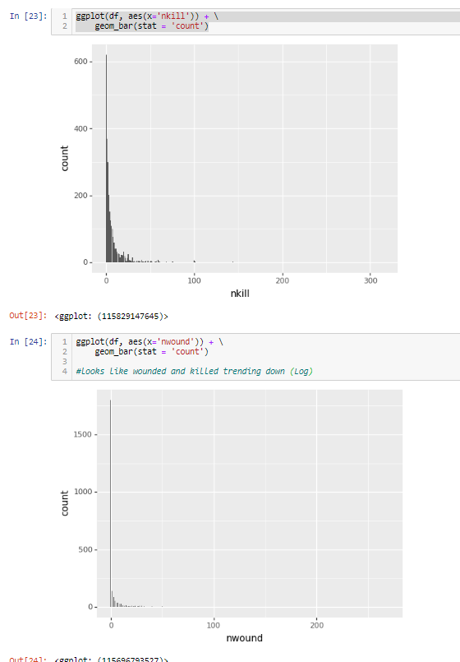
Overall trend: Unlikely to cause death or wounding, in general (logarithmic)
The Good News: it appears that BH attacks’ likelihood of inflicting wounding or casualties is very small based upon the engagement history

Slide 43
SS5: Look for correlations
1 death per every 2 wounded based on data visualization.
No real correlation between time of year and attack impacts.
Temperature (high) does not appear to reduce BH attacks.

Slide 44
SS6: Consider how to solve problem manually
IRC can use a factor of 1 killed for every 2 wounded; however, the likelihood of any wounding or deaths is dramatically small based upon the GTD data.

Slide 45
SS7: Identify promising transformations
Eliminate blank data/NANs first
Impute missing values (assumed zero the safest)
Blank deaths assume zero
May skew the calculations slightly

Slide 46
SS7: Identify useful extras
Best to avoid BH engagements where possible because of their historical use of lethal attacks.
Time of year and number wounded are beneficial to determining casualties by BH attacks using LR (explore further).
High temperatures in region unlikely to impact BH operations.

Slide 47
SS9: Document what you learned
LR appears to be more than adequate to calculate impacts of BH attacks.
Additional factors, to include wounding's, are needed to further fine-tune casualty predictions.
Data cleaning is required to support calculations, but concerned (researcher) if there may be skewing due to outlier data that may better tune the LR model overall.

Slide 48
Step 6. Preparing and Cleaning Data (Anonymization)
SS1: Data Anonymization – Not required; Open-source with no PII data
Other cleaning activities: replacing blanks with zero (0), NANs, etc.

Slide 49
Step 7: Exploring Multiple Models
Explored available training models to include literature review and Python code reviews of instructor’s models.
The two best candidates were:
Linear Regression(LR)
Logistics Regression (LogR)
Selected Linear Regression (LR) based, in part, on the following:
“The dependent variable
Logistic regression is used when the response variable is categorical in nature. For instance, yes/no, true/false, red/green/blue, 1st/2nd/3rd/4th, etc.
**Linear regression is used when your response variable is continuous. For instance, weight, height, number of hours, etc.” (Grus, 2019; StackOverflow, n.d.)

Slide 50
Assumptions
GTD is one of the most extensive and well-kept terrorism databases.
A normal distribution of wounding and killings.
Multiple regression and data visualization will show data relationships.
More wounded results in more casualties.
Higher monthly temperatures will result in reduced wounded personnel and reduced deaths.
GREEN – TRUE
RED – NOT TRUE
STEP 8. Fine-tuning

Slide 51
System Limitations
The Linear regression model assumes there is a linear relationship.
The model misses' extremes, outliers, that may be just as important.
Requires further human subject matter expertise
STEP 8. Fine-tuning (cont.)

Slide 52
Study Results
Appears that for every two persons wounded there is one death.
NOT TRUE: There is a non-linear data relationship.
Time of year (higher temperatures) has no effect on BH attacks.
STEP 9. Results

Slide 53
Study Results (cont.)
Relationship between wounding and kills
Medical Team (sample) for October (10), Day (24), predicated wounding numbers (4) =
6.9 killed out of 11
Food Resupply Team for July(7), Day (27), (6) wounded =
7.8 killed out of 28
Data Science Team for Jan (1), Day (27), and (1) person wounded =
6.9 killed out of 7
STEP 9. Results (cont.)
Casualty Calculator for Boko Haram (2009-2018).ipynb

Slide 54
Casualties based on historical data and wounding of personnel
Non-linear relationship
STEP 9. Results (cont.)
Data_visualization_major_factors.ipynb

Slide 55
No best time to avoid BH/ Higher temperatures have no effect
STEP 9. Results (cont.)
Source: Climate Data. (n.d.).
Data_visualization_major_factors.ipynb

Slide 56
References
Army Study Guide. (1999). OCOKA. Army Study Guide. Retrieved from https://www.armystudyguide.com/content/army_board_study_guide_topics/survival/ocoka.shtml
Climate Data. (n.d.). Maiduguri climate. Climate-data.org. Retrieved from https://en.climate-data.org/africa/nigeria/borno/maiduguri-545/#climate-table
Fang, X., Xu, M., Xu, S., & Zhao, P. (2019). A deep learning framework for predicting cyber attacks rates. EURASIP Journal on Information Security, 2019(1), 1–11. Retrieved from http://franklin.captechu.edu:2123/10.1186/s13635-019-0090-6
Grus, J. (2019). Data science from scratch. Boston, MA: O’Reilly Media.
Hubbard, D., & Seiersen, R. (2016). How to measure anything in cybersecurity risk. Hoboken, NJ: John Wiley & Sons.
StackOverflow. (n.d.). What is the difference between linear regression and logistic regression? StackOverflow. https://stackoverflow.com/questions/12146914/what-is-the-difference-between-linear-regression-and-logistic-regression Retrieved from
University of Maryland. (2019). Global terrorism database [Data file]. Retrieved from https://gtd.terrorismdata.com/register-type/?type=non-commercial

Slide 57
Questions?

Slide 58
Hypothesis: Attacks are less prevalent when environmental conditions are too hot (>95 deg)
Deductive approach-generalizing to a specific outcome or likelihood
MONTHS: March, April, May
Had no effect on BH operations
Source: Climate Data. (n.d.).

