Slide 1

Final Project Presentation Data Science Project: Boko Haram “Casualty Calculator” DSM-920: Dr. Perry
Mark A. Russo
December 16, 2019

Slide 2
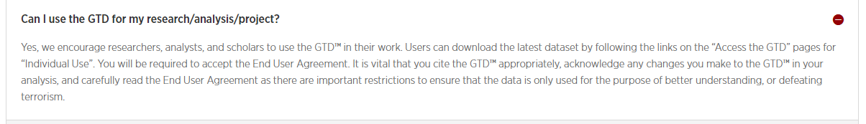
Data Ethics/Data Rights
Ethical Data protection
There are no data ethic concerns.
Using University of Maryland’s Global Terrorism Database (GTD).
No Personally Identifiable Information (PII) of any kind used.
User Agreement is the following:
Licensing Information Link : https://www.start.umd.edu/gtd/
STEP 1. Data Ethics

Slide 3
Objective
Based on past historical wounding of International Red Cross (IRC) support teams by the Boko Haram (BH) terror group, what is the predicted number of casualties based upon the day and month of the year?
STEP 2. Frame Business Problem

Slide 4

Performance Measures
Predict numbers of IRC personnel expected to be killed by BH attacks.
Use current IRC historical data of numbers wounded by BH engagements:
IRC Medical teams: 11 personnel size , 4 wounded per operation
IRC Food resupply teams: 28, 6 wounded
IRC Data science teams: 7, 1 wounded
STEP 3. Performance Measures

Slide 5

Data Description
BH attack data is collected from 2009 to 2018 using the Global Terror Database (GTD) [currently 92MB].
The GTD is a major event collection effort of terrorist categorical (description) and continuous (number/quantity) variables from around the globe by University of Maryland.
STEP 4. Get Data

Slide 6
Business Objective Achieved
Supervised predictive analytics is used:
Multiple Regression
Applied to BH specific attack data from 2009 to 2018
STEP 5. Explore Data

Slide 7
Prepare Data
Constrained to BH activities only.
Missing data replaced with zero values.
Conversion from Microsoft Excel to Comma Separated Value (csv) files.
STEP 6. Prepare/clean Data

Slide 8
Remarks
What worked:
Multiple Regression
What did not work:
(Univariate) Linear Regression
Logistic Regression
STEP 7. Explore Models

Slide 9
Assumptions
GTD is one of the most extensive and well-kept terrorism databases.
A normal distribution of wounding and killings.
Multiple regression and data visualization will show data relationships.
More wounded results in more casualties.
Higher monthly temperatures will result in reduced wounded personnel and reduced deaths.
GREEN – TRUE
RED – NOT TRUE
STEP 8. Fine-tuning

Slide 10
System Limitations
The Linear regression model assumes there is a linear relationship.
The model misses' extremes, outliers, that may be just as important.
Requires further human subject matter expertise
STEP 8. Fine-tuning (cont.)

Slide 11
Study Results
Appears that for every two persons wounded there is one death.
NOT TRUE: There is a non-linear data relationship.
Time of year (higher temperatures) has no effect on BH attacks.
STEP 9. Results

Slide 12
Study Results (cont.)
Relationship between wounding and kills
Medical Team (sample) for October (10), Day (24), predicated wounding numbers (4) =
6.9 killed out of 11
Food Resupply Team for July(7), Day (27), (6) wounded =
7.8 killed out of 28
Data Science Team for Jan (1), Day (27), and (1) person wounded =
6.9 killed out of 7
STEP 9. Results (cont.)
Casualty Calculator for Boko Haram (2009-2018).ipynb

Slide 13
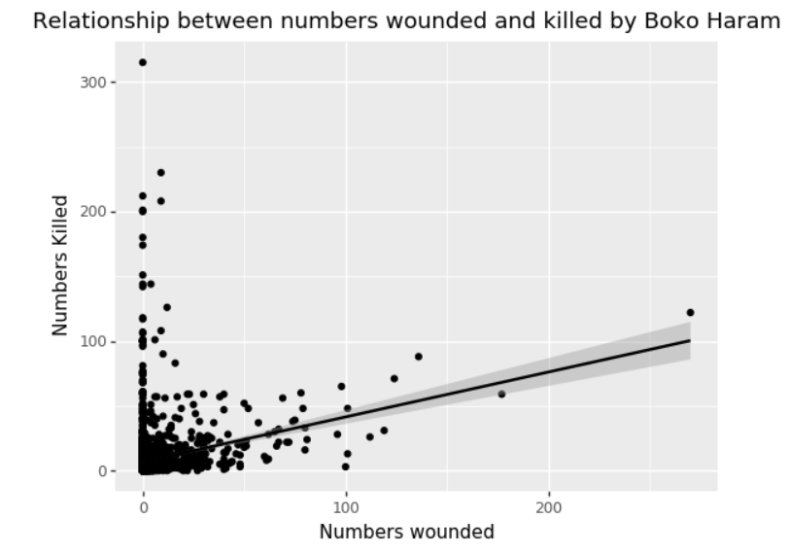
Casualties based on historical data and wounding of personnel
Non-linear relationship
STEP 9. Results (cont.)
Data_visualization_major_factors.ipynb

Slide 14
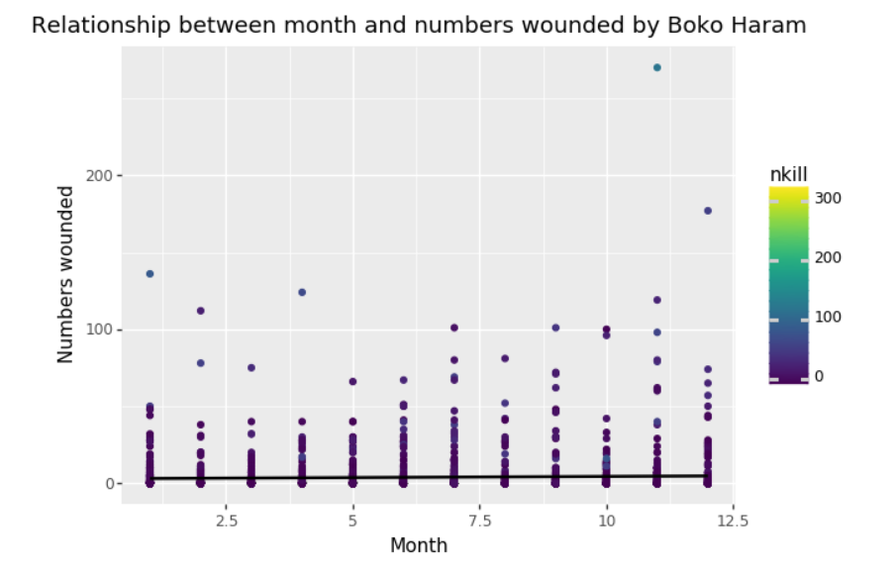
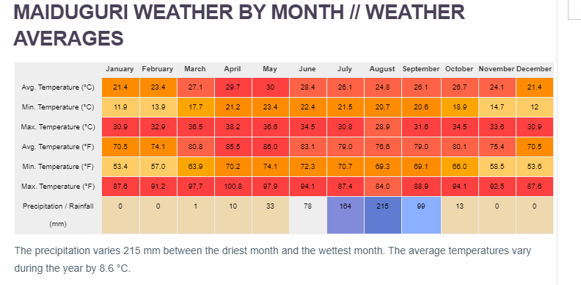
No best time to avoid BH/ Higher temperatures have no effect
STEP 9. Results (cont.)
Source: Climate Data. (n.d.).
Data_visualization_major_factors.ipynb

Slide 15
References
Climate Data. (n.d.). Maiduguri climate. Climate-data.org. Retrieved from https://en.climate- data.org/africa/nigeria/borno/maiduguri-545/#climate-table
Grus, J. (2019). Data science from scratch. Boston, MA: O’Reilly Media.
StackOverflow. (n.d.). What is the difference between linear regression and logistic regression? StackOverflow. Retrieved from https://stackoverflow.com/questions/12146914/what-is-the-difference-between-linear-regression-and-logistic-regression Retrieved from
University of Maryland. (2019). Global terrorism database [Data file]. Retrieved from https://gtd.terrorismdata.com/register-type/?type=non-commercial

Slide 16
Questions?

