Slide 1
The Dataset
Which dataset you chose to analyze?
2013 China Air Quality Index (AQI) dataset [Kaggle.com] from Weeks 3, 5, and 6
What makes these datasets important?
Good data to be analyzed statistically

Slide 2
The Dataset (cont.)
How the dataset apply to a specific business decision?
Determining optimal locations for building a factory in China with good access to resources/labor (GDP) and quality of life (AQI)
Creating metrics/statistics
Why your analysis would be important and/or how it closes gaps in knowledge?
Can use as a model for other businesses venturing into China

Slide 3
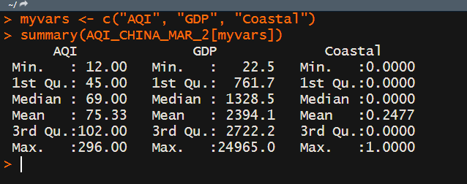
Summary( )
Notes:
Worked. Min/max, 1 and 3 quartile, note coastal

Slide 4
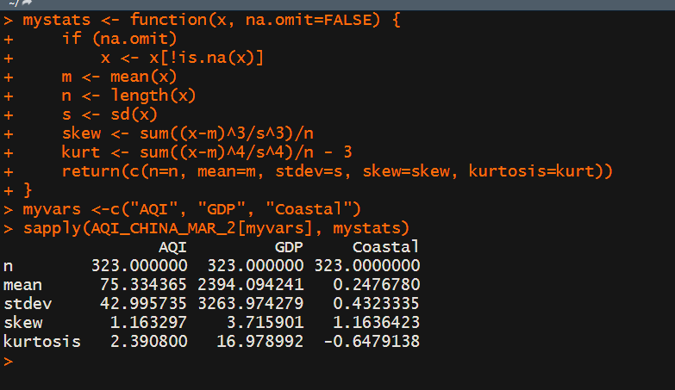
Descriptive statistics using sapply
Notes:
N all match, 323 obs, mean, etc

Slide 5
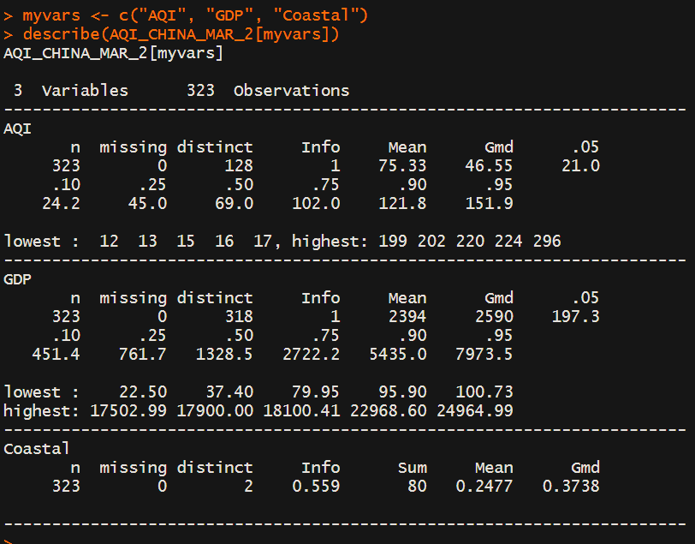
Hmisc
Notes:
Use Hmisc passed values, no missing values, liked seeing that confirmed, distinct?

Slide 6
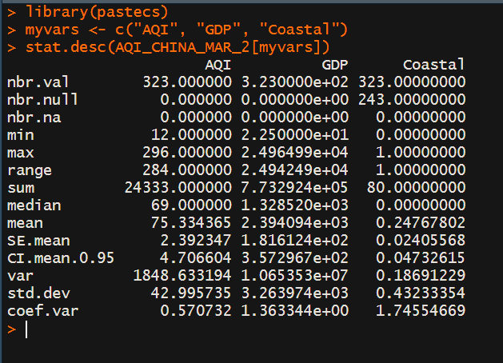
Stat.desc( )
Notes:
OK

Slide 7
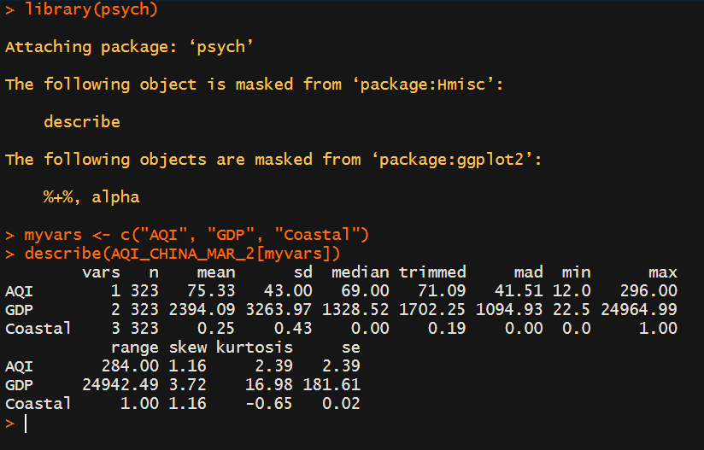
Describe( ) in psych
Notes:
psych

Slide 8
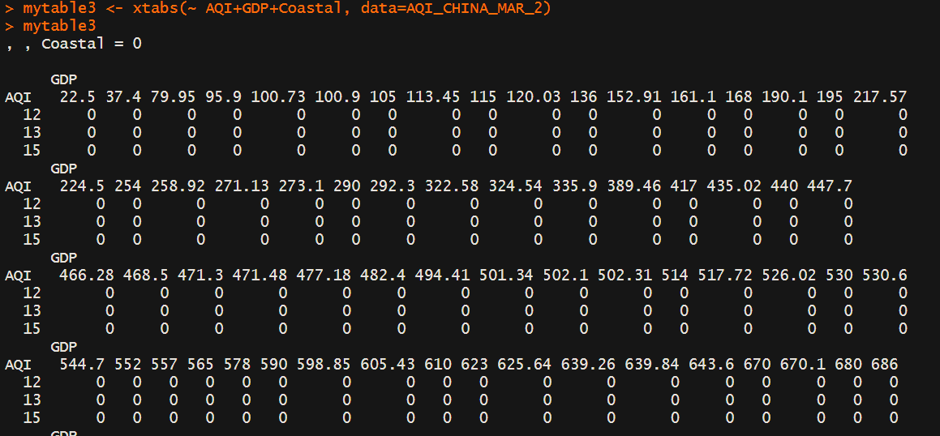
Three-way Contingency Table (not so good)
Notes:
Not so good, does order it by not on the coast = 0, messy

Slide 9
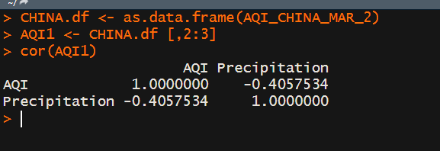
Corr ( ) -- Negative

Slide 10
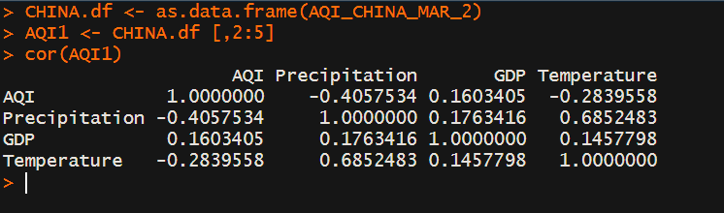
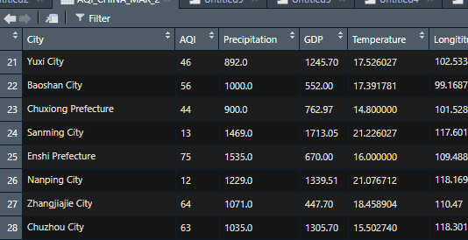
Correlations “Pearson”
5
2:
Notes:
Correlations Pearson linear relationship between 2 quantitative variables used actual
Had to convert dataset spreadsheet to dataframe HERE
Seys AQI first corr, appears neg for precip, pos GDP, neg Temp; precip: neg AQI, pos GDP pos with temp—makes sense that weather would have a greater corr nearing 1

Slide 11
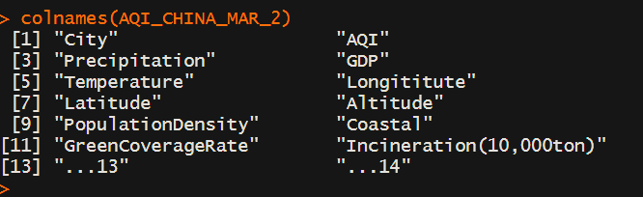
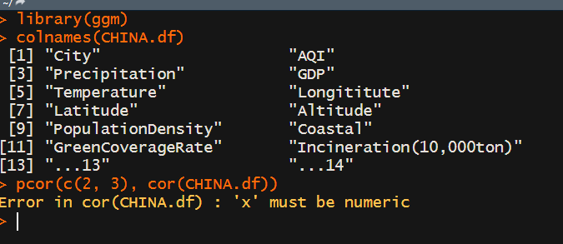
Partial correlations “must be numeric”
Notes:
Could not get to work with pcor not sure; even tried it with cor—originally cov!!

Slide 12
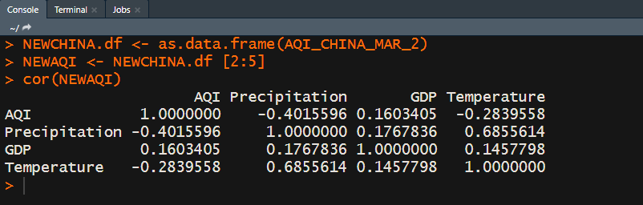
Reset Dataframe

Slide 13
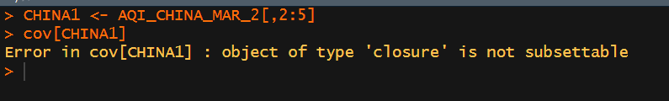
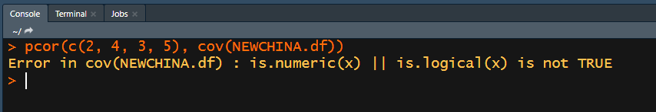
2nd TRY
Notes:
Covariance again

Slide 14
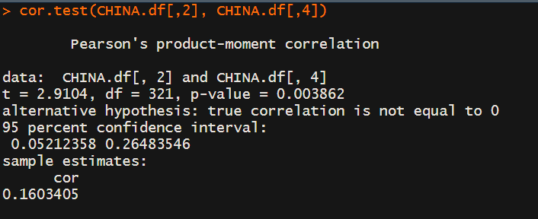
Testing correlation for significance
Notes:
Tests null hypothesis, corr betw AQI (2) and GDP (4) THERE IS A POSITIVE SAMPLE CORR OF 0.16—OK.

Slide 15
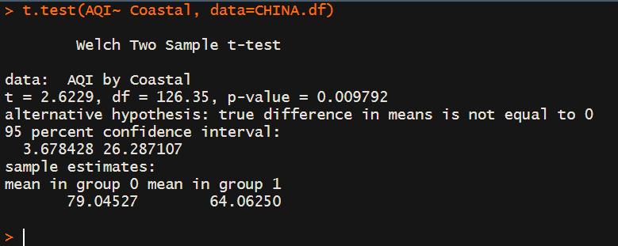
Independent t-test
Notes:
Y is numeric, AQI, and coastal is dichotomous…had to use for this It compares being on the COAST, group 1, with not being on the coast, group 0 where the AQI is higher ARE YOU MORE LIKELY TO BE EXPOSED TO A HIGHER AQI ON THE COAST (GP1) versus NOT GROUP 2. You are actually 15% LESS likely going to be exposed to higher AQI…altitude/higher is BETTER.

Slide 16
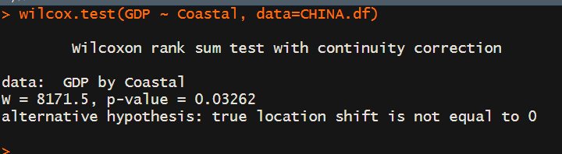
Non-parametric (compares 2 groups)
Notes:
Wilcoxon or Mann-Whitney U test—are obs sampled from the same probability distribution? You can reject the null hypothesis that GDP and coastal location are the same for working on the coast or not. ASSUMPTION closer to coast higher GDP

Slide 17
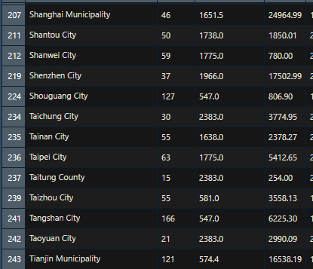
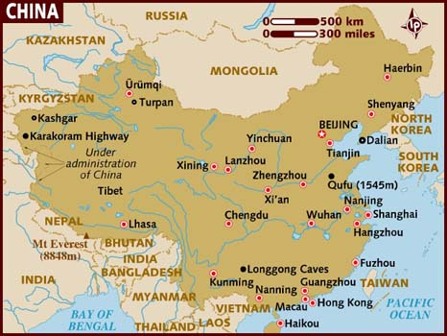
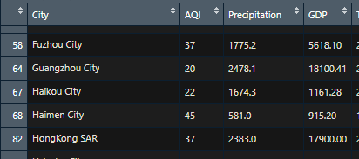
Coastal ~ GDP
Notes:
Further data analysis of coastal

Slide 18
R Lessons Learned
A lot of powerful statistics packages
Sometimes dataset conversions vital
Descriptive Statistics → Interest is Predictive Statistics/Analytics

