Slide 1
What should you include?
Which dataset you chose to analyze? Air Quality Index (AQI) for China (from Week 3)
What makes this dataset important?
Provides numerical data that can be used for analysis
What (potential) research questions you are asking?
What are the top ¼ (quantile) locations for building a factory in China?
With best access to labor and resources?
“Quality of life” locations?
How the dataset applies to a specific business decision?
Provides Courses of Action (COA) for a business establishing a factory in China
Why your analysis would be important and/or how it closes gaps in knowledge?
Provides a “roadmap” for other businesses attempting the same

Slide 2
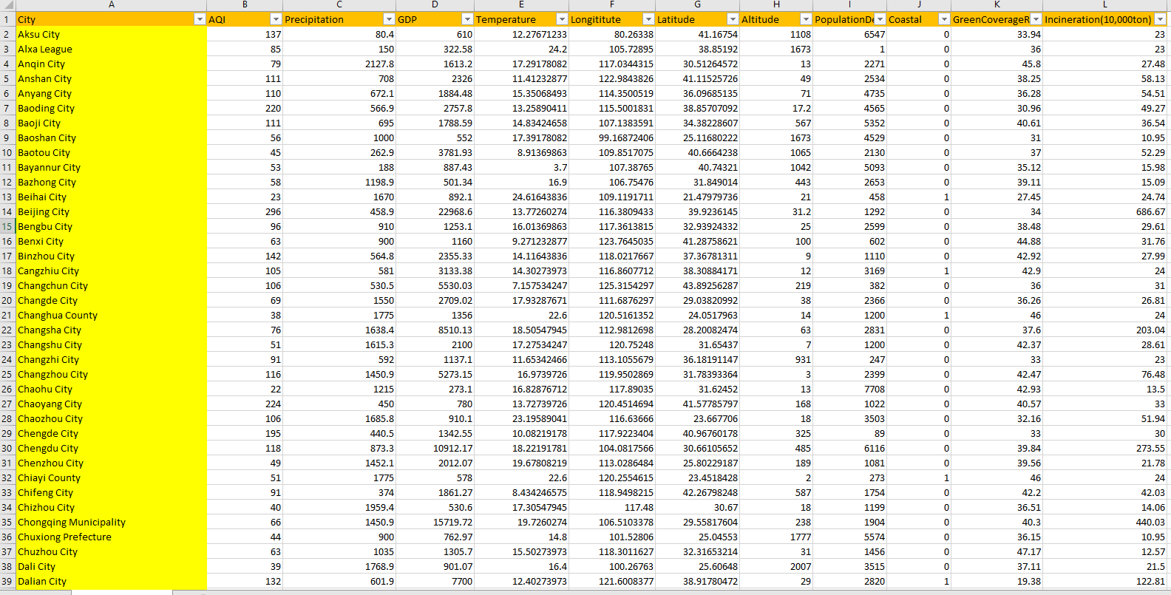
Dataset (AQI_CHINA_MAR_2) variables=12 observations=323

Slide 3
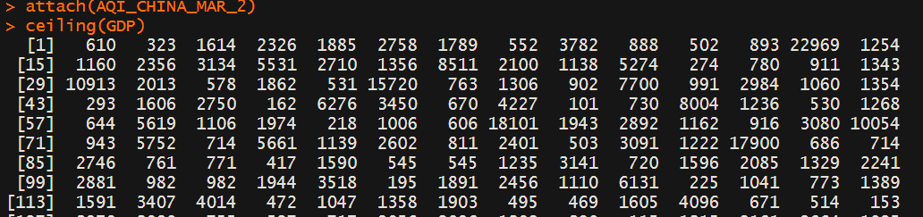
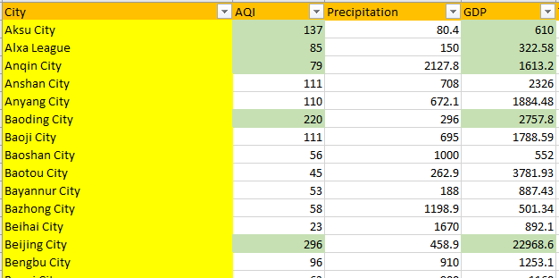
Ceiling(GDP)

Slide 4
The Challenge
Find a city/region that can provide needed labor and resources
Locate a good “quality of life” area with low pollution concerns

Slide 5
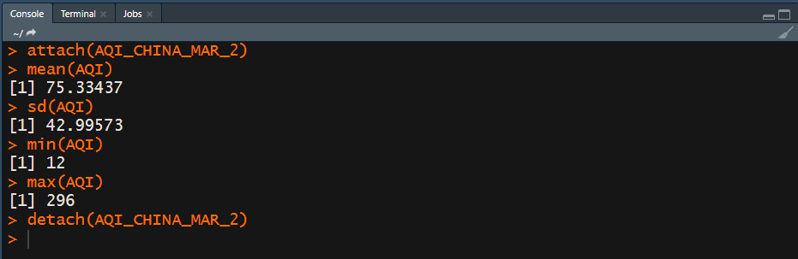
AQI Analysis
Best and worst AQI numbers

Slide 6
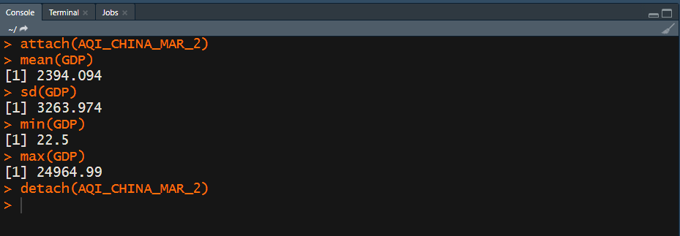
GDP Analysis
Assumption:
Higher the GDP, the greater the access to resources and needed labor

Slide 7
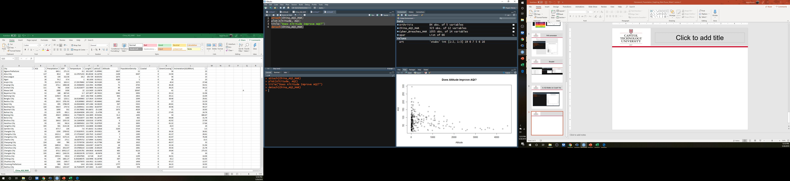
A Factor that may improve “quality of life” locations
Altitude is better for lower AQI
Sea Level [coastal] worse
From Week 3 Observation

Slide 8
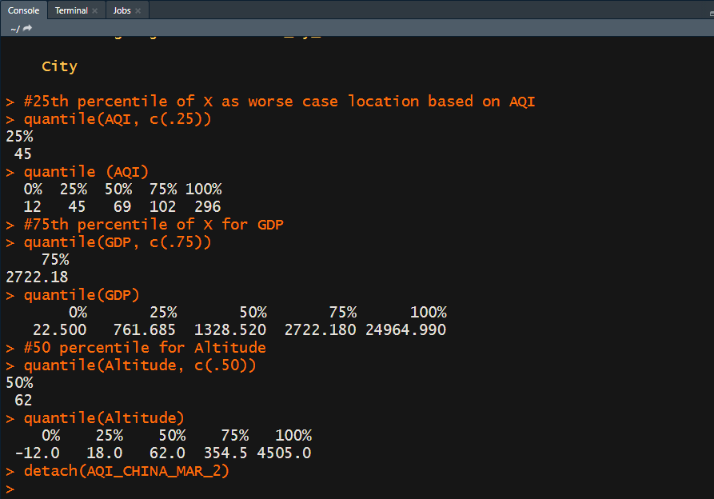
Select Criteria Create quantiles
AQI <= 45
GDP >= 2722.18
Altitude >= 62

Slide 9
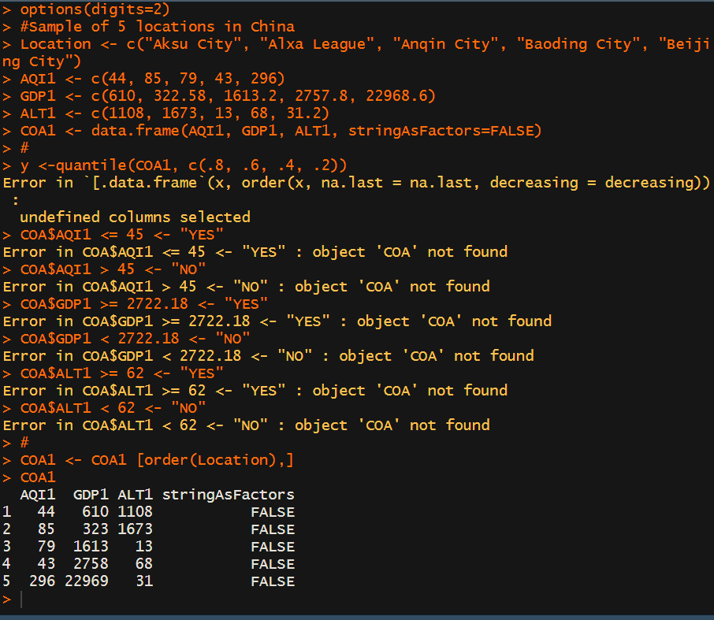
Sample Dataframe – COA1

Slide 10
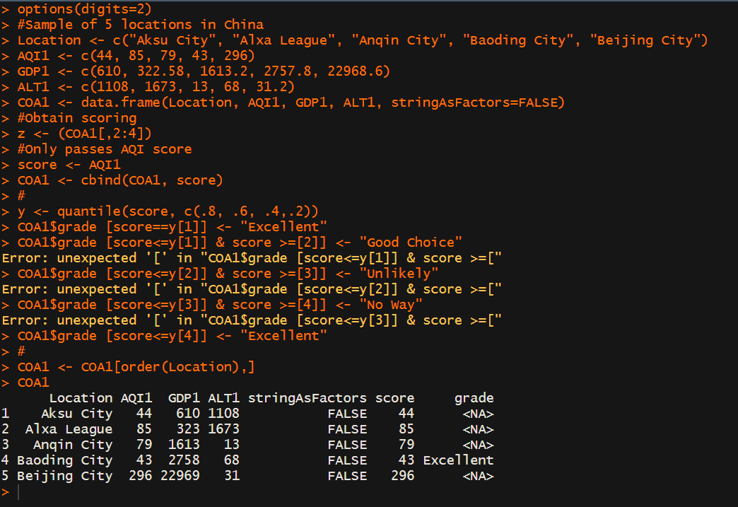
Initial: Backwards - Lower AQI better
Originally “Yikes”
Ordered by Location

Slide 11
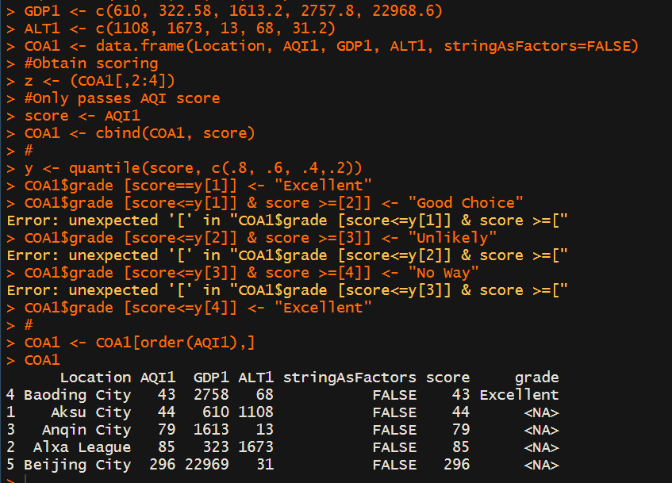
AQI Order
Ordered by AQI1

Slide 12
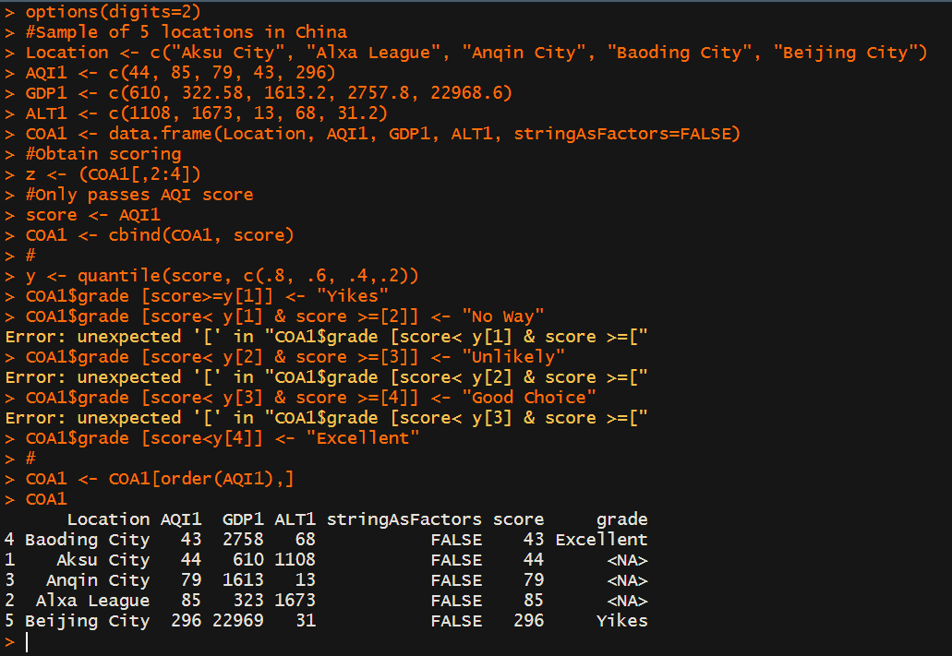
Chasing brackets [
Missing something
Problems

Slide 13
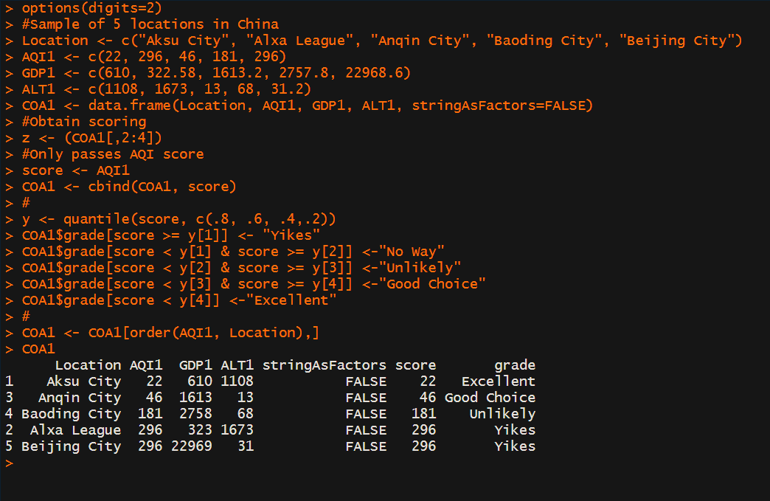
Fixed It!!
Attention to details
Missing y[#]
AQI = variable
AQI1 = new variable passing data
Order() –Damn comma at end

Slide 14
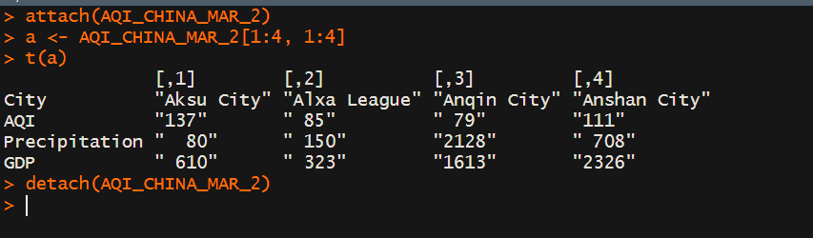
Aggregation Methods: Transpose

Slide 15
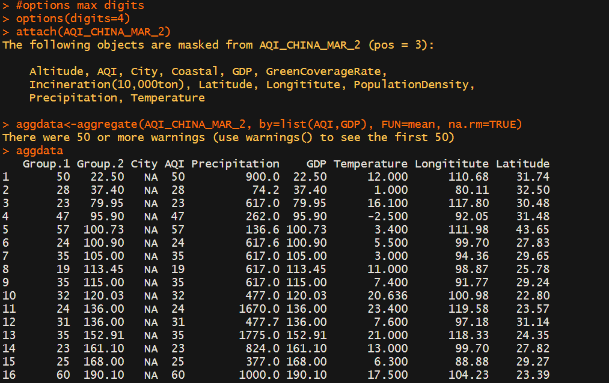

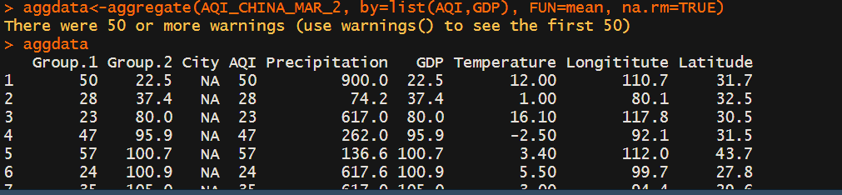
Aggregation Methods: Aggregate

Slide 16
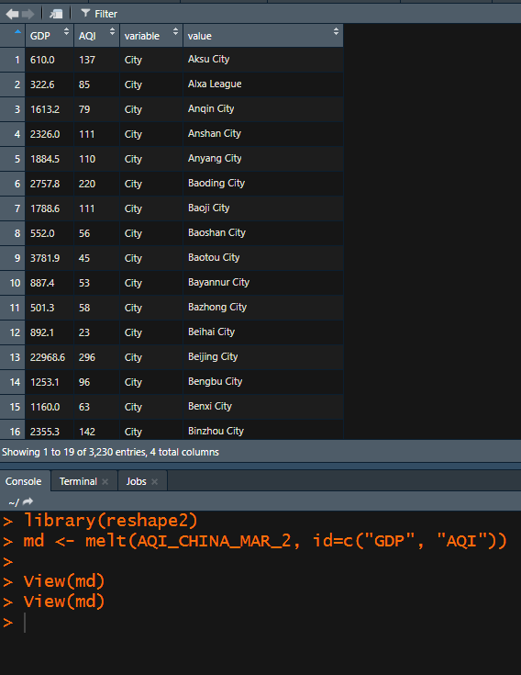
Aggregation Methods: Reshape2 Package
“Melted” GDP and AQI to Front

Slide 17
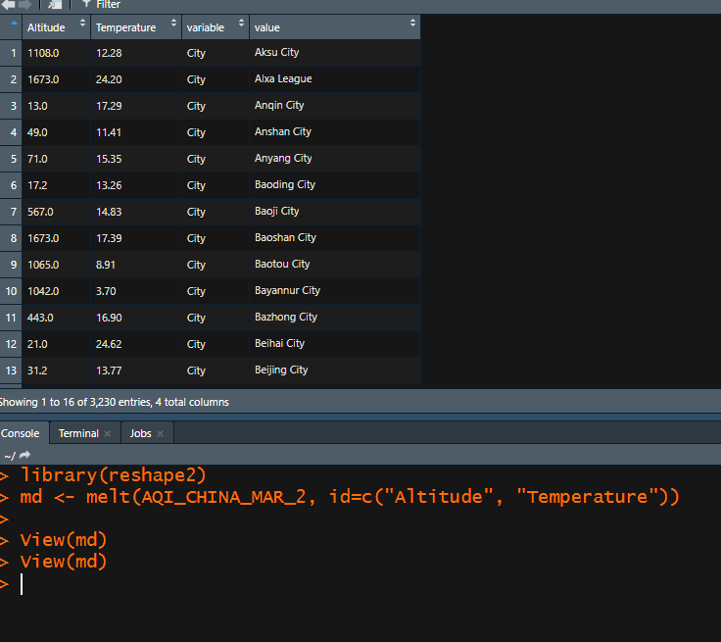
Aggregation Methods: Reshape2 Package
“Melted” Altitude and Temperature to Front

Slide 18
R Lessons Learned
“Attention to details”!!!

