Slide 1
Messaging Layer Security
(MLS)
RFC 9420

Slide 2
TABLE OF CONTENTS
01
04
02
05
03
06
Protocol Overview
TreeSync
TreeKEM
OpenMLS
TreeDEM
My project

Slide 3
0
Why MLS ?

Slide 4
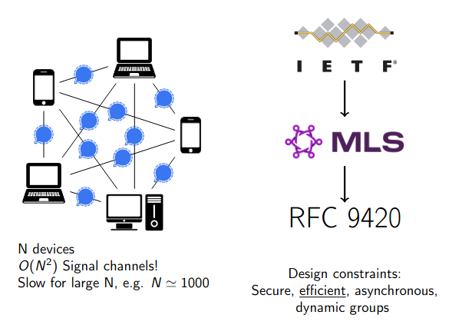
State of the art before MLS

Slide 5
01
PROTOCOL OVERVIEW

Slide 6
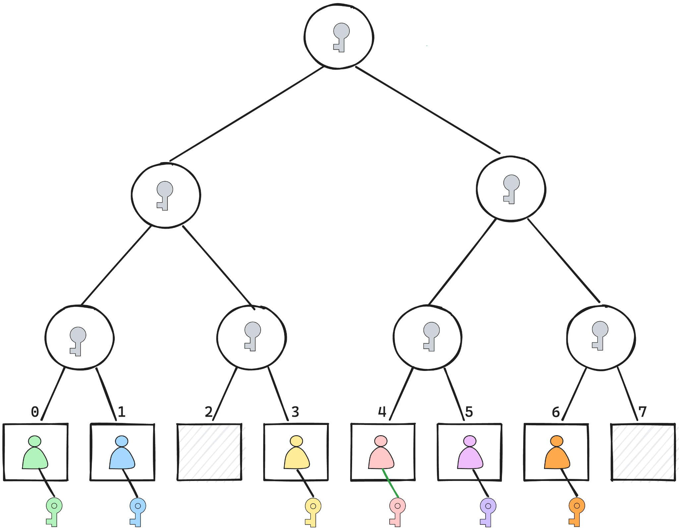
Groups
MLS provides a way for clients to form groups within which they can communicate securely.
As groups change membership and group or member properties, they advance from one epoch to another and the cryptographic state of the group evolves
The group is represented as a tree, which represents the members as the leaves of a tree. It is used to efficiently encrypt to subsets of the members. Each member has a state called a LeafNode object holding the client's identity, credentials, and capabilities
Notes:
MLS consente ai client di formare gruppi all'interno dei quali comunicare in modo sicuro. Ad esempio, un gruppo di utenti può utilizzare i client sui propri telefoni o laptop per unirsi a un gruppo e comunicare tra loro. Un gruppo può essere piccolo come due client (ad esempio, per la semplice messaggistica da persona a persona) o grande come centinaia di migliaia. Un client che fa parte di un gruppo è un membro di quel gruppo. Quando i gruppi cambiano i membri e le proprietà dei gruppi o dei membri, passano da un'epoca all'altra e lo stato crittografico del gruppo si evolve. Il gruppo è rappresentato come un albero, che rappresenta i membri come le foglie di un albero. Viene utilizzato per crittografare in modo efficiente i sottoinsiemi dei membri. Ogni membro ha uno stato chiamato oggetto LeafNode che contiene l'identità, le credenziali e le capacità del cliente.

Slide 7
Threats
The main threats to messages sent over MLS are:
from network attackers
from malicious servers
and from compromised group members whose cryptographic state and keys have been obtained by the adversary.

Slide 8
Security Goals - 1
Message Confidentiality: If a client C sends a message M in epoch E of group G, and C believes that the membership of G in E is C0,…,Cn, then M is kept secret from the adversary as long as none of these members is compromised.
Forward Secrecy: If a client C sends (or receives) a message M in epoch E of group G, then any compromise of C after this point does not affect the confidentiality of M.
Message Authentication: If a client C accepts a message M in epoch E of group G, and if C believes that the membership of G in E is C0,…,Cn, and if none of these members are compromised at the time of reception, then M must have been sent by one of these group members for the group G in epoch E.

Slide 9
Security Goals - 2
Sender Authentication: If a client C accepts a message M seemingly sent by a client C’ in epoch E of group G, and if C’ is uncompromised at the time of reception, then M must indeed have been sent by C’ in epoch E of group G.
Membership Agreement: If a client C accepts a message M from a client C’ in epoch E of group G, then C and C’ must agree on the membership of G at E.
Post-Remove Security: If a client C was member of group G in epoch E, and was no longer a member in epoch E+1, then even if C was compromised in epochs <= E, it does not affect the confidentiality of messages sent in epochs >= E+1.
Post-Update Security: If a client C was member of group G in epoch E, and has updated its cryptographic keys in epoch E+1, then even if the previous state of C in epochs <= E was compromised, it does not affect the confidentiality of messages sent in epochs >= E+1.

Slide 10
Membership Agreement
The first truly novel security goal in MLS is membership agreement, which guarantees that group members agree with each other on the current membership. In practice, MLS requires an even stronger agreement on the entire membership history of the group and its cryptographic states. Note that currently deployed group protocols like Signal Sender Keys do not provide membership agreement.

Slide 11
Evolution of an epoch
Various messages are used in the evolution from epoch to epoch:
A Proposal message proposes a change to be made in the next epoch, such as adding or removing a member.
A Commit message initiates a new epoch by instructing members of the group to implement a collection of proposals. Proposals and Commits are collectively called Handshake messages.
A KeyPackage provides keys that can be used to add the client to a group, including its LeafNode, and Signature Key.
A Welcome message provides a new member to the group with the information to initialize their state for the epoch in which they were added.
Notes:
I messaggi KeyPackage e Welcome sono utilizzati per avviare un gruppo o per introdurre nuovi membri, quindi vengono scambiati tra i membri del gruppo e i client che non ne fanno ancora parte. Un client pubblica un KeyPackage tramite il DS, consentendo così agli altri client di aggiungerlo ai gruppi. Quando un membro di un gruppo vuole aggiungere un nuovo membro al gruppo, utilizza il KeyPackage del nuovo membro per aggiungerlo e costruisce un messaggio di benvenuto con il quale il nuovo membro può inizializzare il suo stato locale.I messaggi di Proposal e Commit sono inviati da un membro di un gruppo agli altri. MLS fornisce un livello di framing comune per l'invio di messaggi all'interno di un gruppo: Un PublicMessage fornisce l'autenticazione del mittente per i messaggi Proposal e Commit non crittografati. Un PrivateMessage fornisce la crittografia e l'autenticazione per i messaggi Proposal/Commit e per i dati dell'applicazione.

Slide 12
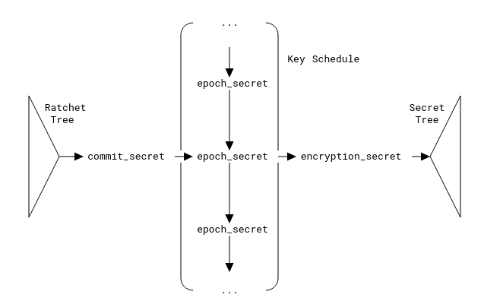
Cryptographic State and Evolution

Slide 13
Areas of responsibility
Ratchet tree
Key schedule
Secret tree
represents the membership of the group, providing group members a way to authenticate each other and efficiently encrypt messages to subsets of the group. Each epoch has a distinct ratchet tree. It seeds the key schedule
describes the chain of key derivations used to progress from epoch to epoch (mainly using the init_secret and epoch_secret), as well as the derivation of a variety of other secrets
tree derived from the key schedule that represents shared secrets used by the members of the group for encrypting and authenticating messages. Each epoch has a distinct secret tree.

Slide 14
Abstract Services
MLS is designed to operate within the context of a messaging service:
Authentication Service (AS) which is responsible for attesting to bindings between application-meaningful identifiers and the public key material used for authentication in the MLS protocol.
Delivery Service (DS) which can receive and distribute messages between group members. The DS is also responsible for storing and delivering initial public key material required by MLS clients in order to proceed with the group secret key establishment that is part of the MLS protocol.

Slide 15
Example Protocol Execution
There are three major operations in the life of a group:
Adding a member
Updating the keys that represent a member in the tree
Removing a member

Slide 16
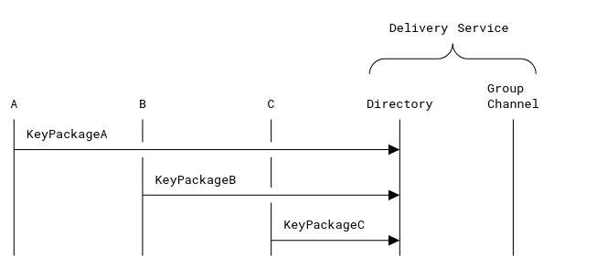
Publish KeyPackages

Slide 17
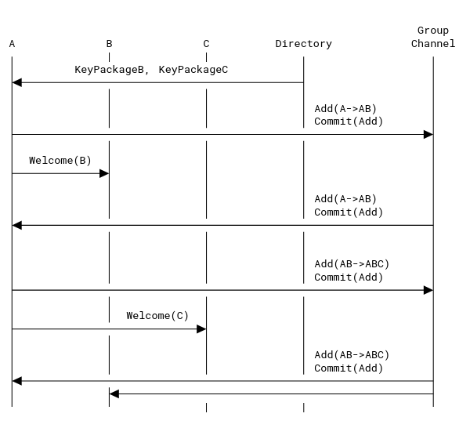
Client A creates a group with clients B and C

Slide 18
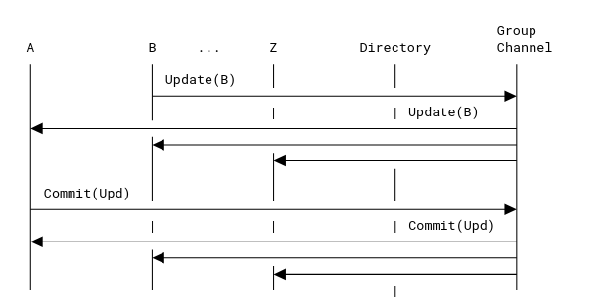
Client B proposes to update its key, and client A commits the proposal

Slide 19
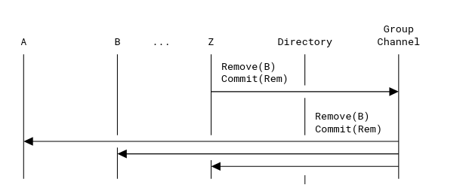
Client Z removes client B from the group
Notes:
The Commit message provides new entropy to all members of the group except the removed member. This new entropy is added to the epoch secret for the new epoch so that it is not known to the removed member. Note that this does not necessarily imply that any member is actually allowed to evict other members; groups can enforce access control policies on top of these basic mechanisms

Slide 20
The MLS Approach
TreeSync, TreeKEM, TreeDEM
Notes:
Il protocollo MLS raggiunge i suoi obiettivi di performance e sicurezza utilizzando alberi binari per rappresentare la struttura dei dati di gruppo e per stabilire in modo efficiente le chiavi di gruppo. In particolare, l'array di membri raffigurato sopra si trasforma in foglie di un albero binario, dove i nodi interni rappresentano sottogruppi costituiti dai membri sottostanti.

Slide 21
02
TreeKEM

Slide 22
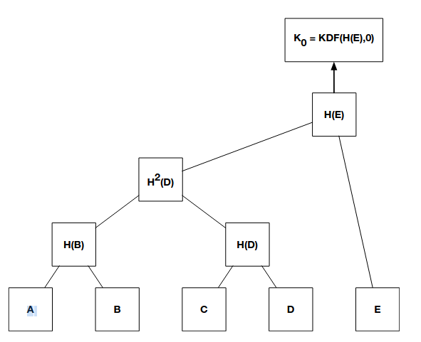
Ratchet Tree Concepts
The protocol uses "ratchet trees" for deriving shared secrets among a group of clients
A ratchet tree is an arrangement of secrets and key pairs among the members of a group in a way that allows for secrets to be efficiently updated to reflect changes in the group
Notes:
TreeKEM è un sottoprotocollo di MLS che si basa su collision-resistant hash function (**H**), un meccanismo di cifratura a chiave pubblica (pgen, penc, pdec), una funzione pseudo-random utilizzata per la key derivation function (**kdf**) e uno schema di cifratura autenticato(gen, enc, dec).

Slide 23
Ratchet Tree Nodes
Each node in a ratchet tree is either blank (containing no value) or it holds an HPKE public key with some associated data:
A public key
A credential
An ordered list of "unmerged" leaves
A hash of certain information about the node's parent, as of the last time the node was changed

Slide 24
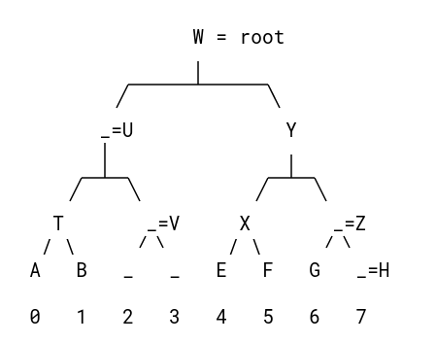
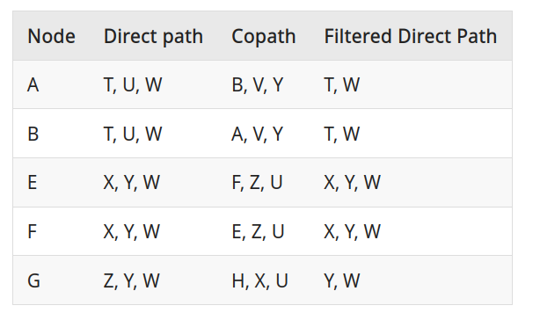
Paths through a Ratchet Tree

Slide 25
Computing Tree Keys
sendcreate(d_i, g′, {d_0, . . . , d_n}):
To a: penc_a(K_a, H(K_b), H(H(K_d)), H(H(H(K_e)))) + public key(K_b), public key(H(K_d)), public key(H(H(K_e)))
To b: penc_b(K_b, H(H(K_d)), H(H(H(K_e)))) + public key(co-path)
To c: penc_c(K_c, H(K_d), H(H(H(K_e)))) + public key(co-path)
.
.
.
Notes:
Per calcolare le chiavi di gruppo, è necessario assegnare a ogni nodo dell'albero una coppia di chiavi nota solo ai membri del gruppo, cioè ai dispositivi che appaiono come foglie nel sottoalbero corrente. In una foglia, generiamo coppie di chiavi KEM fresche per ogni dispositivo (chiave segreta(d_i), chiave pubblica(d_i)). Per ogni nodo interno, la chiave segreta viene calcolata come hash della chiave segreta di uno dei due figli, intuitivamente l'ultimo figlio che ha effettuato un'operazione di gruppo. La chiave di autenticazione per la cifratura del gruppo di messaggistica (encryption key(d_j)) è derivata (come una catena di invocazioni KDF) dalla sequenza di chiavi alla radice dell'albero. In TreeKEM, quindi, le chiavi interne dei nodi dipendono solo da uno dei due figli. Le chiavi dei nodi interni di TreeKEM non sono contributive (a differenza di ART) e questo porta direttamente ad alcuni dei vantaggi di TreeKEM per quanto riguarda la concorrenza. Si noti che la chiave di cifratura del gruppo di messaggistica è ancora contributiva, nel senso che incorpora il materiale di cifratura di tutti i nodi che hanno avviato un'operazione di gruppo.

Slide 26
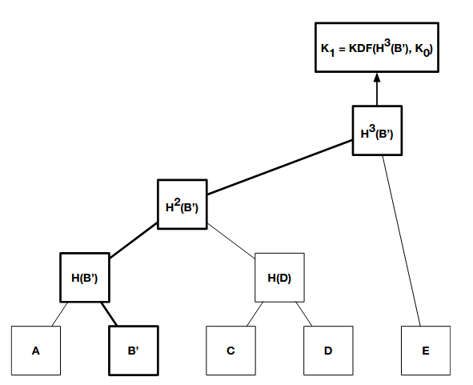
Key update
sendupdate(d_i, g_j):
To a: penc_a(H(K′b)) + public key(K′b)
To cd: penc_(H(K_d))(H(H(K′b))) + public key(H(K′b))
To e: penc_(H(H(Ke) (H(H(H(K′b)))) + publickey(H(H(K′b)))

Slide 27
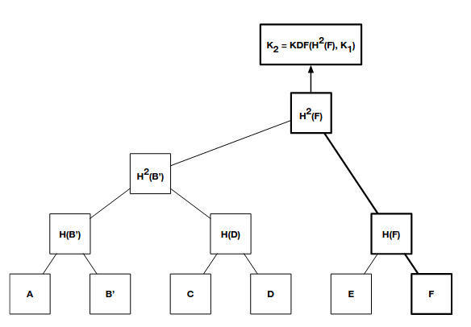
New device has been added

Slide 28
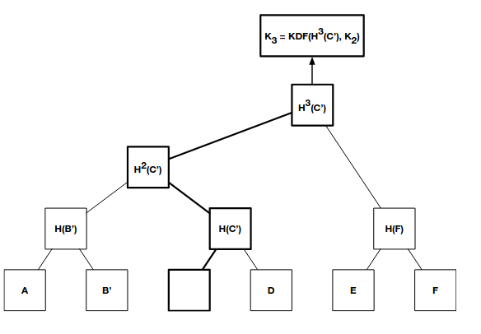
Device removal

Slide 29
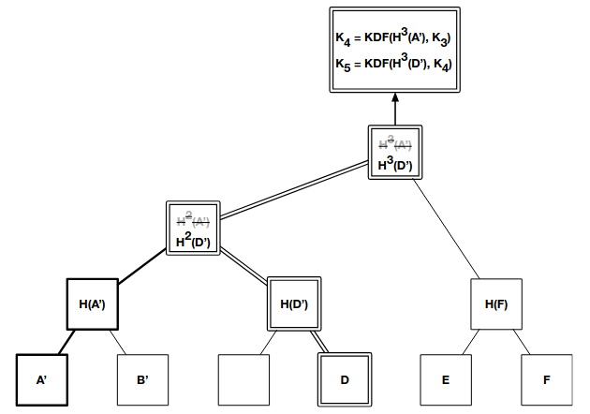
Simultaneous updates

Slide 30
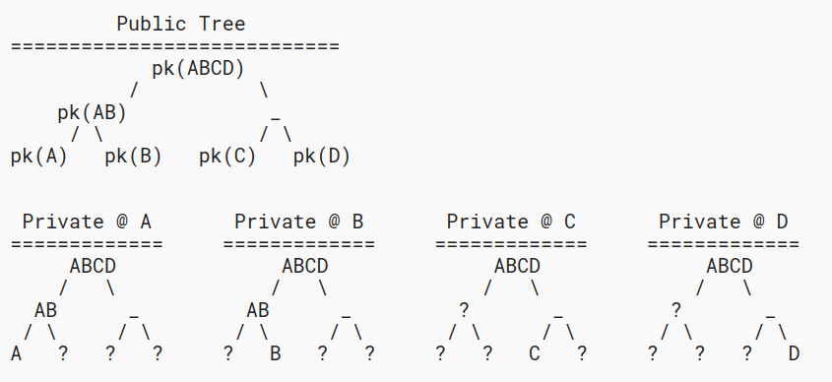
Views of a Ratchet Tree
The private key for a node in the tree is known to a member of the group only if the node's subtree contains that member's leaf

Slide 31
03
TreeDEM

Slide 32
TreeDEM: Group Message Encryption
Given an epoch secret, the TreeDEM protocol derives message encryption keys for each member in the current group and specifies how they are used to send and receive application messages, handshake messages (containing TreeKEM proposals and commits), and Welcome messages for new members.

Slide 33
How TreeDEM authenticates and encrypts
application messages
Each application message is serialized into a bitstring along with metadata indicating the group, epoch, and sender
This bitstring is then signed with the sender’s signing key
and then MACed with a key derived from current epoch secret
The serialized message, its signature, and MAC are then encrypted using an authenticated encryption (AEAD) scheme
The recipient performs the reverse set of operations to decrypt the message, verify the signature and MAC to ensure that the message was sent by a sender who is a member of the group

Slide 34
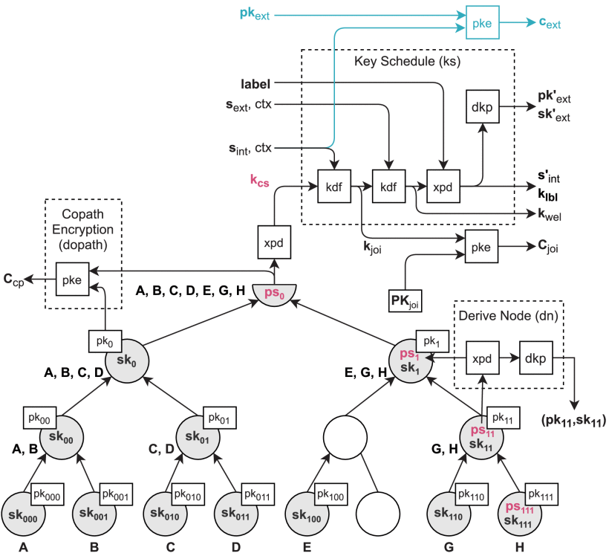

Slide 35
Key Schedule

Slide 37
04
TreeSync

Slide 38
Why?
Assuming Alice enters a secure group and receives the public key tree, how can she be sure that these keys are not controlled by an attacker?
How can she be sure about who the participants in the group are? Can an attacker be in the group without her knowing? Is Bob really Bob or is he someone else?
TreeSync aims to solve these problems by going to authenticate TreeKEM states. Specifically:
authenticates all public keys
authenticate group membership agreements

Slide 39
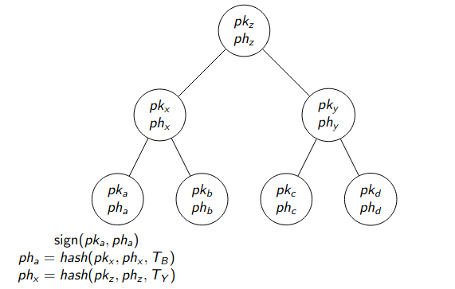
TreeSync - Final Attempt

Slide 40
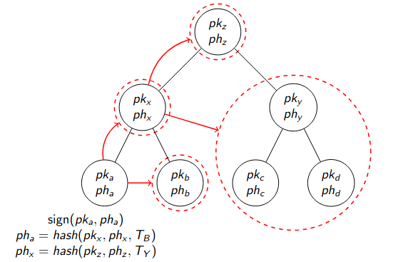
TreeSync - Final Attempt

Slide 41
05
OpenMLS

Slide 42
OpenMLS
A open source implementation of the Messagging layer security protocol
It has a safe and easy-to-use interface that hides the complexity of the underlying cryptographic operations.
The OpenMLS library is written in pure Rust. It supports different cryptographic backend libraries. It ships with a backend based on RustCrypto and an optional backend based on Evercrypt.
https://openmls.tech/

Slide 43
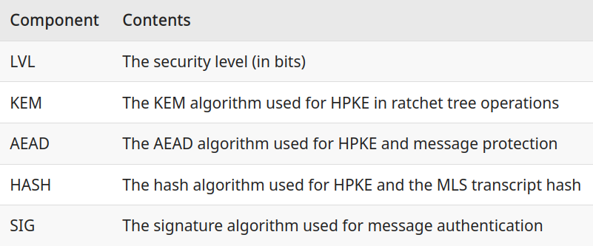
Supported ciphersuites
MLS_128_HPKEX25519_AES128GCM_SHA256_Ed25519 (MTI)
MLS_128_DHKEMP256_AES128GCM_SHA256_P256
MLS_128_HPKEX25519_CHACHA20POLY1305_SHA256_Ed25519
Cipher suite names follow the naming convention:
CipherSuite MLS_LVL_KEM_AEAD_HASH_SIG = VALUE;

Slide 44
06
My project

Slide 45
My Project
My project simulates the following operations:
Alice creates a group
Alice adds Bob
Alice sends a message to Bob
Bob updates and commits
Alice updates and commits
Bob adds Charlie
Charlie sends a message to the group
Charlie updates and commits
Charlie removes Bob

Slide 46
RESOURCES
RFC 9420
https://www.ietf.org/archive/id/draft-ietf-mls-architecture-15.html
TreeKEM
TreeSync
OpenMLS
Security Analysis of the MLS Key Derivation
End-to-End Encrypted Group Chats with MLS: Design, Implementation and Verification
Three (thousand) may keep a secret

