Slide 1
Experimental Data

Slide 2
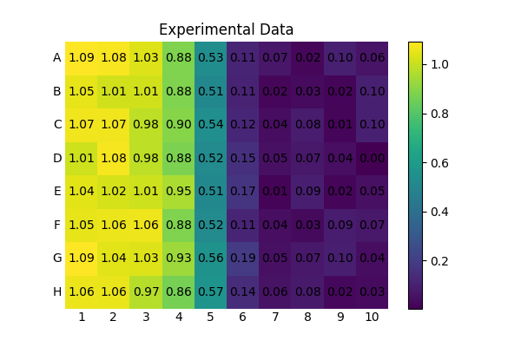

Slide 3
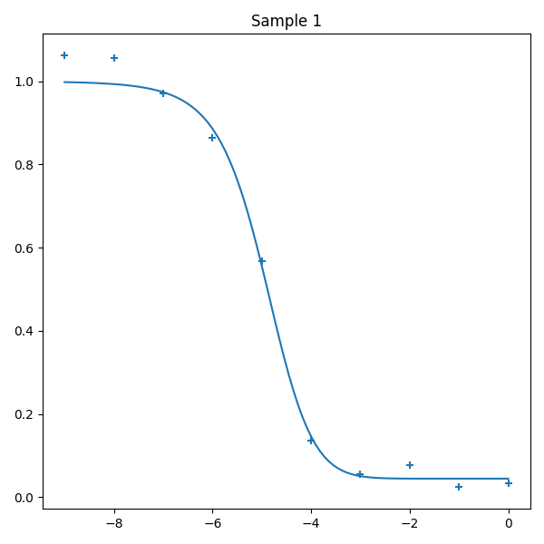

Slide 4
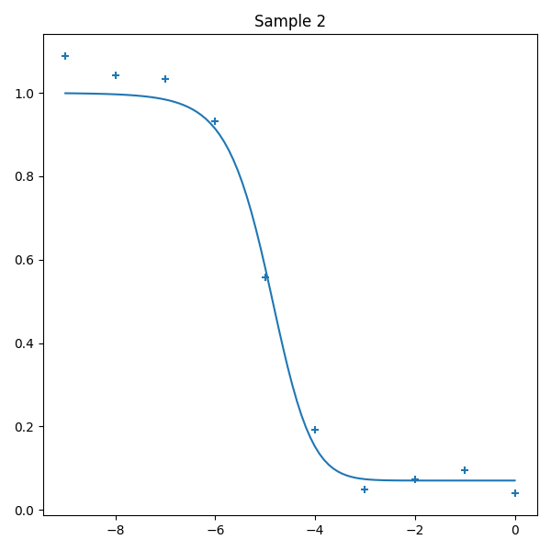

Slide 5
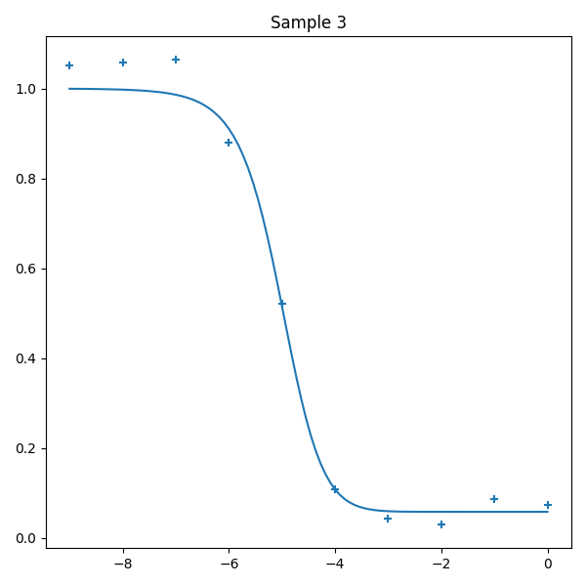

Slide 6
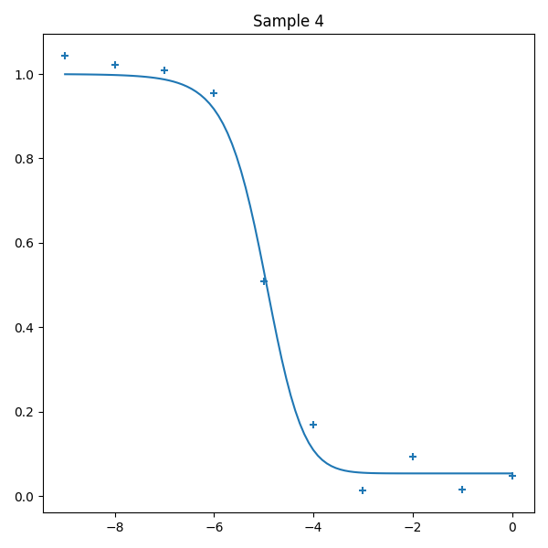

Slide 7
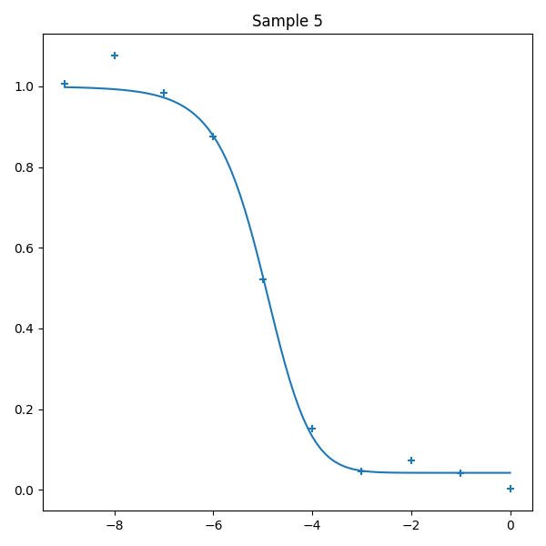

Slide 8
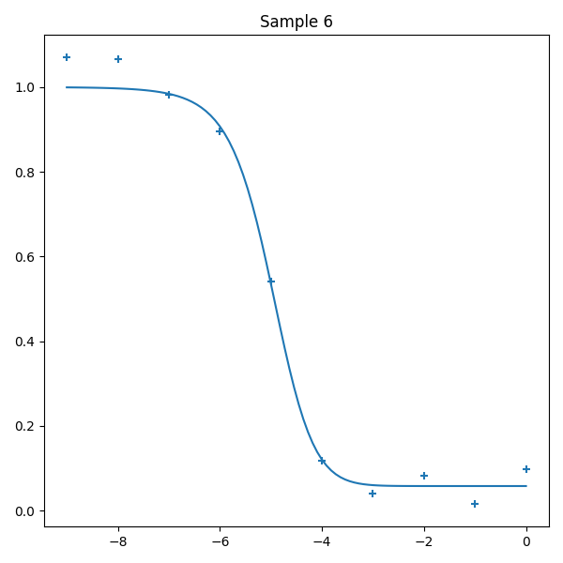

Slide 9
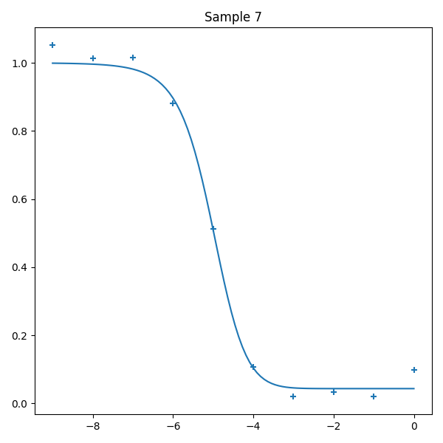

Slide 10
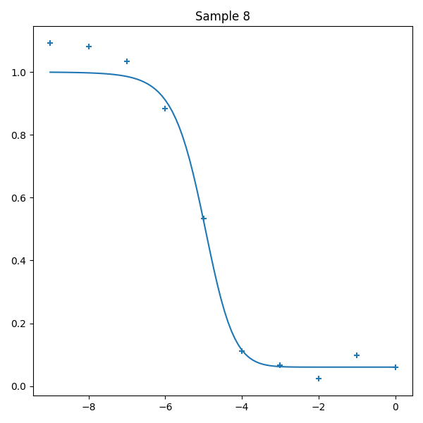

Slide 11
Sample ID | IC50 [M]
Sample 1 | 1.175E-05
Sample 2 | 1.222E-05
Sample 3 | 9.502E-06
Sample 4 | 1.036E-05
Sample 5 | 1.044E-05
Sample 6 | 1.028E-05
Sample 7 | 9.515E-06
Sample 8 | 9.896E-06

