Slide 1

Celery Project

Slide 2
Alexei Who?
Brazilian born and raised, but no football, sorry
½ Russian + ½ Armenian, yes vodka
lived/lives: Brazil, Argentina, New Zealand
husband + dad of a 6yrs old
Unix/Linux Sysadmin (...in 1995-ish), Web Developer (...in 2000-ish)
The Age of IBM WebSphere App Server (2002-2012)
The IT Support years (2012-2016)
Delivery Services Engineer
timbre Digital @Aucks since May 2017
Lots of python lately – not a python guru yet!
Notes:
Starting using python seriously for ~1 year.
SKIP THE ACCENT JOKE, DAMNIT

Slide 3

What
Distributed Task Queue
Current Version 4.2.0 (11/Jun/2018)
http://www.celeryproject.org/
Notes:
Python 2 must be 2.7
For older python, try older celery
Python 3 must be 3.[4,5,6]
PyPy 5.8

Slide 4
Why
Background tasks
Asynchronous tasks with retries
Periodic work
Distributed computing
Parallel execution
Notes:
What kinds of things should I use Celery for?
* Running something in the background. For example, to finish the web request as soon as possible, then update the users page incrementally. This gives the user the impression of good performance and “snappiness”, even though the real work might actually take some time.
* Running something after the web request has finished.
* Making sure something is done, by executing it asynchronously and using retries.
* Scheduling periodic work.

Slide 5
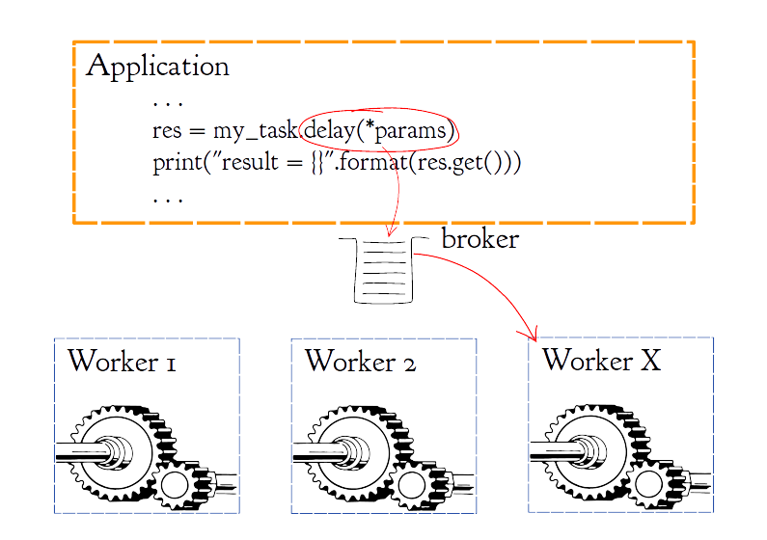
Quickstart – Calling Tasks
Notes:
App = 1..N processes (multi hosts)
Workers = 1..N processes (multi hosts)
The integration point between apps and workers is the broker

Slide 6
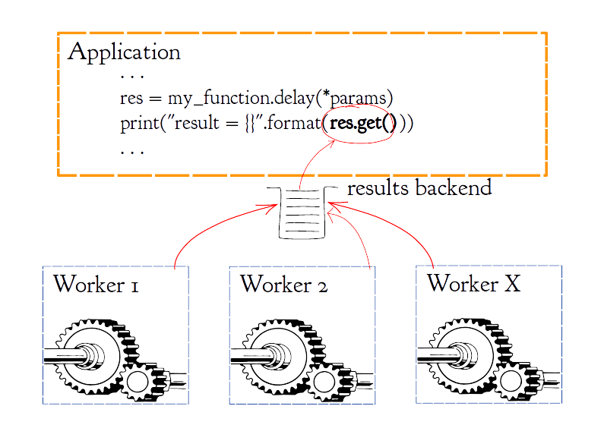
Quickstart – Getting results

Slide 7
Installation/Configuration
Requirements
Python 2.7 or >=3.4
Broker transport (RabbitMQ, Redis, ...)
Installing
$ pip install celery
Configuring
from celery import Celery
app = Celery('hello', broker='amqp://guest@localhost//')
Notes:
If you are not using virtualenv, you should. Virtualenvwrapper, pyenv, etc...
Start celery workers – wrap in a start/stop script or systemctl service file

Slide 8
Celery Workers

Slide 9
Broker
Message Queue system – or similar
RabbitMQ (AMQP), Redis, Amazon SQS, Zookeeper(*)
Single or multiple queues, routing options
Underlying messaging library: Kombu
(*) Experimental
Notes:
"or similar":
* In v3.1 +: MongoDB, CouchDB, Django DB, SQL Alchemy, Iron MQ(?)
* recent versions dropped support for many different types of brokers.
Kombu and Celery have the same lead maintaner

Slide 10
(De-)Serialization
“process of translating data structures or object state into a format that can be stored or transmitted and reconstructed later.” - Wikipedia
Default: JSON
Other formats: pickle, yaml and msgpack(*).
(*) Experimental
Notes:
Data-structure must be serializable: dicts, list/arrays, string, numbers, booleans.
Type 'set' is not JSON serializable
¬example:
Django model objects

Slide 11
Results

Slide 12
Calling tasks

Slide 13
Getting Results

Slide 14
Chaining Tasks

Slide 15
Synchronization Strategies

Slide 16
Events

Slide 17
Heartbeat

Slide 18
Flower

Slide 19
Jobstatic

Slide 20
LIVE

Slide 21
References
http://www.celeryproject.org/
http://docs.celeryproject.org/en/latest/getting-started/first-steps-with-celery.html
http://docs.celeryproject.org/en/latest/userguide/configuration.html
https://pypi.org/project/kombu/

Slide 22
Q&A
Questions

Slide 23
Contact
Alexei Znamensky
mail/russoz@gmail.com
twitter/@russoz
github.com/russoz
linkedin.com/alexeiz

