Slide 1
Android Development
by
Russ Ray
Russell (Russ) Ray –Linkedin
russray2008 --Twitter

Slide 2
SDK Setup Steps
Download Android SDK
http://developer.android.com/sdk/index.html
Add %ANDROID_HOME%
C:\android-sdk-windows
UPDATE %PATH%
tools and platform-tools

Slide 3
Eclipse Setup Steps
Download Eclipse IDE
http://www.eclipse.org/
Add Android Plug-in
http://developer.android.com/sdk/eclipse-adt.html
Point Plug-in to Android SDK
Setup Android Virtual Devices

Slide 4
Getting Started
Create New Project
Review Project Structure
Run Emulator

Slide 5
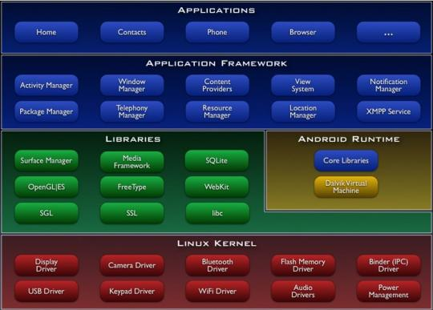
Android Stack

Slide 6
Building Blocks of Android
View
Activity
Intent
Content Provider
Service
Manifest File

Slide 7
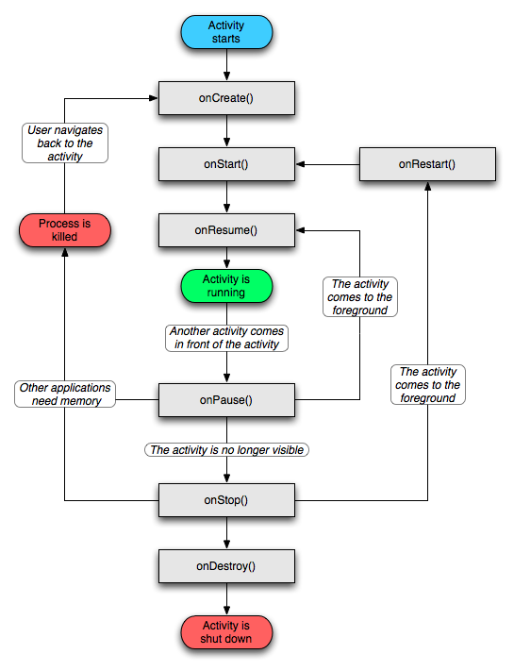
Android Activity
User Interface concept
Usually a single Screen
Well defined lifecycle
Android OS manages

Slide 8
Android Intent
The “glue” between Activities
Late Time Binding
Broadcasts to Receivers
Starts a Service

Slide 9
Android Views
UI Elements
Smart

Slide 10
Android Content Provider
Data Sharing between App
Usually an Activity or Service

Slide 11
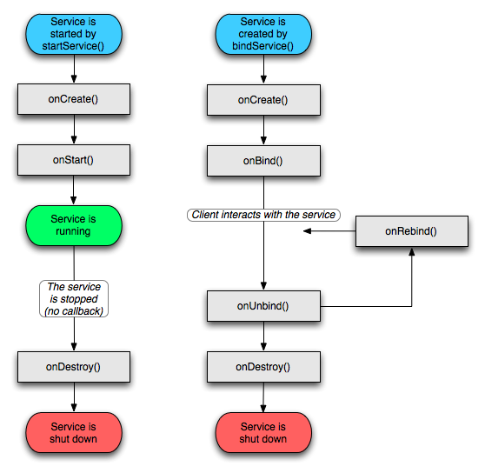
Android Service
Background process
May run long time
Start Service for App
Bind Service for App

Slide 12
Android Manifest File
<?xml version="1.0" encoding="utf-8"?>
<manifest xmlns:android="http://schemas.android.com/apk/res/android"
package="com.news"
android:versionCode="1"
android:versionName="1.0">
<!-- This has to be here or will not be a well-formed document. -->
<uses-sdk android:minSdkVersion="10" />
<uses-permission android:name="android.permission.INTERNET" />
<application android:icon="@drawable/icon" android:label="@string/app_name">
<activity android:name=".NewsActivity"
android:configChanges="orientation|keyboardHidden"
android:label="@string/app_name">
<intent-filter>
<action android:name="android.intent.action.MAIN" />
<category android:name="android.intent.category.LAUNCHER" />
</intent-filter>
</activity>
</application>
</manifest>

Slide 13
Native Android App Dev
Web Browser Engines
Webkit
Google Chrome
Presto
Opera
Gecko
Mozilla Firefox
Trident
Internet Explorer

Slide 14
Native Android App Dev

Slide 15
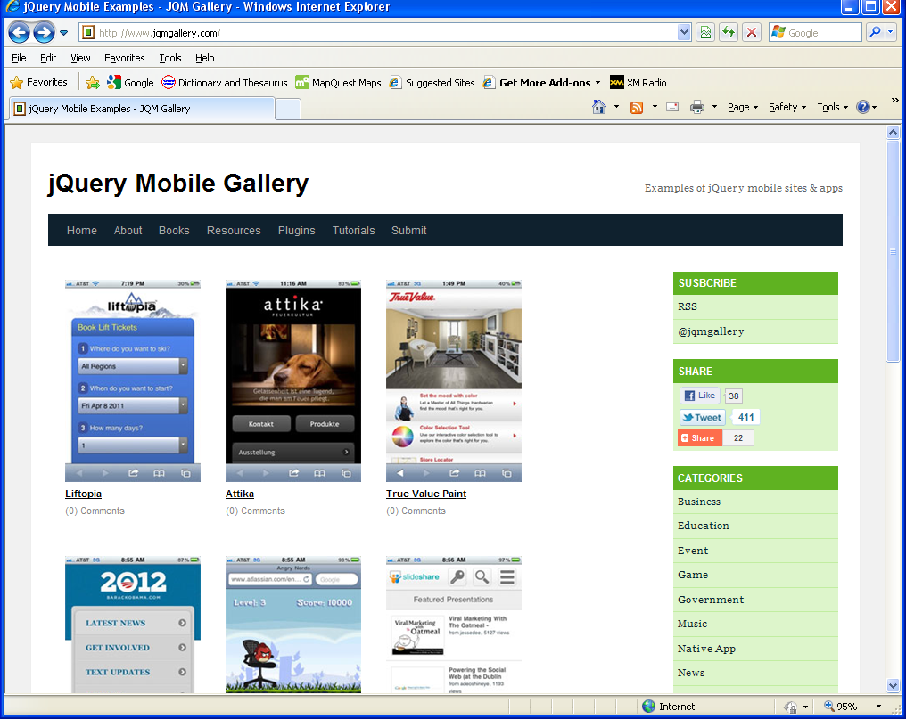
JavaScript Framework
JQuery Mobile

Slide 16

HTML5
Gelocation API
Offline Web App Support
Web Storage
CSS3 Selector
2D Animation

Slide 17
News App
Simple RSS Feed Reader
Web Storage

Slide 18
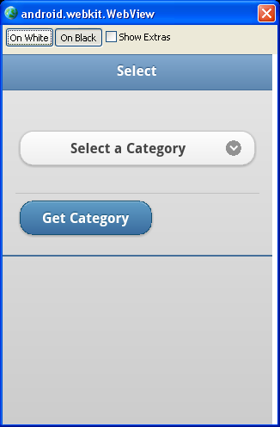
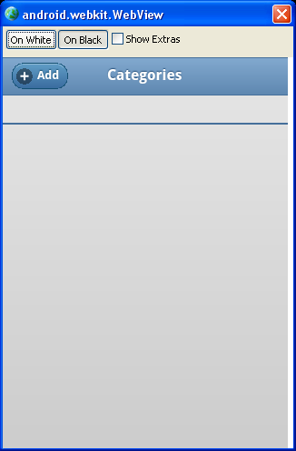
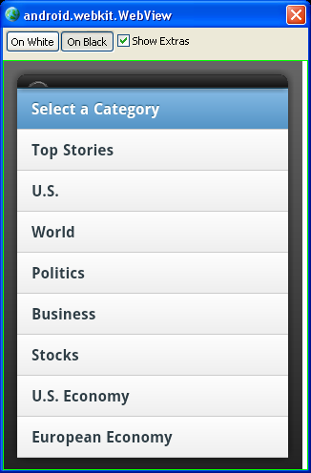
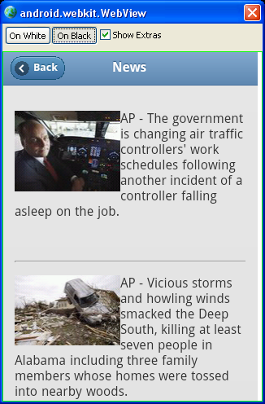
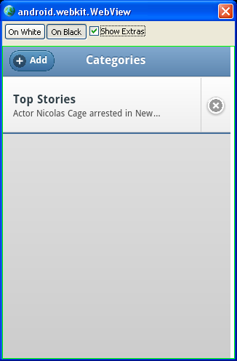
News App Screens

Slide 19

Project Source Code
GitHub
git://github.com/russray2008/News.git

Slide 20
AnDevCon
First Conf for Android Dev
Over 800 attended
5 one day workshops
48 technical classes

Slide 21
Technical Classes
Beginner to Intermediate
Taught by Developers
Focused areas for 1-hour

Slide 22
Beginner Classes
Android 101
Mobile Dev Platforms
Android Internals
Build w/ HTML5, CSS3, JavaScript
SCM for Android Developers w/ Git
Test and Debug Tools
Maven for Android Dev

Slide 23
Intermediate Classes
Developers new to Android
Coding for Motorola Xoom Tablet
Using PhoneGap
Develop with Pay Pal
Building Location Based Service
Android Internals—SDK to NDK
Refactor Web Apps for Mobile

Slide 24
Entrepreneur Track
Running an Android Business
Topics
Publishing
Advertising
Analytics
Enhancing Application
Free Services

Slide 25
Questions?

