Slide 1
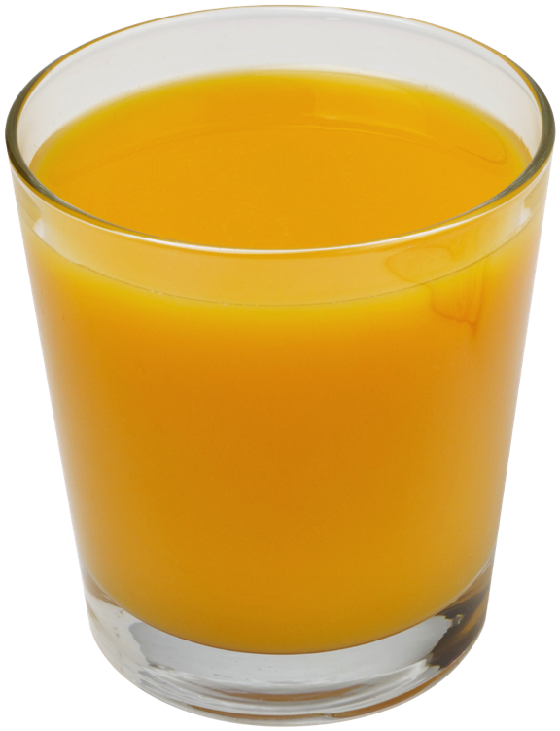


Analysis of Algorithms
Presentation for use with the textbook Data Structures and Algorithms in Java, 6th edition, by M. T. Goodrich, R. Tamassia, and M. H. Goldwasser, Wiley, 2014
Input
Algorithm
Output

Slide 2
Running Time
Most algorithms transform input objects into output objects.
The running time of an algorithm typically grows with the input size.
Average case time is often difficult to determine.
We focus on the worst case running time.
Easier to analyze
Crucial to applications such as games, finance and robotics

Slide 3
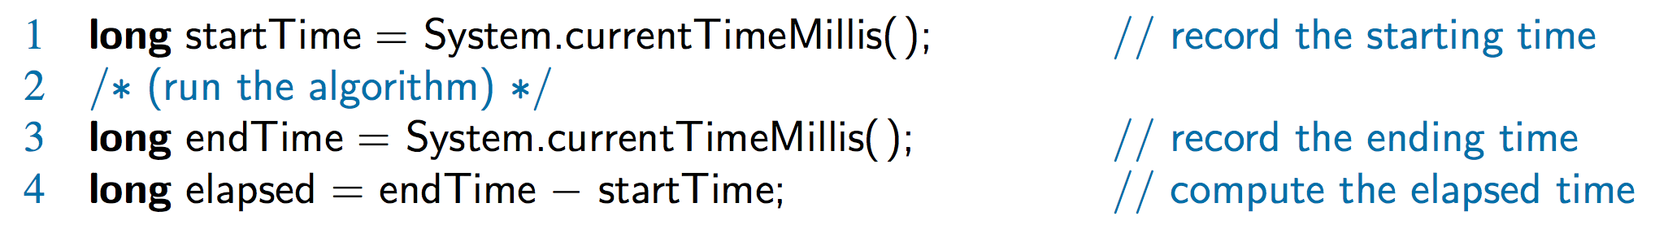
Experimental Studies
Write a program implementing the algorithm
Run the program with inputs of varying size and composition, noting the time needed:
Plot the results

Slide 4

Limitations of Experiments
It is necessary to implement the algorithm, which may be difficult
Results may not be indicative of the running time on other inputs not included in the experiment.
In order to compare two algorithms, the same hardware and software environments must be used

Slide 5
Theoretical Analysis
Uses a high-level description of the algorithm instead of an implementation
Characterizes running time as a function of the input size, n
Takes into account all possible inputs
Allows us to evaluate the speed of an algorithm independent of the hardware/software environment

Slide 6
Pseudocode
High-level description of an algorithm
More structured than English prose
Less detailed than a program
Preferred notation for describing algorithms
Hides program design issues

Slide 7
Pseudocode Details
Control flow
if … then … [else …]
while … do …
repeat … until …
for … do …
Indentation replaces braces
Method declaration
Algorithm method (arg [, arg…])
Input …
Output …
Method call
method (arg [, arg…])
Return value
return expression
Expressions:
Assignment
Equality testing
n² Superscripts and other mathematical formatting allowed

Slide 8
The Random Access Machine (RAM) Model
A RAM consists of
A CPU
An potentially unbounded bank of memory cells, each of which can hold an arbitrary number or character
Memory cells are numbered and accessing any cell in memory takes unit time
2
1
0

Slide 9
Seven Important Functions
Seven functions that often appear in algorithm analysis:
Constant ≈ 1
Logarithmic ≈ log n
Linear ≈ n
N-Log-N ≈ n log n
Quadratic ≈ n²
Cubic ≈ n³
Exponential ≈ 2^{n}
In a log-log chart, the slope of the line corresponds to the growth rate

Slide 10
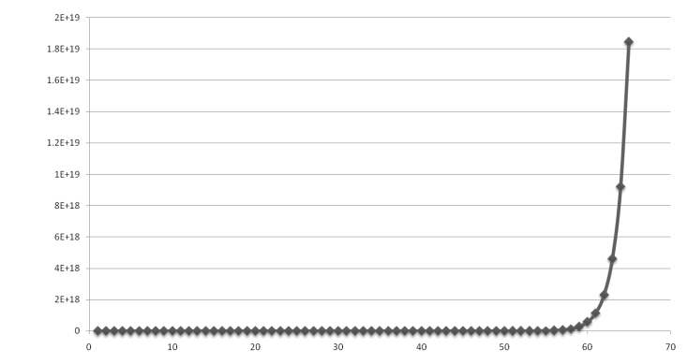
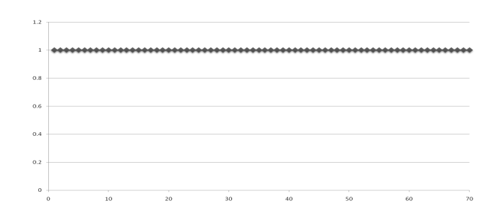
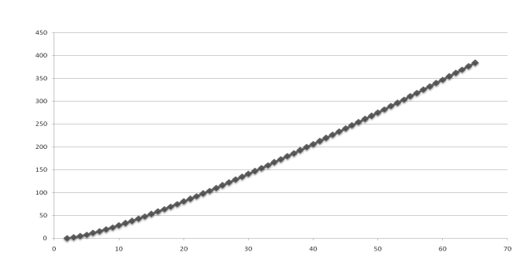
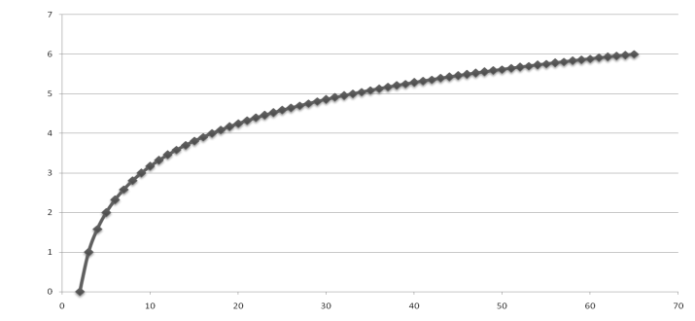
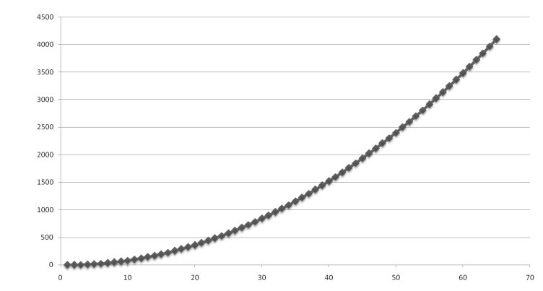
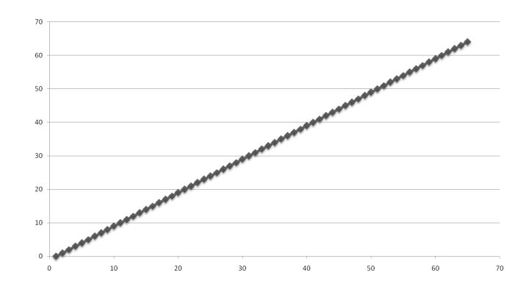
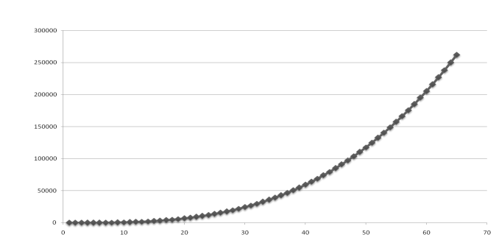
Functions Graphed Using “Normal” Scale
Slide by Matt Stallmann included with permission.
g(n) = n lg n
g(n) = 1
g(n) = 2^{n}
g(n) = n²
g(n) = lg n
g(n) = n
g(n) = n³

Slide 11
Primitive Operations
Basic computations performed by an algorithm
Identifiable in pseudocode
Largely independent from the programming language
Exact definition not important (we will see why later)
Assumed to take a constant amount of time in the RAM model
Examples:
Evaluating an expression
Assigning a value to a variable
Indexing into an array
Calling a method
Returning from a method

Slide 12
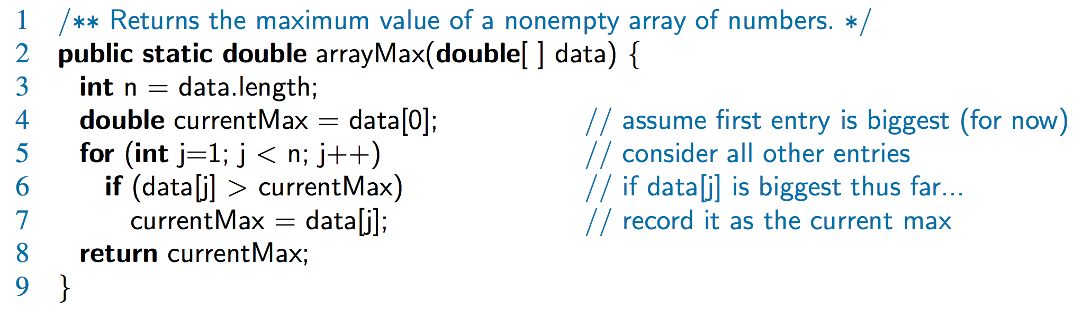
Counting Primitive Operations
By inspecting the pseudocode, we can determine the maximum number of primitive operations executed by an algorithm, as a function of the input size
Step 3: 2 ops, 4: 2 ops, 5: 2n ops, 6: 2n ops, 7: 0 to n ops, 8: 1 op

Slide 13
Estimating Running Time
Algorithm arrayMax executes 5n + 5 primitive operations in the worst case, 4n + 5 in the best case. Define:
a = Time taken by the fastest primitive operation
b = Time taken by the slowest primitive operation
Let T(n) be worst-case time of arrayMax. Then a (4n + 5) ≤ T(n) ≤ b(5n + 5)
Hence, the running time T(n) is bounded by two linear functions

Slide 14
Growth Rate of Running Time
Changing the hardware/ software environment
Affects T(n) by a constant factor, but
Does not alter the growth rate of T(n)
The linear growth rate of the running time T(n) is an intrinsic property of algorithm arrayMax

Slide 15
Why Growth Rate Matters
Slide by Matt Stallmann included with permission.
if runtime is... | time for n + 1 | time for 2 n | time for 4 n
c lg n | c lg (n + 1) | c (lg n + 1) | c(lg n + 2)
c n | c (n + 1) | 2c n | 4c n
c n lg n | ~ c n lg n + c n | 2c n lg n + 2cn | 4c n lg n + 4cn
c n² | ~ c n² + 2c n | 4c n² | 16c n²
c n³ | ~ c n³ + 3c n² | 8c n³ | 64c n³
c 2^{n} | c 2 ^{n+1} | c 2 ^{2n} | c 2 ^{4n}
runtime
quadruples
when problem
size doubles

Slide 16
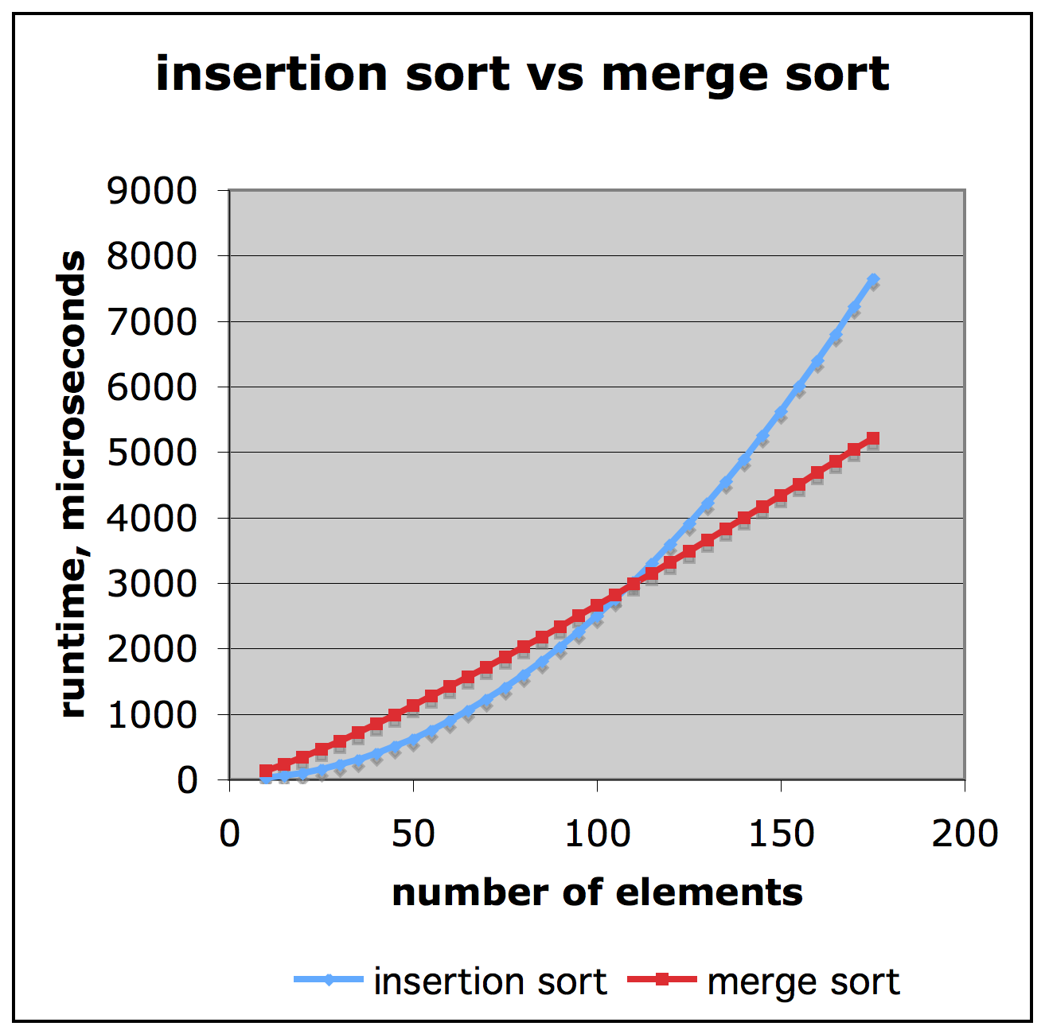
Comparison of Two Algorithms
Slide by Matt Stallmann included with permission.
insertion sort is
n² / 4
merge sort is
2 n lg n
sort a million items?
insertion sort takes
roughly 70 hours
while
merge sort takes
roughly 40 seconds
This is a slow machine, but if
100 x as fast then it’s 40 minutes
versus less than 0.5 seconds

Slide 17
Constant Factors
The growth rate is not affected by
constant factors or
lower-order terms
Examples
10²n + 10⁵ is a linear function
10⁵n² + 10⁸n is a quadratic function

Slide 18
Big-Oh Notation
Given functions f(n) and g(n), we say that f(n) is O(g(n)) if there are positive constants c and n₀ such that
f(n) ≤ cg(n) for n ≥ n₀
Example: 2n + 10 is O(n)
2n + 10 ≤ cn
(c − 2) n ≥ 10
n ≥ 10/(c − 2)
Pick c = 3 and n₀ = 10

Slide 19
Big-Oh Example
Example: the function n² is not O(n)
n² ≤ cn
n ≤ c
The above inequality cannot be satisfied since c must be a constant

Slide 20
More Big-Oh Examples
7n - 2
7n-2 is O(n)
need c > 0 and n₀ ≥ 1 such that 7 n - 2 ≤ c n for n ≥ n₀
this is true for c = 7 and n₀ = 1
3 n³ + 20 n² + 5
3 n³ + 20 n² + 5 is O(n³)
need c > 0 and n₀ ≥ 1 such that 3 n³ + 20 n² + 5 ≤ c n³ for n ≥ n₀
this is true for c = 4 and n₀ = 21
3 log n + 5
3 log n + 5 is O(log n)
need c > 0 and n₀ ≥ 1 such that 3 log n + 5 ≤ c log n for n ≥ n₀
this is true for c = 8 and n₀ = 2

Slide 21
Big-Oh and Growth Rate
The big-Oh notation gives an upper bound on the growth rate of a function
The statement “f(n) is O(g(n))” means that the growth rate of f(n) is no more than the growth rate of g(n)
We can use the big-Oh notation to rank functions according to their growth rate
 | f(n) is O(g(n)) | g(n) is O(f(n))
g(n) grows more | Yes | No
f(n) grows more | No | Yes
Same growth | Yes | Yes

Slide 22
Big-Oh Rules
If is f(n) a polynomial of degree d, then f(n) is O(n^{d}), i.e.,
Drop lower-order terms
Drop constant factors
Use the smallest possible class of functions
Say “2n is O(n)” instead of “2n is O(n²)”
Use the simplest expression of the class
Say “3n + 5 is O(n)” instead of “3n + 5 is O(3n)”

Slide 23
Asymptotic Algorithm Analysis
The asymptotic analysis of an algorithm determines the running time in big-Oh notation
To perform the asymptotic analysis
We find the worst-case number of primitive operations executed as a function of the input size
We express this function with big-Oh notation
Example:
We say that algorithm arrayMax “runs in O(n) time”
Since constant factors and lower-order terms are eventually dropped anyhow, we can disregard them when counting primitive operations

Slide 24
Computing Prefix Averages
We further illustrate asymptotic analysis with two algorithms for prefix averages
The i-th prefix average of an array X is average of the first (i + 1) elements of X:
A[i] = (X[0] + X[1] + … + X[i])/(i+1)
Computing the array A of prefix averages of another array X has applications to financial analysis

Slide 25
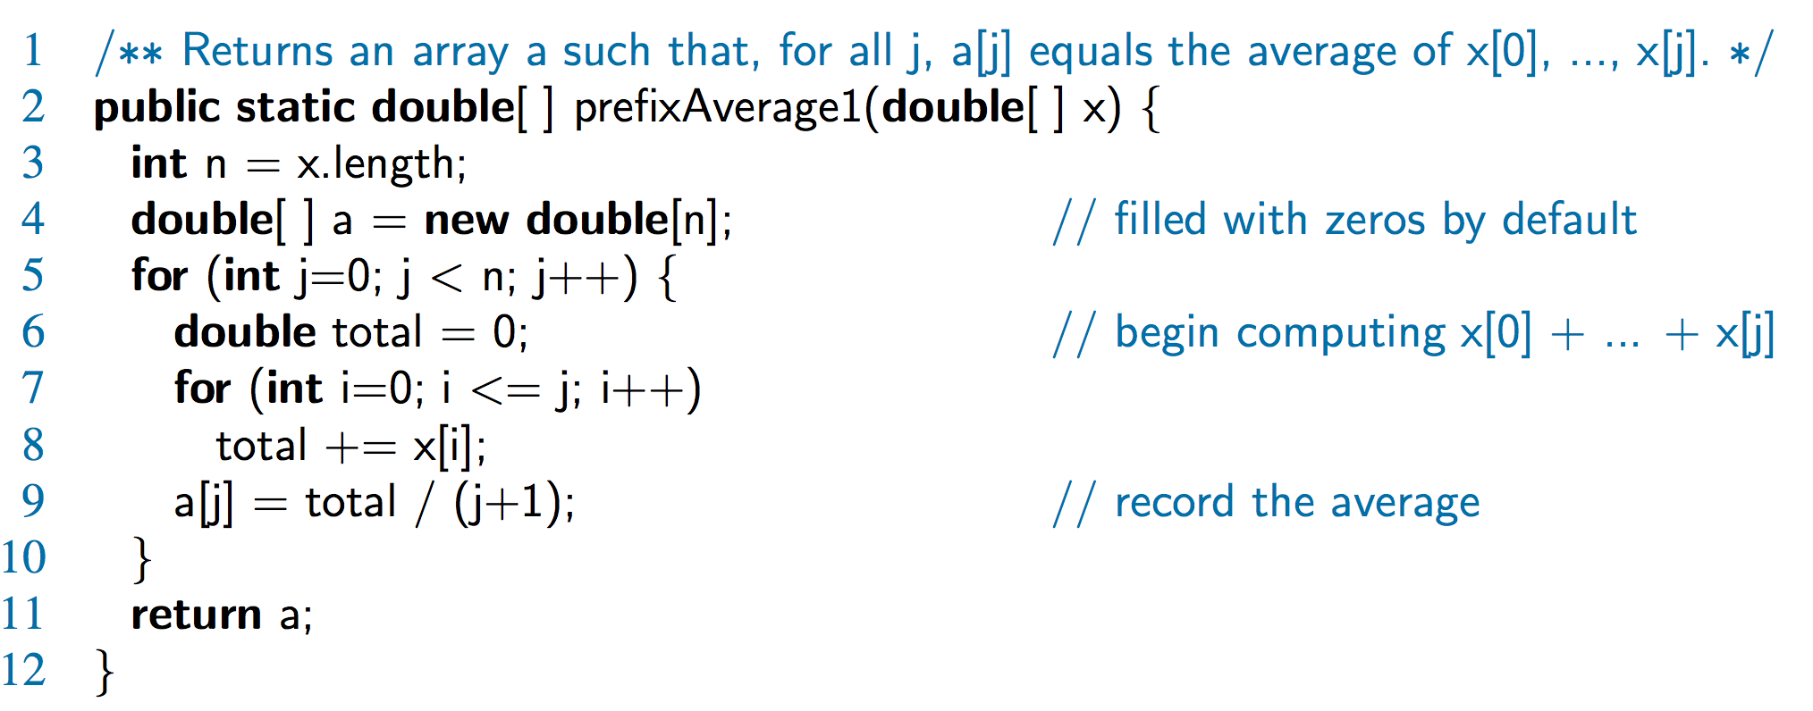
Prefix Averages (Quadratic)
The following algorithm computes prefix averages in quadratic time by applying the definition

Slide 26
Arithmetic Progression
The running time of prefixAverage1 is O(1 + 2 + …+ n)
The sum of the first n integers is n(n + 1) / 2
There is a simple visual proof of this fact
Thus, algorithm prefixAverage1 runs in O(n²) time

Slide 27
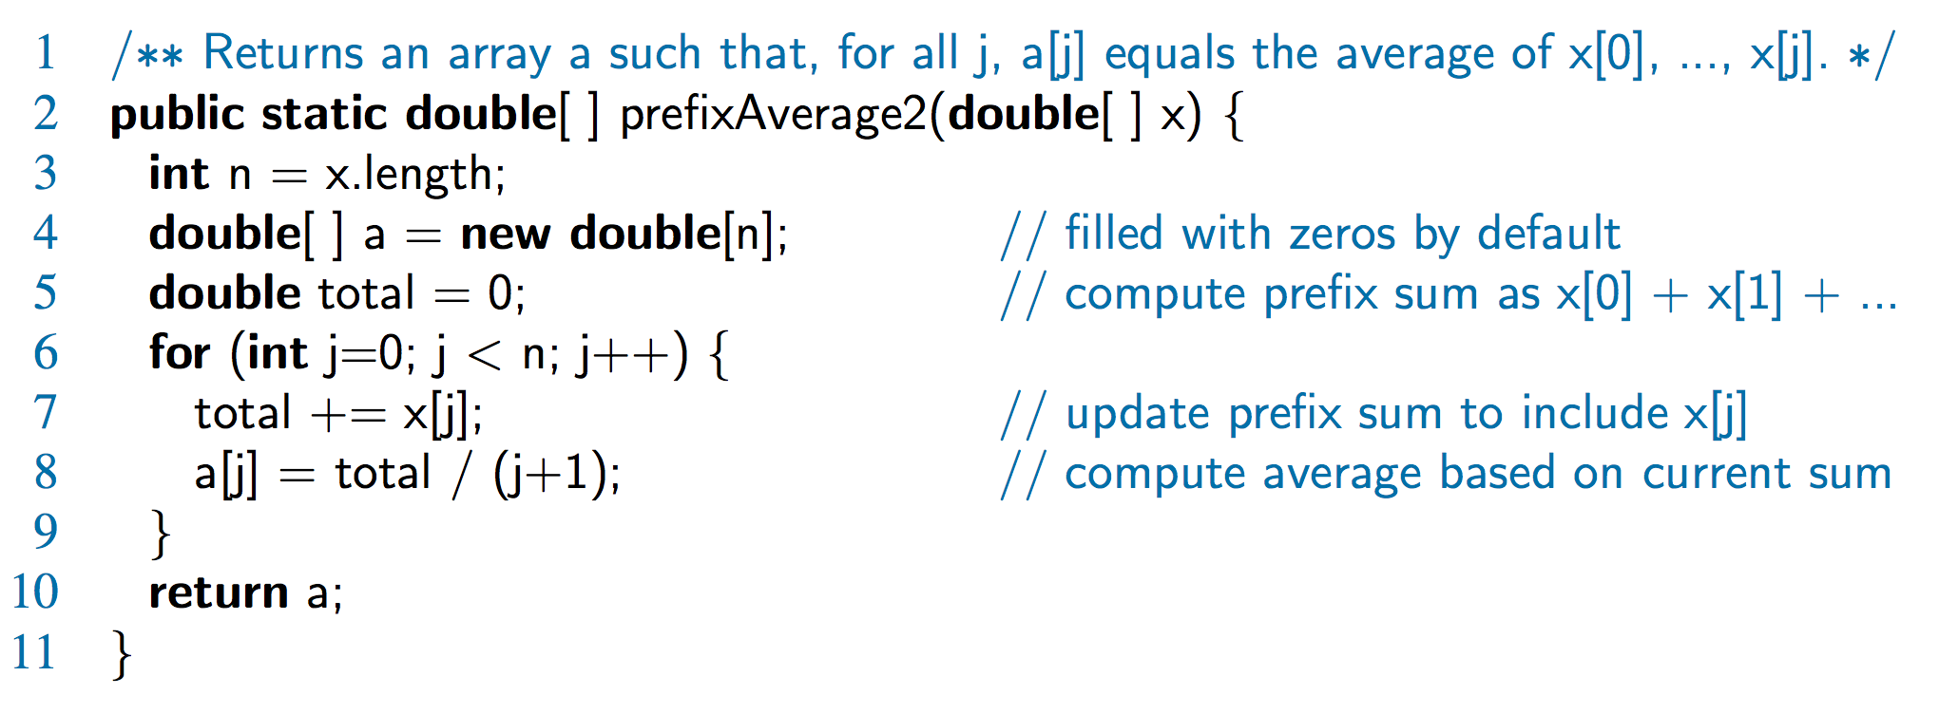
Prefix Averages 2 (Linear)
The following algorithm uses a running summation to improve the efficiency
Algorithm prefixAverage2 runs in O(n) time!

Slide 28
Math you need to Review
Summations
Powers
Logarithms
Proof techniques
Basic probability
Properties of powers:
a^{(b+c)} = a^{b}a ^{c}
a^{bc} = (a^{b})^{c}
a^{b} /a^{c} = a^{(b-c)}
b = a ^{log}_{a}^{b}
b^{c} = a ^{c*log}_{a}^{b}
Properties of logarithms:
log_{b}(xy) = log_{b}x + log_{b}y
log_{b} (x/y) = log_{b}x - log_{b}y
log_{b}xa = alog_{b}x
log_{b}a = log_{x}a/log_{x}b

Slide 29
Relatives of Big-Oh
big-Omega
f(n) is Ω(g(n)) if there is a constant c > 0 and an integer constant n₀ ≥ 1 such that
f(n) ≥ c g(n) for n ≥ n₀
big-Theta
f(n) is Θ(g(n)) if there are constants c’ > 0 and c’’ > 0 and an integer constant n₀ ≥ 1 such that
c’g(n) ≤ f(n) ≤ c’’g(n) for n ≥ n₀

Slide 30
Intuition for Asymptotic Notation
big-Oh
f(n) is O(g(n)) if f(n) is asymptotically less than or equal to g(n)
big-Omega
f(n) is Ω(g(n)) if f(n) is asymptotically greater than or equal to g(n)
big-Theta
f(n) is Θ(g(n)) if f(n) is asymptotically equal to g(n)

Slide 31
Example Uses of the Relatives of Big-Oh
5n² is Ω(n²)
f(n) is Ω(g(n)) if there is a constant c > 0 and an integer constant n₀ ≥ 1 such that f(n) ≥ c g(n) for n ≥ n₀
let c = 5 and n₀ = 1
5n² is Ω(n)
f(n) is Ω(g(n)) if there is a constant c > 0 and an integer constant n₀ ≥ 1 such that f(n) ≥ c g(n) for n ≥ n₀
let c = 1 and n₀ = 1
5n² is Θ(n²)
f(n) is Θ(g(n)) if it is Ω(n²) and O(n²). We have already seen the former, for the latter recall that f(n) is O(g(n)) if there is a constant c > 0 and an integer constant n₀ ≥ 1 such that f(n) < c g(n) for n ≥ n₀
Let c = 5 and n₀ = 1

