Slide 1
Introduction to threading and futures
Prepared by Kent Marete
Github: maretekent

Slide 2
contents
What is concurrency?
Threads?
Rust base concepts and fundamentals
Rust data structures
Introduction to threading in Rust
Single threading and multi-threading
Build a simple webserver and a daemon
Talk about MIO and tokio
Introduction to futures

Slide 3
What’s rust?
Rust is a systems language pursuing the trifecta:
safety, concurrency, and speed.
Focus today
concurrency

Slide 4
Concurrency
Concurrency addresses how to create threads to run multiple pieces of code at the same time
Memory safety bugs and concurrency bugs often come down to code accessing data when it shouldn’t. Rust’s secret weapon is ownership, a discipline for access control that systems programmers try to follow, but the Rust’s compiler checks statically for you.

Slide 5
Threads
Basic building blocks of concurrency is threads.
There are 2 types of threads
OS threads -- offered by OS
green threads -- sits on top of OS (abstraction of OS )
you may set 10 green threads per every OS threads

Slide 6
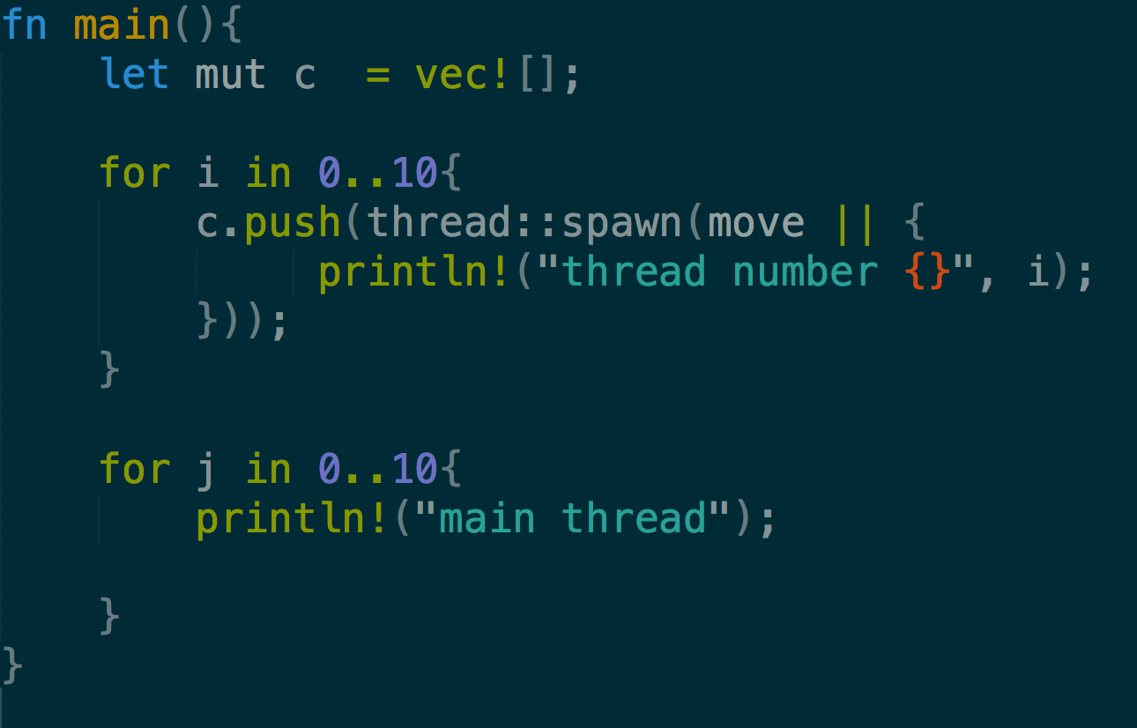
Threads

Slide 7
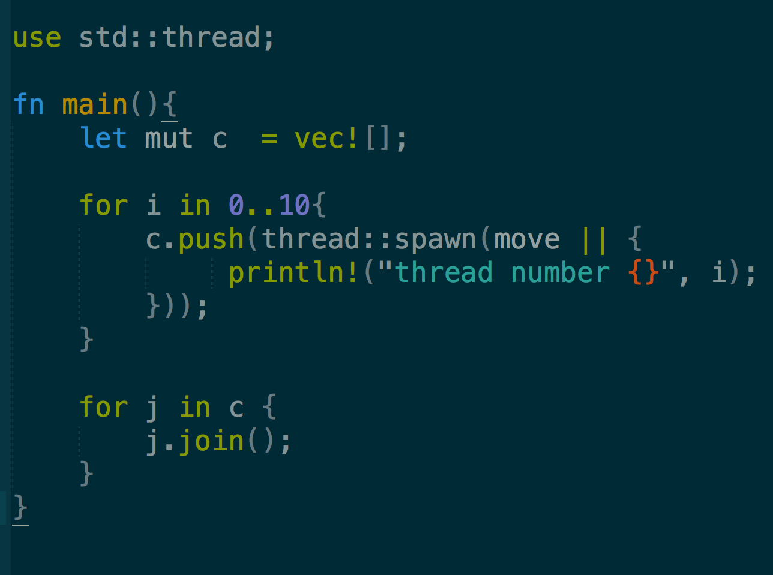
Threads
-- force all threads to wait to resolve

Slide 8
Threads
move - to force closure to take ownership of the vector
it helps us capture the value rather than by reference

Slide 9
Base concepts
Mutability: - something can change
- By default everything is immutable
Ownership & Borrowing: - who owns the data and who gets it lend to
- Every data piece can be owned and passed
- when data reaches end of scope its destructed
- you can borrow mutably once
- or multiple times immutably
- we can not have both mutable and immutable borrow

Slide 10
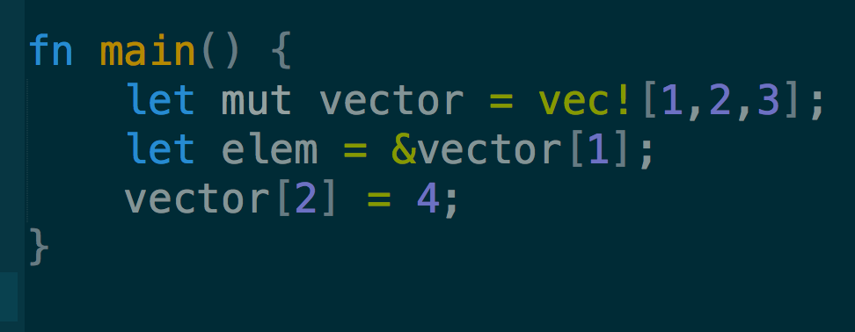
Problem:
Common mistake languages like C++ make
Immutable borrow is active and cannot mutate the collection

Slide 11
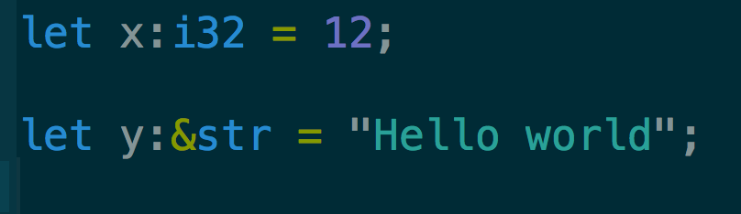
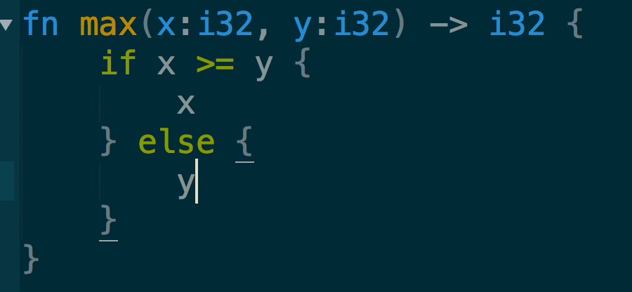
Things to note
Rust is statically type language – every value is of specific type
Variables: type annotations are optional
Functions : type annotations not often required, but must be explicit about their types

Slide 12
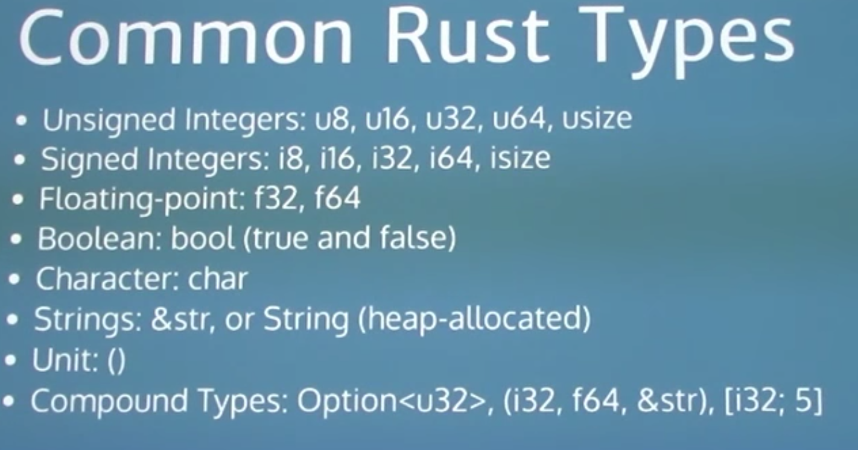
Things to note:

Slide 13
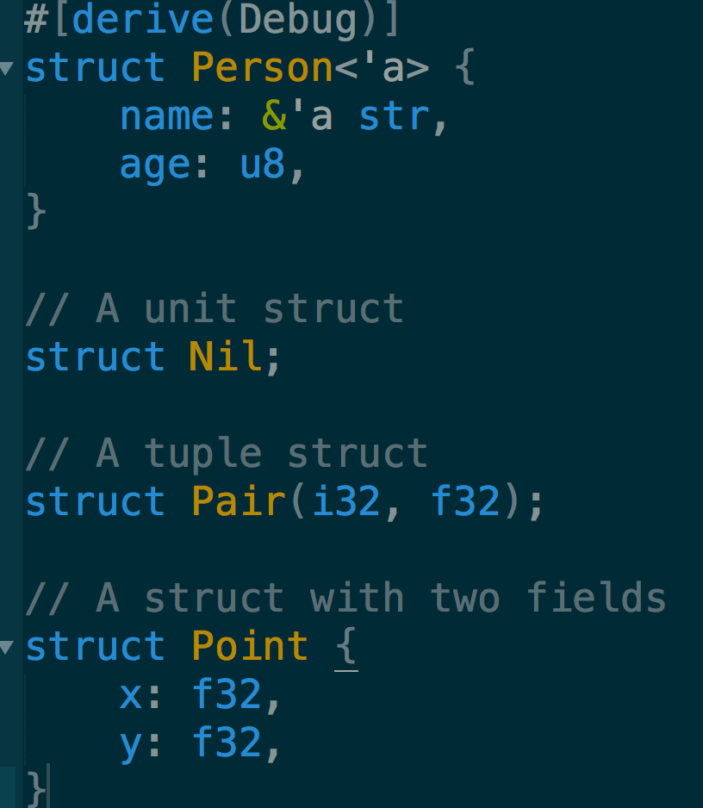
Things to note:
Structs
Types:
Tuple structs, which are,
basically, named tuples.
The classic C structs
Unit structs, which are
field-less, are useful for generics.

Slide 14
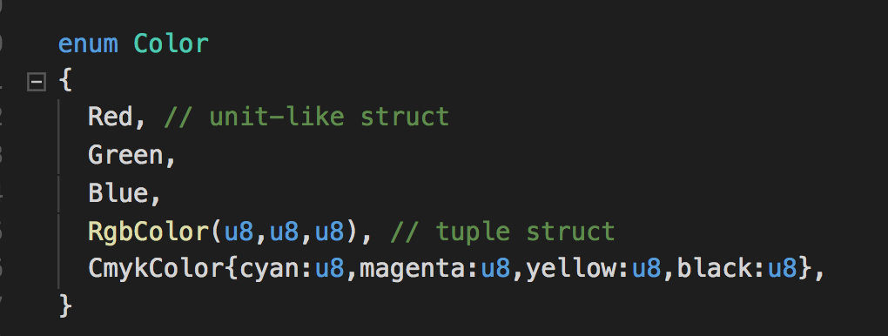
Things to note:
Enums:

Slide 15
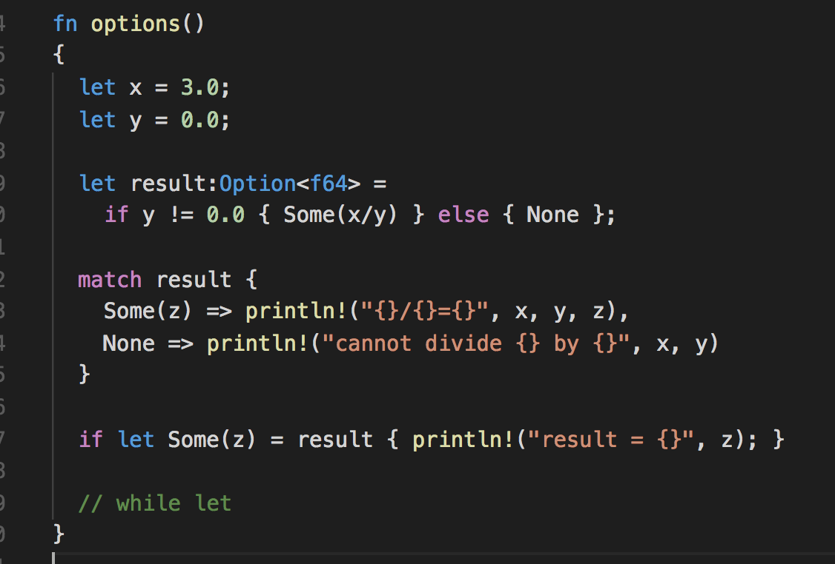
Things to note:
Options:
used when absence is a possibility
May return some value
Or no value

Slide 16
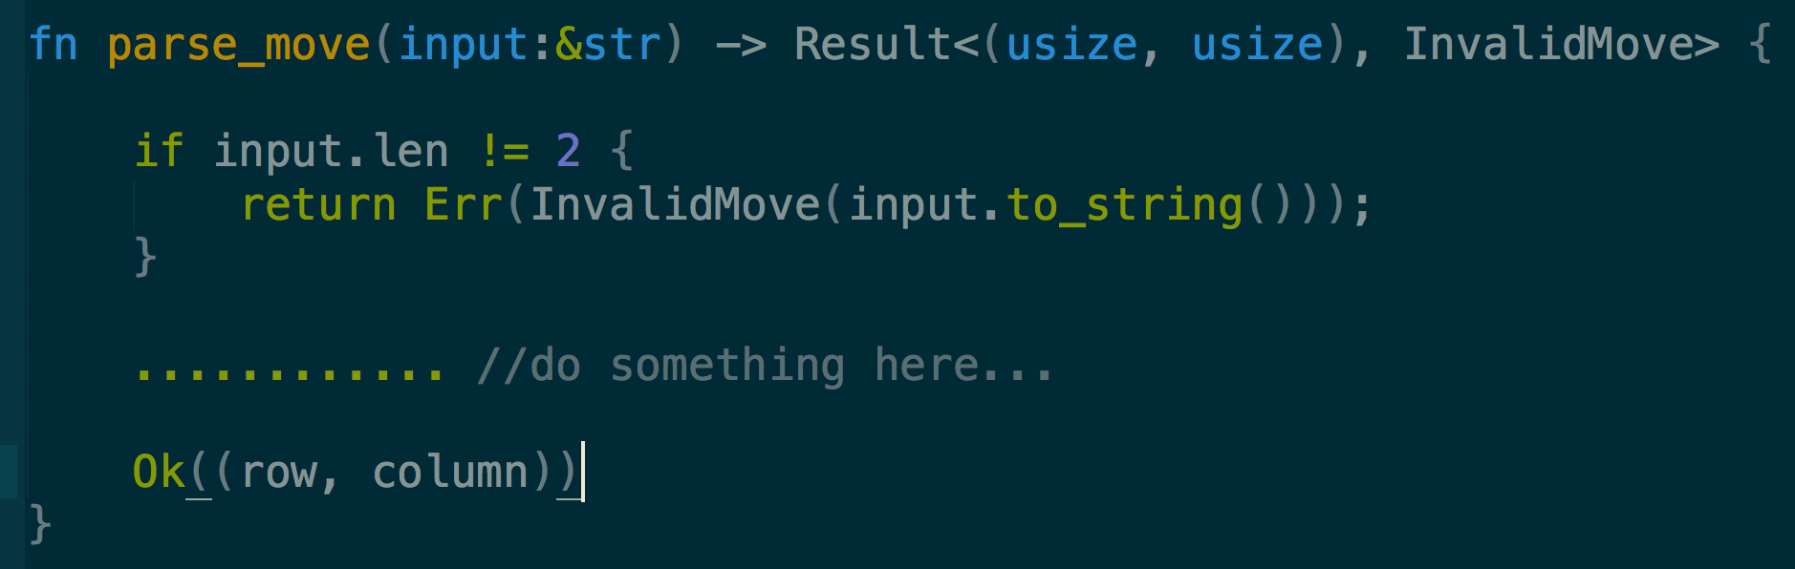
Things to note:
Result:
richer version of the Option type
Result<T, E> could have one of two outcomes:
Ok<T>: An element T was found
Err<E>: An error was found with element E

Slide 17
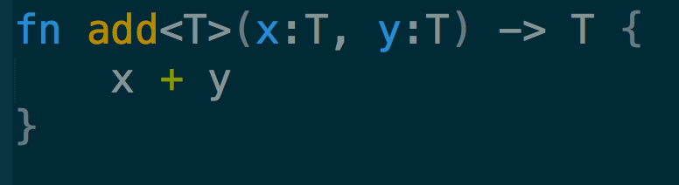
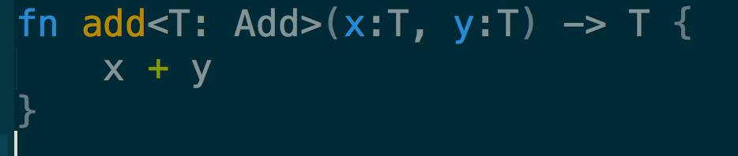
Data structures
Advanced features
Generics – helps us avoid duplication in writing structures of diff types
cannot be applied to type T
Traits - interfaces in java, type class in haskell - collection of types that all implement a calling interface

Slide 18
contents
What is concurrency?
Threads?
Rust base concepts and fundamentals
Rust data structures
Introduction to threading in Rust
Single threading and multi-threading
Build a simple webserver and a daemon
Talk about MIO and tokio
Introduction to futures

Slide 19
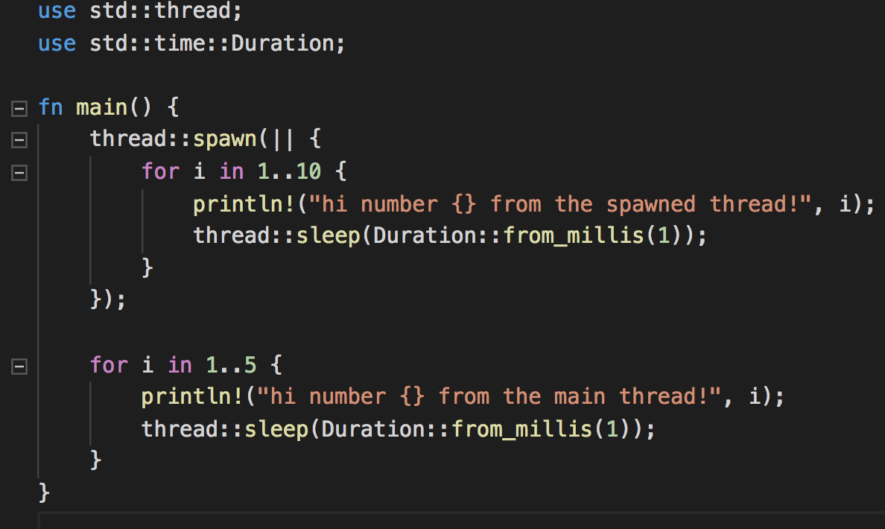
Introduction to threading in Rust
Rust uses OS threads and this helps lower runtime

Slide 20
Introduction to threading in Rust
Running pieces of codes simultenously
thread::sleep force a thread to stop its execution for a short duration, which allows a different thread to run
thread::spawn - function used to create a new thread and pass it a closure

Slide 21
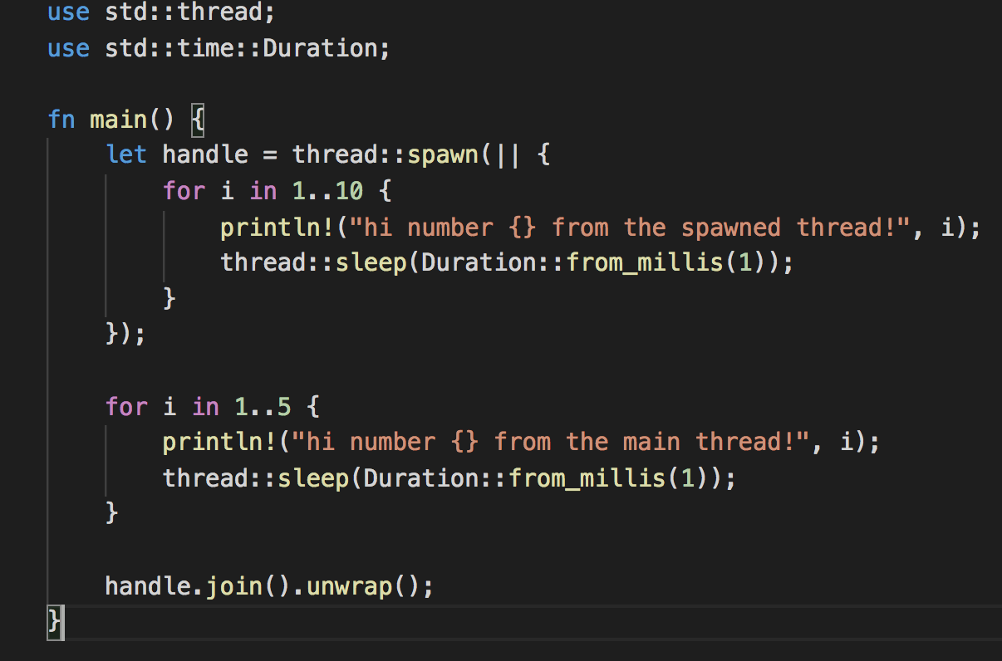
Introduction to threading in Rust

Slide 22
Introduction to threading in Rust
Join handle from thread::spawn to guarantee the thread is run to completion
Calling join on the handle blocks the thread currently running until the thread represented by the handle terminates
Using move

Slide 23
Introduction to threading in Rust
Sync & send
Sync - Types for which it is safe to share references between threads.
Send – Types for which it is safe to send references to another thread
Send and Sync are fundamental to Rust's concurrency

Slide 24
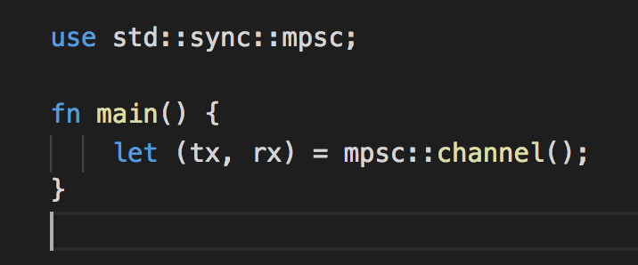
Introduction to threading in Rust
Message passing - ensures safe concurrency
channel in programming : a transmitter and a receiver

Slide 25
Introduction to threading in Rust
Shared state concurrency
Mutex
Multiple threads ownership of mutex

Slide 26
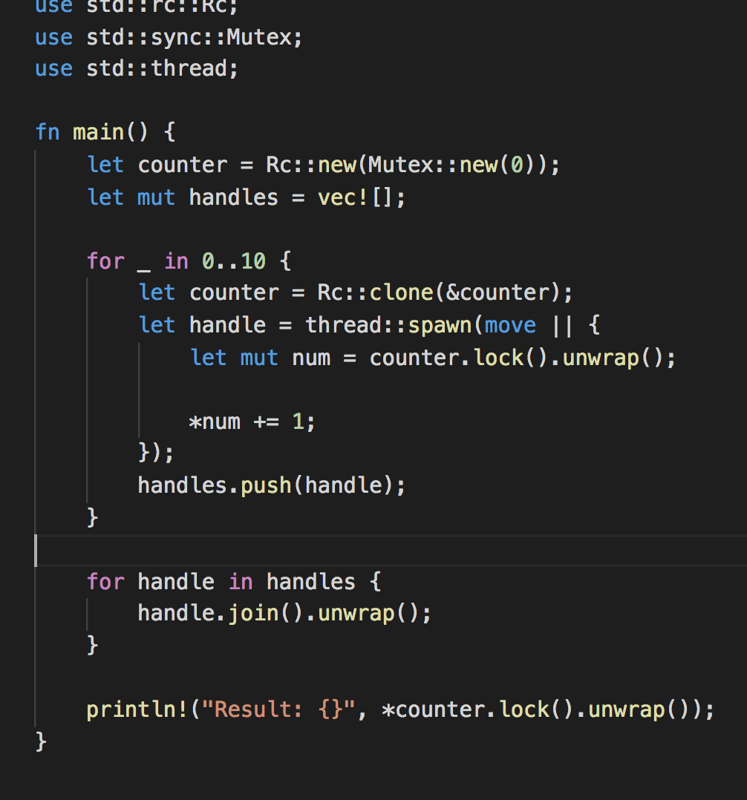
Introduction to threading in Rust
Rc<T> to allow multiple threads to own the Mutex<T>

Slide 27
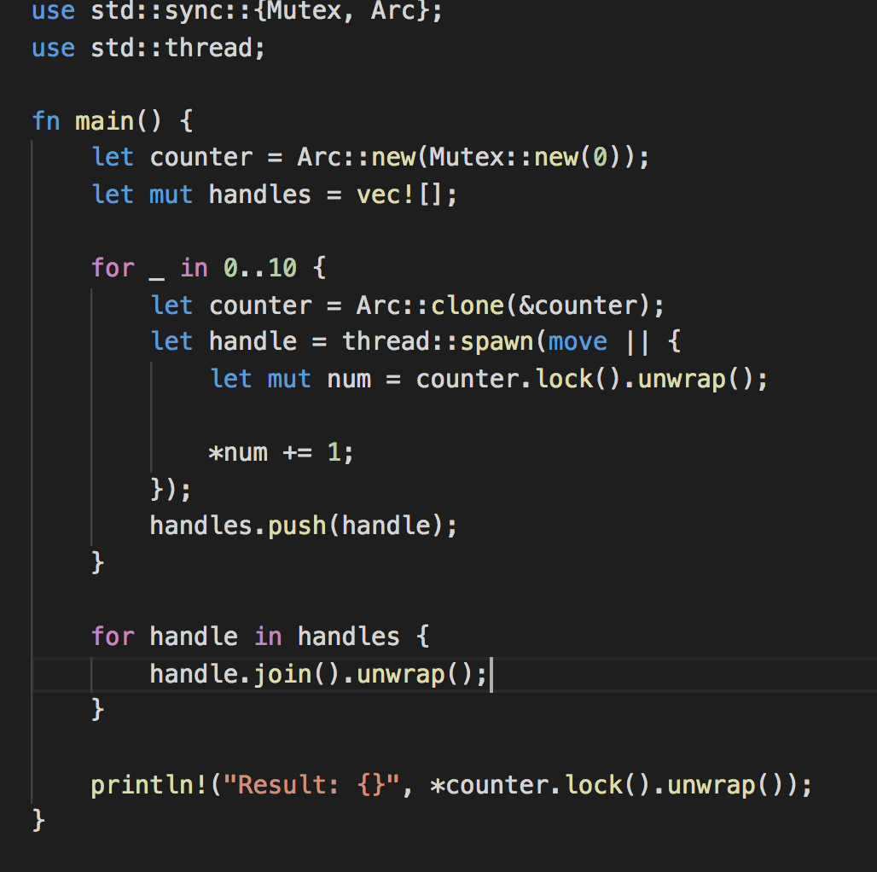
Introduction to threading in Rust
Using an Arc<T> to wrap the Mutex<T> to be able to share ownership across multiple threads

Slide 28
contents
What is concurrency?
Threads?
Rust base concepts and fundamentals
Rust data structures
Introduction to threading in Rust
Single threading and multi-threading
Build a simple webserver and a daemon
Talk about MIO and tokio
Introduction to futures

Slide 29
Single threaded -- single threaded web server
Learn a little bit about TCP and HTTP
Listen for TCP connections on a socket
Parse a tiny number of HTTP requests
Create a proper HTTP response
Improve the throughput of our server with a thread pool

Slide 30
Single threaded -- single threaded web server
Hypertext Transfer Protocol (HTTP) – powers web
Transmission Control Protocol (TCP) - reliable byte-stream channel (in order, all arrive, no duplicates)
Protocol is an agreement
Stands for:
meaning of packets
structure and size of packets

Slide 31
Single threaded -- single threaded web server
TCP/IP provides end-to-end connectivity specifying how data should be
formatted,
addressed,
transmitted,
routed, and
received at the destination

Slide 32
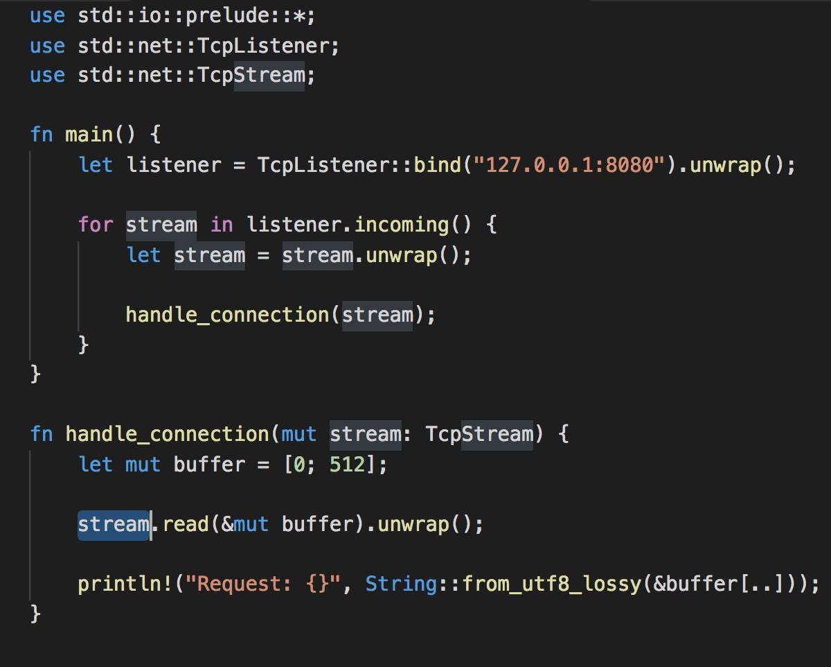
Single threaded
TcpListener allows us to listen for TCP connections

Slide 33
Single threaded
std::io::prelude - To bring traits into scope that let us read from and write to the stream
Response – html, 404 page
Slow connection
- A thread pool is a group of spawned threads that are ready to handle some task.

Slide 34
locks

Slide 35
Futures
A future is a value that represents the completion of an asynchronous computation
A database query that’s executing in a thread pool. When the query finishes, the future is completed, and its value is the result of the query.
An RPC invocation to a server. When the server replies, the future is completed, and its value is the server’s response.
A timeout. When time is up, the future is completed, and its value is ().
A long-running CPU-intensive task, running on a thread pool. When the task finishes, the future is completed, and its value is the return value of the task.
Reading bytes from a socket. When the bytes are ready, the future is completed – and depending on the buffering strategy, the bytes might be returned directly, or written as a side-effect into some existing buffer.

Slide 36
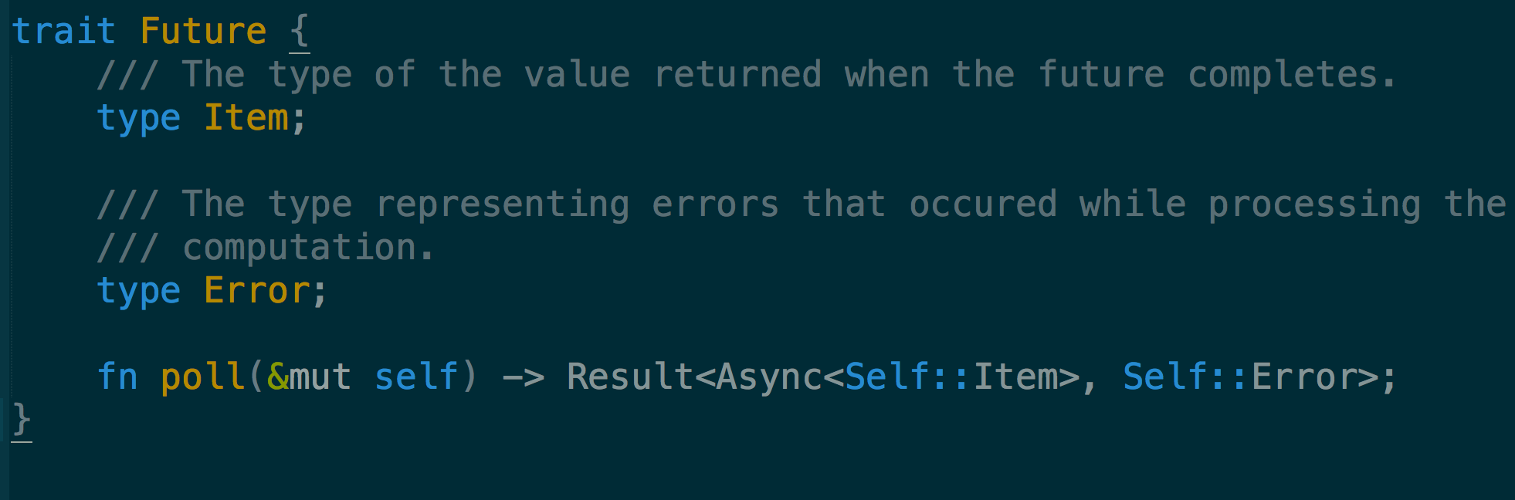

Slide 37
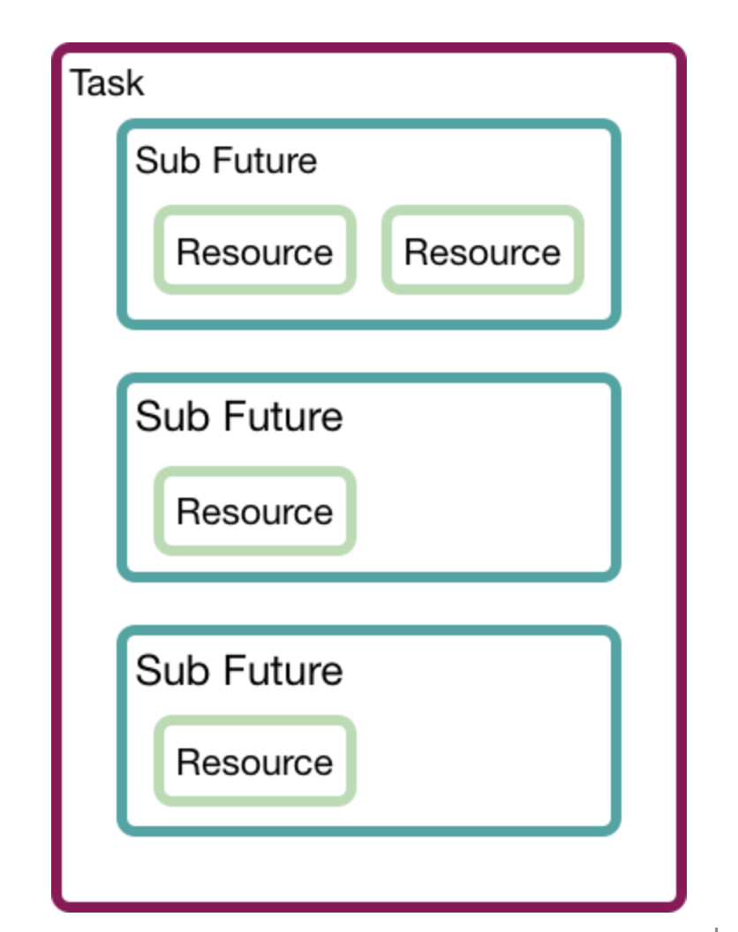
Futures --Task

Slide 38
Futures - Task
The futures crate provides a sync module which contains some channel types that are ideal for message passing across tasks.
oneshot is a channel for sending exactly one value.
mpsc is a channel for sending many (zero or more) values.
Streams example

Slide 39
More…
More content:
https://github.com/tokio-rs/website/blob/master/content/docs/getting-started/futures.md

Slide 40
END

