Slide 1

Two Years stable
Rust Zürichsee Meetup
Locationsponsor: Liip.ch

Slide 2
Organisation of the evening
Beginners workshop:
  Speaker: Sebastian
  Topics:
    Ownership & Borrowing
Advanced workshop:
  Speaker: Stefan
  Topics:
    CLI Argumentparsing with docopt
    Async Networking with tokio
Cake:

Slide 3
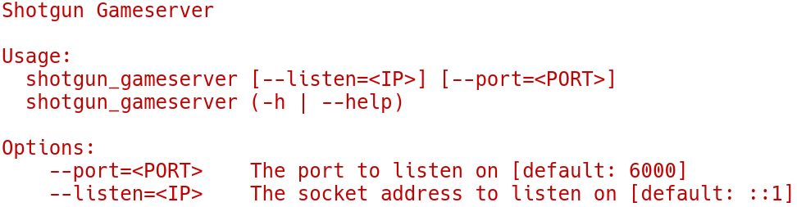
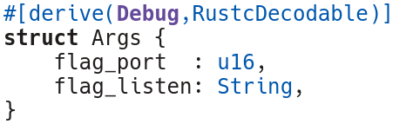
Argument Parsing
How to get from text
to a rust struct?

Slide 4
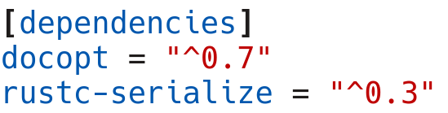

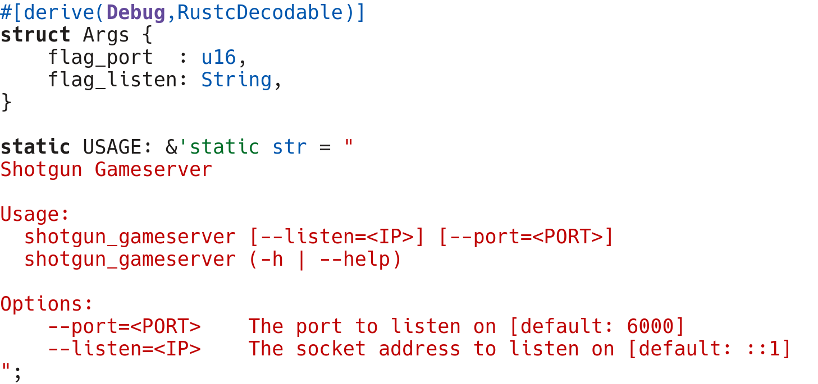
Argument Parsing
Import docopt
and rustc-serialize
Add extern crate
Make string static
and create the struct
(The stuff from before)
Add runtime-parsing:

Slide 5
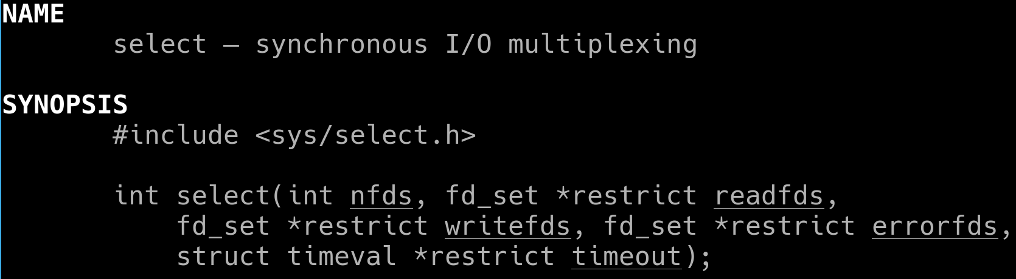

Async Networking
What kind of tools do we have?
Sync IO with Threads using pools
select
man 3 select
event-loops

Slide 6
Tokio Architecture
Futures
Tokio IO – I/O Traits and Combinators
Tokio Core – Byte Streams, Frames
Tokio Proto – Independent Layers (eg. TLS)
Tokio Service – Request/Response (eg. HTTP)

Slide 7
The story of this project

Slide 8
Questions

Slide 9
Cake
Thank you for your attention

