Slide 1

Python Backend Development
Mentors: Rustamov Javohir
Oripov G`iyos

Slide 2
PLAN
Python core I (1 oy)
Python advanced II (1 oy)
Database (postgresql)( 0.5-1 oy)
Django (tradional,DRF (rest api)) (2 -2,5 oy)
Telegram bot (3-8 tagacha tgbot yaratamiz xoxishlarizga qarab) (1-2 oy )

Slide 3
Python I
1 Introduction
2 Variables
3 String
4 Numbers and Math, Decimal
5 Conditional Statement
6 List and Tuple. guess game
7 Dictionary and Set
8 Loop
9 Function
10 Time, Datetime,Calendar
11 Tic Tac Toe
12 RegEx

Slide 4
PythonII
Product A
Product B
OOP
Dunder methods
decorators
Iterators and Generators
File Input Output
CSV, Pikles and Json
Context managers
Envs, Modules, Packeges
Multithreading
Matplotlib
Git
Sqlite

Slide 5
Postgresql
1) PostgreSQL, Overview
2) Environment Setup
3) Syntax
4) Data Types
5) Create Database
6) Select Database
7) Drop Database
8) Create Table
9) Drop Table
10) Schema
11) Insert Query
12) Select Query
13) Operators
14) Expressions
15) Where Clause
16) Aggregate Functions
17) AND & OR Clauses
18) Update Query
19) Delete Query
20) Like Clause
21) Limit Clause
22) Order By Clause
23) Group By
24) With Clause
25) Having Clause
26) Distinct Keyword
27) Constraints
28) Joins
29) Unions Clause
30) NULL Values
31) Alias Syntax
32) Triggers
33) Indexes
34) Alter Table Command
35) Truncate Table Command
36) Views
37) Transactions
38) Locks
39) Sub Queries
40) Auto Increment
41) Privileges
42) Date/Time Functions & Operators
43) Functions
44) Json, Jsonb
45) Useful Functions
46) Partitions (optional)

Slide 6
Django
Django Tradional
Internet texnologiyalari
web dasturlarning texnologiyalari
Django famework
Django ORM
Views and URLs
Forms and Templates
Django Admin
Deploy
Django REST
DRF framework
DRF Serialazers and Validation
DRF Viewsets and CRUD
DRF Authentication and Permission
Django Filter and search

Slide 7
Telegram bot
Aiogram documentions boyicha telegram botlar qurishni organamiz
wikipediabot
imlobot
online bozor bot
va hk... lar yasaymiz

Slide 8
Portifolio
Python coreda
Omborxona ,Library projectlarini conselda ishlatamiz
Django(tradional)
Contact me ,Blog Post ,(e commerse vaqt yetsa qilamiz)
Django (REST)
Todo list (library vaqt yetsa )

Slide 9
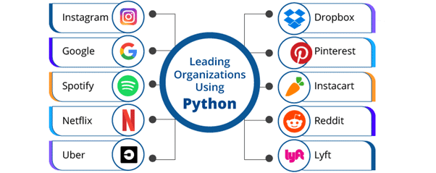
Python-dan foydalanadigan etakchi tashkilotlar

Slide 10
Qulayliklar
video dars
zoom (haftasida 3marta)
codelar
lecture(slaydlar)
Sifatli content
TUGADI !!!
THANKS FOR EVERTHING

