Slide 2
我们如何通过手工汇编代码
击败 Rust 的零成本抽象
叶万标

Slide 3
…………………………………………………………………
…………………………………………………………………
…………………………………………………………………
…………………………………………………………………
…………………………………………………………………
…………………………………………………………………
Introduction: RISCV
Introduction: CKB-VM
Approach: Partitioned code in ASM
Approach: Hand-Writing register allocation
Approach: Tail recursion
Thanks
3
4
6
8
12
16

Slide 4
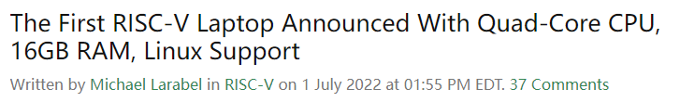

Introduction: RISC-V
What’s RISC-V?
RISC–V is an open and free ISA first conceptualised in 2010 with the initial goals of research
and education in mind. RISC-V is attracting more and more people to join:
Notes:
RISC-V 是 2010 年首次概念化的开放式 ISA, 最初的目标是研究和教育. 与广泛使用的 x86–64 ISA 相比, 它采用 RISC(精简指令集计算机)方案通过提供更少的功能指令和内存寻址模式来简化微架构的设计.

Slide 5
Introduction: CKB-VM
What’s CKB-VM?
CKB VM is a pure software implementation of the RISC-V instruction set used as scripting VM in CKB. Right now it implements full IMCB instructions for both 32-bit and 64-bit register size support. In the future we might also implement V extensions to enable better crypto implementations.
Right now CKB VM has 3 different modes:
Rust interpreter mode
Assembly based interpreter mode(ASM mode)
Ahead-of-time compilation mode(AOT mode)
Notes:
CKB VM是 RISC-V 指令集的纯软件实现，用作 CKB 中的脚本 VM。现在，它对32位和64位寄存器大小支持实施完整的IMC指令。将来，我们还可以实施V扩展，以实现更好的加密实现。

Slide 6
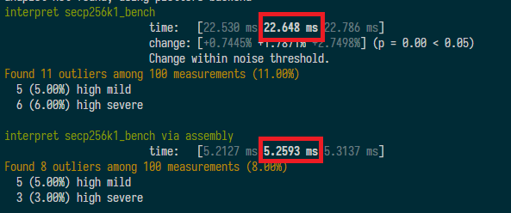
Introduction: CKB-VM
Performance test about Rust interpreter and ASM:
secp256k1 refers to the parameters of the elliptic curve used in Bitcoin's public-key cryptography
Rust is fast, but it can be faster … by some tricks
Notes:
CKB VM是 RISC-V 指令集的纯软件实现，用作 CKB 中的脚本 VM。现在，它对32位和64位寄存器大小支持实施完整的IMC指令。将来，我们还可以实施V扩展，以实现更好的加密实现。

Slide 7
Approach: Partitioned code in ASM
Writing an interpreter is the most intuitive. We just need to fetch instructions one by one and execute it on the native.
But this easiest way is limited by the performance of the Rust language itself, and at the same time we have to obey Rust's safety specifications(memory or pointers).
Notes:
CKB VM是 RISC-V 指令集的纯软件实现，用作 CKB 中的脚本 VM。现在，它对32位和64位寄存器大小支持实施完整的IMC指令。将来，我们还可以实施V扩展，以实现更好的加密实现。

Slide 8
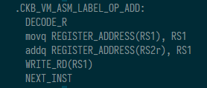
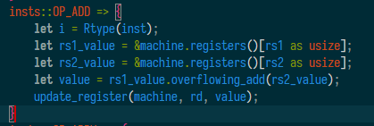
Approach: Partitioned code in ASM
Writing partitioned code in Assembly
Writing assembly code is not an easy task. There is a huge difference between the x86 architecture and the RISC-V architecture.
Notes:
CKB VM是 RISC-V 指令集的纯软件实现，用作 CKB 中的脚本 VM。现在，它对32位和64位寄存器大小支持实施完整的IMC指令。将来，我们还可以实施V扩展，以实现更好的加密实现。

Slide 9

Approach: Hand-writing register allocation
In many programming languages, the programers may use any number of variables. The computer can quickly read and write registers in the CPU, so the computer program runs faster when more variables can be in the CPU's registers.
Registers are a core part of the CPU, accessing a register's value will typically require very few clock cycles (likely just 1), as soon as memory is accessed, things get more complex and cache controllers / memory buses get involved and the operation is going to take considerably more time.
Notes:
CKB VM是 RISC-V 指令集的纯软件实现，用作 CKB 中的脚本 VM。现在，它对32位和64位寄存器大小支持实施完整的IMC指令。将来，我们还可以实施V扩展，以实现更好的加密实现。

Slide 10

Approach: Hand-writing register allocation
Rigisters: Limited, typically only 16 or 32 general purpose registers
Memory: Typically “unlimited”
It is impossible to directly and statically map a variable to a register.
Notes:
CKB VM是 RISC-V 指令集的纯软件实现，用作 CKB 中的脚本 VM。现在，它对32位和64位寄存器大小支持实施完整的IMC指令。将来，我们还可以实施V扩展，以实现更好的加密实现。

Slide 11
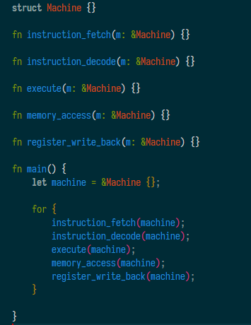
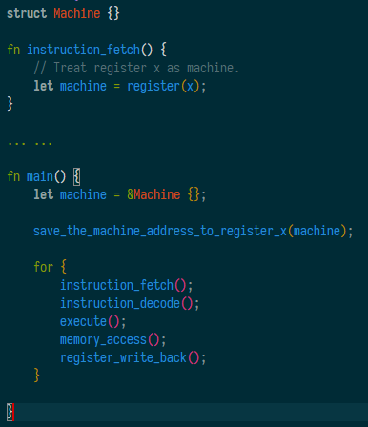
Approach: Hand-writing register allocation
Machine have a long lifetime, it’s possible do some tricks
pseudo code
Notes:
CKB VM是 RISC-V 指令集的纯软件实现，用作 CKB 中的脚本 VM。现在，它对32位和64位寄存器大小支持实施完整的IMC指令。将来，我们还可以实施V扩展，以实现更好的加密实现。

Slide 12
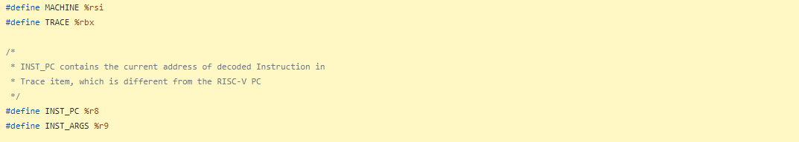
Approach: Hand-writing register allocation
Example of static register allocation in CKB-VM ASM interpreter mode
https://github.com/mohanson/ckb-vm/blob/develop/src/machine/asm/execute_x64.S#L74-L120
Notes:
CKB VM是 RISC-V 指令集的纯软件实现，用作 CKB 中的脚本 VM。现在，它对32位和64位寄存器大小支持实施完整的IMC指令。将来，我们还可以实施V扩展，以实现更好的加密实现。

Slide 13
Approach: Tail recursion
Basic block
There is a concept in the interpreter called basic block. A basic block has only one entry and exit, and executes the instructions in the block sequentially. Any instruction that can change the flow of execution will end up with a basic block(Jumps, calls, returns and syscalls).
Basic block is also known as Trace.
Notes:
CKB VM是 RISC-V 指令集的纯软件实现，用作 CKB 中的脚本 VM。现在，它对32位和64位寄存器大小支持实施完整的IMC指令。将来，我们还可以实施V扩展，以实现更好的加密实现。

Slide 14
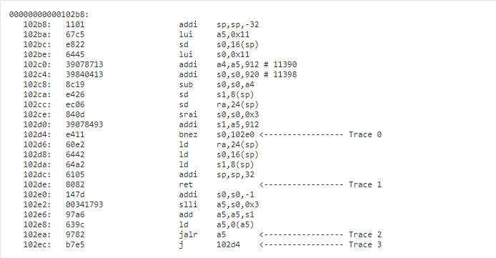
Approach: Tail recursion
Can you split the codes below into Traces? Note: bnez is a condition jump, ret is a return, jalr and j is a jump.
Notes:
CKB VM是 RISC-V 指令集的纯软件实现，用作 CKB 中的脚本 VM。现在，它对32位和64位寄存器大小支持实施完整的IMC指令。将来，我们还可以实施V扩展，以实现更好的加密实现。

Slide 15
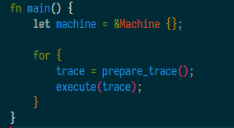
Approach: Tail recursion
Main interpreter loop with Trace(pseudo code):
execute() is written by Assembly
Returning from assembly to the main transcode loop comes with big performance penalties. These are imposed by the first context switch, code cache lookup, and second context switch necessary for starting execution of the next basic block.
We used the method of recursive translation: When the parser arrives at end of trace , translation of the next trace is started recursively.
Notes:
CKB VM是 RISC-V 指令集的纯软件实现，用作 CKB 中的脚本 VM。现在，它对32位和64位寄存器大小支持实施完整的IMC指令。将来，我们还可以实施V扩展，以实现更好的加密实现。

Slide 16
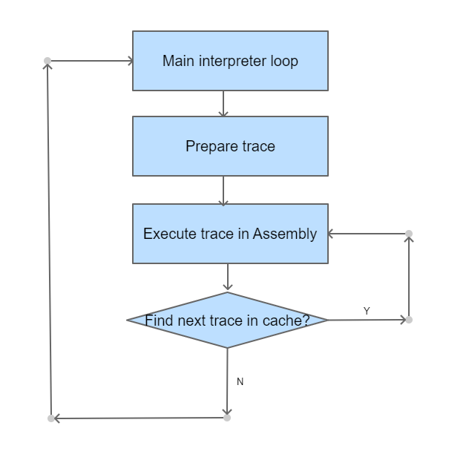
Approach: Tail recursion
ckb_vm_x64_execute:
.prepare_trace:
if find_trace:
jump .NEXT_INST
else:
jump .UNLOADED
.NEXT_INST:
execute_inst
if is_end_of_trace:
jump .prepare_trace
else:
jump .NEXT_INST
.exit_trace:
. UNLOADED:
mov $RET_DECODE_TRACE, ARG_RETd
retq
Rust
………………………………………………
Assembly
Notes:
CKB VM是 RISC-V 指令集的纯软件实现，用作 CKB 中的脚本 VM。现在，它对32位和64位寄存器大小支持实施完整的IMC指令。将来，我们还可以实施V扩展，以实现更好的加密实现。

