Slide 1

Accessible Microsoft Office: Excel 2010/2013
Richard Steinberg, Accessibility Specialist
Notes:
Welcome and introductions to what brought you to this class, your skillsets

Slide 2


Accessible Spreadsheets
Introductions
Notes:
Quick intros and what brought you to this class.

Slide 3
A11y Considerations
Keyboard Only
Screen Magnification
Use of Color
Screen Reader Friendly
Cognitive Load
Notes:
Why we’re doing what we’re doing and who it affects.
Keyboard only users – Excel keyboard accessible if it’s in the grid.
Screen magnifier users – People with low vision or blocked vision.
Use of color – Be aware not everyone sees color the same way.
Screen Reader Friendly – What is a screen reader? Will spend time making Excel files readable for screen readers.
Cognitive Load – Simplifying tables and presentation will make the info easier to quickly consume for everyone.

Slide 4

What does success look like?
Begin with the end in mind. -- Stephen Covey
Notes:
If you’re here, you probably aren’t familiar w/what an accessible Excel file looks like, so we’re going to start with that, so that we’re clear on what our goals are today.
Spot the difference partner exercise, group share.

Slide 5
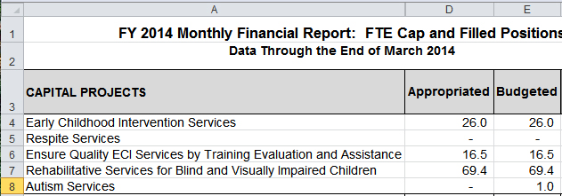
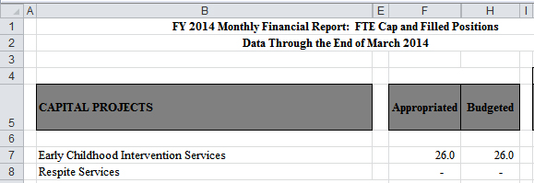
Spacing and Fonts
Optimize for users who use screen magnification.
Notes:
(slide in) another consideration is to optimize for screen magnification.
Many people with low vision will use a screen magnifier to read documents. And any anyone accessing a document on a phone or tablet will have a limited viewport, as well.
when using a limited view port, a user can only see a few cells at a time, and will start at the top and pan left to right.
(slide in) for example, when this table with a limited viewport, right off, they would see an empty column A, read the titles rows 1 and 2, and then empty rows 3 and 4. That’s a lot of blank space to wade through to get to the actual information on this sheet. So it’s best to eliminate blank rows and columns in excel. And It’s also important to check is that the information makes sense when read left to right top to bottom.
Another thing that happens under screen magnification is that fonts begin to pixelate. Therefore it’s important to use a sans serif font like Arial or Verdana.
Also the font need to be a minimum of size 12.
Lastly, you need to use strong contrast to maximize readability. The headers on this table do not have enough contrast between the background color and the text color.
Here’s an example of the same table but it has been optimized for accessibility. (slide in)
Empty rows and columns were deleted.
The font was changed to Arial and bumped up to size 12.
And the color contrast was fixed on the headers.
You will probably agree that these changes have made the table much more readable for anyone, not just thse with visual imairments
Overall, this table is pretty difficult for anyone to read.

Slide 6


How to Set Default Font
Notes:
Here’s a tip. Save time by making the fonts in your Microsoft Excel program accessible by default.
Just go to File > Options > General >and look for “ When Creating New Workbooks…
Choose a sans serif font such as Verdana or Arial and choose font size 12.
Also be sure to always set the zoom to 100% or the font won’t really be the size you’ve set them at. And set first cell at A1 on first worksheet.

Slide 7
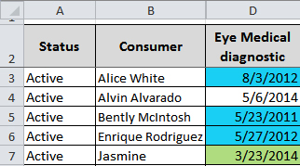
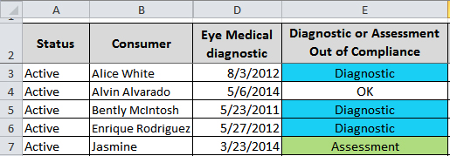
Intro to Color Blindness
Information should not be conveyed by color alone
Notes:
When color is included in your spreadsheets, you need to make sure that information is not conveyed with color *alone*.
This is because not everyone sees colors the same way, and also not everyone can see. Those who can’t see, use screen readers that read the information on the screen aloud. Let’s look at an example (slide in).
Here is a table with a date column that has past due thresholds, indicated by blue and green backgrounds. Presumably there would be a legend that would explain exactly what the blue and green shading mean. The problem is that some users may not be able to distinguish between the blue and green colors; and people who use screen readers would hear the text in the cells but would not be aware of the background colors at all. So this is an example of how using color to convey information can be inaccessible.
But… with some small tweaks, this table can be made accessible. For example, you could add a column that *says* what is past threshold – in this table it is either a diagnostic, an assessment, or neither. For those who can distinguish the color shading, it is much more obvious now that blue means (diagnostic) and green means (assessment). And for those who can’t rely on color, the information is clearly communicated in text. This table is now accessible.
By the way, watch out for color in charts too. For example, in a pie chart, you can add labels and values next to each wedge so that users who are color blind can have an alternate way to get the information.

Slide 8
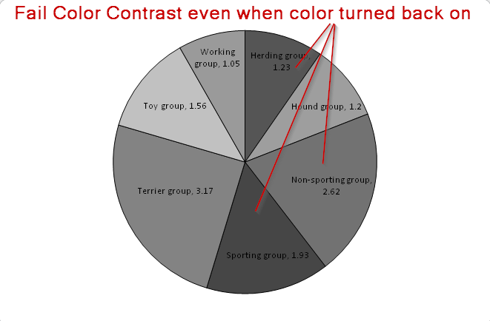
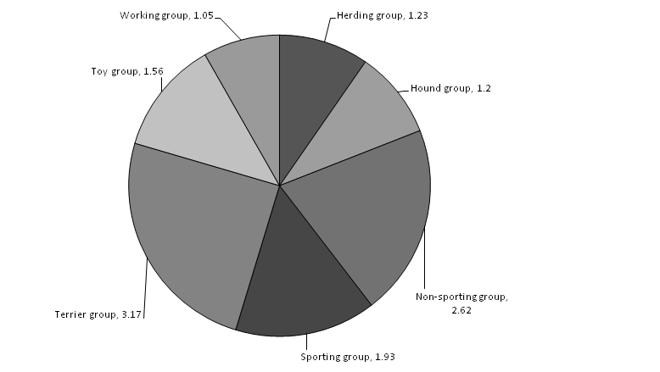
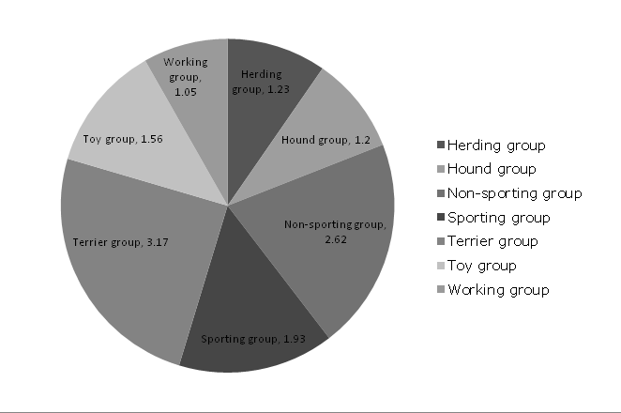

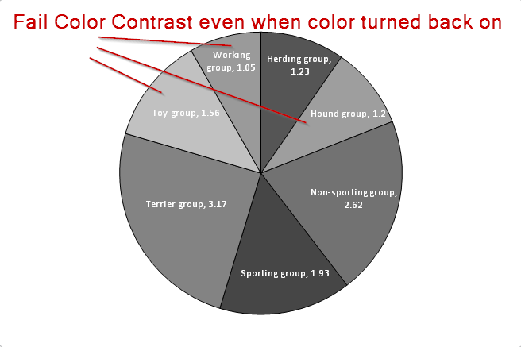
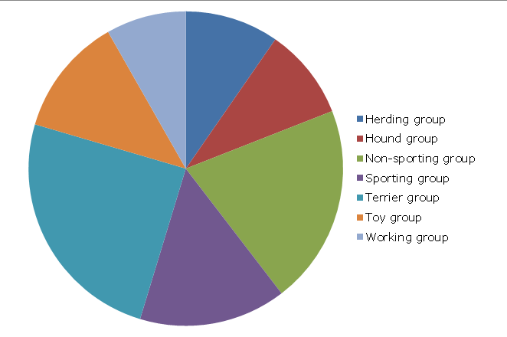
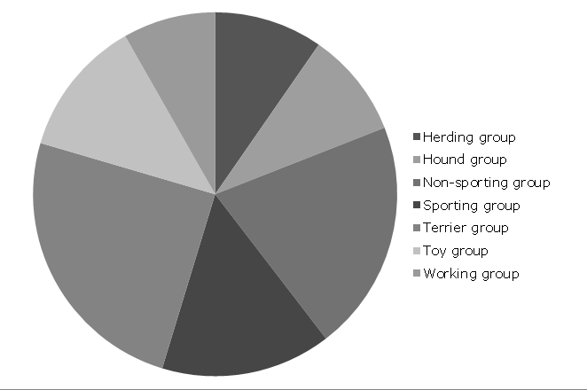
Pie Chart Examples
Notes:
Keep in mind that some of your excel-generated charts and graphs may also be used for presentations in small to large groups. Having said that, make sure that associate a number with each bar in your graph along with the name.
Checked preloaded palettes for pie charts in Excel 2013 and none pass for accessibility with black or white characters.

