Slide 1

Advancing Accessibility
Gerard K Cohen
linkedin.com/in/gerardkcohen/
https://gerardkcohen.me

Slide 2

Atlassian Design System, Accessibility Engineering
linkedin.com/in/gerardkcohen
gerardkcohen.me
pluralsight.com/authors/gerard-cohen

Slide 3

bit.ly/3MKMMVB

Slide 4
Before we get started

Slide 5
Advance accessibility

Slide 6
What is “Shift left?”

Slide 7
What is “Shift left?”
Moving tasks and processes to earlier stages of the development lifecycle

Slide 8
We need to shift lefter!

Slide 9
Engineering

Slide 10
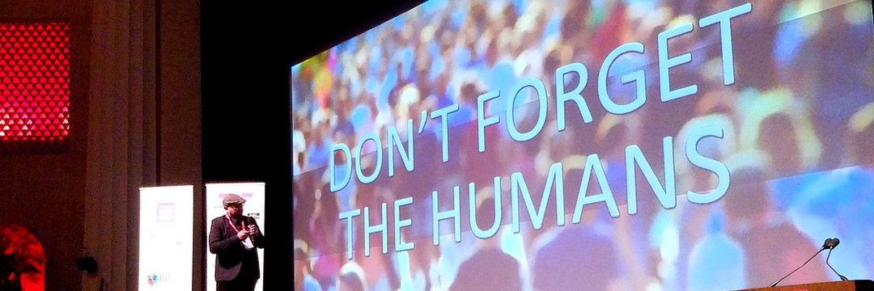

Slide 11
Automation still cannot replace the work that humans need to do

Slide 12
Education before automation

Slide 13
Operationalize the people you already have

Slide 14
Do not pre-optimize your accessibility efforts

Slide 15
Accessibility needs to stop whispering

Slide 16
Accessibility is just replacing what was originally removed

Slide 17
Design

Slide 18
Designers need to understand semantics

Slide 19


Slide 20
New designers have grown up in the digital age

Slide 21
Accessible design is about simplifying without excluding

Slide 22
Content

Slide 23
1.17%
Sessions related to accessible content at CSUN

Slide 24
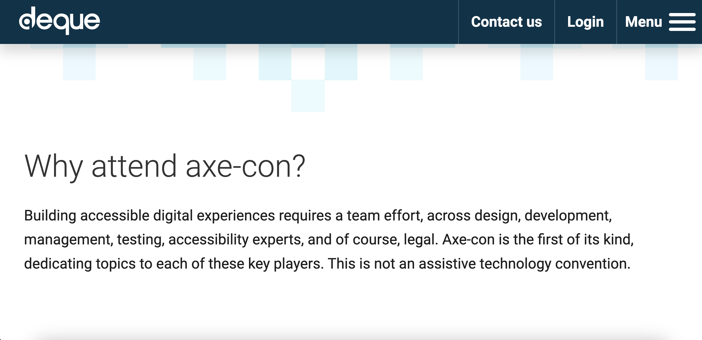

Slide 25
1.66%
Sessions related to accessible content at axe-con

Slide 26
0%
Sessions related to accessible content at a11yTO

Slide 27
Content is the least represented craft in accessibility

Slide 28
~25%
WCAG met or enhanced by Content

Slide 29
Content is the #1 secret weapon to great accessibility

Slide 30
Good content designers help simplify layouts and user journeys

Slide 31
Great content designers try to write less

Slide 32
Designs are like jokes…
If you have to explain them, they weren’t that good to begin with

Slide 33
Engineering/ Design Managers (EM/DM)

Slide 34
Managers are not equipped to handle accessibility or disabled workers

Slide 35
Hire people experienced in accessibility

Slide 36
Not all disabled people are experts on all disabilities

Slide 37
Training!
Operationalize the people you already have

Slide 38
Leave time for accessibility

Slide 39
Managing Disabled Workers

Slide 40
Chances are high that someone on your team has a disability

Slide 41
Think about how deprioritizing accessibility affects disabled workers

Slide 42
Direct reports may have undisclosed disabilities

Slide 43
Performance issues may actually be an undisclosed disability

Slide 44
You do not have to explain or disclose any special circumstances

Slide 45
Managers are not equipped to support disabled workers

Slide 46
Project Management (PM)

Slide 47
PM’s can be the biggest blocker to accessibility

Slide 48
Accessibility is not the reason for delays, it’s lack of planning

Slide 49
PM’s need to leave room for accessibility

Slide 50
PM’s need to understand priority and severity of accessibility issues

Slide 51
Priority is the order and timing to address issues

Slide 52
Severity is the impact to disabled people

Slide 53
Step 1: Categorize areas of your product

Slide 54
Step 2: Apply severities

Slide 55
Only qualified accessibility professionals can set severity

Slide 56
Start with the primary
job to be done

Slide 57
Rinse and repeat with supporting functions

Slide 58
Pay attention to issue counts

Slide 59
Human Resources (HR)

Slide 60
HR is not equipped to handle employees with disabilities

Slide 61
Do job posts list accessibility as a desired skill?

Slide 62
Accessibility professionals are more likely to apply

Slide 63
How is accessibility evaluated during interviews?

Slide 64
Are interviewers qualified to evaluate accessibility?

Slide 65
Is onboarding accessible?

Slide 66
Procurement

Slide 67
Growth/career ladders

Slide 68
Is accessibility required at all levels?

Slide 69
Performance assessments?

Slide 70
Shift Up

Slide 71
Leadership needs to be activated

Slide 72
Track and measure your accomplishments

Slide 73
Share progress and accomplishments publicly

Slide 74
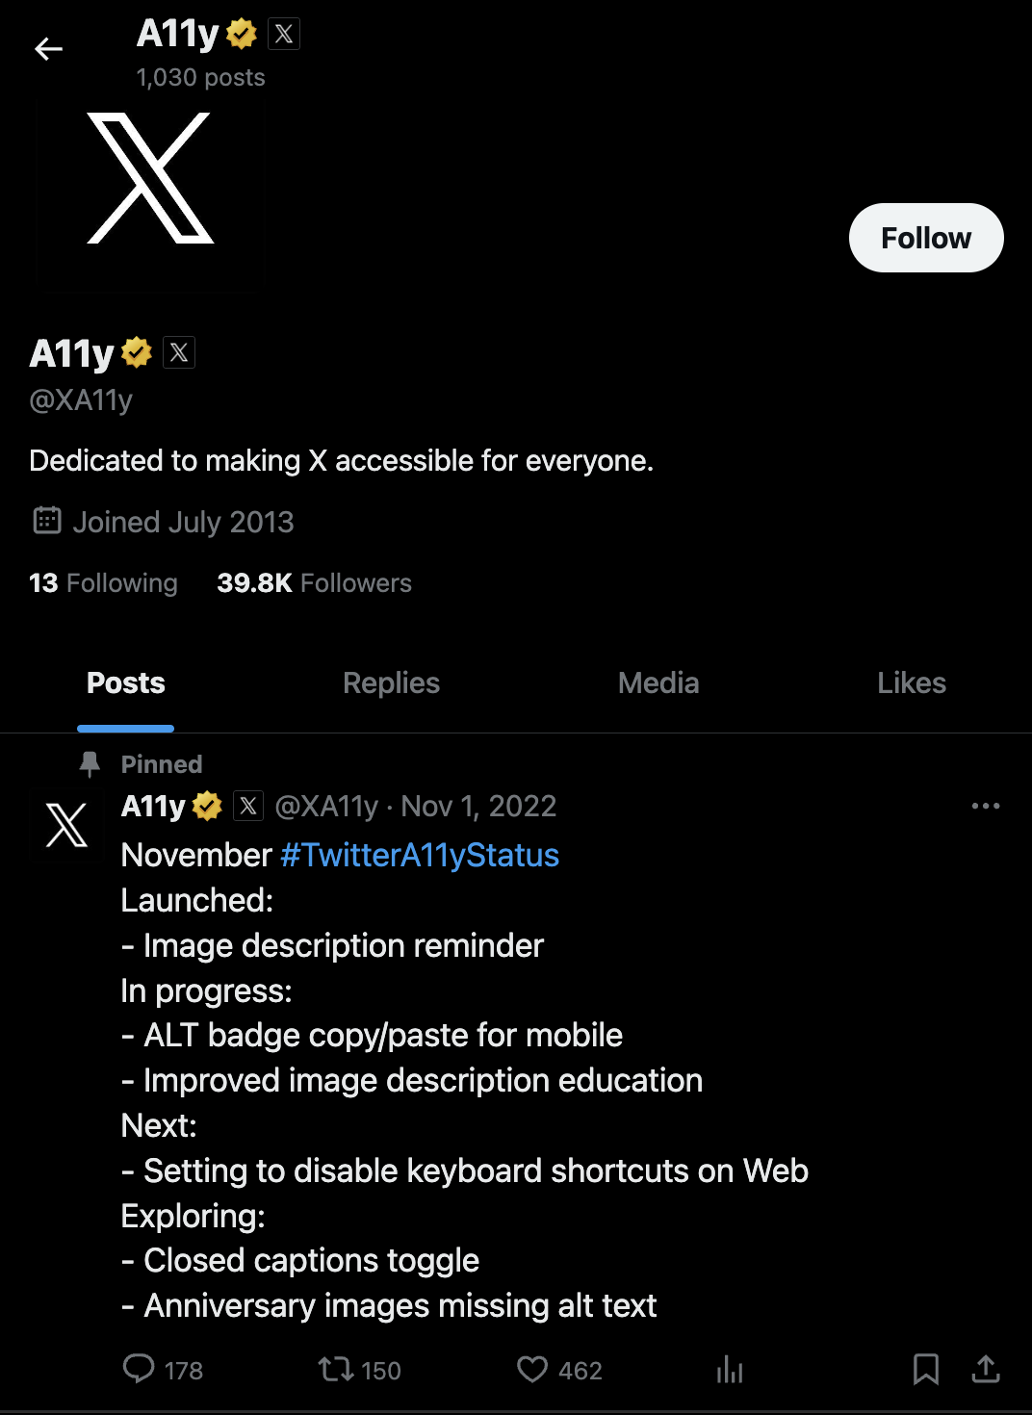

Slide 75
Get testimonials from teams you have helped

Slide 76
WIIFM
(What’s in it for me?)

Slide 77
What motivates leaders?
Increase gains or avoid losses

Slide 78
Document everything and share with leaders

Slide 79
Acknowledge leaders when they do the right thing

Slide 80
Leadership can be at any level

Slide 81
Support does not equate to mandating accessibility

Slide 82
Make sure you are ready!

Slide 83
Shift out

Slide 84
We’re still talking about the same things
Notes:
We’ve been talking about the same things, for at least the last 10yrs I’ve been here. With the exception of AI topics recently, its the same thing year after year. [CLICK]

Slide 85
Technology is leaving us behind

Slide 86
Web accessibility is easy

Slide 87
Web accessibility is easy, until it gets complicated

Slide 88
Web is getting bigger
Notes:
<pause> According to this years WebAIM million report, the number of elements on a typical homepage has gone up to like 1100 items. The web is getting bigger, and more complex.<pause> [CLICK]

Slide 89
Modern problems require modern solutions

Slide 90
At a certain level, HTML is not enough

Slide 91
Shift some focus off engineers to browsers, OS, and AT vendors

Slide 92
We need to be kinder to each other

Slide 93
Some final words

Slide 94
Don’t give up!

Slide 95
Go back and review your published accomplishments

Slide 96
Don’t underestimate your impact

Slide 97
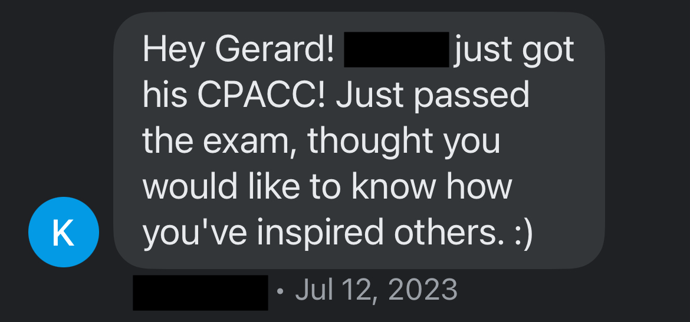

Slide 98
Progress over perfection

Slide 99
Progress over perfection

Slide 100
Progress is all that is required of you today

Slide 101
Let us keep shifting left, up, and out!

Slide 102
Gerard K Cohen
linkedin.com/in/gerardkcohen/
https://gerardkcohen.me

