Slide 1

Accessibility
&
Contracts / Procurement

Slide 2

Introductions
Glenda the Goodwitch
glendathegood.com
Tell me about you…

Slide 3


Definitions
What is IT?
What is Accessibility?

Slide 4

EIT: Electronic & Information Technology
Information technology and any equipment or interconnected system or subsystem of equipment, that is used in the creation, conversion, or duplication of data or information.

Slide 5
EIT: Electronic & Information Technology
Includes (but is not limited to)
telecommunications products (such as telephones)
information kiosks
transaction machines
web sites
multimedia
office equipment (such as copiers and fax machines)
computers
software application and operating systems
Source: Electronic and Information Technology
Accessibility Standards (Section 508)
§ 1194.4 Definitions
www.access-board.gov/sec508/standards.htm

Slide 6
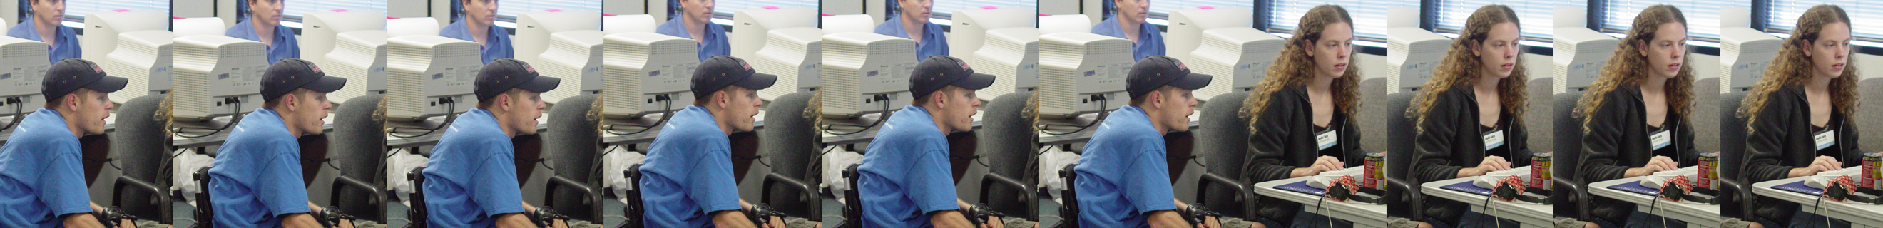
what is accessibility?
When all users - regardless of disability - can obtain the same information and perform the same functions.

Slide 7

Plan for Buying Accessible EIT
Initial Setup
  Accessibility Expert(s)
  Determine IT Accessibility
  Laws, Policies and Guidelines
  for your institution
  Accessible IT Procurement Goals
  Accessible IT Requirements in RFPs
Ongoing Tasks
  Accessibility Review of bid(s) products
  Report to Purchasing & Vendor

Slide 8

Accessibility Expert
Ideally has
accessibility work as 50% or more of their job
experience in accessibility & remediation
accessibility testing tools
continuing accessibility training
Recommended job duties
accessibility testing (proactive)
accessibility training/consulting
accessibility remediation

Slide 9

Objectives of Accessibility Laws
Equal opportunity
Independence
For most people technology makes things easier.
For people with disabilities,
technology makes things possible.
President’s Council on Disabilities

Slide 10
Accessibility Laws: Federal
United States Federal Laws
  Section 504 of the 1973 Rehabilitation Act (Federal)
    “No otherwise qualified individual with a disability in the United States …shall be excluded from the participation in, be denied the benefits of, or be subjected to discrimination under any program or activity receiving Federal financial assistance”
    http://ericec.org/sect504.html
  Americans with Disabilities Act (ADA) of 1990 (Federal)
    National mandate to eliminate discrimination against individuals with disabilities
    http://www.usdoj.gov/crt/ada/pubs/ada.txt
  Section 508 of the 1973 Rehabilitation Act (1998) (Federal)
    Applies accessibility standards to procurement and development of electronic and information technologies by federal government agencies
    www.section508.gov
International Guideline
Web Content Accessibility Guideline 2.0 (WCAG) of 2008 (W3C)
http://www.w3.org/TR/WCAG20/
508
WCAG 2.0

Slide 11
















Accessibility Law: State
At least 21 states have explicit statutes or executive orders
  Arizona, Arkansas, California, Colorado, Delaware, Florida, Indiana, Illinois, Kentucky, Louisiana, Maryland, Minnesota, Missouri, Montana, Nebraska, New York, North Carolina, Oklahoma, Texas, Virginia, W. Virginia
  At least 6 states have Accessibility Policies
    Georgia, Hawaii, Kansas, Massachusetts, Ohio, Rhode Island
Most reference Section 508
All have procurement requirements
Notes:
http://people.rit.edu/easi/itd/itdv09n1/golden.htm
http://74.125.47.132/search?q=cache:c9eeRUmIGmkJ:www.access-board.gov/sec508/refresh/teitac2nd/TEITAC_Buck_Nov_2006.ppt+procurement+accessibility+state+law+what+states+have%3F&hl=en&ct=clnk&cd=6&gl=us&client=firefox-a
New York - http://www.oft.state.ny.us/policy/s04-001/index.htm
Ohio - http://ohio.gov/policies/accessibility/
Georgia – http://www.georgia.gov/00/static/0,2085,4802_0_0_Accessibility,00.html
Hawaii - http://www.ehawaii.gov/dakine/docs/ada.html
Kansas- http://www.kansas.gov/about/accessibility_policy.html
Mass - http://www.mass.gov/?pageID=mg2utilities&L=1&sid=massgov2&U=utility_policy_accessibility
Rhode Island - http://www.ri.gov/resource/standards/

Slide 12

Accessibility Law: State of Texas
Texas Administrative Code
  Chapter 206: State & Higher Ed Web Sites
    TAC 206 B: State Agency Web Sites
      206.50: Accessibility & Usability (“copy” of 508)
    TAC 206 C: Higher Education Web Sites
      206.70: Accessibility & Usability (“copy” of 508)
  Chapter 213: Electronic & Information Resources
    TAC 213 B: Accessibility Standards for State Agencies
    TAC 213 C: Accessibility Standards for Higher Education
Texas Government Code
2054:456 Access to Electronic & Information Resources by State Employees w Disabilities
2054:457 Access to Electronic & Information Resources by Other Individuals w Disabilities

Slide 13

Target & Accessibility
  Federal judge sustains discrimination claims against Target; precedent establishes that retailers must make their websites accessible to the blind under the ADA
  www.nfb.org/nfb/Target_Sept_Release.asp?SnID=35783695
  Target Agrees to $6 Million Settlement
  over Accessiblity of target.com
  www.nfb.org/nfb/NewsBot.asp?MODE=VIEW&ID=357
Notes:
DOW JONES NEWSWIRES
A disabilities class action suit against Target Corp. (TGT) will be allowed to go forward after a federal judge ruled Wednesday that the
retail giant may be sued if its Web site is inaccessible to the blind. Target unsuccessfully sought a dismissal of the action in U.S. District
Court for the Northern District of California, arguing that that only its stores are covered by disabilities laws. The court ruled instead that all services provided by Target, including its Web site, must be accessible to the disabled. The suit brought by the National Federation of the Blind charges that Target's Web site is inaccessible to the blind, and therefore violates the Americans with Disabilities Act as well as California state laws.
Federal Judge Sustains Discrimination Claims Against Target; Precedent Establishes That Retailers Must Make Their Websites Accessible to the
Blind Under the ADA: http://biz.yahoo.com/prnews/060907/cgth051.html?.v=55

Slide 14
Accessibility Laws, Policies & Guidelines
Organization
Policies & Guidelines
State Laws
508
Access
!

Slide 15

Accessible IT Procurement Goals
Insure equally effective access to EIT
  Equally effective means:
    comparable in quality
    comparable in timeliness of delivery & availability
    appropriate manner and medium

Slide 16

The Reality of Accessible EIT Procurement
  508 compliance is a primary selection factor
    TAC 206 & TAC 213
  YOU should verify 508 compliance
  TRUST but VERIFY
  508 verification adds time to procurement process
  Vendor may need accessibility training
    Awareness
    Technical

Slide 17
Accessible IT
Requirements in RFPs
Insert language into “all” EIT RFPs stating:
508/TAC 206&213 - vendor products must conform with all applicable 508/TAC 206/213 standards
  Applies to all electronic and information resources
  developed & procured.
VPAT - vendors must provide a Voluntary Product Accessibility Template (VPAT) to disclose product conformance with 508 standards
Test - authorizing YOU to perform product accessibility conformance testing prior to completion of purchase

Slide 18

Rare General Exceptions
508 Not Required in RFP
national security system
incidental product
only used by service personnel for maintenance, repair, or occasional monitoring of equipment
undue burden
www.section508.gov/index.cfm?FuseAction=Content&ID=92

Slide 19

Accessibility & Legacy Systems
Accessibility for all EIT
New
Legacy
Purchased
Developed

Slide 20

CSU Sample
RFP Language
“Any acquisition considered electronic and information technology (E&IT) as defined by Section 508 (36 CFR Part 1194) requires the submission of a completed Voluntary Accessibility Product Template in order for the CSU to ascertain conformance with the applicable E&IT standards developed by the U.S. Access Board.”

Slide 21
CSU Sample
RFP Language
“The CSU reserves the right to perform real-world testing of a vendor’s product or service in order to validate vendor claims regarding Section 508 conformance. In order to facilitate this testing, the vendor shall, upon request, provide to the CSU a copy of the product being considered for purchase for a period of at least 30 calendar days. The version of the product that is provided for testing purposes must be equivalent in functionality and features to the commercial version that is under consideration for purchase. The CSU in its sole discretion, will determine the level of compliance with Section 508 on all products being reviewed.

Slide 22
CSU RFP
Additional Suggestions
Request that the vendor describe their capacity to respond to and resolve any complaint regarding accessibility of products or services. Require the name of a person and contact information for addressing accessibility questions and issues with the product.
For every E&IT product or service accepted under the contract that does not conform to the accessibility standards (sole source, commercial non-availability, or a product that meets some but not all of the standards) and for which an exception does not apply, request from the vendor a plan and timeline by which accessibility standards will be incorporated into the product.

Slide 23
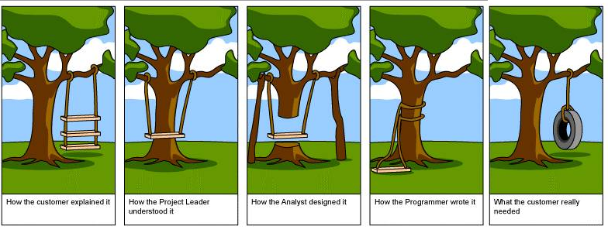
The Importance of Testing

Slide 24

A Practical Testing Plan
Code Validation
Browser Testing
  Turn off images
  Don’t use the mouse
  Increase font size
  Change window size
Online Accessibility Testing (representative pages)
  use more than one tool, example: Worldspace & Wave
Screenreader Testing
  JAWS
Enterprise Accessibility Report
  like Worldspace by Deque or WebXM
Hands-on Accessibility Testing

Slide 25

Play RFP Survivor
Create a requirements metric
  (based on RFP)
508/TAC 206 & 213 Accessibility = Primary Requirement
Rate bids on RFP metric
Vote bids “off your island”

Slide 26


Exceptions
Or what to do when
there is no one left on the island
Commercial Non-Availability
Fundamental Alteration
Undue Burden
Even if exception applies your organization must still provide alternative access

Slide 27

Review Results with Vendor
Possible Scenarios:
Vendor understands results and makes changes
Vendor needs minor technical education
Vendor is unaware of web accessibility
Vendor believes accessibility does not apply

Slide 28

Accessibility
It is up to YOU

Slide 29
Resources for Further Learning
www.section508.gov
www.calstate.edu/Accessibility/EIT_Procurement/

