Slide 1
Let us C
Introduction to programming with C

Slide 2
Why(and why not) to learn C
Why
One of the most popular languages.
Very efficient and fast.
Used everywhere
computers, supercomputers, routers, phone, cars, robots , ….
Can program in most languages if you already know C
Very small in size: just 32 keywords
And why not ?
Harder to learn than some languages
Less readable code
…

Slide 3
About C
Created 1970 by Dennis Ritchie
Successor of language “B” created at bell labs
C is imperative , procedural , compiled language
Imperative : commands run one by one
Procedural : made up of functions of different types
Compiled : program converted from C to machine code before execution.

Slide 4
In this class
We will cover the basics of C
While we will learn C , we will be using C++ compiler to keep things easy.
And we will make video games
PacMan

Slide 5
Using Visual Studio
Best development environment for developers
Makes the compilation process simple
Super easy debugger.

Slide 6
Hello World in C/C++
This version of the code is C++
Launch Visual Studio
Select language C++
Use Empty Project
#include <iostream>
int main()
{
std::cout << "Hello World!\n";
return 0;
}

Slide 7
Computer’s unit of understanding
Humans use languages
Computers use bit/nibble/byte

Slide 8
Bit
Most basic unit of computers memory
Can have only 2 values
0
1

Slide 9
Nibble
4 bits make a nibble
0000
0001
0010
Can you figure out how many values of 4 digits with a nibble ?
2 x 2 x 2 x 2 = 16

Slide 10
Byte
8 bits make a byte
1010 0101
0101 0001
Lets find out how many unique value can a byte represent

Slide 11
Recall and revisit from class 1
Bit , byte , nibble
Hello world using VS/C++
Key takeaways
Range for bits, powers of 2s
Why Visual studio , why C++ ( and not C)
And why C

Slide 12
Today’s project : Calculator
Be able to add/subtract/multiply/divide two numbers
Be able to get numbers from user
Print the result on screen
Go again.

Slide 13
Integer
char : 1 byte: 8 bits :character : 256 unique values
int :
4 bytes : can vary on different computers
Bits ? 32
Value range ?
Examples
1
-1
0
12344555133
…

Slide 14
Integer
Range
Low : -2147483648
High : 2147483647

Slide 15
Floating point numbers
float
Numbers with decimals
1.01
-2.01
567.789
Size : 4 bytes
Range
Very large .. With upto 38 decimal numbers
For curious : ±1.18 x 10⁻³⁸ to ±3.4 x 10³⁸ and 0.0

Slide 16
Calculator : 1
Lets code together
Define 2 integers
Add them
Print the result

Slide 17
Calculator : 2
Get the number for users
Use cin
Use cout

Slide 18
Calculator (final)
#include <iostream>
using namespace std;
int main()
{
int num1;
int num2;
cin >> num1;
cin >> num2;
int result = num1 / num2;
cout << result;
return 0;
}

Slide 19
Recall and Reflect
Why C/C++ ?
Who created C
And who created C++
Data types
Integer
Float

Slide 20
Recall and Reflect
Why C/C++ ?
Simple, fast, universal
Who created C : Dennis Ritchie
And who created C++ : Bjarne Stroustroup
Data types
Integer
Has limits
Float
Larger than integer but still has limits
Re-run calculator

Slide 21
Calculator 2
We know
How to get 2 numbers
How to operate on them ( +, -, *, /)
We will learn
how get operations from the user
Use if/else

Slide 22
Calculator 2 : char
New Data type : char
Short for character
Single character of alphabet
‘a’,
’b’,
‘0’
‘1’
‘+’
Denoted by single quotes
Uses 1 byte on most systems
char operation;

Slide 23
Calculator : conditions
1< 2 : true
2>10 : false
2 == 2 : true
2 == 3 : false
2 != 2 : false
2 != 3 : true

Slide 24
Calculator 2: if/else
if(operation == '+’)
{
}
else
{
}

Slide 25
Calculator 2 : if
if(operation == ‘-’)
{
}

Slide 26
Calculator 2 : if() else if()
if (operation == ‘+’)
{
cout << num1 + num2;
}
else if (operation == ‘-’)
{
}
else
{
}

Slide 27
Calculator 2 :
Take 2 numbers from user
Take 1 operation from user ( +, - , / ,*)
Perform the operation and print the result
If operation does not exist : print error

Slide 28
Calculator 2 : Full implementation
{
int num1;
int num2;
char operation;
cout << " Provide 2 numbers \n";
cin >> num1;
cin >> num2;
cout << "\n Provide the operation \n";
cin >> operation;
if (operation == '+’)
cout << num1 + num2;
else if (operation == '-’)
cout << num1 - num2;
else if (operation == '*’)
cout << num1 * num2;
else if (operation == '/’)
cout << num1 / num2;
else
cout << "Error : not a valid operation";
}

Slide 29
Flowcharts
What are flowcharts for?
a graphical representation of a computer program’s sequence of functions (as distinct from the data it processes).
Why use flowcharts?
Flowcharts show the relationship between input, processes and output in a visual form.

Slide 30
Flowcharts
Different symbols –
Start/end ->
Arrows – shows relationship between shapes
Input/output ->
Process ->
Decision ->
Connector – represents the continuation of the flow of the chart, usually used for charts going over multiple pages ->

Slide 31
Flowcharts: example
Start
Stop
Initialize distance sensor
True
NOTICE –
Different shapes
Arrows indicating the order processes are happening
False
Define distance variables
Distance less or equal to1 in
Distance from object before stopping = 1 inch
Read distance with sensor

Slide 32
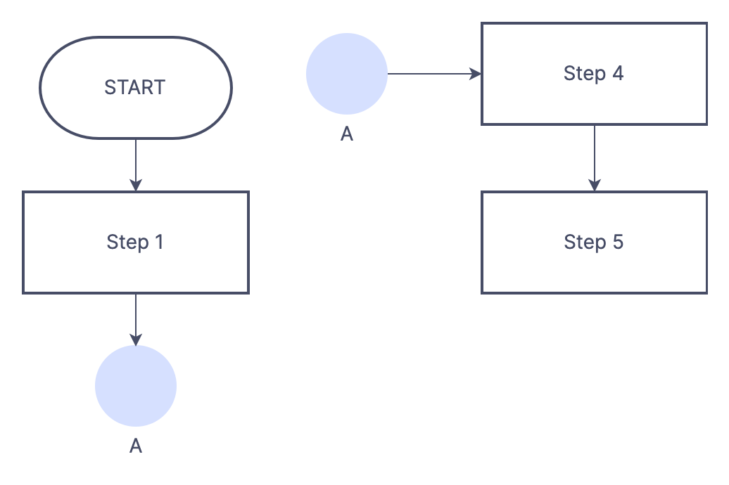
Flowcharts: example with a connector
NOTICE –
Notice how the connector acts like a place holder.

Slide 33
Decision Box
Has at least one entry
And 2 (or more exits)
Is A>B
Yes
No
A
B

Slide 34
Flowchart: Calculator 1
Run Program
A
Result = num1 + num2
Read num1
Print Result
Read num2
A
B

Slide 35
Exercise : Calculator 2
Take 2 numbers from user
Take 1 operation for user( *,/,+,-)
Based on the operation decide how to calculate result
Print the result
If operation is invalid print error
Hint (you would need)
3 input boxes
4 decision checks
2 output boxes
Etc.

Slide 36
C/C++ review
Who is the creator of ..?
C
C++
What is the smallest unit of computer memory ? BIT
How much is int in bytes (on modern computers)?
What is the range of int?
What is char?
And why are we learning C/C++ ?

Slide 37
Flowchart : Largest number (of 2)
Of 2 numbers (provided by user)
Print the largest of the two.
Hint
Either use operator “greater than” : ‘>’
Or use operator “less than” : ‘<’

Slide 38
Flowchart : Largest number (of 3)
Of 3 numbers (provided by user)
Print the largest of the three.
(Observe the increase in number of flowchart boxes from previous to this problem)

Slide 39
Flowchart : Largest number of (4,5,6,…)
Do not draw the flowchart
Question : what changes do you see when the number of inputs increases ?
What patterns ?
What number of new boxes?
Is there a calculation that can generalize it ?
1+2+3+4+5

Slide 40
Loops
Can you print the sum of first 3 numbers
i.e. 1+2+3 ??
Then can you print the sum of first ‘x’ numbers
i.e. 1+2+3+4+….+x ??
What do you need to do this ?
You need a loop!!!!

Slide 41
Loops
Loops are used for repetition for predefined number of times
There are at least 4 ways to do loops
do…while loop
while loop
for loop
Can you guess the most popular loop ??

Slide 42
Do … while loop
do {
statement 1;
statement 2;
}
while(a>b);
// do while until false

Slide 43
Print the sum
Of first ‘x’ numbers
Where ‘x’ is provided by user
Hint
Use loops

Slide 44
Find a number
Print every 3rd number till 100
i.e 1, 4, 7 ….
Print every x^{th} number till 100
4th
5th
6th

Slide 45
Find factorial of a number
Create a function to find a factorial of a number
Read a number from user
Pass the number as function argument
Return the result from the function
Print the result
Factorial of a number
1! = 1
2! = 1 x 2
3! = 1 x 2 x 3
4! = 1 x 2 x 3 x 4
You would need to know/learn
How to use a loop ( for loop is good)
How to create a function

