Slide 1
Cyto Auto Cluster
Enhancing Cytometry With
Deep Learning
By Likitha Dadi

Slide 2
Problem Statement
CytoAutoCluster aims to integrate semi-supervised learning approaches within cytometry workflows. By utilizing both labeled and unlabeled data, this project seeks to develop a robust clustering algorithm that can adaptively learn from the inherent structure of cytometric data. This innovative approach not only aims to enhance the accuracy of cell classification but also to reduce the reliance on extensive labeled datasets, which can be labor-intensive and time-consuming to create.

Slide 3

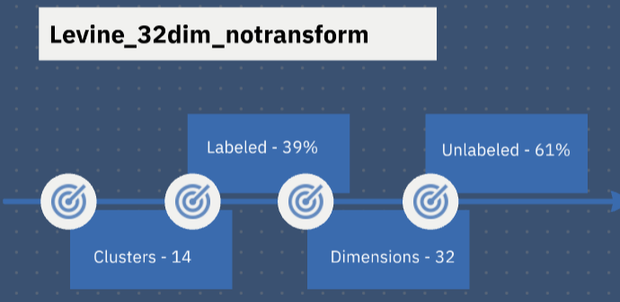
Data set
nmdbvjxcjvbdkj

Slide 4
Methodoligies
EDA
Box Plot
Correlation Matrix
Kurtosis
Skewness
DIMENSIONALITY REDUCTION TECHNIQUES
PCA
t-SNE
Log Loss
DATA AUGUMENTATION
Binary Masking
Corruption data
CLASSIFICATION
Logistic Regression
XGBoost

Slide 5
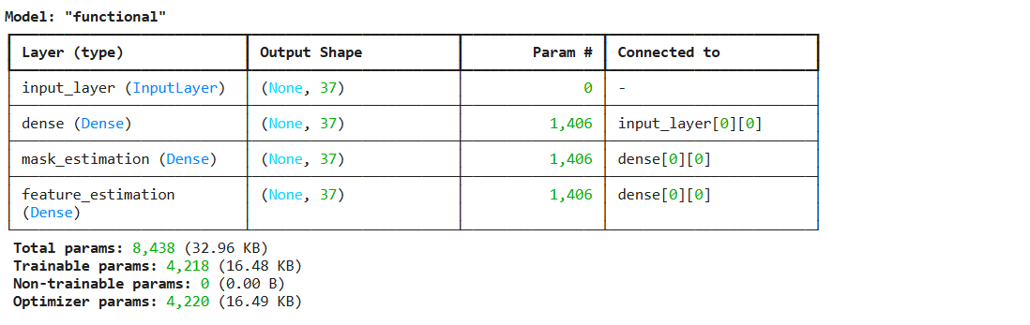
ENCODER
Encoders in a dataset are techniques used to convert categorical variables into numerical formats, making them suitable for machine learning algorithms. Common methods include one-hot encoding, which creates binary columns for each category, and label encoding, which assigns a unique integer to each category.

Slide 6
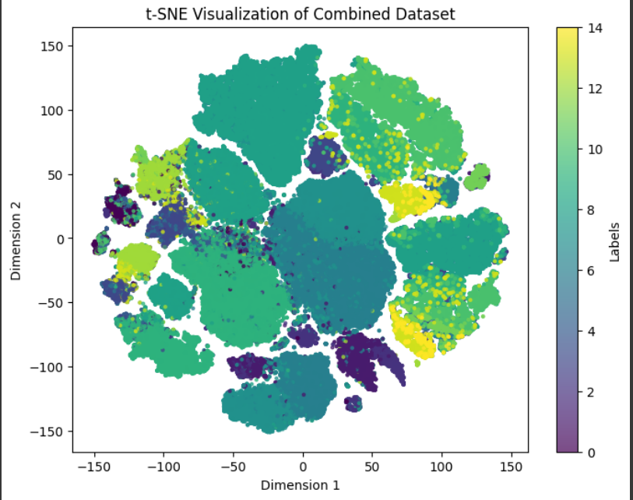
t-SNE
t-Distributed Stochastic Neighbor Embedding (t-SNE) is used for visualizing high-dimensional data in a low-dimensional space, typically 2D or 3D.t-SNE preserves the local structure of data, so similar points in the high-dimensional space stay close in the visualization. It does this by minimizing the differences in probability distributions of point distances between high and low dimensions, resulting in clusters that reflect the original relationships.

Slide 7
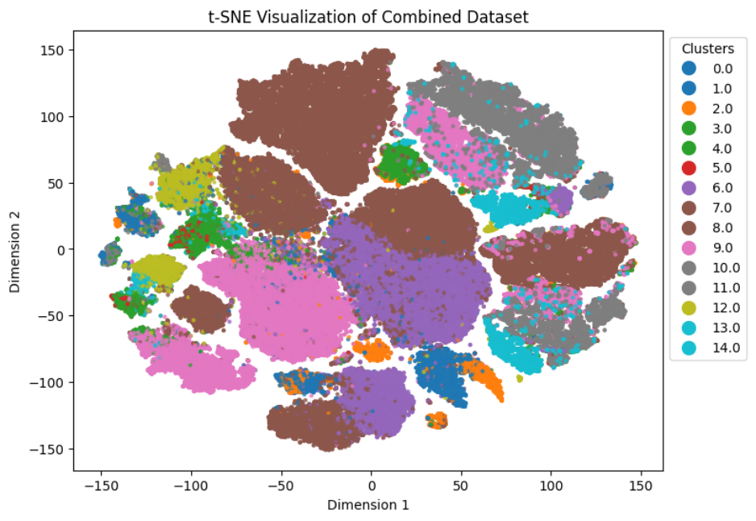
Semi-Supervised Learning
Validation Loss: 0.6611, Total Loss: 0.1747
We perform semi-supervised learning framework combining labeled and unlabeled data. It uses a custom neural network trained with supervised and unsupervised losses, balancing them with a beta parameter. An encoder extracts features from the data, and the model is trained in batches over multiple epochs. Finally, the trained model generates predictions for test data.
The Modified Cluster Values are visualized by performing t-SNE on the new data.

Slide 8
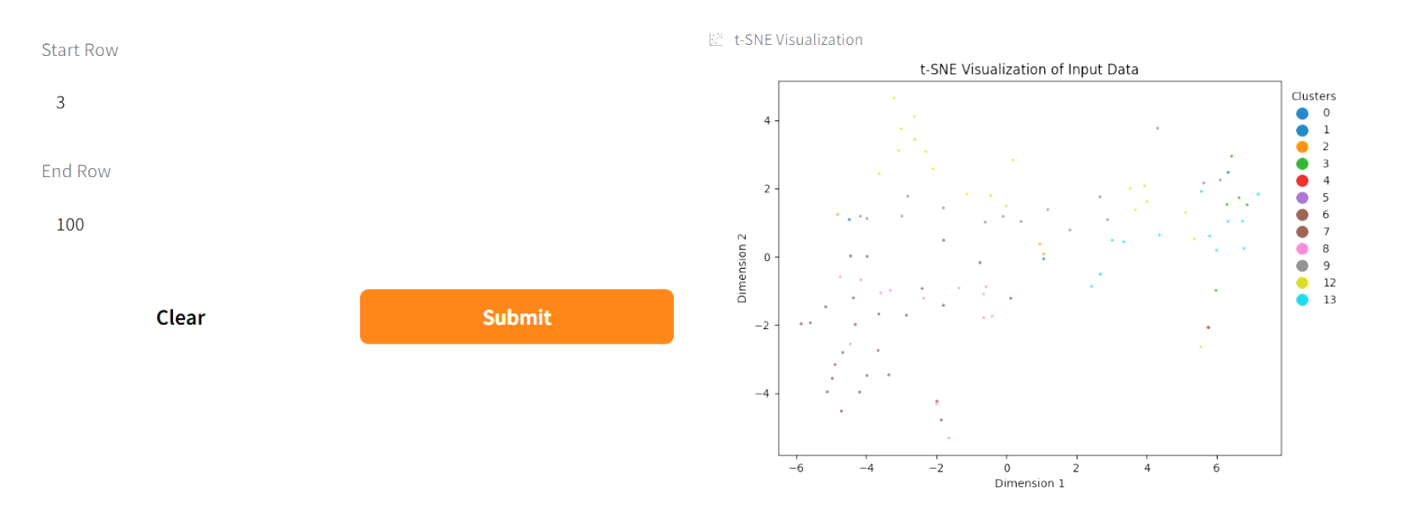
Results
Logistic Regression Log Loss: 0.0649
XGBoost Log Loss: 0.0073
Self-Supervised Model Accuracy: 93.54%, AUROC: 99.09%

Slide 9
Gradio Interface For User Interaction
The Visual Representation of Gradio Interface for our model is showcased in the below live demo video.
Live Demo Access Link :
Click Here

Slide 10
Thank You.
Email : likithadadi08@gmail.com
Linked In : www.linkedin.com/in/dadilikitha
GitHub : https://github.com/LIKITHAADADI/

