Slide 1

Infosys 5.0 Internship
Name: Shreya Singh
Role: AI/ML Intern
Mentor- Anurag Sista

Slide 2
Problem Statement
MRI-Based AI for Breast Cancer Detection
Breast cancer is one of the leading causes of mortality among women worldwide. Early and accurate detection is critical to improving survival rates, yet existing diagnostic methods can be prone to false positives or negatives, which can delay treatment and lead to patient anxiety. Magnetic Resonance Imaging (MRI) has emerged as a powerful imaging technique for identifying abnormalities in breast tissue.
However, accurately interpreting MRI scans remains challenging due to the complex nature of the scans and the potential for human error. TumorTrace aims to leverage artificial intelligence (AI) to enhance the precision and efficiency of breast cancer detection by analysing MRI scans. By employing advanced machine learning algorithms, TumorTrace seeks to reduce misdiagnosis, accelerate detection, and improve overall patient outcomes, making early intervention more feasible and effective.

Slide 3
DATA DISTRIBUTION
Class Imbalance Challenges
Malignant class significantly outnumbers the benign class.
Potential model bias towards predicting malignant.
May lead to poor performance on the benign class.
Mitigation Strategies
Oversampling: Increase benign samples using techniques like SMOTE.
Undersampling: Reduce malignant samples to balance dataset.
Class Weights: Assign higher weights to the minority class.
Data Augmentation: Augment benign samples with techniques like rotation and flipping.
Evaluation Metrics
Use F1 score, Precision, and Recall to address class imbalance.
Avoid relying solely on accuracy.
Training Set:
Benign: 5,559
Malignant: 14,875
Test Set:
Benign: 1,938
Malignant: 4,913
Validation Set:
Benign: 408
Malignant: 1,581

Slide 4
Methodology
Overview:
Steps:
Collect MRI image datasets for analysis.
Preprocess images to prepare them as model inputs.
Train and evaluate deep learning models.
Data Collection – Gather labeled MRI datasets from reliable sources.
Data Preprocessing – Perform image resizing, pixel value normalization, and apply data augmentation techniques.
Model Development – Utilize advanced deep learning architectures such as VGG16 and ResNet for classification or detection tasks.
Evaluation – Evaluate model performance using key metrics such as accuracy, precision, recall, and F1 score.

Slide 5
Data Collection and Preprocessing
Dataset:
Dataset contains MRI images labelled as either benign or malignant.
Source of Dataset:
Preprocessing Steps:
Grayscale Conversion: Convert the images to grayscale to reduce computational complexity while retaining essential features.
Resizing: Resize images to a fixed dimension (i.e. 224x224) to maintain consistency across the dataset.
Normalisation: Scale pixel values to a normalised range, often [0, 1], to ensure consistent input for neural networks.
Data Augmentation: Enhance the dataset using techniques like random rotation, flipping, zooming, and shifting to make the model more robust.
Addressing Class Imbalance: Apply strategies such as oversampling minority classes, under-sampling majority classes, or using class weights to balance the dataset and prevent bias toward dominant classes.

Slide 6
Models Used And Development
Models:
VGG16: A 16-layer convolutional neural network, simple and effective for image classification.
ResNet18 & ResNet50: Deep architectures with residual connections for enhanced training efficiency.
Model Selection:
VGG16: Selected for its straightforward design and reliability in classification tasks.
ResNet18 & ResNet50: Chosen for superior performance in deeper layers through residual learning.
Development Steps:
Initialize pre-trained models.
Fine-tune using the breast cancer MRI dataset.
Train and validate models using evaluation metrics.

Slide 7
Recall (Sensitivity): Assesses the model's ability to correctly detect actual positive cases.
Accuracy: The ratio of correct predictions to the total predictions made by the model.
Precision: Measures the model's ability to correctly identify positive cases while minimizing false positives.
Evaluation Metrics
AUC (Area Under Curve): Evaluates the model's capability to differentiate between benign and malignant cases, providing a single performance metric.
F1 Score: The weighted harmonic mean of precision and recall, balancing the trade-off between the two.
Confusion Matrix: A summary table showing counts of true positives, true negatives, false positives, and false negatives, offering detailed insight into classification performance.

Slide 8
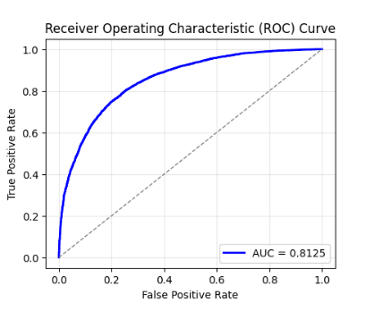
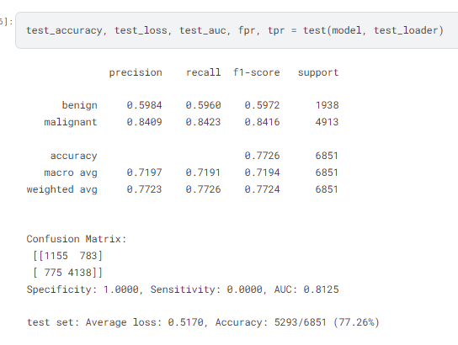
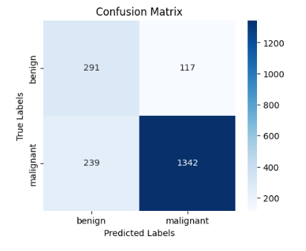
RESULTS-VGG16

Slide 9
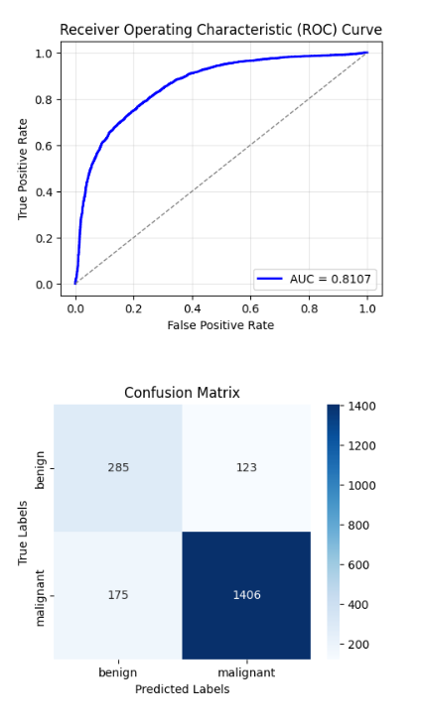
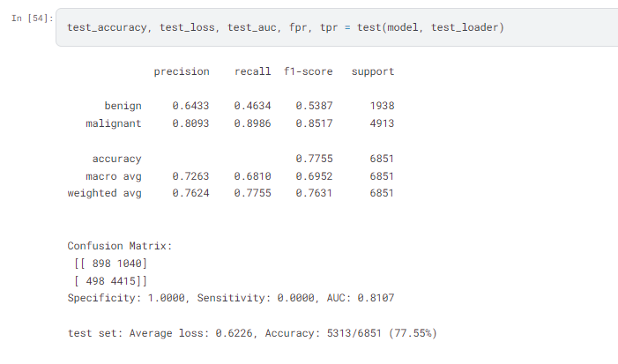
RESULTS-Resnet18

Slide 10
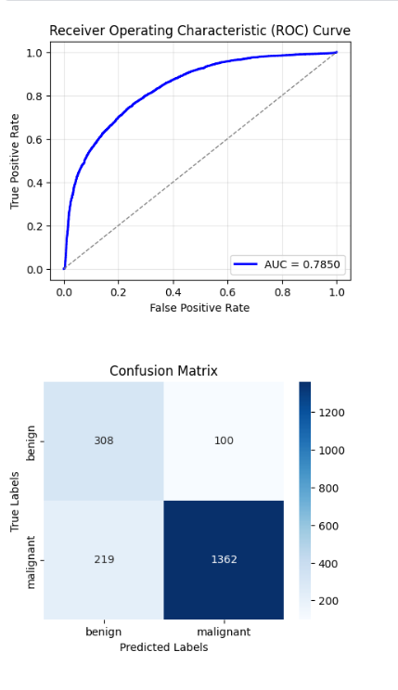
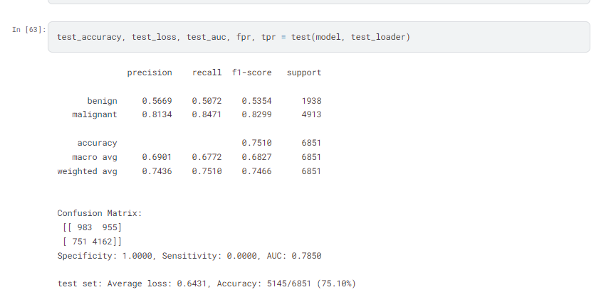
RESULTS-Resnet50

Slide 11
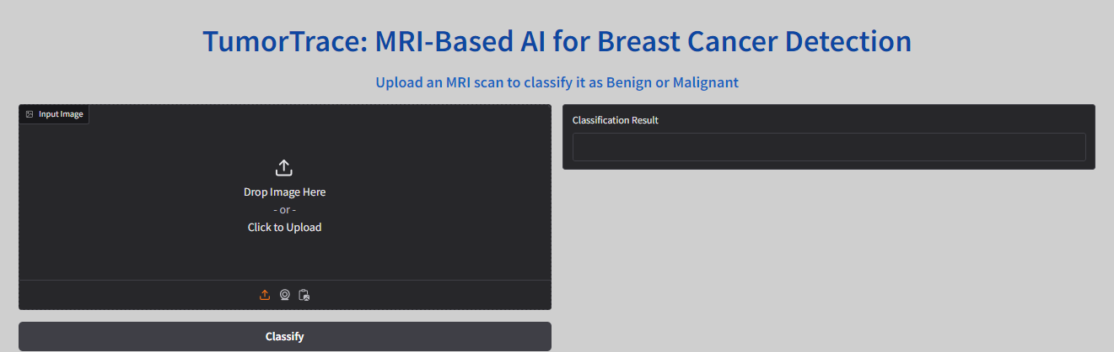
User Accessible Frontend
Project Overview Demo Video link: https://www.youtube.com/watch?v=toRlHG4jcpM
Gradio working model link: https://www.youtube.com/watch?v=AnzA4LFvZ80

Slide 12
Thank You

