Slide 1
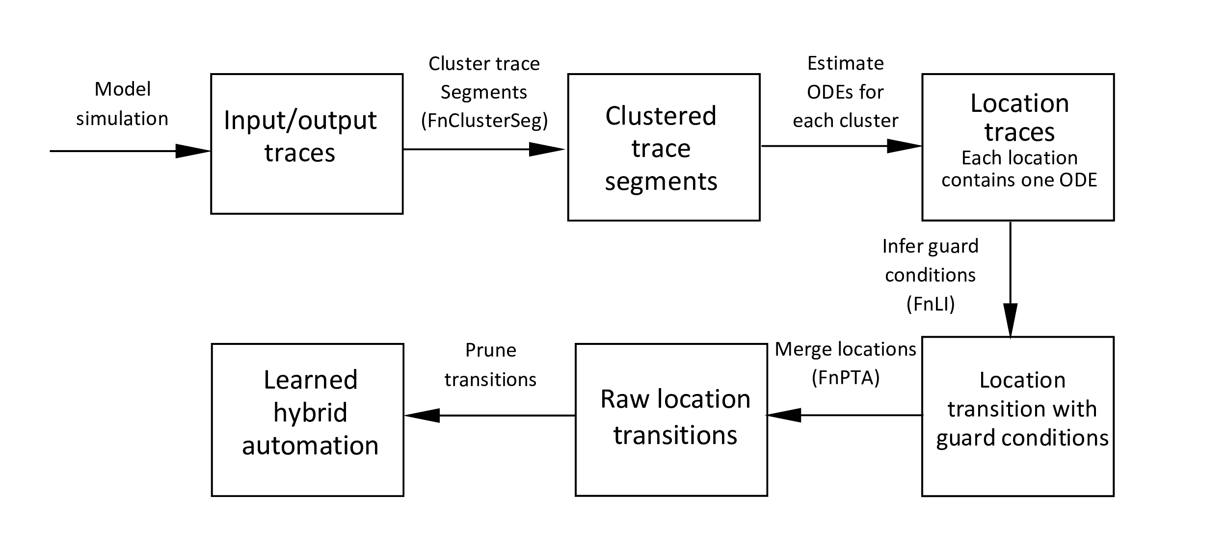
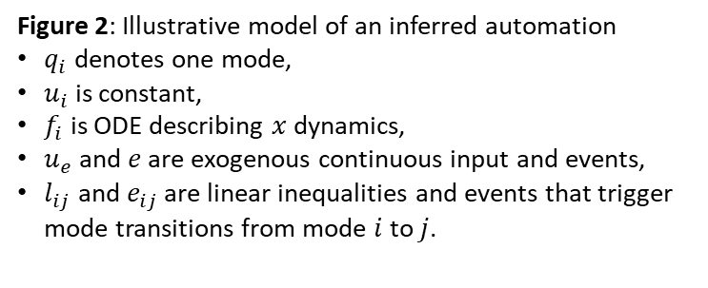







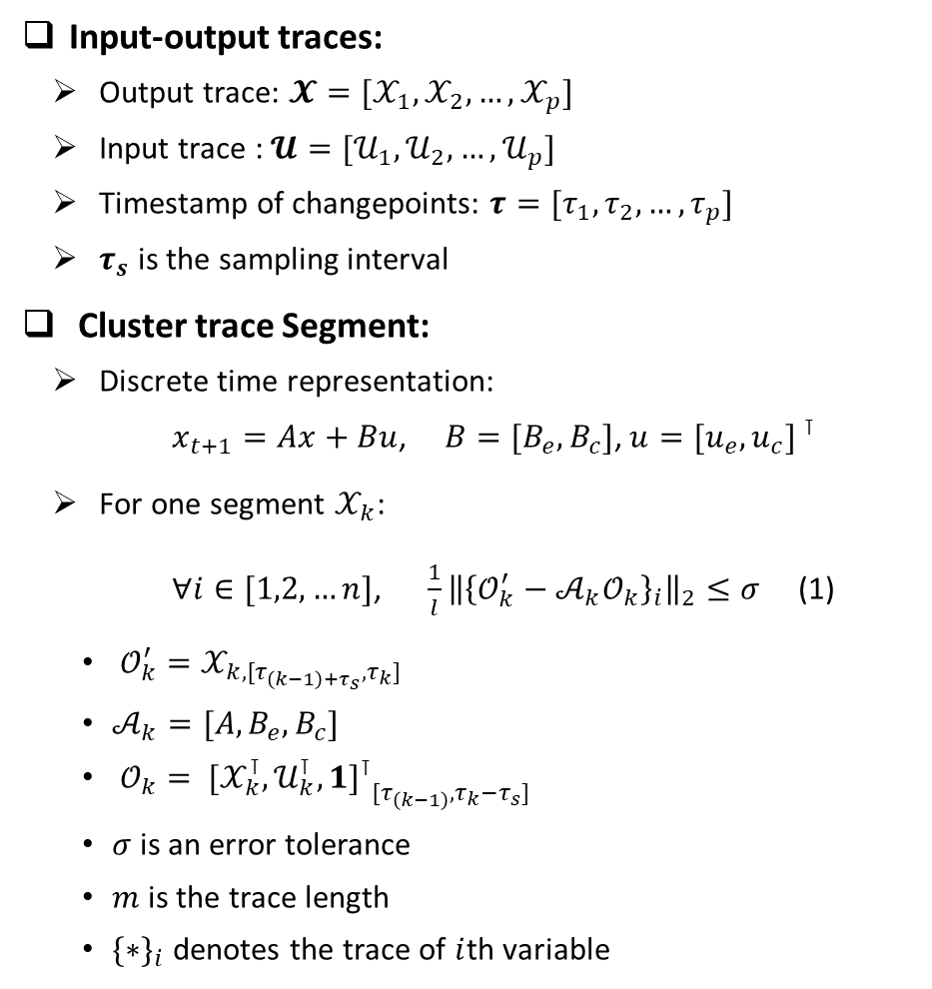




Hybrid System Identification from Input-Output Traces
Input-output traces:
Output trace: $𝓧=[𝒳_{1},𝒳_{2},…,𝒳_{p}]$
Input trace : $𝓤=[𝒰_{1},𝒰_{2},…,𝒰_{p}]$
Timestamp of changepoints: $τ=[τ_{1},τ_{2},…,τ_{p}]$
$τ_{s}$ is the sampling interval
Cluster trace Segment:
Discrete time representation:
$x_{t+1}=Ax+Bu$, $B=[B_{e}, B_{c}]\text{, }u={[u_{e}, u_{c}] }^{⊺}$
For one segment $𝒳_{k}$:
$∀i∈[1,2,…n]$, ${\frac{1}{l}\left\|{\left\{𝒪_{k}^{′}−𝒜_{k}𝒪_{k}\right\}}_{i}\right\|}_{2}≤σ$ (1)
$𝒪_{k}^{′}=𝒳_{k,[τ_{\left(k−1\right)+τ_{s}},τ_{k}]}$
$𝒜_{k}=[A,B_{e}, B_{c}]$
$𝒪_{k}= {{[𝒳_{k}^{⊺},𝒰_{k}^{⊺}, 1]}^{⊺}}_{[τ_{\left(k−1\right)},τ_{k}−τ_{s}]}$
$σ$ is an error tolerance
$m$ is the trace length
${\{∗\}}_{i}$ denotes the trace of $i$th variable
Figure 1: Overview of the framework
$$q_{i}$$
$$f_{i}: \dot{x}=A_{i}x+B_{i}\left[\begin{matrix}u_{e} \\ u_{c}\end{matrix}\right]$$
$$u_{c}=u_{i}$$
$$I≔[u_{e},e]$$
$$l_{ij}/e_{ij}$$
$$l_{ik}/e_{ik}$$
$$out≔x$$
$$l_{ji}/e_{ji}$$
$$l_{ki}/e_{ki}$$
$$q_{j}$$
$$……$$
$$q_{k}$$
Figure 2: Illustrative model of an inferred automation
$q_{i}$ denotes one mode,
$u_{i}$ is constant,
$f_{i}$ is ODE describing $x$ dynamics,
$u_{e}$ and $e$ are exogenous continuous input and events,
$l_{ij}$ and $e_{ij}$ are linear inequalities and events that trigger mode transitions from mode $i$ to $j$.

Slide 2
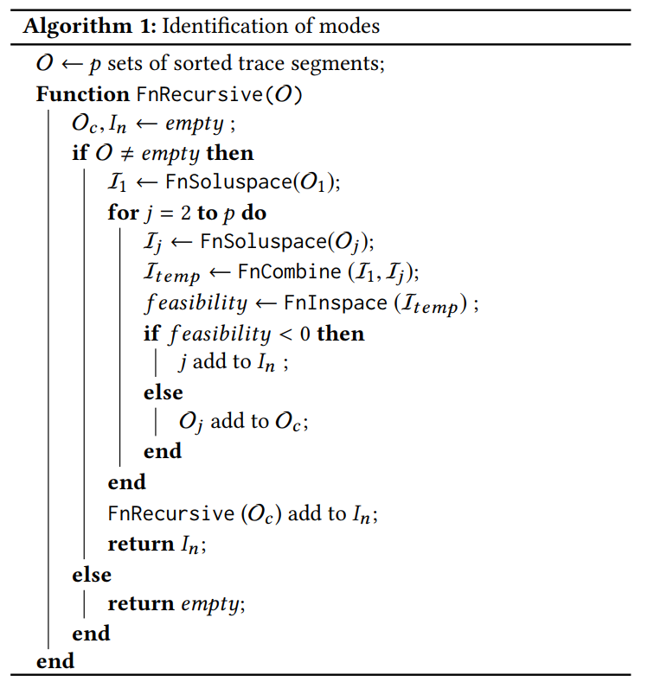
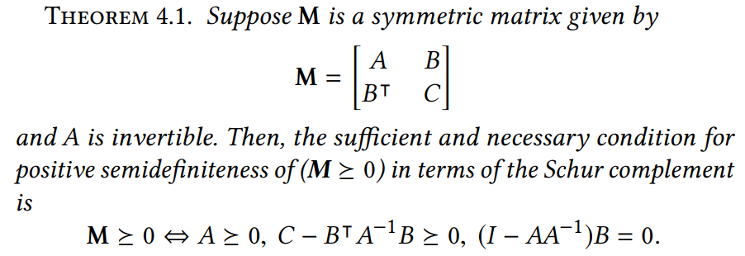
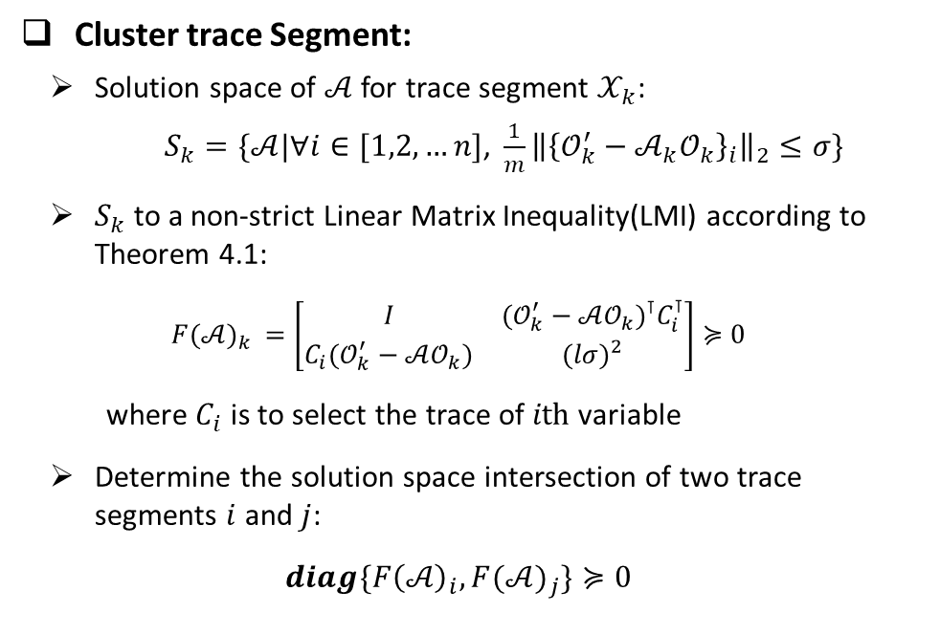
Hybrid System Identification from Input-Output Traces
Cluster trace Segment:
Solution space of $𝒜$ for trace segment $𝒳_{k}$:
$S_{k}=\{𝒜|∀i∈[1,2,…n]\text{, }{\frac{1}{m}\left\|{\left\{𝒪_{k}^{′}−𝒜_{k}𝒪_{k}\right\}}_{i}\right\|}_{2}≤σ\}$
$S_{k}$ to a non-strict Linear Matrix Inequality(LMI) according to Theorem 4.1:
$$F{(𝒜)}_{k} =\left[\begin{matrix}I & {(𝒪_{k}^{′}−𝒜𝒪_{k})}^{⊺}C_{i}^{⊺} \\ C_{i}(𝒪_{k}^{′}−𝒜𝒪_{k}) & {(lσ)}^{2}\end{matrix}\right]≽0$$
where $C_{i}$ is to select the trace of $ith$ variable
Determine the solution space intersection of two trace segments $i$ and $j$:
$$diag\{F{\left(𝒜\right)}_{i}, F{(𝒜)}_{j}\}≽0$$
Returns solution space in LMI
Merge two LMIs
Solve LMI
Store segment IDs that belongs to one cluster

Slide 3
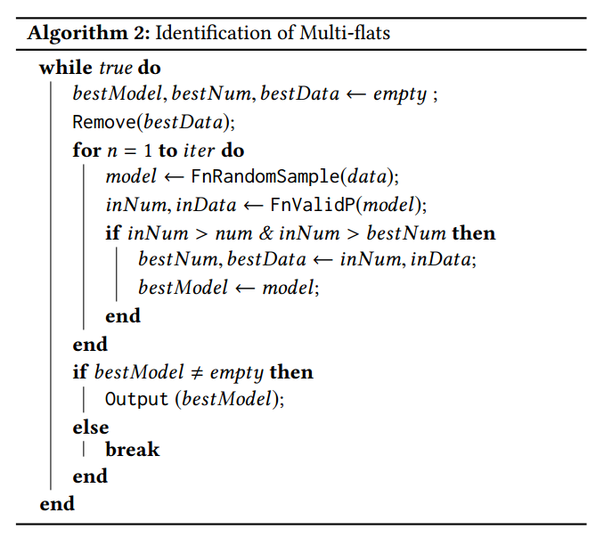
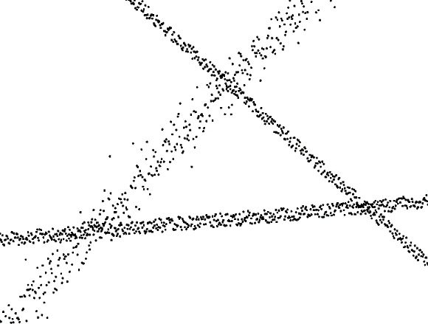
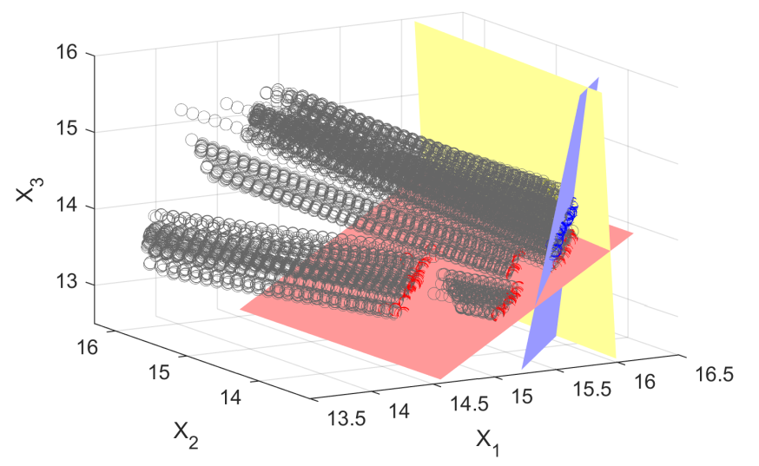
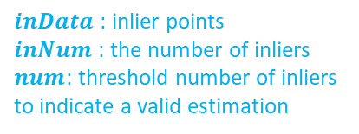

Hybrid System Identification from Input-Output Traces
Inference of Guard Conditions
Sequential Random Sample Consensus:
The changepoints having the same source ODE and the same destination ODE are collected into one date set.
Inequality sign is determined by data trajectory
Randomly selects a model candidate
Return points that are compatible with the model candidate.
$inData$ : inlier points
$inNum$ : the number of inliers
$num$: threshold number of inliers to indicate a valid estimation
Estimated linear inequality
inlier
Tolerance $ε$ to check points’ compatibility
outlier
Figure 3: Demonstration of sequential RANSC
Figure 4: Linear inequality estimation and data trajectory.

Slide 4
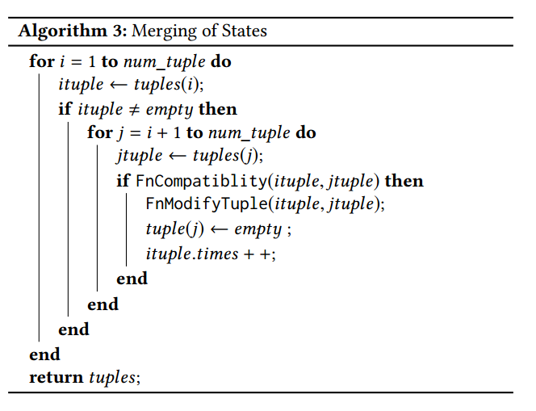
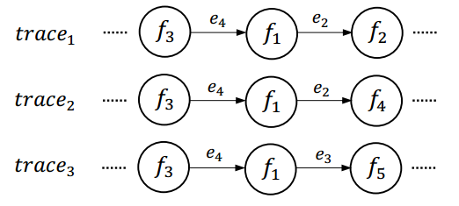
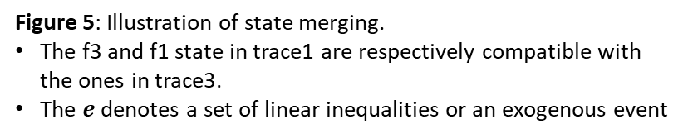
Hybrid System Identification from Input-Output Traces
Merging of Locations
Compatibility criterion
The source ODE, destination ODE and guard conditions of two transitions are the same, and meanwhile, in the subsequent transition, there doesn’t exist diﬀerent transitions triggered by the same guard condition.
The first states in each trace are compatible.
Check compatibility
Merge states
Figure 5: Illustration of state merging.
The f3 and f1 state in trace1 are respectively compatible with the ones in trace3.
The $e$ denotes a set of linear inequalities or an exogenous event

Slide 5
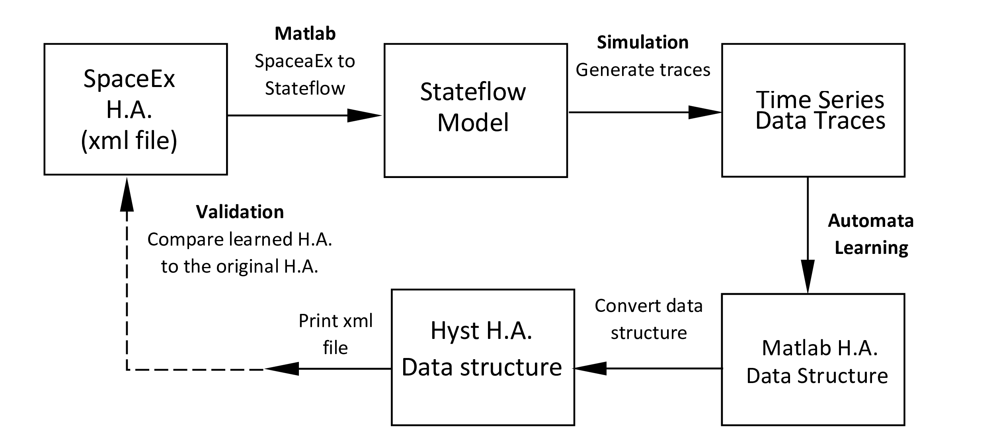
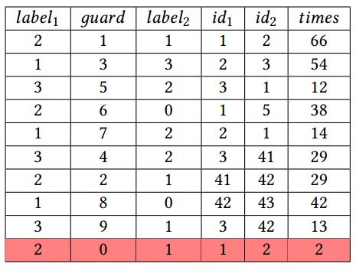
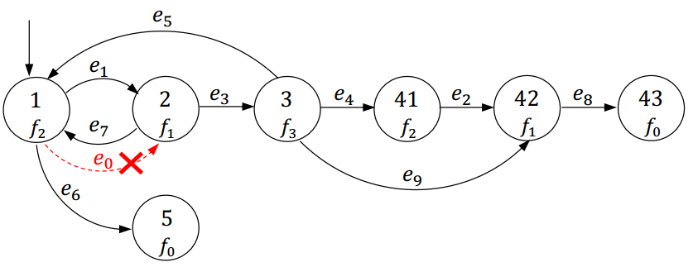
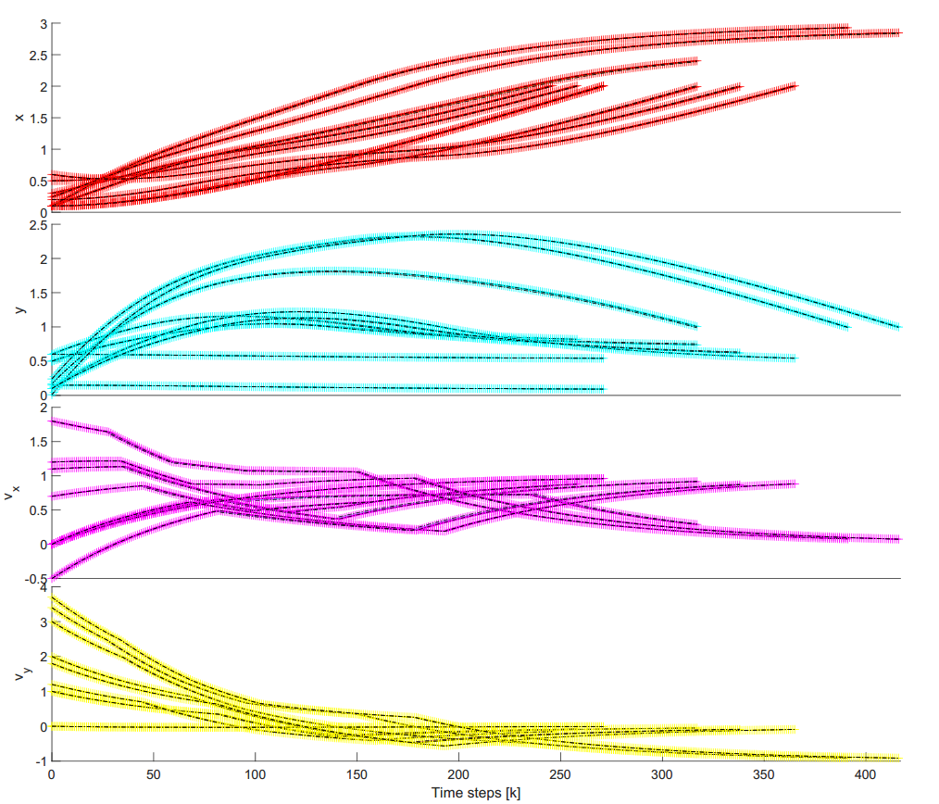
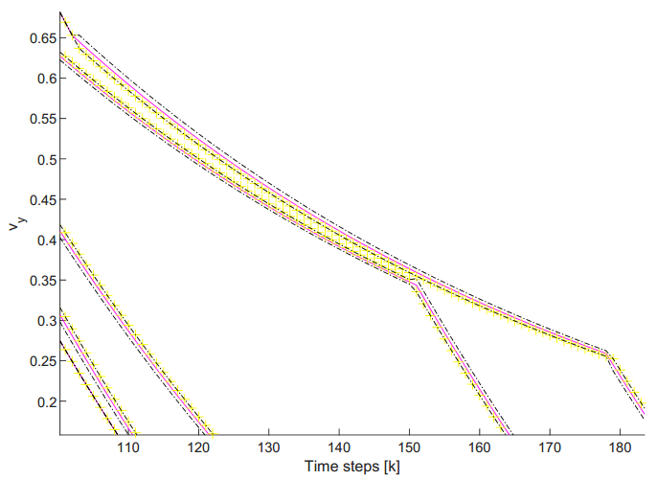
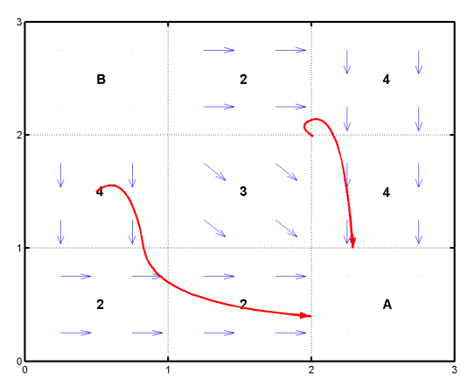
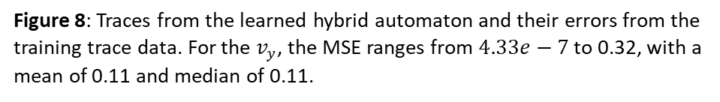

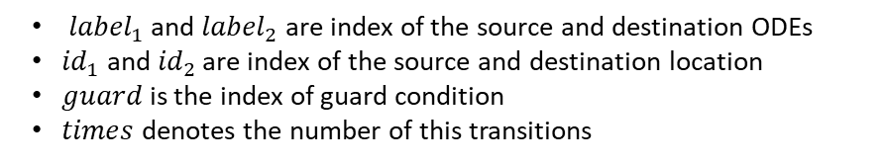
Validation Framework
Table 1: Estimated state transitions expressed in a list of 6 tuples
Figure 7: Estimated hybrid automaton
${label}_{1}$ and ${label}_{2}$ are index of the source and destination ODEs
${id}_{1}$ and ${id}_{2}$ are index of the source and destination location
$guard$ is the index of guard condition
$times$ denotes the number of this transitions
Navigation system
Figure 6: Navigation system in a 3×3 grid. $\dot{v}=A\left(v−v_{d}\right)$ and $v_{d}$ is desired velocity in each grid
Figure 8: Traces from the learned hybrid automaton and their errors from the training trace data. For the $v_{y}$, the MSE ranges from $4.33e−7$ to 0.32, with a mean of 0.11 and median of 0.11.

Slide 6
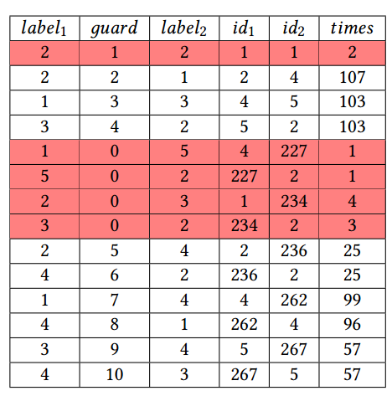
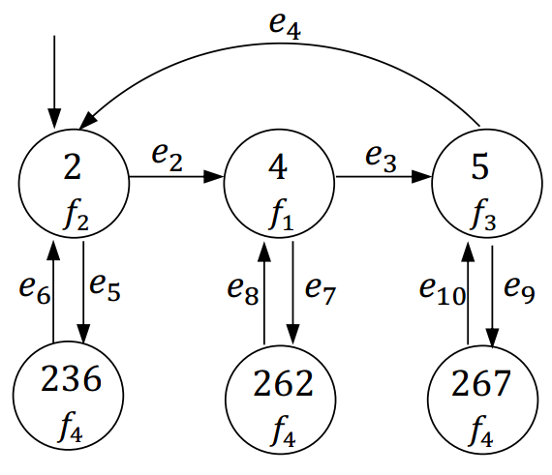
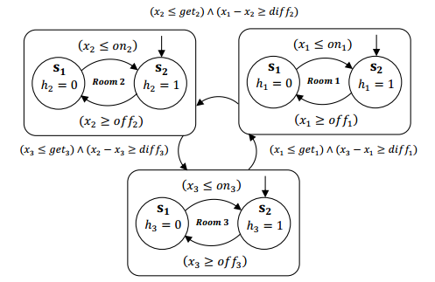
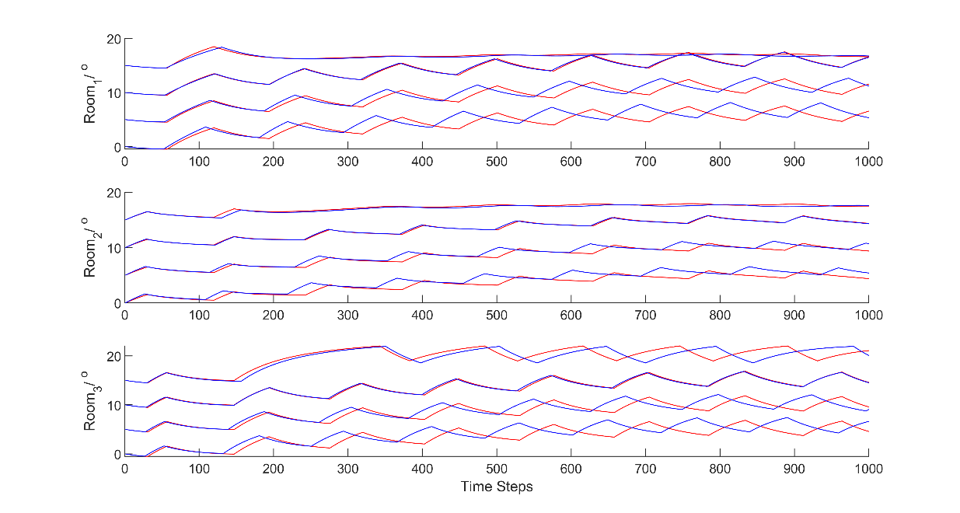
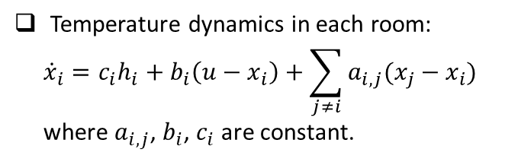
Multi-room Heating System
Temperature dynamics in each room:
$${\dot{x}}_{i}=c_{i}h_{i}+b_{i}\left(u−x_{i}\right)+\sum_{j≠i}{a_{i,j}(x_{j}−x_{i})}$$
where $a_{i,j}$, $b_{i}$, $c_{i}$ are constant.
Table 2: Estimated state transitions
Figure 10: Estimated hybrid automaton
Original system
Figure 9: Controller of the heating system
Estimated system
Figure 11: Traces from the learned hybrid automaton

