Slide 1
INSTALL PREREQUISITES
Install Python 3.5+
pip install jupyter
pip install numpy
pip install matplotlib
Open current directory in command prompt and run jupyter notebook to begin

Slide 2
Introductory session on numpy

Slide 3
NumPy is a library for the Python programming language.
It adds support for multi-dimensional arrays and matrices, along with a large collection of mathematical functions to operate on these arrays.

Slide 4
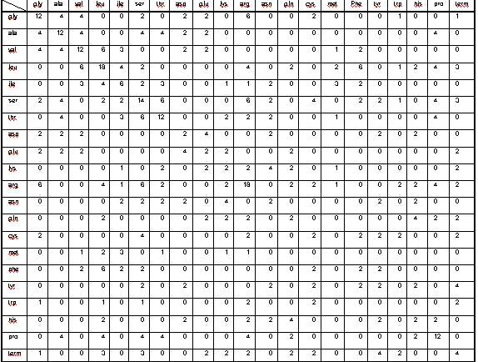
Creating large arrays and matrices

Slide 5
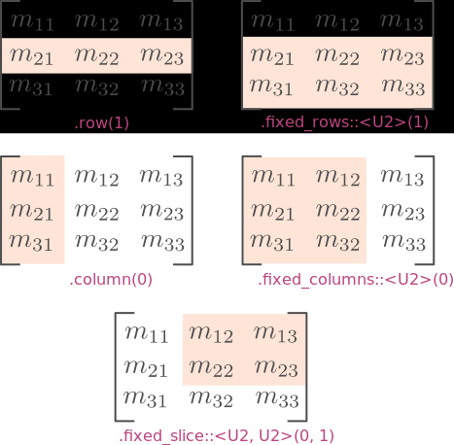
Slicing arrays and matrices

Slide 6
Performing Operations
Matrix Addition
Matrix Subtraction
Transpose
Reshape
Determinant
Inverse
Vector Operations
Dot Product
Cross Product
Mean
Standard Deviation
Variance
Eigen values
Eigen vectors
Fourier Transform

Slide 7
1. Basic NumPy
Learn basic NumPy operations

Slide 8
BASIC SYNTAX
Create np.array()
one = np.array([1,2,3,4,5])
two = np.array([[1,2,3], [4,5,6]])
Slicing
matrix([2:4,5:9])
x:y – x is inclusive but y is exclusive

Slide 9
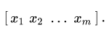
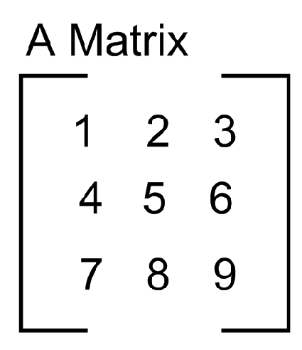
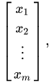
CREATING MATRICES
Row matrix:
Column matrix:

Slide 10
TASK 01:
Open the image task-power.png in matplotlib
Display it within jupyter notebook
Convert RGB to grayscale
Crop the image using numpy matrix slicing

Slide 11
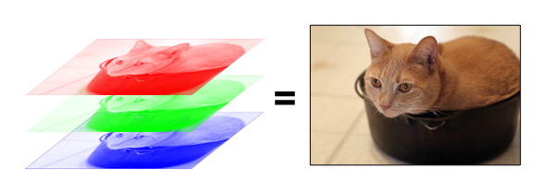
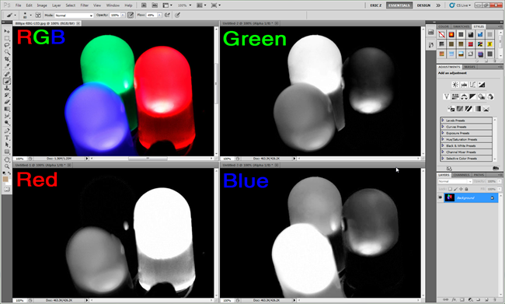
RGB Color Channels

Slide 12
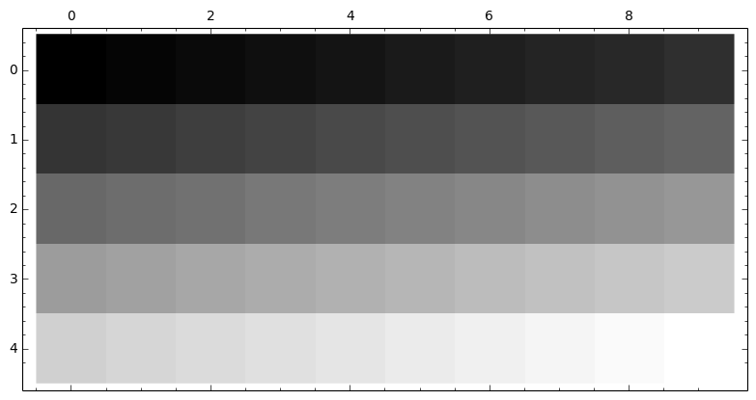
Grayscale Images
Values range from 0 to 1 (or 0-255) where 0 represent black and 1 represents white, values lying in between form various shades of grey

Slide 13
NOTE
slice = matrix[1,2] is not what you think
Always use
slice = matrix[1,2].copy()

Slide 14

MORE TASKS:
Display Image resolution
Add black border to your crop using numpy slicing
Do it in an alternate way
Save the result as output.png

Slide 15
2. Basic NumPy Functions
Learn to use common NumPy functions

Slide 16
Some Numpy Functions
np.zeros()
np.identity()
np.ones()
np.min()
np.max()
np.mean()
np.std()
np.square()
np.sqrt()
np.sum()

Slide 17
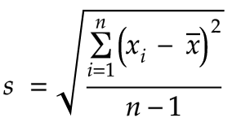
TASK 02:
Open weight-height.csv using np.genfromtxt()
Find mean height
Find max height
Find standard deviation of weights
Find standard deviation of heights manually using the formula:

Slide 18
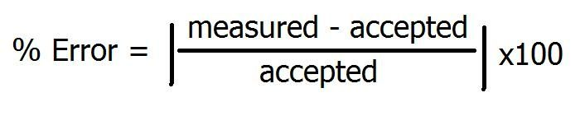
TASK 03:
Find standard deviation of heights using np.std()
Find percentage error between the two values of standard deviation of heights

Slide 19
THANKS!
Session Content will be posted soon

