Slide 1
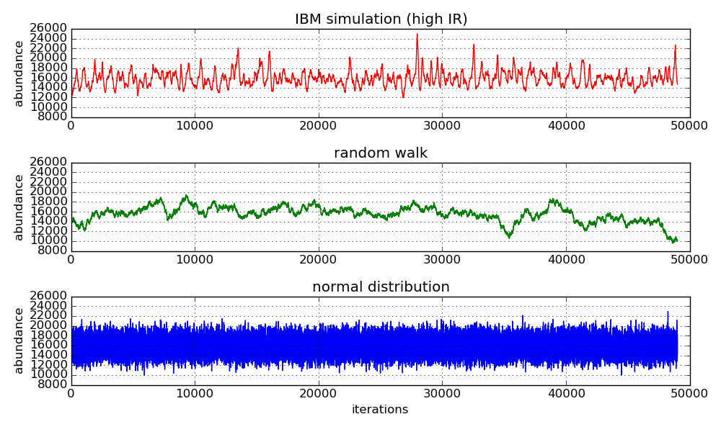
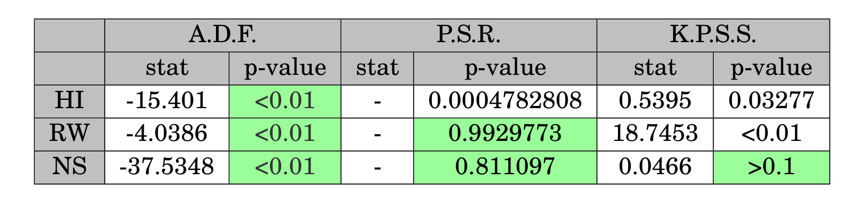
Stationarity tests

Slide 2
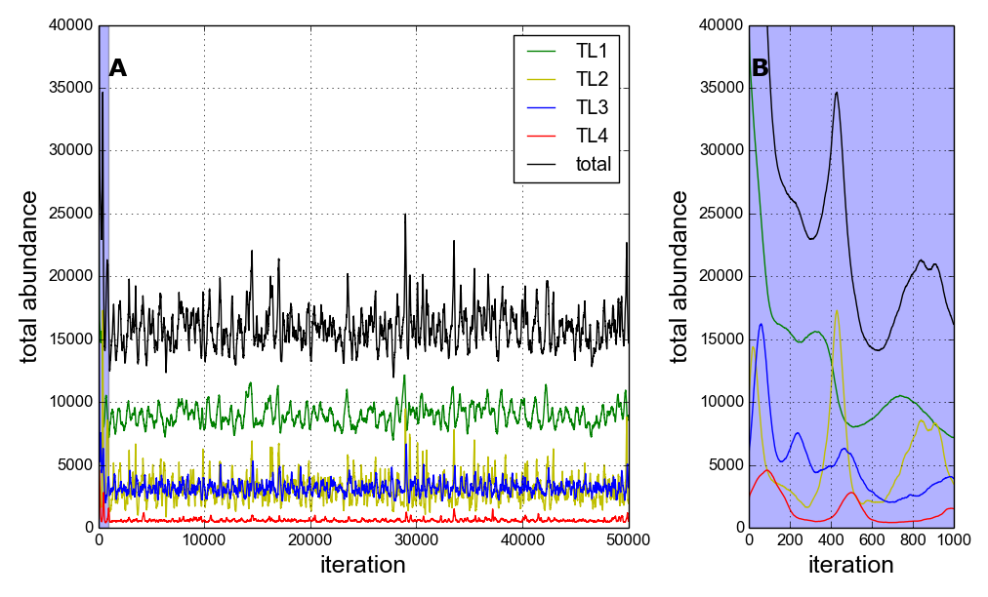
High IR Simulation – dynamics by trophic level

Slide 3
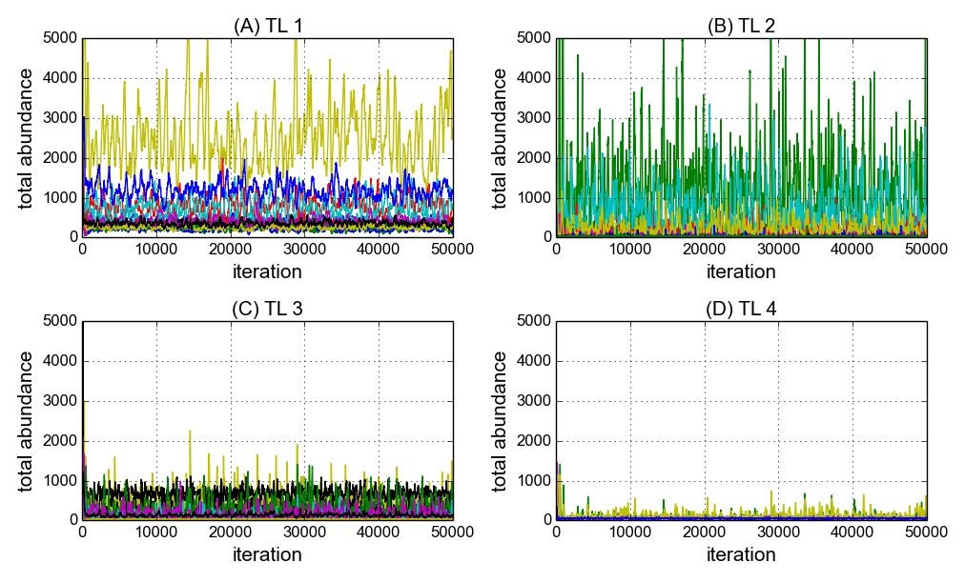
High IR Simulation – species dynamics by trophic level

Slide 4
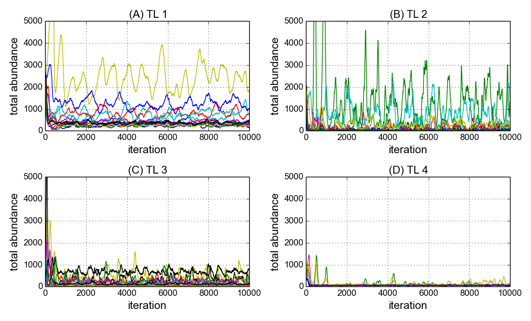
High IR Simulation – species dynamics by trophic level part simulation : 10,000 iteration

Slide 5
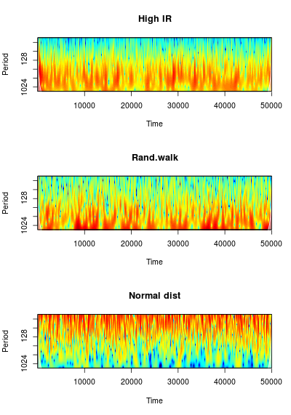
Wavelet Analysis – 50,000 iterations. Paul wavelet.

Slide 6
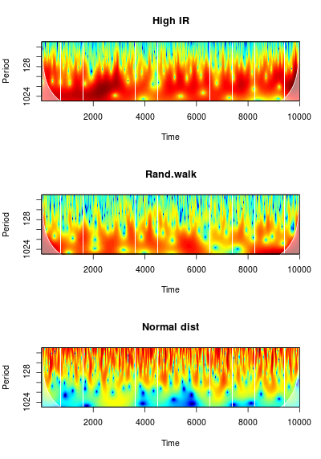
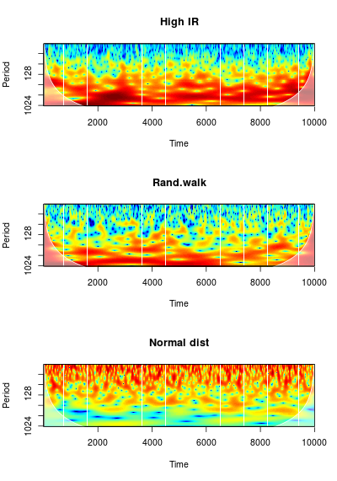
Wavelet Analysis – 10000 iterations. Paul wavelet (left) and Morlet (right)

Slide 7
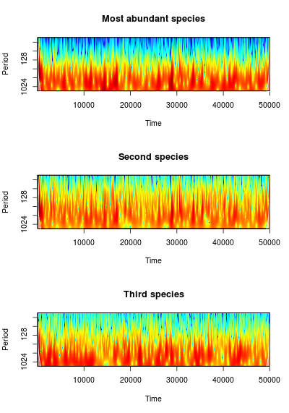
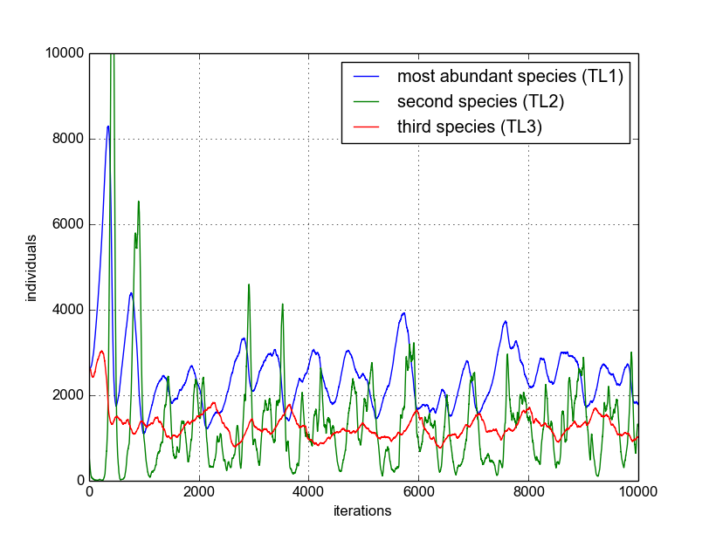
Wavelet Analysis – Three most abundant species.
50,000 iterations. Paul wavelet.

Slide 8
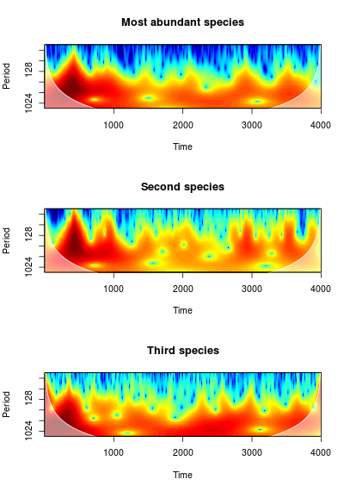
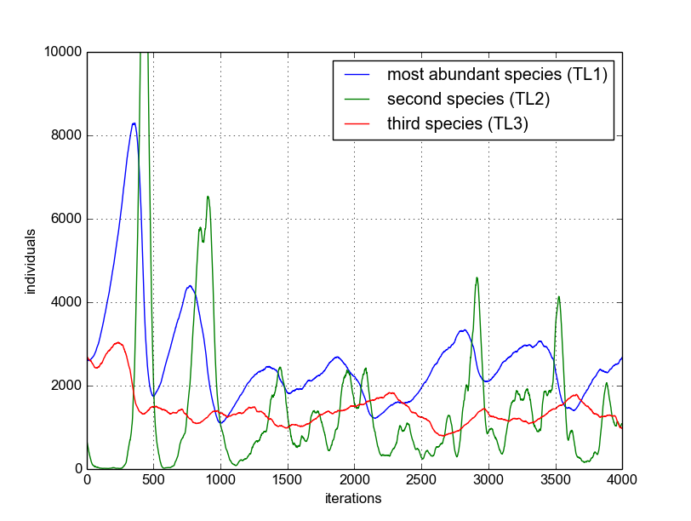
Wavelet Analysis – Three most abundant species.
4,000 iterations. Paul wavelet.

