Slide 1
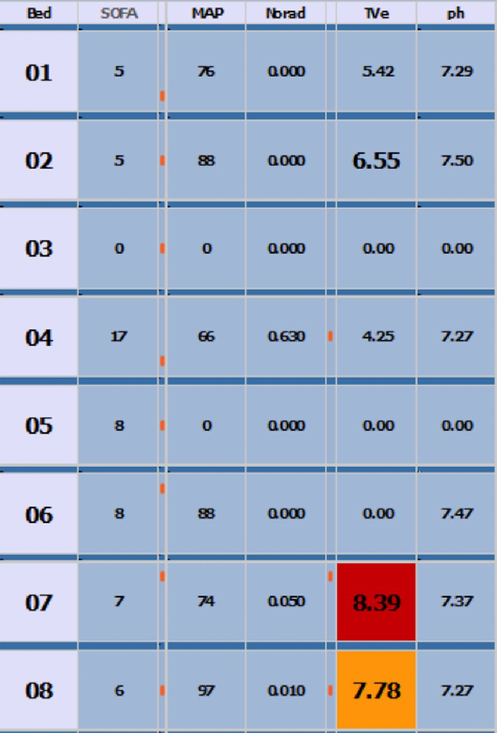

Dashboard appearance.
Christopher P Bourdeaux et al. BMJ Open 2016;6:e010129
©2016 by British Medical Journal Publishing Group
Notes:
Dashboard appearance.

Slide 3
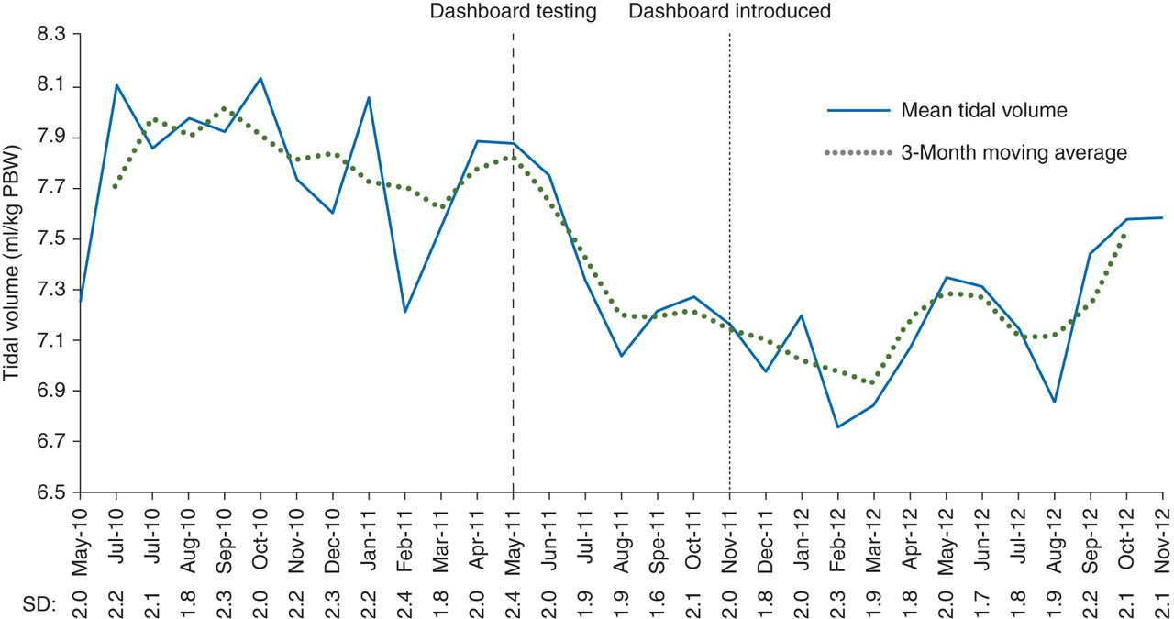

Mean tidal volume in each month and 3-month rolling averages during the periods before dashboards, during testing (May–November 2011), and after the full introduction of the display screens in November 2011.
C. P. Bourdeaux et al. Br. J. Anaesth. 2015;115:244-251
© The Author 2015. Published by Oxford University Press on behalf of the British Journal of Anaesthesia. All rights reserved. For Permissions, please email: journals.permissions@oup.com
Notes:
Mean tidal volume in each month and 3-month rolling averages during the periods before dashboards, during testing (May–November 2011), and after the full introduction of the display screens in November 2011.

Slide 5
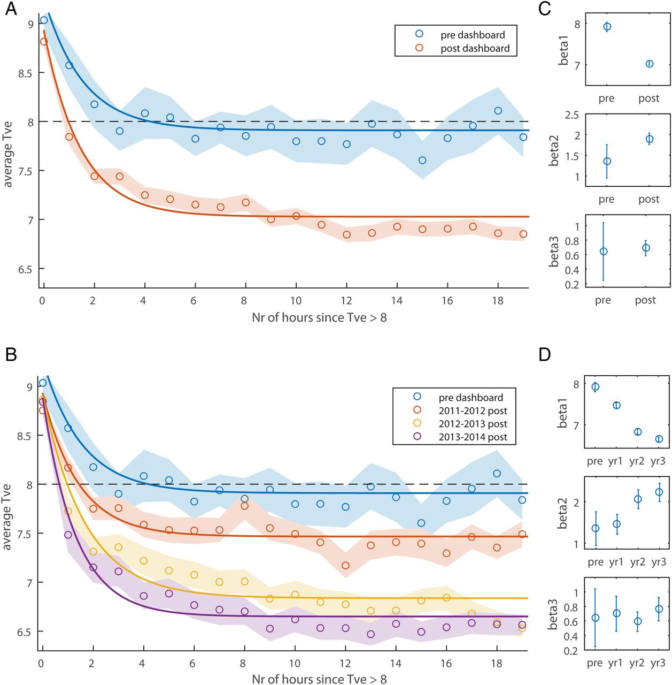
Tidal volume (TVe) following dashboard warning.
Christopher P Bourdeaux et al. BMJ Open 2016;6:e010129
©2016 by British Medical Journal Publishing Group
Notes:
Tidal volume (TVe) following dashboard warning. Panels A and B show the average TVe as a function of the number of hours since TVe first crossed the warning threshold. A Shows the data split by predashboard and postdashboard, and B splits the dashboard data further into yearly postintervention periods. Averages are 50% trimmed means, and shaded regions are bootstrapped SEs. The lines are best-fit three-parameter exponential functions fit to the raw data. The black dashed line illustrates the threshold for dashboard warnings. C and D Show β weights for the best-fit lines in A and B respectively. Error bars are 95% CIs.

Slide 6
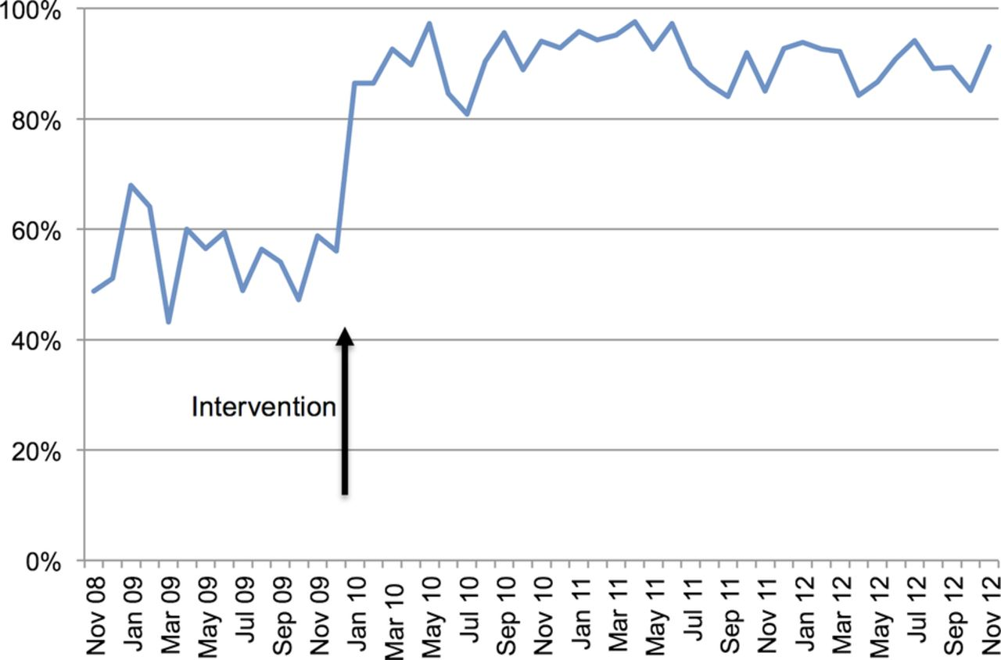

Graph showing the percentage of eligible patients prescribed chlorhexidine mouthwash four times per day.
Bourdeaux C P et al. BMJ Qual Saf doi:10.1136/bmjqs-2013-002395
Copyright © BMJ Publishing Group Ltd and the Health Foundation. All rights reserved.
Notes:
Graph showing the percentage of eligible patients prescribed chlorhexidine mouthwash four times per day. The arrow indicates the inclusion of chlorhexidine on the prescribing template.

Slide 7
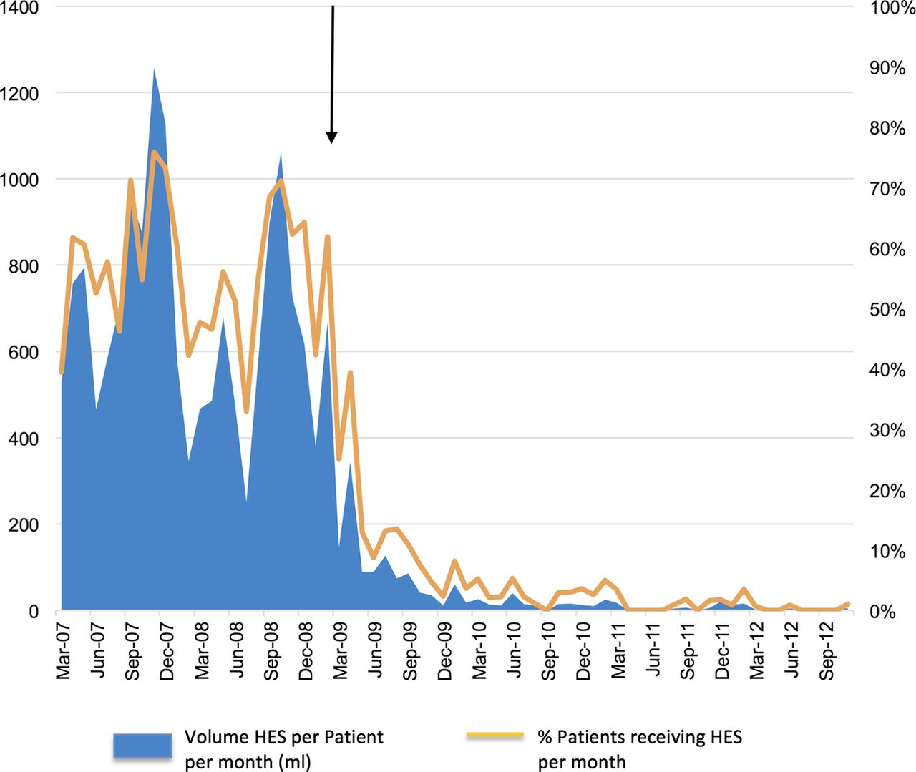
Graph showing the delivery of hydroxyethyl starch (HES) solution to patients in the intensive care unit preintervention and postintervention.
Bourdeaux C P et al. BMJ Qual Saf doi:10.1136/bmjqs-2013-002395
Copyright © BMJ Publishing Group Ltd and the Health Foundation. All rights reserved.
Notes:
Graph showing the delivery of hydroxyethyl starch (HES) solution to patients in the intensive care unit preintervention and postintervention. The arrow indicates the removal of Voluven 6% as an option on the prescribing template.

Slide 8
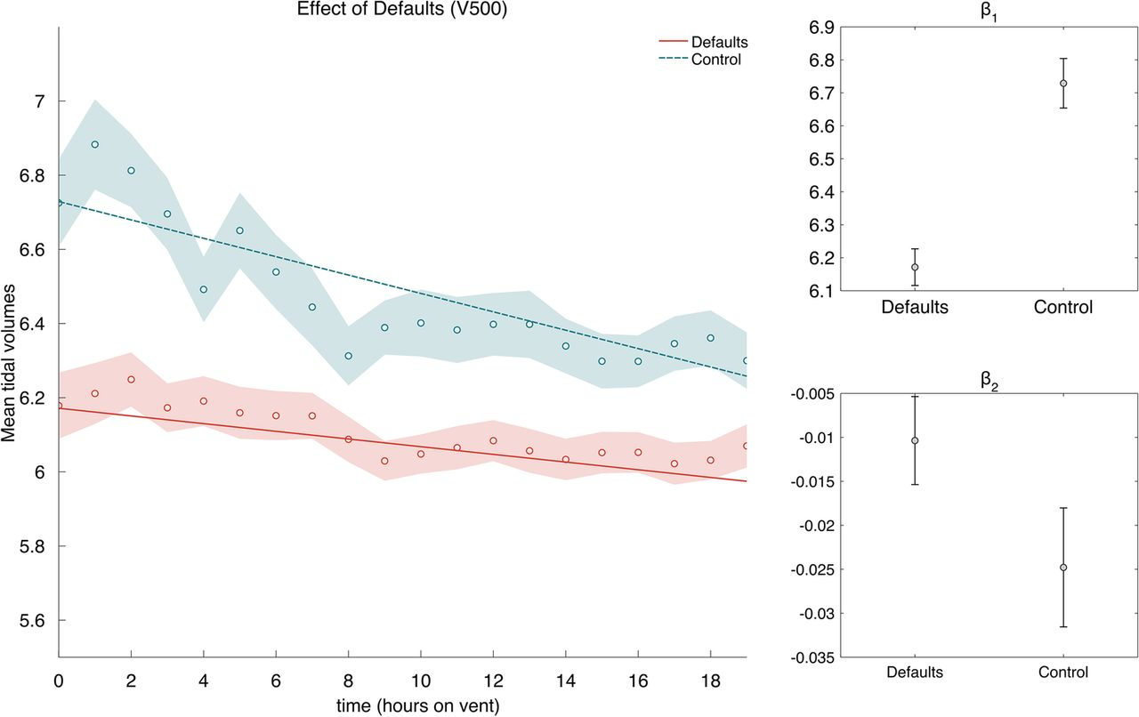
Effect of defaults and starting value on mean tidal volume.
Christopher P Bourdeaux et al. BMJ Open 2016;6:e010129
©2016 by British Medical Journal Publishing Group
Notes:
Effect of defaults and starting value on mean tidal volume. Tidal volume is displayed as a function of hours the patient was on ventilation. Averages are 50% trimmed means, and shaded regions are bootstrapped SEs. The lines are best-fit lines fit to the raw data. Intercepts and slopes are shown for the best-fit lines in the main figure. Error bars are 95% CIs.

