Slide 1

Coding Challenge
by Paul Garcia
Powerpoint Templates

Slide 2
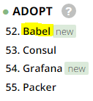
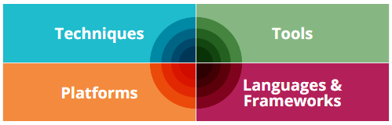
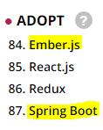
My Technology Stack :

Slide 3
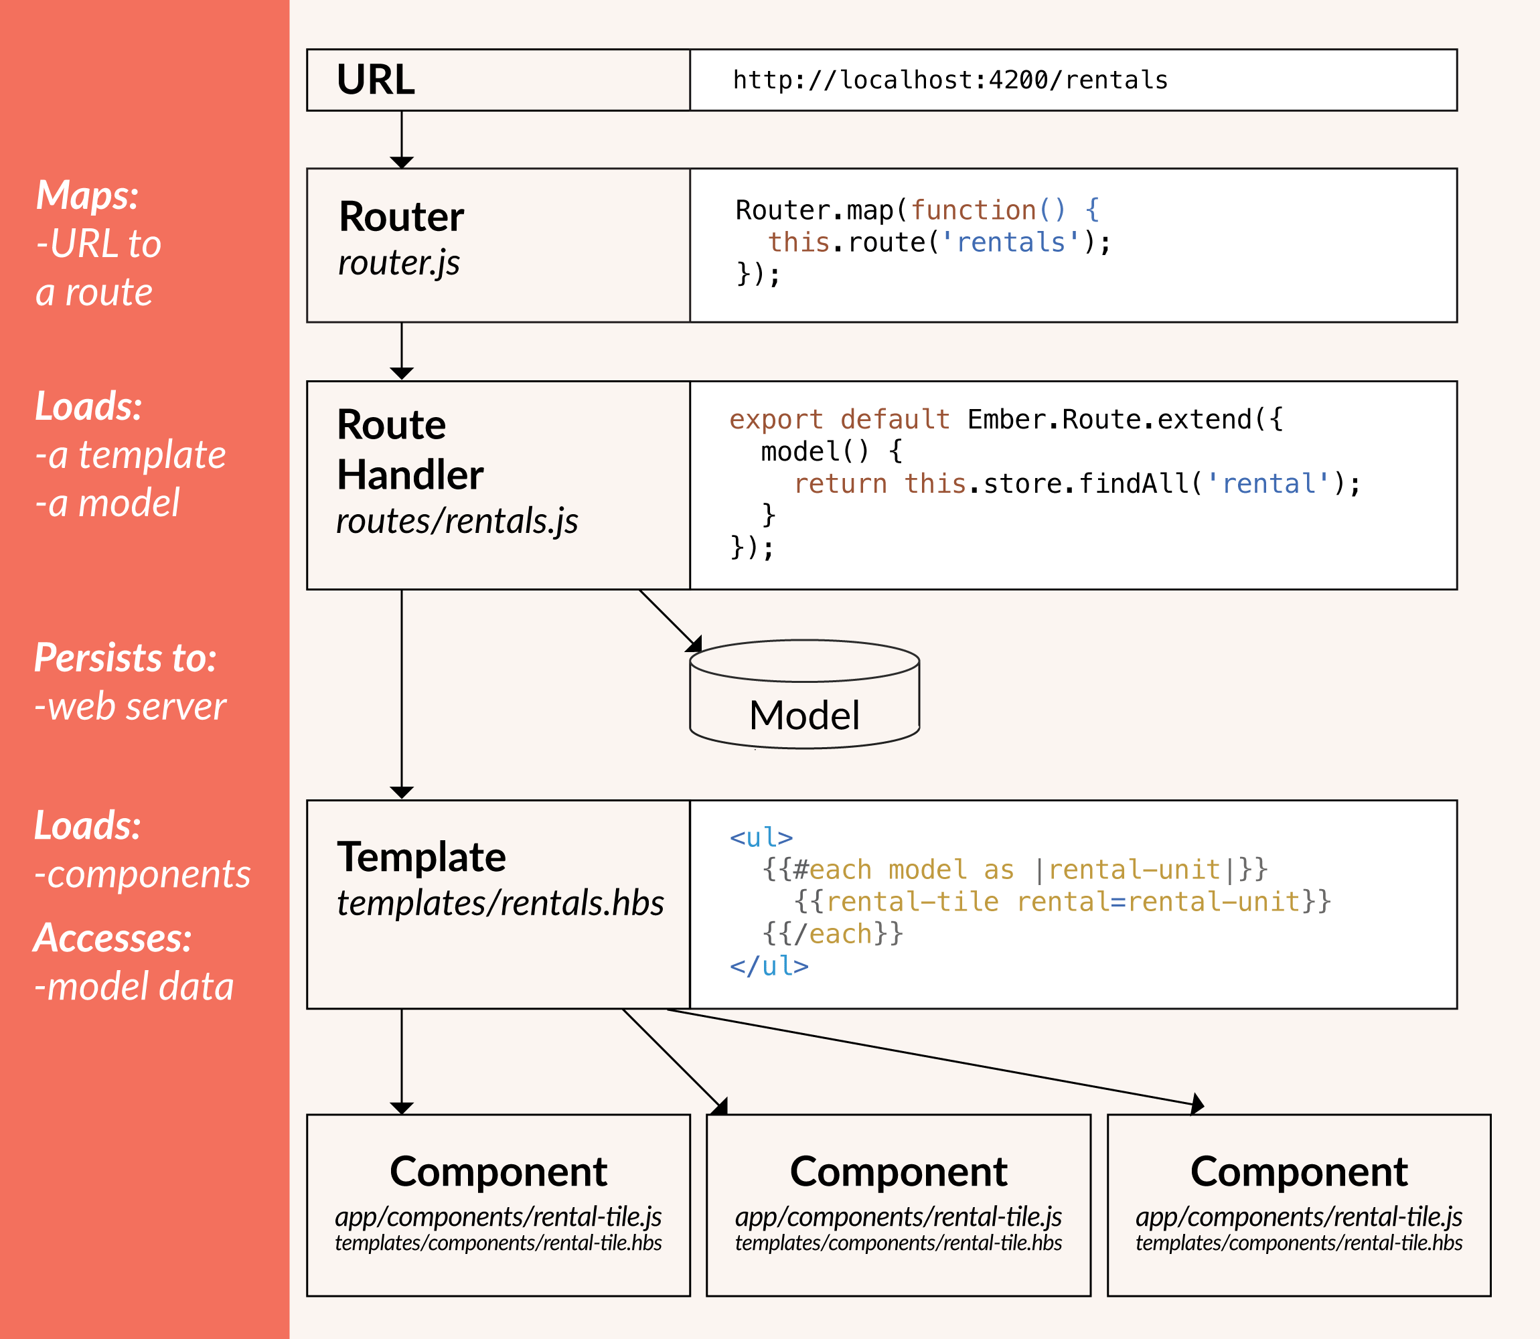

Slide 4
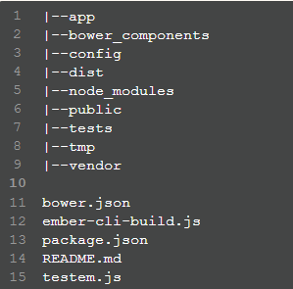
Using the Ember Command Line Interface (CLI)
Ember CLI uses the “ember” command.
To get a new application created, use the “new” command:
ember new code_challenge
This generates the following file structure:

Slide 5
Ember generate command
The generate command is what is used to create routes, templates, components, controllers
The “generate” command can be shortened to “g”

Slide 6

Spring Boot:
Spring boot makes it extremely easy to setup production grade, standalone applications. Spring boot takes an opinionated view of the Spring platform so that you can get up and running in a minimal amount of time.
On the spring website you can download a build file which, with the help of either gradle or maven, can help you setup an IDE with all dependencies already loaded.
A built in server also comes pre-packeged with spring boot, leaving one less thing to worry about.
At the end of the day, spring boot will build a war file for you to deploy on a web server, or an executable jar file, containing all dependencies that can be ran anywhere.

