Slide 1
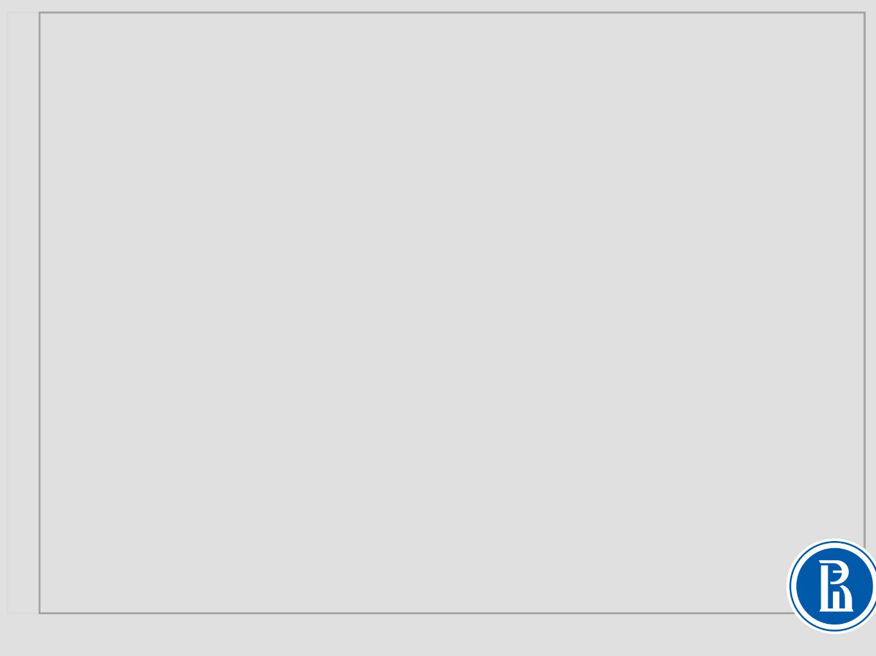
Model Selection and Regularization

Slide 2
Overfitting in linear regression

Slide 3
Week goals
Understand concept of overfitting
Be aware of bias-variance trade-off
Understand validation and cross-validation techniques
Use regularization with linear models
Apply feature selection techniques

Slide 4
Non-linear task

Slide 5
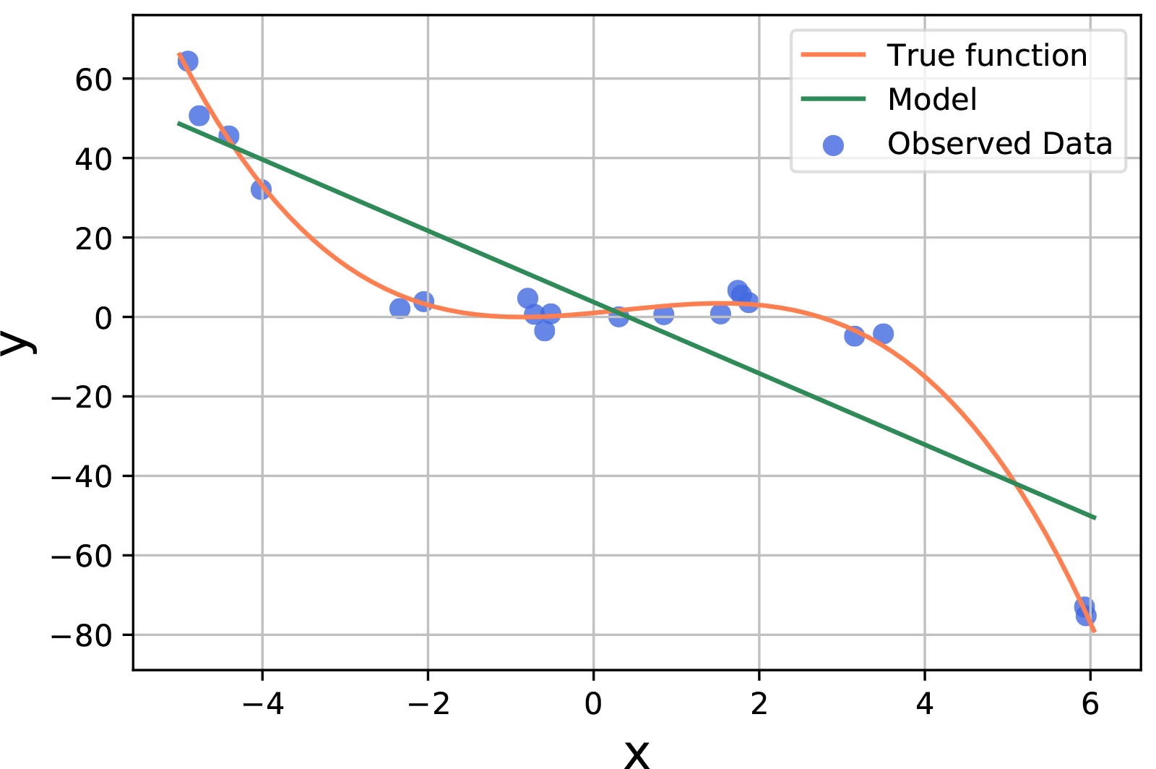

Non-linear task
$$a\left(x\right)=w_{0}+w_{1}x$$

Slide 6
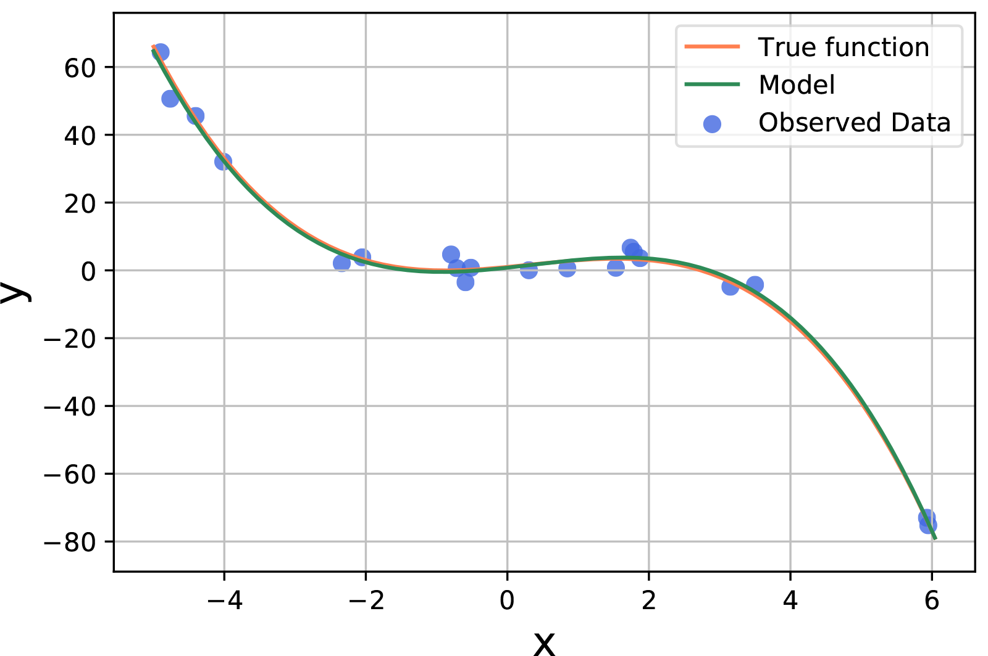

Non-linear task
$$a\left(x\right)=w_{0}+w_{1}x+w_{2}x^{2}+w_{3}x^{3}+w_{4}x^{4}$$

Slide 7
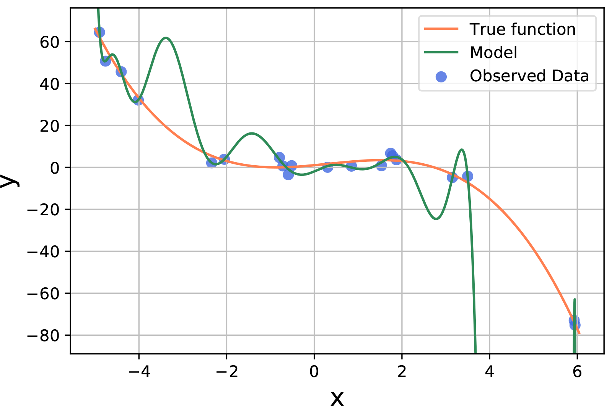

Non-linear task
$$a\left(x\right)=w_{0}+w_{1}x+w_{2}x^{2}+w_{3}x^{3}+w_{4}x^{4}+…+w_{15}x^{15}$$

Slide 8

Overfitting Symptom
$$a\left(x\right)=0.5+13458922x−43983740x^{2}+…$$
Large coefficients – symptom of overfitting in linear regression

Slide 9

Overfitting Symptom: example
Why is it bad to have large coefficients?
Assume, that we predict height using weight as a feature:
$$a(x)=698x−41714$$
Increase in the weight by 0.01 kg corresponds to increase in the height by 7 cm

Slide 10
How to avoid overfitting
Validation Dataset
Cross-Validation
Regularization
Feature Selection
Notes:
The rest of the week will be devoted to the topics, which will help us to avoid overfitting. Using validation and cross-validation will help us to compare models and evaluate their performance and generalization abilities. While regularization and feature selection methods can restrict model complexity, making it less prone to overfitting.
In the next video we will discuss bias-variance trade-off. The concept which will give us a more formal understanding of what is overfitting.

Slide 11
Bias-Variance trade-off
Notes:
In this video we will talk about bias-variance trade-off

Slide 12
Non-linear task
Notes:
Recall the example

Slide 13
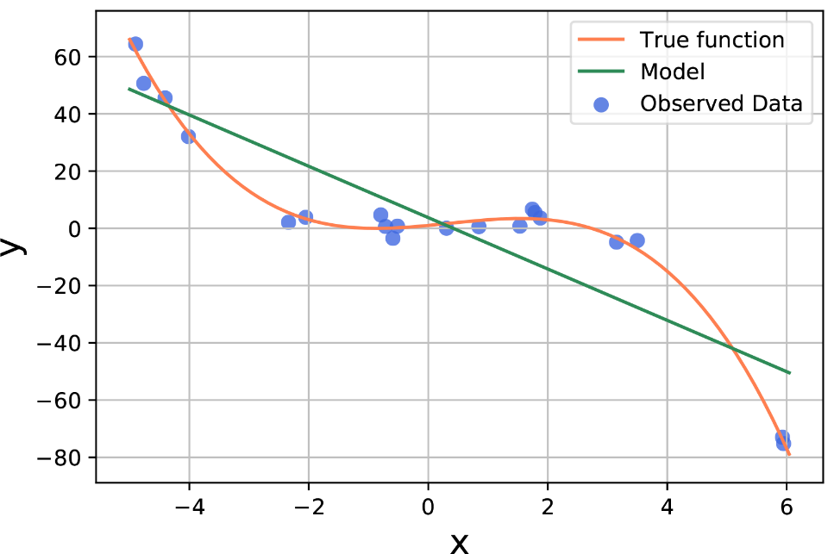
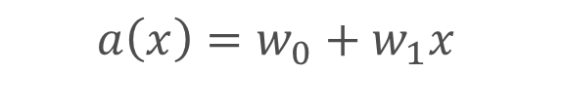

Non-linear example: Bias
$$a\left(x\right)=w_{0}+w_{1}x$$
$$MSE≈238.48$$
Notes:
On the other hand, we can fit polynomial of power 15. Even though the resulting model looks quite strange, we observe that it nicely fit the training data and has very low MSE

Slide 14
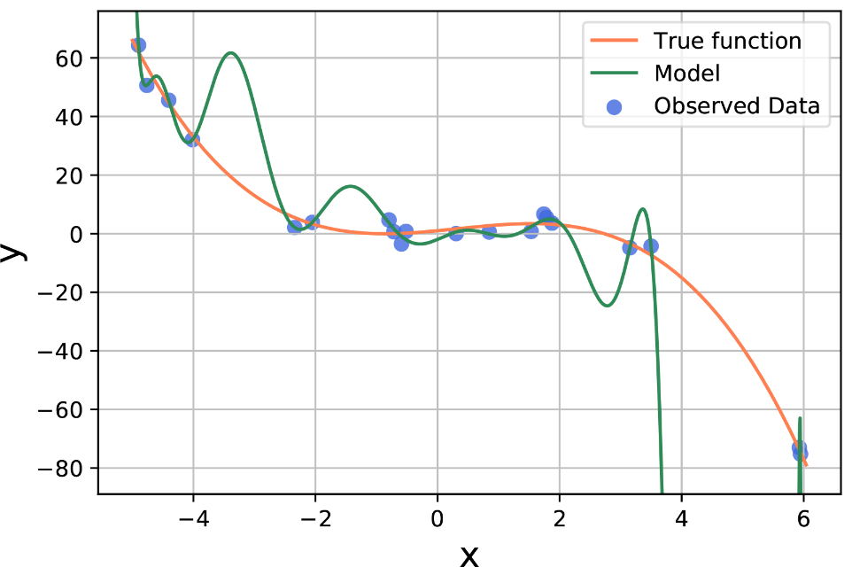

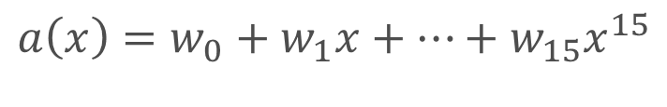
Non-linear example: Bias
$$a\left(x\right)=w_{0}+w_{1}x$$
$$a\left(x\right)=w_{0}+w_{1}x+…+w_{15}x^{15}$$
$$MSE≈238.48$$
$$MSE≈1.34$$
Notes:
On the other hand, we can fit polynomial of power 15. Even though the resulting model looks quite strange, we observe that it nicely fit the training data and has very low MSE

Slide 15
Non-linear example: Bias
High Bias
Low Bias
$$MSE≈238.48$$
$$MSE≈1.34$$
Notes:
The ability of the model to capture relationship in the data is called Bias. Just by looking on this example we can see that as the more complex model is, the lower is bias. At the same time, lower bias does not mean that the model is definitely better

Slide 16
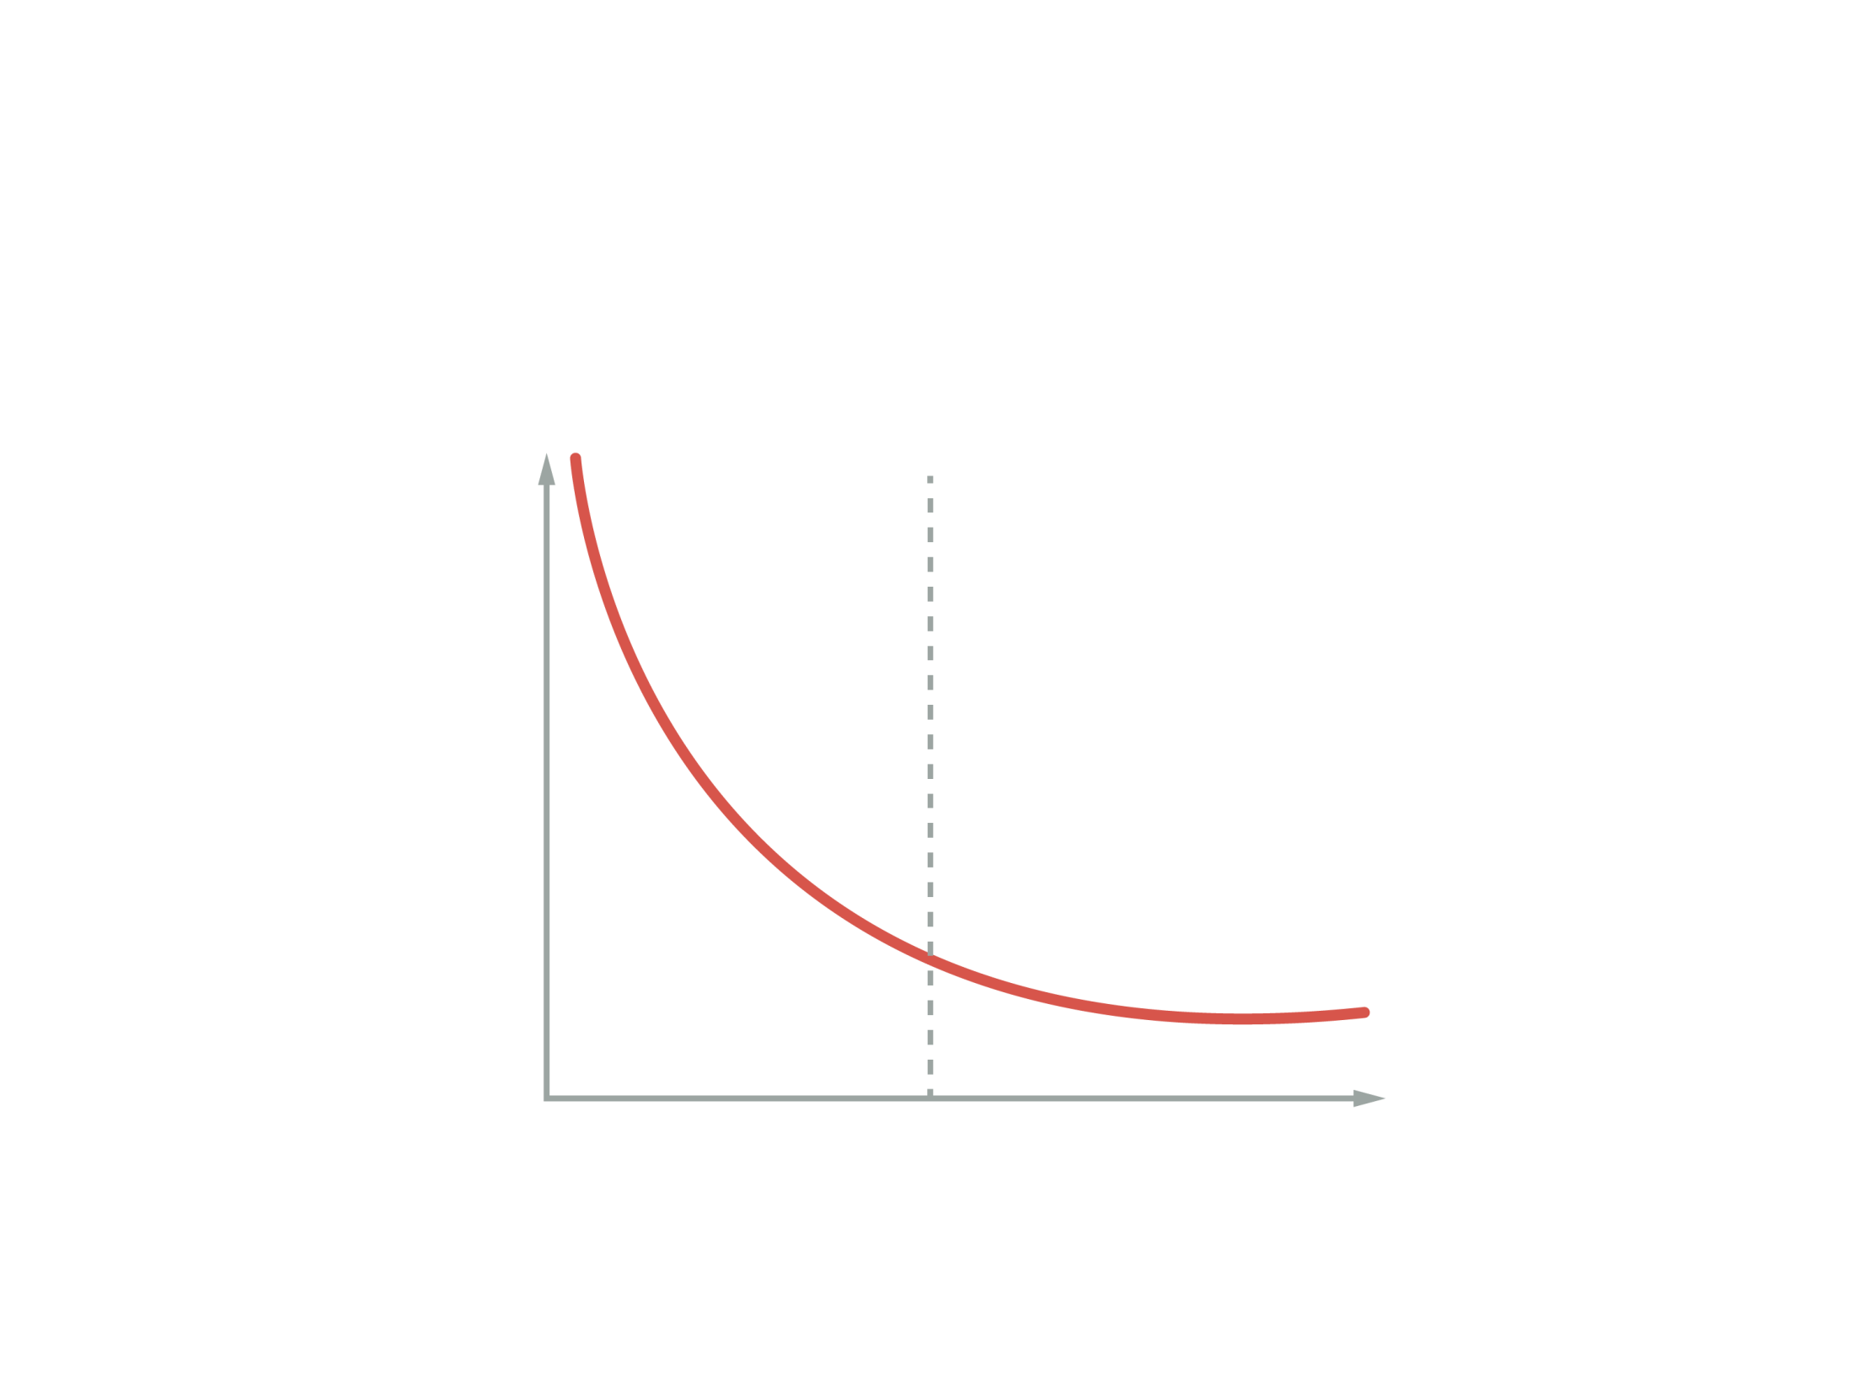
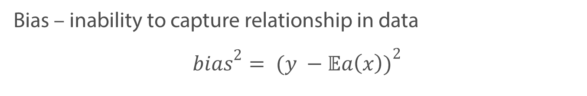
Non-linear example: Bias
Bias – inability to capture relationship in data
$${bias}^{2}= {(y −𝔼a\left(x\right))}^{2}$$
Bias²
Model Complexity

Slide 17
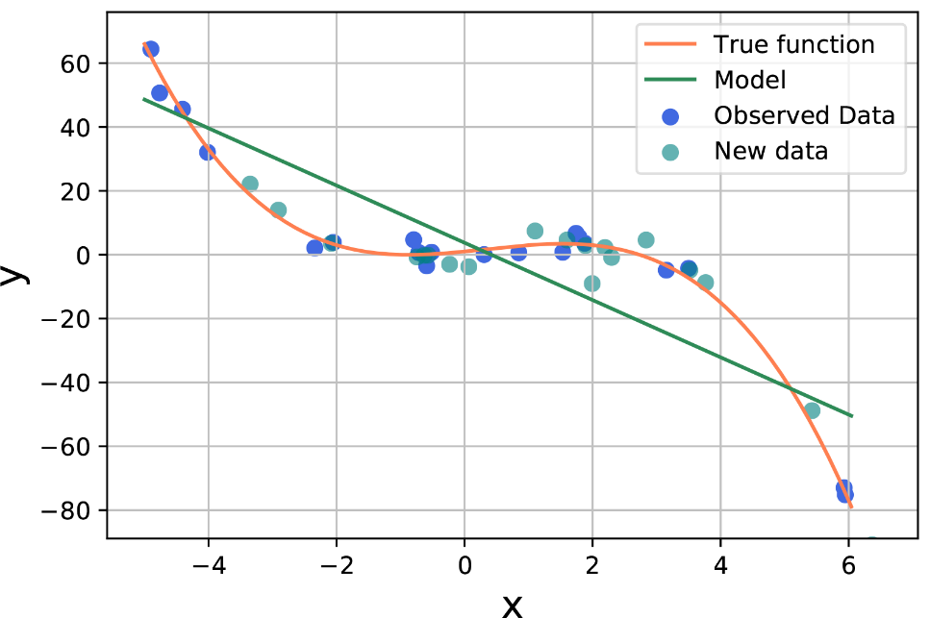
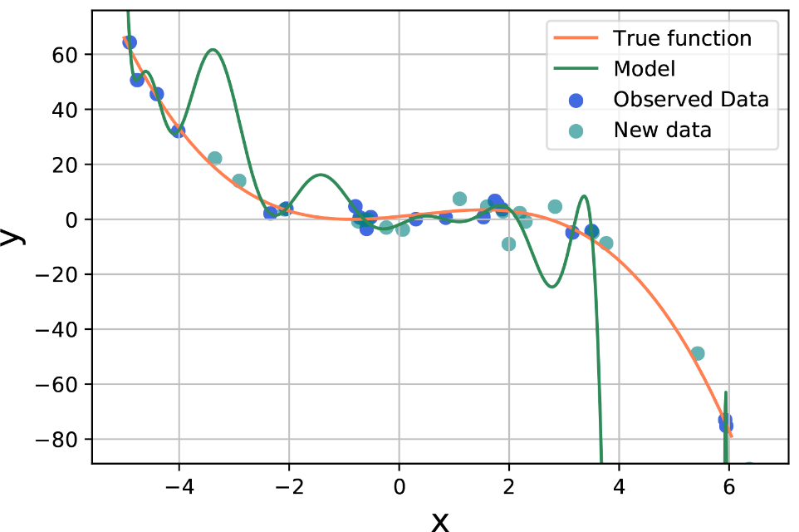
Non-linear example: Variance
How different would be the model, if we get another sample?
Notes:
So, we already know, that even when the model fits our training data, we can be sure, that it is a good model. We want to make sure that the model is stable. Simply speaking, if I get another sample (from exactly same distribution), and train a model one more time, I want to receive a similar result. In term of our example, what would happen is instead of blue point, I would observe green ones?

Slide 18
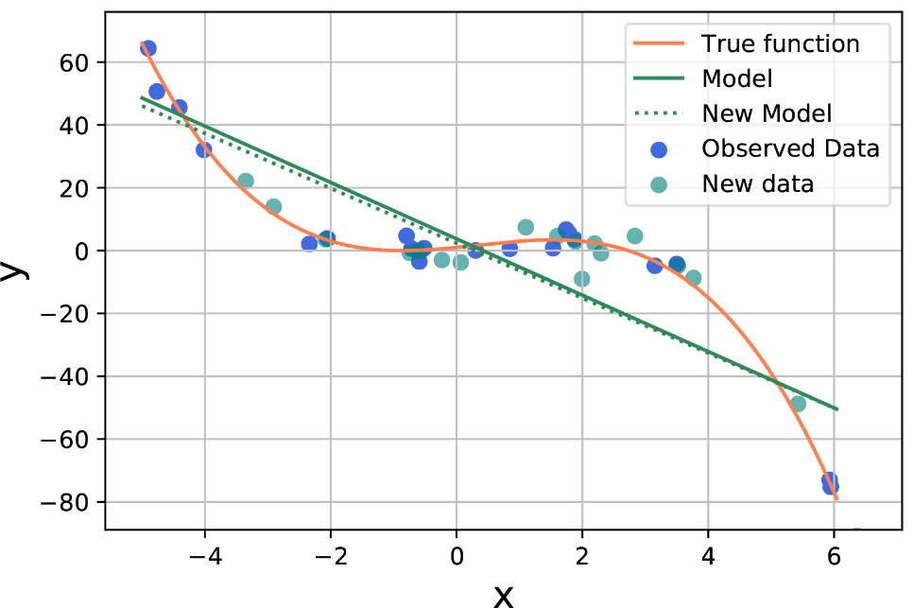
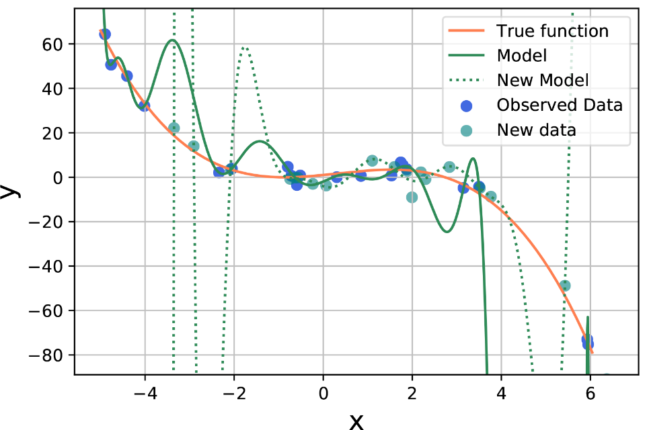
Non-linear example: Variance
How different would be the model, if we get another sample?
Notes:
We can see, that the simple mode does not change much (compare solid and dashed line, they are almost identical). But when it comes to the second model, the situation is opposite. The dashed line has almost nothing in common with the solid one.

Slide 19
Non-linear example: Variance
Variance – sensitivity of the model to the fluctuations in the data
Low Variance
High Variance
Notes:
This property of the model is called variance. Basically, it shows, how sensitive the model is to the fluctuations in the data. So the question that you can ask here, is how can measure the variance? We have seen, that we can understant which model has the lower bias by looking and the MSE.

Slide 20




Non-linear example: Variance
Variance – sensitivity of the model to the fluctuations in the data
Low Variance
High Variance
$$MSE test≈632.13$$
$$MSE test≈\text{540186894}.34$$
$$MSE train≈238.48$$
$$MSE train≈1.34$$
Notes:
Turns out, that we can approximate the variance of the model by looking at MSE (or other loss function that we used) on the these new points. They are depicted in green on the graph. Let us call it test set – because it is used test how good the model predicts target variable on the new data. If the difference between MSE train and test data is large, the model is said to have large variance.

Slide 21
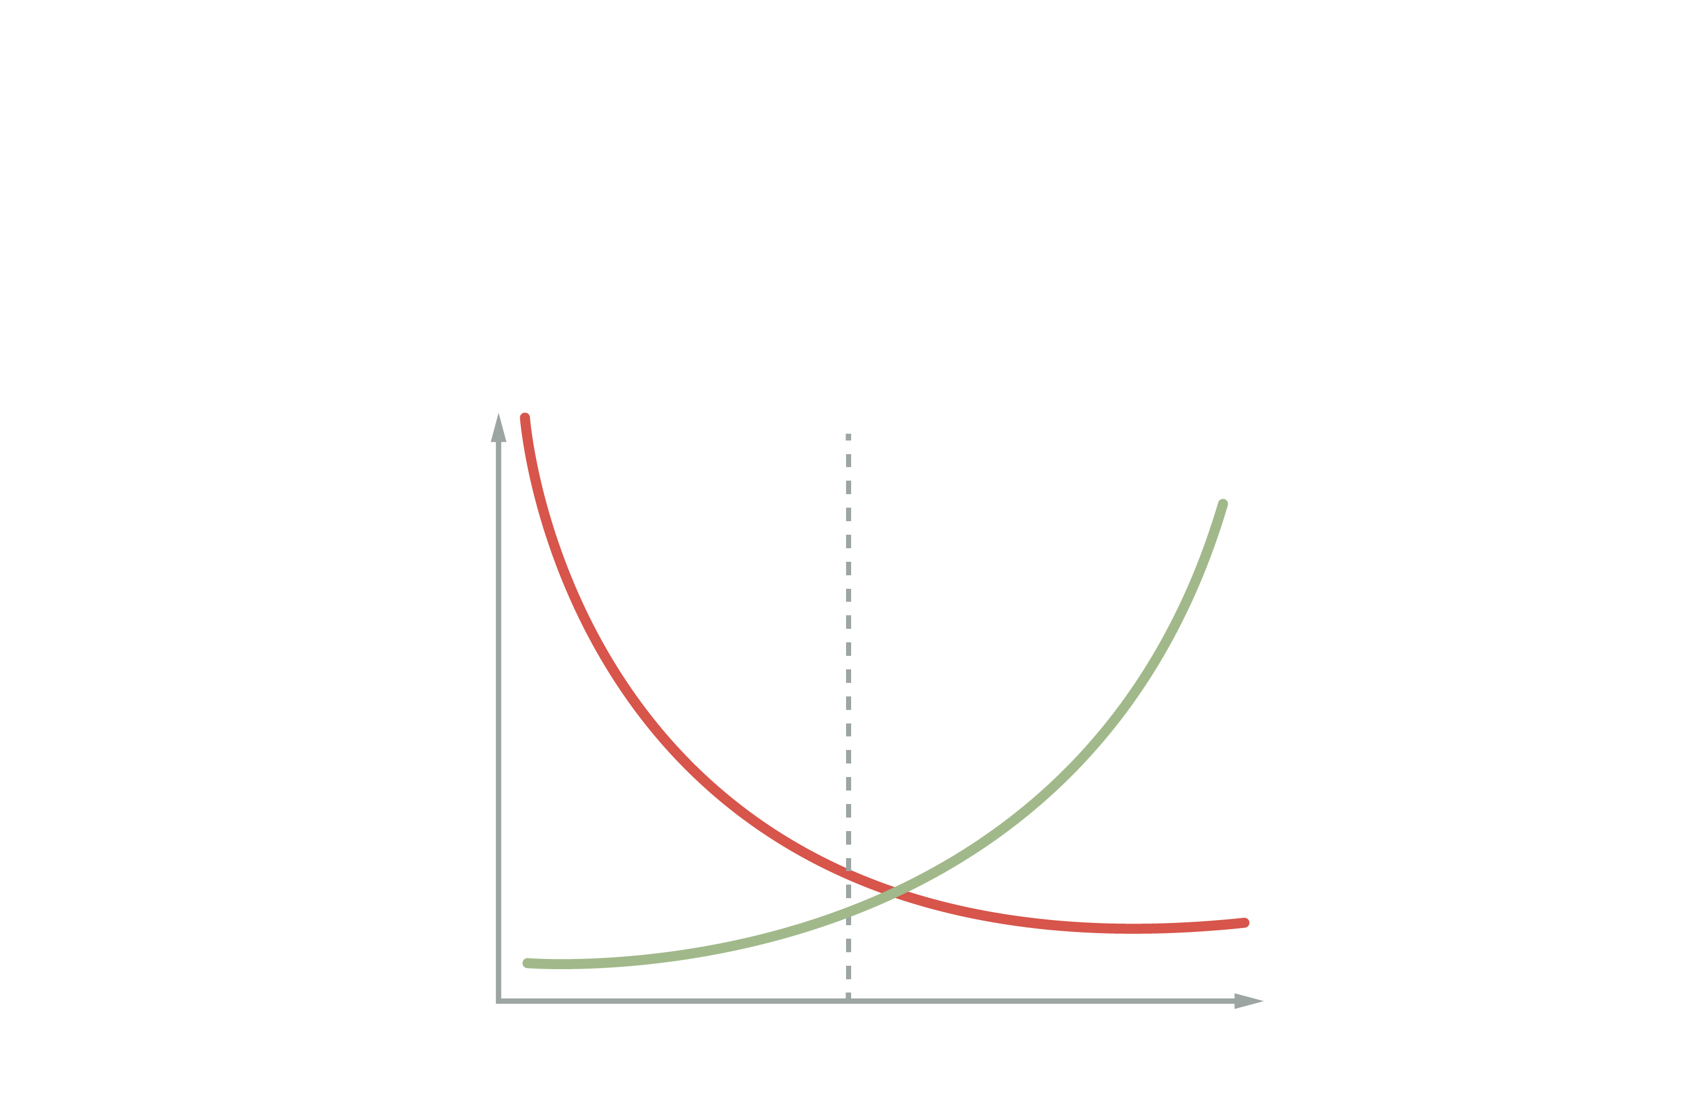
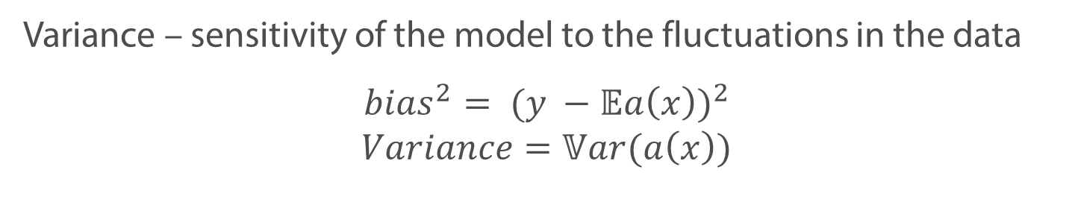
Bias-variance trade-off
Variance – sensitivity of the model to the fluctuations in the data
$${bias}^{2}= {(y −𝔼a\left(x\right))}^{2}$$
$$Variance=𝕍ar(a\left(x\right))$$
Bias²
Variance
Model Complexity

Slide 22
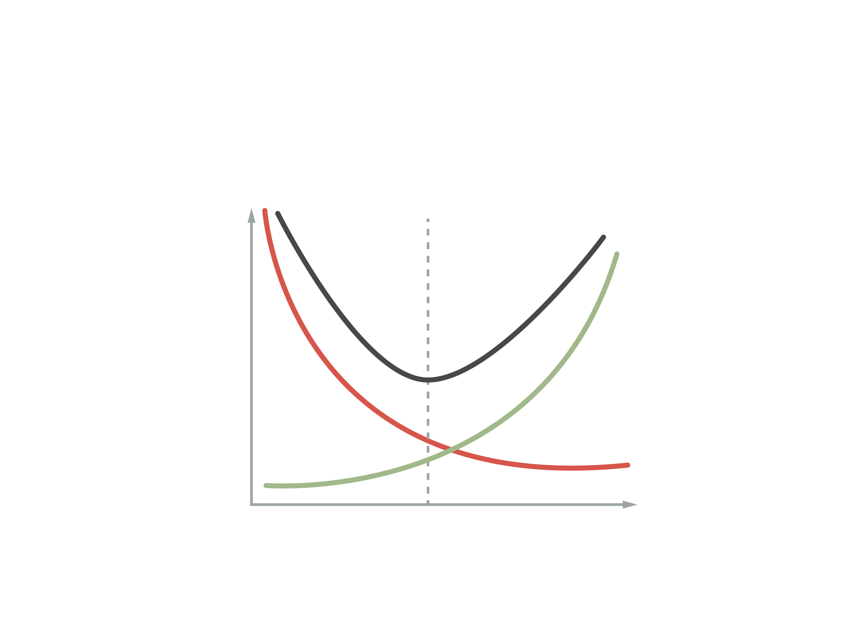
Bias-variance trade-off
$${𝔼{[y −a\left(x\right)]}^{2}= bias}^{2}+Variance$$
Error
Bias²
Variance
Model Complexity
Notes:
It can be shown, that the expected squared error of the model on the test set the sum of the squared bias and variance. You can see it on the graph, depicted with the black line

Slide 23
Bias-variance trade-off
Simple models may have large bias (underfitting)
Excessively complex models have large variance (overfitting)
Error
Bias²
Variance
Model Complexity
Notes:
In the net video we will see, how MSE loss, that you are already familiar with can be decomposed into the sum of the squared bias and variance

Slide 24
Bias-Variance trade-off: Derivation

Slide 25
Validation

Slide 26


How to evaluate the model?
Loss calculated on the data used for training
$$MSE≈238.48$$
$$MSE≈1.34$$

Slide 27


How to evaluate the model?
Loss calculated on the data used for training
$$MSE≈238.48$$
$$MSE≈1.34$$
Loss calculated on the new data
$$MSE≈632.13$$
$$MSE≈\text{540186894}.34$$

Slide 28
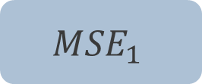
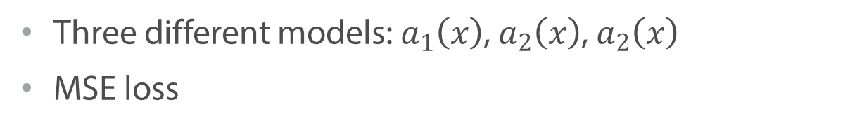
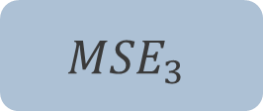

Model comparison
Three different models: $a_{1}\left(x\right)$, $a_{2}\left(x\right)$, $a_{2}\left(x\right)$
MSE loss
All the available data
Train
$${MSE}_{1}$$
Model with the lowest MSE – The best model
$${MSE}_{2}$$
$${MSE}_{3}$$

Slide 29
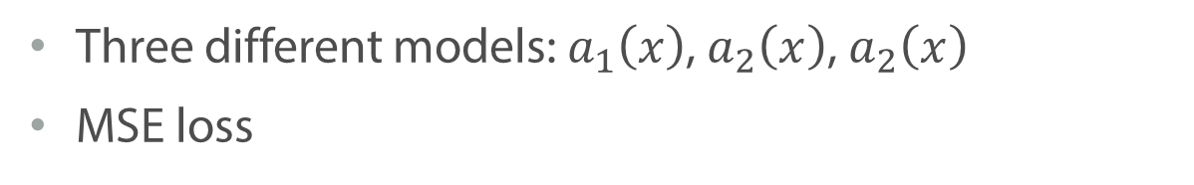
Model comparison
Three different models: $a_{1}\left(x\right)$, $a_{2}\left(x\right)$, $a_{2}\left(x\right)$
MSE loss
All the available data
Train
$${MSE}_{1}$$
Model with the lowest MSE – The best model
Best model
$${MSE}_{2}$$
$${MSE}_{3}$$

Slide 30
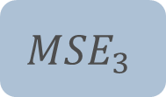
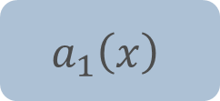

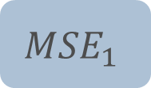


Model comparison
Three different models: $a_{1}\left(x\right)$, $a_{2}\left(x\right)$, $a_{2}\left(x\right)$
MSE loss
All the available data
Train Data
Validation Data
Train
Eval.
$$a_{1}\left(x\right)$$
$${MSE}_{1}$$
Model with the lowest MSE – The best model
$$a_{2}\left(x\right)$$
$${MSE}_{2}$$
$$a_{3}\left(x\right)$$
$${MSE}_{3}$$

Slide 31
How good is the validation set?

Slide 32
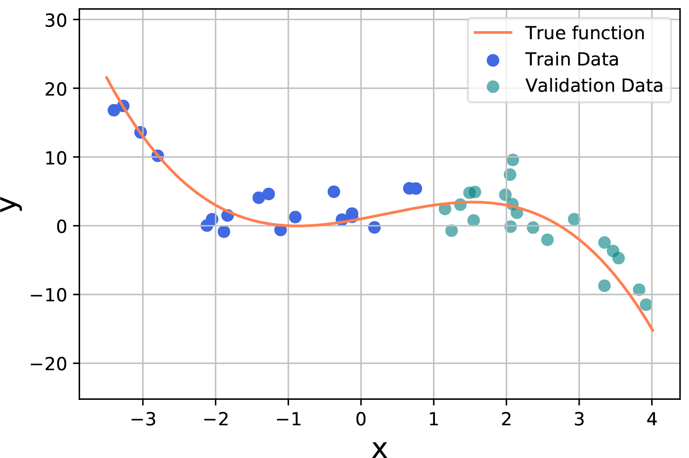
How good is the validation set?

Slide 33
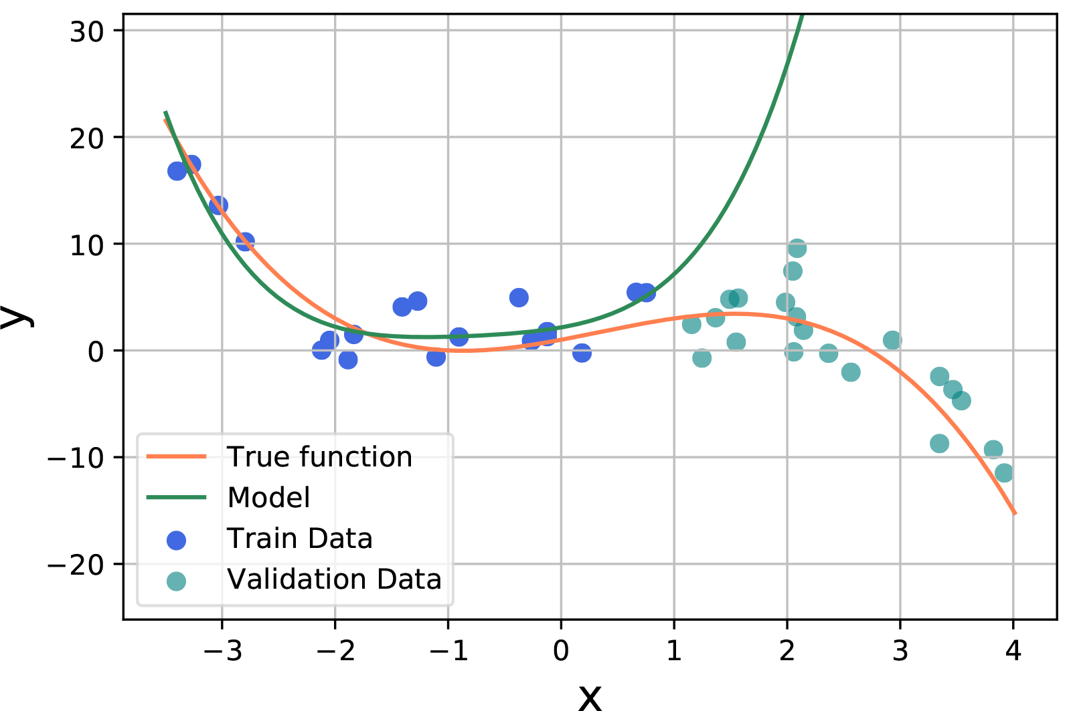
How good is the validation set?

Slide 34
Do you have enough observations?

Slide 35
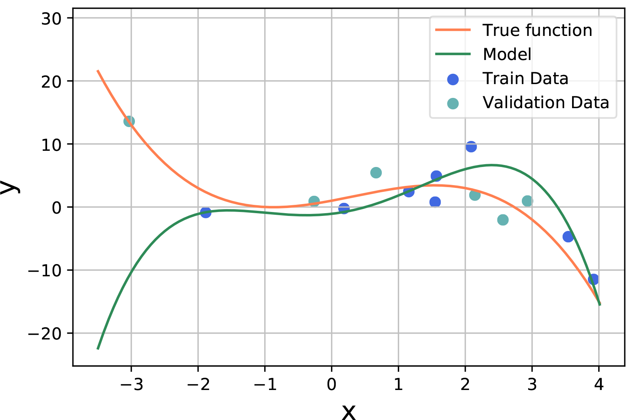
Do you have enough observations?

Slide 36
Cross-Validation

Slide 37
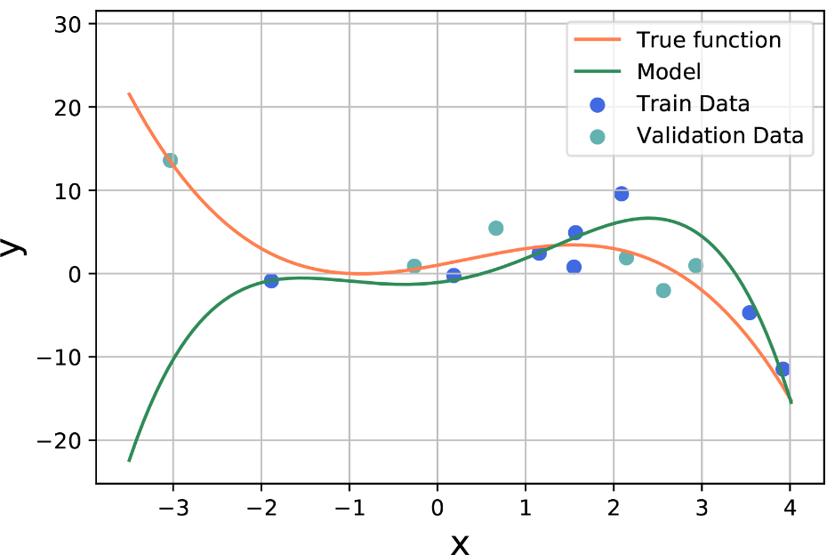
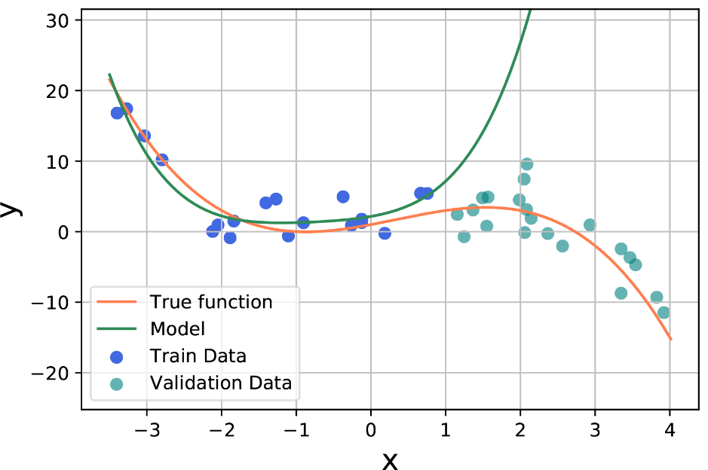
How good is the validation set?

Slide 38
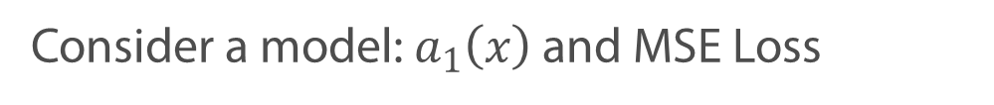
The best validation is the whole dataset
Consider a model: $a_{1}\left(x\right)$ and MSE Loss
All the data

Slide 39
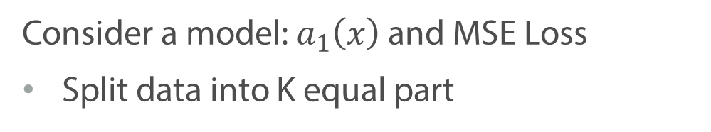

The best validation is the whole dataset
Consider a model: $a_{1}\left(x\right)$ and MSE Loss
Split data into K equal part
Fold 2
Fold K
All the available data
Fold 1
$$⋯$$

Slide 40
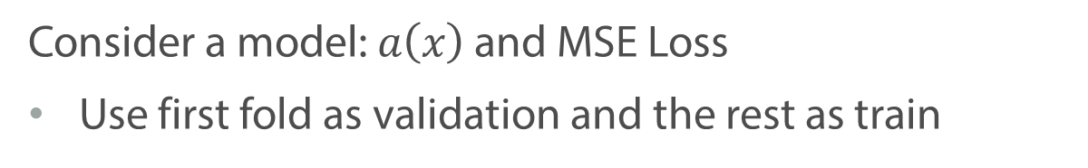
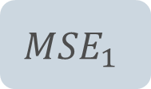
The best validation is the whole dataset
Consider a model: $a\left(x\right)$ and MSE Loss
Use first fold as validation and the rest as train
Fold 2
Fold K
All the available data
Fold 1
$$⋯$$
Eval.
$${MSE}_{1}$$

Slide 41
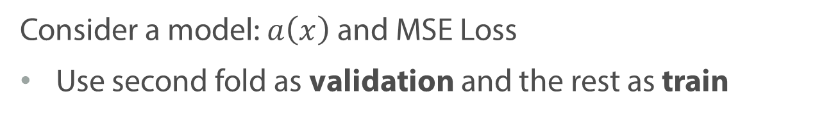
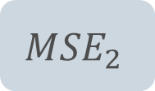
The best validation is the whole dataset
Consider a model: $a\left(x\right)$ and MSE Loss
Use second fold as validation and the rest as train
Fold 2
Fold K
All the available data
Fold 1
$$⋯$$
Eval.
$${MSE}_{1}$$
$${MSE}_{2}$$

Slide 42

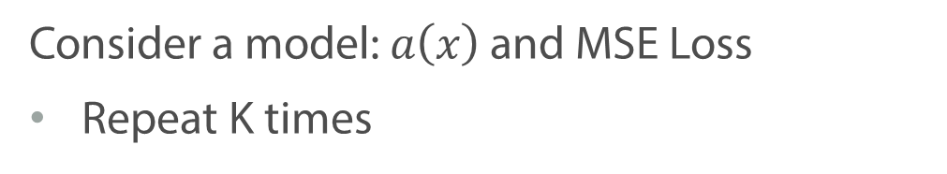
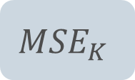
The best validation is the whole dataset
Consider a model: $a\left(x\right)$ and MSE Loss
Repeat K times
Fold 2
Fold K
All the available data
Fold 1
$$⋯$$
Eval.
$${MSE}_{1}$$
$${MSE}_{2}$$
$${MSE}_{K}$$
$$⋯$$

Slide 43
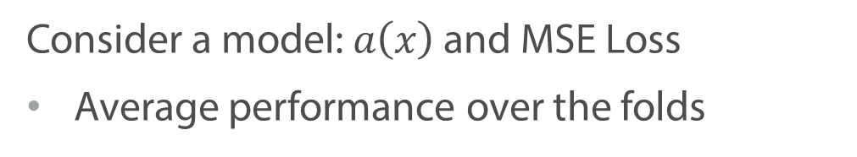
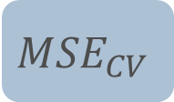
The best validation is the whole dataset
Consider a model: $a\left(x\right)$ and MSE Loss
Average performance over the folds
Fold 2
Fold K
All the available data
Fold 1
$$⋯$$
$${MSE}_{1}$$
$${MSE}_{2}$$
$${MSE}_{K}$$
$${MSE}_{CV}$$
$$⋯$$
Notes:
In the end we average all the MSE. As a result, all objects in our dataset appear at least once in the validation and train -> more robust

Slide 44
Summary
Overfitting and underfitting are bad for generalization of the model
We need validation to fairly compare different models and evaluate their generalization ability
Cross-Validation allows us to use the whole dataset for validation

Slide 45
Regularization

Slide 46

Overfitting in Linear Regression
$$a\left(x\right)=0.5+13458922x−43983740x^{2}+…$$
Notes:
Let us go back to our example, where we trained polynomial regression of the power 15. We observed, that the resulting model overfits: it perfectly fits our training data, but I would give you a new point from the same distribution, the model would probably completely fail. One of the symptoms of overfitting are extremely large values of the weights. In this video we will discuss, how we can make use of this observation in order to fight overfitting. The model, that we will be using for that is called regularization

Slide 47
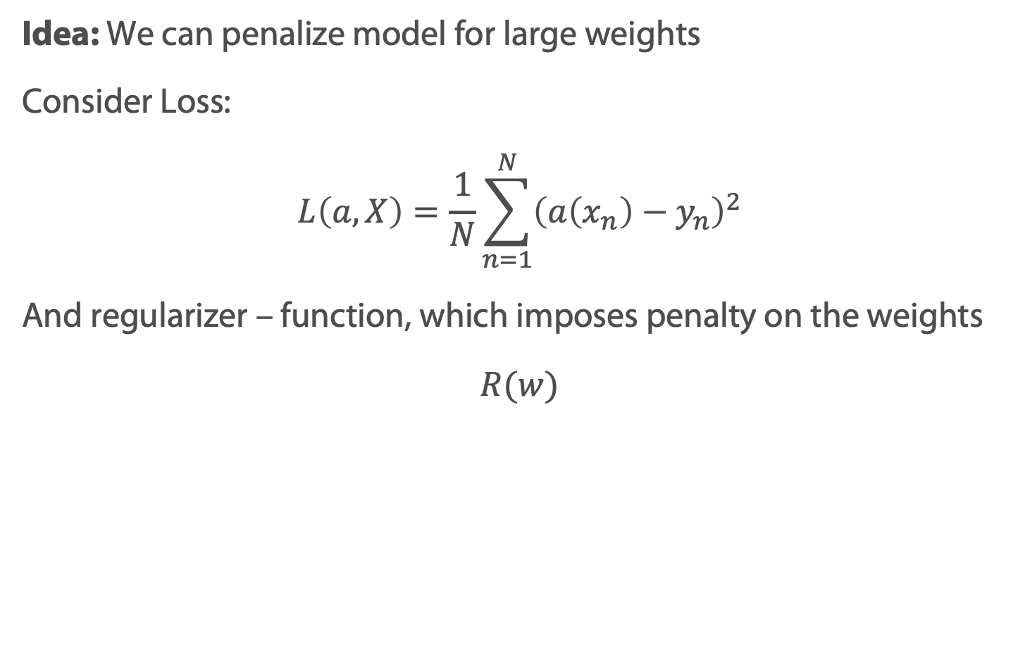
Regularization
Idea: We can penalize model for large weights
Consider Loss:
$$L\left(a, X\right)=\frac{1}{N}\sum_{n=1}^{N}{{\left(a\left(x_{n}\right)−y_{n}\right)}^{2}}$$
And regularizer – function, which imposes penalty on the weights
$$R(w)$$
Notes:
The idea of the method is rather simple. We now that that large values of the weights in most cases means something bad – so let us train the model and in the same time penalize it for the large coefficients. The penalty is called regularizer – it is some function, which takes as input the vector of weights and returns a number, which tells us how big our weights are.

Slide 48

Regularization
Reguralized Loss$:$
$$\min_{w}{\frac{1}{N}\sum_{n=1}^{N}{{\left(a\left(x_{n}\right)−y_{n}\right)}^{2}}+λR(w)}$$
$λ$ – regularization coefficient
Notes:
We add this regularizer to our loss function with some weight lambda and optimize the resulting function with respect to the parameters of the model. Now, we have two components in our loss: the first one measures the error of the model predictions and pushes our model to fit to the training data. The second one, instead, restricts the model. Combination of the two, results in some sense in a balance.

Slide 49

Regularization
Reguralized Loss$:$
$$\min_{w}{\frac{1}{N}\sum_{n=1}^{N}{{\left(a\left(x_{n}\right)−y_{n}\right)}^{2}}+λR(w)}$$
$λ$ – regularization coefficient
Use Validation or Cross-Validation to select optimal $λ$
Notes:
It is quite important to select regularization coefficient properly. In a few slides we will see an example of how different your results might be, depending on its values. But intuitively, it is quite clear that if lambda is very large, we will restrict out model too much and it won’t be able to learn anything reasonable. On the other hand, if it is too small – will not fight the overfitting. To choose lambda, one cannot use training set, because then the optimal lambda will be zero: it restrict out model from overfitting under the train data. Instead, we have to compare models with different values of lambda using either validation or cross-validation.

Slide 50
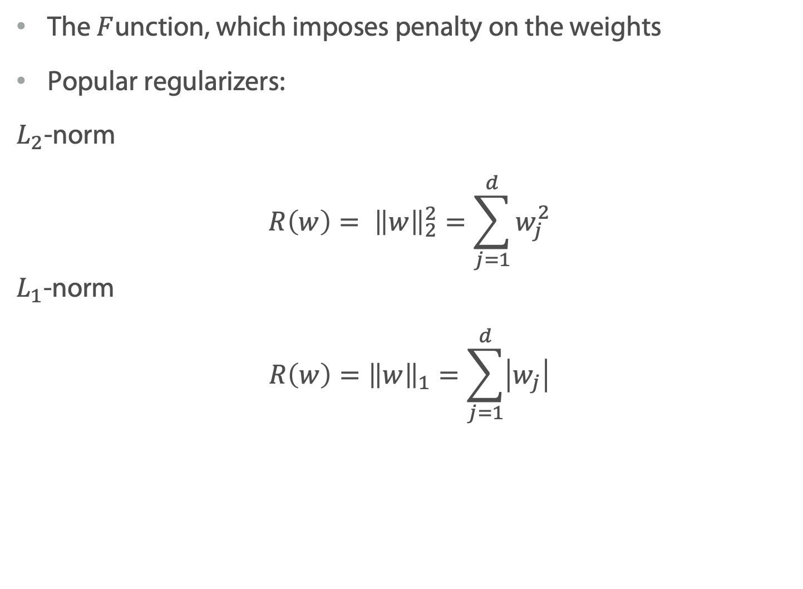
What is a regularizer?
The $F$unction, which imposes penalty on the weights
Popular regularizers:
$L_{2}$-norm
$$R\left(w\right)= {\left\|w\right\|}_{2}^{2}=\sum_{j=1}^{d}{w_{j}^{2}}$$ $L_{1}$-norm
$$R\left(w\right)={\left\|w\right\|}_{1}=\sum_{j=1}^{d}{\left|w_{j}\right|}$$
Notes:
There different regularizers, that people use in practice. The most popular ones are L1 and L2 norms, that you can see on the slide.

Slide 51
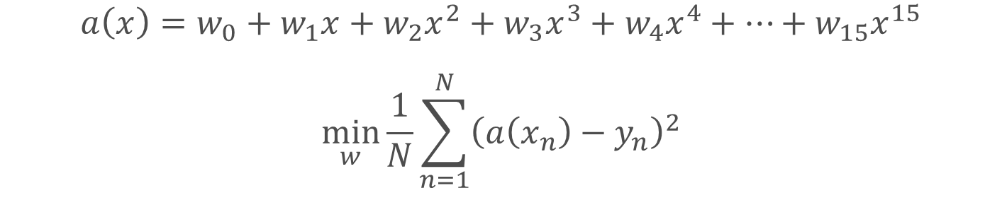
Effect of Regularization
$$a\left(x\right)=w_{0}+w_{1}x+w_{2}x^{2}+w_{3}x^{3}+w_{4}x^{4}+…+w_{15}x^{15}$$
$$\min_{w}{\frac{1}{N}\sum_{n=1}^{N}{{\left(a\left(x_{n}\right)−y_{n}\right)}^{2}}}$$

Slide 52


Effect of Regularization
$$a\left(x\right)=w_{0}+w_{1}x+w_{2}x^{2}+w_{3}x^{3}+w_{4}x^{4}+…+w_{15}x^{15}$$
$$\min_{w}{\frac{1}{N}\sum_{n=1}^{N}{{\left(a\left(x_{n}\right)−y_{n}\right)}^{2}}+0.01{\left\|w\right\|}_{2}^{2}}$$

Slide 53


Effect of Regularization
$$a\left(x\right)=w_{0}+w_{1}x+w_{2}x^{2}+w_{3}x^{3}+w_{4}x^{4}+…+w_{15}x^{15}$$
$$\min_{w}{\frac{1}{N}\sum_{n=1}^{N}{{\left(a\left(x_{n}\right)−y_{n}\right)}^{2}}+1{\left\|w\right\|}_{2}^{2}}$$

Slide 54


Effect of Regularization
$$a\left(x\right)=w_{0}+w_{1}x+w_{2}x^{2}+w_{3}x^{3}+w_{4}x^{4}+…+w_{15}x^{15}$$
$$\min_{w}{\frac{1}{N}\sum_{n=1}^{N}{{\left(a\left(x_{n}\right)−y_{n}\right)}^{2}}+100{\left\|w\right\|}_{2}^{2}}$$

Slide 55
Lasso and Ridge Regression

Slide 56

What is a regularizer?
The $F$unction, which imposes penalty on the weights
Popular regularizers:
$L_{2}$-norm
$$R\left(w\right)= {\left\|w\right\|}_{2}^{2}=\sum_{j=1}^{d}{w_{j}^{2}}$$ $L_{1}$-norm
$$R\left(w\right)={\left\|w\right\|}_{1}=\sum_{j=1}^{d}{\left|w_{j}\right|}$$

Slide 57

Ridge Regression
$$\min_{w}{\frac{1}{N}\sum_{n=1}^{N}{{\left(a\left(x_{n}\right)−y_{n}\right)}^{2}}+λ{\left\|w\right\|}_{2}^{2}}$$
Has analytical Solution:
$$w={\left(X^{T}X+λI\right)}^{−1}X^{T}y$$
Has shrinkage effect on weights
Notes:
If we combine MSE loss with L2 regularization, we will get the model, which is called Ridge regression. It is a very convenient model in the sense that we use MSE loss, which is differentiable, add convex regularizer, which makes things even better. As a results we can not only easily use GD to optimize such loss function, but also write down the closed-form solution. Remember, that when we didn’t have the regularization, solution was very similar, but it did have identity matrix times lambda. Turns out, that this additional term improves the stability of the inversion. Which is one more advantage of Ridge regression.

Slide 58

Lasso Regression
$$\min_{w}{\frac{1}{N}\sum_{n=1}^{N}{{\left(a\left(x_{n}\right)−y_{n}\right)}^{2}}+λ{\left\|w\right\|}_{1}}$$
LASSO (Least Absolute Shrinkage and Selection Operator)
No analytical solution
Some weights zero out (selection)
Notes:
If instead of L2 we combine MSE loss with L1 regularizer, we would obtain model, which is usually called LASSO, or Least Absolute Shrinkage and Selection Operator. Notice, that since L1 norm is a some of modules, optimization becomes slightly harder. You all know, hopefully, that absolute values are not differentiable at 0. And of course, there is not analytical solution for such proble. Of course, there are optimization methods, which can deal with this, but why even bother? Why can’t we just use L2 instead? Turns out, that happens because this model has quite an important property – it zeros out some of the weights completely. Not just reduce their values, line Ridge does. This which is has the word selection in its name: basically, it serves as an automatic feature selection method.

Slide 59
Prediction of Diabetes Progression
Target – quantitative measure of disease progression one year after baseline
10 Features
Age
Sex
Body mass index
Average blood pressure
Six Blood Serum Measurements (S1, S2, S3, S4, S5, S6)

Slide 60


Prediction of Diabetes Progression
Coefficients after training with different values of $λ$
Lasso:

Slide 61


Prediction of Diabetes Progression
Coefficients after training with different values of $λ$
Lasso:
Ridge:

Slide 62
Summary
Large weights – one of the symptoms of overfitting in linear regression
We can add a function to the loss, which penalizes model for large weights. It is called regularization
Both Lasso and Ridge regression have shrinkage effect
Lasso performs automatic feature selection

Slide 63
Geometric Interpretation

Slide 64
Feature Selection

Slide 65
Feature Selection Methods
Set of methods, which reduce irrelevant feature from the dataset
Better performing model
Easier interpretation
Faster training and inference
Notes:
In this video we will discuss feature selection methods – that is a set of techniques, which allows us to remove some feature from the dataset before (occasionally at the same time) fitting the final model.
But before we start with the exact methods, let me give you some motivation, why even bother about feature selection? You already know, that modern algorithms and technologies allow us to work with really huge datasets: we have efficient optimization algorithms, powerful computers. But still, removing irrelevant features might be quite useful for the following reasons:
1. better performing model 2. Easier to interpret 3. Runs faster

Slide 66



Feature Selection
Filter methods
Evaluate individual features and choose the most promising ones
Wrapper methods
Find the best combination of features
Embedded methods
Automatic feature selection during training

Slide 67
Filter Methods
Evaluate individual features and choose the most promising ones
Possible criterions:
Variance
Correlation with the target
All features
Criterion
Train Model
Best Subset

Slide 68
Wrapper Methods
Find the best combination of features from a given model
Forward/Backward Selection
Recursive Feature Elimination
All features
Generate subset
Train Model

Slide 69
Embedded Methods
Automatic feature selection during training
Lasso
Tree-based (later in the course)
Train Model and select relevant features
All features

Slide 70
Summary
Feature selection helps to improve model performance, interpretability and running speed
There are filter, wrapper and embedded methods
No silver bullet, you have to discover what works best for a specific problem

