Slide 1
Git
A Beginner's Guide to Git Version Control
By Yashita Mittal

Slide 2
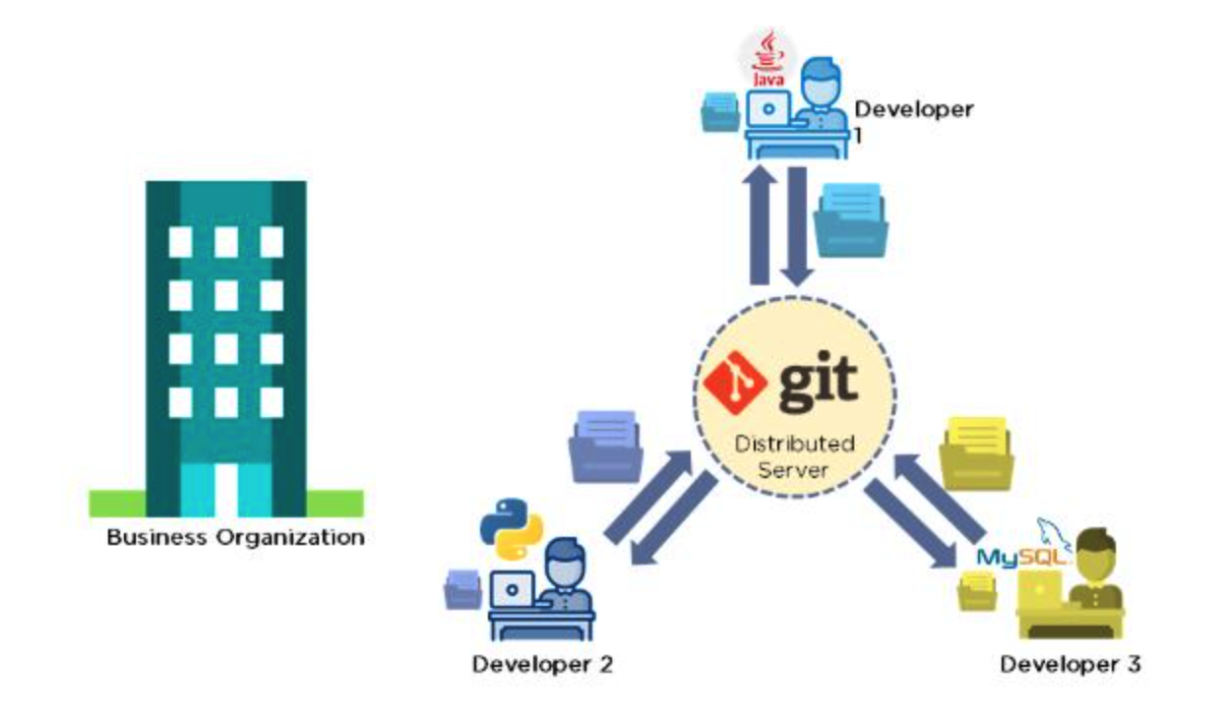
Git is a version control system used for tracking changes in computer files. It is generally used for source code management in software development.
Git is used to tracking changes in the source code
The distributed version control tool is used for source code management
It allows multiple developers to work together
It supports non-linear development through its thousands of parallel branches
Features of Git
Tracks history
Free and open source
Supports non-linear development
Creates backups
Scalable
Supports collaboration
Branching is easier
Distributed development

Slide 3
Why do we use version control?
Version control enables teams to collaborate and streamline development to resolve conflicts and create a centralized location for code.
- It helps you track different versions of your code and collaborate with other developers. If you are working on a project over time, you may want to keep track of which changes were made, by whom, and when those changes were made.
- Version control helps teams solve these kinds of problems, tracking every individual change by each contributor and helping prevent concurrent work from conflicting.
Benefits of version control Quality Teams can review, comment, and improve each other’s code and assets. Acceleration Branch code, make changes, and merge commits faster. Visibility Understand and spark team collaboration to foster greater release build and release patterns.

Slide 4
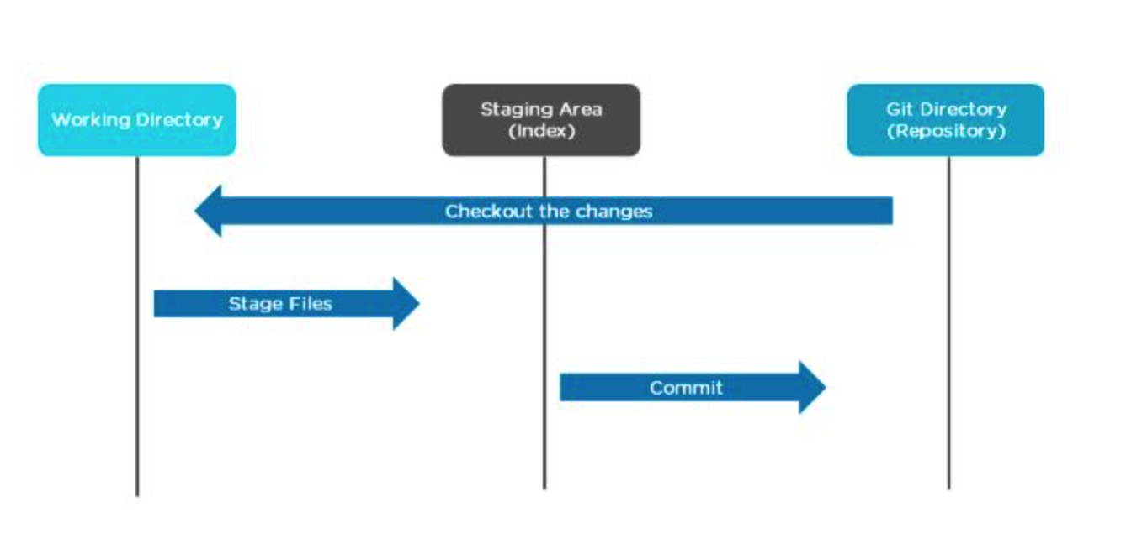
Git Workflow
The Git workflow is divided into three states:
Working directory - Modify files in your working directory
Staging area (Index) - Stage the files and add snapshots of them to your staging area
Git directory (Repository) - Perform a commit that stores the snapshots permanently to your Git directory. Checkout any existing version, make changes, stage them and commit.

Slide 5
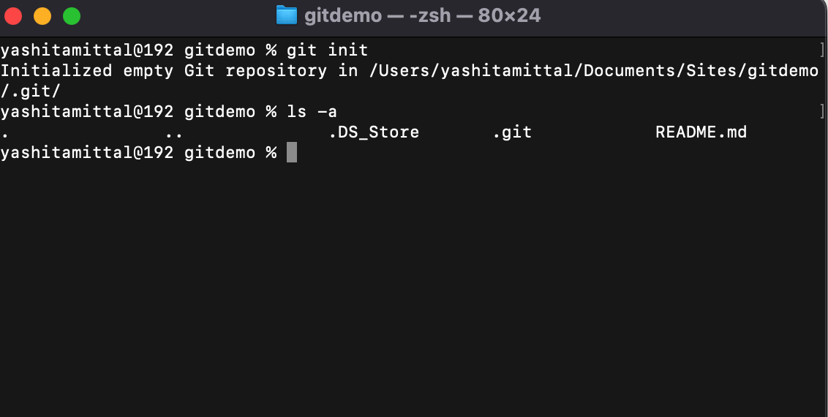
What is a Git Repository?
The repository is the .git folder inside our project folder. It will track all the changes made to the files in our project and record that history over time.
How to Create a Git Repository
Once we are in our project folder, in order to start using Git we will need to create (or initialize) a repository using the git init command.
Once we execute the command by typing it in the terminal and pressing enter, it will probably seem like not much happened. But don’t be deceived, Git can be sneaky sometimes and it carries out a lot of actions behind the scenes.
In order to see what Git did behind the scenes we will have to view our hidden files. Make sure to open your project folder in your file system. Then, if you are on a mac you can select Command + Shift + Dot in order to see hidden files in your file system. If you are on a windows OS then you can change your view settings in order to view hidden files in your file system.
In order to view hidden files in the terminal we can use the command ls -a.
What we should see now is a .git folder inside our project folder. This is generally what represents our repository.

Slide 6
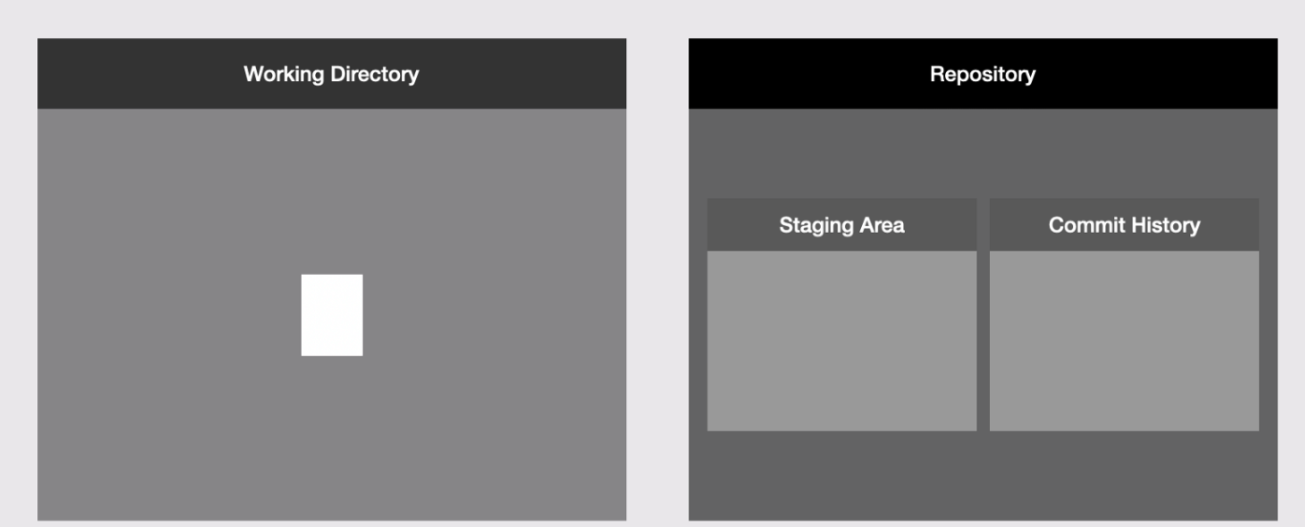
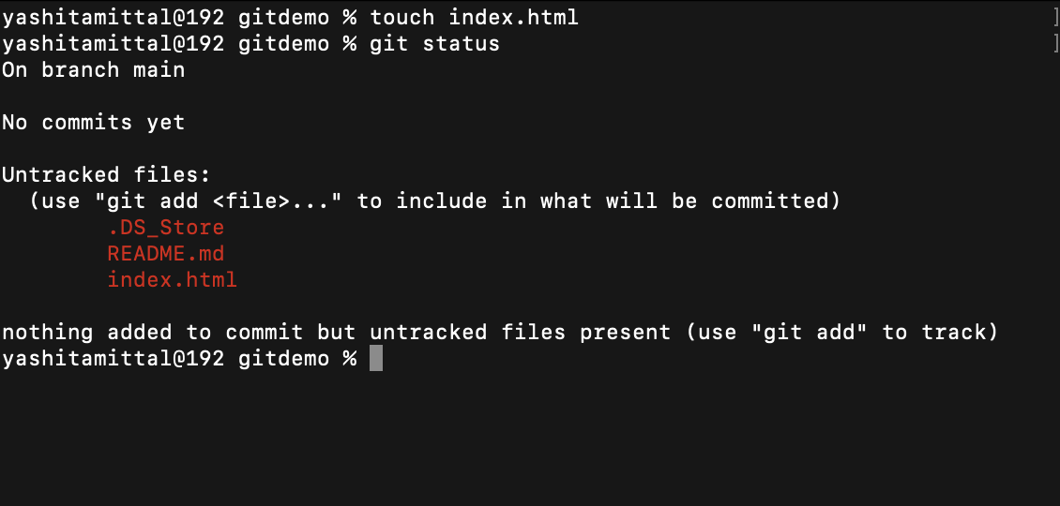
How Do I Make a Commit in Git?
Step 1 — Edit Files
1. If you have a new project, you will create the very first file in your new project. In our gitdemo project folder we will make a simple text file called index.html. We can either do this using a text editor or directly in the terminal. In our example we do it directly in the terminal by typing touch index.html.
If you have an existing project then you will edit some of your existing files, add new files, or delete files.
2. Next, we can use the git status command. This command will tell us the state of our working directory and staging area and will tell us if there are any differences between the two.
Our file is in the working directory
In our example, we added just one new file to our new project and we have another untracked file. When we use the git status command, Git tells us that we have an untracked file in our working directory and that we need to use the git add command to include it in what will be committed. Which takes us to step 2.

Slide 7
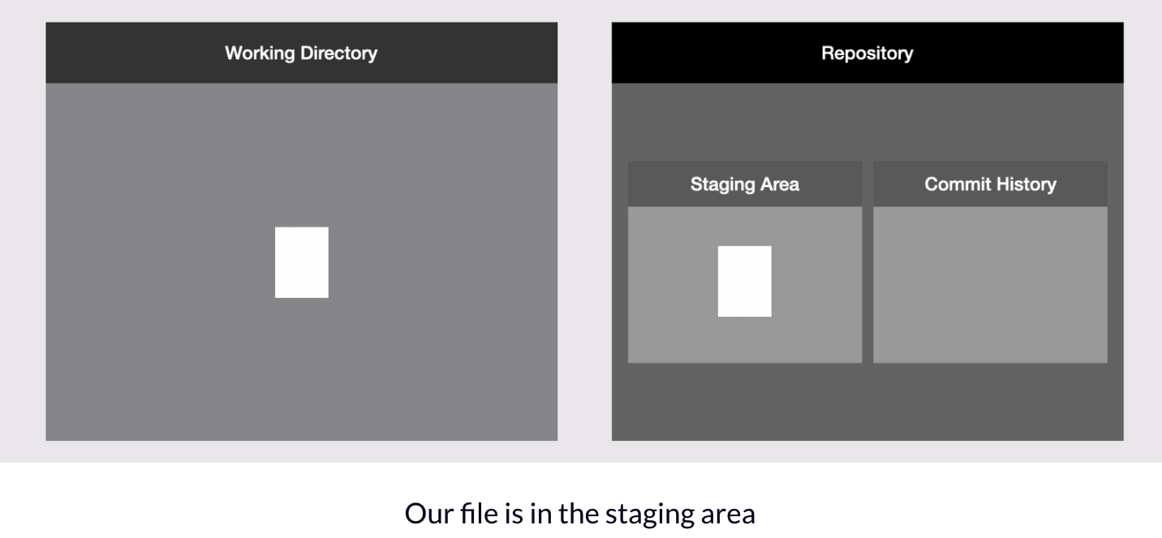
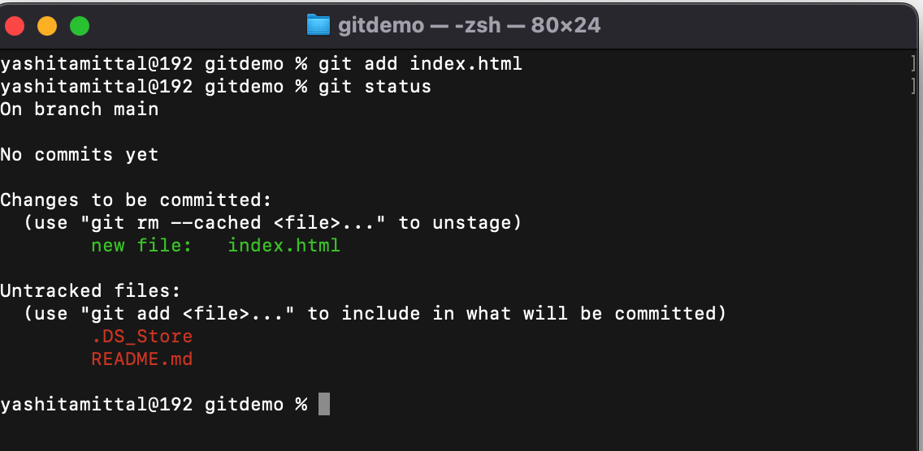
Step 2 — Add Files to the Staging Area
- We can use the git add command in order to add new or updated files to the staging area. If we decide we don’t want to include some of the files we changed in our next commit then we simply make sure not to add those particular files to the staging area.
In our example, we add the index.html file in our project to the staging area using the git add command and passing in the name of the file. Then if we use the git status command we will see that Git will tell us that we have added our file to the staging area.

Slide 8
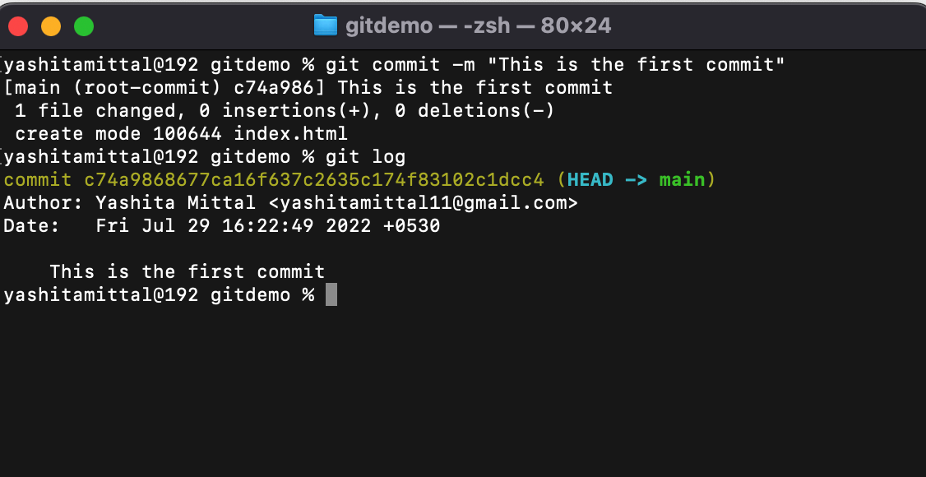
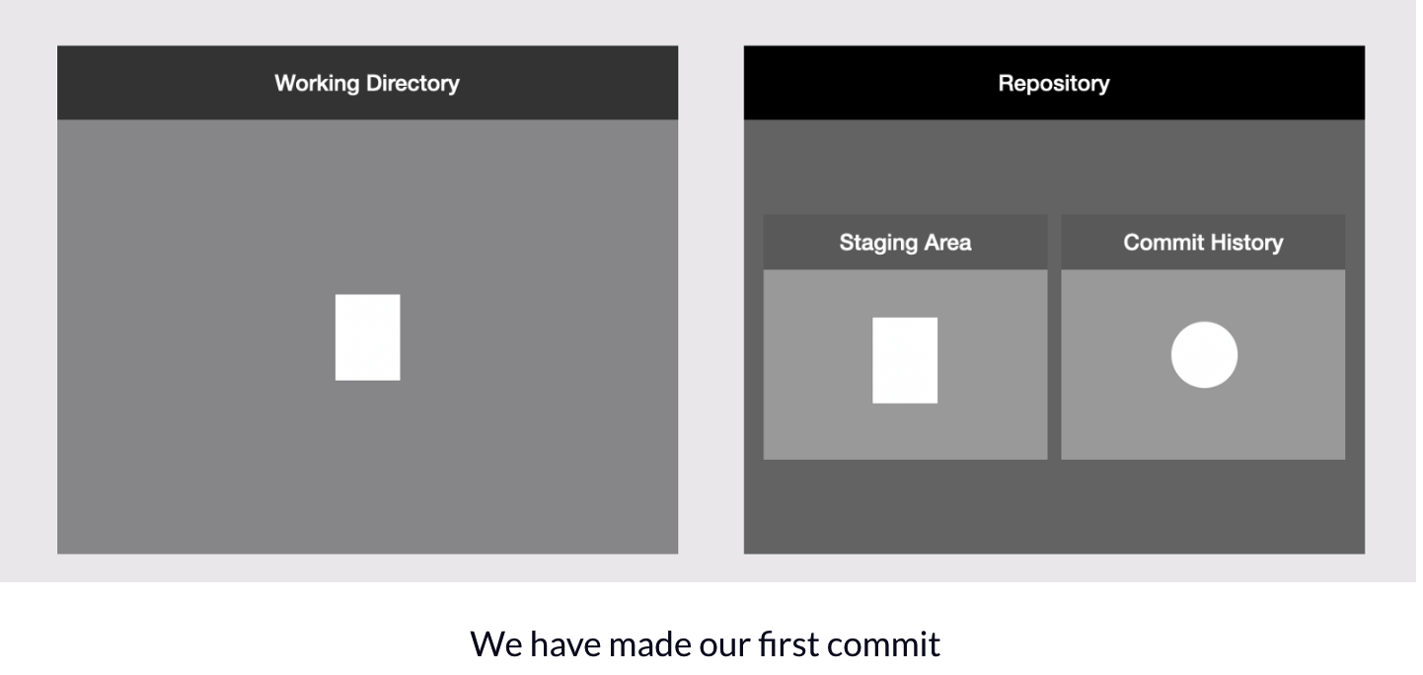
Step 3 — Make the Commit
Finally, to make the commit we use the git commit command with -m option and pass in a commit message, for example git commit -m "This is the first commit".
We can then use the git log command in order to list all the commits we have in our project in reverse chronological order. In our example we only have one commit.

Slide 9
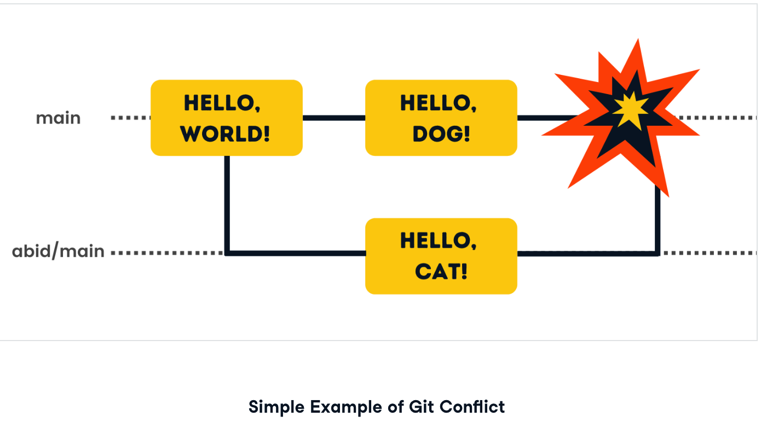
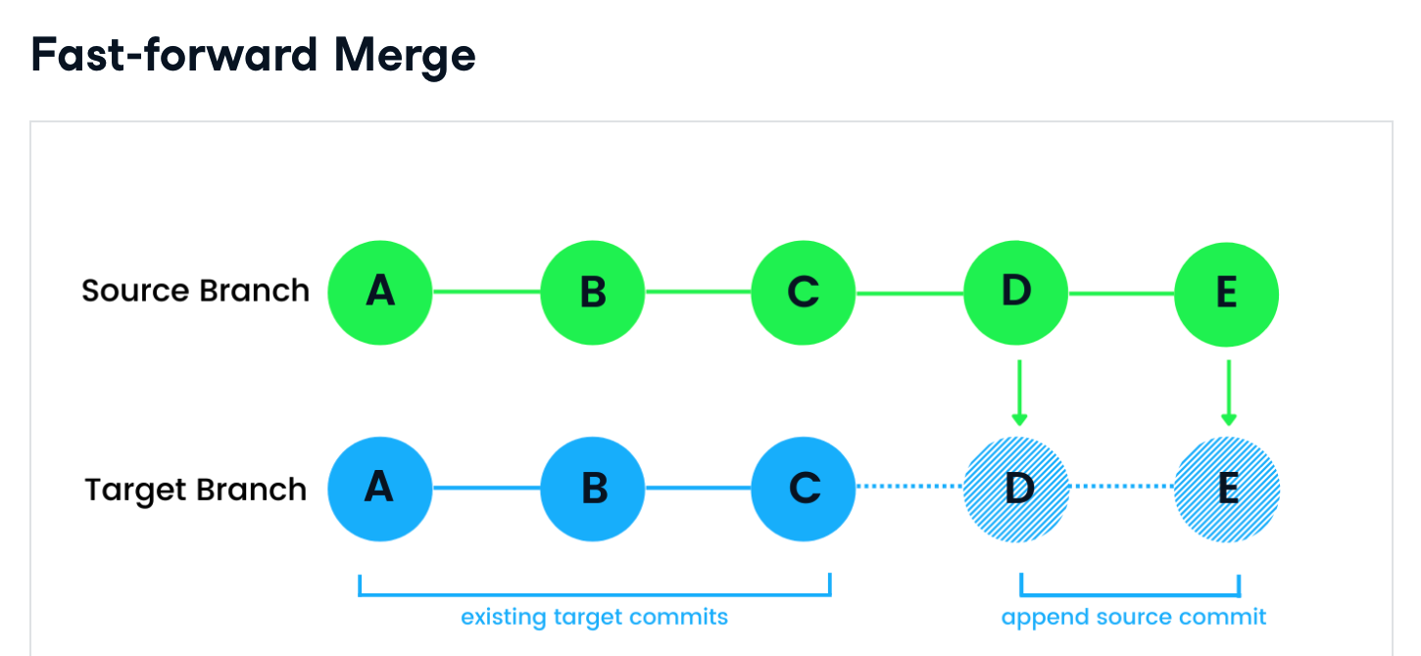
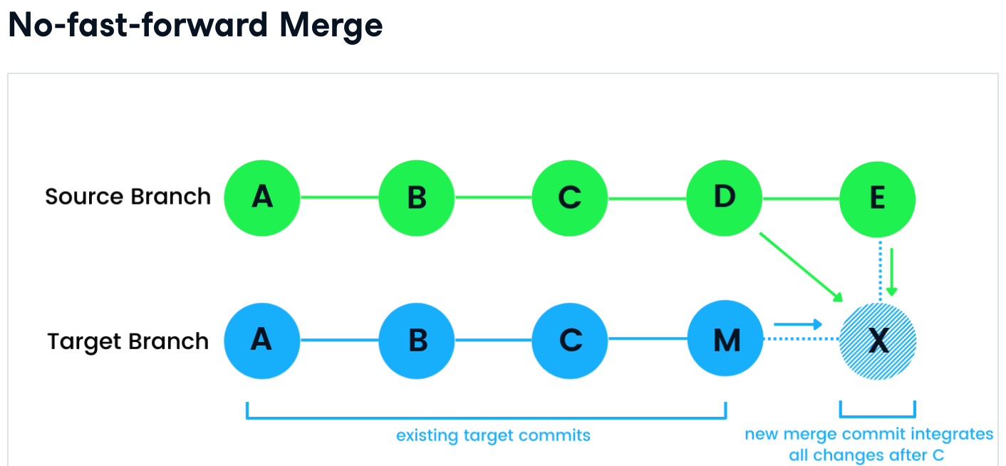
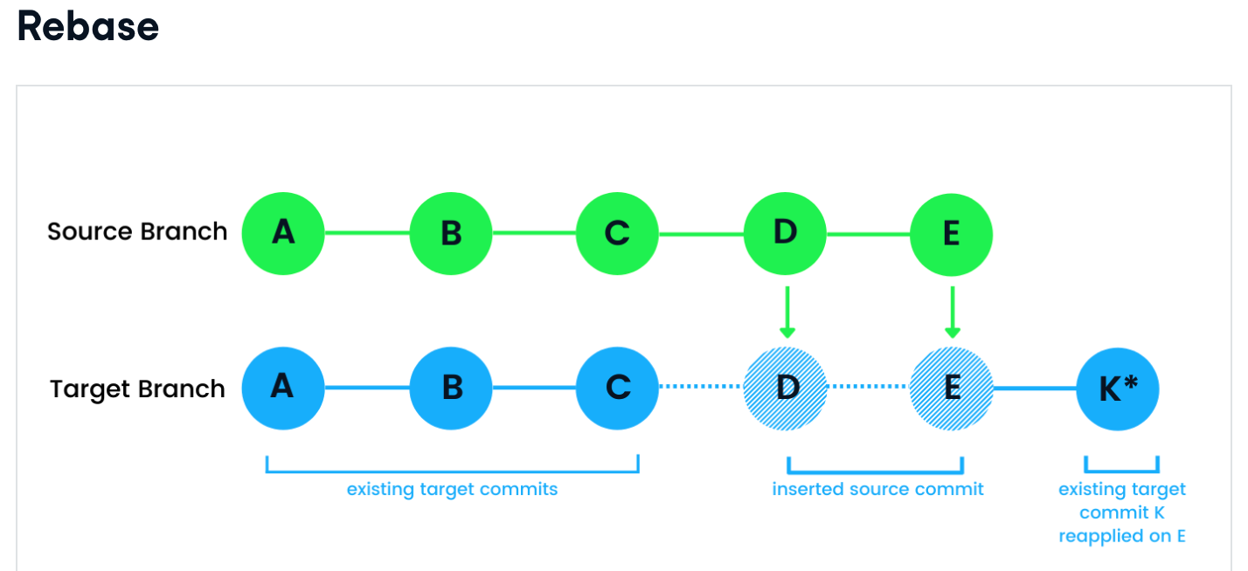
What is a Git Merge?
Sometimes multiple developers are working on the same line of code, and when they try to merge the changes, conflicts arise.
Merge types
By default, Git merge uses fast-forward to integrate missing commits into the target branch. For example, it is used to update the local branch from a remote server using the pull command. Fast-forward does not raise merge conflict issues as Git will not apply it if the head of the target branch is missing in the source branch.
A no-fast-forward merge is also called a three-way or true merge. It creates a new commit on a target branch by integrating changes in both the source and target branch. The changes are blended after the last common commit in both branches. In our case, it is after the C. This type of merge will prompt Git merge conflict if the source branch is in dispute with the target branch.
Git rebase is a bit different from other types. It changes the sequence of target branch commit history. The rebase integrates the source branch in such a way that the target branch contains all the changes from the source branch, followed by all target branch commits after the last common commit.

Slide 10
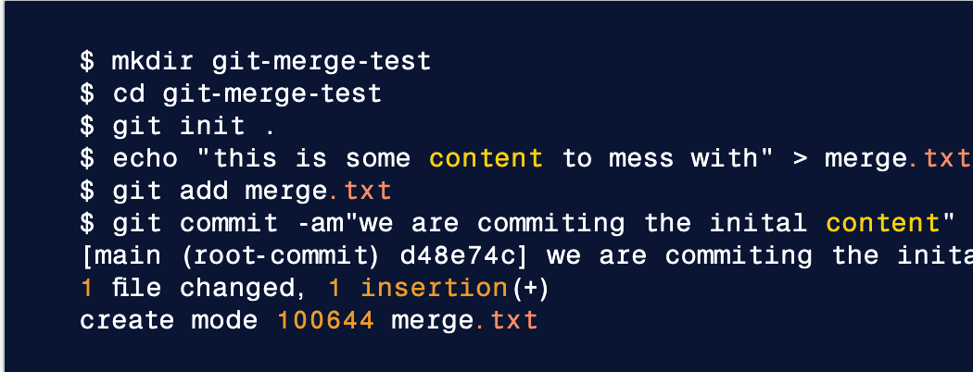
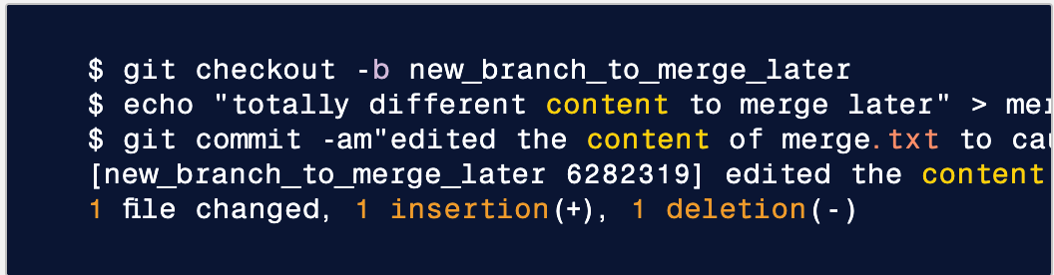
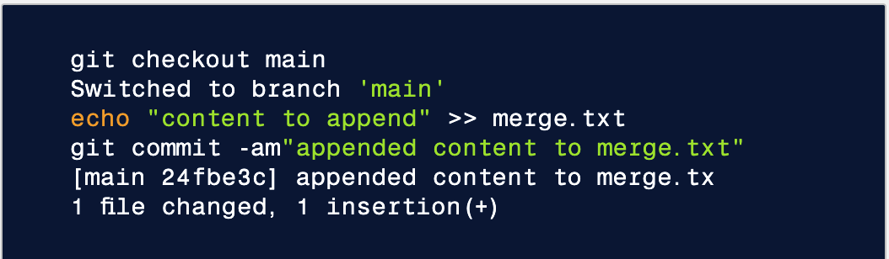
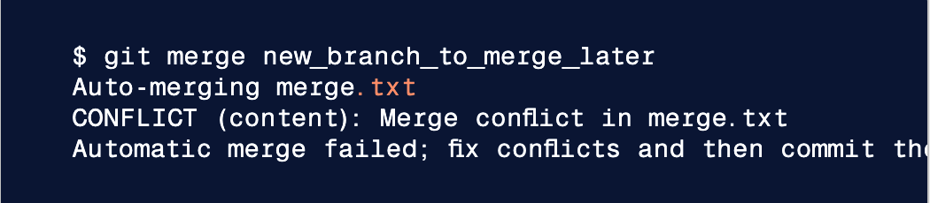
Creating a merge conflict
This code example executes a sequence of commands that accomplish the following. - Create a new directory named git-merge-test, change to that directory, and initialize it as a new Git repo. - Create a new text file merge.txt with some content in it. - Add merge.txt to the repo and commit it. Now we have a new repo with one branch main and a file merge.txt with content in it. Next, we will create a new branch to use as the conflicting merge.
This command sequence achieves the following:
create and check out a new branch named new_branch_to_merge_later
overwrite the content in merge.txt
commit the new content With this new branch: new_branch_to_merge_later we have created a commit that overrides the content of merge.txt
This chain of commands checks out the main branch, appends content to merge.txt, and commits it. This now puts our example repo in a state where we have 2 new commits. One in the main branch and one in the new_branch_to_merge_later branch. At this time lets git merge new_branch_to_merge_later and see what happen!
BOOM 💥. A conflict appears. Thanks, Git for letting us know about this!

Slide 11
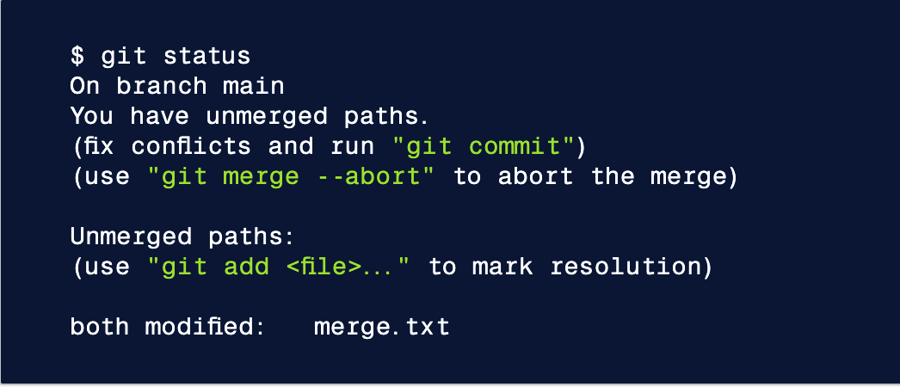
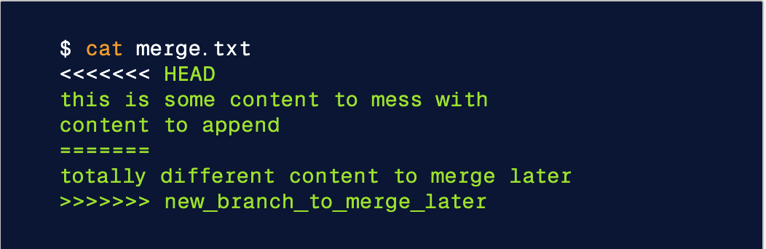
How to identify merge conflicts
As we have experienced from the proceeding example, Git will produce some descriptive output letting us know that a CONFLICT has occured. We can gain further insight by running the git status command
The output from git status indicates that there are unmerged paths due to a conflict. The merge.text file now appears in a modified state. Let's examine the file and see whats modified.
Here we have used the cat command to put out the contents of the merge.txt file. We can see some strange new additions
<<<<<<< HEAD
=======
>>>>>>> new_branch_to_merge_later
Think of these new lines as "conflict dividers". The ======= line is the "center" of the conflict. All the content between the center and the <<<<<<< HEAD line is content that exists in the current branch main which the HEAD ref is pointing to. Alternatively all content between the center and >>>>>>> new_branch_to_merge_later is content that is present in our merging branch.

Slide 12

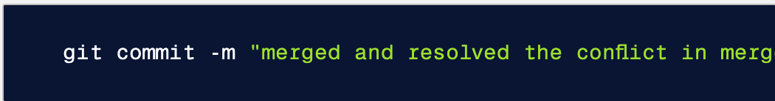
How to resolve conflicts using the command line
The most direct way to resolve a merge conflict is to edit the conflicted file. Open the merge.txt file in your favorite editor. For our example lets simply remove all the conflict dividers. The modified merge.txt content should then look like:
Once the file has been edited use git add merge.txt to stage the new merged content. To finalize the merge create a new commit by executing:
Git will see that the conflict has been resolved and creates a new merge commit to finalize the merge.

Slide 13
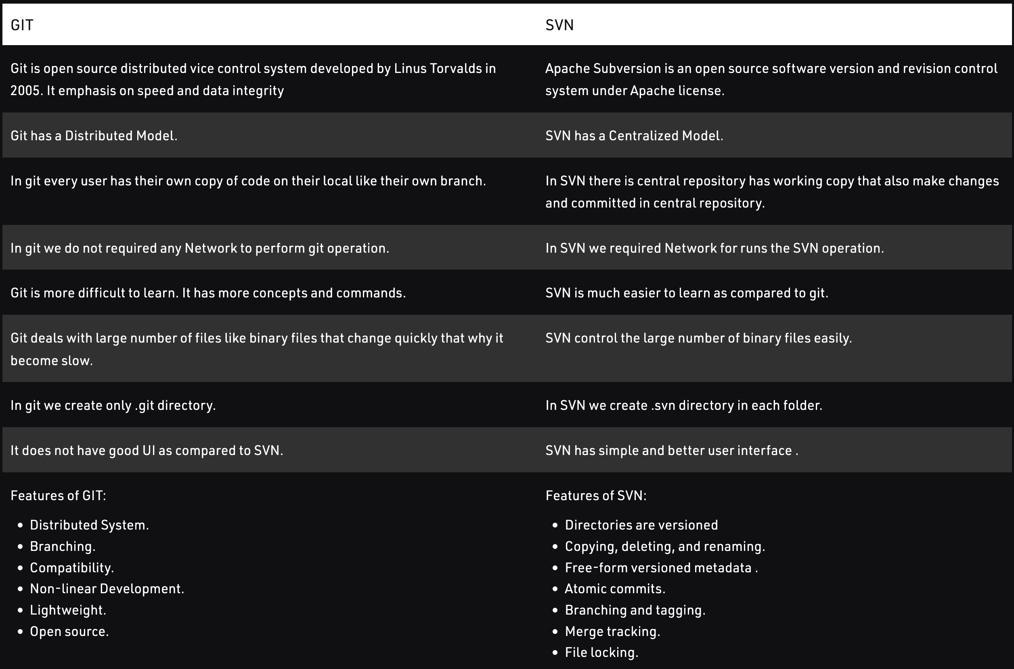
How it GIT different from Subversion(SVN)
GIT: Git is an open-source distributed version control system developed by Linus Torvalds in 2005. It is powerful and cheap branching with easy merge in which each developer has his repository and have a local copy in which they can change history. It supports non-linear development branches and applications with a large number of codes files.
SVN: Apache Subversion is an open-source software version and revision control system under the Apache license. It managed files and folders that are present in the repository. It can operate across the network, which allows it and used by people on different computer .we can say that a repository is like an ordinary file server which allows it to be used by people on a different computer.

Slide 14
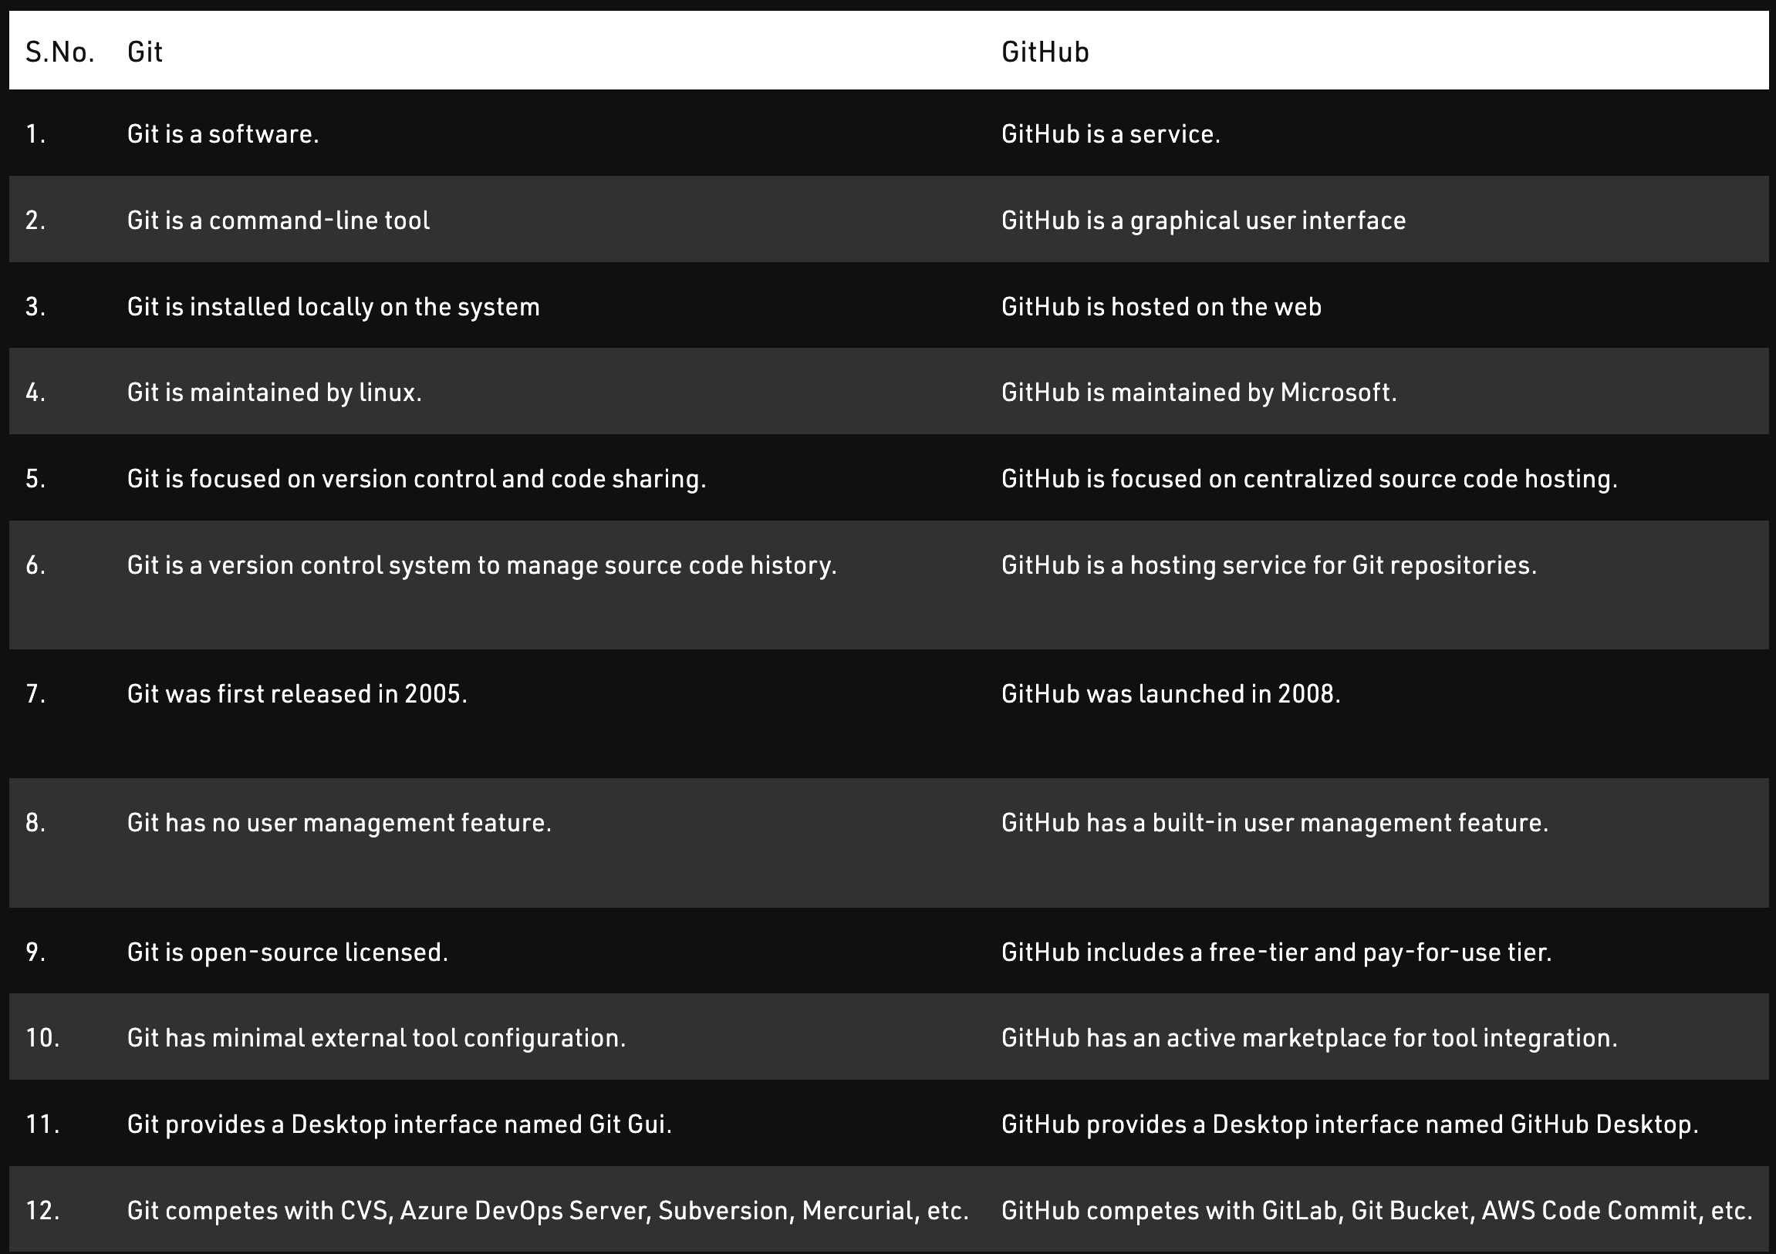
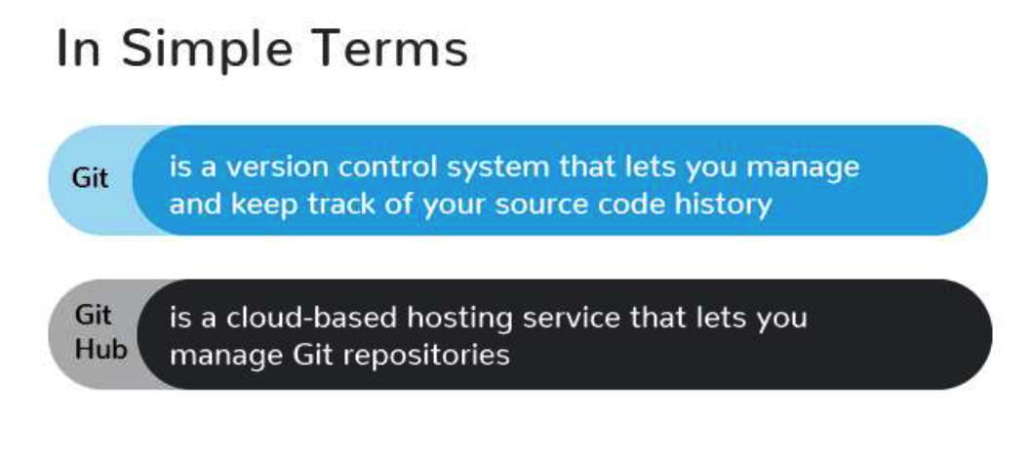
Git vs. GitHub in Simple Terms

Slide 15
Thank You!!

