Slide 1
Deep Learning-Based Defect Detection and Localization in Steel Surface Images
Rusty Johnston – ECEN 5743 final project – Spring ‘26

Slide 2


Motivation
Magnetic Flux Leakage (MFL) used for pipeline defect detection
Produces grayscale “field maps” of material anomalies
Requires:
Defect detection
Defect localization

Slide 3
Project Analogies
Steel surface images ≈ MFL signal maps
Defects appear as spatial patterns in grayscale data
Similar ML task:
Identify presence of defects
Locate defect regions

Slide 4
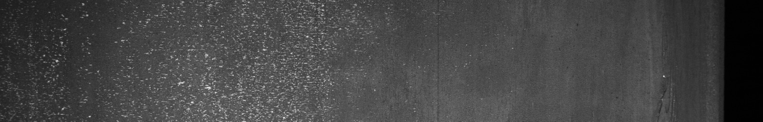
Dataset: Severstal Steel Defect Detection
Kaggle competition dataset
High-resolution grayscale steel surface images
Pixel-level defect annotations (RLE encoded masks)
4 defect classes + non-defective images

Slide 5
Approach Overview
Step 1: Binary classification (CNN)
Step 2: Multiclass segmentation (U-Net, 4 classes)
Step 3: Binary segmentation (U-Net, defect vs background)
Framework:
PyTorch
GPU: NVIDIA A10G

Slide 6
Classification Model
Input: 128 x 128 grayscale images
CNN architecture
Output: defect / no defect
Metric: F1 score
Results:
F1= 0.82
Accuracy = 0.80

Slide 7
MULTICLASS SEGMENTATION (U-NET)
Output: 4-channel mask (one per defect class)
Loss: BCEWithLogitsLoss
Metric: Dice Coefficient
Issues:
Severe class imbalance
Sparse defect regions
Results:
Dice = 0.32

Slide 8
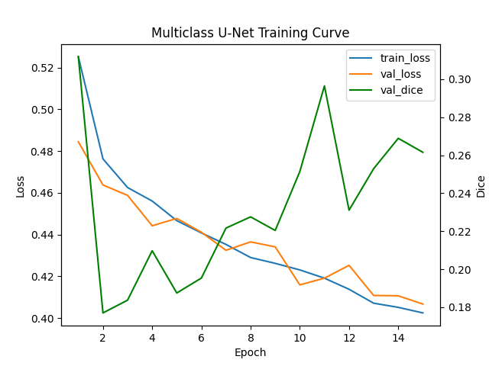
Multiclass Training Behavior
Loss decreases steadily
Dice climbs some but fluctuates and remains low
Indication of difficulty learning class-specific masks

Slide 9
Binary SEGMENTATION (U-NET)
Output: 1-channel mask (defect vs background)
Loss: BCEWithLogitsLoss
Metric: Dice Coefficient
Advantages:
Reduced class imbalance
Stronger learning signal from combined defect regions
Better alignment with detection objective
Results:
Dice = 0.56

Slide 10
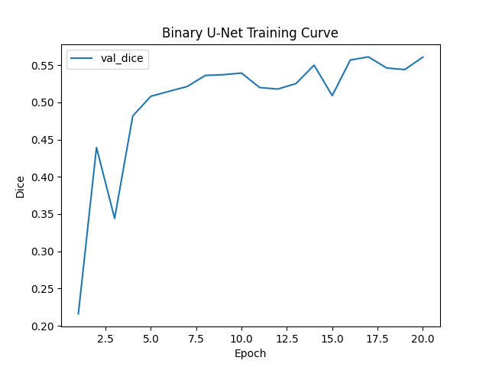
Binary Training Behavior
Rapid early improvement
Stable convergence around 0.55
Much better learning signal

Slide 11
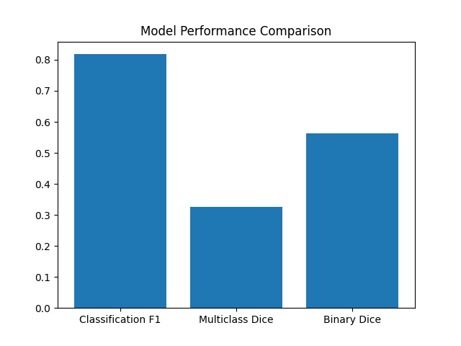
Results comparison
Classification using CNN performs well with minimal adjustments
Multiclass segmentation struggles
Binary segmentation significantly improves target metric performance
Important to distinguish target metric performance vs. problem solution

Slide 12
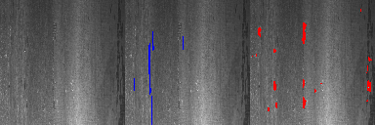
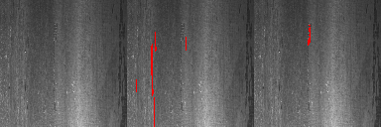
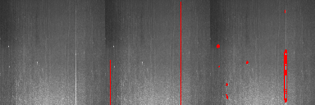
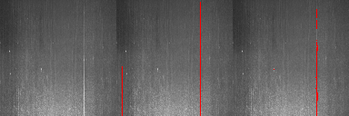
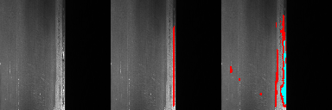
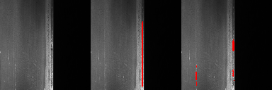


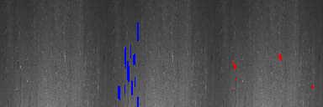

Multiclass VS BINARY EXAMPLES
Multiclass
Binary

Slide 13
Discussion: Trade offs in segmentation
Multiclass
binary
Takeaway
Advantages
Can distinguish classes
Limits
Class imbalance hurts performance
Sparse and inconsistent labels
Weak class-specific learning goal
Advantages
Stronger learning signal
Improved detection and spatial coherence
Higher metric performance
Limits
Cannot distinguish defect types
Higher dice does not imply a better overall solution
Model formulation must match end application

Slide 14
Conclusion
Two successful examples of detection and localization pipeline
Key metric improvement
Strong baseline for improvement for future project
Future work for improvement:
Data augmentation
High resolution inputs
Pretrained encoders
Multiclass strategies with improved class balancing

