Slide 1
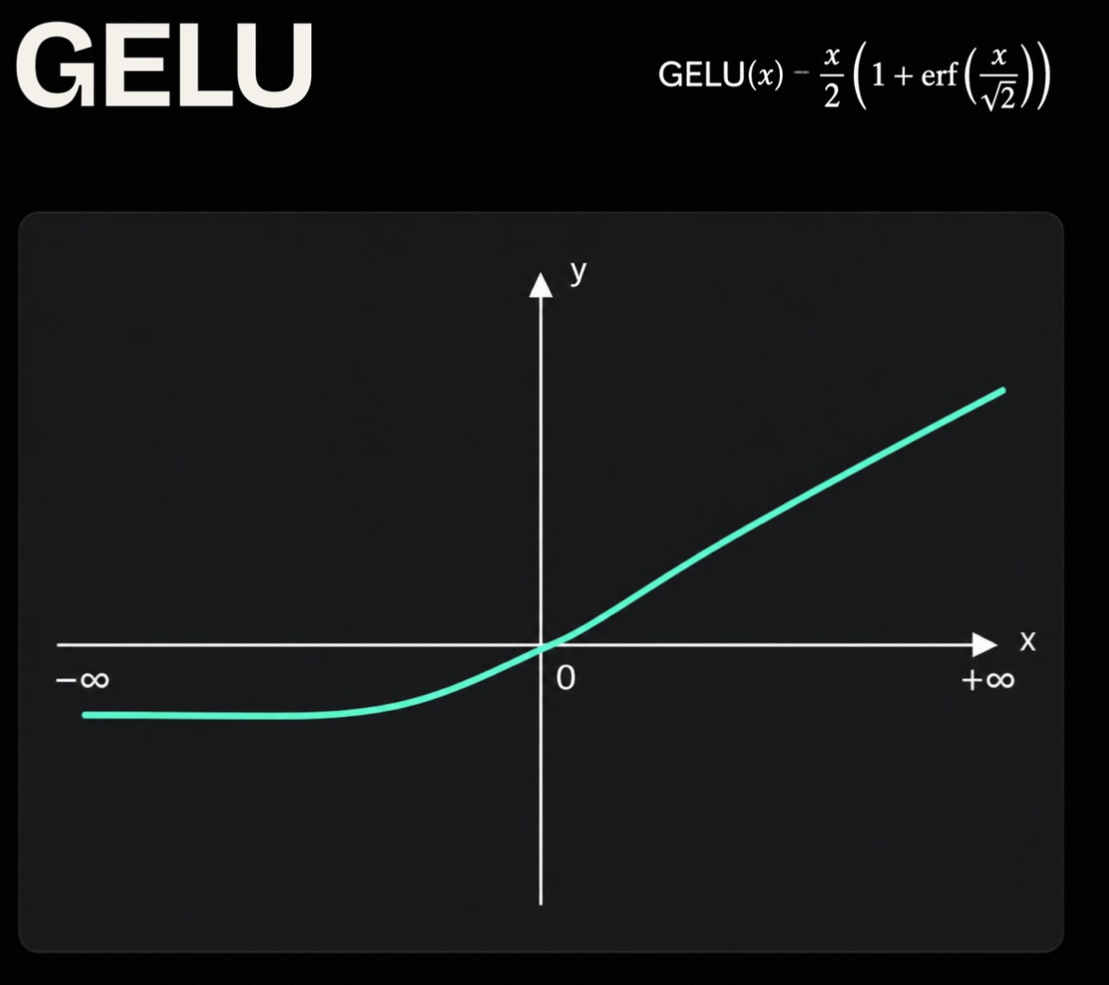
DATE 28.05.2026
SKILLAB INNOVATION CHALLENGE 2026
AN
anGeLU

Slide 2
TABLE OF CONTENTS
TABLE OF CONTENTS
PRODUCT OVERVIEW
1
2
3
4
5
6
7
8
9
Who We Are
Introduction
HealthCare
IT
Education
Green Energy
Tourism
General Analysis
Candidate Analysis

Slide 3
CYMBAL
PRODUCT OVERVIEW
WHO WE ARE
CYMBAL
PRODUCT OVERVIEW

Slide 4



Ian Stefan-Cazacu
Rus Vlad-Andrei
Razvan Stan
OUR STORY
WHO WE ARE

Slide 5
CYMBAL
PRODUCT OVERVIEW
Introduction:
CYMBAL
PRODUCT OVERVIEW

Slide 6
OUR VISION
INTRODUCTION
Introduction: How do we analyse the market?
Demand frequency: skill job count / max skill job count in domain
Supply frequency: skill profile count / max skill profile count in domain
Course frequency: skill course count / max skill course count in domain
Relevance index: 0.45 * demand + 0.25 * shortage + 0.2- * trend + 0.10 * course coverage

Slide 7
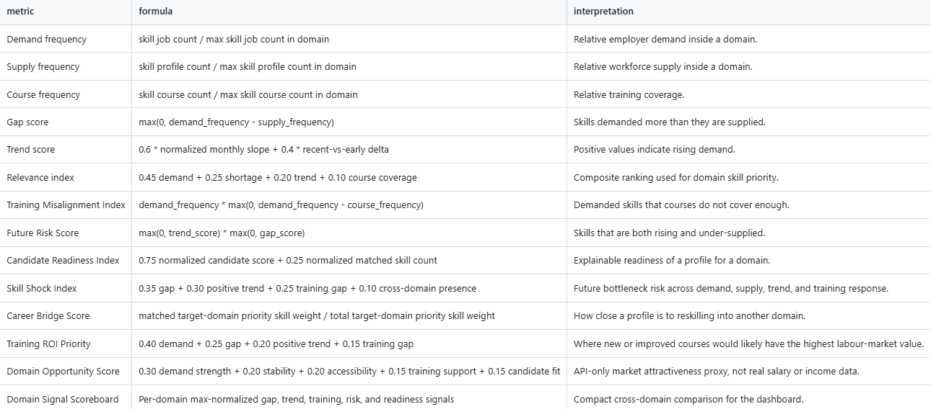

Slide 8
CYMBAL
PRODUCT OVERVIEW
HealthCare:

Slide 9
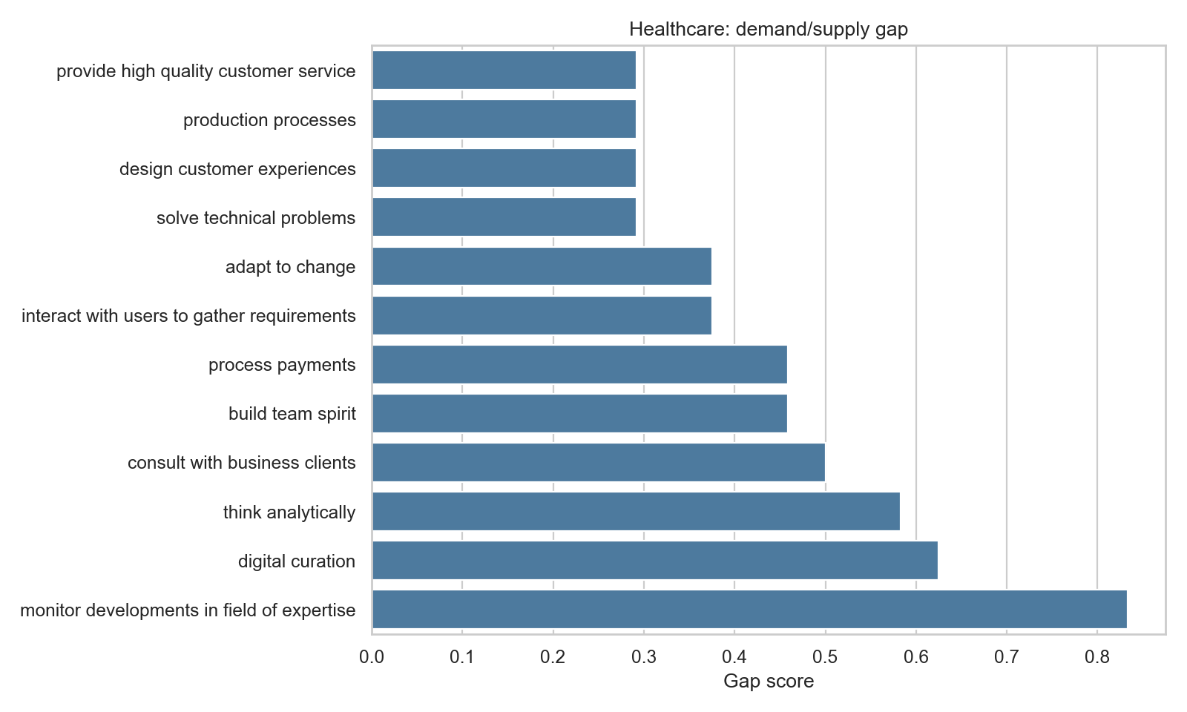
HealthCare: Demand/Supply Skill Gap

Slide 10
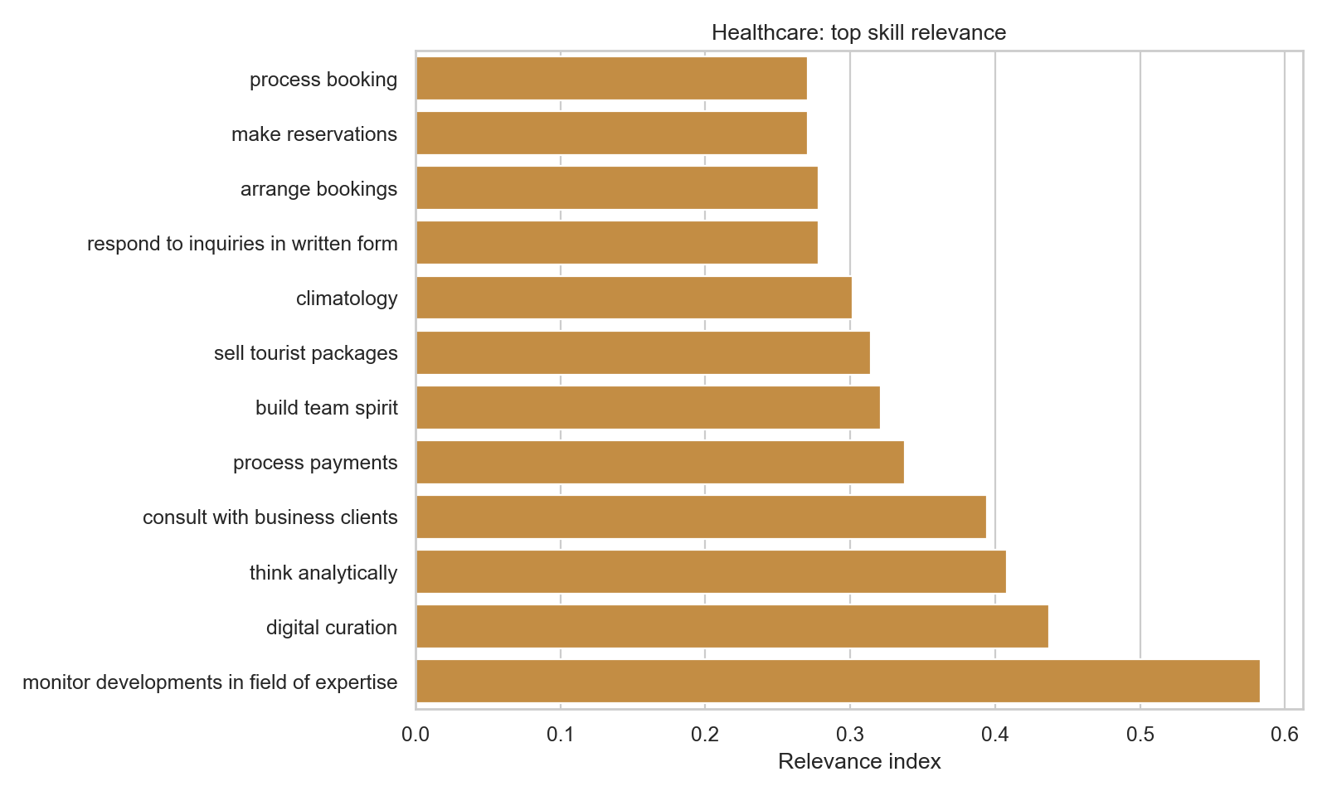
HealthCare: Skill Relevance

Slide 11
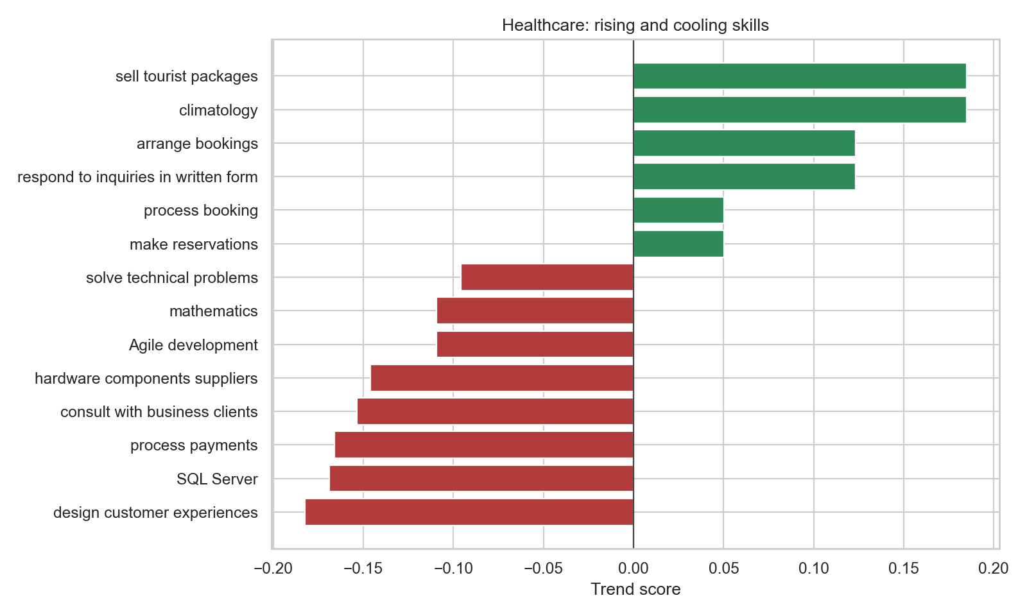
HealthCare: Rising and Cooling Skills

Slide 12
CYMBAL
PRODUCT OVERVIEW
IT:

Slide 13
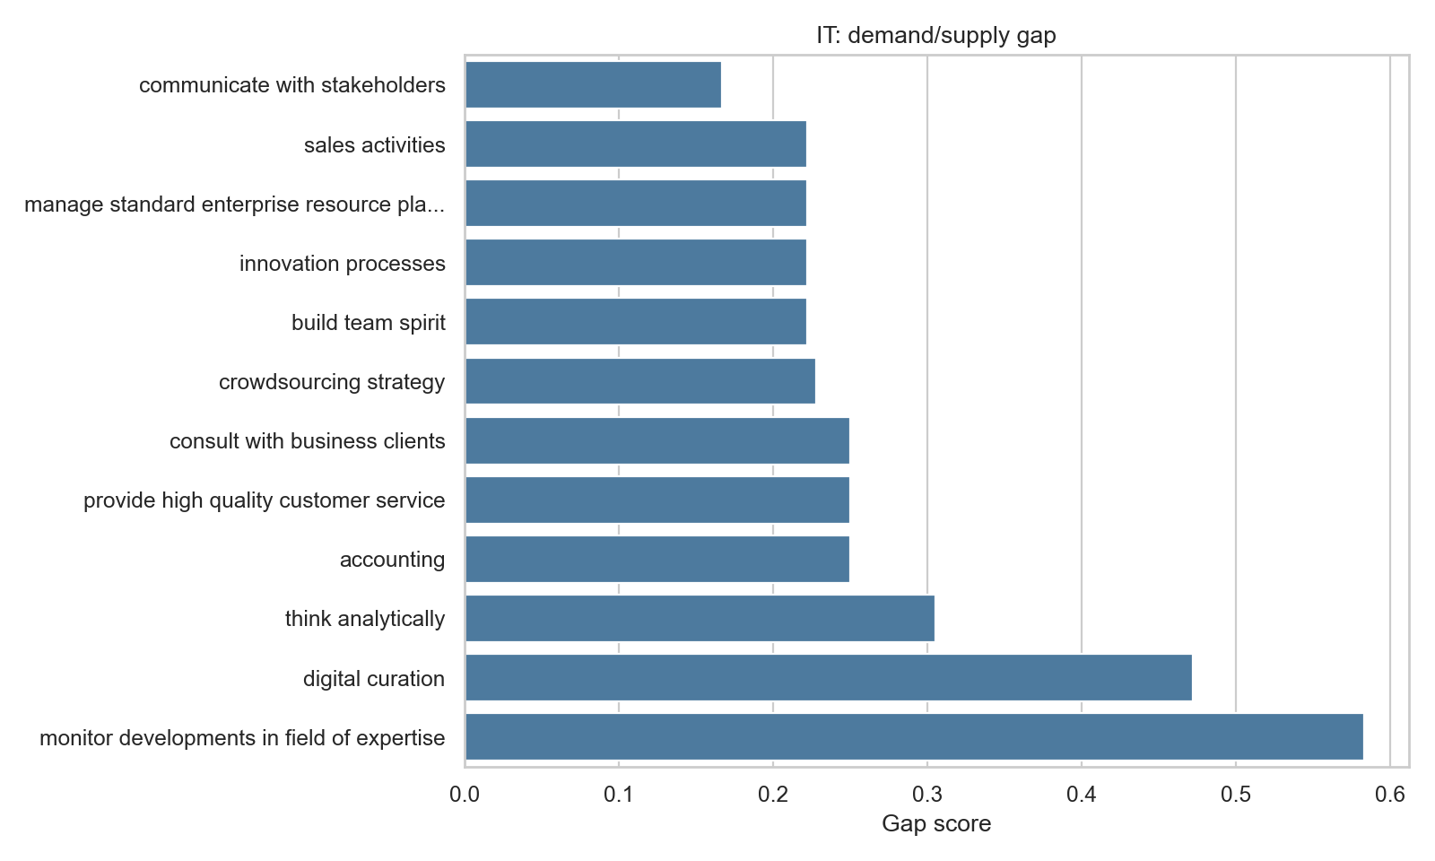
IT: Demand/Supply Skill Gap

Slide 14
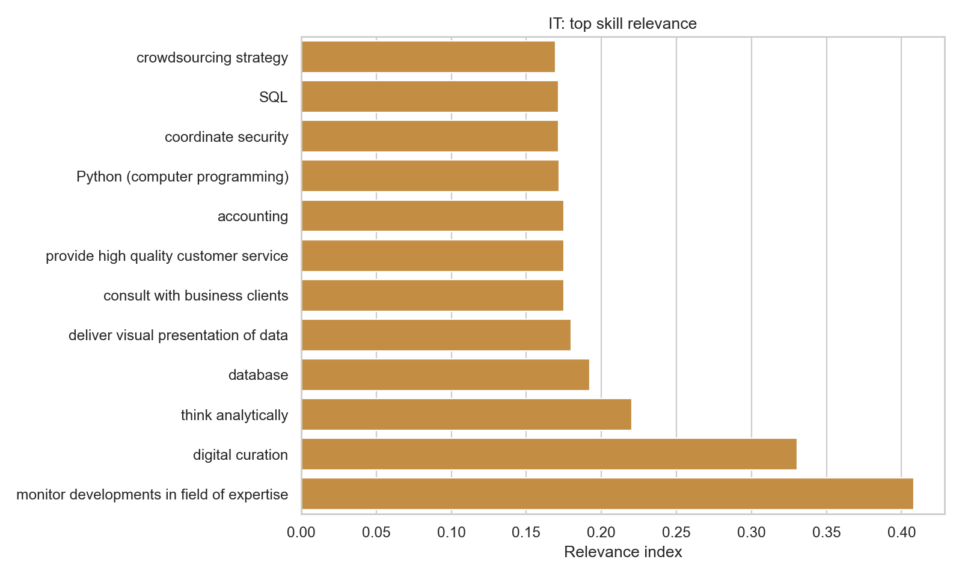
IT: Skill Relevance

Slide 15
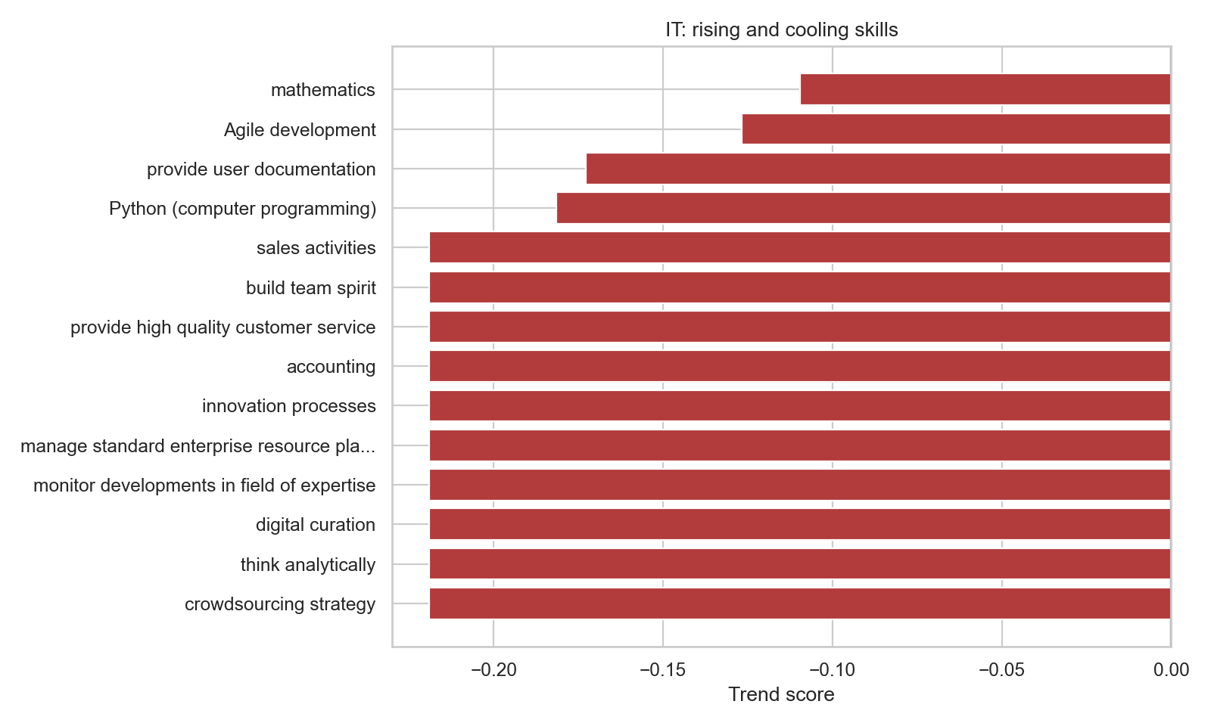
IT: Rising and Cooling Skills

Slide 16
CYMBAL
PRODUCT OVERVIEW
Education:

Slide 17
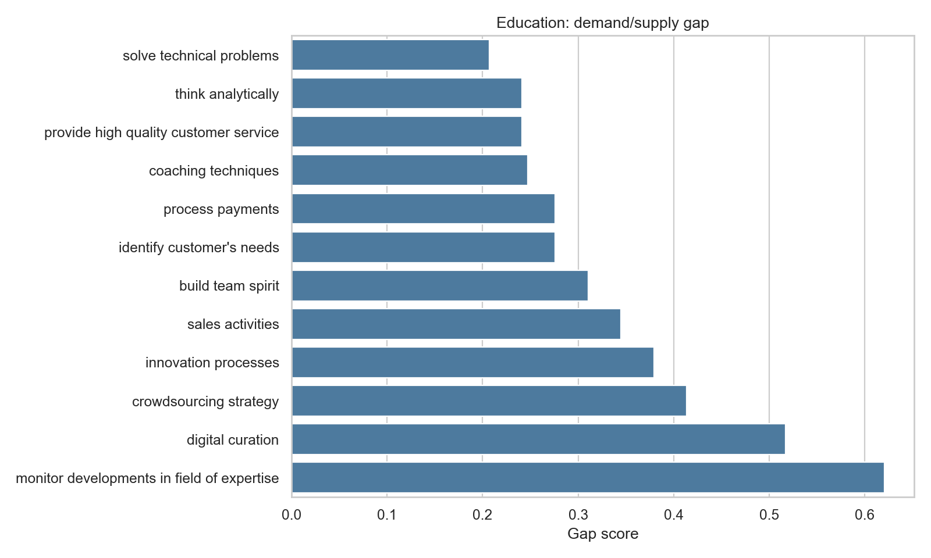
Education: Demand/Supply Skill Gap

Slide 18
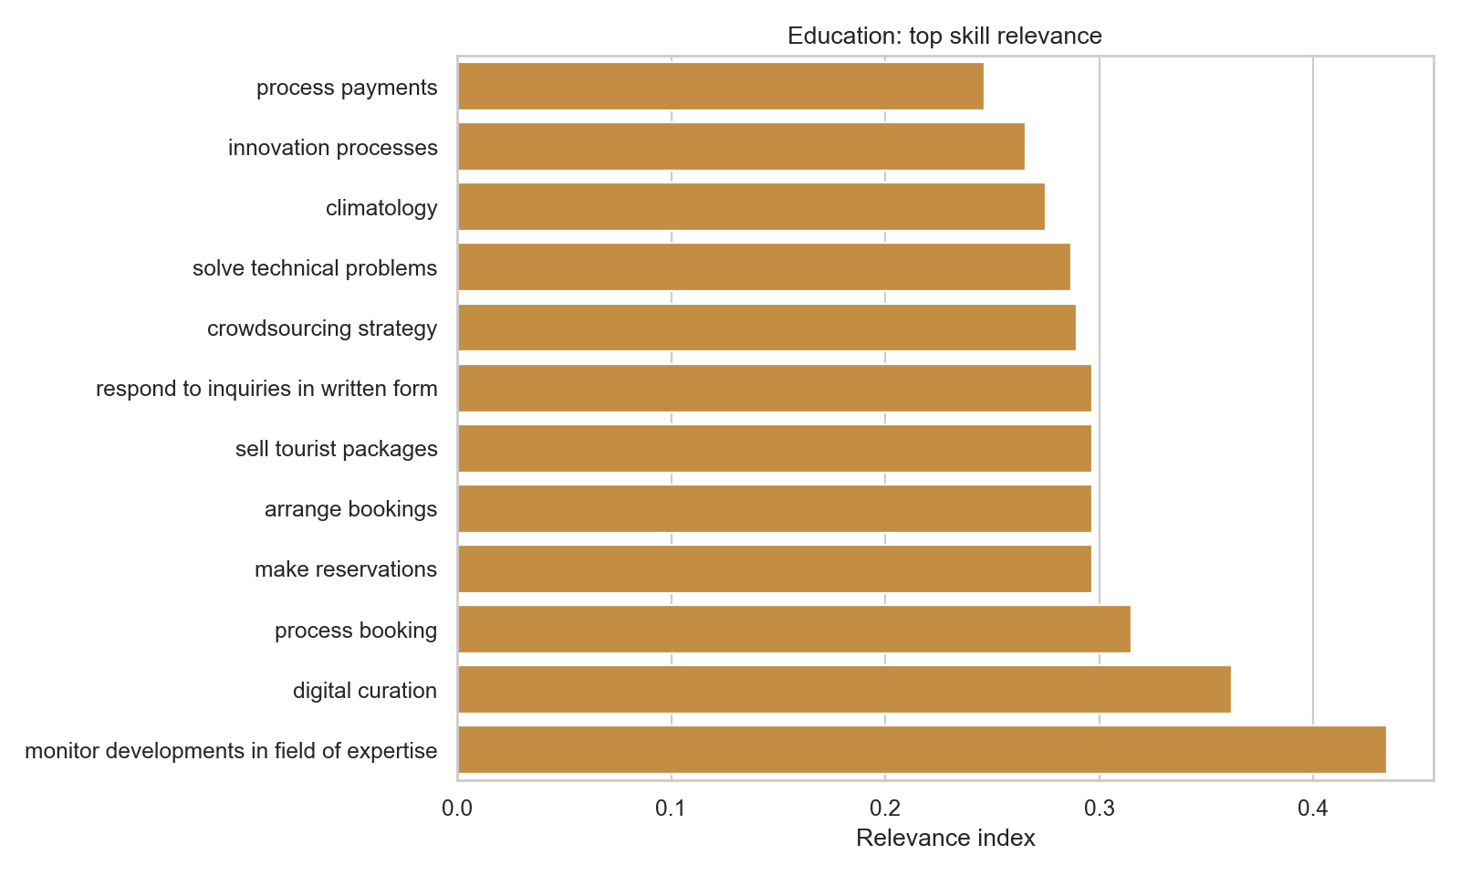
Education: Skill Relevance

Slide 19
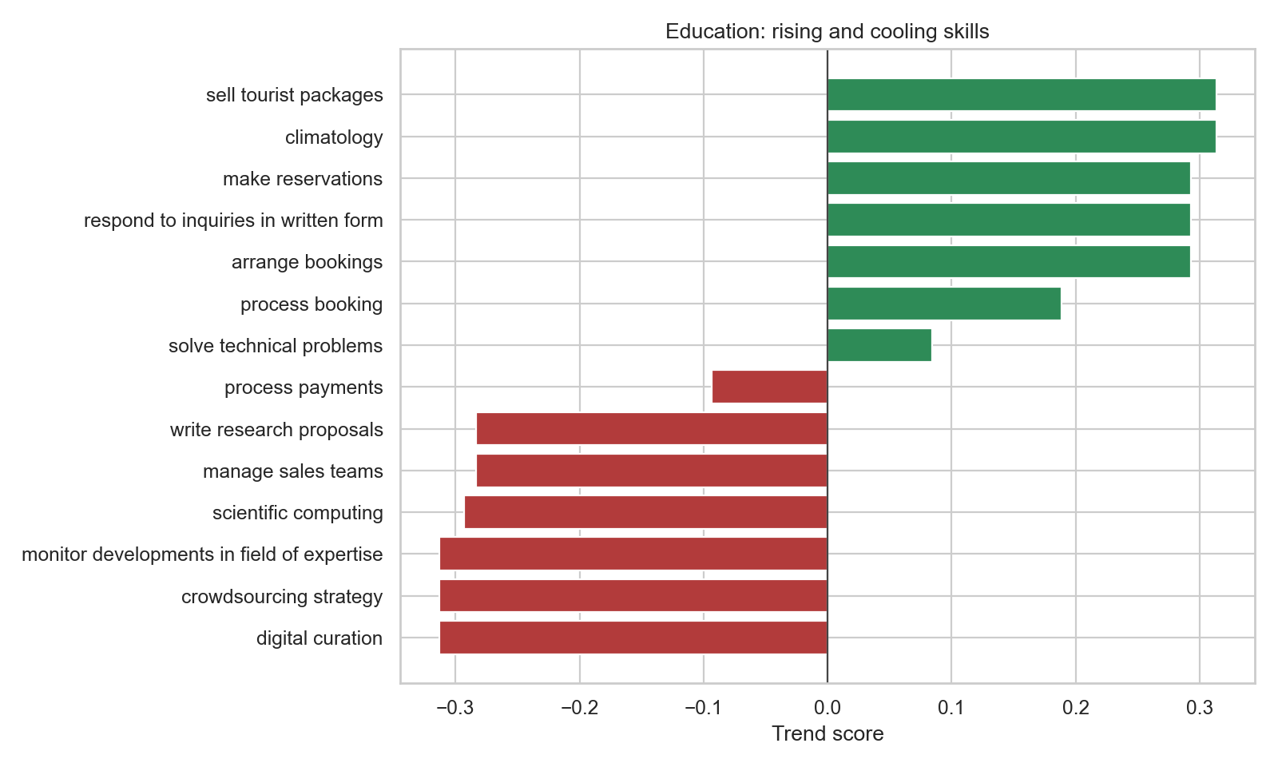
Education: Rising and Cooling Skills

Slide 20
CYMBAL
PRODUCT OVERVIEW
Green Energy:

Slide 21
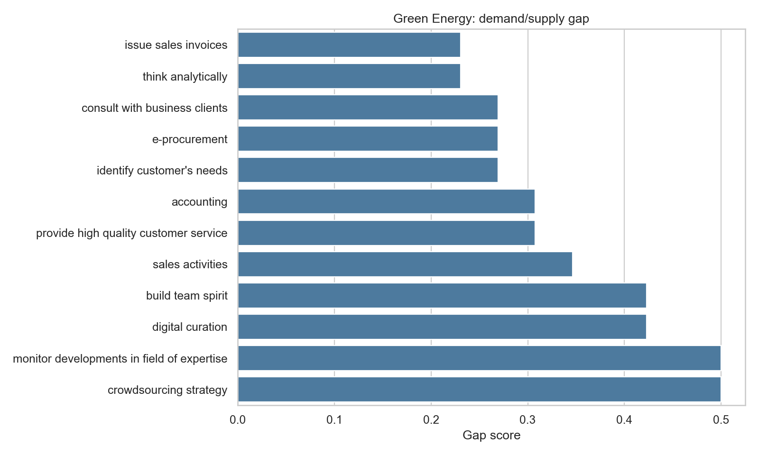
Green Energy: Demand/Supply Skill Gap

Slide 22
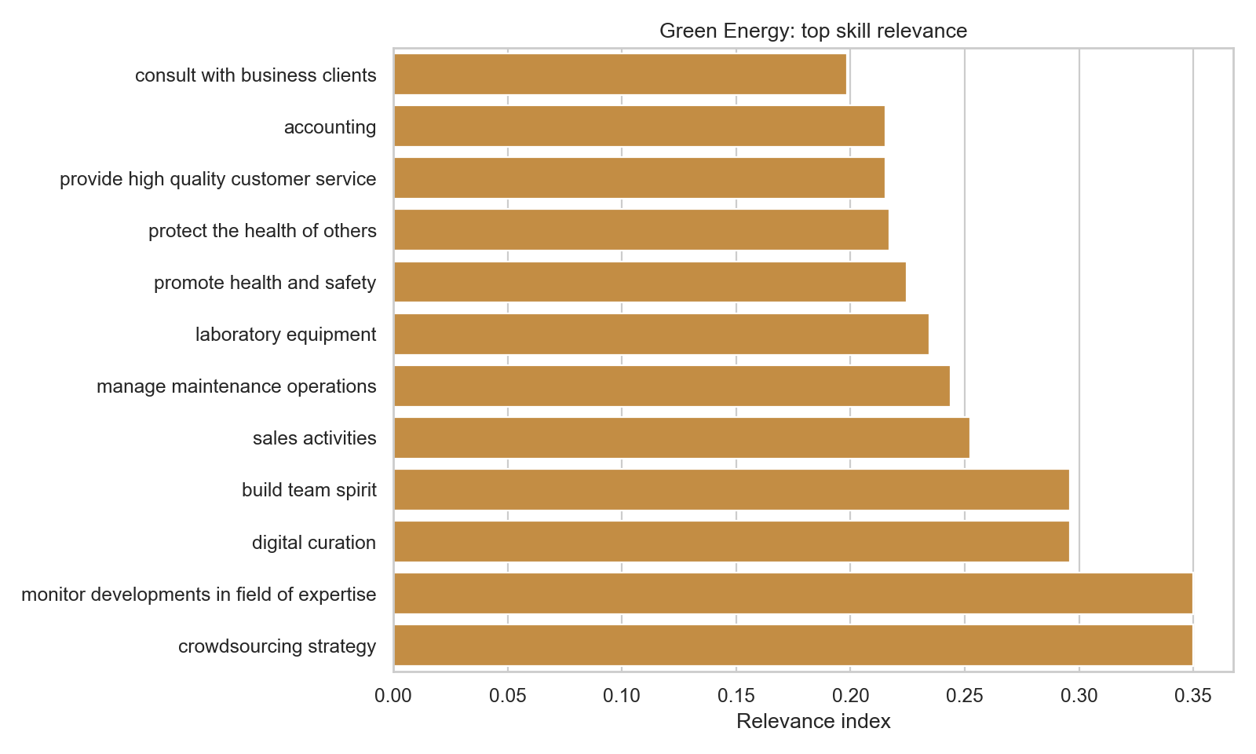
Green Energy: Skill Relevance

Slide 23
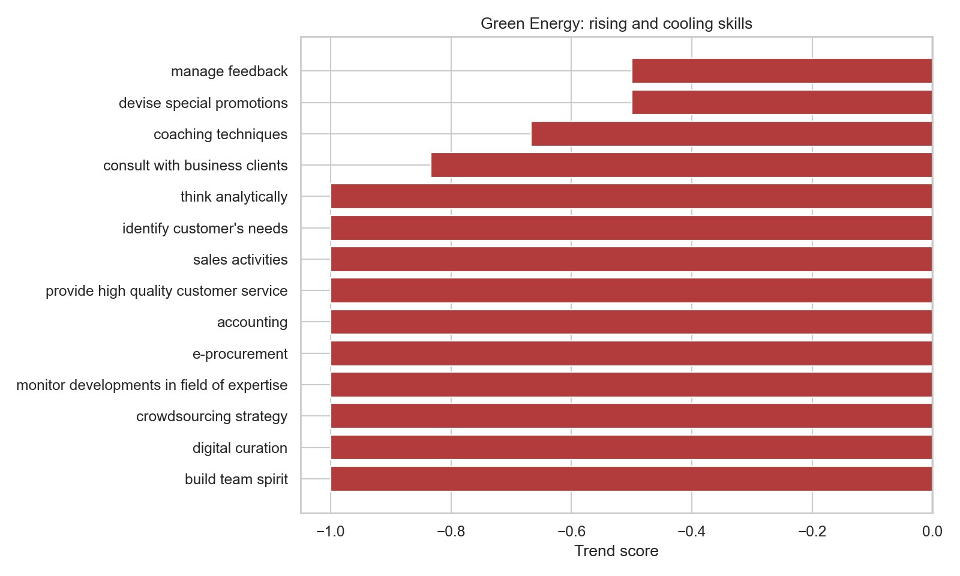
Green Energy: Rising and Cooling Skills

Slide 24
CYMBAL
PRODUCT OVERVIEW
Tourism:

Slide 25
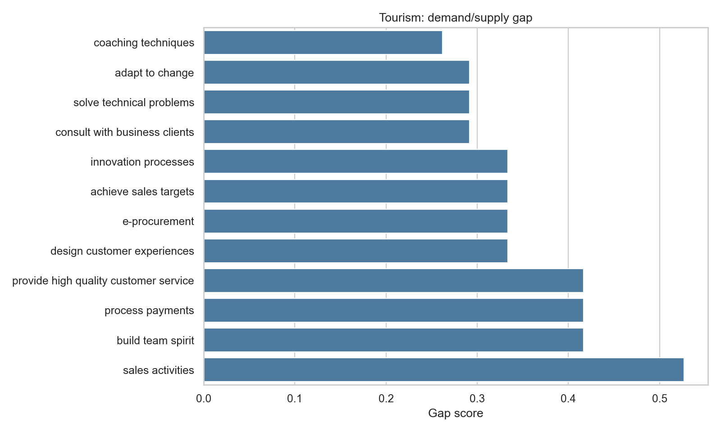
Tourism: Demand/Supply Skill Gap

Slide 26
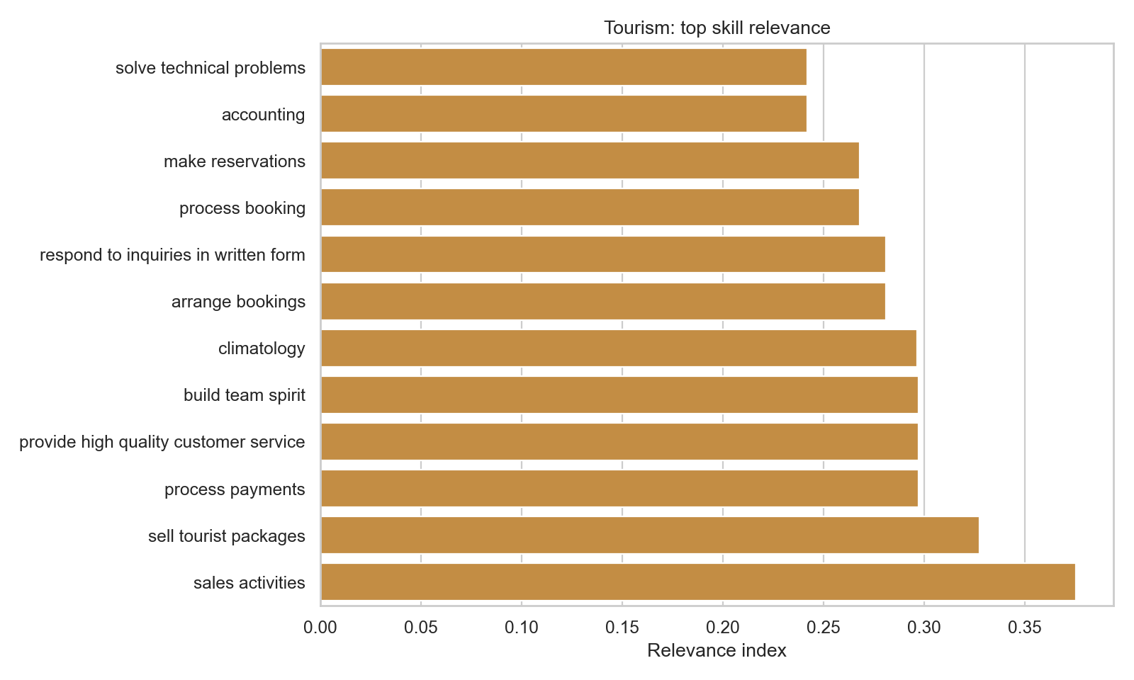
Tourism: Skill Relevance

Slide 27
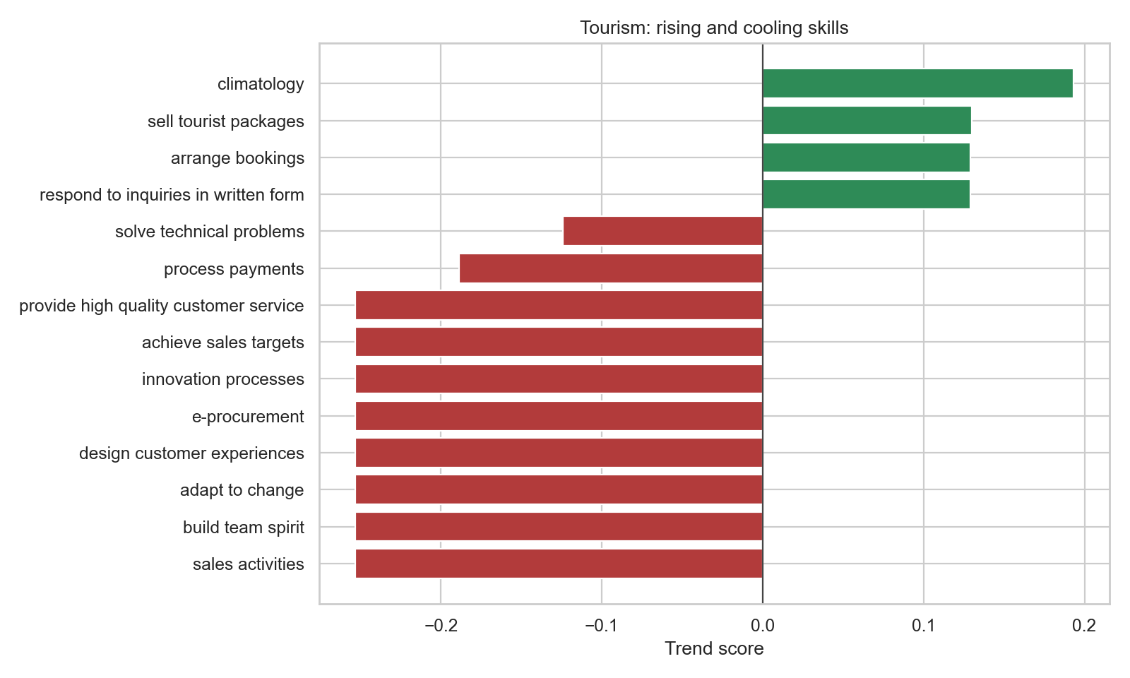
Tourism: Rising and Cooling Skills

Slide 28
CYMBAL
PRODUCT OVERVIEW
General Analysis:

Slide 29
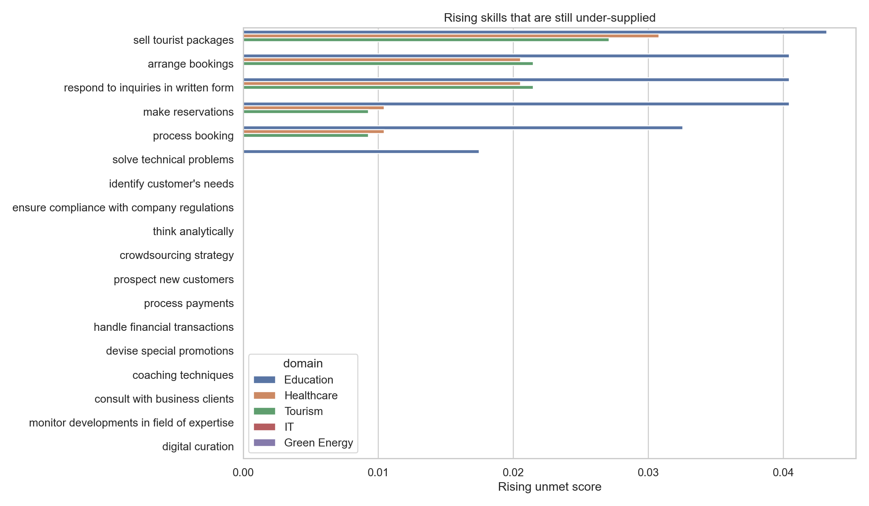
Rising skills under-supplied
Skills that are required but not many people have earned them yet.

Slide 30
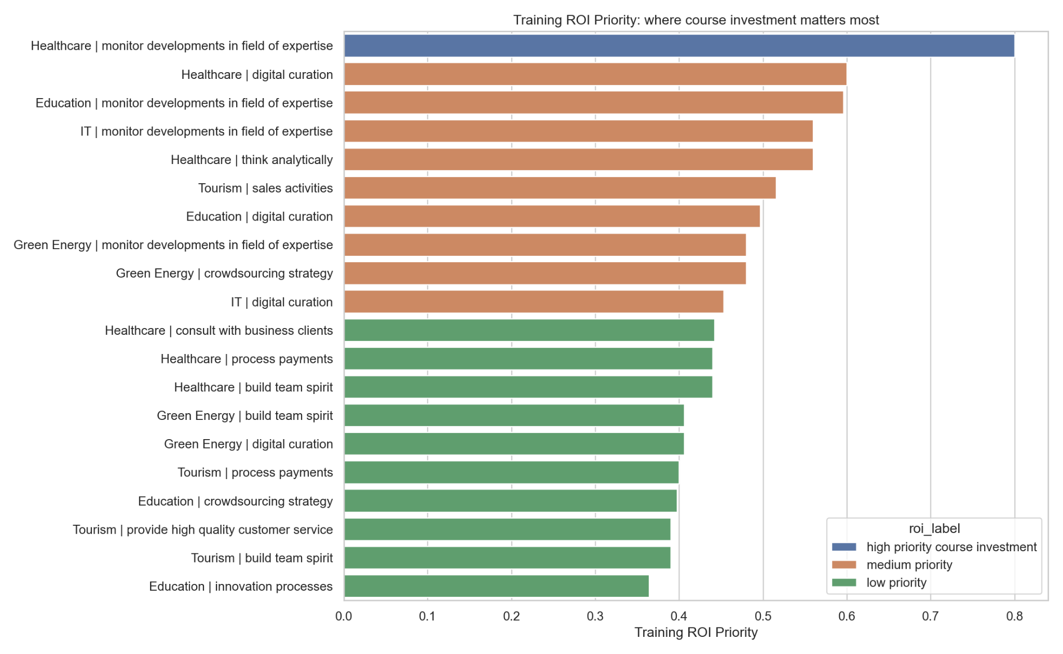
Training ROI Priority:
Which course helps the candidate the most:

Slide 31
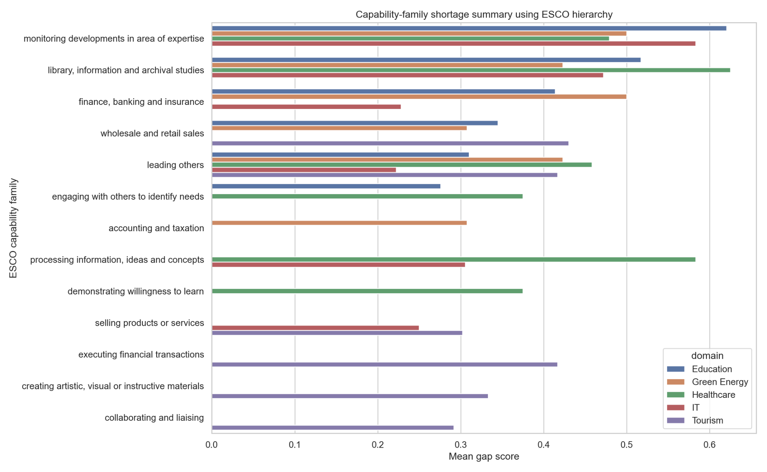
Capability-family shortage:
Based on the ESCO hierarchy, which family of skills is most important:

Slide 32
CYMBAL
PRODUCT OVERVIEW
Candidate Analysis:

Slide 33
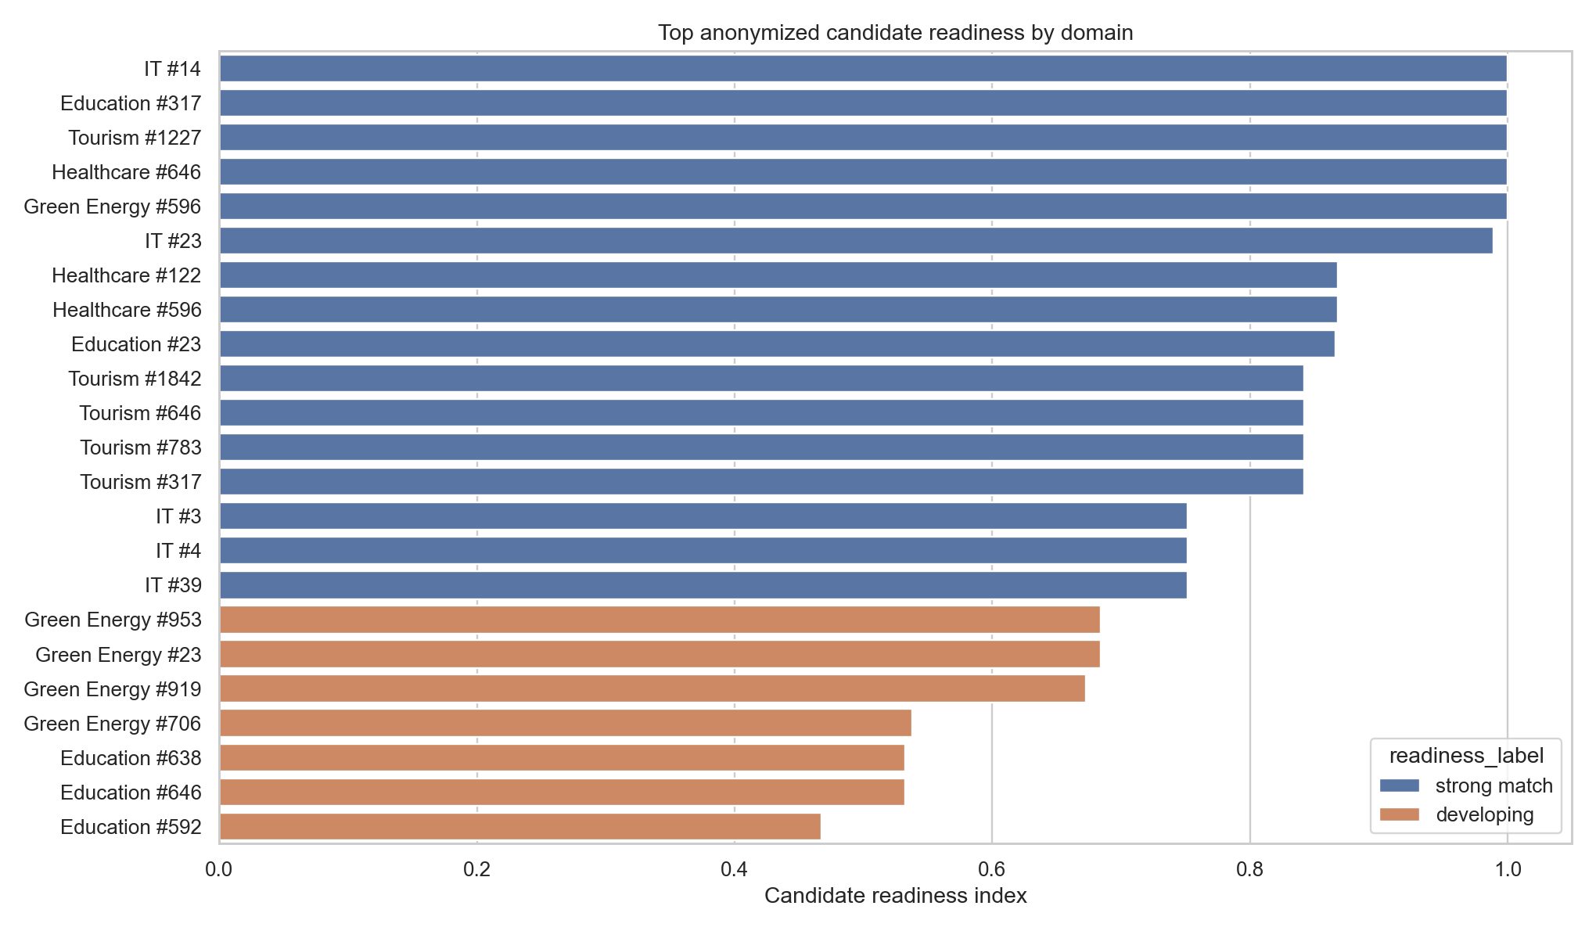
Top candidate readiness by domain:
Best candidate for domains:

Slide 34
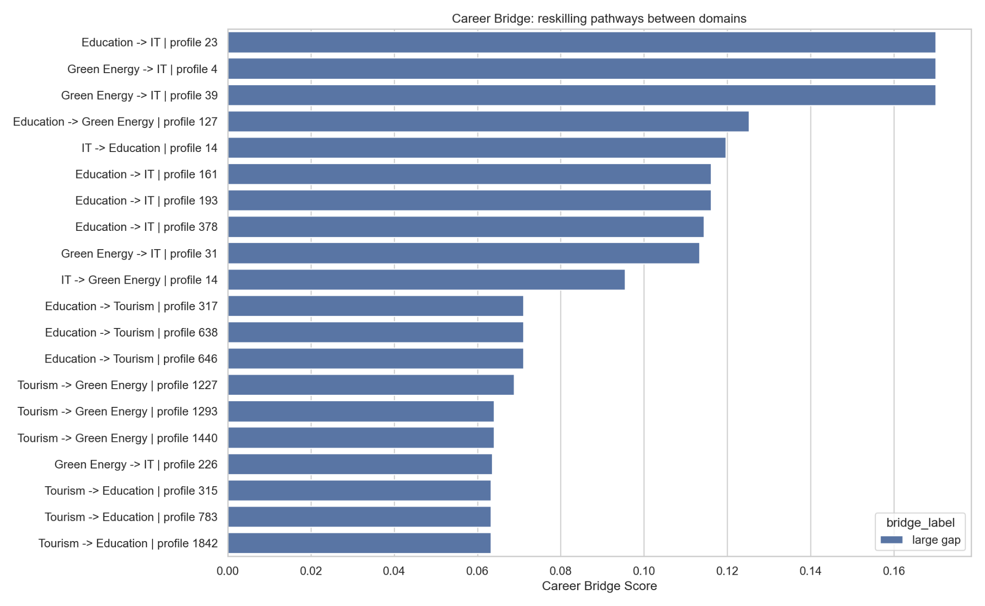
Career Bridges:
For which candidate the transition is easiest from one domain to another:

Slide 35
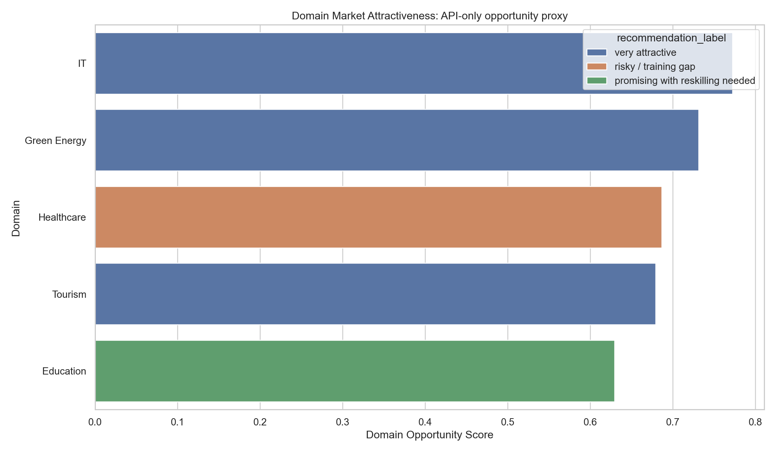
Domain Market Attractiveness:
Which domain is most attractive/ most people want to build a career in:

Slide 36
THANK YOU!
Q&A?

