Slide 1

Performance and Energy Consumption in Mobile Applications

Slide 2


What is Mobile Performance?
1. Speed (Responsiveness)
2. Efficiency (Resource Use)
The app's ability to react to user input and deliver content. This includes startup latency, smoothness of scrolling and animations, and the responsiveness of UI elements.
The app's consumption of finite system resources. This includes memory (RAM) footprint, disk storage size, and, critically, its impact on battery life through energy consumption.

Slide 3
Core Metric: Startup Time
Start Type | System State | Process Status | Ideal Goal (Eng) | Android Vitals (Penalty)
Cold | App not in memory | Process created, runtime initialized | < 500ms | > 5s
Warm | Process in memory | Process reused, UI recreated | (Not specified) | > 2s
Hot | App & UI in memory | App brought to foreground | (Not specified) | > 1.5s

Slide 4


Core Metric: Rendering & Jank
The Frame Budget
Understanding Jank
The non-negotiable deadline to produce one frame. This deadline shrinks as device refresh rates increase.
Jank is the "visual hiccup" from missing the frame budget. It's caused by Frame Time Variance, not low average FPS.
•
60Hz: 1000ms / 60 = 16.67ms
A game with a consistent 30 FPS (33ms) feels smoother than an app with 55 FPS average but spikes of 100ms+.
•
90Hz: 1000ms / 90 = 11.1ms
•
120Hz: 1000ms / 120 = 8.3ms

Slide 5
The Silent Drain
Module 2: Understanding Energy Consumption. Apps seen as "battery hogs" are uninstalled 2.5x more frequently.

Slide 6





Primary Energy Drivers
The Screen
CPU / GPU Load
Network Radio
OLED: Black pixels are "off" (0 power). Dark Mode saves massive energy. LCD: Backlight is always on. Dark Mode provides no battery benefit.
Inefficient code causes high CPU load, which generates heat. The OS throttles the CPU to cool it, which then causes jank. An energy problem becomes a speed problem.
The "Energy Tail": The radio stays in high-power mode for 5-10 seconds *after* a request. "Chatty" apps with frequent small packets never let the radio sleep.

Slide 7
Flutter's Architecture
Module 3: How Flutter Changes the Equation.

Slide 8

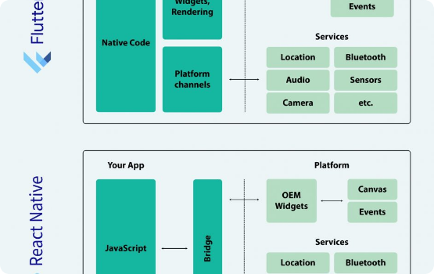
Flutter "Owns the Pixels"
No Native Widgets
Flutter does not act as a "bridge" to native platform widgets (like React Native). It ships its own rendering engine (Skia/Impeller) and paints every single pixel directly to the screen.
Pro: Pixel-perfect UI consistency and AOT-compiled native speed.
Con: Flutter is 100% responsible for the performance of its own widget set.

Slide 9


Flutter's Rendering Pipeline & Engine
The Three Trees
Engine: Skia vs. Impeller
Flutter's optimization strategy is to separate configuration from work:
Skia (Old): Powerful, but suffered from runtime shader compilation. This was the cause of "first-run jank" (e.g., the first time a blur effect appeared).
•
1. Widget Tree: The blueprint. Immutable and cheap to rebuild.
Impeller (New): Built for Flutter. Has no runtime shader compilation. All shaders are pre-compiled at build time, guaranteeing predictable performance.
•
2. Element Tree: The mediator. Holds state and compares widget trees.
•
3. Render Tree: The worker. Does layout and painting. Very expensive to touch.

Slide 10
Bottlenecks & Fixes
Modules 4 & 5: Diagnosing and Fixing Common Problems

Slide 11
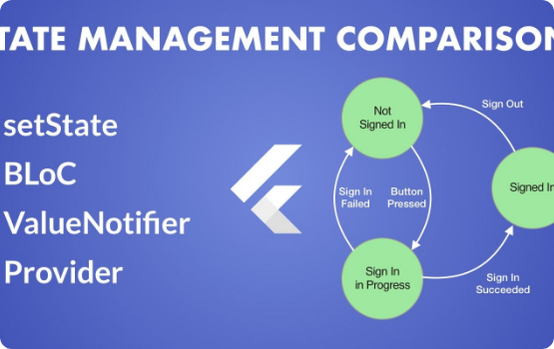
Bottleneck: `setState()` & `const`
Stop Rebuilding Everything!
Problem: Calling `setState()` high in the widget tree (e.g., on the whole screen) forces Flutter to rebuild the *entire* UI for one tiny change.
Fix 1 (State): Use a state management solution (like Provider or Bloc) to rebuild *only* the specific widget that needs to change.
Fix 2 (Code): Use `const` constructors. This is the easiest win. It tells Flutter to "short-circuit" the rebuild, skipping the entire widget subtree.

Slide 12


Bottleneck: Lists & Heavy Work
`ListView` vs. `ListView.builder`
Offload Work with `compute()`
Bad: `ListView(children: [ ... 1000 items ... ])`
Problem: Running heavy, synchronous work (like parsing a large JSON file or running a complex algorithm) on the main UI thread will freeze the app.
This builds ALL 1,000 items at once, even those off-screen. It causes a long app freeze and massive memory bloat.
Fix: Use `compute()` (Isolates). This spawns a new isolate (like a thread, but no shared memory) to do the heavy work, keeping the main UI thread free to render frames 60x per second.
Good: `ListView.builder()`
This lazy loads items, building them only as they are about to scroll onto the screen. This keeps CPU and memory usage low and constant.

Slide 13
Bottleneck: Deceptively Expensive Widgets
Opacity and ClipRRect are not cheap. They are a primary cause of jank, especially in animations or ListViews.
They trigger a "saveLayer" operation. This is an extremely GPU-intensive, multi-step process:
The engine must allocate a new off-screen buffer in GPU memory.
It must render the entire child subtree into this new buffer.
It then applies the opacity or clip to the buffer as a single texture.
Finally, it composites this buffer back onto the main screen.
This is a major bottleneck. Use FadeInImage or other, more efficient methods when possible.

Slide 14
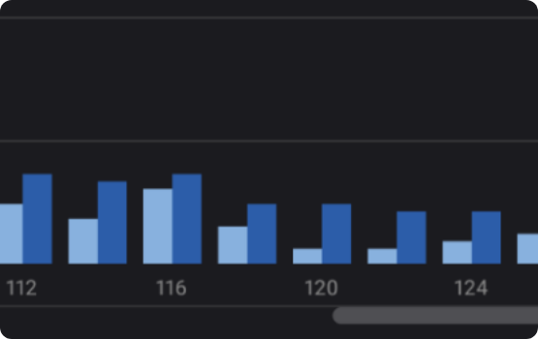
The Analyst's Toolkit: Flutter DevTools
How to Find the Bottleneck
1. ALWAYS run in Profile Mode (`flutter run --profile`). Debug mode performance is not representative.
2. Look at the Performance Chart. A red bar is a janky frame. The bar's color tells you why:
Blue Bar (UI Thread) = Your Dart code is slow.
(e.g., an inefficient `build()` method, a bad `setState()` call).
Green Bar (Raster Thread) = The GPU is slow.
(e.g., you used an `Opacity` or `ClipRRect`, causing an expensive `saveLayer()`).

Slide 15

JIT vs AOT compilation
in Mobile Runtime Environments

Slide 16








The Compilation Spectrum
Interpretation
JIT (Just-In-Time)
AOT (Ahead-Of-Time)
Fetch-Decode-Execute: Reads source or bytecode instruction by instruction. No compilation latency, but high runtime CPU overhead.
Hybrid Model: Compiles "hot" code paths during execution. Uses runtime profiling for speculative optimizations.
Static Compilation: Translates to machine code before execution (build/install time). Analysis must be conservative.
Adaptive performance, High memory use.
Fast startup, Low runtime overhead.
Zero startup time, High portability.

Slide 17


The "Iron Triangle" of Compilation
1
2
3
Startup Latency
Peak Throughput
Memory Footprint
Time from icon tap to responsiveness. AOT wins here (no compilation at runtime).
Max execution speed at steady state. JIT wins here (profile-guided optimization).
RAM consumed by runtime & code. AOT is leaner (no compiler in RAM).
"Improving one metric often degrades the others. Mobile architectures must navigate this triangle under strict constraints."

Slide 18


JIT vs. AOT Comparison
Just-In-Time (JIT)
Ahead-Of-Time (AOT)
▹
Mechanism: Translates "hot" bytecode to native code during execution.
▹
Mechanism: Compiles to native binary before launch (build or install time).
▹
Pros: Adaptive optimization based on real data (PGO), smaller install size (bytecode).
▹
Pros: Instant startup, consistent performance, lower RAM usage, better security ($W \oplus X$).
▹
Cons: High CPU usage during warmup (battery drain), stutter/jank, requires executable memory (security risk).
▹
Cons: Cannot adapt to runtime conditions, larger binary size on disk, rigid optimization.
▹
Ideal For: Long-running server processes, dynamic scripting.
▹
Ideal For: Mobile apps requiring instant response (iOS model).

Slide 19

Constraint 1: Energy Budget
The Double Tax of JIT
Mobile processors are constrained by finite battery life. JIT introduces a "double tax":
1.
Energy spent compiling the code.
2.
Energy spent executing the code.
Race to Idle
CPUs are most efficient when they finish tasks quickly and sleep. JIT keeps the CPU active longer for compilation, hurting the "Race to Idle" strategy for short bursty tasks (like checking a notification).

Slide 20
Android's Architectural Evolution
From pure interpretation to a sophisticated hybrid model.
Dalvik (Trace JIT)
Early ART (Pure AOT)
Modern ART (Hybrid)
Cloud Profiles
Android 2.2 - 4.4
Android 5.0 - 6.0
Android 7.0+
Android 9+
Space-constrained Trace JIT. Caused UI jank during compilation.
Install-time compilation. Fast execution but slow updates & massive app sizes.
Interpreter + JIT + Background AOT (Profile Guided).
Aggregated usage data enables AOT performance from first launch.

Slide 21




The Hybrid Lifecycle (Modern ART)
1. Interpretation
2. JIT Profiling
3. Idle AOT
4. Next Launch
App launches instantly in the Interpreter. Zero compilation wait time.
Hot methods are identified during run. JIT compiles them for current session speed.
When device is idle & charging, daemon compiles hot paths to native code.
App loads pre-compiled native code for hot paths. Fast start + High speed.

Slide 22

Constraint 2: Security
Write XOR Execute
A fundamental security principle: Memory can be Writable (to generate code) or Executable (to run it), but never both.
The iOS "Walled Garden"
iOS strictly enforces this. JIT requires flipping memory permissions, which is forbidden for consumer apps to prevent code injection attacks.
Result: Mandatory AOT. All iOS apps are native machine code. (Exception: Safari's JavaScriptCore has special entitlements).

Slide 23
Cross-Platform Approaches
React Native
Flutter
▹
Legacy: Used a "Bridge" to serialize JSON between JS and Native UI. High overhead.
▹
Dual Mode Strategy:
▹
Debug: Uses JIT for "Hot Reload" and fast dev cycle.
▹
Modern (Hermes): Uses Bytecode AOT. JS is pre-compiled to bytecode, reducing parse time and TTI.
▹
Release: Compiles to Pure AOT native machine code.
▹
JSI: New interface allows direct C++ calls, bypassing the bridge.
▹
Benefit: Near-native performance (60/120 FPS) with no interpreter overhead in production.

Slide 24
Advanced Runtime Optimizations
Inline Caching (IC)
On-Stack Replacement (OSR)
Dynamic languages don't know object shapes (e.g., memory offset of `obj.x`).
What if a loop runs forever inside a method that hasn't finished?
Optimization: The runtime caches the lookup result at the call site. "Monomorphic" calls (always same type) become single-instruction checks.
Optimization: OSR allows the runtime to switch from Interpreter to Compiled Code in the middle of execution. It maps stack frames from one state to the other seamlessly.
Critical for V8/JS performance.

Slide 25
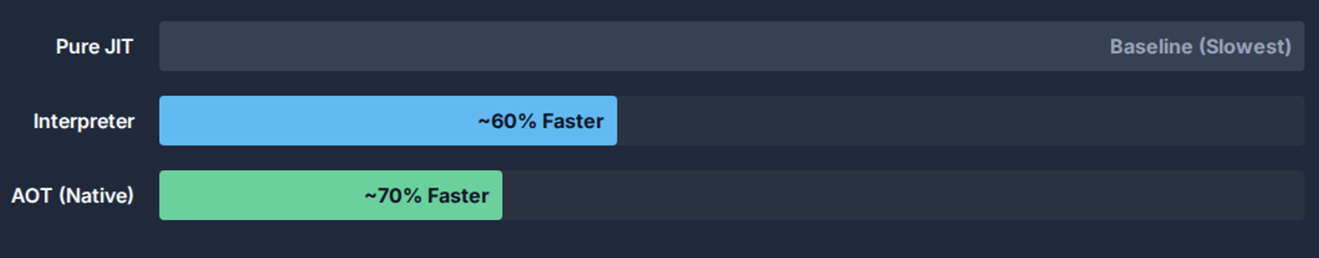
Data: Startup Latency Impact
AOT and Interpretation significantly outperform JIT in startup because they avoid initial compilation overhead.

Slide 26









Conclusion
Convergence
Security Drivers
Optimization
Pure JIT and Pure AOT are both insufficient. The industry has converged on Hybrid Models (Android) or AOT + Cloud/Bitcode (iOS).
OS security policies ($W \oplus X$) effectively mandate AOT for strictly sandbosed environments, pushing JIT to privileged system processes.
Future optimizations will focus on hiding the cost of abstraction through cloud-assisted profiling and smarter hybrid lifecycles.

Slide 27

The Cost of Tree Mutations
Architectural Analysis of Widget and RenderObject Dynamics in Flutter

Slide 28


The Economics of Rendering
The Widget Wager
The Rendering Reality
Goal: Aggressive Composability.
Constraint: Physics of Layout & Paint.
The system accepts the computational cost of allocating thousands of short-lived objects to purchase efficiency in the kernel space.
Mutating the underlying layout and painting state involves expensive tree traversals ($O(N)$) and memory bus synchronization.
"Rebuilding widgets is cheap."
"Rebuilding render objects is expensive."

Slide 29






The Three Trees Architecture
Widget Tree
Element Tree
RenderObject Tree
The declarative blueprint. Immutable configurations. Rebuilt frequently (60fps).
The persistent nervous system. Manages lifecycle and bridges the gap. Performs "diffing".
The heavy machinery. Handles layout, painting, and hit-testing. Long-lived and mutable.

Slide 30

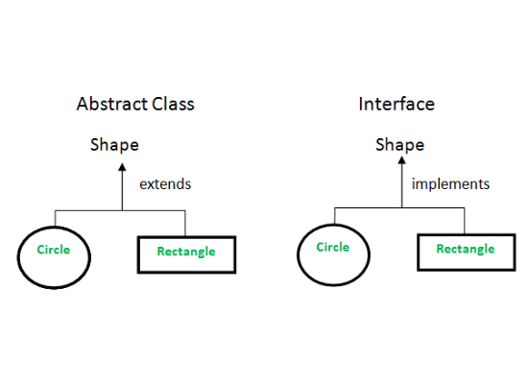
1. The Widget Tree
Blueprint of the UI
Widgets are strictly immutable configuration objects. They contain no state and perform no execution.
Cost Function: Allocation.
Because Dart uses a generational garbage collector, allocating and discarding these objects is computationally trivial ($O(1)$). They act as "config files" for the heavier elements below.

Slide 31
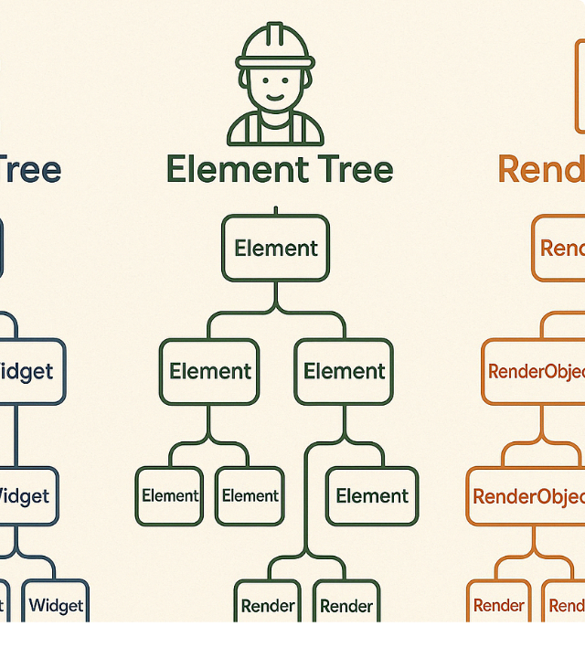
2. Element Tree & Reconciliation
The Diffing Algorithm
Elements persist across frames. When a new Widget tree is built, the Element tree runs a linear scan ($O(N)$) to reconcile changes.
Success Path: `canUpdate` returns true (Same Key & RuntimeType). Element updates its reference. RenderObject is reused.
Failure Path: `canUpdate` returns false. Old Element/RenderObject are destroyed. New ones are inflated (Expensive).

Slide 32
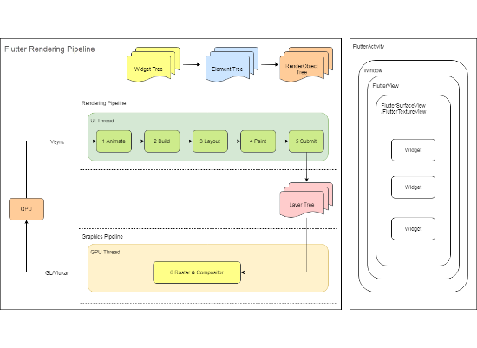
3. The RenderObject Tree
The Heavy Machinery
Layout: Calculates geometry (Size, Position). Changes here can ripple up and down the tree.
Painting: Issues draw commands to layers.
Compositing: Stacks layers for the GPU.
Persistence: These objects are expensive to instantiate and initialize. The goal of the framework is to keep them alive as long as possible.

Slide 33
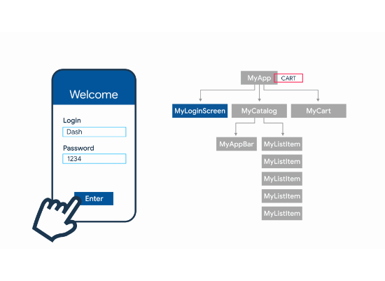
The Role of Keys
Avoiding the Performance Trap
In lists or collections, changing order without Keys confuses the diffing algorithm.
Without Keys: Flutter matches by position. If types match, it overwrites the state. If types differ, it destroys and recreates RenderObjects unnecessarily.
With Keys: Flutter identifies the move. It physically moves the RenderObject in memory, preserving its state and internal caches.

Slide 34

The High Cost of GlobalKeys
"Heavy Artillery"
GlobalKeys allow reparenting (moving a widget to a totally different parent), but at a steep price.
Tree Surgery: The Element must be detached and re-attached (O(N) search + attach).
Invalidation: Triggers a full layout and paint invalidation in both the old and new locations.
Inheritance Check: All InheritedWidget dependencies must be re-resolved.

Slide 35
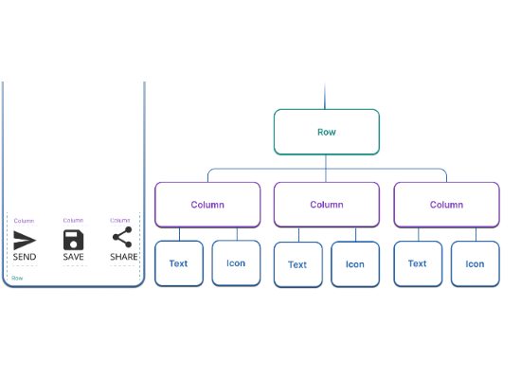
Layout Dynamics
Constraints Down, Sizes Up
Standard layout is a single-pass $O(N)$ depth-first traversal.
Relayout Boundaries: RenderObjects that decouple child layout from parent layout. They act as firewalls, stopping the propagation of dirty flags.
The Trap: Intrinsic Sizing (e.g., `IntrinsicWidth`). Violates single-pass rule. Can cause $O(N^2)$ complexity in nested scenarios.

Slide 36

RepaintBoundaries & VRAM
The VRAM Formula
Isolation vs. Memory
`RepaintBoundary` creates a separate layer in the compositor. This stops paint invalidation from spreading.
(4 bytes for RGBA)
However, it consumes Video RAM (VRAM) to store the rasterized texture.
Anti-Pattern: Wrapping every item in a scrolling list. This "shatters" the layer tree and explodes VRAM usage.

Slide 37
Raster Cache & Engines
The engine (C++) decides when to rasterize vectors to bitmaps based on `isComplex` and `willChange` hints.
Feature | Skia (Legacy) | Impeller (Modern)
Shaders | Runtime Compilation (JIT). Causes "Jank" on first run. | Ahead-of-Time (AOT) Compilation. Pre-compiled shaders.
Caching | Heavy reliance on Raster Cache to avoid expensive draw calls. | Uses "Entity Pass" and UBOs. Less penalty for cache misses.
Performance | Vulnerable to shader compilation stutter. | Predictable performance, takes advantage of Metal/Vulkan.

Slide 38
Algorithmic Cost Matrix
Operation | Complexity | Determinants of Cost
Widget Construction | O(1) | Allocating in Eden Space (Bump pointer). Trivial.
Tree Reconciliation | O(N) | Linear scan. Optimized by Keys.
GlobalKey Reparenting | O(N) + O(H) | Search + Tree Surgery + Layout Invalidation.
Intrinsic Sizing | O(N^2) | Multi-pass layout. Exponential in nested scenarios.

Slide 39
Optimization Best Practices
Use `const` Constructors: Enables canonicalization. If a widget is const, `updateChild` short-circuits the entire subtree diffing.
Manage Keys Properly: Use Keys for collections that reorder. Avoid `UniqueKey` unless destruction is explicitly desired.
Profile with Flame Chart: Look for deep stacks in `performLayout` or `updateChild` to identify thrashing.
Isolate Turbulence: Apply `RepaintBoundary` only to leaf nodes that animate (e.g., spinners), not entire lists.

