Slide 1


Offline-First Flutter Applications
Architectural Patterns, Synchronization Strategies, and Technical Trade-offs

Slide 2

Executive Summary
The Core Dichotomy
The Paradigm Shift
Modern mobile development has shifted from an "online-first" assumption to an "offline-first" requirement. An offline-first architecture is not a feature; it is a fundamental structural commitment that inverts the traditional client-server relationship.
Firebase Ecosystem: Offers rapid development with a cohesive but opaque synchronization engine. Best for prototyping and simple data models.
Custom SQLite (Enterprise): Provides granular control over data consistency, query performance, and schema evolution. Best for complex, mission-critical applications.
The local device becomes the primary authority for the UI, while the network serves merely as a background synchronization utility.

Slide 3



Theoretical Framework: The Inversion of Truth
Traditional Model
Offline-First
Request-Response Cycle
Inversion of Truth
In traditional apps, the UI waits for the server. A user action triggers a network request, and the UI updates only upon a successful response.
Local Read Authority: UI reads exclusively from local persistence, guaranteeing consistent 60fps rendering.
Optimistic Write Authority: User actions mutate local state immediately. Network requests are background side-effects.
UI = f(Network_Response)
Fragile: Latency breaks UX.
UI = f(Local_Database)

Slide 4






The CAP Theorem in Mobile Context
Mobile devices operate in a perpetually partitioned state. Therefore, offline-first apps must prioritize Availability and Partition Tolerance over immediate Consistency.
Partition Tolerance
Availability
Consistency
The system continues to operate despite an arbitrary number of messages being dropped or delayed by the network.
Every request receives a (non-error) response, without the guarantee that it contains the most recent write.
Sacrificed. We accept Eventual Consistency, creating the architectural challenge of synchronization and conflict resolution.

Slide 5
Data Synchronization Topologies
Topology | Mechanism | Latency | Battery Impact | Ideal Use Case
Push-Based | WebSockets (e.g., Firebase, GraphQL Subscriptions) | Real-time | High (Keep-alive) | Chat, Live Tracking, Collaborative Editing
Pull-Based (Polling) | Fixed Interval Requests (REST GET) | High | High (Radio wake-ups) | Non-critical updates, Legacy backends
Hybrid (Delta Sync) | Request "changes since X" on trigger | Moderate | Low | Enterprise Data, Inventory, Social Feeds
The choice between Firebase and SQLite is largely a choice between a managed Push-Based topology and a developer-constructed Hybrid topology.

Slide 6

Approach A: The Firebase Ecosystem
Google's Firebase offers an "out-of-the-box" solution by abstracting local storage and synchronization.
The Local Cache Mechanism
Interceptor Pattern: The SDK intercepts queries and inspects the local persistence layer first.
Pending Write Queue: Writes are applied atomically to the local cache and appended to a persistent queue for background syncing.
Latency Compensation: The UI reflects changes instantly via snapshots, bypassing the network stack entirely.

Slide 7
Firebase Implementation Details
Handling Data Availability
A robust implementation must explicitly handle scenarios where the network is unavailable and fallback to the cache. Standard error handling often misses this nuance.
Configuration
While persistence is enabled by default, cache size management is critical for enterprise apps to prevent the eviction of vital operational data.

Slide 8




Critical Limitations & Risks
Indexing Bottleneck
Billing Anomalies
Firestore guarantees performance via server-side indexing. However, the local cache lacks these indexes. Offline queries often result in full table scans, causing significant UI jank with large datasets.
Syncing after a long offline period can trigger thousands of read operations instantly (one per updated document), leading to unexpected "bill shock."
Transactional Integrity
Opaque Cache
Transactions strictly require online connectivity. Complex business logic involving prerequisite checks cannot be executed atomically while offline.
The cache is a "Black Box" managed by LRU (Least Recently Used). Developers cannot "pin" critical documents, risking data eviction before use.

Slide 9
Approach B: Custom SQLite (Enterprise Standard)
For applications requiring strict data sovereignty or high-performance offline querying, a custom architecture using Drift (formerly Moor) is the superior choice.
Feature | Sqflite (Raw) | Drift (Recommended)
Type Safety | None (Dynamic Maps) | Full Compile-time Safety
Reactivity | Manual StreamController | Built-in Streams (watch())
Boilerplate | High (Manual Mapping) | Low (Code Generation)
Migrations | Manual SQL Scripts | Managed Schema Versioning

Slide 10
Schema Design: The "Tombstone" Pattern
Identification Strategy
Auto-increment IDs cause collisions in distributed systems. UUIDs generated on the client are mandatory.
Sync Metadata
Every table requires tracking columns to manage the sync state:
updatedAt: For Last-Write-Wins resolution.
isDirty: Flags records needing sync.
deletedAt: The "Tombstone". We never physically delete rows; we mark them to ensure the deletion propagates to the server.

Slide 11


The Sync Engine: Push Loop
The Outbox Pattern
We do not call the API immediately upon user action. Instead, we insert a record into a local SyncQueue table.
1. Capture Intent: User saves data -> Insert into DB + Insert into SyncQueue (Atomic Transaction).
2. Process Queue: Background worker reads FIFO queue.
3. Execute: Attempt API call.
4. Finalize: If 200 OK -> Delete Queue Item + Clear isDirty. If Fail -> Retry later.

Slide 12

The Sync Engine: Pull Loop (Delta Sync)
The Problem
Logic Flow
Downloading the entire database on every sync is bandwidth-prohibitive and slow.
1. Request: Client sends last_synced_at timestamp.
2. Query: Server finds records where updated_at > timestamp.
The Solution: Delta Sync
The client requests only what has changed since the last successful synchronization checkpoint.
3. Upsert: Client iterates response:
If deleted_at is set -> Local Delete.
GET /api/sync?since=2023-10-27T10:00:00Z
Else -> Insert or Update.
4. Checkpoint: Update local last_synced_at to server time.

Slide 13




Background Execution with Workmanager
To ensure eventual consistency, synchronization must occur even when the app is closed. The workmanager package bridges the gap to Android WorkManager and iOS BGTaskScheduler.
Android
iOS Constraints
Reliable. Periodic tasks can be scheduled with a minimum interval of 15 minutes.
Highly restrictive. The OS decides when to run tasks based on user behavior (heuristics). Execution is not guaranteed.
Best Practice: Use Workmanager for "best effort" background sync, but always trigger an immediate sync when the app enters the foreground (didChangeAppLifecycleState).

Slide 14






Conflict Resolution Strategies
Last Write Wins (LWW)
Semantic Merge
CRDTs
Logic: Field-level inspection. Apply changes only to modified fields.
Logic: Mathematical convergence (Conflict-free Replicated Data Types).
Logic: if (remote.time > local.time) overwrite.
Pros: Simple to implement.
Pros: Preserves data integrity.
Pros: Mathematically guaranteed consistency.
Cons: Data loss. If User A changes Title and User B changes Body, one entire record is lost.
Cons: Requires custom business logic per entity.
Cons: High storage overhead (operation history) and complexity.

Slide 15
Architecture Comparison
Feature | Firebase (Firestore) | Custom SQLite (Drift) | Implication
Data Topology | NoSQL (Graph) | Relational (SQL) | Drift allows rigorous normalization.
Offline Queries | Restricted (Full Scans) | Unrestricted (Indexed) | Firestore is unsuitable for complex offline reporting.
Transactions | Online Only | Offline Supported | Critical for financial/inventory integrity.
Search | None Offline | FTS5 (Full Text Search) | SQLite allows "Search as you type" offline.
Cost Model | Usage (Reads/Writes) | Fixed (Infrastructure) | Firebase costs can explode with inefficient sync.

Slide 16


Recommendations
Choose Custom SQLite When:
Choose Firebase When:
Enterprise Field Apps: Offline for days; complex filtering needed.
Prototyping: Speed is the primary metric.
Social Apps: Simple data relationships; LWW is acceptable.
Transaction-Critical: Cannot risk data corruption.
Live Collaboration: Real-time push is a core feature.
Cost-Sensitive Scaling: High read volume prohibits per-read billing.
The "Third Way": Middleware solutions like PowerSync offer a middle ground, providing SQLite performance with managed sync infrastructure.

Slide 17


Synchronization
Conflict-Free Replicated Data Types (CRDTs) and Lattice Theory

Slide 18

Executive Summary
The Challenge
The CRDT Solution
Distributed systems face a binary choice between strong consistency and availability (CAP theorem). Traditional consensus algorithms (Paxos, Raft) sacrifice availability during partitions, which is unacceptable for real-time, collaborative applications.
Conflict-free Replicated Data Types offer a rigorous alternative rooted in Abstract Algebra. By structuring data as monotonic join-semilattices, CRDTs guarantee Strong Eventual Consistency (SEC) without runtime arbitration.

Slide 19

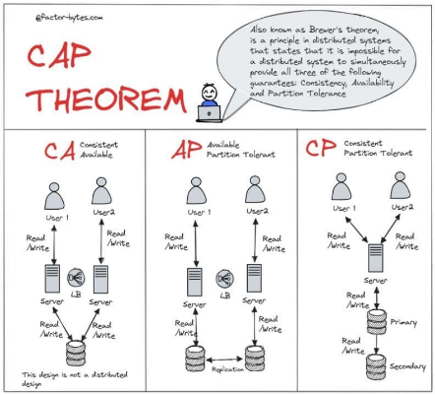
The Consistency-Availability Trade-off
The CAP theorem posits that a distributed store can only provide two of three guarantees: Consistency, Availability, and Partition Tolerance.
•
CP Systems: Refuse writes during partitions to maintain consistency (e.g., Spanner, Etcd). High latency.
•
AP Systems: Prioritize uptime and low latency, allowing replicas to diverge. The challenge is reconciliation.

Slide 20
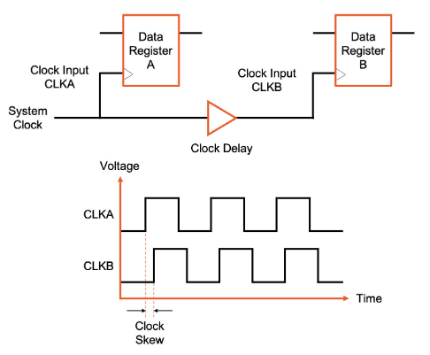
The Failure of "Last-Write-Wins"
Naive eventual consistency often relies on "Last-Write-Wins" (LWW) based on wall-clock timestamps. This approach is mathematically unsound in asynchronous environments.
•
Clock Skew: "Now" is a local illusion. A physically later write can be overwritten by a lagging clock.
•
Data Loss: LWW discards information rather than merging it. Concurrent edits to different fields may obliterate each other.

Slide 21

Mathematical Foundations: Order Theory
Partial Orders
Join-Semilattices
For a state set , we define a relation satisfying:
To resolve concurrent states, we need a Least Upper Bound (LUB), or supremum. A Join-Semilattice is a set where every pair has a unique LUB .
•
Reflexivity:
•
Antisymmetry:
This represents the union of all information in both states.
•
Transitivity:

Slide 22
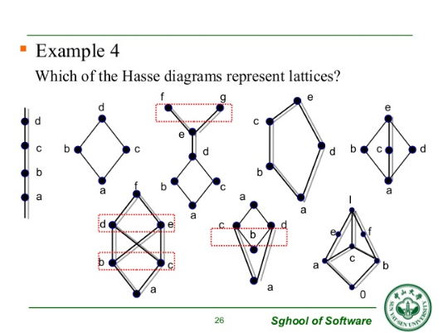
The Lattice of Convergence
In a lattice-based system, the state only moves "upwards" towards a more complete state. Convergence is not arbitration, but a calculation.
If Replica A has state and Replica B has , the merged state is:
This guarantees that any two replicas that have seen the same updates will be in the exact same state.

Slide 23





The ACI Properties
Associativity
Commutativity
Idempotence
Grouping doesn't matter. Enables arbitrary gossip topologies.
Order doesn't matter. Messages can arrive in any sequence.
Duplication is fine. Processing the same message twice is a no-op.

Slide 24

Taxonomy: State-based vs. Op-based
State-based (CvRDT)
Operation-based (CmRDT)
Mechanism: Replicas broadcast their full local state.
Mechanism: Replicas broadcast individual operations (e.g., "insert 'a'").
Protocol: Gossip / Anti-Entropy.
Protocol: Reliable Broadcast / Pub-Sub.
Pros: Robust against network failures; simple messaging requirements.
Pros: Highly bandwidth efficient.
Cons: Requires strict causal delivery guarantees; fragile if ops are lost.
Cons: High bandwidth usage (sending whole state for small changes).

Slide 25


Primitives: The Algebra of Counting
G-Counter (Grow-Only)
PN-Counter (Pos-Neg)
A simple integer fails merge ( ). A G-Counter uses a vector of integers, one per replica.
To support decrements, we compose two G-Counters: (increments) and (decrements).
Merge: Pointwise Maximum.
Value:
The state always grows monotonically, even if the value fluctuates.

Slide 26
Set Theory: The OR-Set
Unique Tags: Every "add" operation generates a unique tag (dot). Adding "milk" twice creates two distinct entries: ("milk", A1) and ("milk", A2).
Observed-Remove: When a user removes "milk", the system identifies all observed tags and moves them to a "Removed" set (tombstones).
Add-Wins Strategy: If Replica A adds "milk" concurrently with Replica B removing it, the new add survives because B could not have "observed" A's new tag.
Lattice Definition:

Slide 27

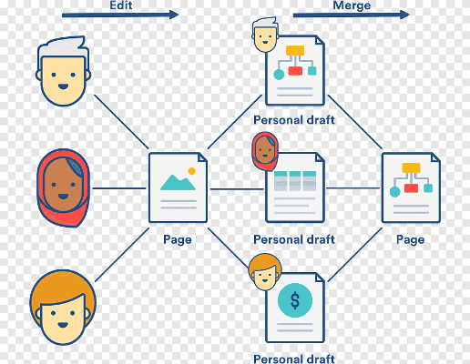
Sequence CRDTs: Text Editing
Collaborative editing requires handling concurrent inserts at arbitrary positions. Naive indexing fails (Index 5 shifts to 6).
•
The Indexing Problem: Fixed indices cannot track dynamic content.
•
RGA (Replicated Growable Array): Uses a linked-list structure where every character has a unique timestamp ID.
•
Tombstones: Deleted characters are marked "dead" but kept to maintain relative structure for concurrent edits.

Slide 28

Optimization: Delta-CRDTs
The Bandwidth Problem
The Delta Solution
Standard CvRDTs must transmit their entire state to merge. For a large G-Set with a million items, adding a single item triggers a massive transfer.
Delta-CRDTs define a mutator that returns a small state fragment, or "delta" ( ).
This reduces bandwidth consumption by orders of magnitude while maintaining the robustness of state-based models.

Slide 29
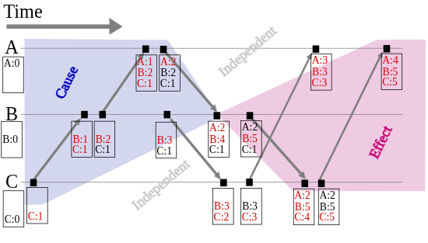
Metadata Management
CRDTs track concurrency using metadata (Vector Clocks, dots, tombstones). Without management, this grows indefinitely.
•
Dotted Version Vectors (DVV): Optimized vector clocks that track individual events to solve the "Actor Explosion" problem.
•
Causal Stability: The only safe way to delete a tombstone is to prove that no future message will ever depend on it.

Slide 30






Industry Adoption
Databases
Collaboration
Local-First
Riak KV: Pioneering use of CvRDTs (Maps, Sets) with DVV.
Yjs & Automerge: JS libraries for Google Docs-like apps. Use complex Sequence CRDTs (YATA, RGA) optimized for JSON.
Ink & Switch: CRDTs enable software that keeps data local and syncs peer-to-peer, guaranteeing ownership and offline capability.
Redis Enterprise: Implements "Active-Active" geo-replication using Op-based CRDTs.

